Slide 1


New Stress Coupons for Steel Health Monitoring
Eleni Aivazoglou, Tatiana Damatopoulou, Spyros Angelopoulos and Evangelos Hristoforou
Laboratory of Electronic Sensors
National TU of Athens, Athens, Greece

Slide 2
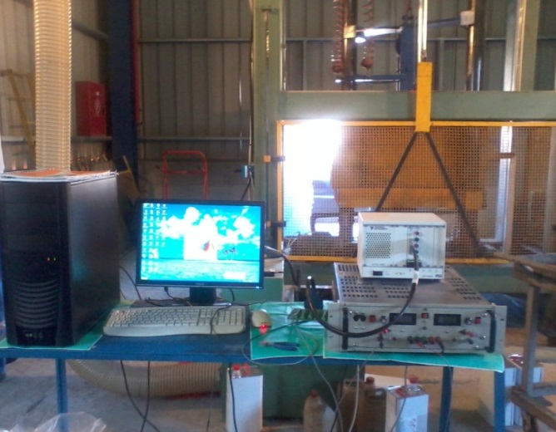
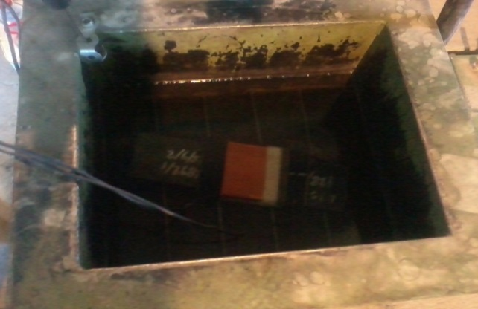
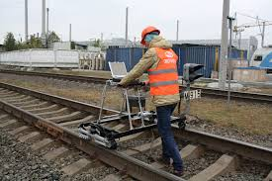
Introduction
Our group has a well known technology on magnetic steel structural health monitoring
Permeability
Technology used in steel manufacturing, e.g. pipeline manufacturing - CPW
Technology used in steel end users, e.g. railway rail structural integrity (in Greece & Italy), pipeline corrosion detection (a new challenge: hydrogen induced pitting corrosion)

Slide 3
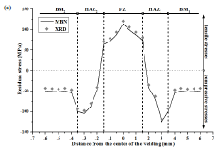
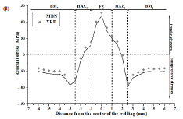
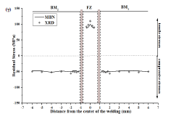
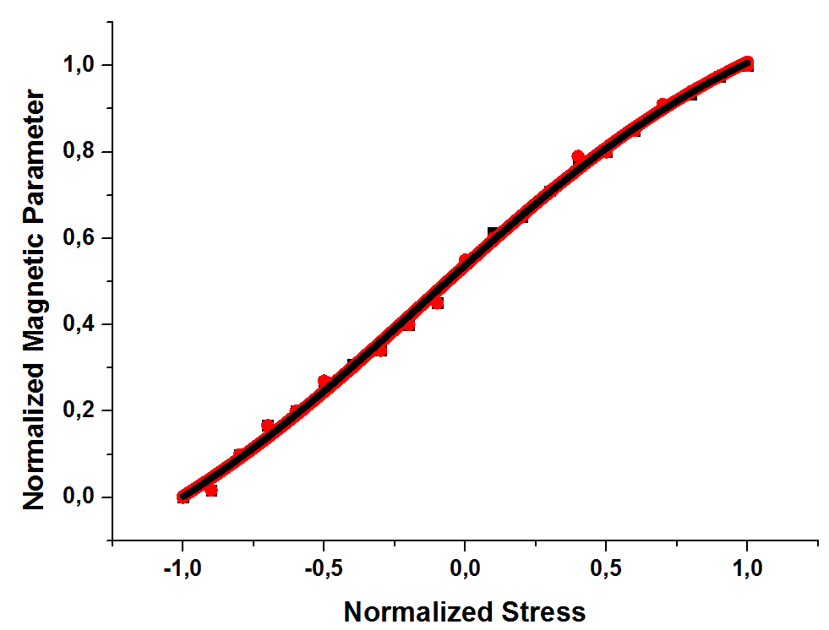
The technology is based on the monotonic dependence of magnetic properties on residual stresses
TIG welding
Plasma welding
Electron beam welding
We have determined the so-called Magnetic Stress Calibration (MASC) curve for different steel grades
➔Universal MASC curve after yield point normalization

Slide 4
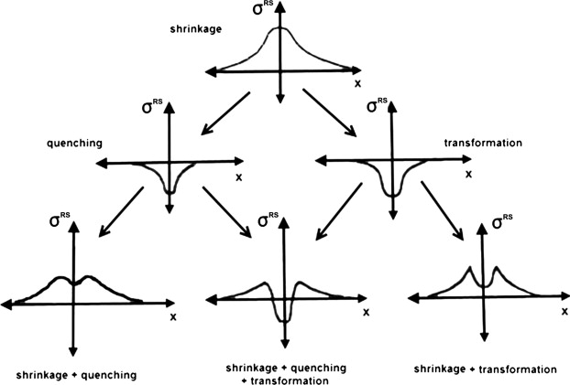
Our initial steel coupons to develop the MASC curves
(introducing all possible kinds of stresses in steels by welding)
TIG :
Plasma
2mm
Welding direction
BM
HAZ
FZ
HAZ
BM
3mm
Rolling Direction
1.5mm
BM
HAZ
FZ
HAZ
BM
Welding direction
2mm
Rolling Direction
TIG, EBW, Plasma, Induction

Slide 5
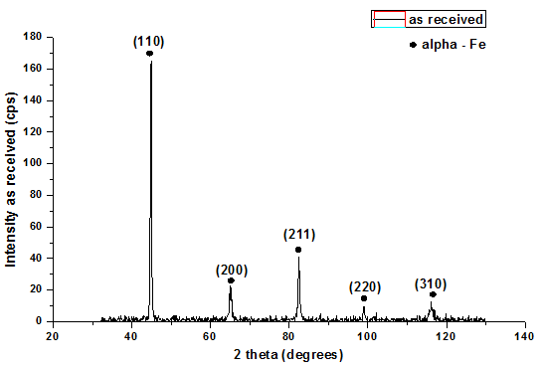
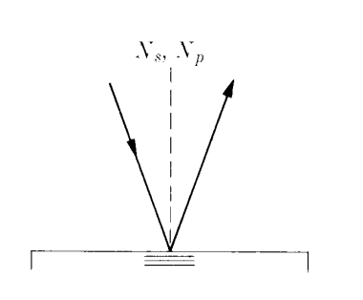
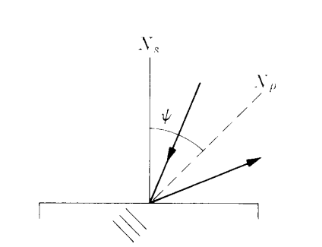
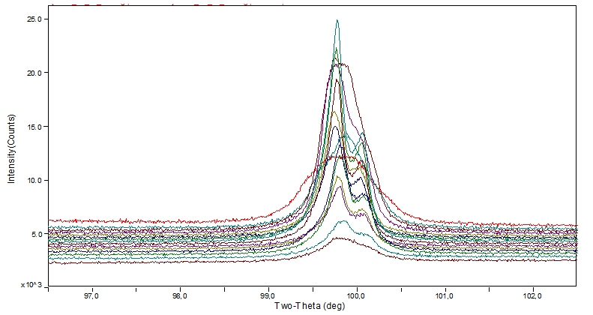
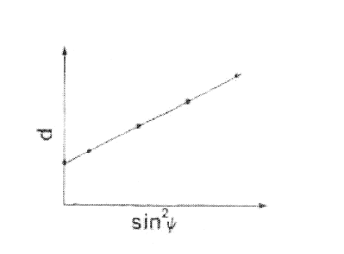
X-ray diffraction for surface 2D-stress determination
Fixing XRD source-receivers in the selected 2θ angle for the selected point
➔ Scanning the selected point with different inclinations ψ (+35º)
XRD histogram on a surface point in a given crystallographic direction for the selection of the most stable 2θ response
Monitoring the XRD counts in all different ψ angles
Determining the stress component at the given point in the direction of the XRD measurement

Slide 6
Challenges with welded samples
Repeatability of welding (different crack initiation during welding)
Mechanical treatment for flat surface (repeatability & roughness)
Phase transformations (temperatures above a threshold)
➔A need for a new steel coupon with certain properties:
To be easily repeatable process – accessible in industrial conditions
Requiring no post-development treatment (surface roughness)
To avoid phase transformations due to elevated temperatures
➔Development of a single heat affected zone with heat & quenching
Localized heating: temperature gradient along the steel (up to 450C)
Consequent quenching: temperature gradient to stress gradient
No phase transformations due to the temperature threshold

Slide 7
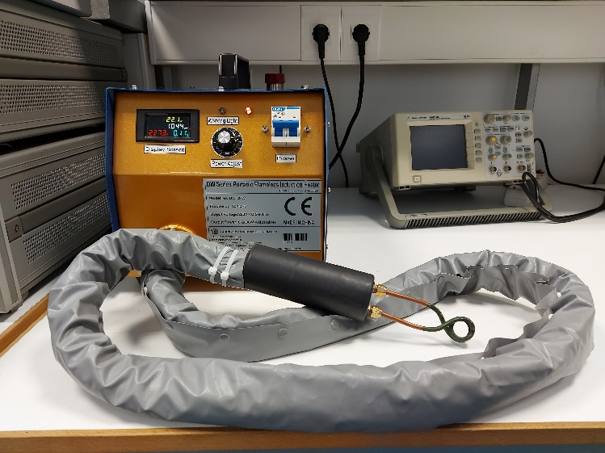
Our first attempt: localized RF induction heating
Initial trials: use of RF induction heater
The process
Heating until T ~ 450C – IR monitored
Consequent quenching in water or oil
T to σ transformation
The results
Fast heat development (seconds)
High T may introduce bending
Not well controlled T maximum
Steel samples may be geometrically deformed

Slide 8
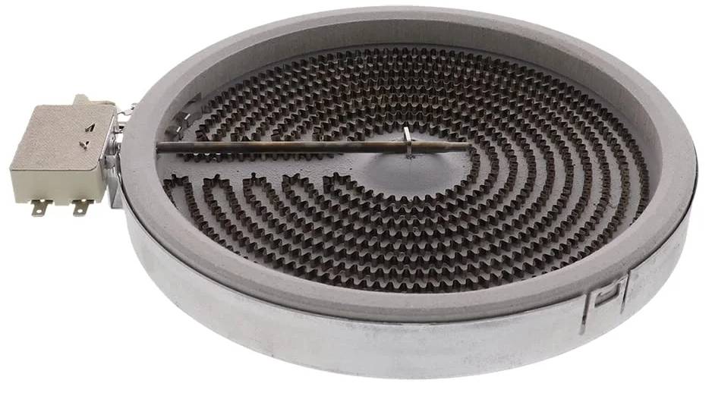
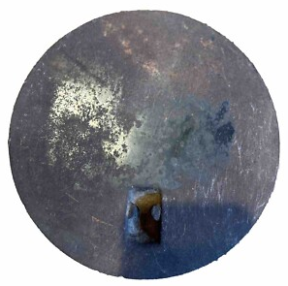

Our second attempt: normal Joule heating (stove eye)
➔ Use of stove eye with thermostat
The process
Heating at desired T with thermostat monitoring employing a Cu plate
Consequent quenching in water or oil
T to σ transformation
The results
Slow heat development (minute)
Controlled T introduces no bending
Use of Cu plate offers uniform T at the heating area
Advantages
Well controlled T maximum & gradient
Well controlled σ gradient on the sample
Repeatable results
Water quenched steel in a pail

Slide 9
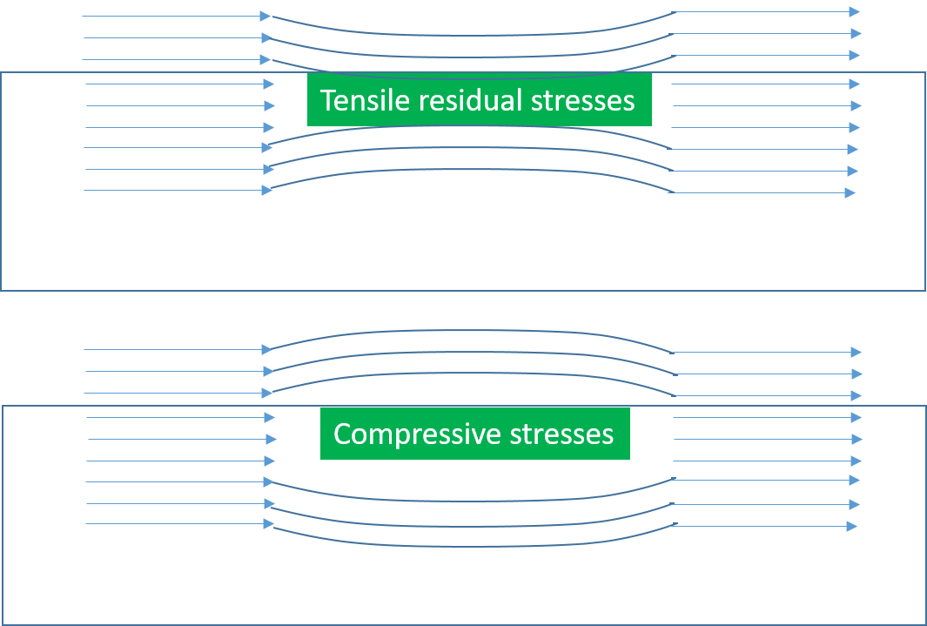
AMR response such stress gradient samples
Tensile stress ➔ higher permeability
Compressive stress ➔ lower permeability
➔ Flux change in the presence of stresses
Dependence of the Bz AMR field component on its position with respect to the middle of the steel with respect to the stove eye

Slide 10
Further steps for the MASC determination
Measure residual stresses using the XRD Bragg-Brentano method, as described in a previous slide
Determine the MASC curve as the dependence of the Bz AMR response on the measured residual stresses
Use other steel grades to monitor the AMR response and determine the corresponding residual stresses
Use the AMR magnetometer 3 field components to investigate their dependence on the residual stresses
Determine the normalized MASC curves with respect to the corresponding yield point and the maximum Bz to check the Universality law
Prepare a group of labs and industries for inter-comparison tests, bearing in mind the repeatability of results
Prepare the draft standard to be applied in a related standard’s organization, like ASTM or IEEE

Slide 11
Thank you for your kind attention
&
look forward to answering questions via the net

