Slide 1
A cantilever beam in mass metamaterial unit cell for vibration control
Muskaan Sethi, PhD Research Scholar
Arnab Banerjee, Associate Professor
Bappaditya Manna, Professor
Department of Civil Engineering, IIT Delhi

Slide 2
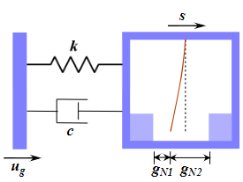
INTRODUCTION
Negative effective mass
METAMATERIALS: Metamaterials are a special class of engineered structures which can possess extreme unconventional engineering properties, like:
Negative stiffness
Negative Poisson’s ratio
Out of phase response shown by resonating units placed inside metamaterial.
Exotic properties of metamaterials become frequency dependent.
Change in overall effective mass of system.
Effects the wave propagation through the system.
Overall transmission is affected.
Cantilever beam in mass metamaterial
A new type of metamaterial.
An inner cantilever beam placed as a resonator inside the outer mass.
Suitable to be placed in a metamaterial chain to control vibration transmission.
(a) A cantilever beam in mass metamaterial unit cell
(b) Cantilever beam in mass metamaterial chain comprising of finite number of unit cells

Slide 3
Linear Complementary Problem (LCP) based Approach
Basic Introduction:
LCP approach can be employed to solve various contact and impact problems.
An LCP equation takes the form: y=Ax+B, such that x$≥0, y≥0 and$y^{T}x=0 i.e. the complementary condition.
Coordinate transformation using Coulomb’s law of friction.
LCP equation formulation in tangential direction
Coulomb’s law of friction used at the interface of inner and outer mass.
Co-ordinate transformation applied as shown in Figure 1, to get an LCP form.
Mathematical form of Coulomb’s friction law
LCP form after coordinate transformation:

Slide 4
Euler’s discretization and formation of final LCP equation:
Dynamic Equation of Motion at acceleration level:
Put
Applying Euler’s discretization:
Applying Taylor series expansion
Normal gap
Tangential relative velocity
Final LCP equation

Slide 5
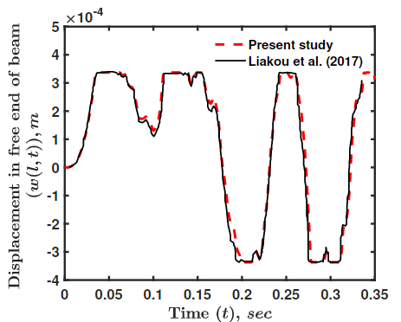
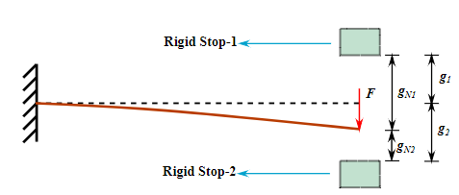
Validation of the Proposed Methodology
Problem of a cantilever beam vibrating between two rigid supports is considered.
The results are compared with existing literature and experimental results.
A cantilever beam vibrating between two rigid supports.
Validation with existing literature

Slide 6
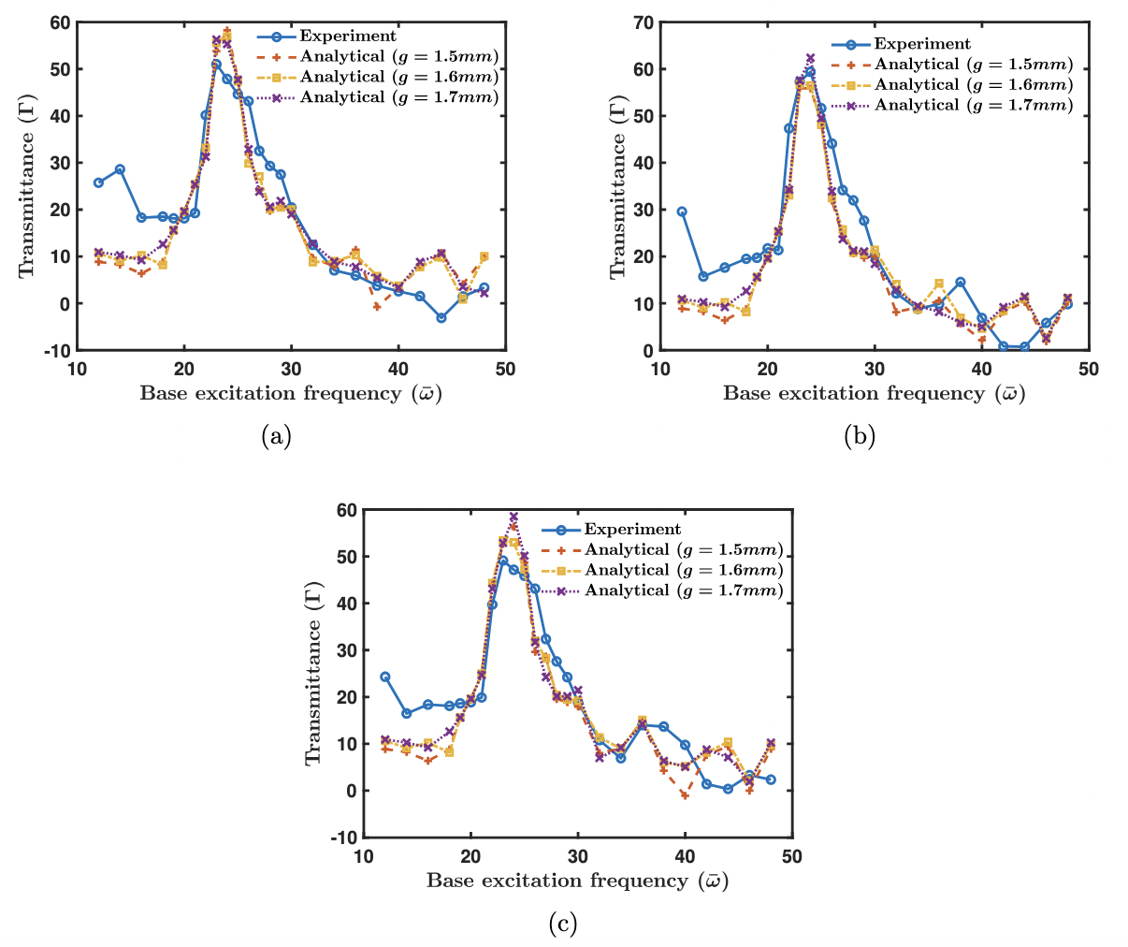
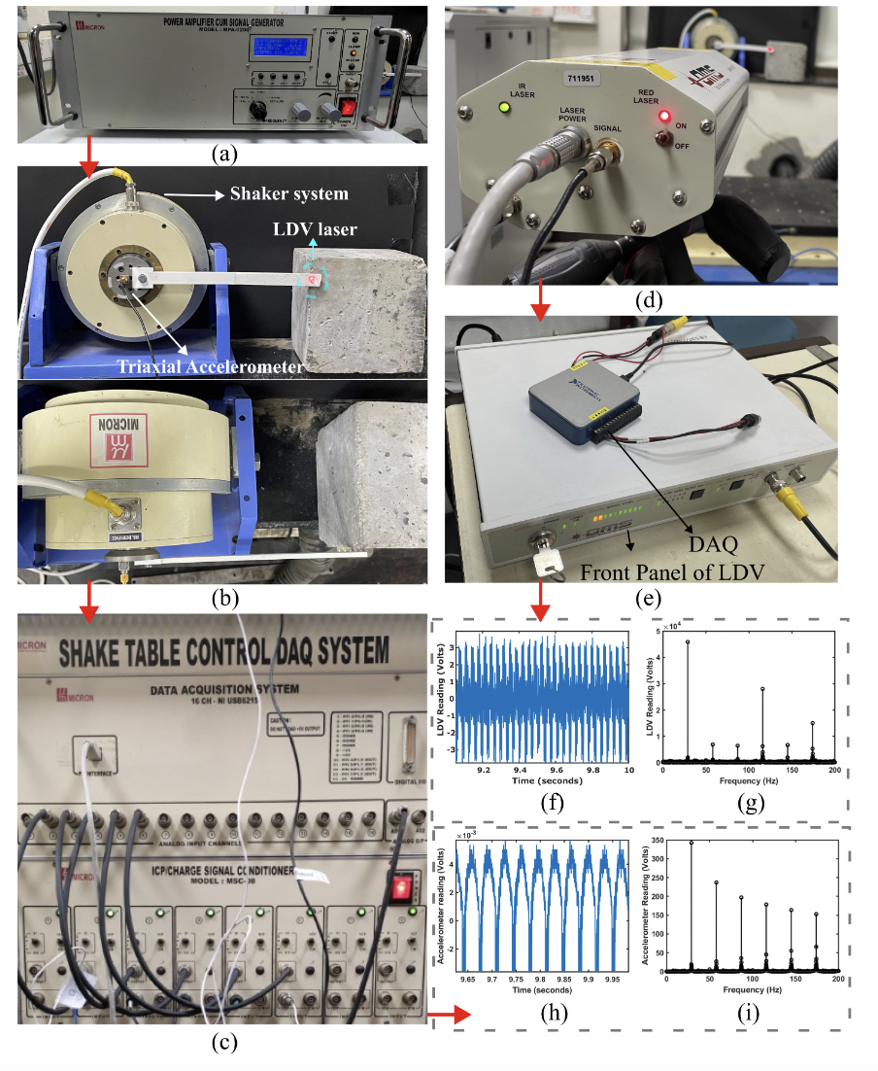
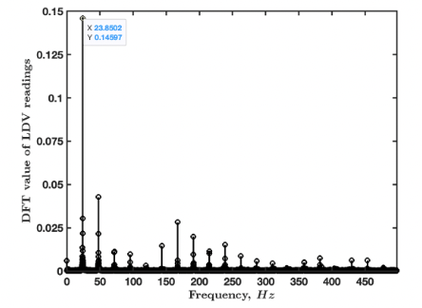
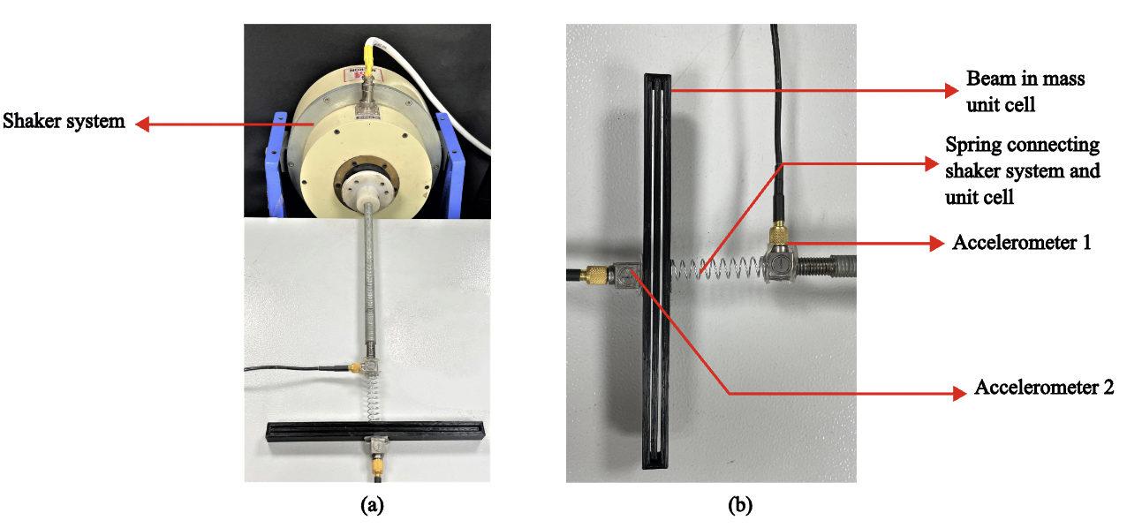
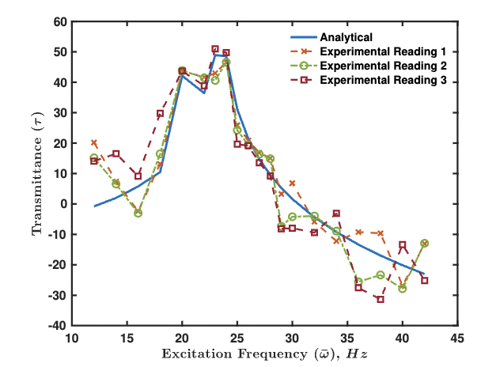
Experimental Validation
A cantilever beam vibrating between two rigid supports.
A cantilever beam vibrating between two rigid supports.
A cantilever beam vibrating between two rigid supports.
A cantilever beam vibrating between two rigid supports.

Slide 7
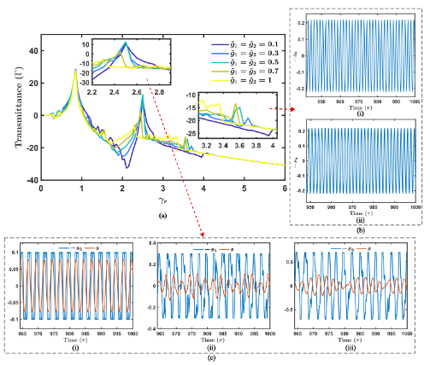
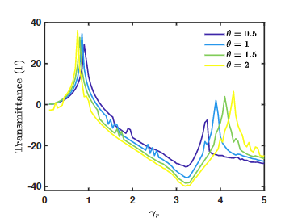
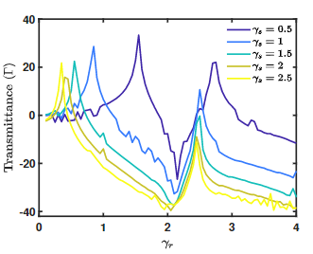
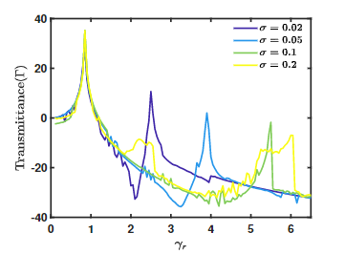
Transmittance plots for the proposed metamaterial unit cell
(b)
(c)
(a)
(d)

Slide 8
Mass-in-Mass Frictional Metamaterial Chain
A cantilever beam in mass metamaterial chain comprising of finite number of unit cells
The same mass-in-mass cantilever beam in mass unit cell is used to form a metamaterial chain comprising of finite number of unit cells.
The transmittance spectrum is plotted for the 7th unit cell in the chain.

Slide 9
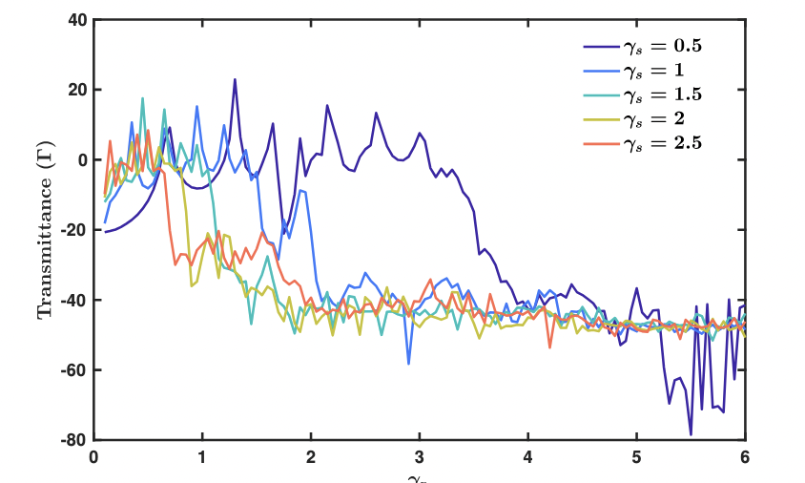
Transmission Spectrum for metamaterial chain
First cut-off frequency shifts towards lower side on increasing $γ_{s}$ .
Since, $γ_{s}$ is inversely proportional to natural frequency of outer mass , there is a reduction in the value of natural frequency of outer mass for higher value of $γ_{s}$ .
Peak for second propagation band not much visible in metamaterial chain for higher values of $γ_{s}$ .
Vibration transmission is reduced for 7th unit cell
Transmittance spectrum for 7th unit cell in a metamaterial chain

Slide 10
Conclusions
Transmission spectrum has been plotted for the beam-in-mass metamaterial unit and metamaterial chain.
Impact between the beam and rigid supports impose damping to the system.
Due to energy dissipation, the propagation band vanishes.
In metamaterial chain, the second propagation band vanishes for higher values of $γ_{s}$.
Such a metamaterial chain has a good future prospect for effective attenuation bandgap generation and vibration control.

Slide 11
Acknowledgement
Inspire faculty grant, grant number DST/ INSPIRE/04/2018/000052
Scientific and Useful Profound Research Advancement, grant number SPR/2020/00278

Slide 12
Thank you

