Slide 1
A Versatile Semi-Analytical Micromechanical Model for Elasticity of Cementitious Composites
Amit Kumar
&
Prof. Shashank Bishnoi
Indian Institute of Technology, Delhi

Slide 2
Contents
Introduction
Literature Survey
Objectives
Methodology
Results
Conclusions

Slide 3
Introduction
Composites
Materials made up of more than one substance that is used for building things.
Applications:
✈️ Aerospace - Carbon fibre composites
🚗 Automotive - Lightweight body panels
🚀 Defence & Military - Bulletproof vests
🏗️ Civil Engineering & Construction - Reinforced concrete
🏥, ⚡, 🎾,… Many more
Why use composites:
High strength-to-weight ratio
Fatigue and corrosion resistance
Tailorable properties (e.g., directional stiffness)
Notes:
Upto this- Why we need to study creep, Next why I am studying analytical modelling

Slide 4
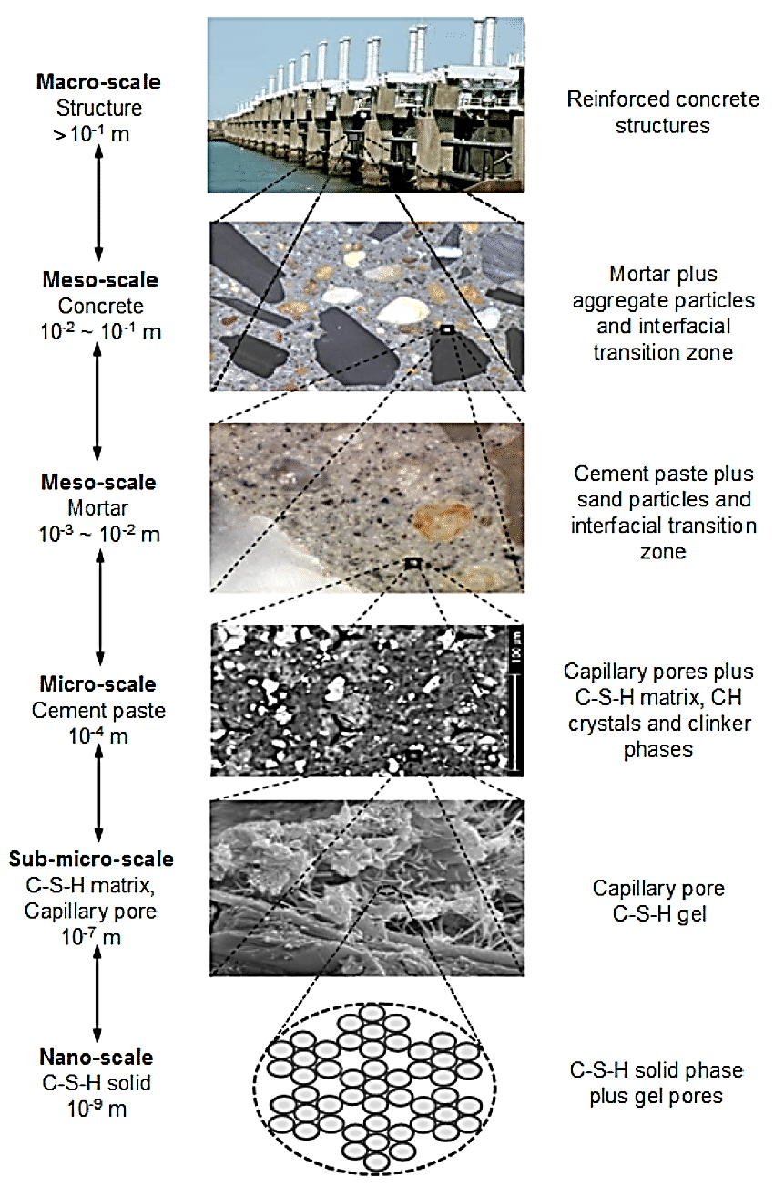
Introduction
Reinforced concrete:
An unpredictable multiscale composite
Constituent Properties
Curing
Mixing
Reasons of variability
Zhang, 2013

Slide 5
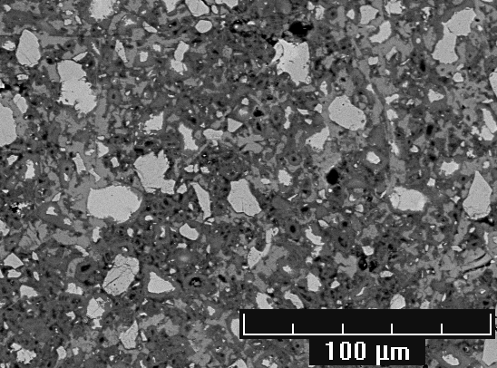
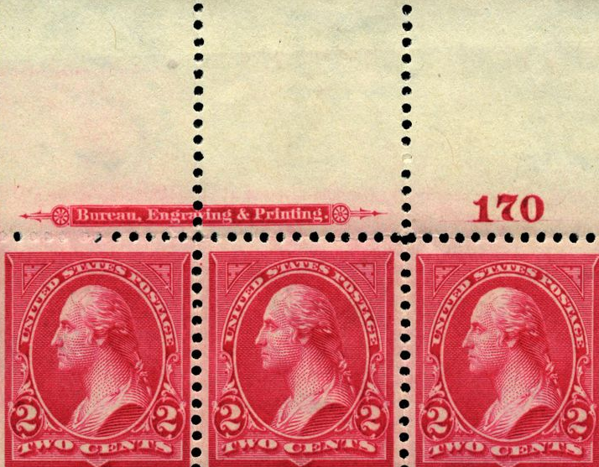
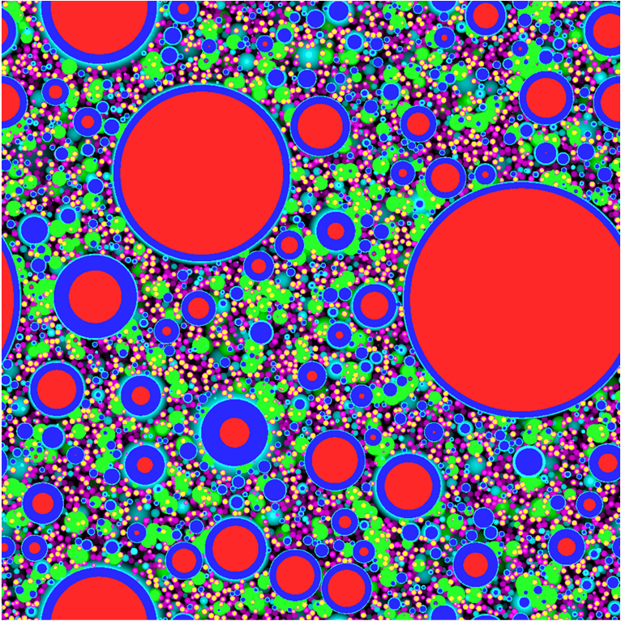
Introduction
Approaches of prediction:
Experiments : Can measure but do not predict. e.g. cube tests??
Some phenomena like creep, fatigue, ASR are years-long.
Empirical techniques: Based on macrostructural behaviour. Not generic.
A better approach: Utilize micro-structural behaviour
FEM techniques:
Great to model local behaviour.
Time-costly for multi-level heterogeneity of concrete.
Mean-Field Homogenisation Techniques
Can analyse multi-level heterogeneity semi-analytically
Less time consuming
Microstructure is simplified but still useful.

Slide 6
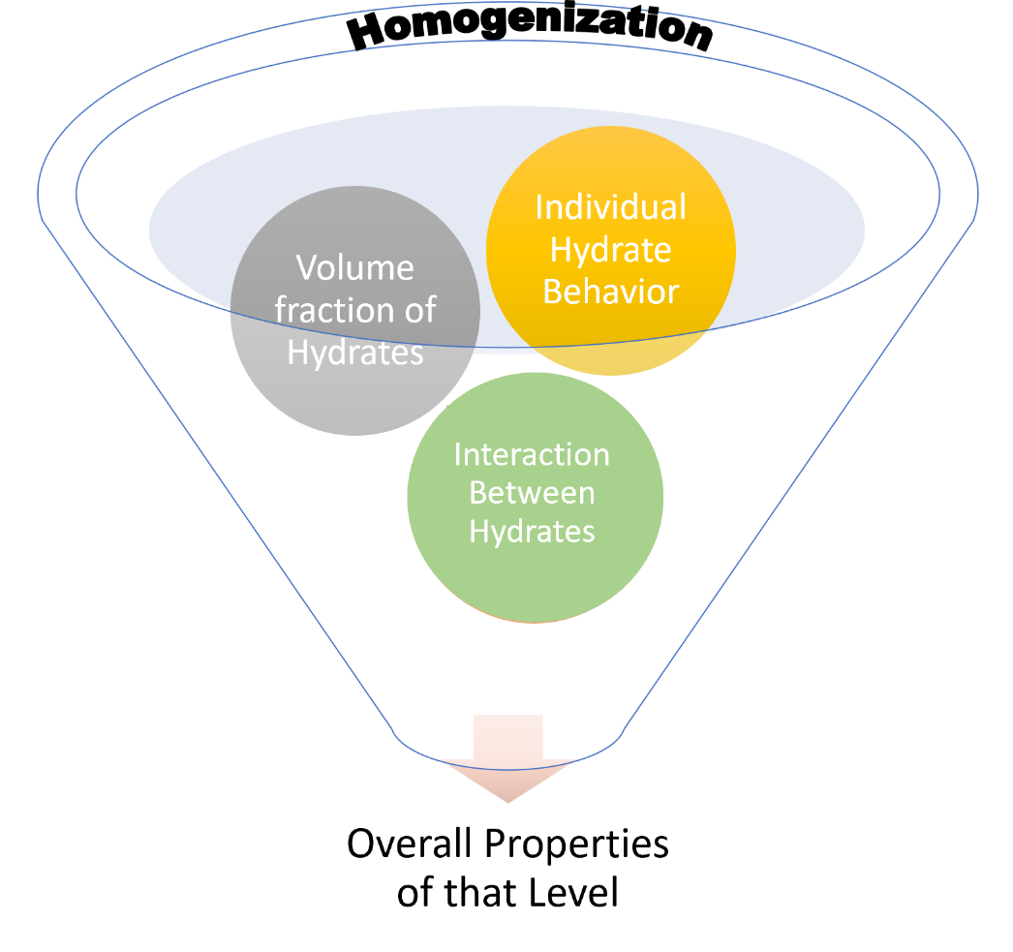
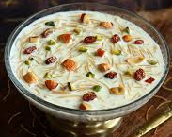
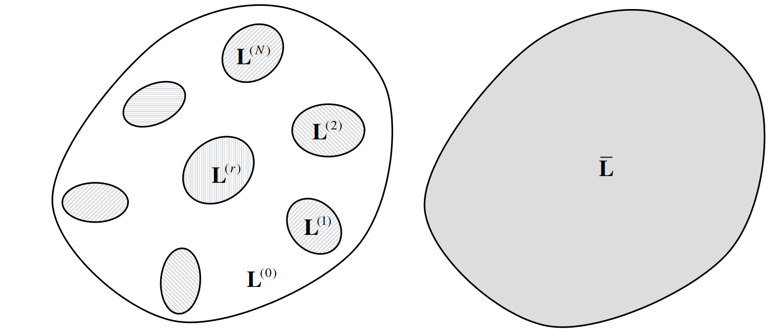
Literature Survey
Principle of homogenisation
Definition: A homogeneous equivalent material storing same strain energy
Principle: The applied macroscopic strain/stress = Average of microscopic strains/stresses
$\overline{ε}$=$\sum_{r=0}^{N}{c_{r}}$ $\overline{ε}$_{r} and $\overline{σ}$=$\sum_{r=0}^{N}{c_{r}}$ $\overline{σ}$_{r}
Where, and
$𝔸_{r}$, $𝔹_{r}$ : Strain and Stress Concentration tensors
Effective Elastic Properties :
$\overline{σ}$= $\overline{𝕃}$ $\overline{ε}$
where $\overline{𝕃}$ =$𝕃0+\sum_{r=1}^{N}{c_{r} \text{(}𝕃r\text{−}𝕃0\text{)}𝔸\text{r}}$
$${\overline{ε}}_{r}= 𝔸_{r}\overline{ε}$$
$${\overline{σ}}_{r}= 𝔹_{r}\overline{σ}$$
RVE
Hashin, 1965

Slide 7
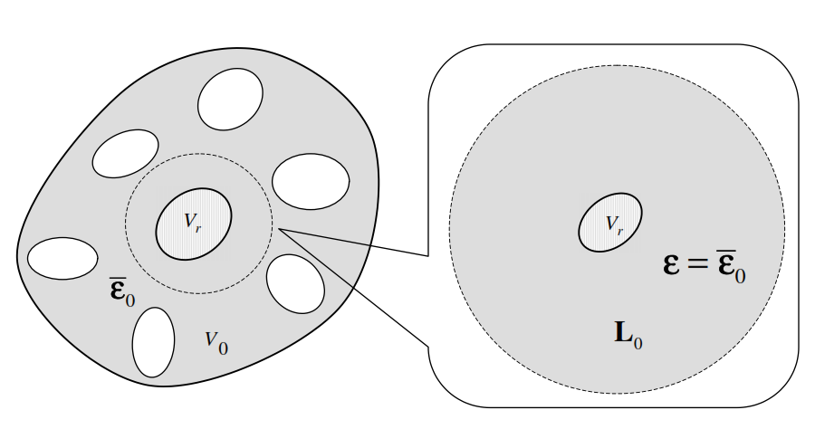
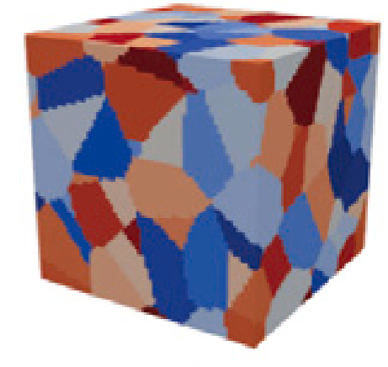
Literature Survey
Popular homogenisation methods
Mori-Tanaka Scheme (Mori & Tanaka, 1973) | Self-Consistent Scheme (Hill, 1965) | Generalized Self-Consistent Schemes
The inhomogeneities are far from each other Effects are transferred through the matrix | The inhomogeneities are Near to each other Direct interaction of inhomogeneities | No distinct matrix exists e.g. a polycrystal material with grains in different orientations.
$𝔸_{r}=𝔾_{r}$ $[c_{0}𝕀+\sum_{n=1}^{N}{ c_{n}𝔾_{n}}$] $$𝔾_{r}={[𝕀+ 𝕊_{r}𝕃_{0}^{−1}{(𝕃_{r}− 𝕃_{0})}^{ }]}^{−1}$$ | $$𝔸_{r}={[𝕀+ {\overline{𝕊}}_{r}{\overline{𝕃}}_{ }^{−1}{(𝕃_{r}− {\overline{𝕃}}_{ })}^{ }]}^{−1}$$ | $$𝔸_{r}={[𝕀+ {\overline{𝕊}}_{r}{\overline{𝕃}}_{ }^{−1}{(𝕃_{r}− {\overline{𝕃}}_{ })}^{ }]}^{−1}$$ ${\overline{𝕃}}_{ }=$ $\sum_{n=1}^{N}{ c_{n}𝔸_{r}𝕃_{r}}$

Slide 8
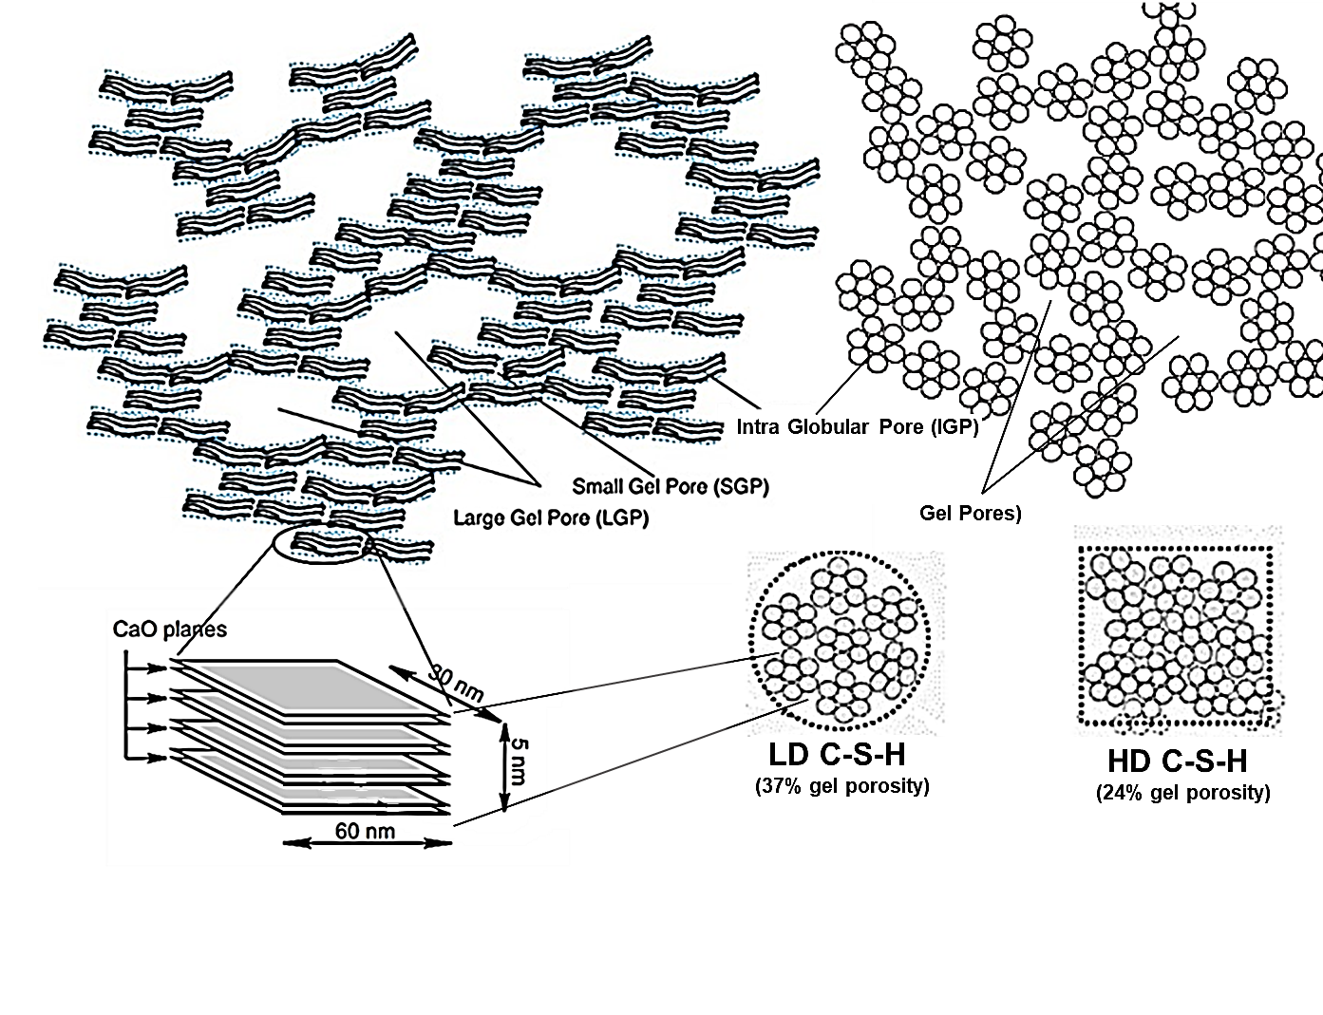
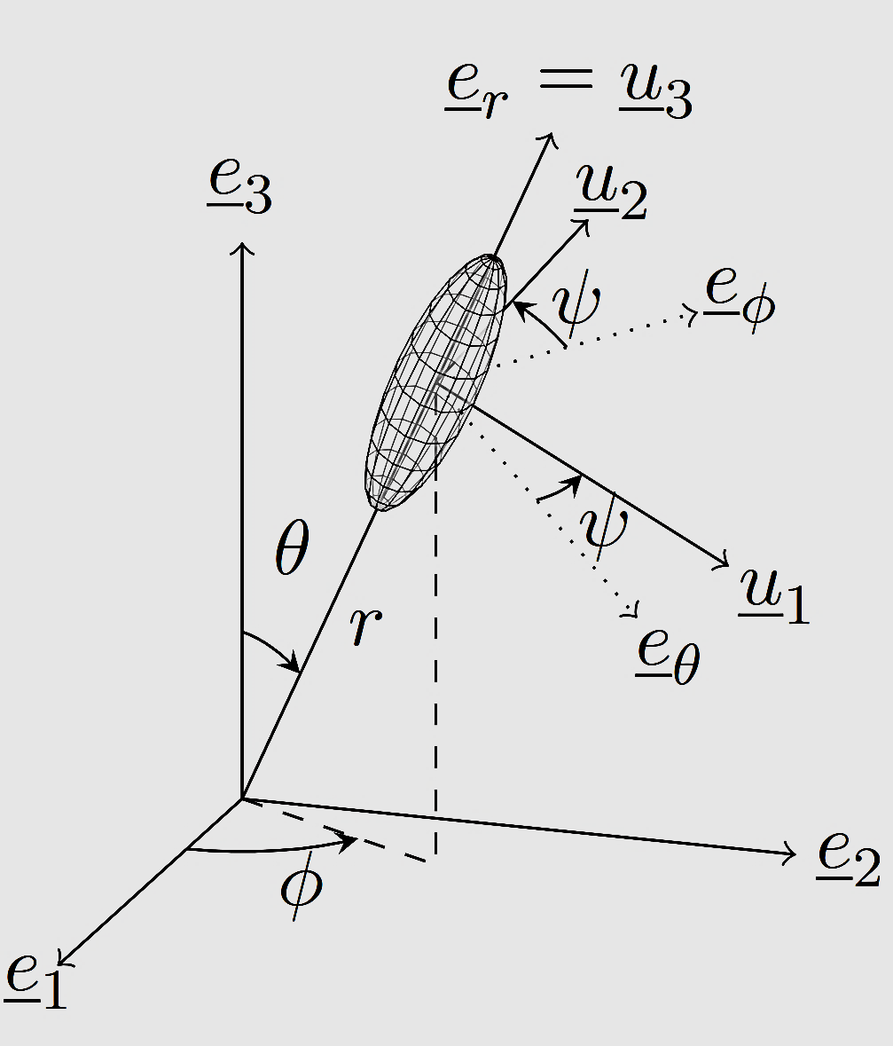
Literature Survey
SCS is frequently used in cementitious systems
Levels | Levels | Constituents | Modelled shape | Remarks
Paste | C-S-H Gel | Solid C-S-H +Gel Pores | Spheroid (varying AR) Sphere | SCS used
 | C-S-H Foam | C-S-H Gel +Capillary Pores | Spheroid sphere | SCS used
Hellmich, 2020
Sanahuja, 2007
Local reference frame needed
$$𝕃^{scs}=\left(1−φ\right)\left[\int_{ψ=0}^{2π}{\int_{∅=0}^{2π}{\int_{θ=0}^{π}{{𝕃_{s}\left(θ,∅,ψ\right):\left[𝕀+ℙ_{sph}^{scs}\left(θ,∅\right):\left(𝕃_{s}\left(θ,∅,ψ\right)−𝕃^{scs}\right)\right]}^{−1}\frac{sinθ}{8π^{2}}dθd∅dψ}}}\right]$$
$${∶\left[\left(1−φ\right)\left[\int_{ψ=0}^{2π}{\int_{∅=0}^{2π}{\int_{θ=0}^{π}{{\left\{𝕀+ℙ_{sph}^{scs}(θ,∅):(𝕃_{s}\left(θ,∅,ψ\right)−𝕃^{scs})\right\}}^{−1}\frac{sinθ}{8π^{2}}dθd∅dψ+φ{(1−𝕊_{sph}^{scs})}^{−1}}}}\right]\right]}^{−1}$$

Slide 9
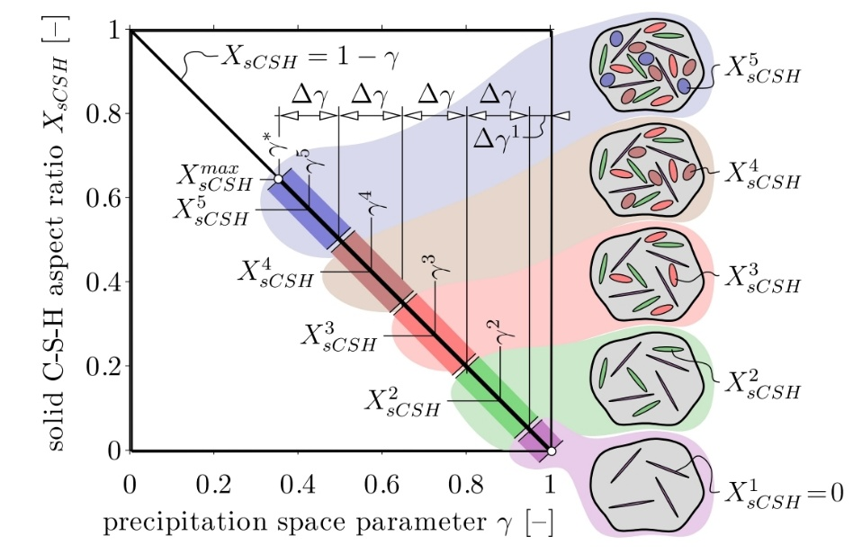
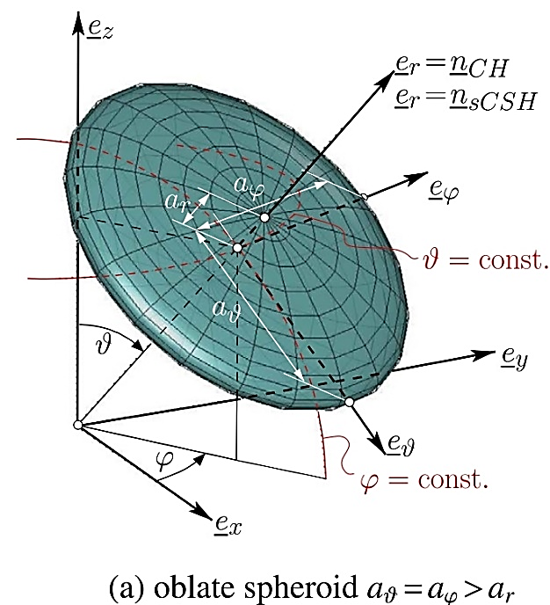
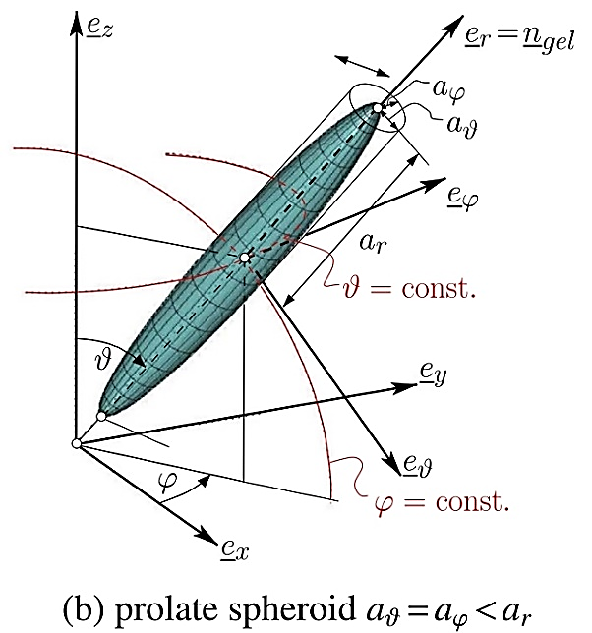
Literature Gap & Objectives
Literature gaps
Complicated techniques used for SCS.
Not easy to comprehend and follow.
Methods not versatile to be used across porosities aspect ratios
Objectives
To devise a simpler method
Versatile to work across for a range of porosities and aspect ratios
Konigsberger, 2020

Slide 10
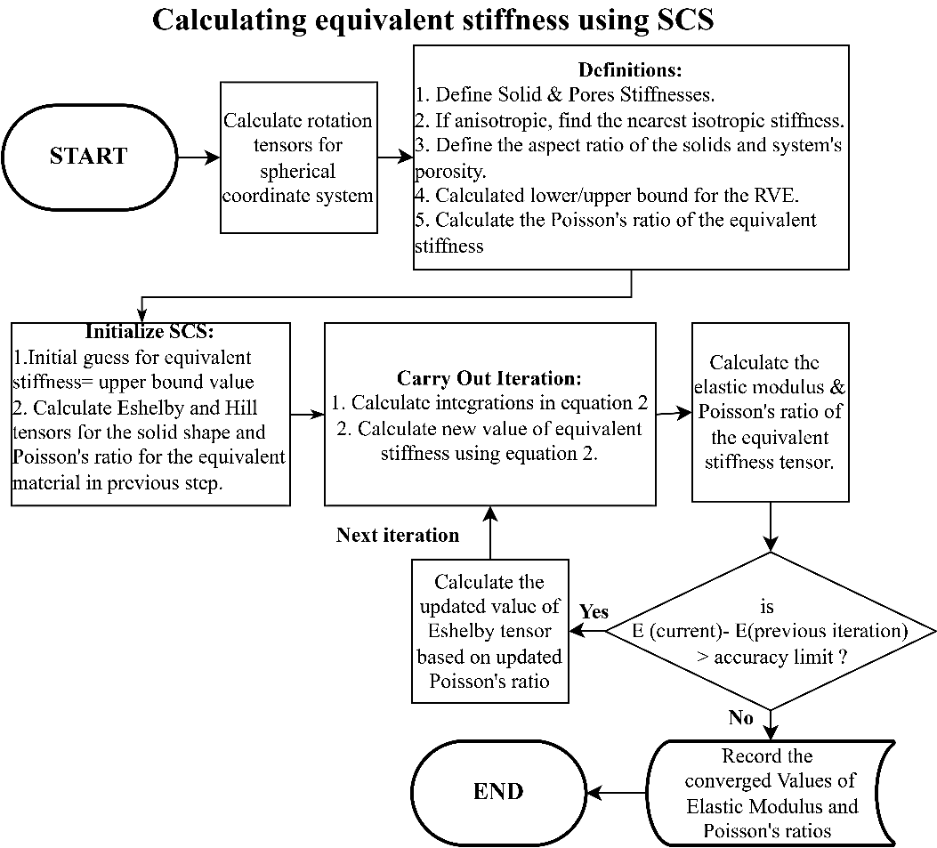
Methodology
$$𝕃^{scs}=\left(1−φ\right)\left[\int_{ψ=0}^{2π}{\int_{∅=0}^{2π}{\int_{θ=0}^{π}{{𝕃_{s}\left(θ,∅,ψ\right):\left[𝕀+ℙ_{sph}^{scs}\left(θ,∅\right):\left(𝕃_{s}\left(θ,∅,ψ\right)−𝕃^{scs}\right)\right]}^{−1}\frac{sinθ}{8π^{2}}dθd∅dψ}}}\right]$$
$${∶\left[\left(1−φ\right)\left[\int_{ψ=0}^{2π}{\int_{∅=0}^{2π}{\int_{θ=0}^{π}{{\left\{𝕀+ℙ_{sph}^{scs}(θ,∅):(𝕃_{s}\left(θ,∅,ψ\right)−𝕃^{scs})\right\}}^{−1}\frac{sinθ}{8π^{2}}dθd∅dψ+φ{(1−𝕊_{sph}^{scs})}^{−1}}}}\right]\right]}^{−1}$$

Slide 11
Methodology
Efficient calculations using Stroh- formalism
$$𝕃^{scs}=\left(1−φ\right)\left[\int_{ψ=0}^{2π}{\int_{∅=0}^{2π}{\int_{θ=0}^{π}{{𝕃_{s}\left(θ,∅,ψ\right):\left[𝕀+ℙ_{sph}^{scs}\left(θ,∅\right):\left(𝕃_{s}\left(θ,∅,ψ\right)−𝕃^{scs}\right)\right]}^{−1}\frac{sinθ}{8π^{2}}dθd∅dψ}}}\right]$$
$${∶\left[\left(1−φ\right)\left[\int_{ψ=0}^{2π}{\int_{∅=0}^{2π}{\int_{θ=0}^{π}{{\left\{𝕀+ℙ_{sph}^{scs}(θ,∅):(𝕃_{s}\left(θ,∅,ψ\right)−𝕃^{scs})\right\}}^{−1}\frac{sinθ}{8π^{2}}dθd∅dψ+φ{(1−𝕊_{sph}^{scs})}^{−1}}}}\right]\right]}^{−1}$$
$$𝕃_{ijkl}^{s}={Ω_{ip}Ω_{jq}𝕃}_{pqrs}^{c}Ω_{kr}Ω_{ls}$$
$$L^{(s)}=K^{ }L^{(c)}K^{T}$$
$$K=\left[\begin{matrix}K^{(1)} & {2K}^{(2)} \\ K^{(3)} & K^{(4)}\end{matrix}\right]$$
$$K_{ij}^{(1)}=Ω_{ij}^{2}$$
$$K_{ij}^{(2)}=Ω_{imod(j+1)}^{ }Ω_{imod(j+2)}^{ }$$
$$K_{ij}^{(3)}=Ω_{mod(i+1)j}^{ }Ω_{mod(i+2)j}^{ }$$
$$K_{ij}^{(4)}=Ω_{mod(i+1)mod(j+1)}^{ }Ω_{mod(i+2)mod(j+2)}^{ }+Ω_{mod(i+1)mod(j+2)}^{ }Ω_{mod(i+2)mod(j+1)}^{ }$$
3x3x3x3 format requires 81 loops per tensor per iteration
6x6 format requires 36 loops per tensor per iteration

Slide 12
Methodology
Nearest isotropic tensors
$$𝕃^{scs}=\left(1−φ\right)\left[\int_{ψ=0}^{2π}{\int_{∅=0}^{2π}{\int_{θ=0}^{π}{{𝕃_{s}\left(θ,∅,ψ\right):\left[𝕀+ℙ_{sph}^{scs}\left(θ,∅\right):\left(𝕃_{s}\left(θ,∅,ψ\right)−𝕃^{scs}\right)\right]}^{−1}\frac{sinθ}{8π^{2}}dθd∅dψ}}}\right]$$
$${∶\left[\left(1−φ\right)\left[\int_{ψ=0}^{2π}{\int_{∅=0}^{2π}{\int_{θ=0}^{π}{{\left\{𝕀+ℙ_{sph}^{scs}(θ,∅):(𝕃_{s}\left(θ,∅,ψ\right)−𝕃^{scs})\right\}}^{−1}\frac{sinθ}{8π^{2}}dθd∅dψ+φ{(1−𝕊_{sph}^{scs})}^{−1}}}}\right]\right]}^{−1}$$
$Eulidean norm$
$$d\left(A−B\right)=\left\|\left(A−\left.\left.B\right)\right\|\right.\right.$$
$$\left\|\left.M\right\|\right.={\left[tr(M^{T}M)\right]}^{1/2}$$
Bulk and shear moduli of nearest isotropic stiffness $${9K}_{B}=(a_{11}+a_{22}+a_{33}+2\left(a_{23}+a_{31}+a_{12}\right)$$ $${30G}_{B}=2\left(a_{11}+a_{22}+a_{33}− a_{23}−a_{31}−a_{12}\right)+3\left(a_{44}+a_{55}+a_{66}\right)$$ $$B={3K}_{B}I_{v}+2G_{B} I_{d}$$

Slide 13
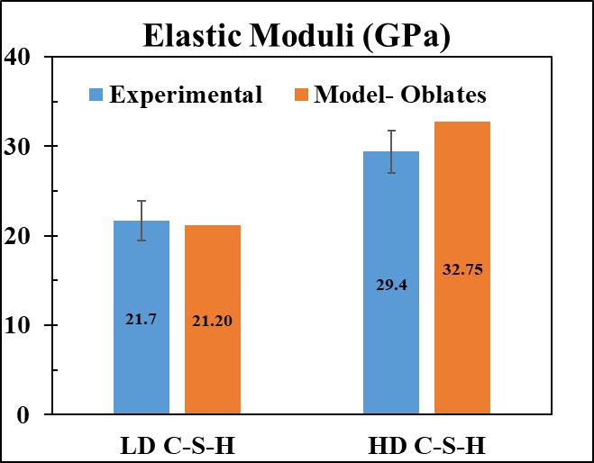
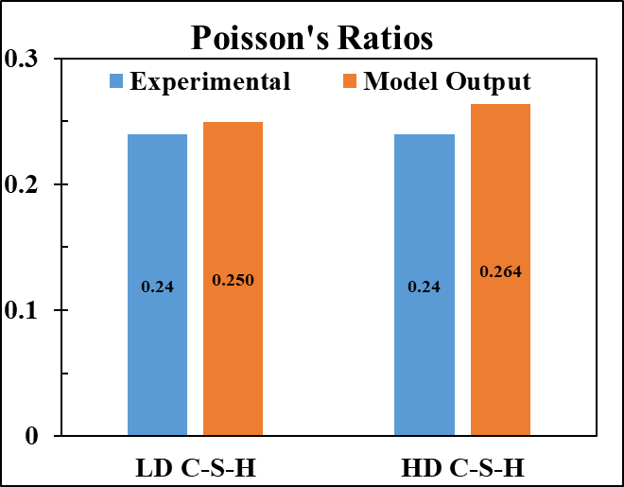
Results
Validation of the model

Slide 14
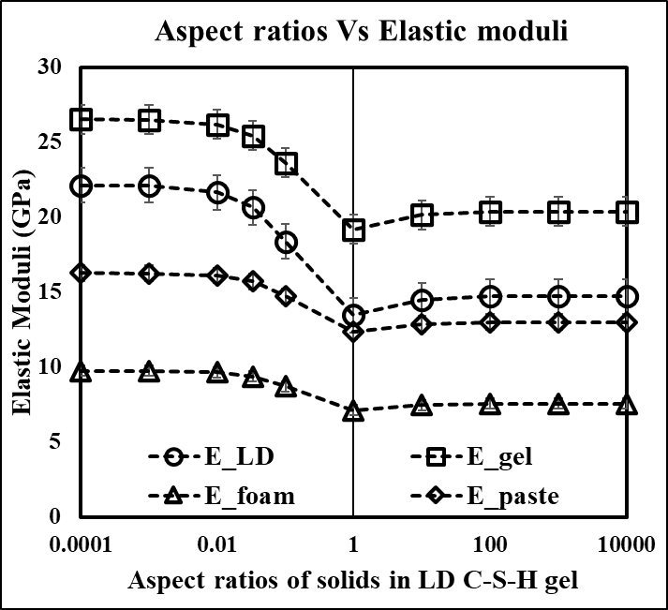
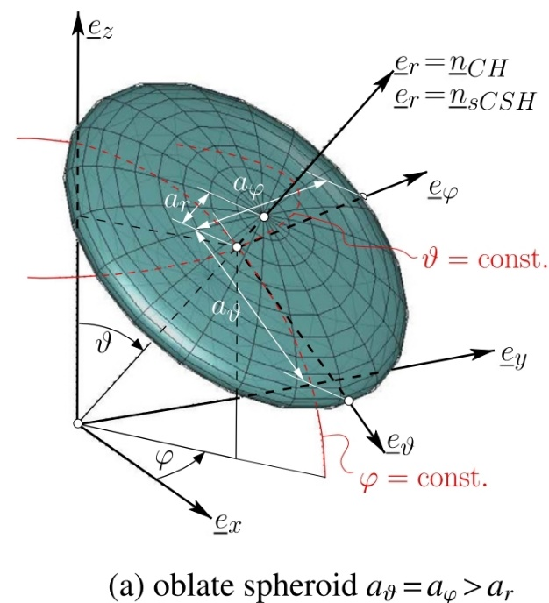
Results
Effect of shape of solids
Oblate shapes appear to be most effective in increasing elastic modulus.
The effect of shapes of the solids reduce at upper scales: C-S-H gels, foam and the paste

Slide 15
Conclusions
Model appears to be efficient and versatile for applying SCS on cementitious composites
Method of the nearest isotropic tensor using minimum Euclidean distance is useful.
Applicable to a wide range of aspect ratios and volume fractions.
Can predict the effect of aspect ratios and porosities
Easily extendible to other applications.

Slide 16
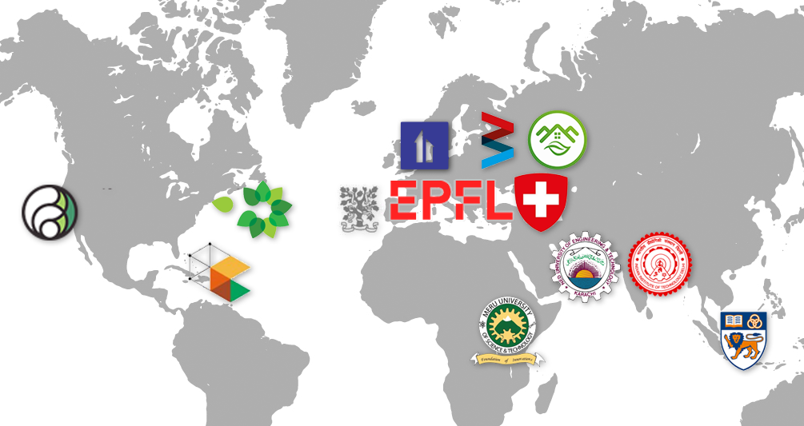
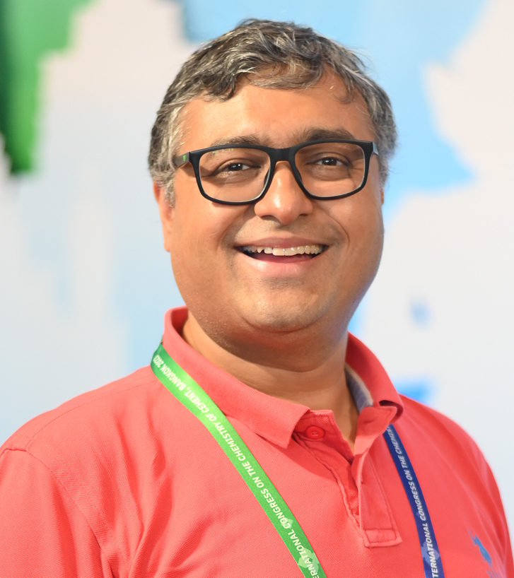
Prof. Shashank Bishnoi

Slide 17
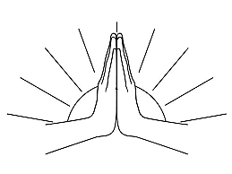
Thank you for your Attention!
Amit Kumar
Ph.D. Scholar
Indian Institute of Technology, New Delhi, India
Email: amit.kumar@civil.iitd.ac.in
iitd.amitkr@gmail.com

Slide 18
Complete Ph.D. Work
Multi-scale modelling of elasticity and creep of cementitious composites
A versatile model that works across different cementitious binders and water-cement ratios.
Link the creep observed in nano-seconds (as observed in indentation-creep tests) and over the years with a single model doe monotonic loading.
The effect of shape and constitutive properties of individual hydration products on the macro-level elastic and viscoelastic properties of cement pastes.
To estimate the effect of a change in capillary porosities on pastes' overall creep and elastic moduli.
To investigate the effect of the composition of C-S-H on the elastic modulus and creep of pastes.

