Slide 1
2nd Olympiad in Engineering Science (OES 2025)
University of Stavanger, Stavanger, Norway
June 10-14, 2025
ML-assisted Grid Refinement of Layered Voronoi-cell Lattice Models for Limit Analysis of Concrete Structures
John Bolander and Qiwei Zhang
Department of Civil and Environmental Engineering
University of California, Davis, CA, USA
Alessandro Fascetti
Department of Civil and Environmental Engineering
University of Pittsburgh, PA, USA

Slide 2
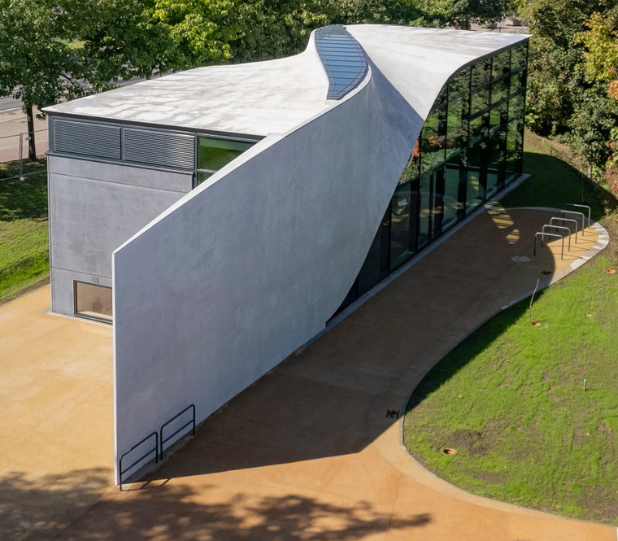
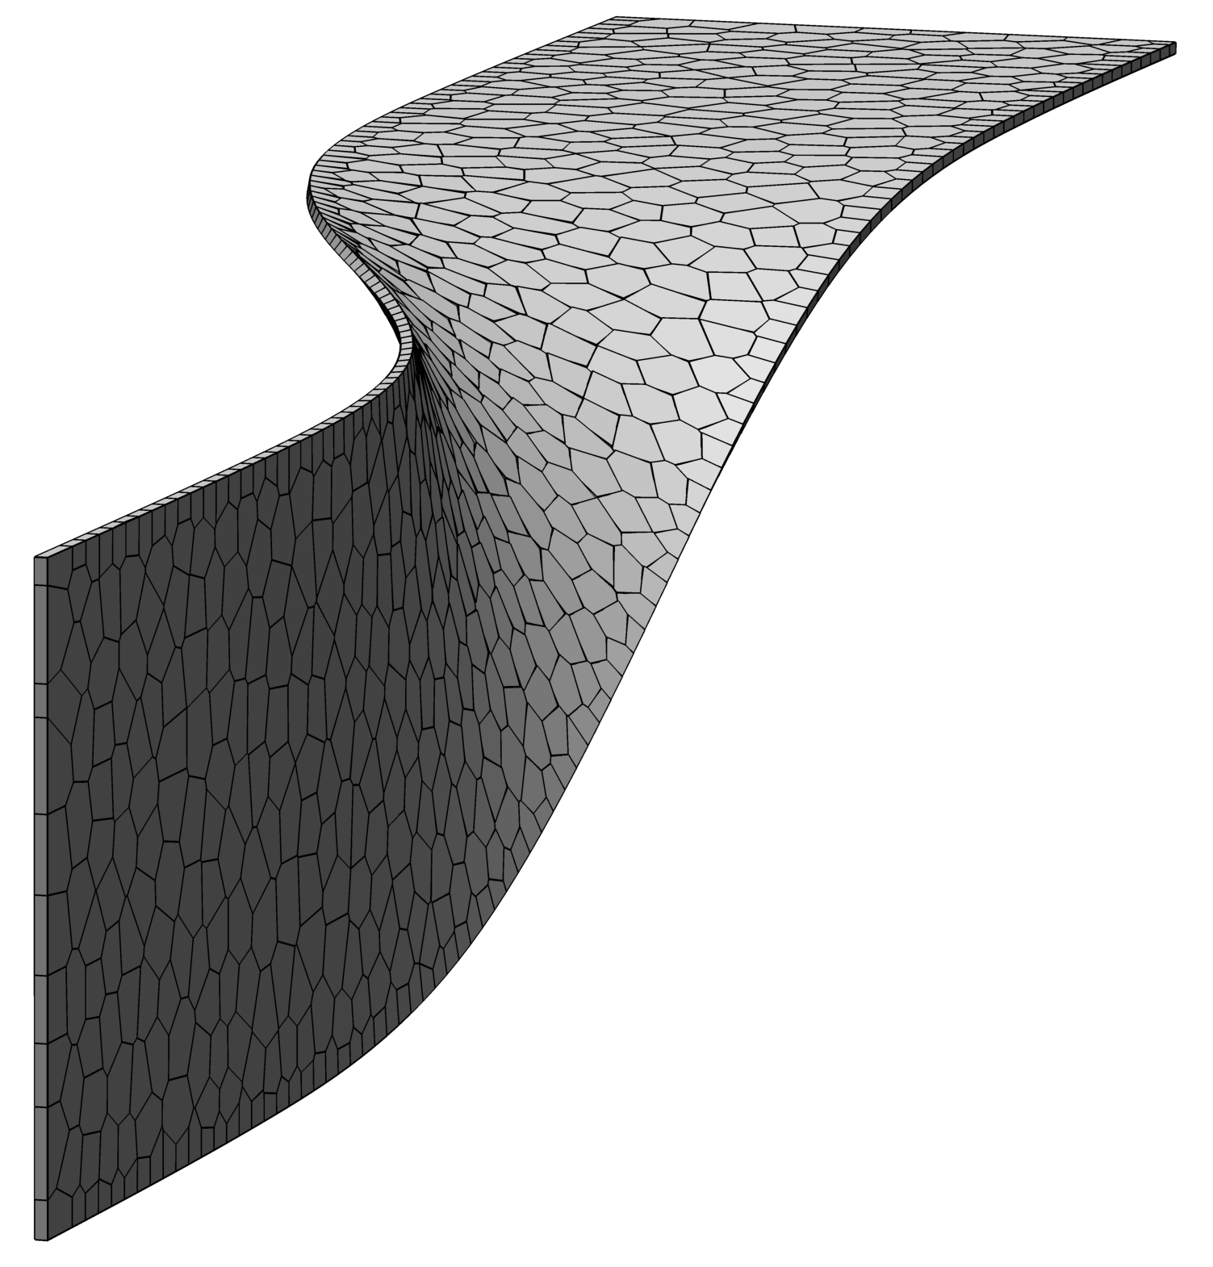
Model of TRC ceiling-wall shell
CUBE structure at the Technical University of Dresden

Slide 3
Presentation Overview
Computational modeling of structural concrete
Continuum versus discrete modeling frameworks
Discrete, layered modeling of planar structures
Simulation examples
Plastic yield-line analysis of slab structures
Ferrocement panels subjected to lateral loading
Summary statements

Slide 4
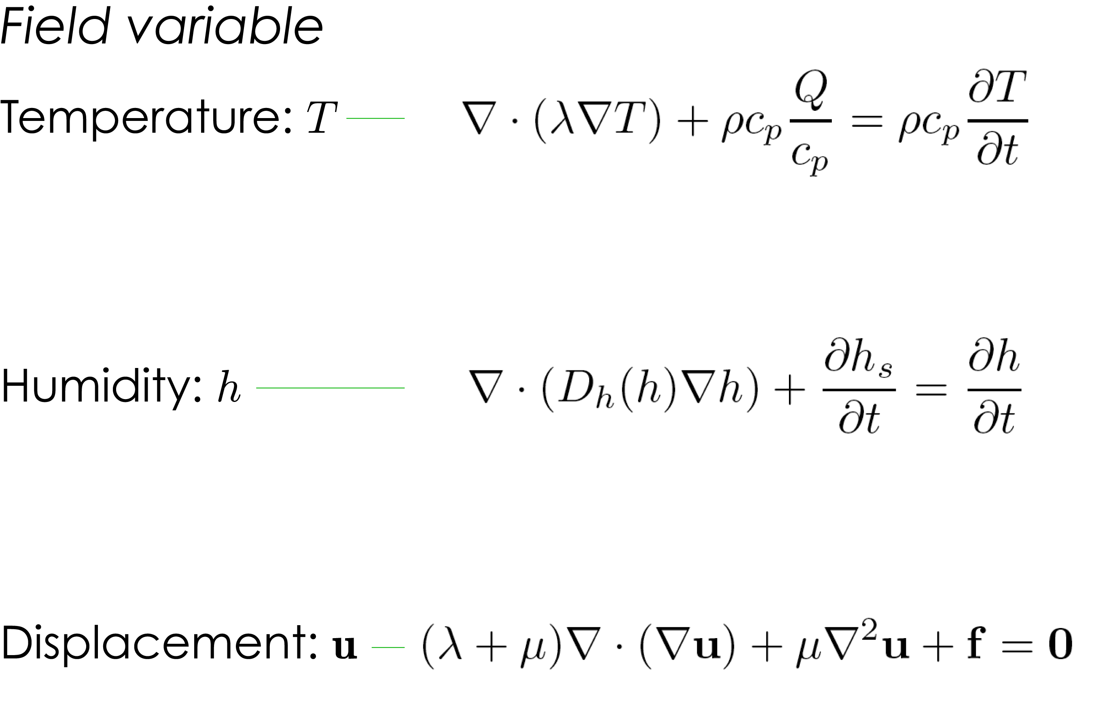
Continuum (FE) model
Governing field equations
Discrete (lattice) model

Slide 5
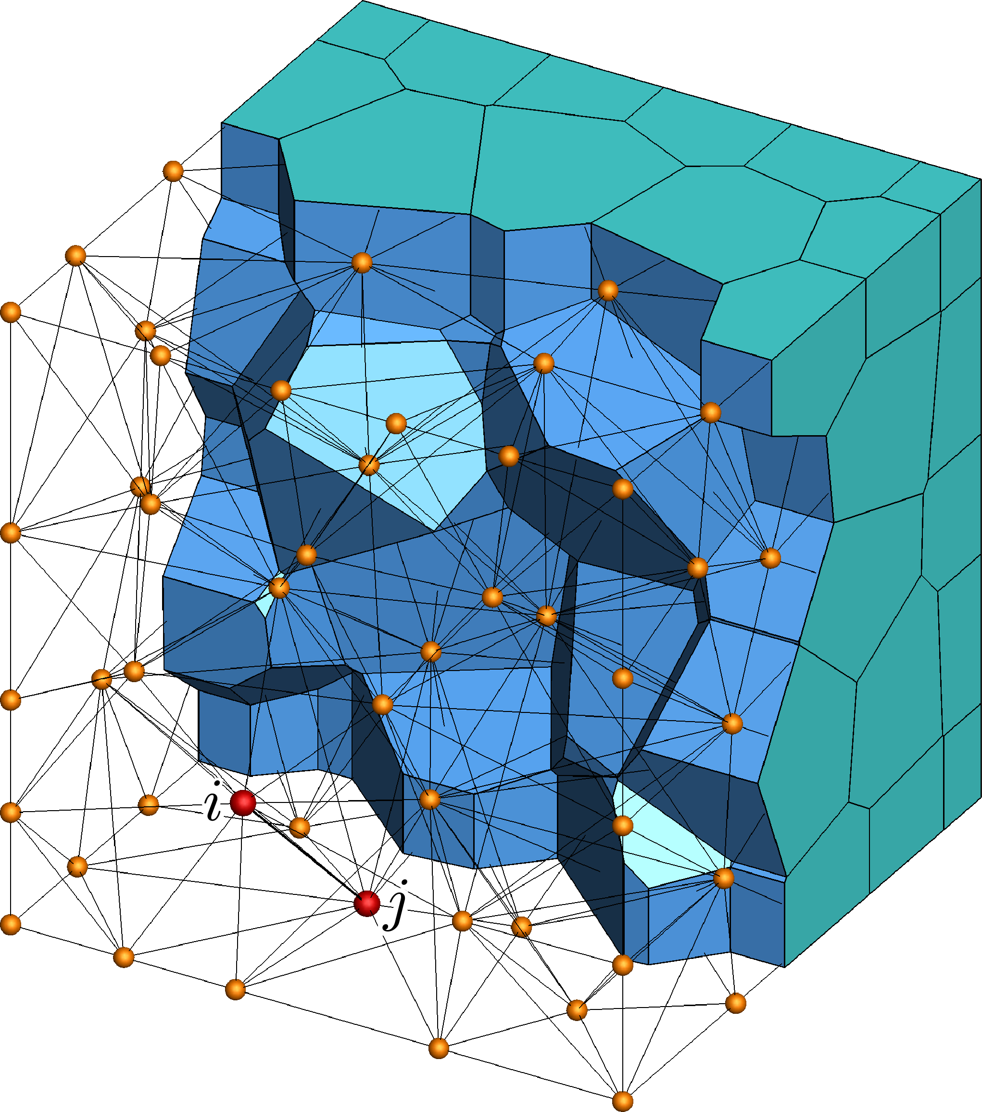
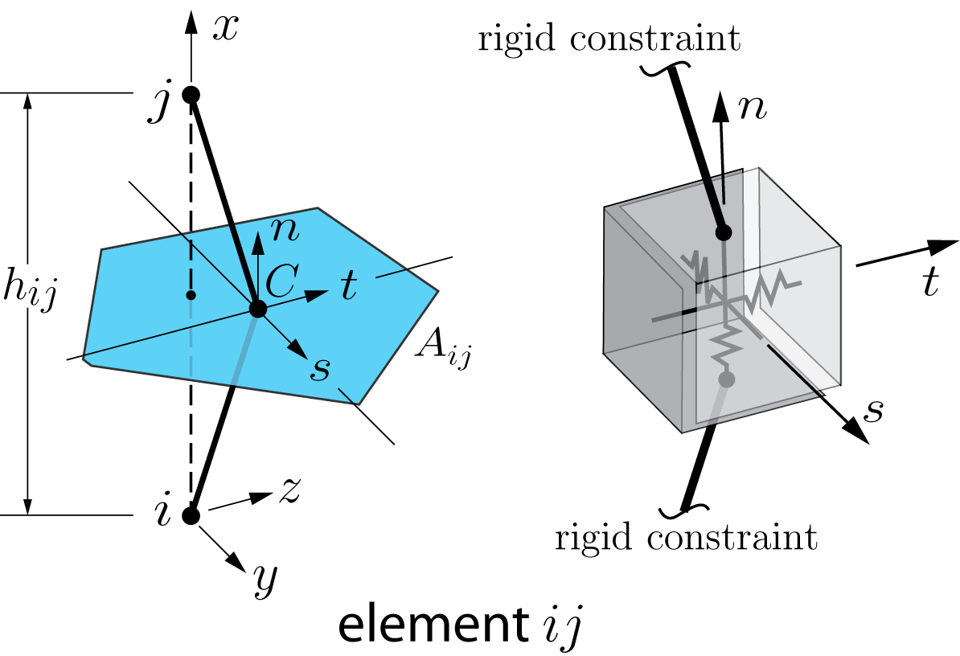
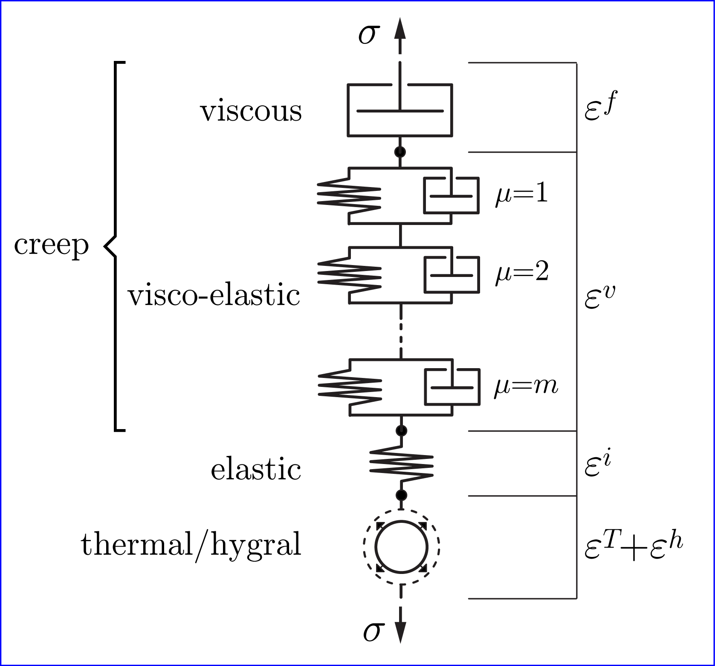
Voronoi-cell lattice model
Solidification-microprestress theory
Bazant ZP and Prasannan S (1989)
Di Luzio G and Cusatis G (2013)

Slide 6
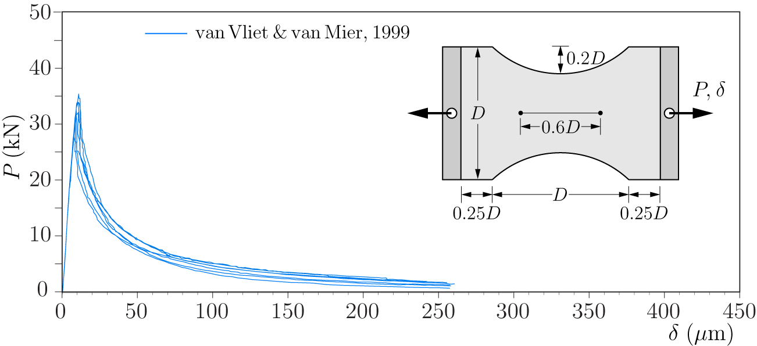
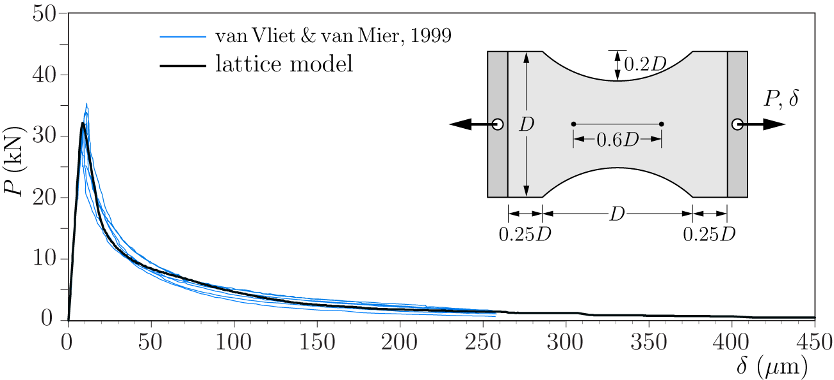
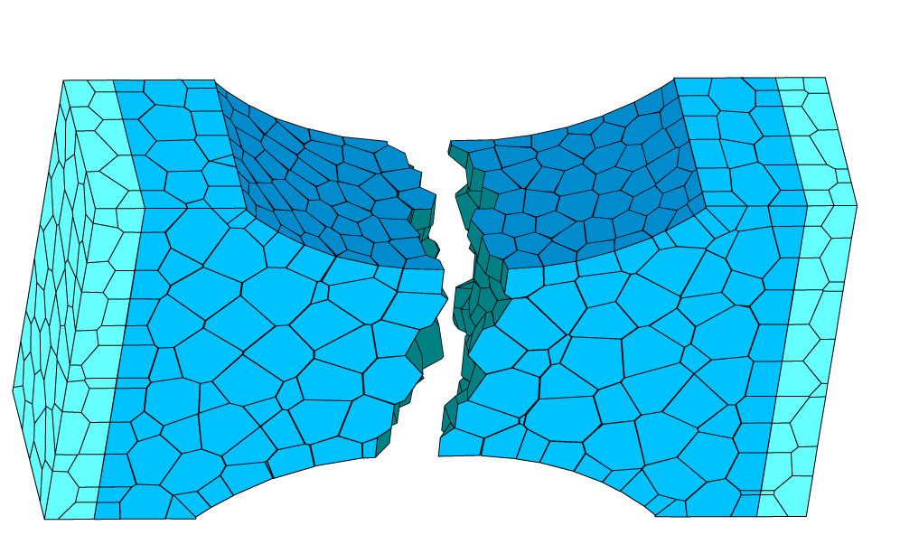
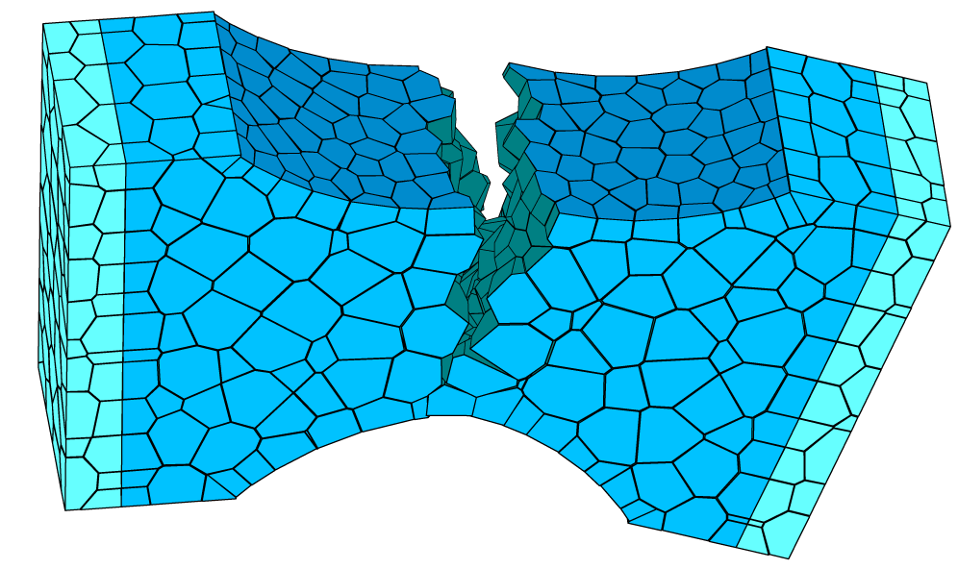
Load-displacement response
Fracture pattern for differing boundary conditions

Slide 7
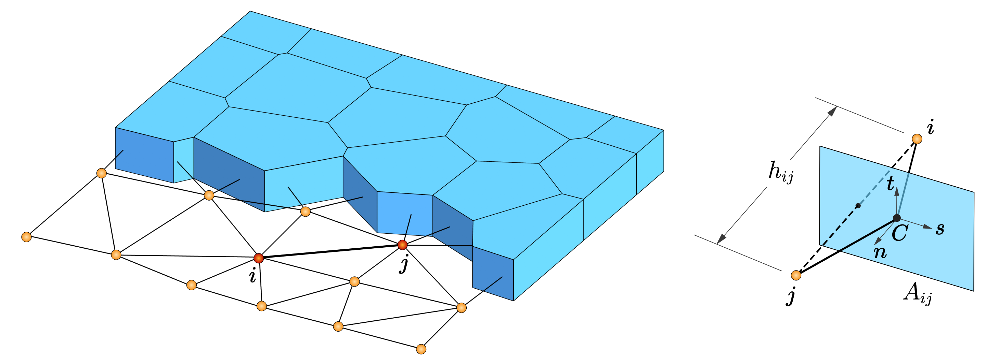
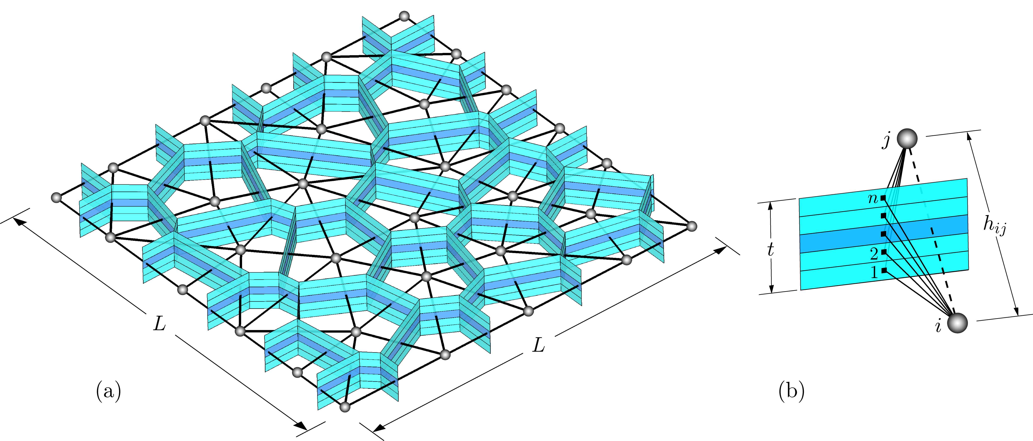
VCLM of planar structure
Layered-VCLM of planar structure

Slide 8
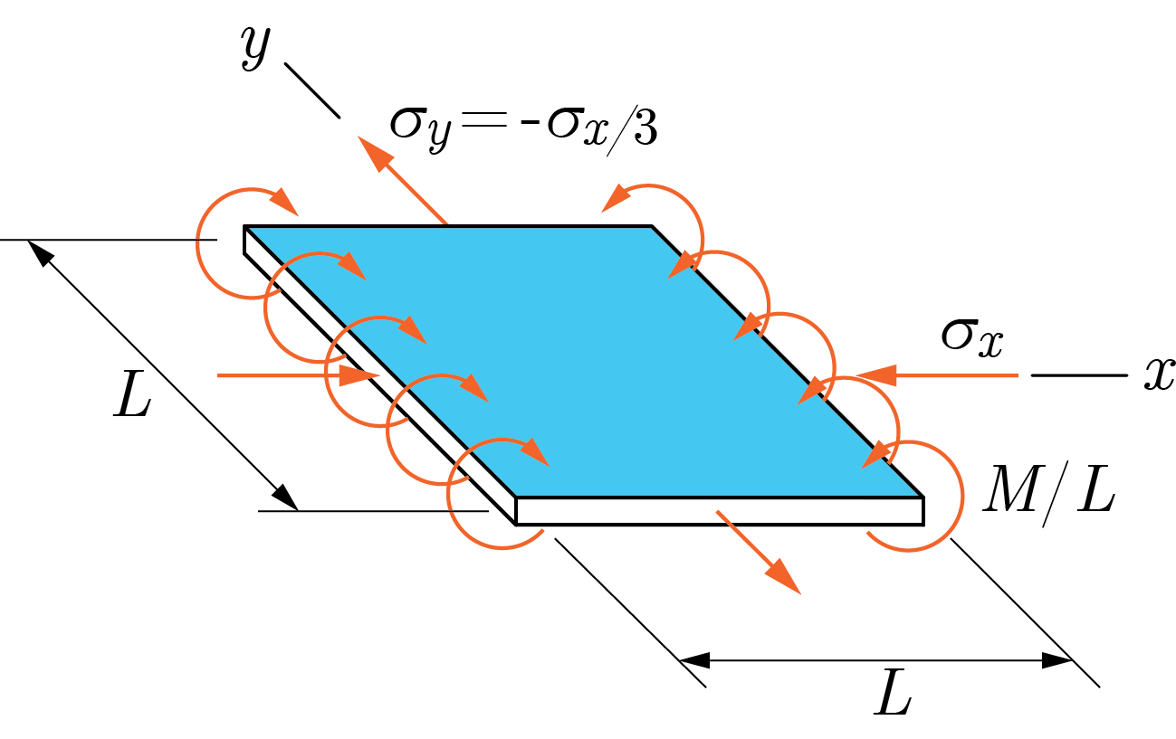
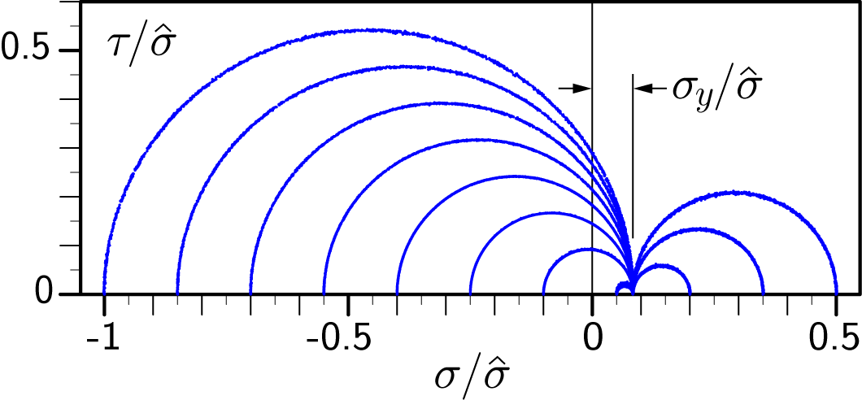
One-way bending and two-way membrane loading
Elemental stress values
11
layer number
10
9
8
7
1
The multi-layer lattice model is elastically homogeneous
6
2
Elastic stress analysis of a planar structure

Slide 9
Simulation examples
Plastic yield-line analysis of slab structures
Ferrocement panels subjected to lateral loading

Slide 10
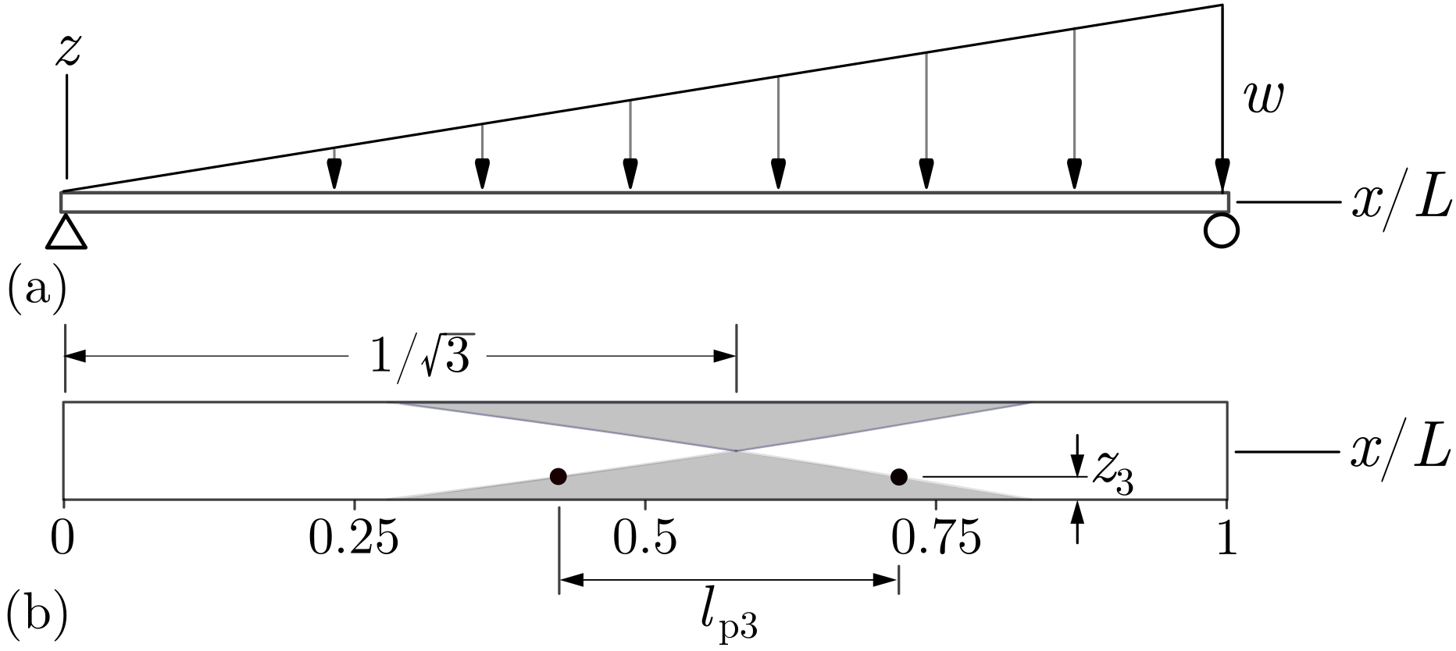
One-way simply-supported slab under lateral pressure: asymptotic limits of plastic yielding

Slide 11
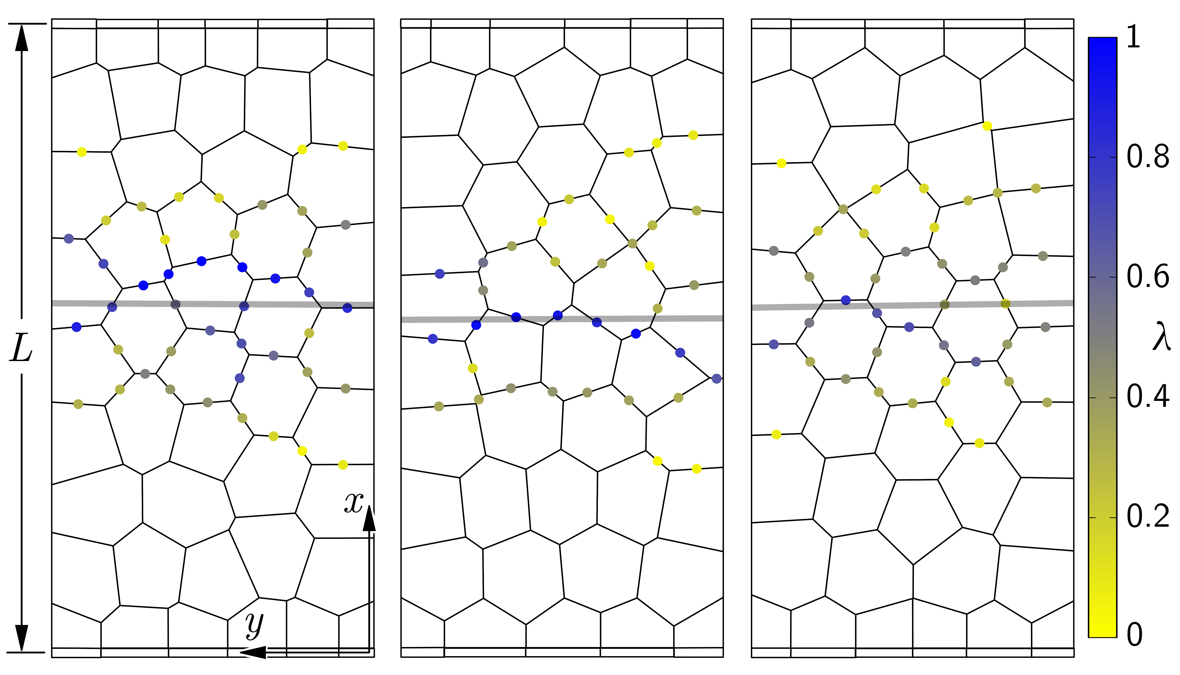
Determination of yield line trajectory based on individual maps of yield events

Slide 12
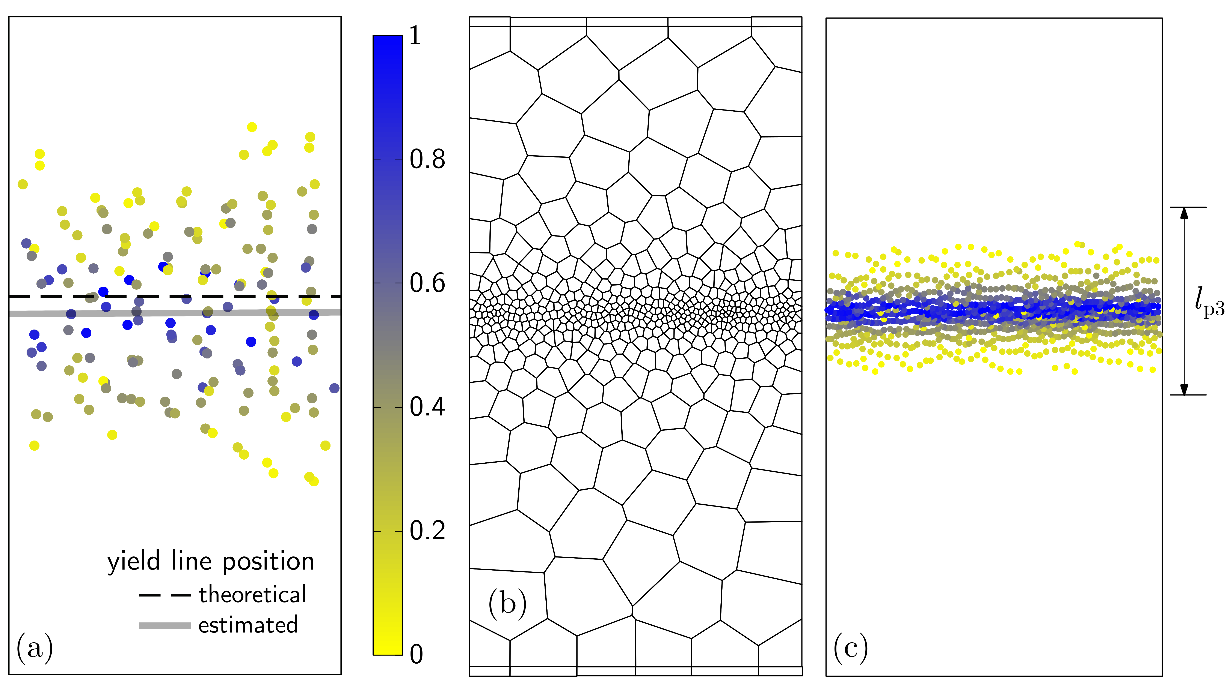
Refined grid using estimated yield line position
Estimated yield line position based on a composite map of four sets of data
Associated yield event map compared with theoretical yield zone bounds

Slide 13
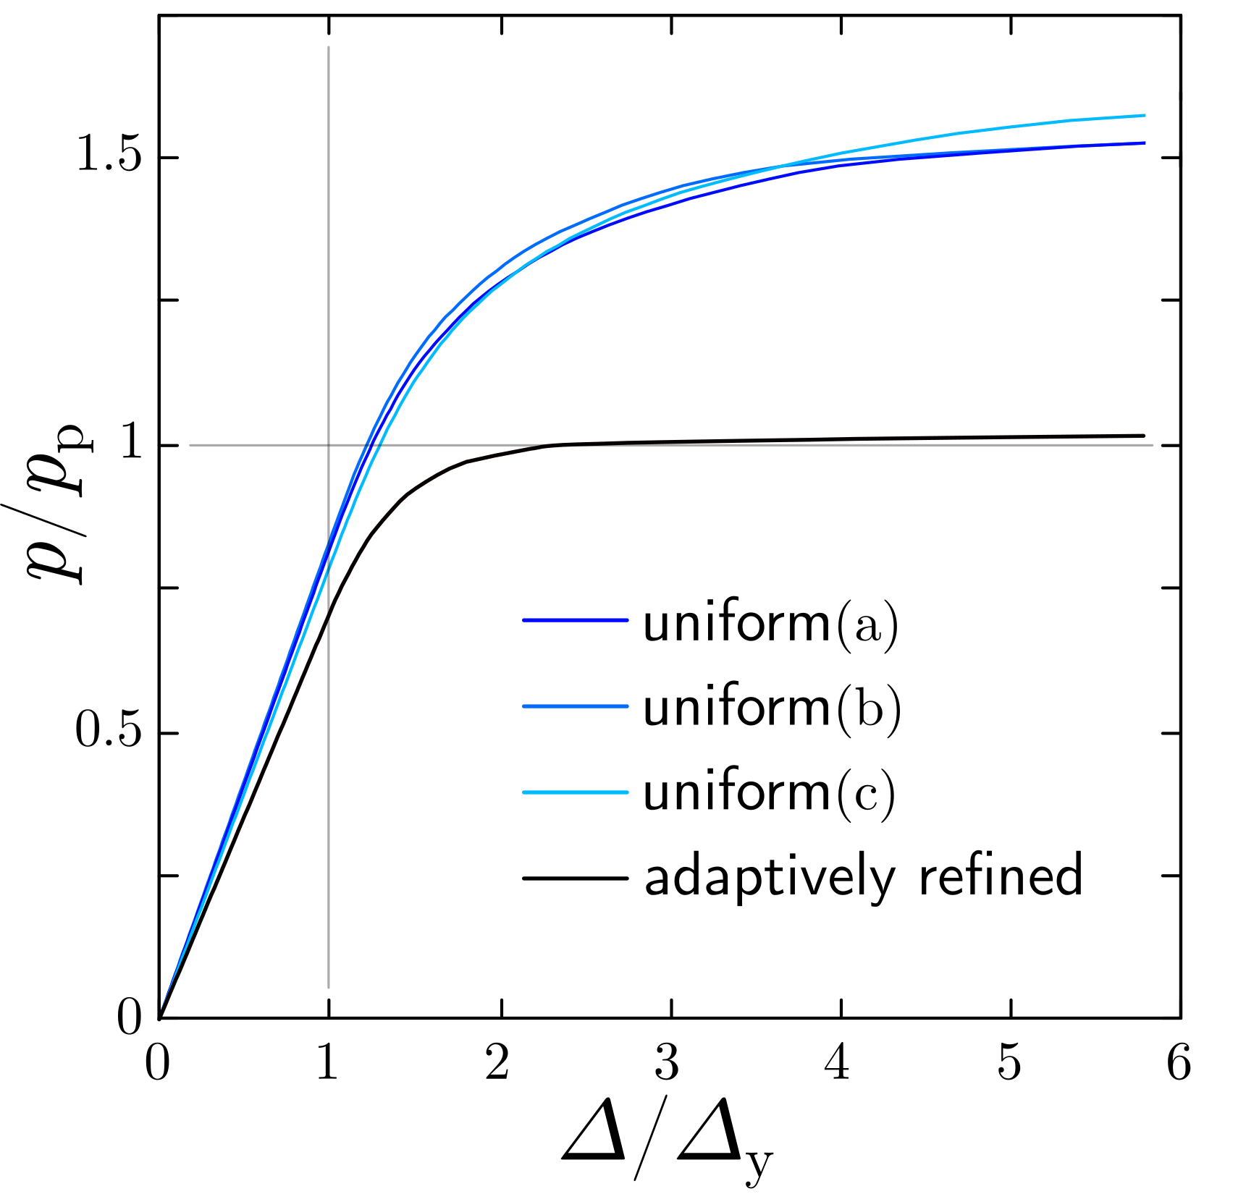
Lateral pressure versus midspan displacement for one-way slab examples

Slide 14
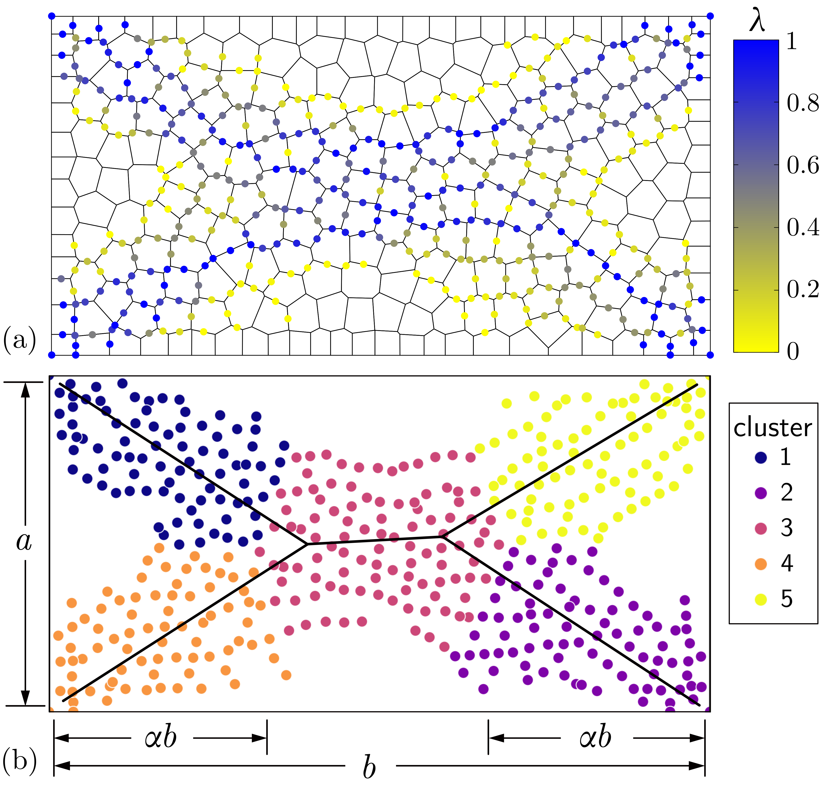
Yield event pattern for two-way slab subjected to out-of-plane loading
Yield line segments identified through cluster analysis

Slide 15
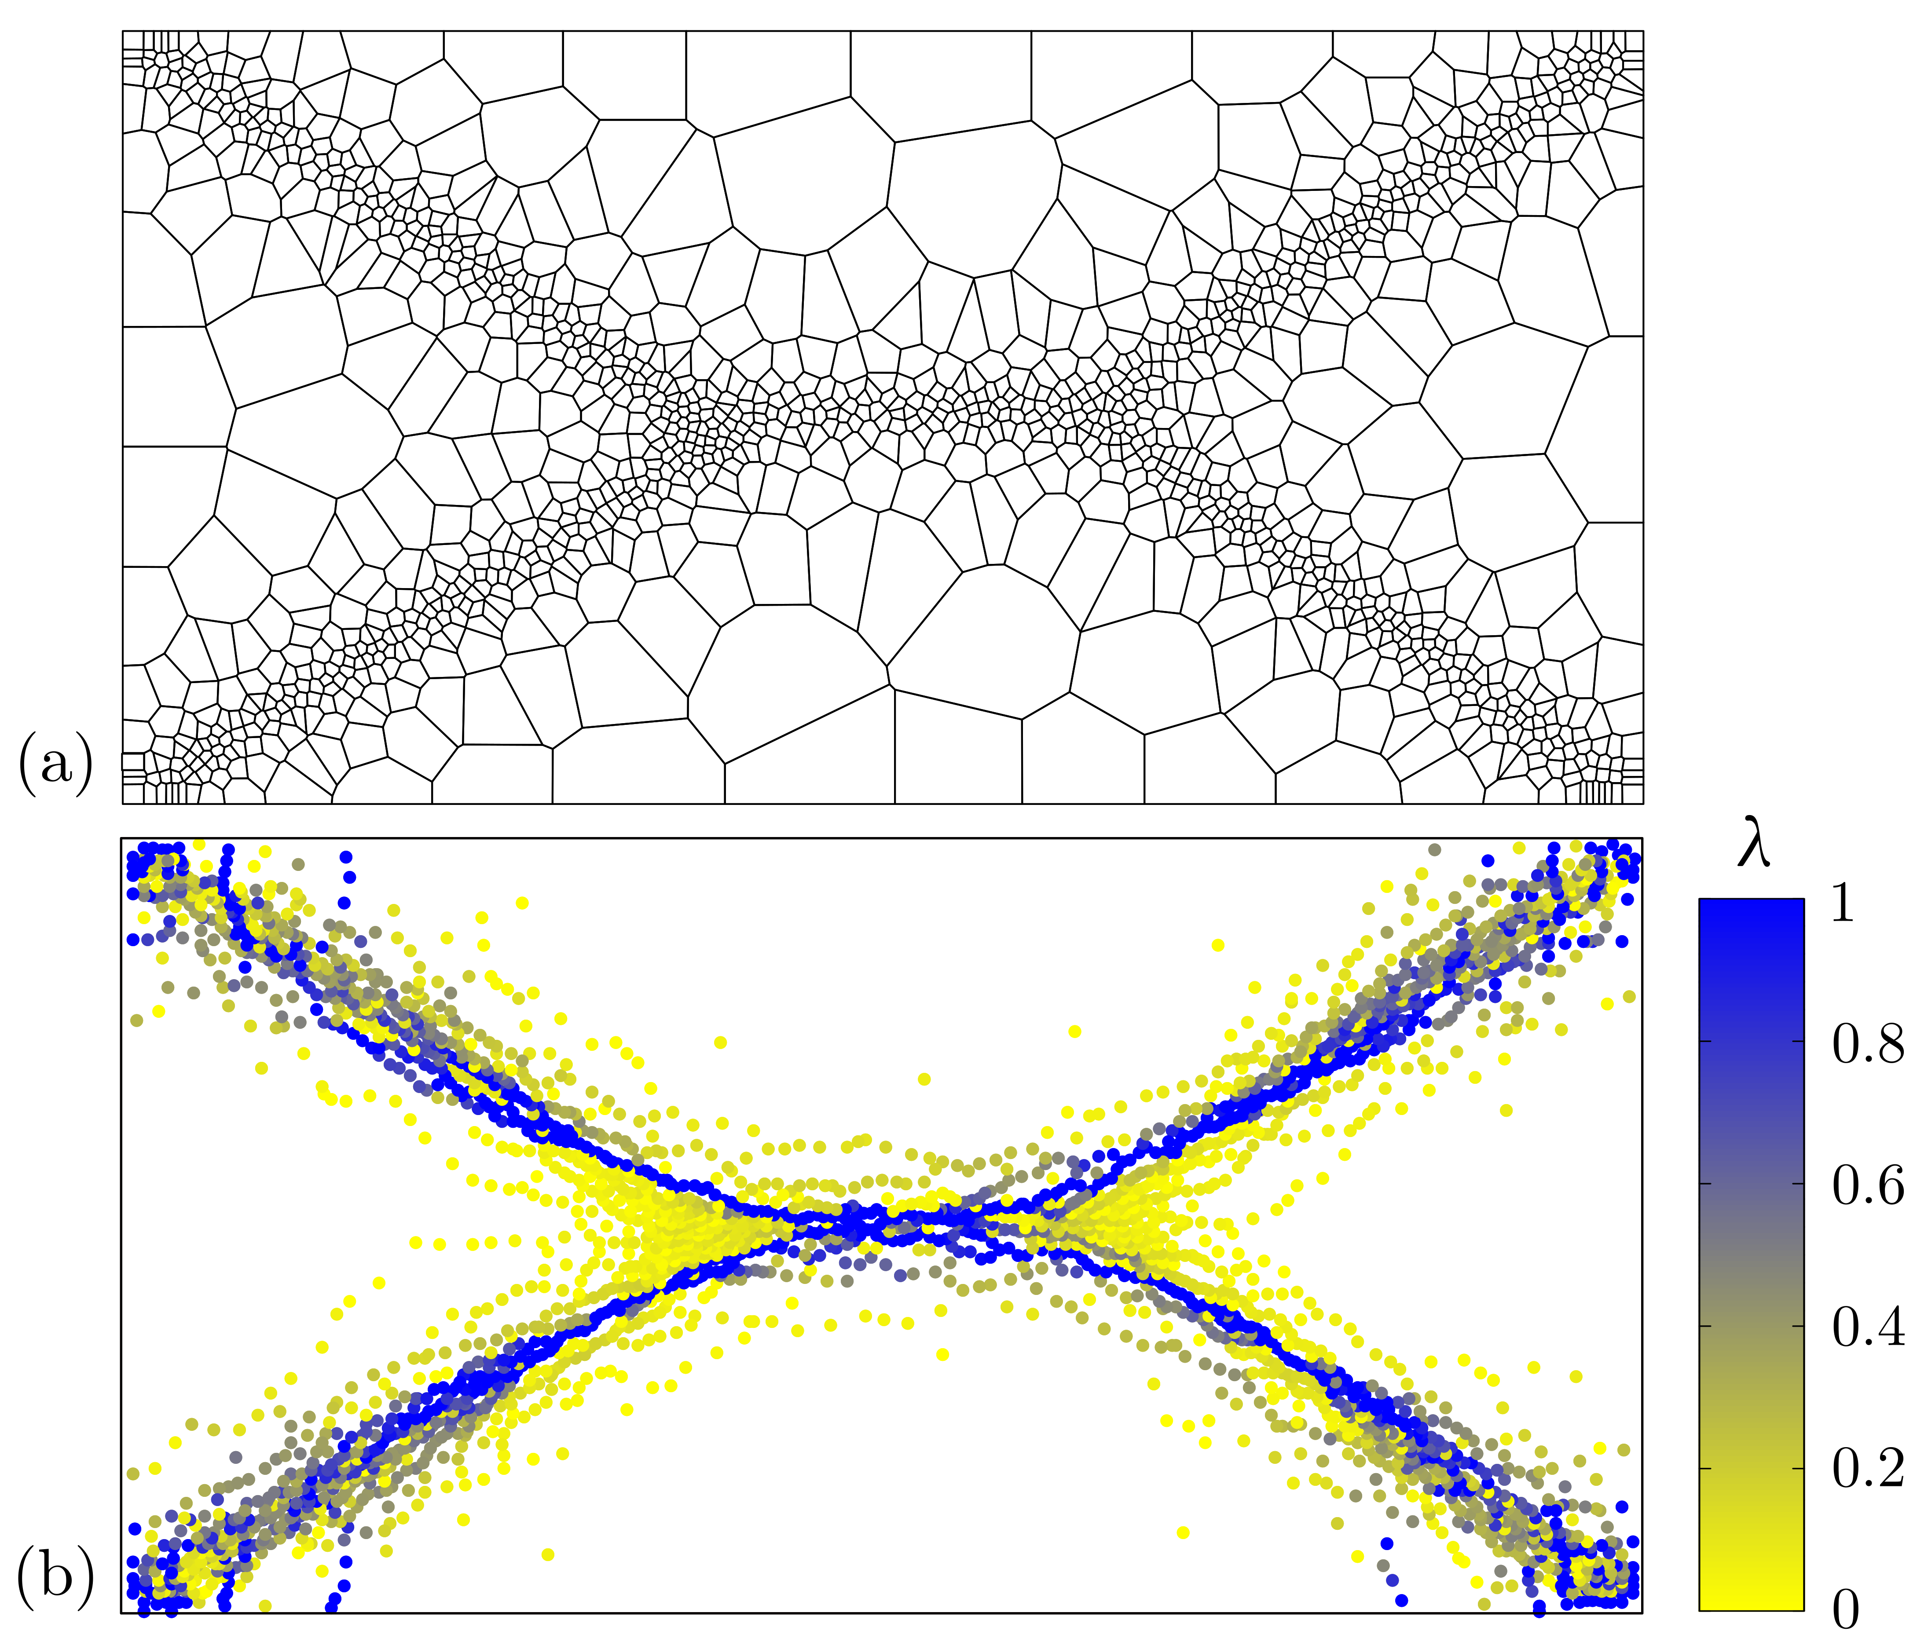
Refined grid
Associated yield event pattern

Slide 16
Load versus mid-span displacement up to plastic collapse

Slide 17
Simulation examples
Plastic yield-line analysis of slab structures
Ferrocement panels subjected to lateral loading

Slide 18
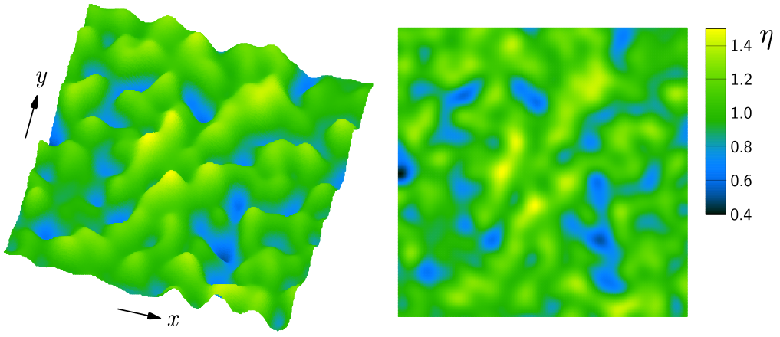
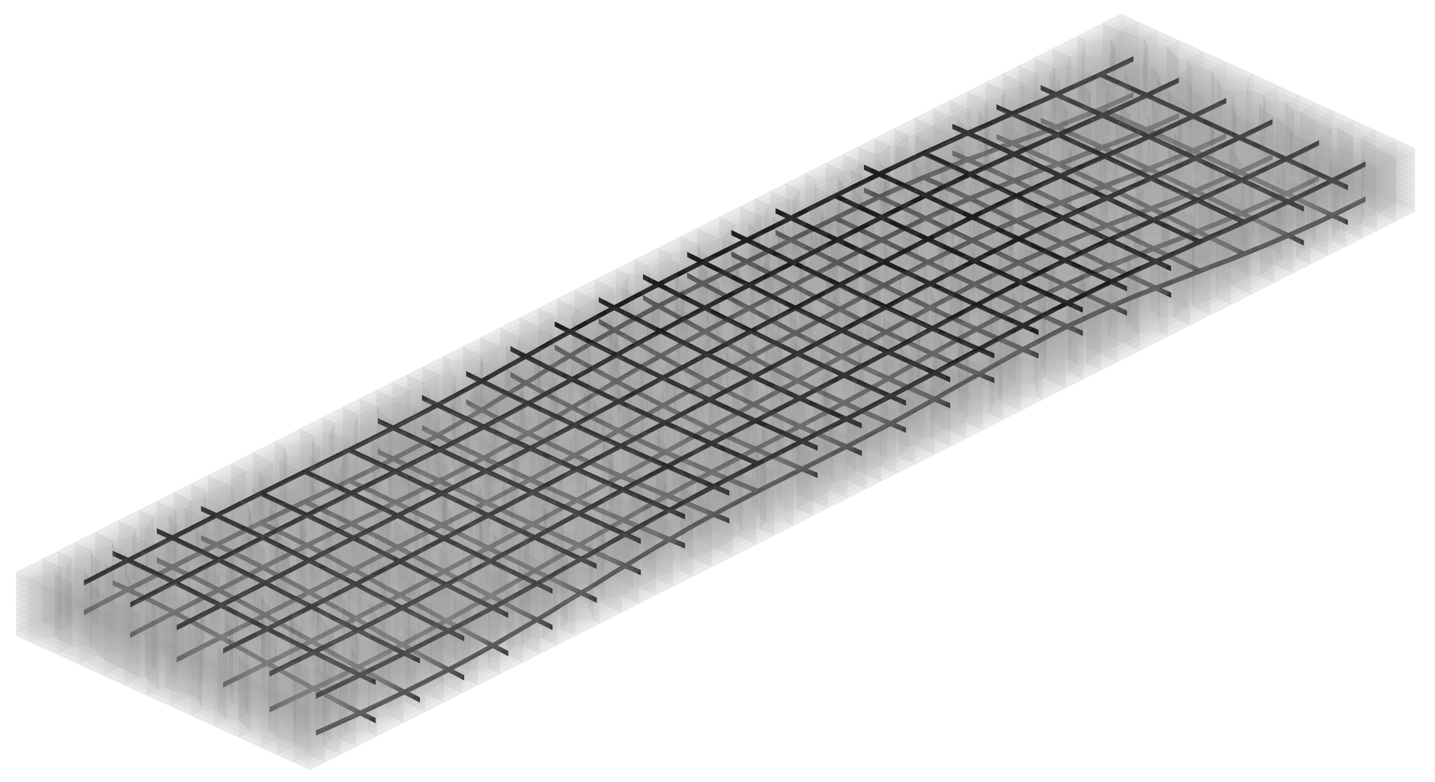
Spatially correlated random field
mean value
correlation length
variance
Ferrocement panel
Welded wire fabric positioned using spatially correlated random fields

Slide 19
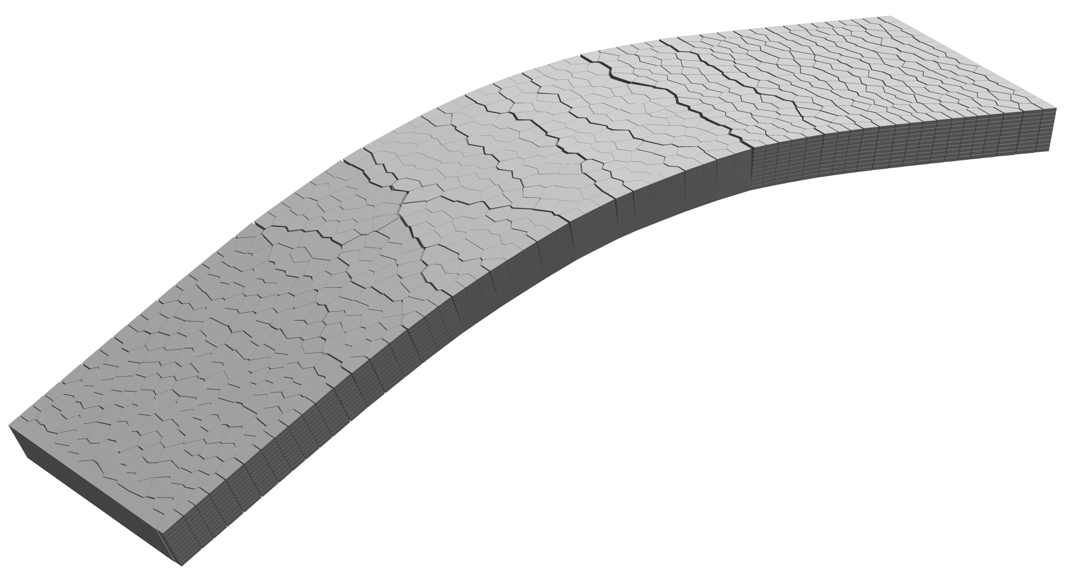
Simulated distributed cracking

Slide 20
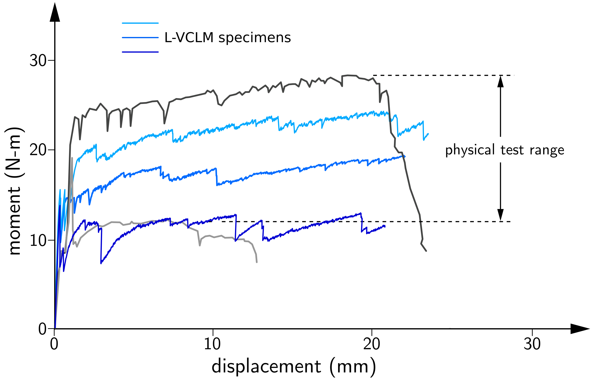
(three random realizations of fabric positioning)
M. Perez Lara (2004)
Observed range of behavior under third-point loading

Slide 21
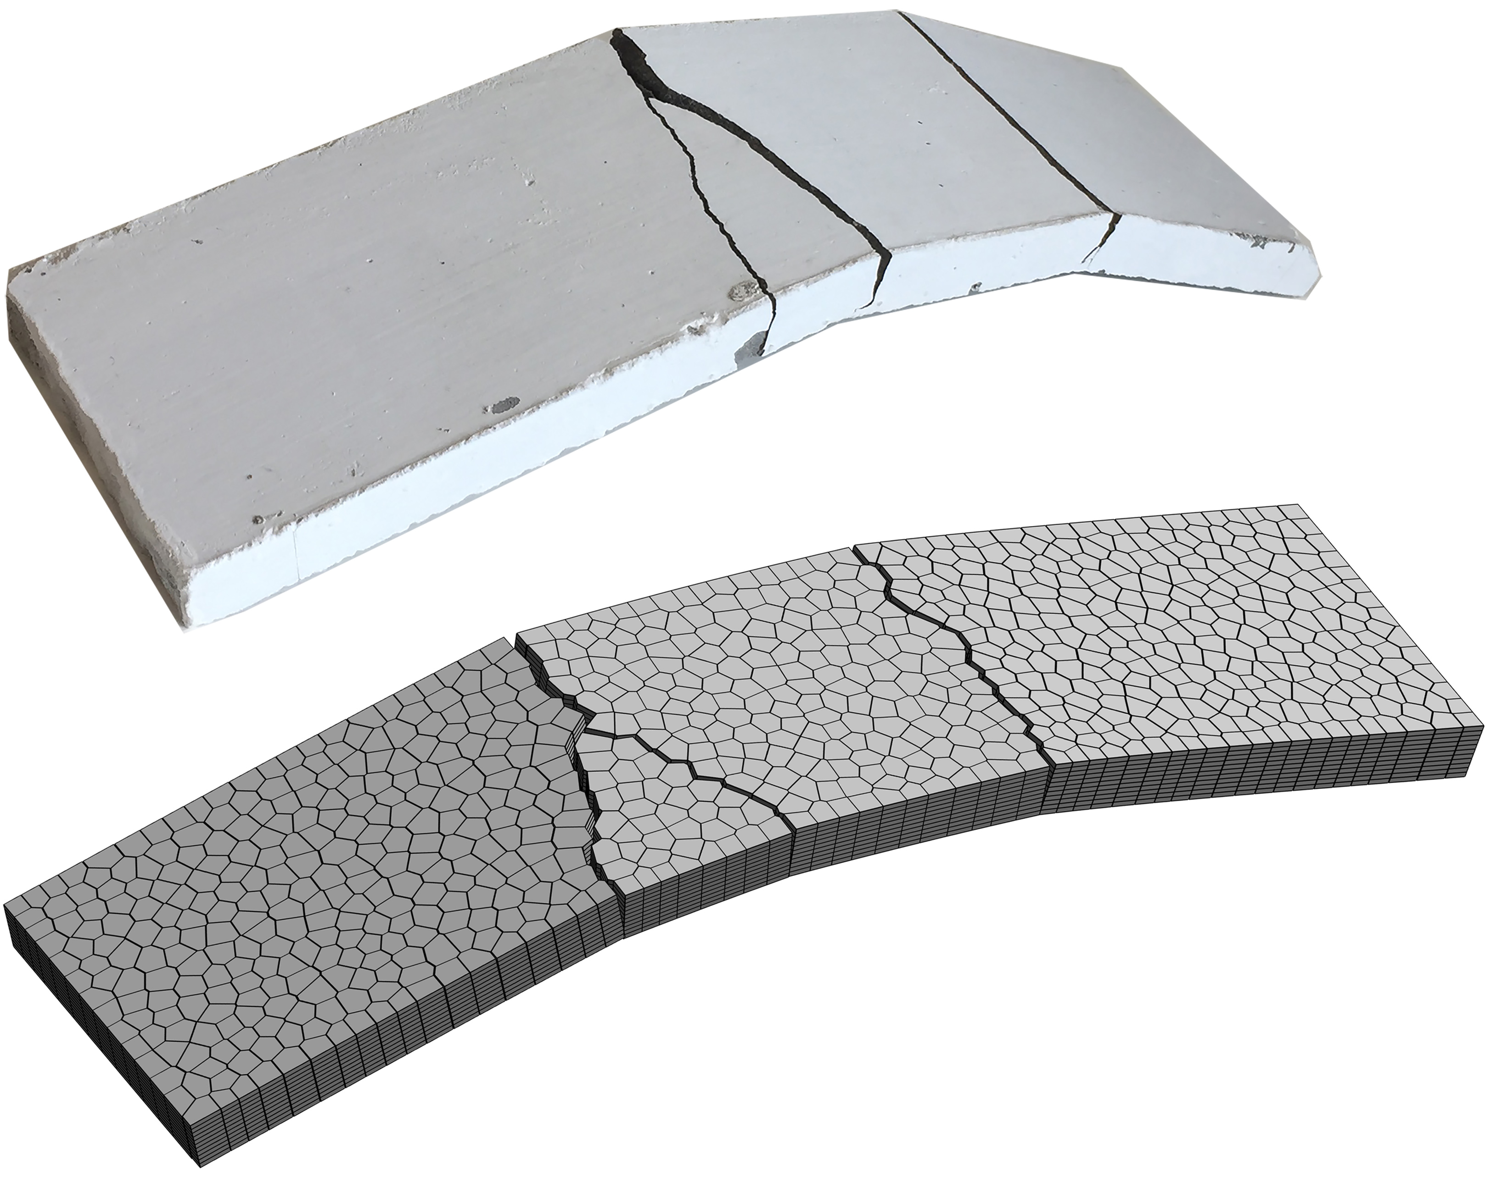
Observed and simulated panel deformation

Slide 22
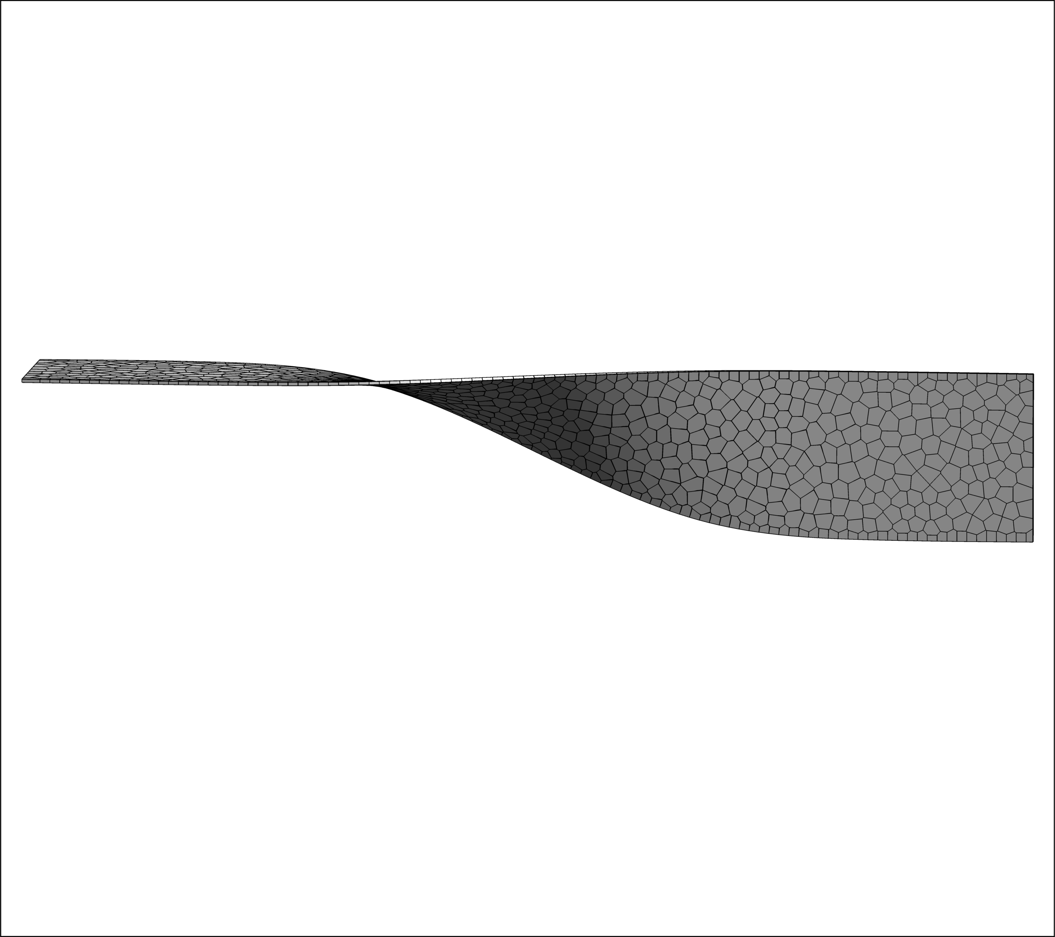
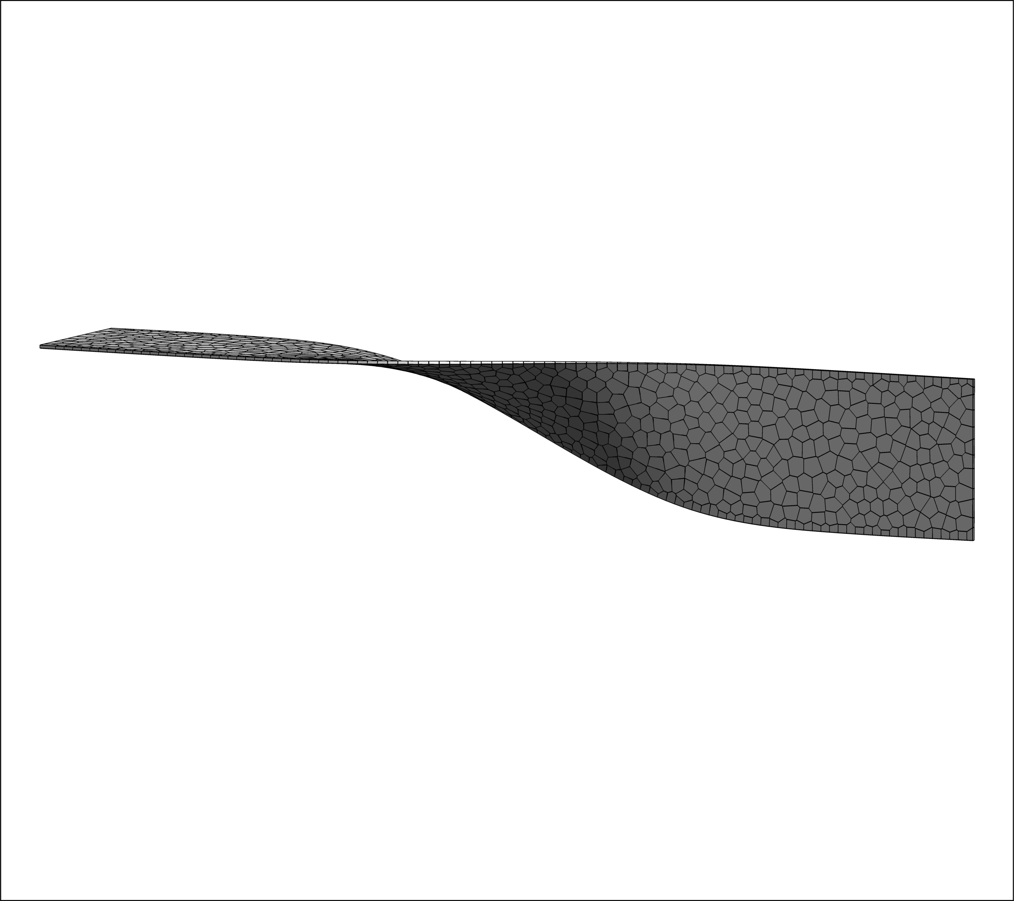
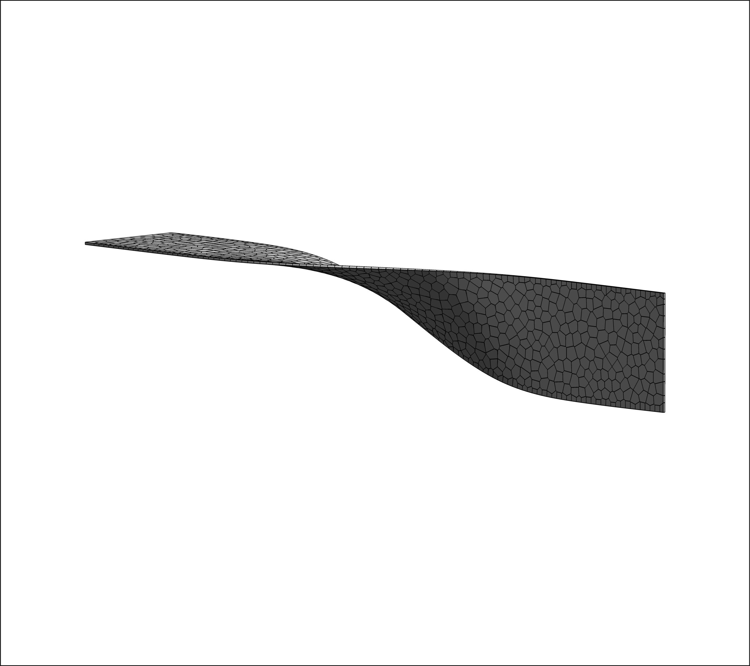
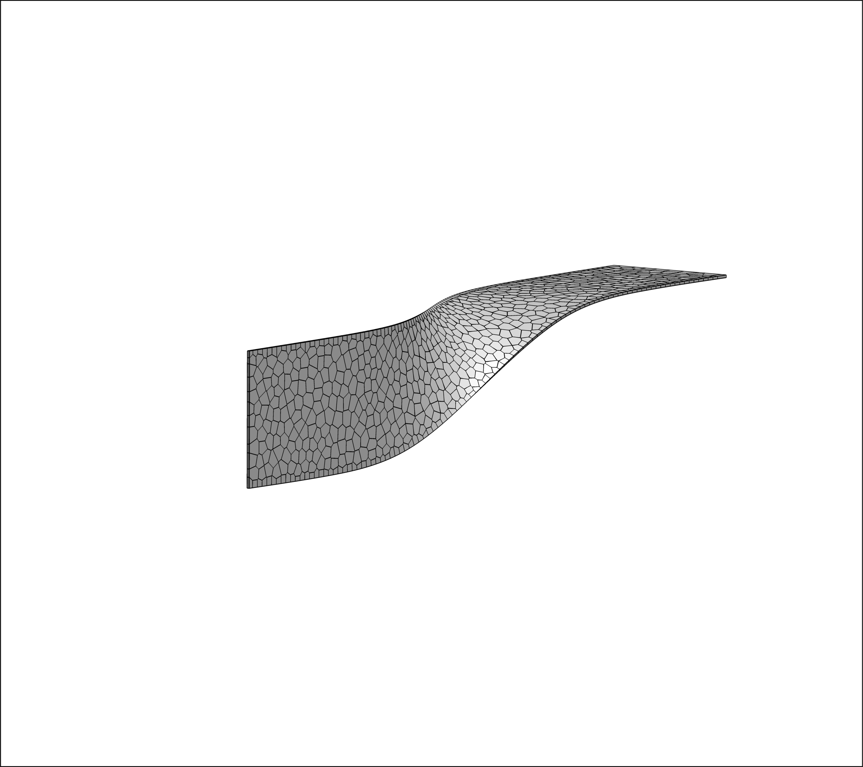
Ceiling-wall shell structure

Slide 23
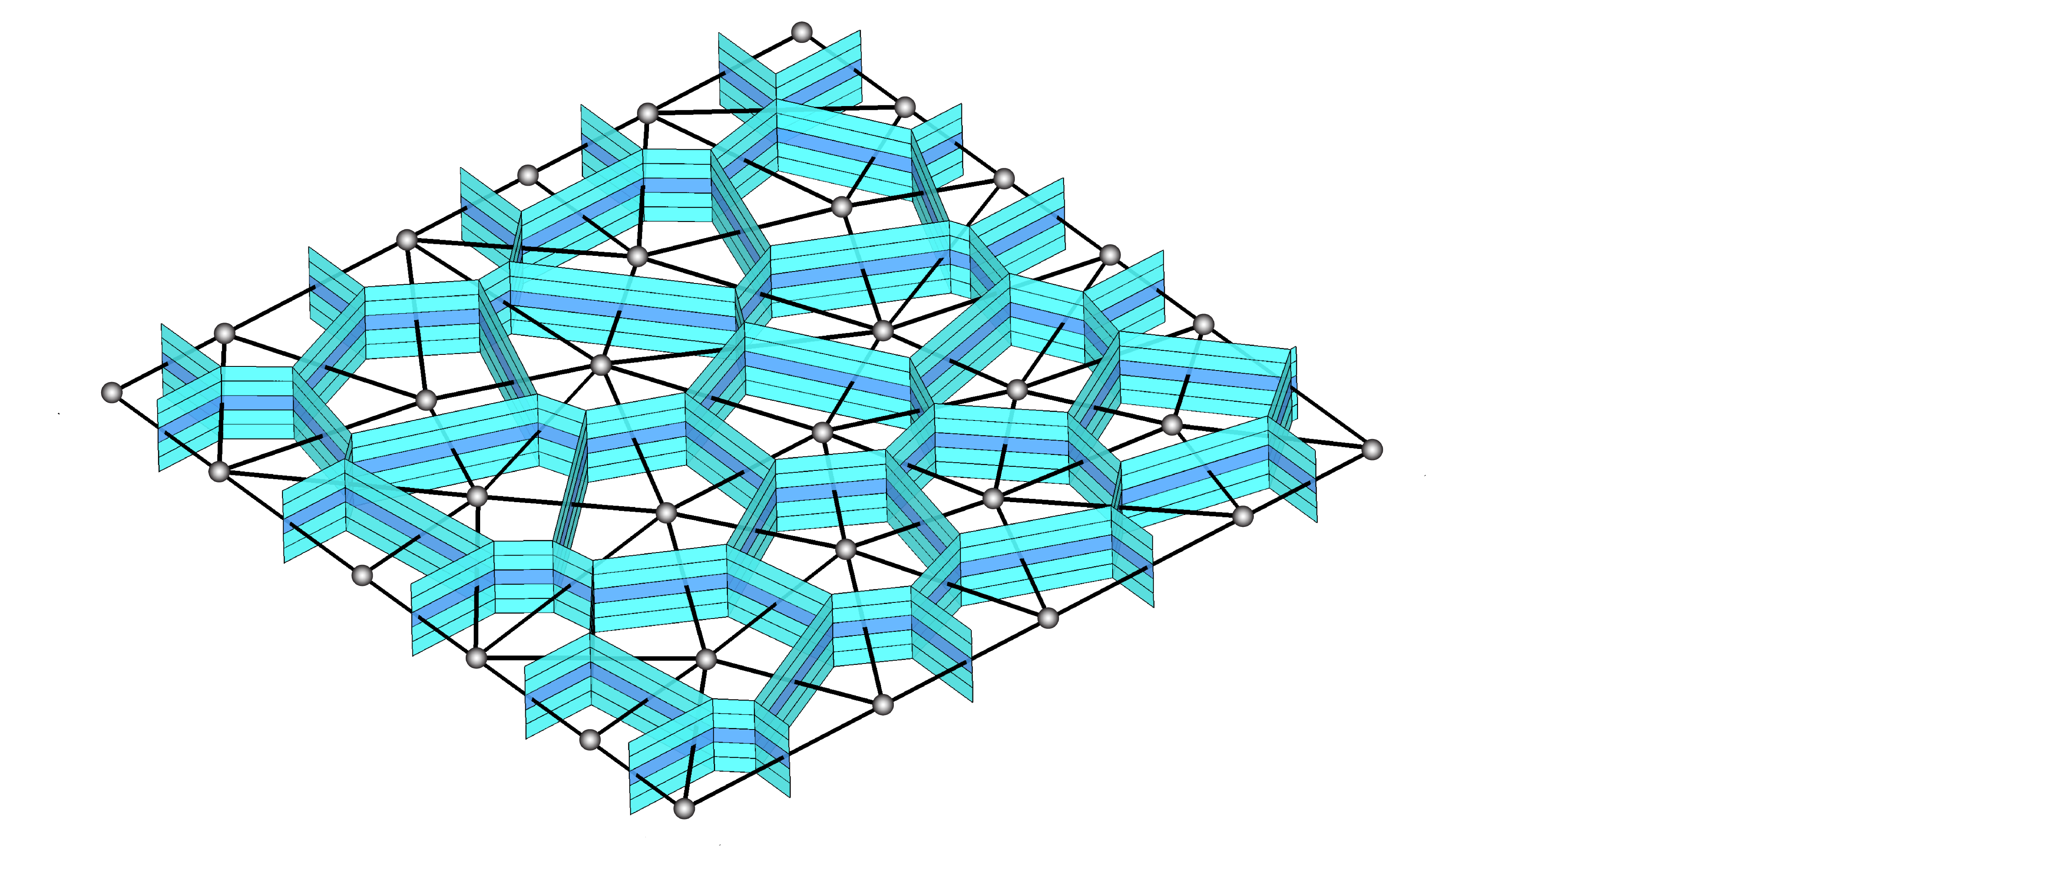
ML-assisted Grid Refinement of Layered Voronoi-cell Lattice Models for Limit Analysis of Concrete Structures
Summary
Choice of modeling framework: continuum or discrete
Discrete, layered approach to modeling planar structures
Layered Voronoi-cell lattice models
Elastically uniform under in-plane loading
Elastically uniform under out-of-plane loading with sufficient grid refinement

Slide 24
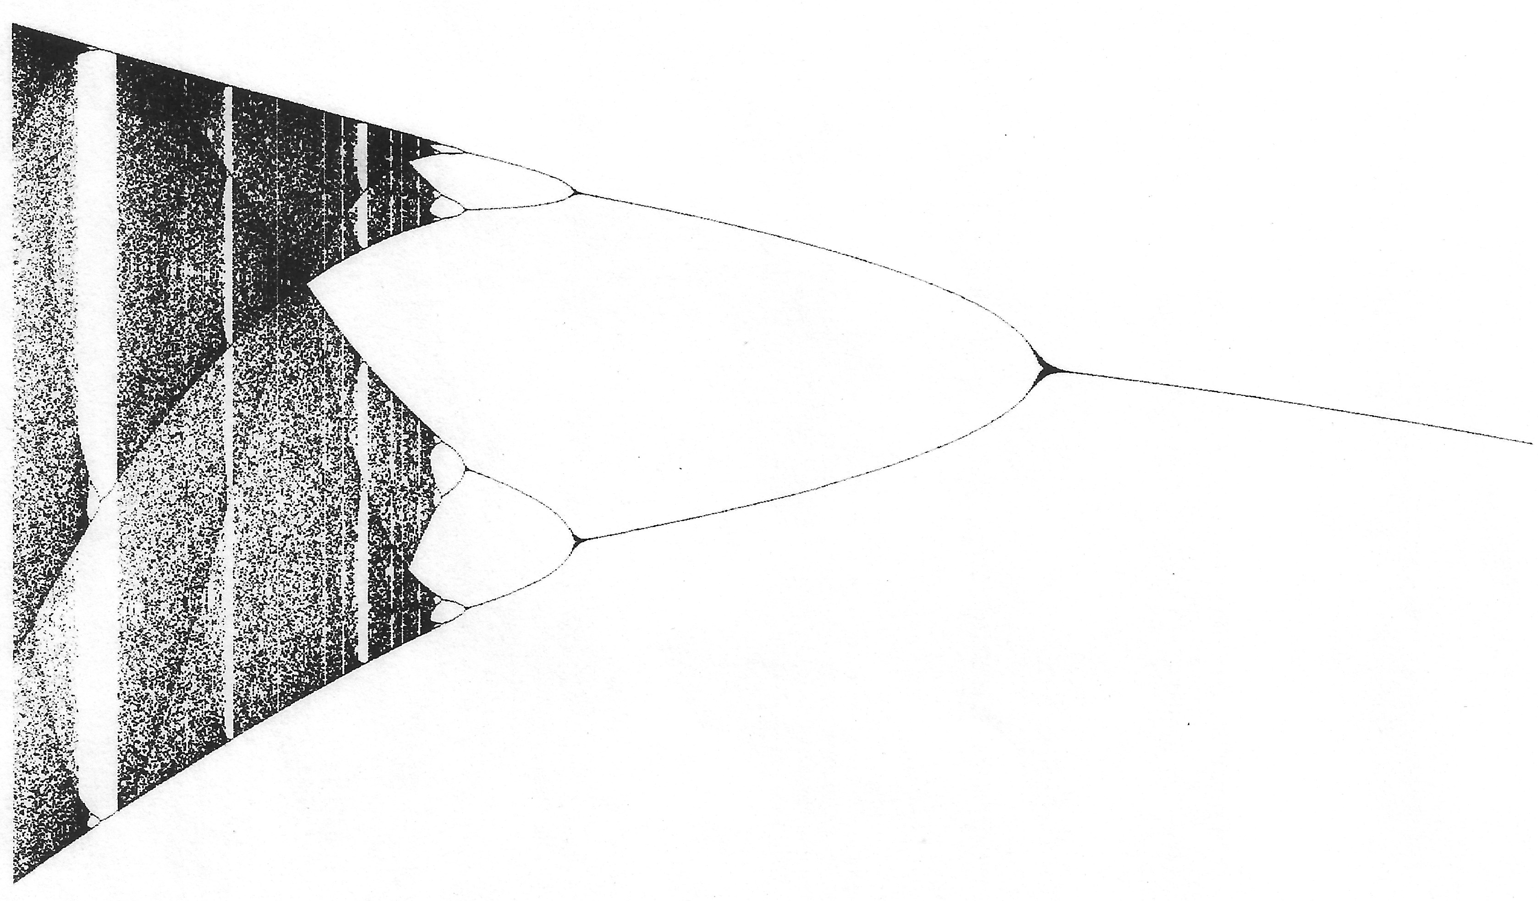
Summary (continued)
Simulation examples: take away points
Elastic homogeneity is achieved by the discrete, layered approach
Accuracy for out-of-plane loading improved by ML-assisted adaptive grid refinement
Free placement of reinforcing components within computational domain
Discrete-like representations of distributed or localized cracking

Slide 25
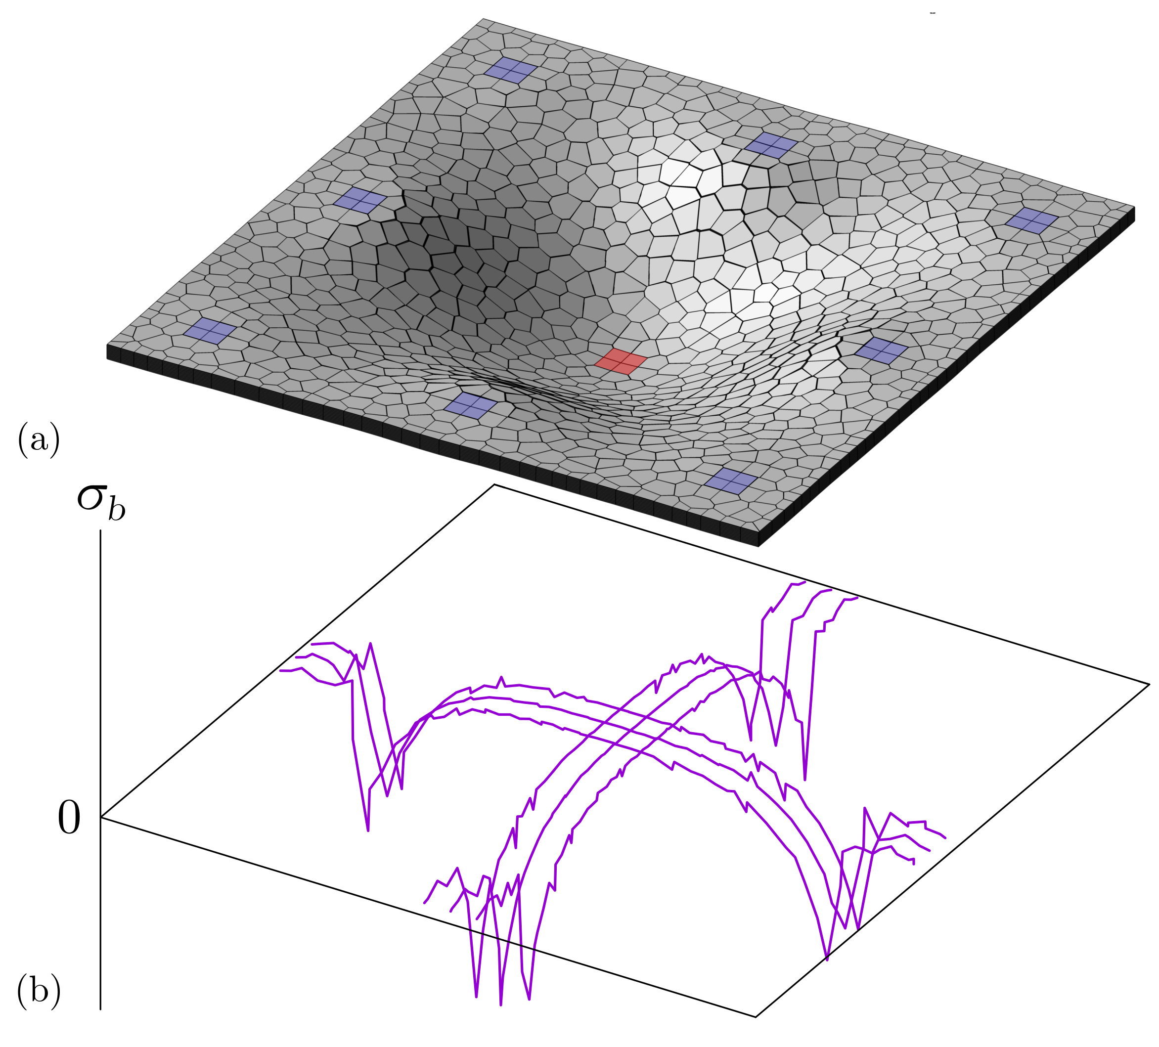
Current research
Elastic deformation of a RC slab due to column removal
Axial stress variation in selected reinforcing bars

