Slide 1
Assessing the Sustainability and Reuse Potential of Pre-fabricated Hollow Core Slabs: A Feasibility Study
Abhiram Sivapalakumar, Nirosha D. Adasooriya

Slide 2
Rethinking Concrete in a Circular World
Concrete is the second-most used substance after water, with over 30 billion tonnes used annually.
~37% of the construction sector’s CO₂ emissions.
The cement industry is projected to fall short without advancement in technology sustainability—set to meet only half of the Paris Agreement targets.
pollution and resource depletion

Slide 5
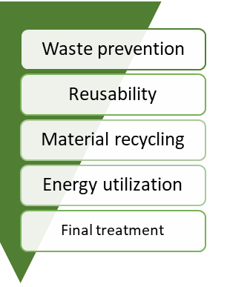
Wastage hierarchy
The primary target is to prevent wastage from occurring and then to control the wastage that has been made in a prioritized order.
Lack of guidelines has made it difficult to accomplish reusability so far.
Material recycling has been the main way to go.

Slide 6
Recycled Concrete Aggregate (RCA)
Recycling is not a viable option!
Core Problem:
RCA retains attached mortar, which brings in impurities:
Glass, metal, dirt, plaster, gypsum, and other waste
This leads to:
Increased porosity
Reduced mechanical strength
Weakened bond with original aggregates
Practical Challenges:
Cleaning requires extra steps:
Water washing or air sifting
Labour-intensive → higher costs
No improvement in structural performance
Norsk betong 2016:
Using RCA as a 20% replacement for natural aggregates may:
Increase cement consumption
Offset sustainability gains
Conclusion: Not yet viable for structural reuse without further innovation

Slide 7
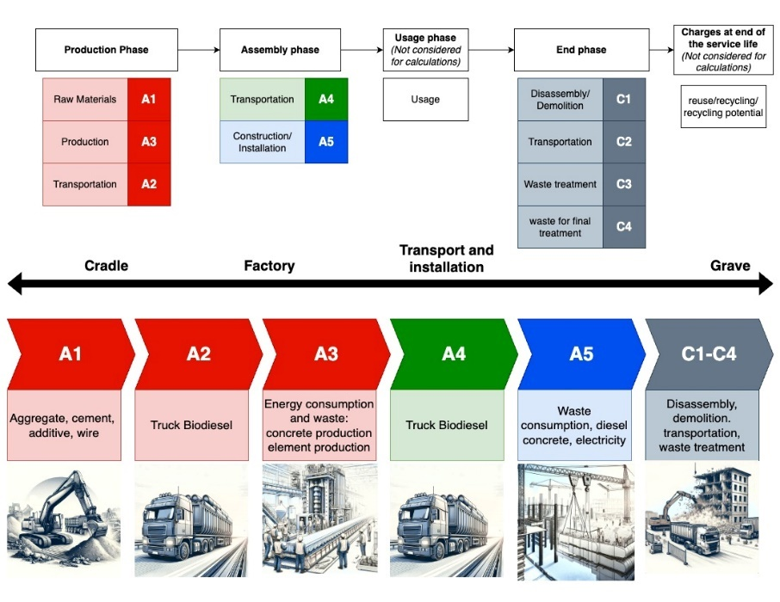
Cradle to grave (CtG)
Process: Extract → Use → Demolish → Waste
Results in:
High embodied carbon loss
Increased construction waste
No material recovery
Still the industry norm in most life cycle assessments

Slide 8
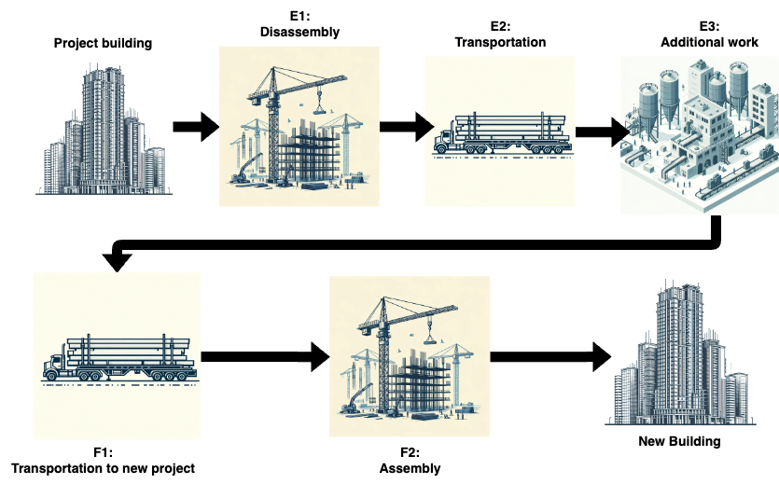
Cradle to Cradle (CtC)
Regenerative approach:
Materials are reused, remanufactured, or repurposed
Key principles:
Narrow resource loops (less input)
Slow material flows (longer life)
Close the loop (reuse/recycling)
To make it possible : Design for Disassembly (DfD)
Allows safe, non-destructive dismantling
Essential for reusing elements like HCSs
Supports structural integrity across lifecycles

Slide 9
Reusability
Advantages
Disadvantages
Often longer technical life span
Costly procedure (high initial cost)
Lack of proper documentation
Environmentally friendly
Technical challenges
Resource efficient
New market
Current regulations for reuse
Lack of clear and harmonized definition of reuse
ISO 20887 defines reusability as the following:
“Ability of a material, product, component or system to be used in its original form more than once and maintain its value and functional qualities during recovery to accommodate reapplication for the same or any purpose”.
Literature study on previous reuse cases:
Poland
Kristian Augustus Road 13 (KA13)
Oslo Storby Legevakt (OSBL)
Norwegian firms survey

Slide 10
SIS- Velferds Bygg (SVB)

Slide 11
Environmental benefits of HCS

Slide 12
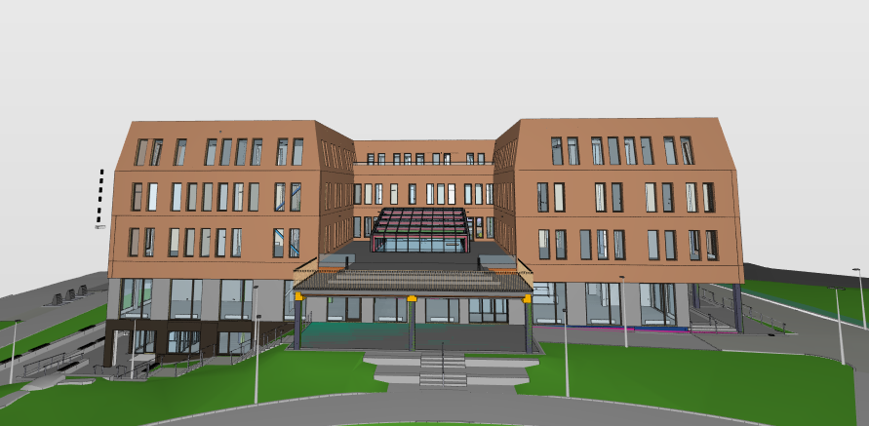
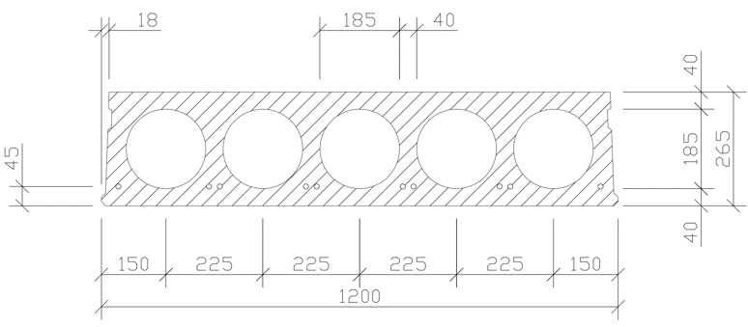
Case study introduction
SVB used HD265 and HD320 slabs
1,898 tonnes of prefabricated concrete
Project Goal:
Repurpose Hollow-Core Slabs (HCSs) from the SVB building
Construct a new student housing facility
Maximize material efficiency while meeting safety and comfort standards

Slide 13
Selection & Planning
Chosen: HD265 slabs, 8.4 m × 1.2 m
Criteria:
Minimal topping & damage
Clean geometry
High compatibility with new layout
Total reused slab area: 1,098.37 m²
Integration in New Design
New floor plan: ~68.5 m × 18.5 m
Functional spaces:20 m² student rooms
Bathrooms, laundry, and shared areas
Support structure:L-shaped & Inverted Tee Beams
Used existing voids for anchorage, reducing extra drilling

Slide 15
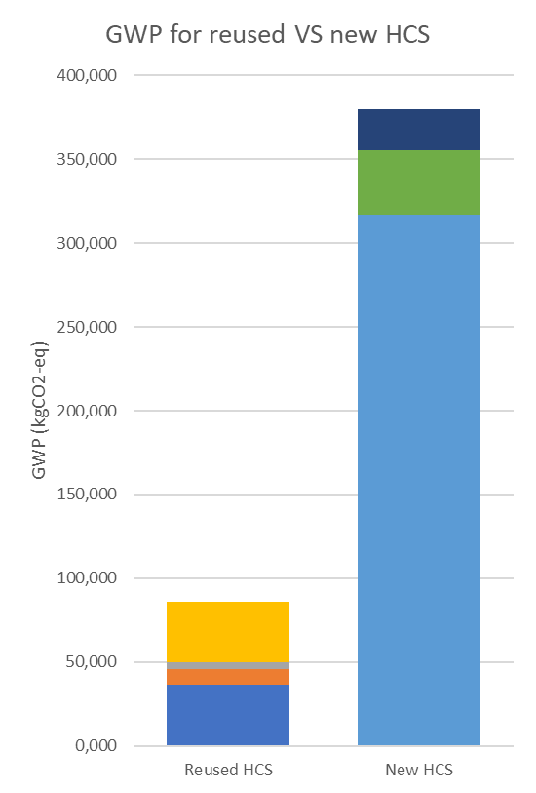
Environmental benefits of reusing HCS from SVB
GWP total with CtG approach
System Limit | GWP-total (Unit: kgCO2-eq) | Percentage (%)
A1 | 34588,412 | 80,37
A2 | 244,525 | 0,57
A3 | 1088,529 | 2,53
A4 | 216,523 | 0,50
A5 | 4101,705 | 9,53
C1 | 1577,579 | 3,67
C2 | 485,105 | 1,13
C3 | 191,281 | 0,44
C4 | 540,321 | 1,26%
GWP total with CtC approach
System Limit | GWP-total (Unit: kgCO2-eq) | Percentage (%)
E1 | 4101,705 | 42,18%
E2 | 216,523 | 2,23%
E3 | 1088,529 | 11,19%
F1 | 216,523 | 2,23%
F2 | 4101,705 | 42,18%

Slide 16
Guidelines
Pre-Disassembly Evaluation
Disassembly Procedures
Testing and Evaluation
Documentation Strategy

Slide 17
Pre-disassembly evaluation
Six key areas for evaluation
Access to elements:
Visibility, accessibility, and building changes from original blueprints. Uses "access map".
Independence
Can HCSs be removed without damaging other parts?
Focus on connections and load paths.
Treatments & Finishes
Are there adhesives, coatings, or sealants that hinder disassembly?
Are they removable
Standardization
Are dimensions, materials, and connections uniform?
Standard = faster, safer, cheaper reuse.
Economic Appraisal
CBA, NPV, IRR, payback period, and risk/sensitivity analyses—will reuse be cost-effective?
Environmental Impact
Compare GWP, waste reduction, water/energy savings vs. traditional demolition.

Slide 19
Disassembly procedure
What is Disassembly?
The reverse of construction — but with resource efficiency, precision, and future reuse in mind.
Planning Before Execution
Site Survey & Document Review (NS 3682 §5.1–5.2)
Analyze slab positions, loads, and connections
Identify potential hazards & supports needed
Tool & Equipment Planning
Cranes, lifting gear, cutting tools
Avoid diagonal cuts – use straight cuts to minimize damage
Disassembly Strategy
Reverse the original assembly sequence
Start with least load-bearing slabs, install temporary supports as needed

Slide 20
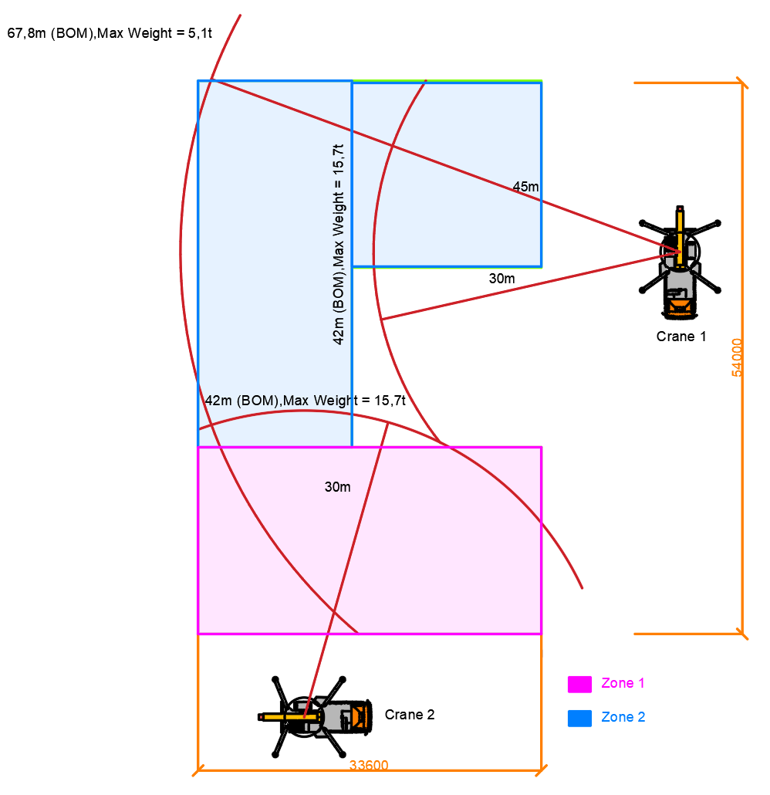
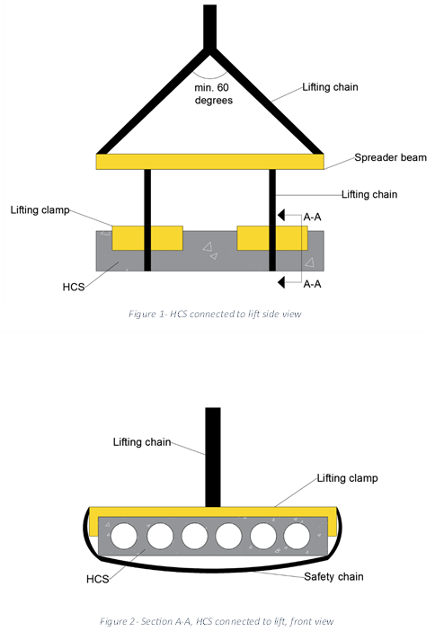
Crane positioning is very important!

Slide 21
Testing and evaluation
Three evaluation areas:
Technical Performance:
Assess structural strength & serviceability
Functional Performance:
Compliance with fire, sound, and system integration needs
Aesthetical Performance
Visual quality & physical condition for reuse
Pass criteria:
The technical lifespan must exceed both functional and aesthetic lifespans for reuse to be approved.

Slide 22
Technical performance
Chemical degradation
Load-bearing capacity tests
Deflection check
Pre-tensioned wires/ RF
Functional performance
Compatibility assessment
Fire resistance
Sound insulation
Aesthetical performance
Visual control
Damage
Connections
Pre-tensioned wires/ RF

Slide 23
Documentation of reusable HCS
Case studies (KA13, OSBL) show: Lack of documentation is a key barrier to HCS reuse.
Ensures traceability, compliance, and market acceptance
Aligns reused HCSs with CE-marked standards via NS 3682
If a reused product meets CE-equivalent standards in one EEA country, Norway must accept it (DOK §14)
Ensures smoother cross-border reuse with no redundant testing

Slide 24
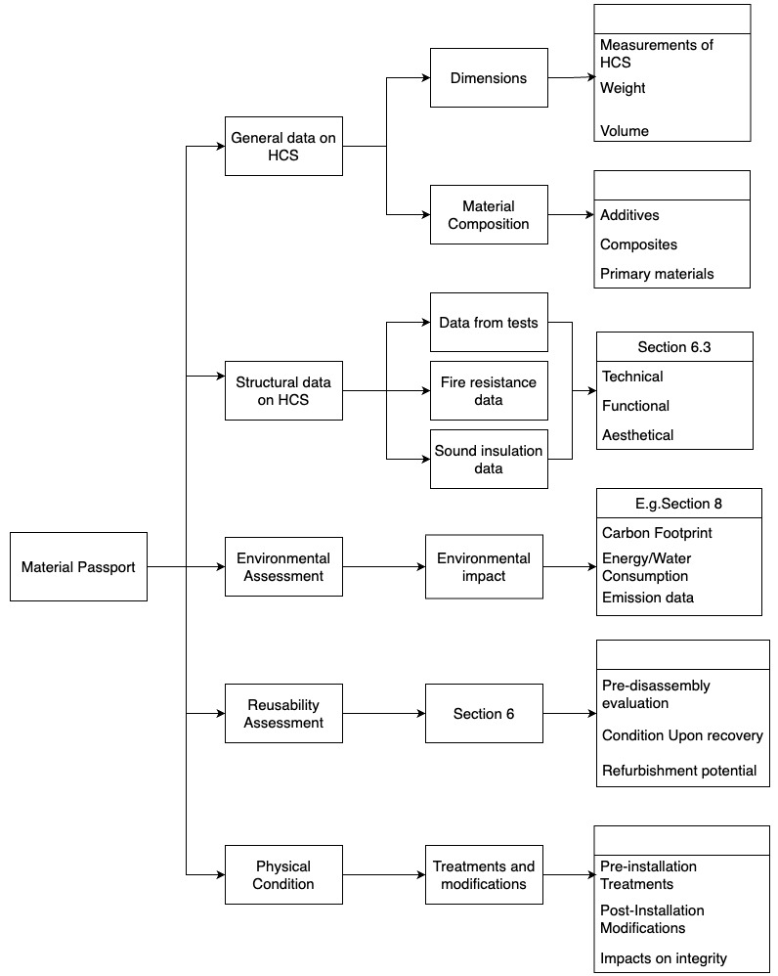
Thorough, standardized documentation is not just regulatory—it's a practical enabler of reuse at scale.

Slide 25
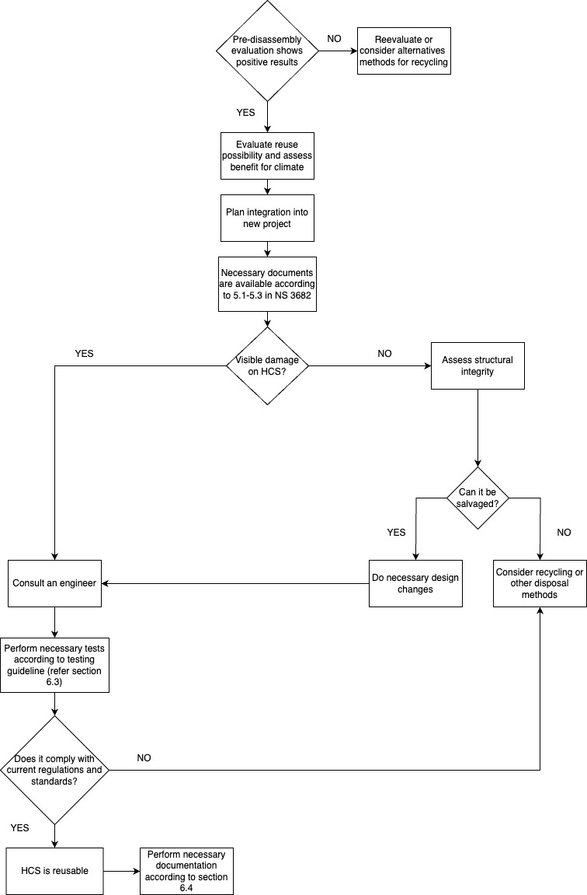
NO
YES
Flowchart summarizing all guidelines

Slide 26
Economic and social perspectives
Economic Challenges:
High upfront costs
Lack of incentives.
Potential Solutions:
Carbon pricing
Subsidies
Green building certifications.
Social Impact:
Public trust
Community benefits
Housing affordability
job creation.

