Slide 1
Non-destructive characterization of steel fiber distribution in concrete: CT-scanning vs inductive method
Álvaro Mena-Alonso¹, Guillem Rojas², Álvaro Muñoz³, Terje Kanstad² and Miguel A. Vicente¹
¹ Department of Civil Engineering, University of Burgos (UBU), Spain
² Department of Structural Engineering, Norwegian University of Science and Technology (NTNU), Norway
³ Stratum Reservoir AS, Norway

Slide 2
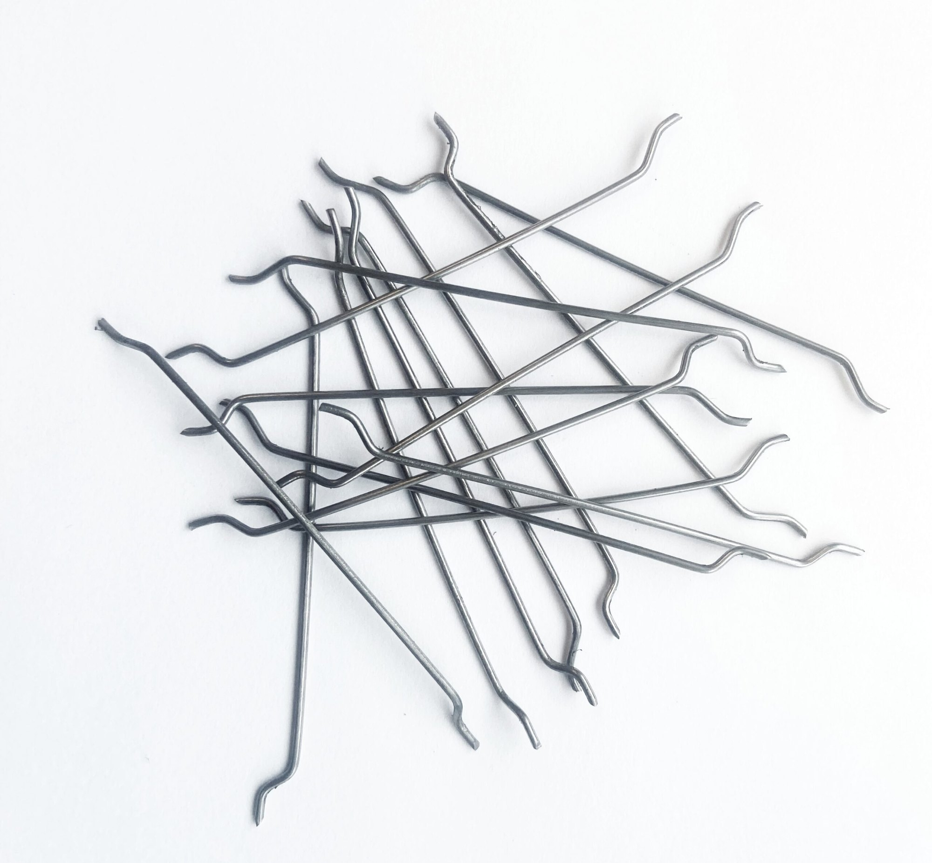
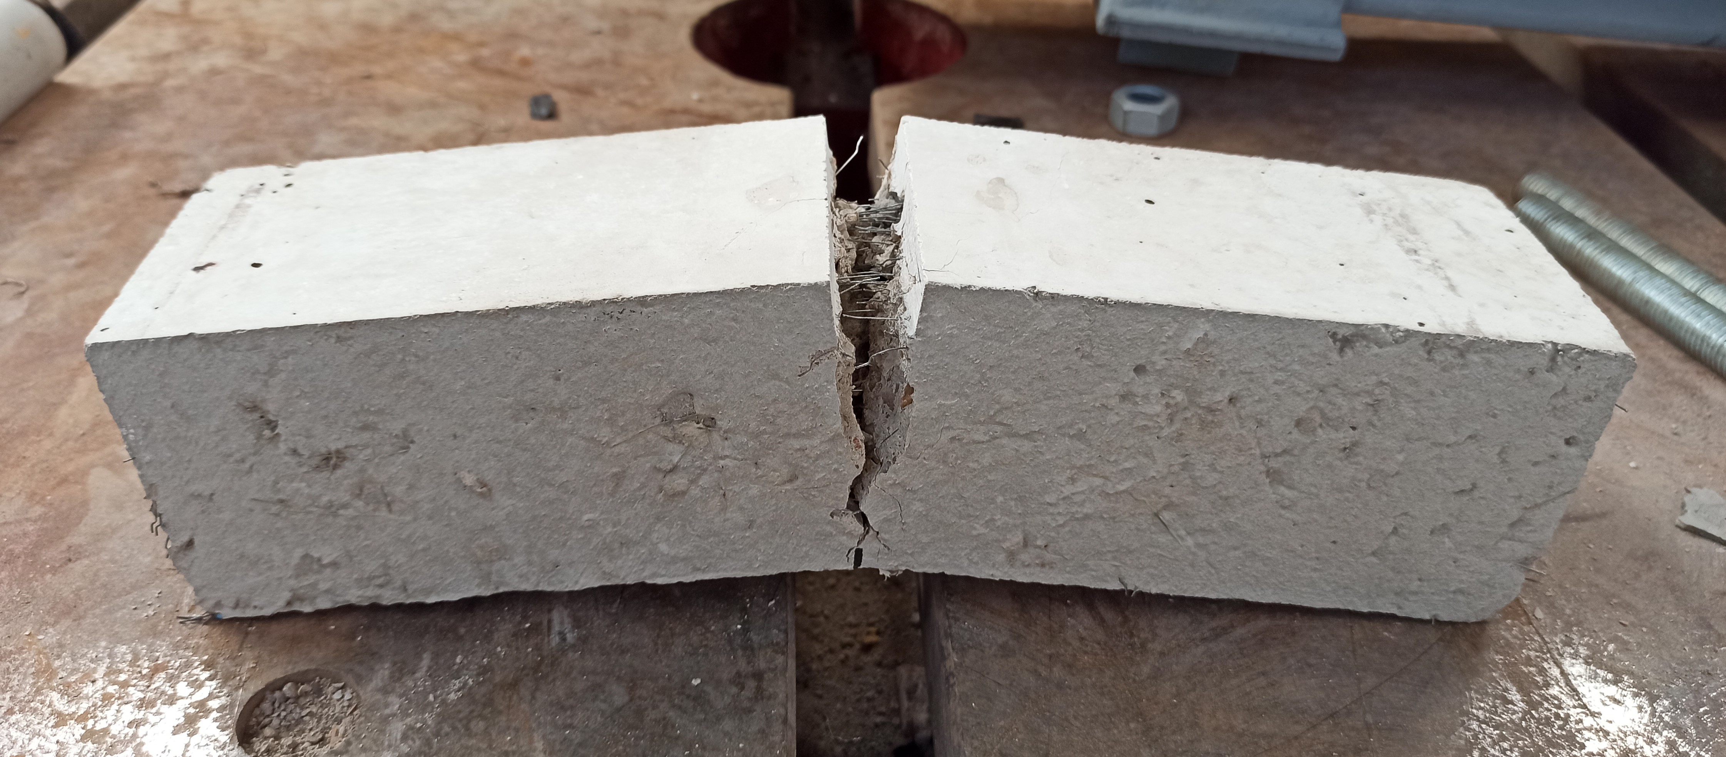
1. introduction
What is fiber-reinforced concrete (FRC)?
It is a composite material made of concrete into which small, short, discrete fibers are added during mixing; these fibers are, in principle, randomly distributed throughout the matrix.
The fibers increase the material’s residual strength and its toughness after cracking.

Slide 3
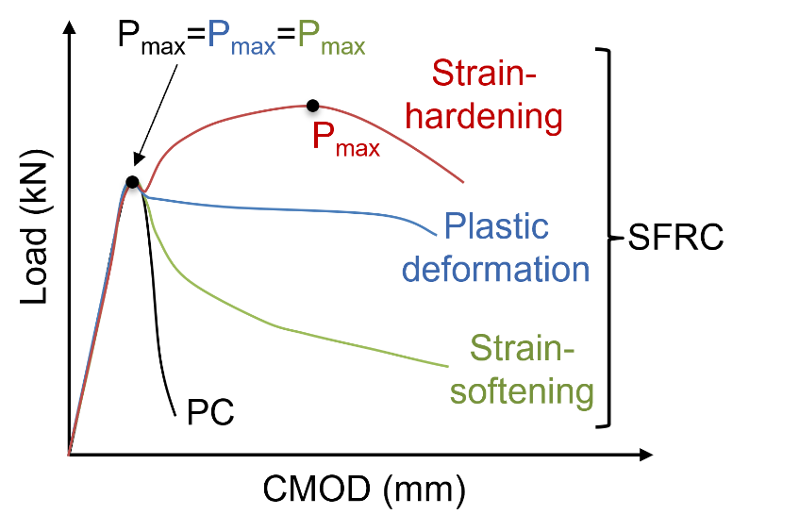
1. introduction
Flexural strength of FRC
The fibers enhance the tensile strength of concrete because they enable stress transfer across cracked sections.
The improvement in mechanical capacity is particularly significant under flexural loading.
The behavior of FRC varies according to parameters such as fiber dosage and fiber type.

Slide 4
1. introduction
Role of fiber orientation
The orientation of fibers inside the concrete is not actually random; it depends on factors such as → mix rheology, casting method, wall effects, the presence of obstacles, etc.
Fiber orientation dictates their structural efficiency → fibers perpendicular/parallel to the crack plane.
(Kruschwitz et al., 2022)

Slide 5
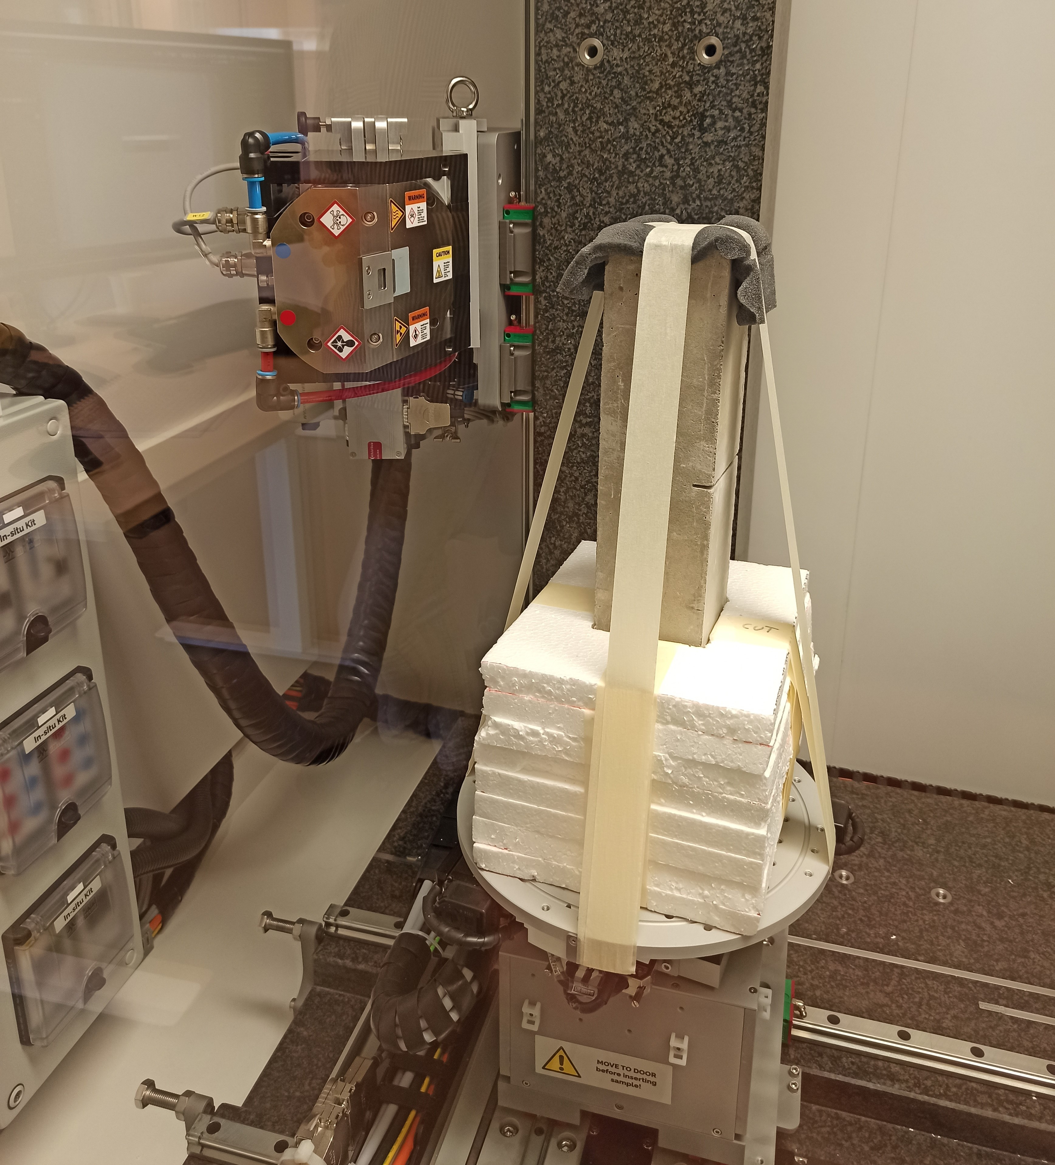
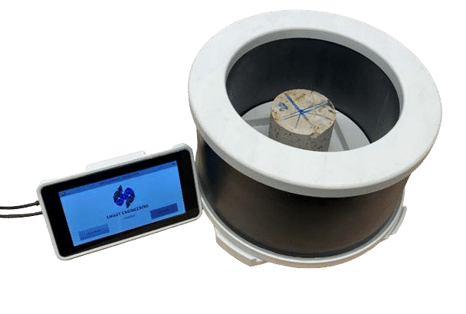
2. Methods for determining fiber orientation
From the above, it follows that non-destructive methods for assessing fiber orientation in FRC structural elements are essential.
Several techniques are available, but two stand out:
In this study, the performance of both methods is compared by determining the fiber orientation in the same cores extracted from FRC walls and slabs.
Computed tomography scanning (CT-scanning)
Inductive Method (IM)

Slide 6
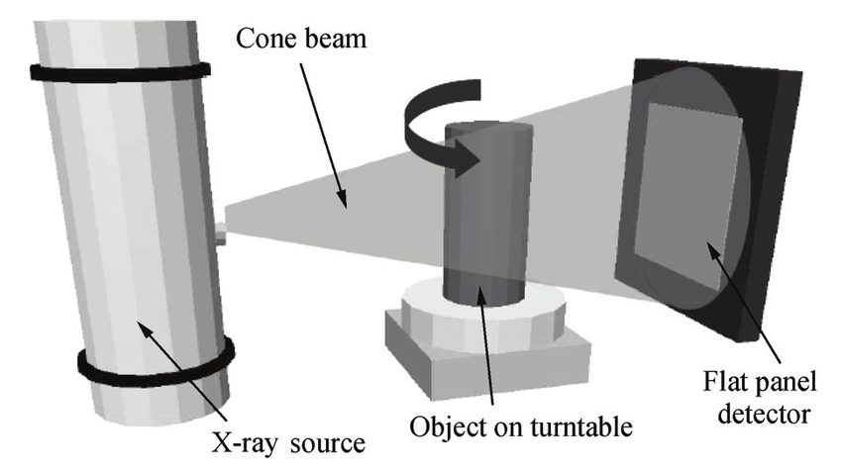
2. Methods for determining fiber orientation
CT-scanning
Computed tomography (CT) relies on the attenuation that X-rays undergo as they pass through a material. This attenuation is proportional to the material’s density.
A CT system comprises three main components:
X-ray source → emits the X-ray beam
Rotating stage → holds and spins the specimen
Detector panel → captures the attenuated signal

Slide 7
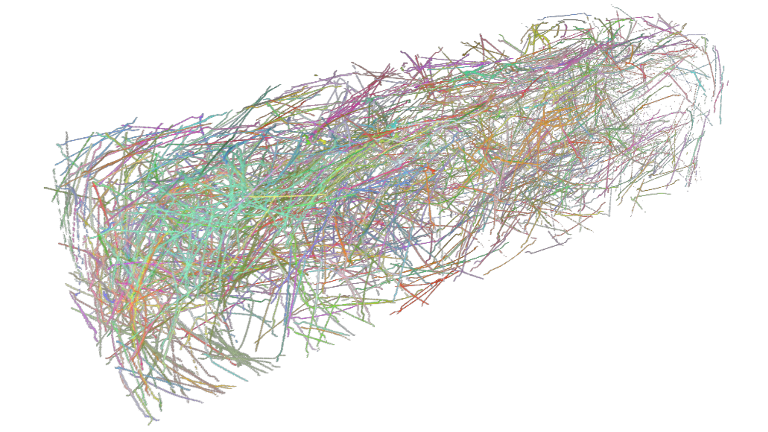
2. Methods for determining fiber orientation
CT-scanning
A tomogram of a specimen is actually a set of many radiographs taken at multiple elevations—and, within each elevation, from numerous angles.
The practical outcome is a 3-D grayscale reconstruction of the sample: darker voxels correspond to lighter (less-dense) materials, and vice versa.
With suitable software and segmentation techniques, the fibers can be isolated, and their individual properties can be extracted: centroid position, orientations, and so on.

Slide 8
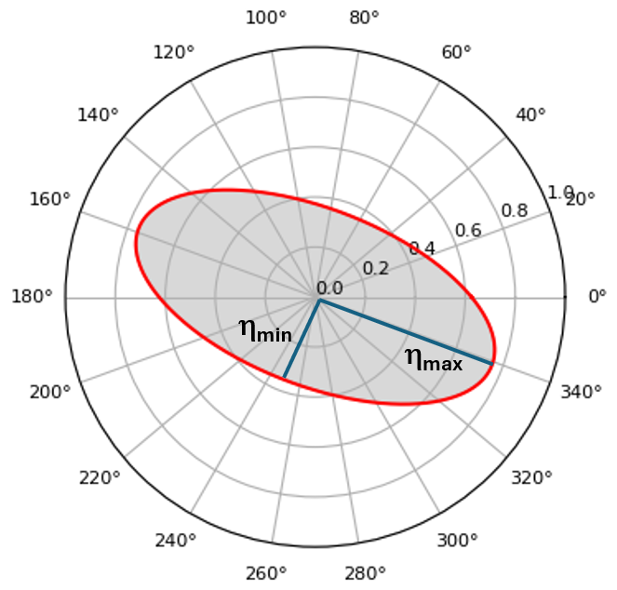
2. Methods for determining fiber orientation
Inductive Method
It consists of applying an electromagnetic field to the FRC specimen.
Measurement principle → the equivalent inductance L_{e} increases linearly with the fiber content C_{f} → C_{f} = β·L_{e} (β is calibrated once by crushing reference specimens; recalibration is required only if the fiber type changes).
From the inductances L_{i} measured along predefined directions, the orientation factors η_{x}, η_{y}, and η_{z} are obtained.

Slide 9
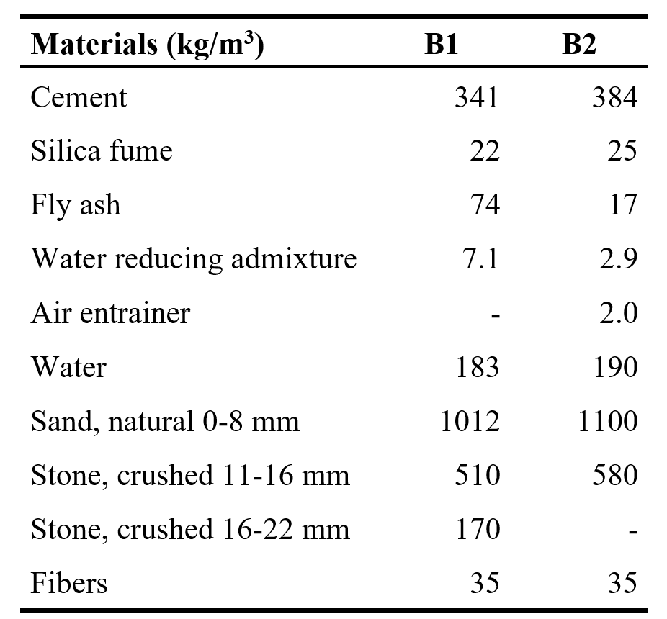
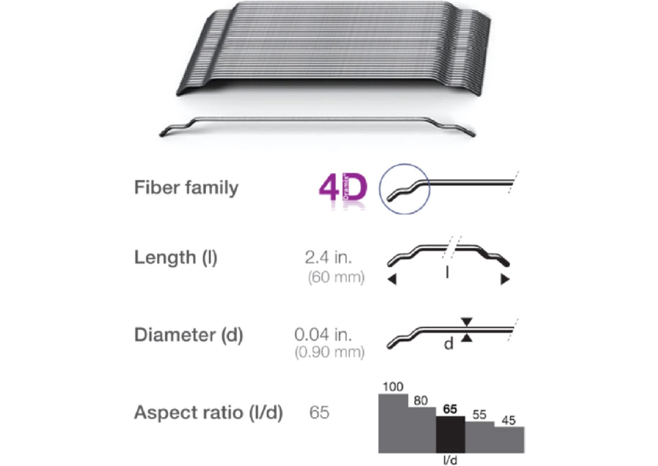
3. Experimental campaign
Mix design
Cores were extracted from structural elements produced in two experimental programs, B1 and B2, each with a different mix design.
The fiber content was identical in both programs: 35 kg/m³.
The fibers used were hooked-end type, 60 mm in length and 0.9 mm in diameter.

Slide 10
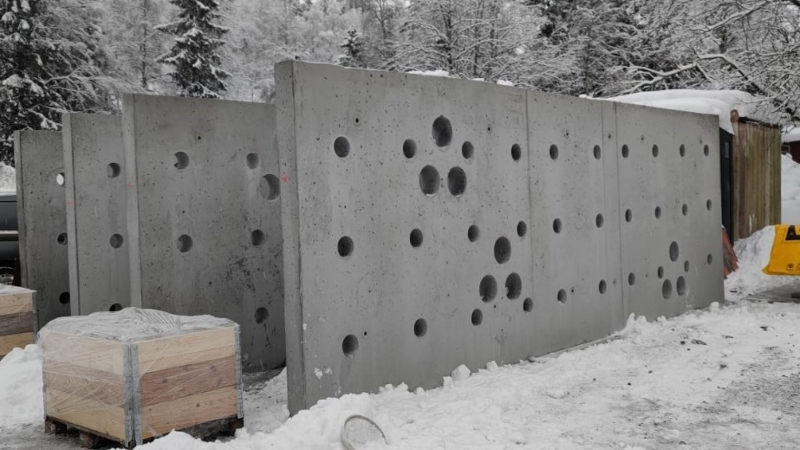
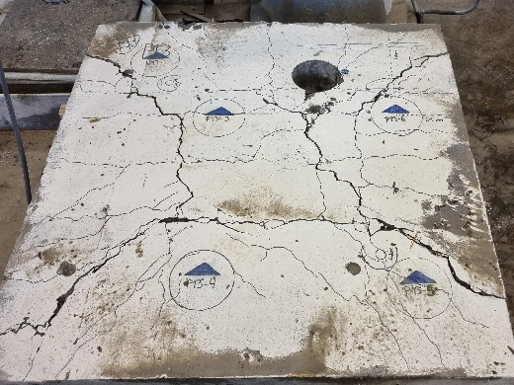
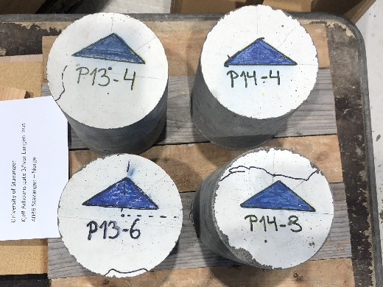
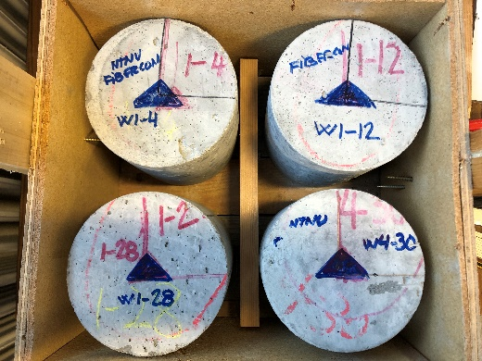
3. Experimental campaign
Specimens
All cores are cylindrical, 150 mm in diameter and 150 mm in height.
Program B1: 4 cores (P13-4, P13-6, P14-3, and P14-4) were taken from 1.2 × 1.2 × 0.15 m slabs cast in Rudshøgda.
Program B2: 4 cores (W1-4, W1-12, W1-28, and W4-30) were taken from 7.0 × 2.5 × 0.20 m walls cast in Gjøvik.

Slide 11
3. Experimental campaign
Assessment of fiber orientation
All specimens underwent inductive method (IM) testing at the NTNU facilities in Trondheim (Norway).
Later they were analyzed using computed tomography (CT) at Stratum Reservoir AS in Stavanger (Norway).
Each specimen was properly identified, clearly indicating its orientation relative to the structural element from which it was extracted.

Slide 12
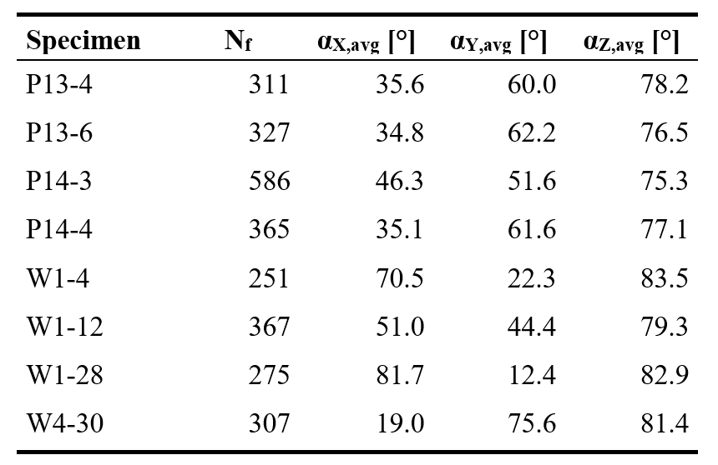
4. results
CT-scanning
CT scanning yields individual-fiber data for each specimen. From this, the total number of fibers and the mean angles that the fibers make with the coordinate axes can be calculated.
The fibers are seen to lie perpendicular to the Z-axis, i.e., perpendicular to the plane of the structural elements.
In the wall cores (W), the fibers are more strongly aligned within the XY plane.

Slide 13
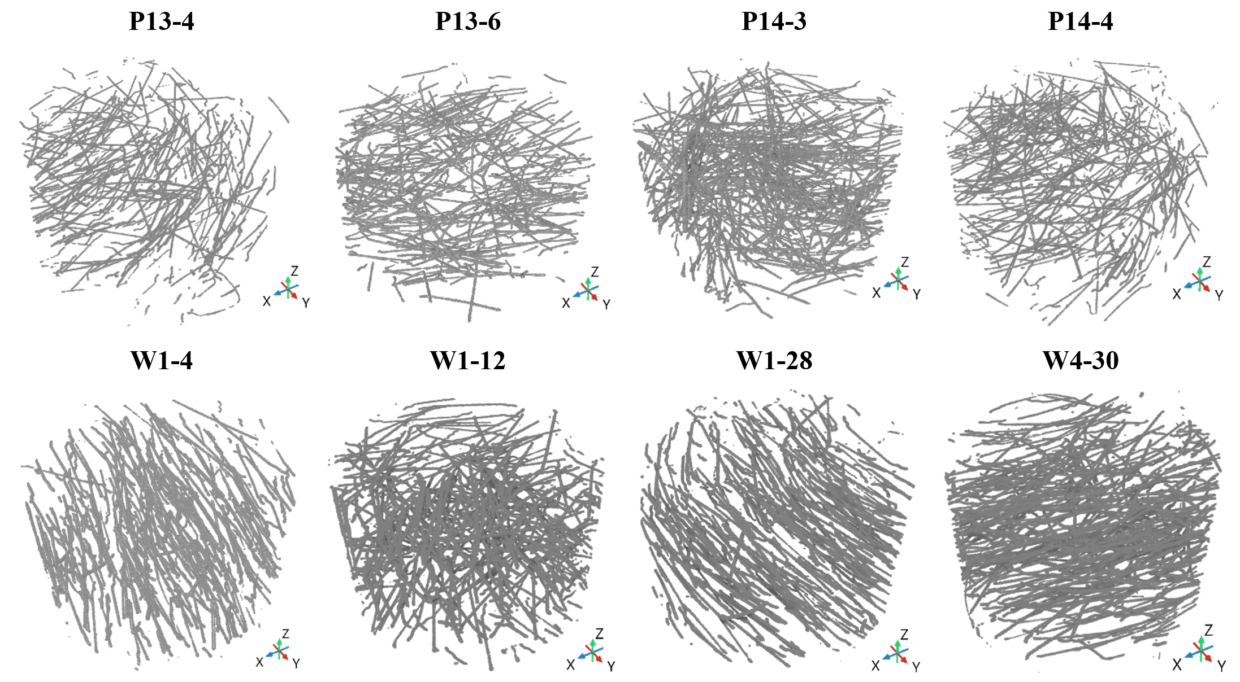
4. results
CT-scanning
3D representation of steel fibers in all specimens:

Slide 14
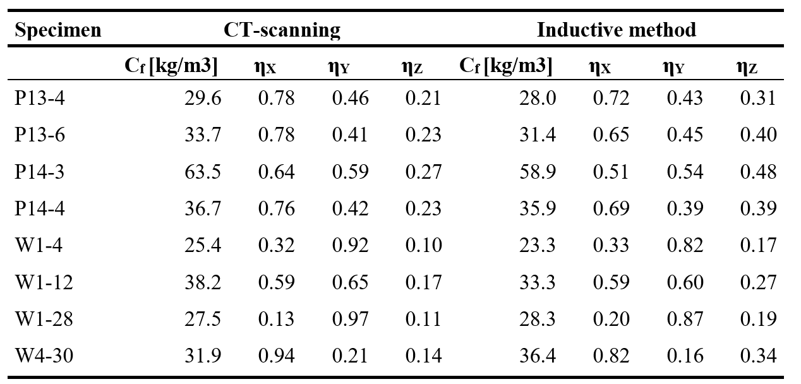
4. results
Comparison CT-scanning vs Inductive Method
The table below compares the fiber-content and orientation results obtained with CT scanning and the inductive method (IM).
In IM, the orientation factors η are calculated from inductance measurements; in CT scanning they are derived from the individual fiber orientations.
A value of η = 1 means all fibers are aligned with the corresponding axis, whereas η = 0 means all fibers are perpendicular to that axis.

Slide 15
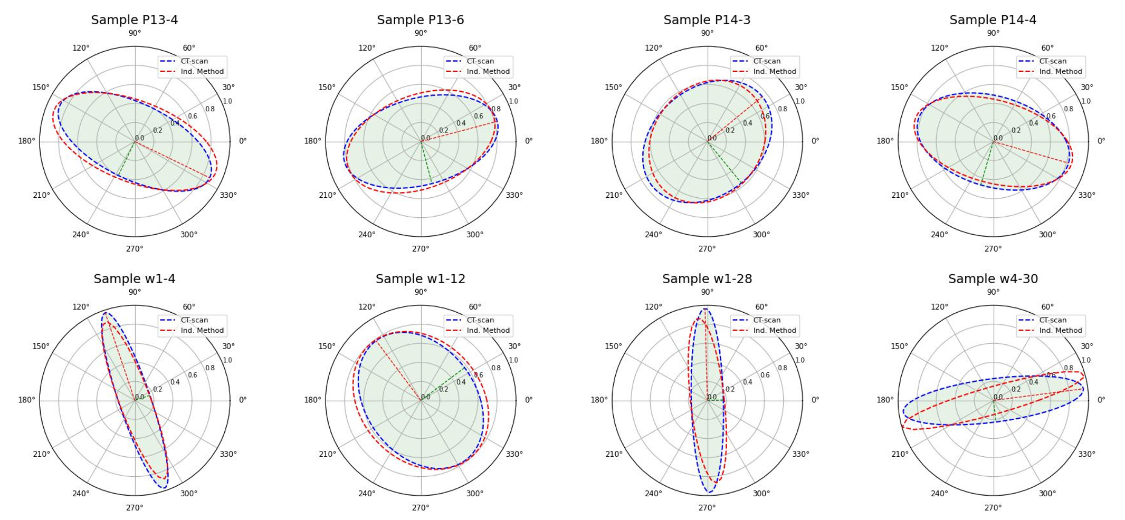
4. results
Comparison CT-scanning vs Inductive Method
For a visual comparison, the orientation ellipses obtained from CT scanning and IM can be plotted for each specimen.
These ellipses depict the dominant fiber orientations in the XY plane (the slab or wall plane) through the corresponding orientation factors.

Slide 16
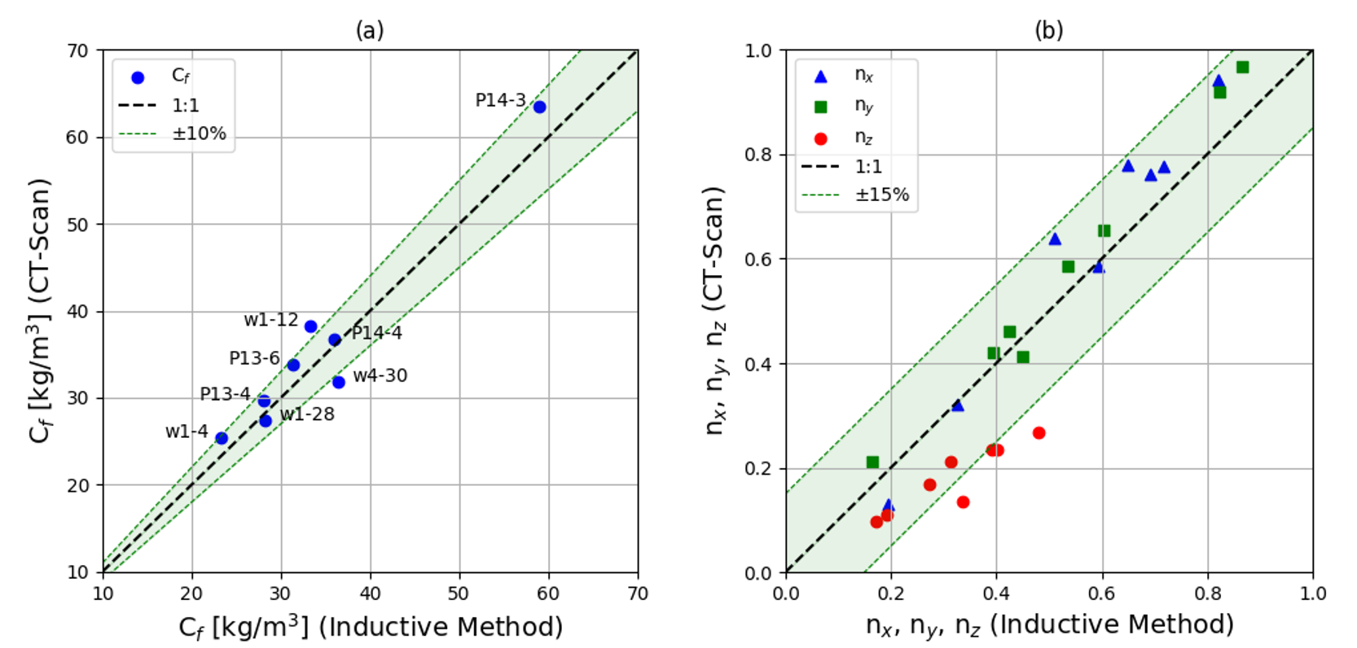
4. results
Comparison CT-scanning vs Inductive Method
Finally, correlation plots between the results of both methods—covering both fiber content and orientations—are presented. They show that the correlation level is very high.

Slide 17
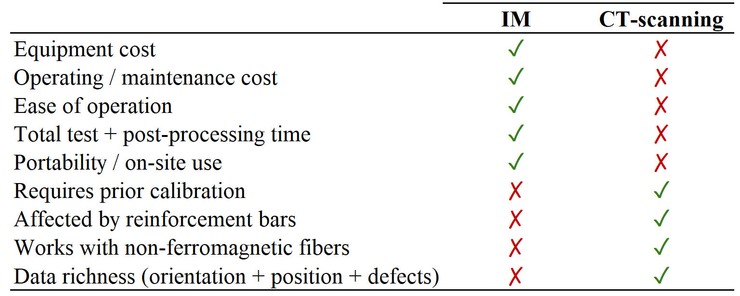
5. CONCLUSIONS
This work validates the inductive method as a reliable technique for assessing fiber orientation when compared with CT scanning (the reference method).
The inductive method can be advantageous over CT scanning in many applications.

Slide 18
Thank you for your attention! Any questions?
Alvaro Mena-Alonso
amena@ubu.es

