Slide 1
A new portable fluorescence-absorbance-scattering spectrometer
Georgios Violakis, Eleftheria Maliaritsi, Nikolaos Vardakis and Evangelos Hristophorou
2nd Olympiad in Engineering Science (OES 2025)
Jun 10 – 14, 2025
University of Stavanger

Slide 2
Motivation
Why was there a need for a ‘new’ spectrometer and what features make it new?

Slide 3
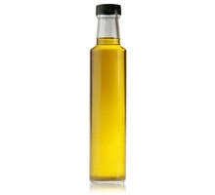



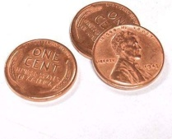

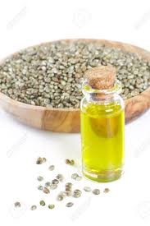
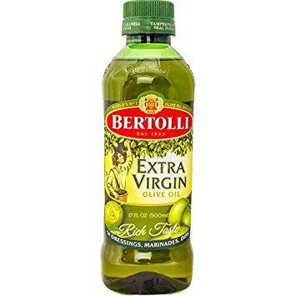
Problem
=
? =
Greece: Excellent olive oil BUT limited added value
Unknown olive oil composition: Undervalued product: loss of income for producer, loss of trust for consumers
Producers
Consumers
???
Intermediates
+
≠
Currently lacking a quick screening method to determine the quality and hence the value of each olive oil batch they want to trade/bottle
Inability to monetize a good quality product because critical quality data cannot be easily derived : Phenol content, linoleic acid content, etc...
Currently: time consuming and expensive methods
Extra Virgin Olive Oil:
Prone to adulteration
(70% of world’s bottled EVOO)
No quality or aging monitoring

Slide 4
The idea
Instead of using independent measurements from expensive state-of-the-art equipment
…use multiple input from low-cost solutions and acquire possible patterns using AI

Slide 5
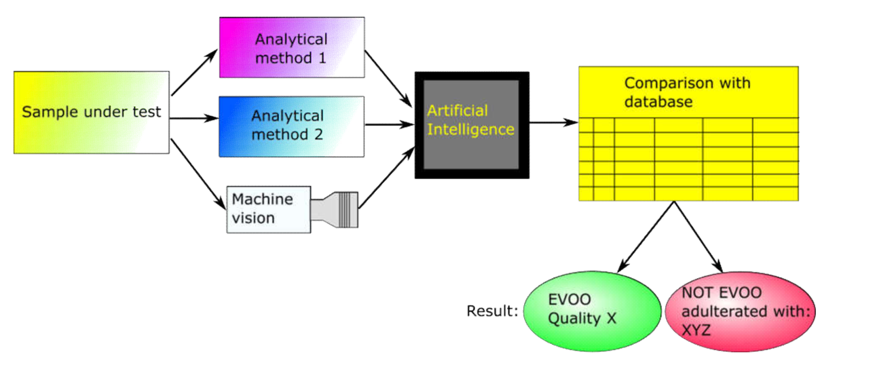
The architecture
Technology: Portable absorption and fluorescence spectrometry, image analysis / scattering data, artificial intelligence along with the corresponding light sources combined in one small, low-cost unit to provide one button click screening results of olive oil samples in plain language.
Database driven results: The device works by comparing the sample to a large in-house database of samples of known quality.

Slide 6
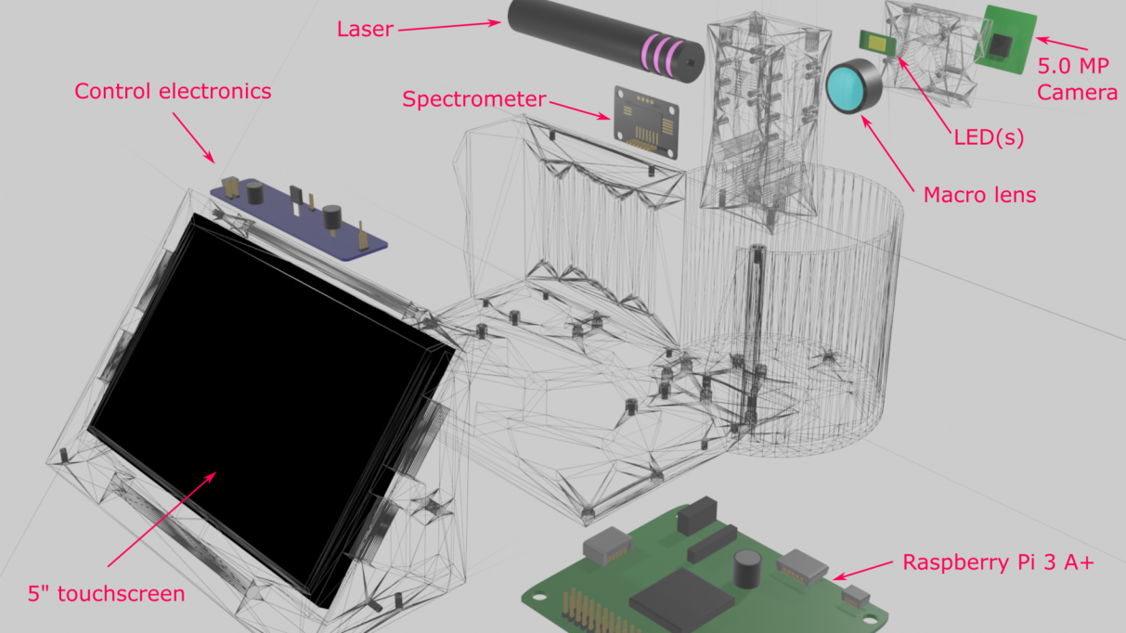
Device exploded view

Slide 7
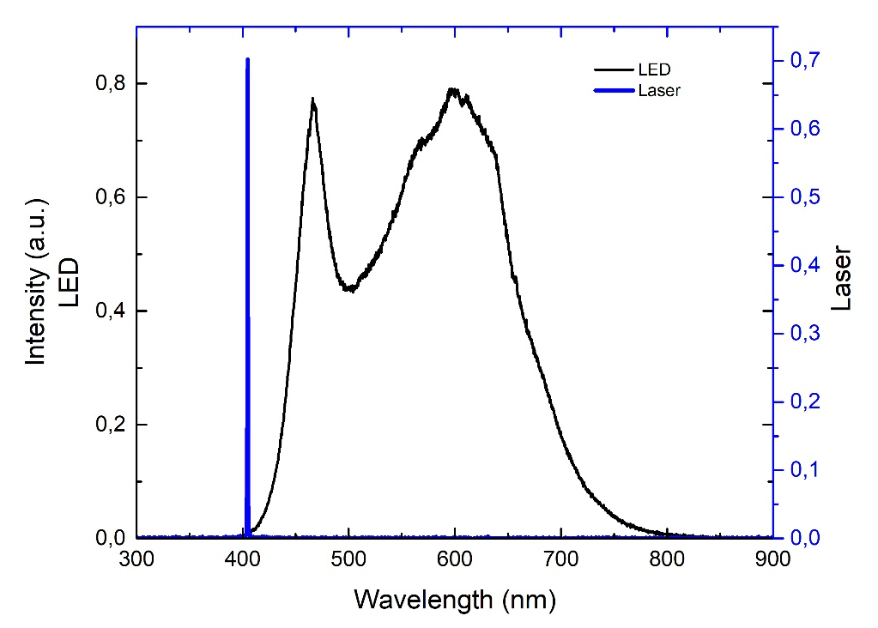
Light sources
White light LED for visible light illumination: Cree 4000K LED source with CRI of 90
Laser source: 405 nm 45mW output Sony laser diode.

Slide 8
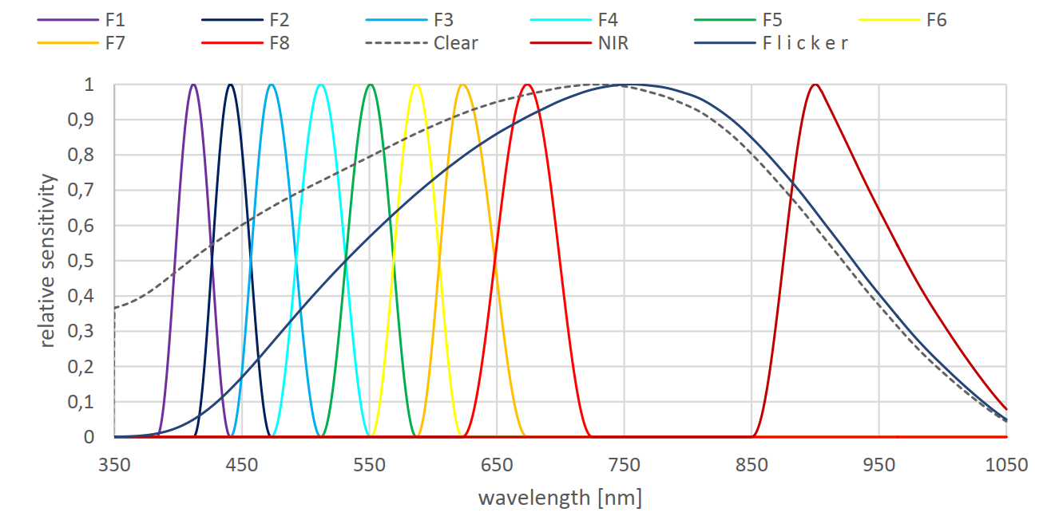
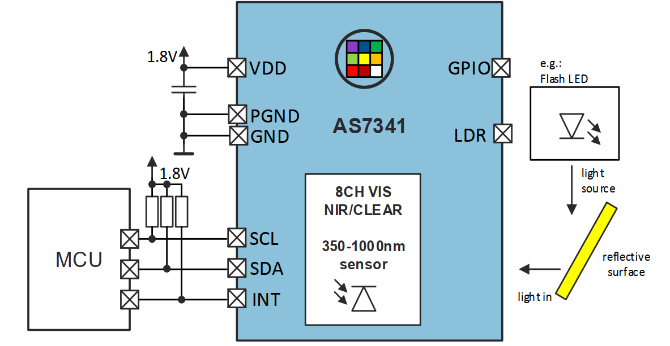
Spectrometer
AS 7341 by AMS Technologies (Osram) : Optical filter on silicon spectrometer with 8 visible channels and one NIR
Low-cost, good visible light coverage, 16-bit depth ADC provides good dynamic range

Slide 9
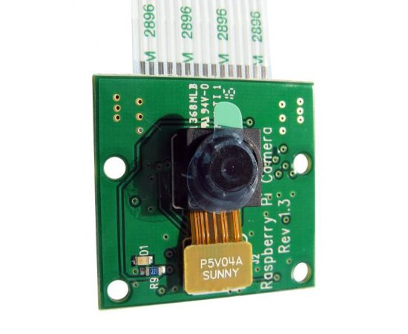
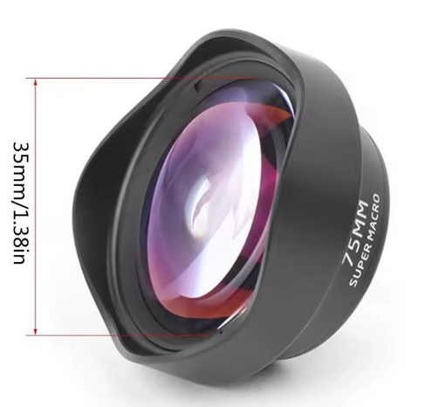
The camera
Raspberry Pi Camera Board v1.3 (5MP, 1080p)
10x macro lens
5MP omnivision 5647 camera module
Still picture resolution of 2592 x 1944
+
The macro lens is necessary for providing a field of view that covers the full cuvette width

Slide 10
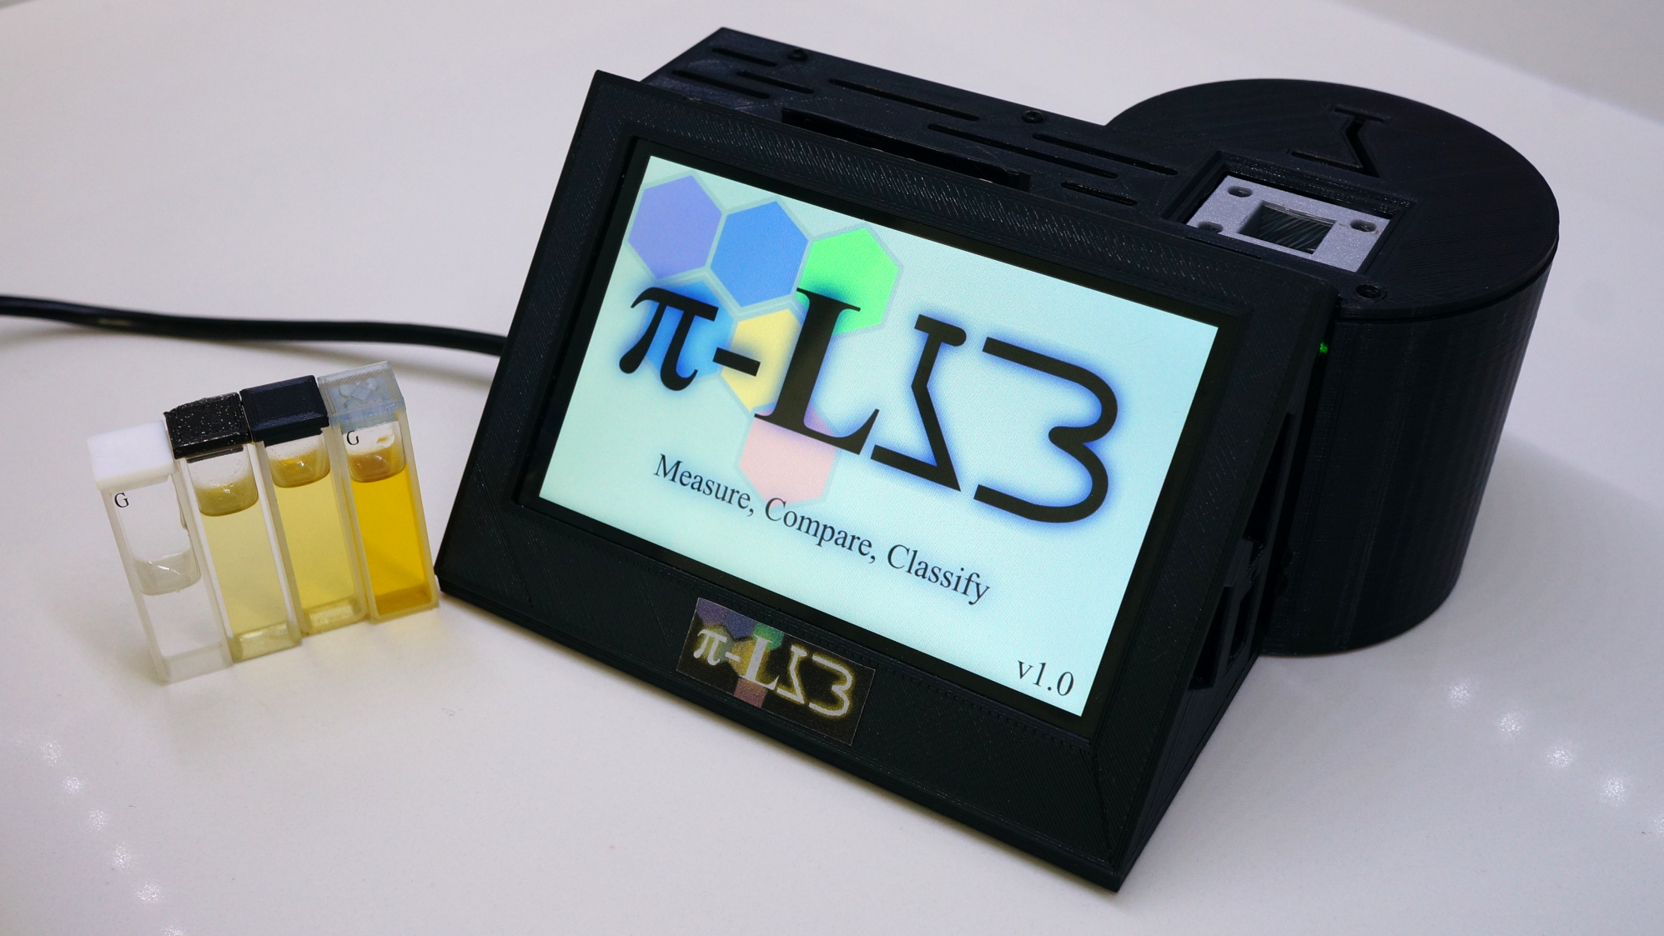
The assembled portable instrument

Slide 11
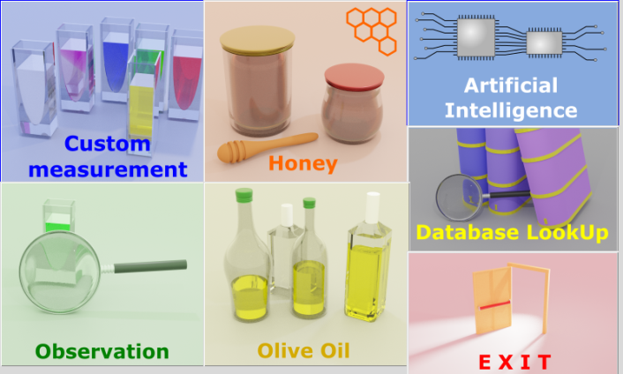
The Software
Open source developed using Python
Easy of use: Easy operation using a Tkinter based user interface developed in Python
Adaptability: End-user can create their own measurement databases and use to train the AI
AI-driven results: Principal Component Analysis or Convolutional Neural Networks can be used to train the algorithm using the recorded database measurements
Fast testing (measurements take several seconds)
Reliability that increases with time as measurements database grows
The π-LAB home screen

Slide 12
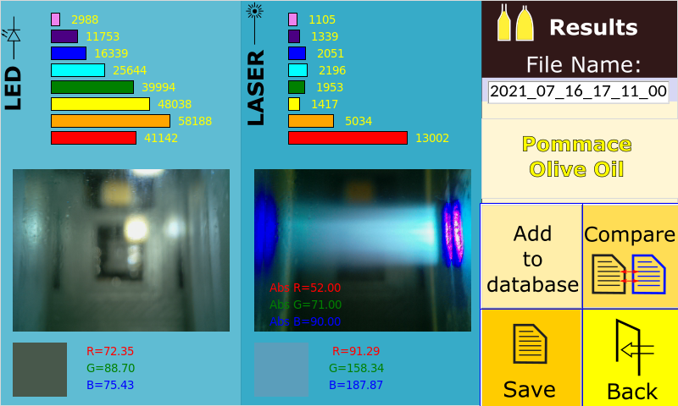
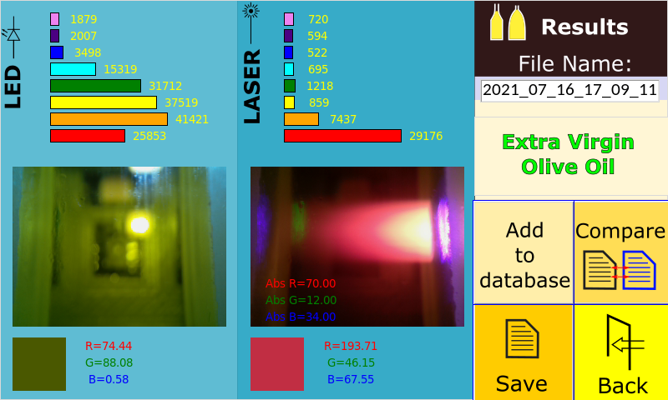
Use case I: olive oil
Principal Component Analysis (PCA) technique used for classifying ~200 olive oil samples of known quality.
Combination of laser induced luminescence and spectral measurements gave the possibility to discriminate between:
Adulterated extra virgin olive oil (with adulteration as little as 2% v/v with pomace olive oil) and
Basic screening of olive oil quality (categorization)

Slide 13
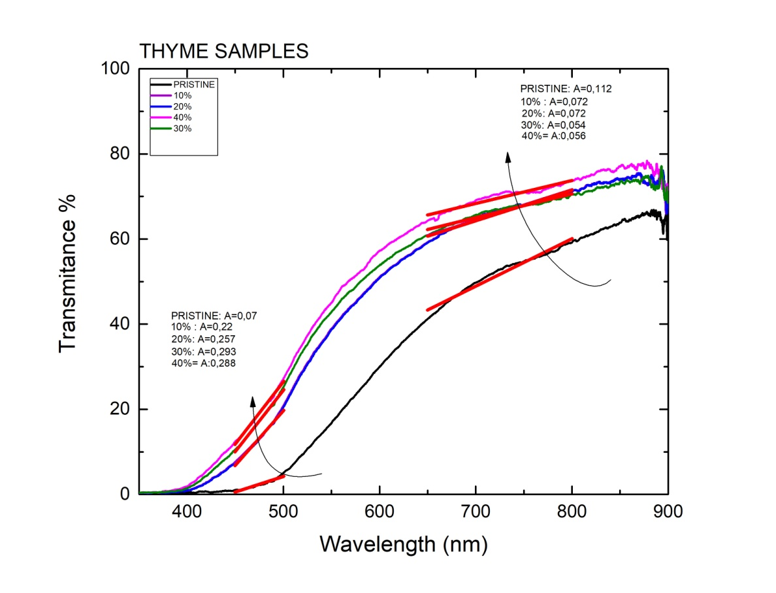
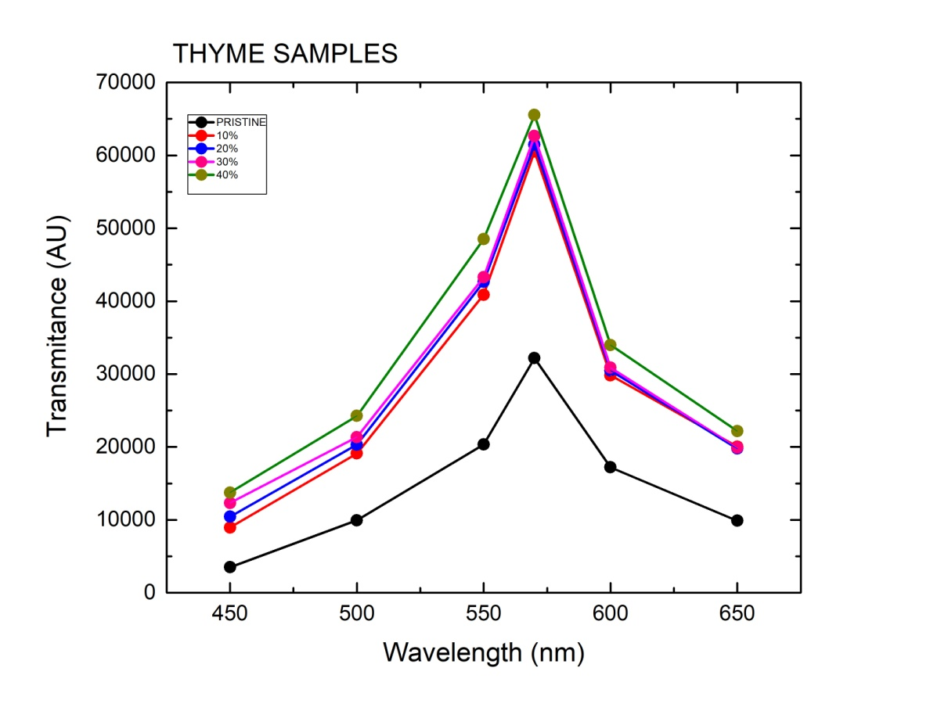
Use case II: honey (1/3)
Thyme honey transmittance using benchtop and π-LAB spectrometer
Adulteration (v/v) using glucose

Slide 14
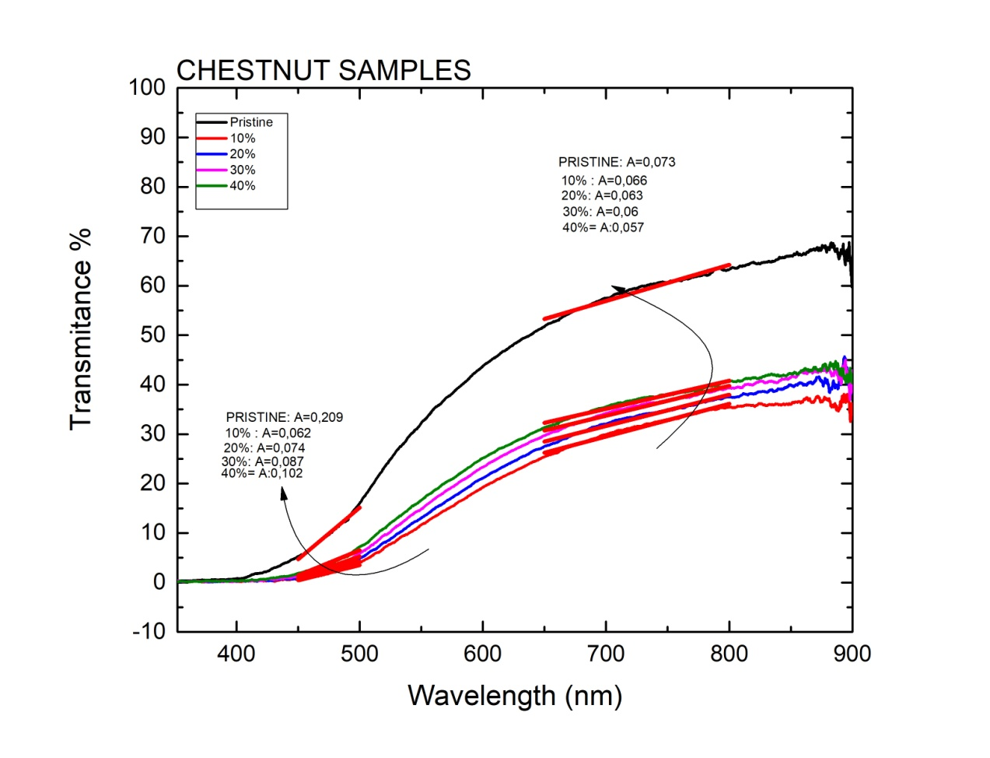
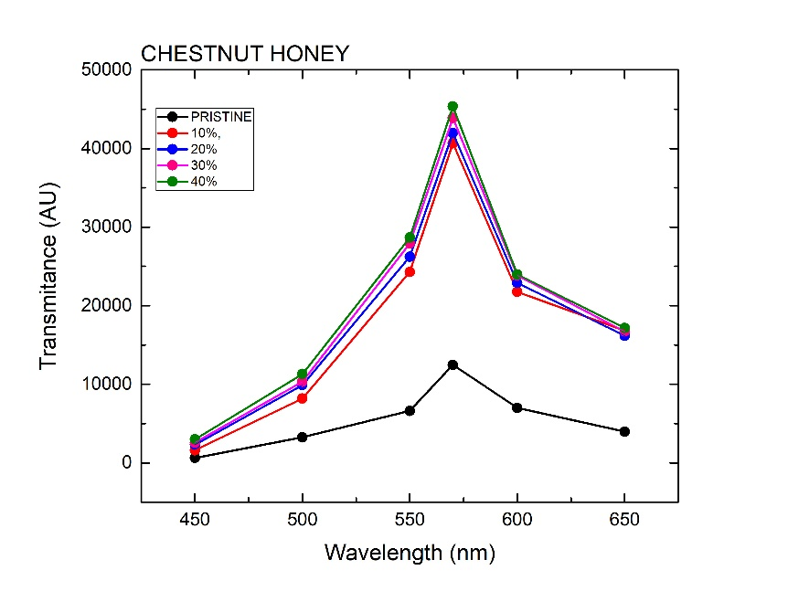
Use case II: honey (2/3)
Chestnut honey transmittance using benchtop and π-LAB spectrometer
Adulteration (v/v) using glucose

Slide 15
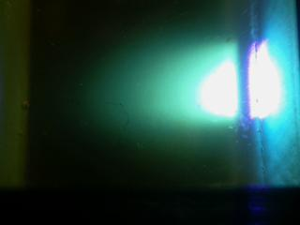
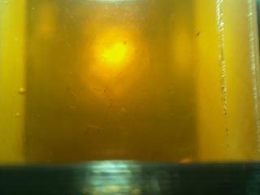
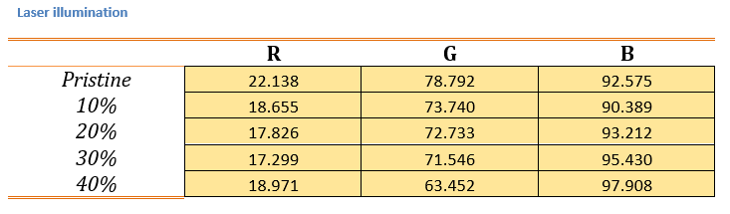
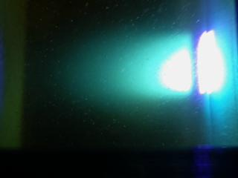
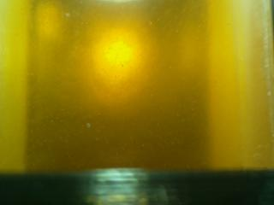
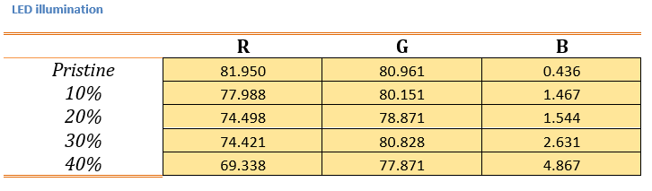
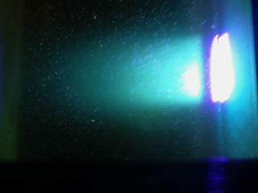
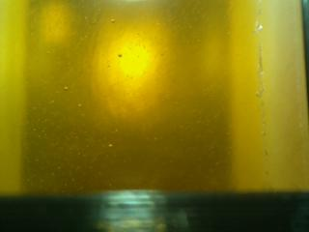
Use case II: honey (3/3)
Laser excitation and color inspection
Laser excitation inspection versus adulteration percentage
RGB color inspection using the images (in addition to the spectrometer data
PRISTINE
20%
40%

Slide 16
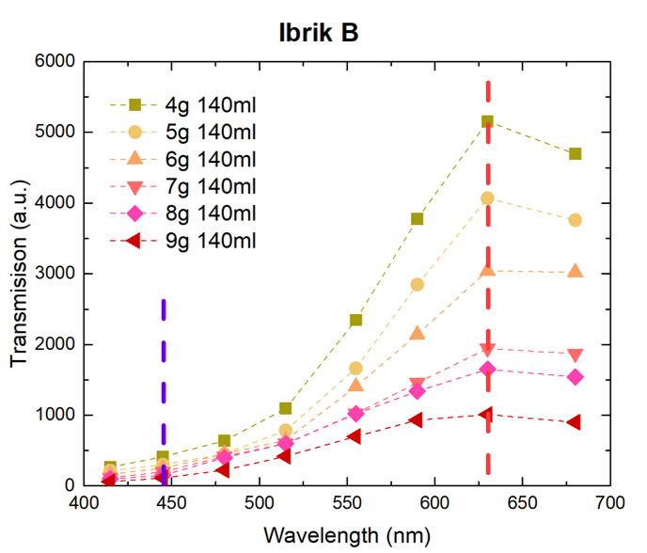
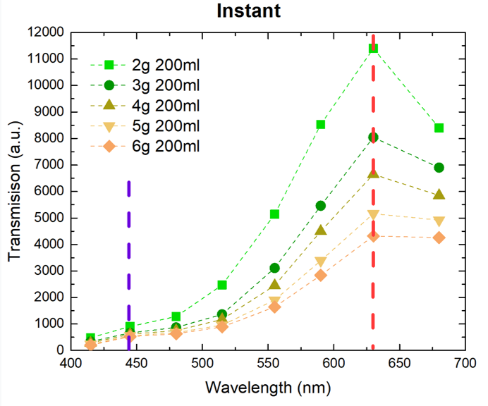
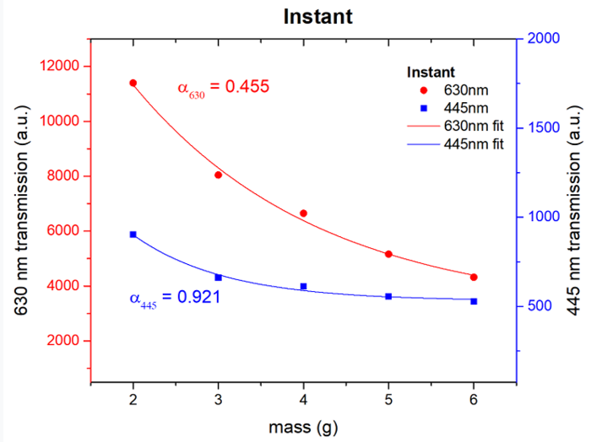
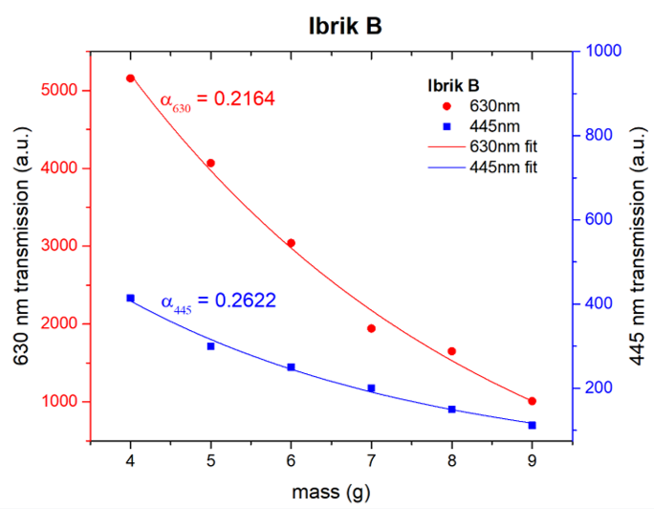
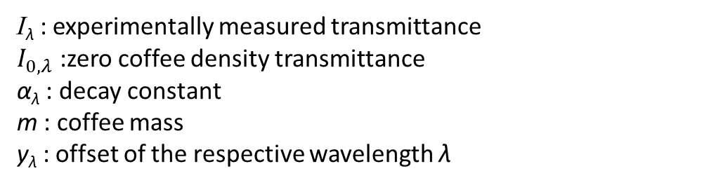

Use case III: Coffee (1/2)
Visible light absorption used to screen / determine coffee content using 445 nm and 630 nm transmittance for 2 different coffee type: Instant and Ibrik
Transmittance differences as a function of coffee mass are plotted for the 2 wavelengths and fitted using an exponential decay curve:
$$I_{λ}=I_{0,λ}e^{−a_{λ}m}+y_{λ}$$
I_{λ} : experimentally measured transmittance
$I_{0,λ}$ :zero coffee density transmittance
α_{λ} : decay constant
m : coffee mass
y_{λ} : offset of the respective wavelength λ

Slide 17
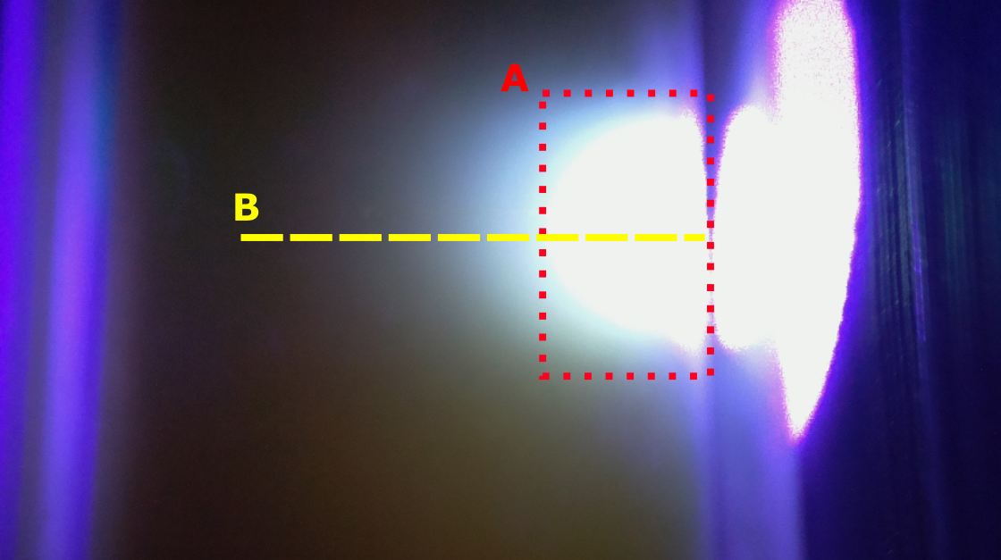
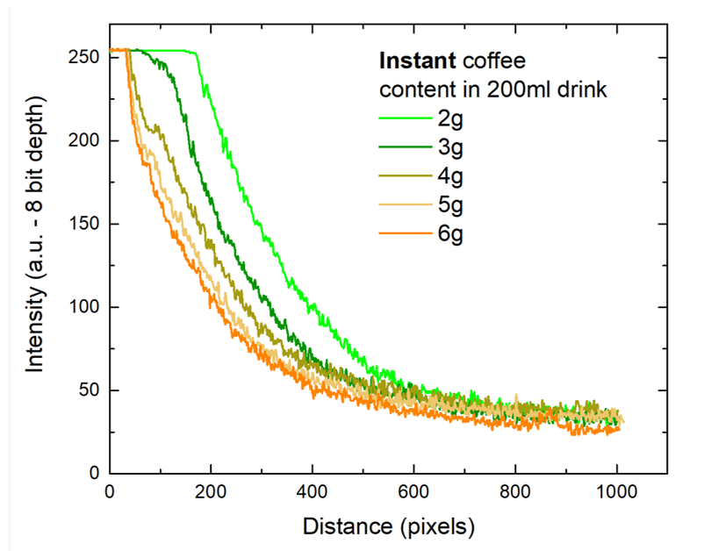
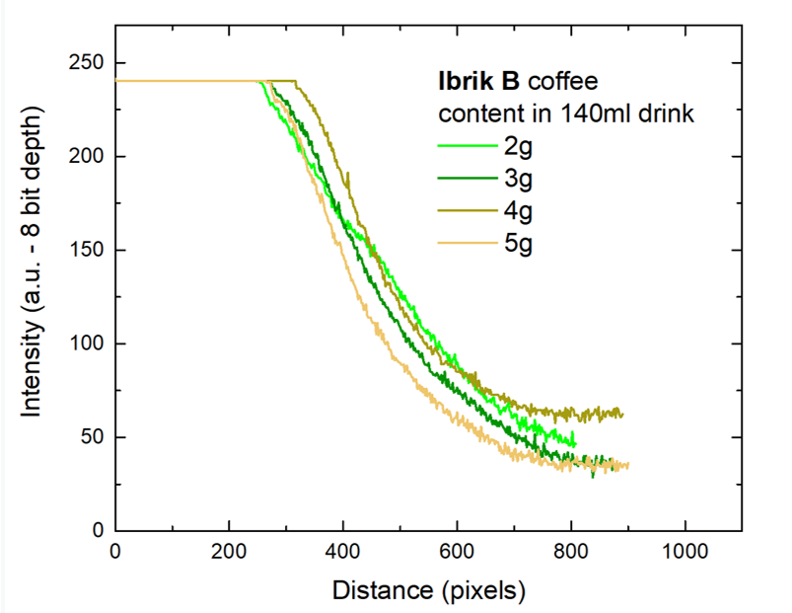
Use case III: Coffee (2/2)
Laser induced scattering / absorption used to further identify / screen coffee content using:
Saturation zone length A
Exponential decay zone B
Again, use of an exponential decay function, the scattering data can be fitted.
Maximum scattered light intensity I_{0,s}, can be used to identify coffee content in grams for a known drink (with unknown coffee content).

Slide 18
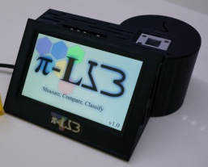

Future steps
Working prototypes
Next steps:
Development of the 2nd generation π-LAB unit with spectroscopic capabilities in the UV, specifically 270nm detection and in the zone between 320-360 nm
Testing of a large number of olive oil samples and correlating measurements
Further investigate capabilities on coffee quality screening / coffee content determination
Development of photonic ‘nose’ using microsctructured plasmonic resonance sensor using low cost replication techniques and embedding the sensor to the unit
Gen.1, portable, working unit prototype
Gen. 2: As Gen I + expansion to UV + utilization of IR channel + plasmonics

Slide 19


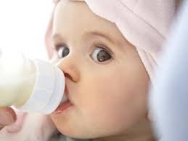
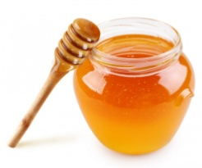

Conclusions
A low-cost, fluorescence absorption, scattering instrument has been developed in order investigate its possible use in food quality screening
Initially, data from olive oil, honey and coffee have been collected as a preliminary ‘mapping’ process of the device to distinguish between samples of known quality.
AI either in the form of ‘simple’ Principal Component Analysis or by using Convolutional Neural Networks is built-in for the classification of samples
Preliminary results show promising potential, but further work and more powerful optical modules are along the line to increase capabilities, toward a vision of a ‘home-analytics’ device
??

Slide 20
Thank you for your attention !!!

