Slide 1
Novel Anomaly Detection for Robust Dynamic Monitoring of Bridges under Freezing Impacts
June, 12th, 2025 | Chen Zheng-Han

Slide 2
Contents
Introduction
Proposed Method
  2.1 Support vector data description (SVDD)
  2.2 Mahalanobis Distance (MSD)
Applications
  3.1 Concrete box girder bridge
  3.2 Steel arch bridge
Conclusion

Slide 3
Introduction
01

Slide 4
Introduction Existing work
AI-driven technology
01
Artificial Intelligence (AI) integrate into SHM systems to process sensor data, enabling autonomous damage detection, integrity assessment, and proactive maintenance for bridges.
Structural Health
Monitoring (SHM)
Modal frequency & temperature
02
Modal frequencies indicate bridge damage through stiffness changes but are affected by temperature (e.g., freezing-induced thermal contraction and ice accumulation), which may mask structural anomalies.
03
Existing challenge
Temperature-induced variations remain problematic as traditional methods cause false alarms, and struggles with severe freezing conditions.

Slide 5
Introduction This study
Objective
Resolve modal frequency signal confusion under freezing conditions
Core Idea
SVDD-MSD Framework
SVDD mapping & boundary definition / MSD kernel enhancement
Workflow
Preprocessing → feature mapping → anomaly detection → validation
Innovation
Robustness / Imbalanced data compatibility / False alarm reduction

Slide 6
Proposed Method
02

Slide 7
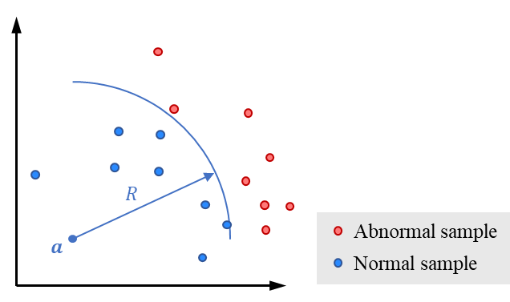
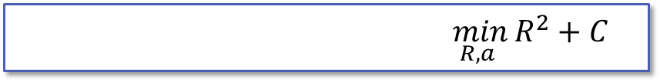


Proposed method Support vector data description (SVDD)
Core concept
SVDD maps data to a high-dimensional space, defining a hypersphere to enclose normal data points for anomaly detection.​
Key Feature
Unsupervised
No labeled data
Imblanced dataset
$$\min_{R, a }{R^{2}+C}$$
Boundary of hypersphere
$$\min_{R, a }{R^{2}+C}$$
Concept of SVDD
Anomaly criterion
$${\left\|x_{i}−a\right\|}^{2}≤R^{2}$$

Slide 8


Proposed method Mahalanobis Distance (MSD)
Euclidean distance
Mahalanobis Distance
$$D_{E}={\left\|x_{i}−a\right\|}^{2}$$
$$D_{M}={\left(x_{i}−a\right)}^{2}Σ^{−1}\left(x_{i}−a\right)$$
Sanctus dolore erat voluptua justo diam euismod et nisl.
Sanctus dolore erat voluptua justo diam euismod et nisl.
Traditional
Proposed
Assumption:
All features are uncorrelated
and have equal variance
Key Improvement:
▸Feature correlations
▸Data covariance structure
Limitations:
Leads to inaccurate distance
measurement
Key Improvement:
▸Adapts to different scales/units
▸Accurate for high-dimensional data

Slide 9
Applications
03

Slide 10
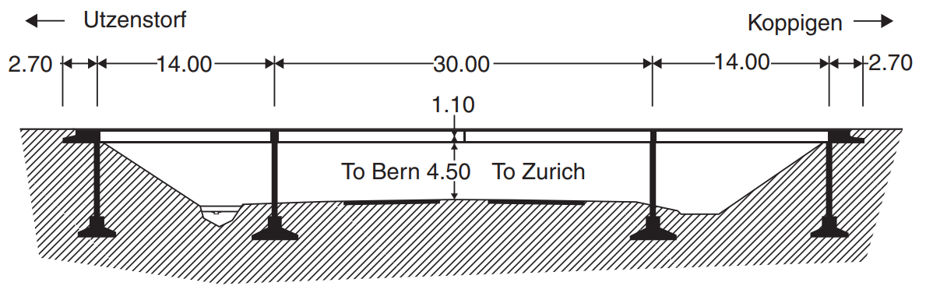
Application-1 Concrete box girder bridge: information
3-span concrete box girder bridge
Located on Switzerland's A1 highway
SHM campaign: acceleration/environmental (temperature) data
Dataset: 3932 samples
Red damaged Green undamaged Blue <0°C
Training: 2780 Testing: 695+457
Fig. Z24 Bridge in Switzerland
Fig. Modal Frequency of Z24 Bridge

Slide 11
Application-1 Concrete box girder bridge: results of SVDD-MSD
Clear division: A 99.99% confidence threshold clearly divides damaged and undamaged samples
High accuracy: 99.82%(all) 99.88%(training set) 99.34%(testing set)
Low false positives: 7 in training (3 sub-0°C, 4 >0°C), 1 in testing (>0°C)
No missed damaged samples (0 false negatives)
Fig. Anomaly detection result for Z24 bridge (SVDD-MSD)
Validates robustness against temperature-induced false alarms

Slide 12
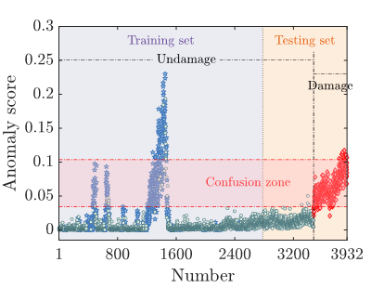
Application-1 Concrete box girder bridge: comparative study
01
DeepSVDD method
Uses deep neural networks to improve SVDD
Comparison: DeepSVDD
02
Confusion zone
Damaged & freezing samples overlap
03
Comparative result
▸Fails to separate environmental effects
▸Environment facts cause false negatives
Fig. Anomaly detection result for Z24 bridge (DeepSVDD)

Slide 13
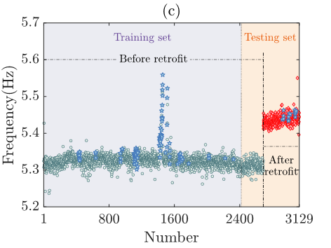
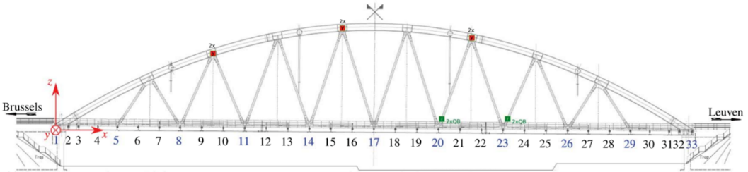
Application-2 Steel arch bridge: information
single-span steel arch bridge
Located on Leuven-Mechelen canal, Belgium
SHM campaign: acceleration/environmental (temperature) data
Dataset: 3129 samples
Red post-retrofit Green pre-retrofit Blue <0°C
Training: 2419 Testing: 269+441
Fig. KW51 Bridge in Belgium
Fig. Modal Frequency of KW51 Bridge

Slide 14
Application-2 Steel arch bridge: results of SVDD-MSD
Clear division: A 99.9% confidence threshold clearly divides pre-retrofit and post-retrofit
High accuracy: 99.78%(all) 99.96%(training set) 99.15%(testing set)
Low false alarm: 1 in training (1>0°C)
6 in testing (6>0°C)
No confusion between low temp. and post-retrofit
Fig. Anomaly detection result for KW51 bridge (SVDD-MSD)
Validates robustness against temperature-induced false alarms

Slide 15
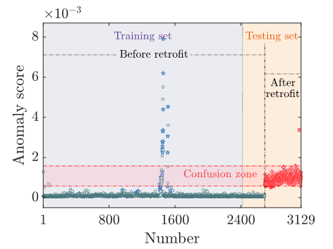
Application-2 Steel arch bridge: comparative study
01
DeepSVDD method
Uses deep neural networks to improve SVDD
Comparison: DeepSVDD
02
Confusion zone
Damaged & freezing samples overlap
03
Comparative result
▸Fails to separate environmental effects
▸Environment facts cause false negatives
Fig. Anomaly detection result for KW51 bridge (DeepSVDD)

Slide 16
Conclusion
04

Slide 17
Conclusion
Proposed SVDD-MSD method
(1) SVDD constructs a hypersphere that contains normal training data in feature space;
(2) MSD computes generalized distances between test samples and the hypersphere center to derive anomaly scores.
Key findings
Complete separation of damaged/retrofitted anomalies from normal states under freezing conditions
Generalizability across structural modification types (damage vs. retrofit)
Superiority over traditional methods (such as DSVDD) that fail to mitigate thermal distortions

Slide 18
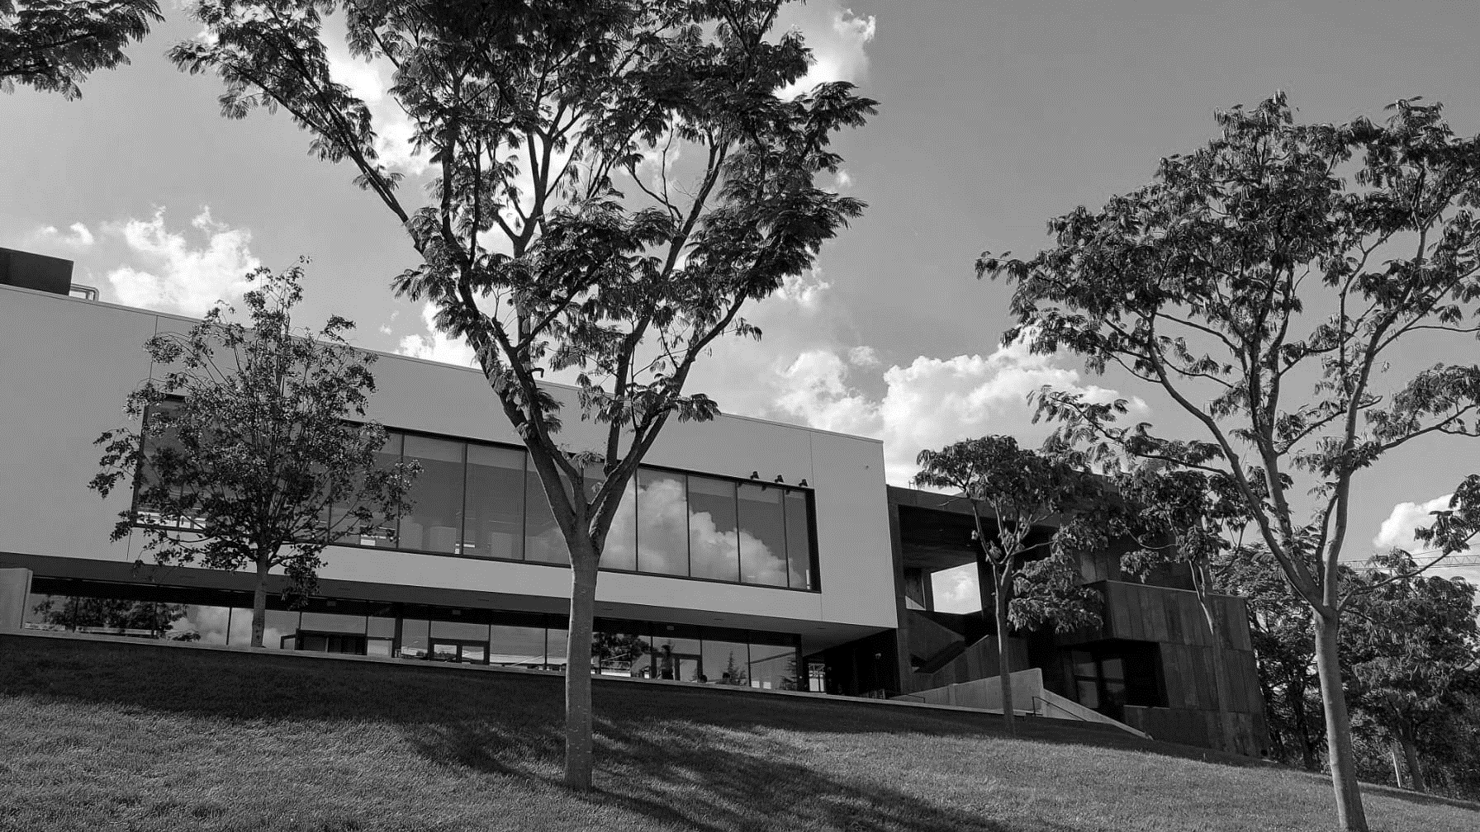
Thank you for your attention.
Chen Zheng-Han

