Slide 1
A Novel Data-Augmented Deep Learning Framework for Predicting Wind-Induced Vibrations in Long-Span Bridges under Small Sample Conditions
June, 12th, 2025 | Chen Zheng-Han

Slide 2
Contents
Introduction
Proposed Framework
  2.1 SMOGN technique
  2.2 GRU model
Application: Hardanger Bridge
  3.1 Overview of Hardanger Bridge
  3.2 Predictors
  3.2 Targets
Prediction of Vertical Vibration Responses
  4.1 Prediction Results
  4.2 Comparative Study
Applications
  5.1 Prediction Results
  5.2 Comparative Study
Conclusion

Slide 3
Introduction
01

Slide 4
A Novel Data-Augmented Deep Learning Framework for Predicting Wind-Induced Vibrations in Long-Span Bridges under Small Sample Conditions
Introduction Existing work
Long-span Bridges
Long-span Bridges face natural (wind-induced vibrations, etc.) & non - natural threats, so SHM matters.
SHM
(Structural Health
Monitoring)
Traditional SHM relies on sensors, but high-cost & complex-installation.
AI/DL methods emerge as alternatives response prediction.
AI in SHM
Challenges
Supervised regression models works, but DL methods struggles with small datasets for SHM, causing unstable/biased predictions.
Data Augmentation
Data augmentation techniques enrich training data without new samples, and enhance model robustness

Slide 5
A Novel Data-Augmented Deep Learning Framework for Predicting Wind-Induced Vibrations in Long-Span Bridges under Small Sample Conditions
Introduction This study
Objective
Propose a framework to predict vibration responses under limited data.
Core Idea
SMOGN-GRU Framework
Enhance dataset/ Supervised learning
Workflow
Preprocessing → SMOGN augmentation → GRU prediction → validation
Innovation
High accuracy / Small sample conditions / Robustness

Slide 6
Proposed Framework
02

Slide 7
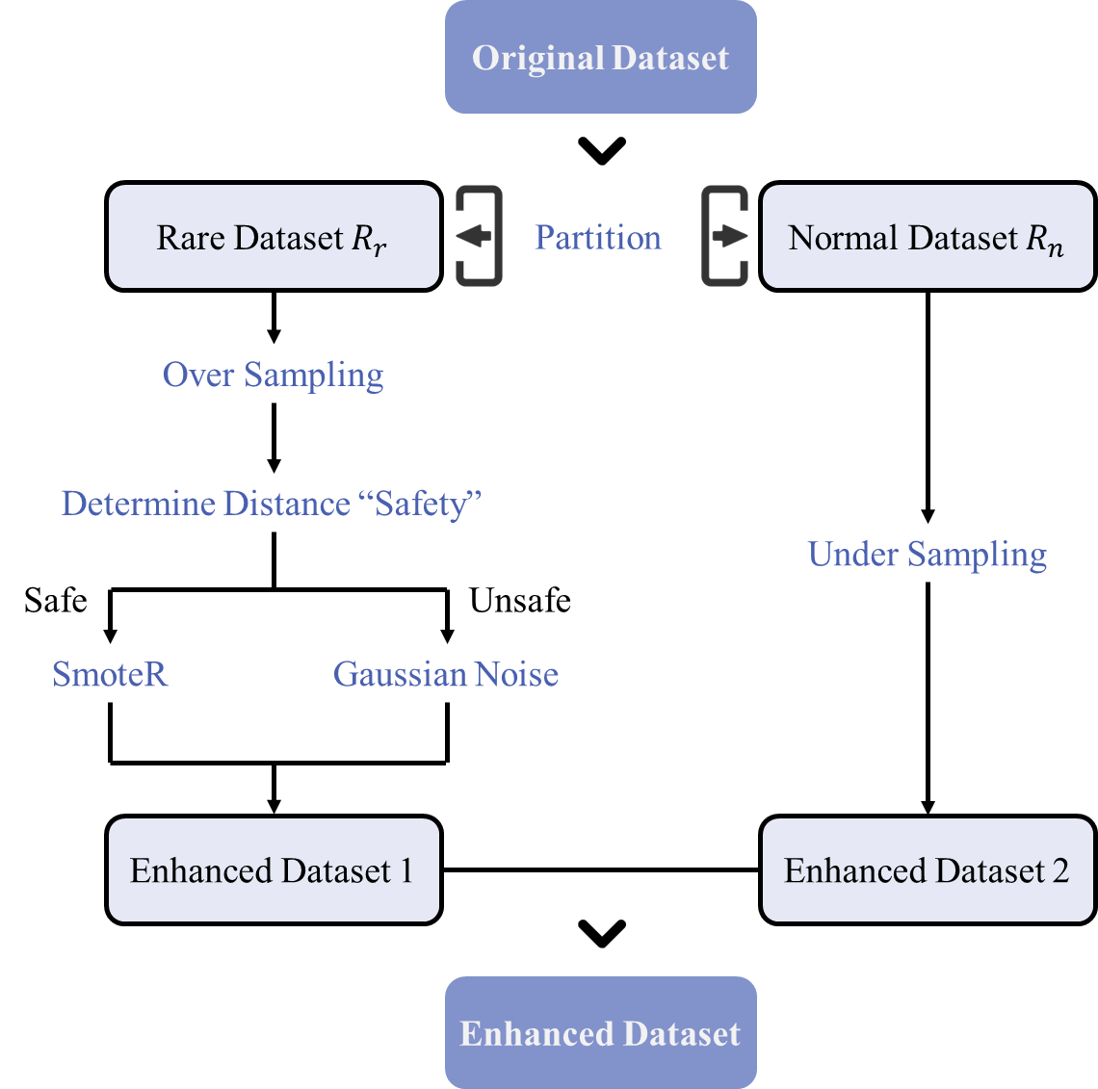
A Novel Data-Augmented Deep Learning Framework for Predicting Wind-Induced Vibrations in Long-Span Bridges under Small Sample Conditions
Proposed method Synthetic Minority Over-sampling Technique for Regression with Gaussian Noise (SMOGN)
Features of SMOGN
Specifically for small-sample regression scenarios, integrating Gaussian noise injection with modified Smote-R.
01
Differentiated sampling strategies, over-sampling for rare samples and under-sampling for standard samples.
02
Adaptively selects interpolation or Gaussian noise to generate synthetic samples based on sample spacing.
03
Fig. Diagram of SMOGN

Slide 8




A Novel Data-Augmented Deep Learning Framework for Predicting Wind-Induced Vibrations in Long-Span Bridges under Small Sample Conditions
Proposed method Gated Recurrent Unit (GRU)
Advantages of GRU
Core Structure
Two Key Gating Units
Update Gate
1. Determines how much past information to retain
2. Formula:
Reset Gate
1. Controls how much past information to forget
2. Formula:
Hidden State Update
1. Candidate hidden state:
2. Final hidden state:
Simple Structure
01
Easier to implement and understand
$$z_{t}=σ\left(W_{z}x_{t}+U_{z}h_{t−1}+b_{f}\right)$$
Faster Training
02
Lower computational complexity, suitable for large datasets.
$$r_{t}=σ\left(W_{r}x_{t}+U_{r}h_{t−1}+b_{r}\right)$$
$${\tilde{h}}_{t}=tanh\left(W_{h}x_{t}+U_{r}\left(r_{t}⊙h_{t−1}\right)+b_{h}\right)$$
Fewer Parameters
03
$$h_{t}=\left(1−z_{t}\right)⊙h_{t−1}+z_{t}⊙{\tilde{h}}_{t}$$
2 gating units (40% fewer parameters than LSTM).

Slide 9
Application: Hardanger Bridge
03

Slide 10

A Novel Data-Augmented Deep Learning Framework for Predicting Wind-Induced Vibrations in Long-Span Bridges under Small Sample Conditions
Application Hardanger Bridge: Overview
Overview
1
Hardanger Bridge, a 1,380-meter suspension bridge in Norway, longest narrow-span suspension structure when completion
SHM System
2
Triaxial accelerometers, ultrasonic anemometers, and GPS sensors. 16 accelerometers on the main girder monitoring vibrations.
Dataset
3
Data from 4 extreme wind events (Ole, Urd, Tor, Nina) in 2015–2016, capturing wind parameters and structural responses.
Fig. Hardanger Bridge

Slide 11

A Novel Data-Augmented Deep Learning Framework for Predicting Wind-Induced Vibrations in Long-Span Bridges under Small Sample Conditions
Application Hardanger Bridge: Predictors and Targets
Predictors
Targets
●Mean wind speed and direction ●Angle of attack ●Turbulence intensities ●Standard deviations
●Length scales of the along-wind ●Cross-wind ●Vertical turbulence ●Components and wind gust factor
●Vertical vibration acceleration $a_{1}(t)$
$$a_{1}\left(t\right)=\frac{1}{2}\left[a_{L}\left(t\right)−a_{R}\left(t\right)\right]$$
●Torsional vibration acceleration $a_{2}(t)$
$$a_{2}\left(t\right)=\frac{1}{b}\left[a_{L}\left(t\right)−a_{R}\left(t\right)\right]$$
Fig. Predictors: Mean wind speed & Mean wind direction

Slide 12
Prediction of Vertical Vibration Response
04

Slide 13
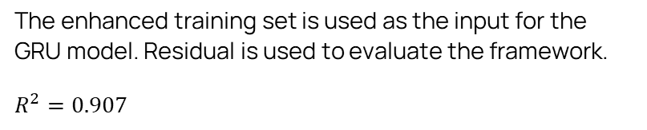
A Novel Data-Augmented Deep Learning Framework for Predicting Wind-Induced Vibrations in Long-Span Bridges under Small Sample Conditions
Prediction: Vertical Result of SMOGN-GRU
01 Data Augmentation
02 Regression
113 sets of data (each containing predictors and targets) are generated via SMOGN.
Before 126 → After 239
The enhanced training set is used as the input for the GRU model. Residual is used to evaluate the framework.
$$R^{2}=0.907$$
Distributions of training sets (before and after SMOGN)
Interval | Quantity (before SMOGN) | Quantity (after SMOGN)
(0.005, 0.01] | 11 | 29
(0.01, 0.015] | 27 | 48
(0.015, 0.02] | 67 | 102
(0.02, 0.025] | 17 | 52
(0.025, 0.03] | 4 | 8
Total | 126 | 239
Fig. Prediction Result

Slide 14
A Novel Data-Augmented Deep Learning Framework for Predicting Wind-Induced Vibrations in Long-Span Bridges under Small Sample Conditions
Prediction: Vertical Comparative Study
Comparative framework
GRU
a
$R^{2}$ value of the proposed framework and four comparative frameworks
noise injection+GRU
Framework | Training set | Testing set | Whole set
Proposed framework | 0.919 | 0.883 | 0.907
(a) GRU | 0.783 | 0.757 | 0.777
(b) noise injection+GRU | 0.817 | 0.768 | 0.805
(c) SMOGN+SVM | 0.785 | 0.757 | 0.775
(d) SMOGN+MLP | 0.561 | 0.526 | 0.554
b
SMOGN+SVM
c
S SMOGN+MLP
d
Findings
The proposed SMOGN-GRU framework shows the best predictive performance with training accuracy 0.919, testing accuracy 0.883, and strong generalization.
Standalone GRU and noise-injection methods have lower testing accuracies (0.757 and 0.768), proving SMOGN's key role in improving robustness.
SMOGN combined with SVM/MLP performs worse (0.757/0.526) than GRU, highlighting GRU's advantage in modeling temporal dependencies.

Slide 15
Prediction of Torsional Vibration Response
05

Slide 16
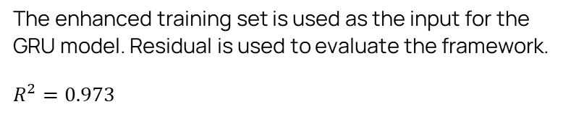
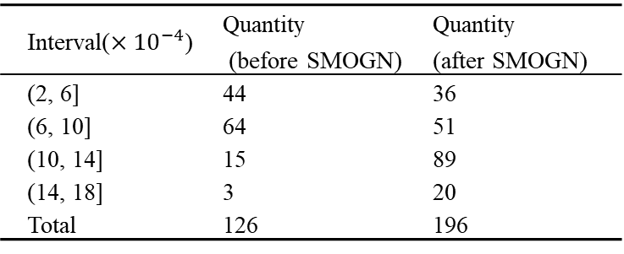
A Novel Data-Augmented Deep Learning Framework for Predicting Wind-Induced Vibrations in Long-Span Bridges under Small Sample Conditions
Prediction: Torsional Result of SMOGN-GRU
01 Data Augmentation
02 Regression
170sets of data (each containing predictors and targets) are generated via SMOGN.
Before 126 → After 196
The enhanced training set is used as the input for the GRU model. Residual is used to evaluate the framework.
$$R^{2}=0.973$$
Distributions of training sets (before and after SMOGN)
Interval($×{10}^{−4}$) | Quantity (before SMOGN) | Quantity (after SMOGN)
(2, 6] | 44 | 36
(6, 10] | 64 | 51
(10, 14] | 15 | 89
(14, 18] | 3 | 20
Total | 126 | 196
Fig. Prediction Result

Slide 17
A Novel Data-Augmented Deep Learning Framework for Predicting Wind-Induced Vibrations in Long-Span Bridges under Small Sample Conditions
Prediction: Vertical Comparative Study
Comparative framework
GRU
a
$R^{2}$ value of the proposed framework and four comparative frameworks
noise injection+GRU
Framework | Training set | Testing set | Whole set
Proposed framework | 0.983 | 0.959 | 0.973
(a) GRU | 0.964 | 0.931 | 0.955
(b) noise injection+GRU | 0.911 | 0.869 | 0.893
(c) SMOGN+SVM | 0.885 | 0.808 | 0.868
(d) SMOGN+MLP | 0.713 | 0.657 | 0.702
b
SMOGN+SVM
c
S SMOGN+MLP
d
Findings
The proposed SMOGN-GRU framework shows the best predictive performance with training accuracy 0.983, testing accuracy 0.959, and strong generalization.
Standalone GRU and noise-injection methods have lower testing accuracies (0.955 and 0.893), proving SMOGN's key role in improving robustness.
SMOGN combined with SVM/MLP performs worse (0.868/0.702) than GRU, highlighting GRU's advantage in modeling temporal dependencies.

Slide 18
Conclusion
06

Slide 19
A Novel Data-Augmented Deep Learning Framework for Predicting Wind-Induced Vibrations in Long-Span Bridges under Small Sample Conditions
Conclusion
Proposed SMOGN-GRU method
(1) SMOGN augments training data by synthesizing samples from limited SHM records;
(2) The enhanced training set is input into the GRU model to predict wind-induced response.
Key findings
The proposed SMOGN-GRU framework article has high accuracy in predicting two types of wind vibration responses.
Resolves small-sample limitations in bridge vibration prediction
Shows practical value for high-cost SHM systems in extreme wind scenarios.

Slide 20

Thank you for your attention.
Chen Zheng-Han

