Slide 1
Unsupervised Bridge Anomaly Detection under Environmental Variability Using GAN-Enhanced Adaptive Affinity Propagation
2nd Olympiad in Engineering Science – OES 2025
Presenter: Wen Gao
Supervisor: Prof. Alireza Entezami
Affiliation: Department of Civil and Environmental Engineering, Politecnico di Milano, Milan, Italy
Date: 12/06/2025

Slide 2
Contents
01
02
03
Research Status and Topics
Methodology
Application and Achievement
Research background and status
Research topics and innovations
Data extraction and enhancement
Adaptive clustering
Abnormal score calculation and anomaly monitoring
Data enhancement results
Application results

Slide 3
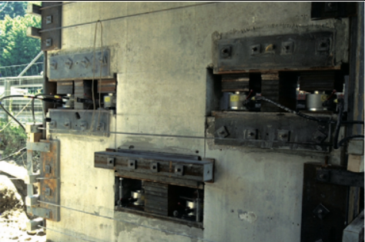
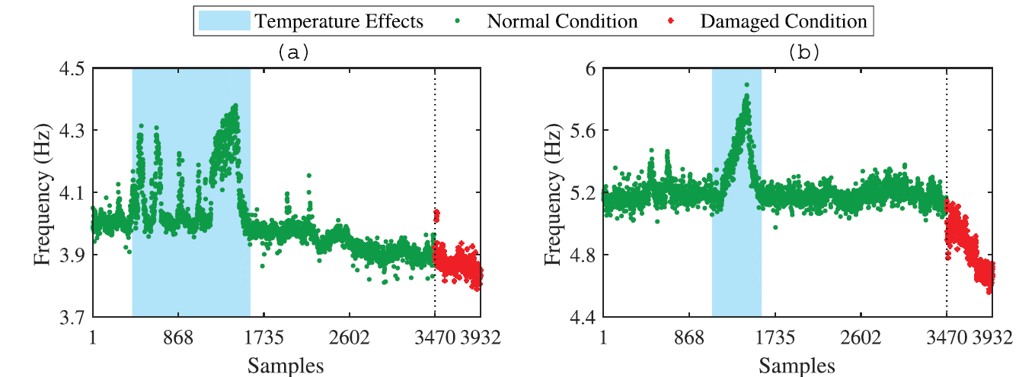
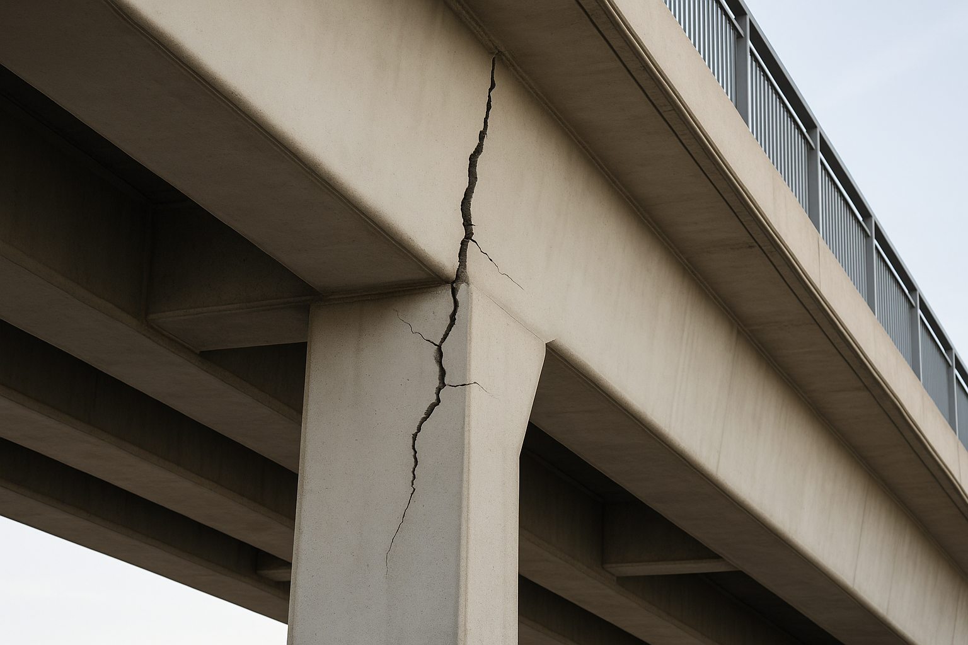
Research Status and Topics
Bridge monitoring data sources
Bridge health monitoring methods
Statistic analysis
Traditional machine learning
Deep learning
Unsupervised Bridge Anomaly Detection under Environmental Variability Using GAN-Enhanced Adaptive Affinity Propagation
Visual data
Environmental impact on data
Problem addressed: the challenges posed by environmental changes
Key focus: distinguishing environmental impacts from structural damage
Emphasis: improving model robustness
Numerical data
Notes:
Research status → research topic (Enhancing Structural Monitoring in Civil Engineering through Machine Learning and Statistical Techniques) → 3 key points (Problem addressed, Key focus, Emphasis)

Slide 4
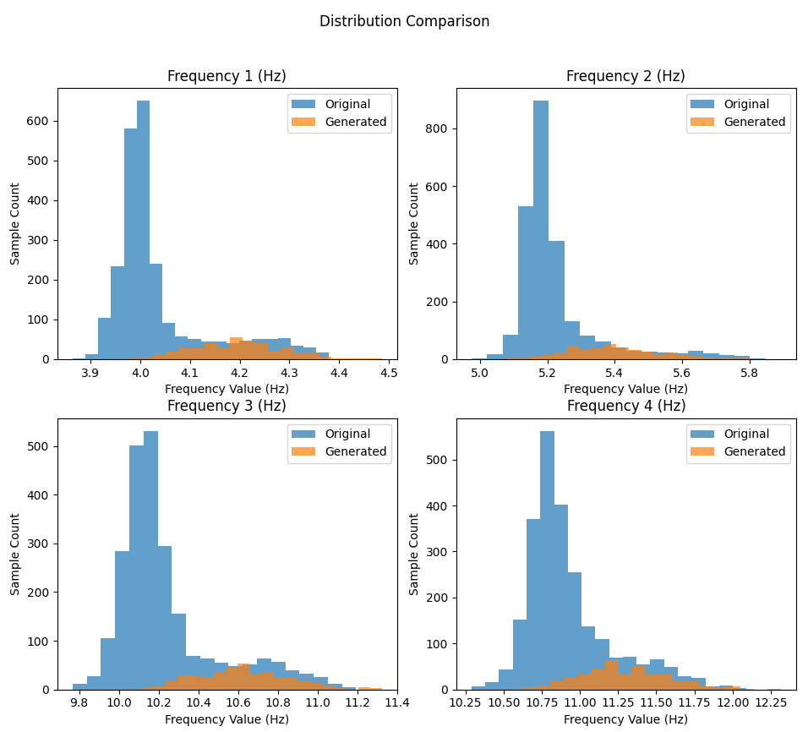
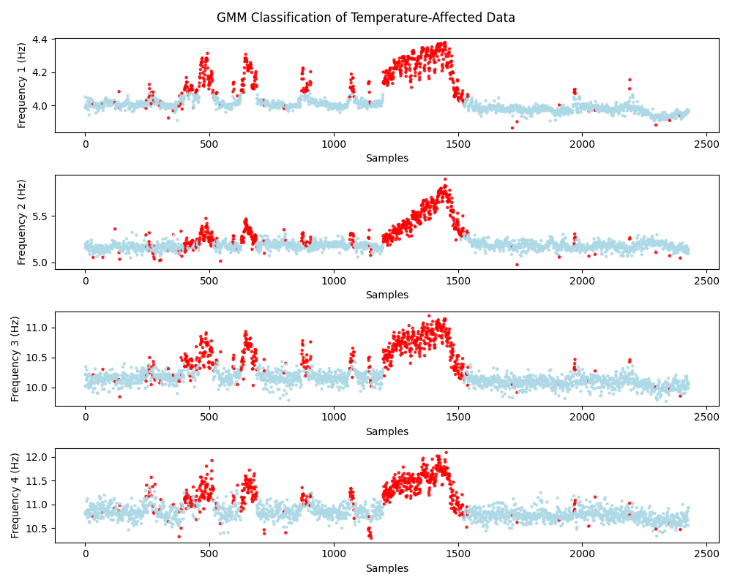
Methodology —— Part 1：Data extraction and enhancement
Step 1: Extracting temperature-affected modal frequency samples using Gaussian mixture model
Step 2: Enhancement of extracted data using Generative Adversarial Networks
Notes:
1. A brief explanation of AP clustering leads to the parameter P
2. Cutting from parameter P, a brief explanation of FOA was used.
3. Conclude with a sentence summarizing and highlighting the content and focus of the section (innovative).

Slide 5
Methodology —— Part 2：Adaptive clustering
Preference parameter P
Fruit Fly Optimization
silhouette index
Specific structure of improved affinity propagation clustering
Notes:
1. A brief explanation of AP clustering leads to the parameter P
2. Cutting from parameter P, a brief explanation of FOA was used.
3. Conclude with a sentence summarizing and highlighting the content and focus of the section (innovative).

Slide 6
Methodology —— Part 3: Abnormal score calculation and anomaly monitoring
A dense set
A sparse set
Dense space:
Sparse space:
High density
Small distance
Low density
Large distance
Mahalanobis-squared distance (MSD)
Local density of data
Anomaly score
Statistic analysis
Threshold
Notes:
1. Briefly describe the principle of the DAD method.
Anomaly points make dense sets sparse
2. describe the method of calculating anomaly scores and the threshold.

Slide 7
Methodology —— How to separate structural damage from environmental variability
Health monitoring process:
While the health data includes environmental effects, the GANs further learn the effect of temperature on the data to improve the robustness of the subsequent clustering, and the clustering results are used to subsequently calculate the anomaly scores.
Vibration data input
Since environment factors have been partially absorbed by the clustering results, the remaining bias is more reflective of structural damage.
GMM extracts data affected by temperature
GANs for data enhancement
FOA optimizes clustering parameter
IAP clustering
Compute anomaly scores
of training data
Compute anomaly scores
of testing data
IMPACT: By introducing FOA to automatically optimize the preference parameter P of the IAP clustering algorithm, the algorithm's self-adaptive ability and global optimization ability are enhanced, which improves the performance of the method in practical applications.
Threshold estimation
Determination of damaged/undamaged states

Slide 8
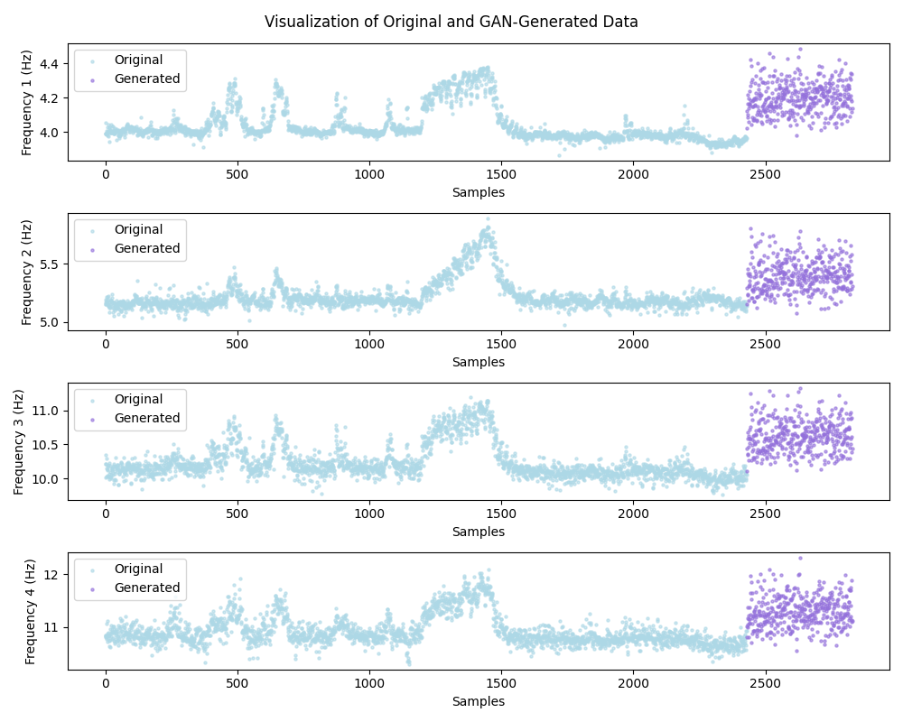
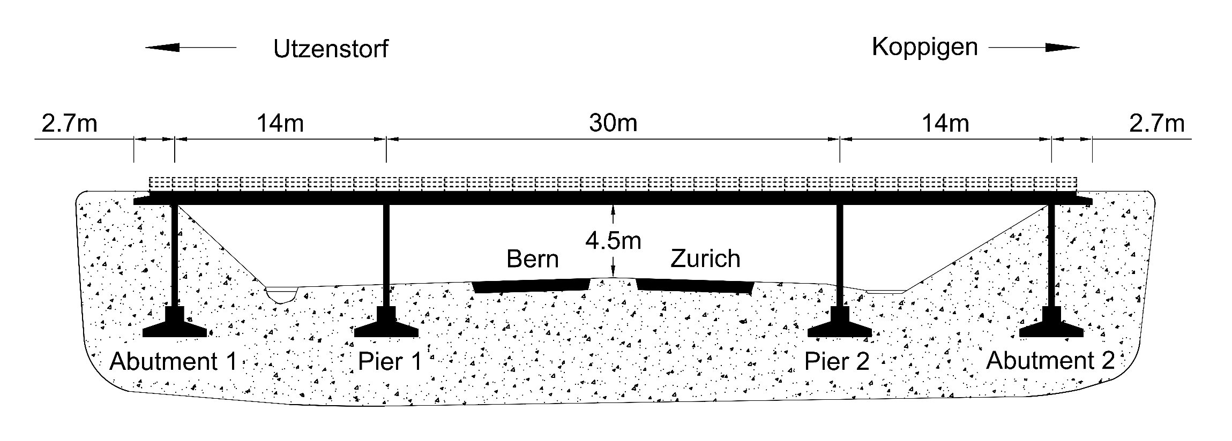
Application and Achievement —— Part 1: Data enhancement results
Case Overview – Z24 Bridge
Enhancement of temperature-affected data using generative adversarial networks yielded 400 enhanced data.
The concrete box-girder bridge (Z24 Bridge)
Data Description
Data size:
(3932 (original)+400 (enhanced)) ✖ 4 (modal frequencies)
Training set 2429 (70% healthy data)+ 400 (enhanced data)
Testing set 1041 (30% healthy data)+ 462 (abnormal data)
Data set segmentation:

Slide 9
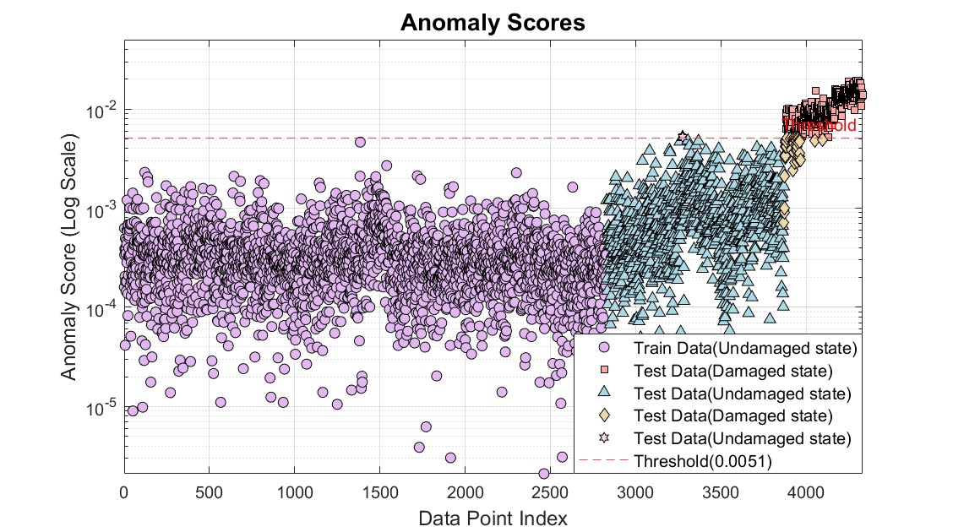
Application and Achievement —— Part 2: Application results
Plot of anomaly detection results using GAN-FOA-IAP for Z24 bridge
Performance comparison of GAN-FOA-IAP with other methods at Z24 bridge
Methods Indicators | GAN-FOA-IAP | FOA-AP | FOA-IAP | GAN-FOA-AP
False alarm | 1 | 3 | 7 | 1
Leakage | 43 | 65 | 42 | 49
Accuracy | 0.9707 | 0.9548 | 0.9674 | 0.9667
Recall | 0.9069 | 0.8593 | 0.9091 | 0.8939
Precision | 0.9976 | 0.9925 | 0.9836 | 0.9976
F1 Score | 0.9501 | 0.9211 | 0.9449 | 0.9429
Balanced Acc | 0.9530 | 0.9282 | 0.9232 | 0.9465
Low FP and FN
Good robustness

Slide 10
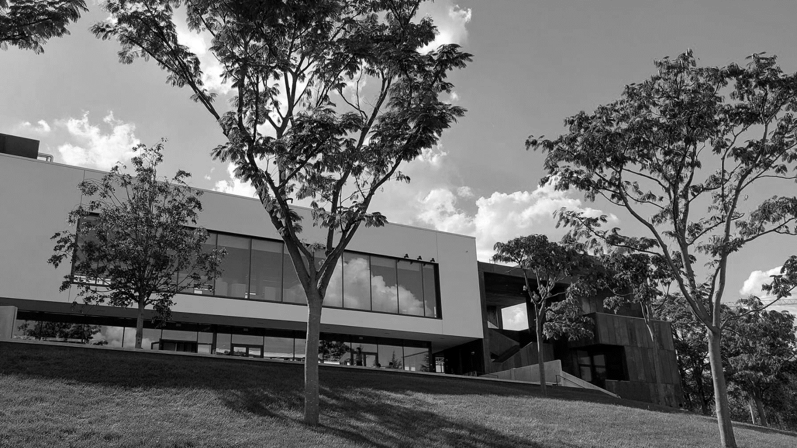
Thanks for your attention!
Wen Gao
Supervisor: Prof. Alireza Entezami
Email: wen.gao@polimi.it

