Slide 1
Dataset Optimisation for Enhanced Automated Sewer Damage Detection
Kamil Altinay, Zehao Ye, Dr. Jelena Ninic
University of Birmingham
Notes:
Hello everyone, my name is Kamil Altinay from the University of Birmingham, and my group mate Zehao is also here with me. Together with our supervisor, Dr. Jelena Ninić, we focus on applying AI and machine learning techniques to civil engineering problems.
Today, I will present one of our recent projects titled

Slide 2
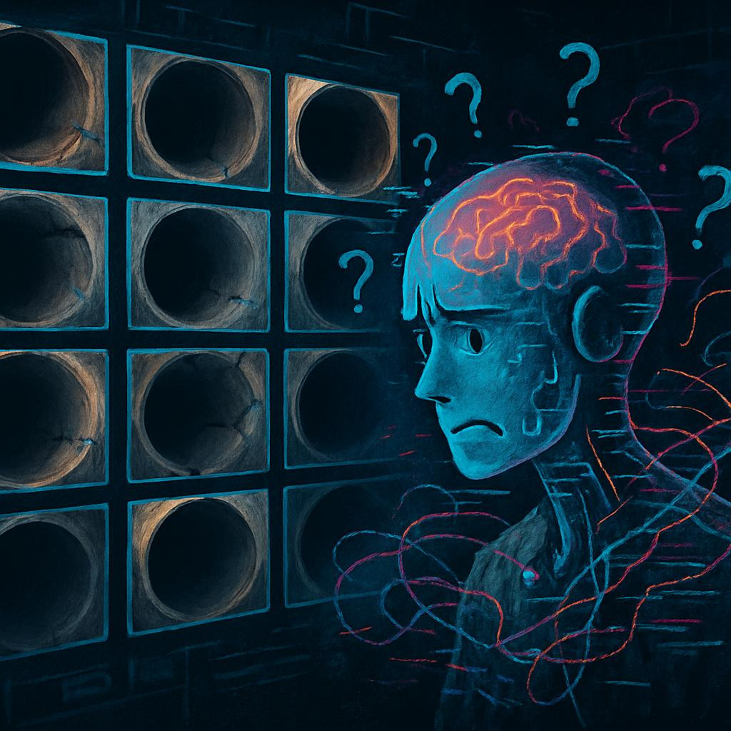
Content
Introduction
Dataset
Methodology
Active learning
Clip-IQA
Reliability Checks
Results
Conclusion
Notes:
First, I’ll introduce the problem and the dataset we worked on, including why it needed optimization. Then, I’ll explain our approach to optimizing it, and finally, I’ll present the results and our conclusions.

Slide 3
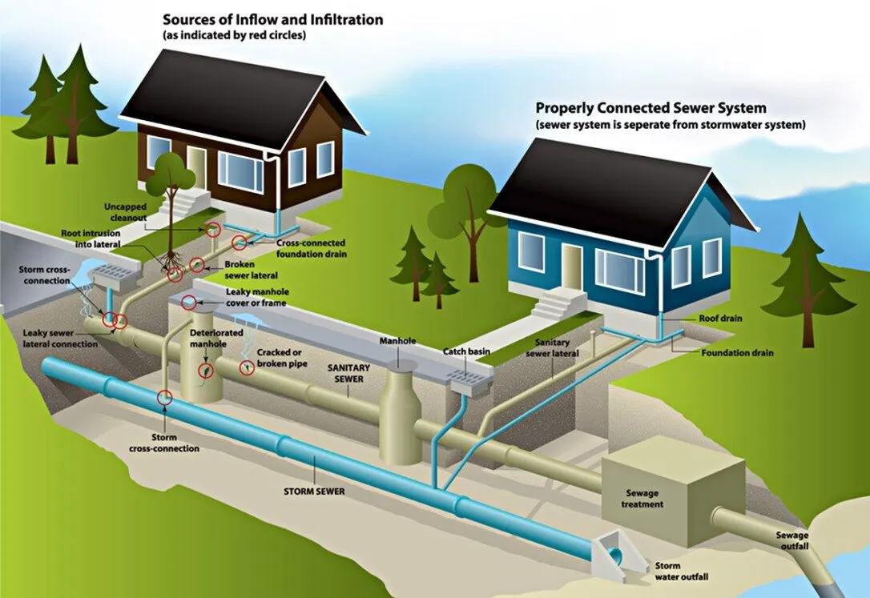
Introduction
Sewage systems are one of the most expensive infrastructures to maintain.
In U.S. $3 billion to replace nearly 7,500 kilometres.
EU loses 24% of its water consumption due to pipeline leakage.
Notes:
The maintenance of sewer systems is crucial for urban infrastructure sustainability, and it represents one of the most expensive infrastructure sectors. Not only is the construction costly, but ongoing maintenance, repair, and damage detection also require significant investment. For example, in 2019, U.S. utilities spent over $3 billion to replace nearly 7,500 kilometers of deteriorating pipelines. Similarly, the EU loses 24% of its water consumption due to pipeline leakage.

Slide 4
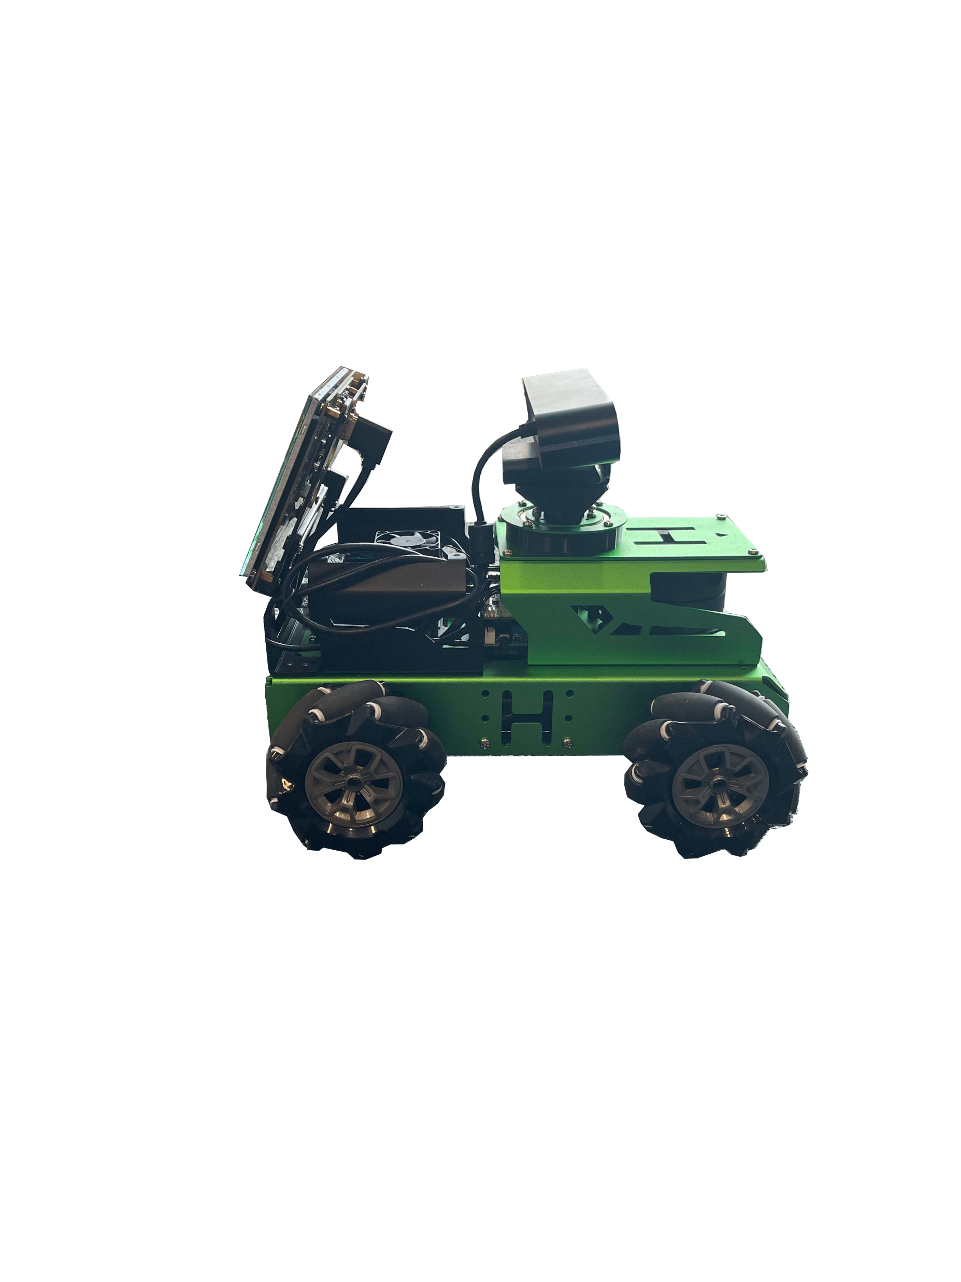
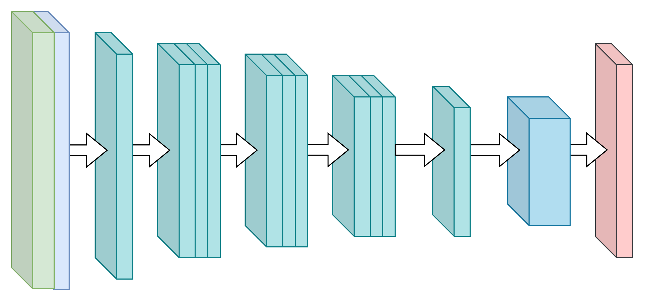
Inspection
Manually inspected by licensed professionals.
Automated systems analyse quicker and more accurately.
Machine learning and computer vision methods offer transformative potential.
Notes:
Traditional sewer inspections face significant challenges. Since most pipelines are buried underground and too narrow for human access, maintenance companies use inspection robots controlled by trained operators to record video footage inside the pipes. These recordings are then manually reviewed by licensed professionals. This process is time-consuming, expensive, and susceptible to human error, which can delay the detection of critical defects.
Automated systems using machine learning and computer vision offer a promising alternative. They can analyze vast amounts of data quickly and more reliably than human inspectors. However, their adoption is limited by the scarcity of high-quality datasets.

Slide 5
Sewer-ML Dataset
The Sewer-ML dataset is a multi-label image dataset 75,618 CCTV inspection from three Danish water utility companies.
Dataset contains more than 1.3 million images.
Sewer-ML dataset (Haurum & Moeslund, CVPR 2021)
Notes:
One of the most significant and currently only publicly available datasets for sewer damage detection is Sewer-ML. It’s a large-scale, multi-label image dataset designed for defect classification, containing over 75,000 CCTV inspection videos collected from three Danish water utility companies. The dataset includes over 1.3 million images, representing a wide range of real-world sewer conditions—such as varying pipe materials, lighting conditions, and defect severities.
[Point to images] On the right, you can see some sample frames from the dataset.
The training split includes over 1 million images. And almost half of the images are labelled as Non-defect.
Training
552,820
487,309
1,040,129

Slide 6
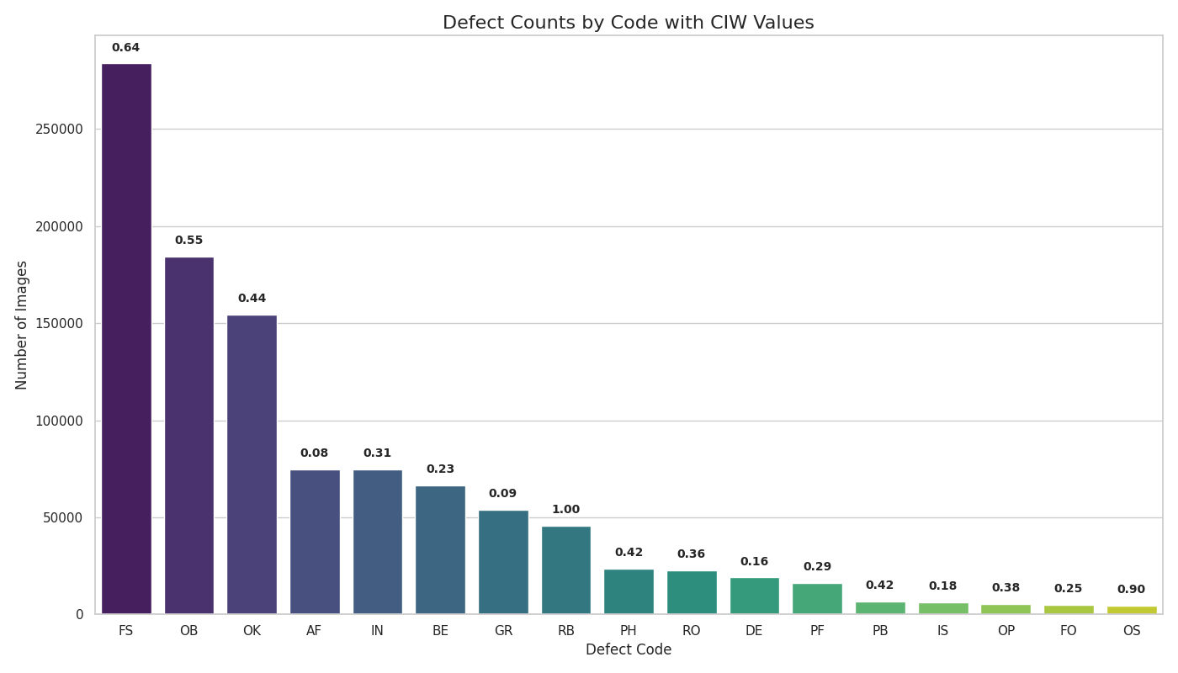
Labels
Dataset includes 17 classes
Multiple classes per image
Imbalanced class distribution
Code | Description
RB | Cracks, breaks, and collapses
OB | Surface damage
PF | Production error
DE | Deformation
FS | Displaced joint
IS | Intruding sealing material
RO | Roots
IN | Infiltration
AF | Settled deposits
BE | Attached deposits
FO | Obstacle
GR | Branch pipe
PH | Chiselled connection
PB | Drilled connection
OS | Lateral reinstatement cuts
OP | Connection with transition profile
OK | Connection with construction changes
Notes:
Sewer-ML includes 17 distinct defect classes, categorized into:
Each image can be labeled with multiple defect types
One challenge is the class imbalance—some defects occur much more frequently than others, which affects model training.
[Point to chart] At the top of the images, you can see the importance weights assigned to each class. These are based on a report by the Danish Water and Wastewater Association, reflecting real-world priorities for damage detection.

Slide 7
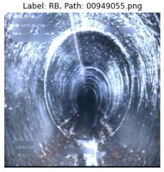
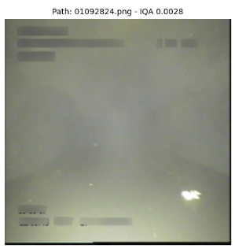
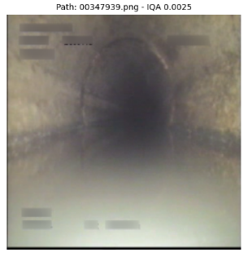
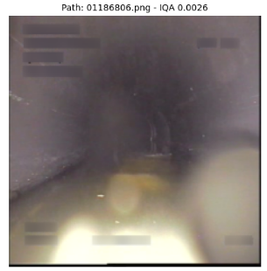
Why Optimisation Is Needed
Insufficient visual quality :
Blurry, poorly lit, or obscured by debris
Impossible to accurately identify defects.
Mislabelling: defects are either incorrectly annotated or missing entirely
Takes days to train
Notes:
Although Sewer-ML is a valuable dataset, it has several limitations. Many images are of low visual quality—they may be blurry, poorly lit, or obstructed by debris—making defect identification difficult or impossible.
Additionally, there are annotation errors, including incorrect or missing labels. These issues can mislead machine learning models during training, leading to poor performance.
Therefore, optimizing the dataset through cleaning, filtering, and curation is essential to improve the reliability and effectiveness of automated sewer inspection systems.

Slide 8
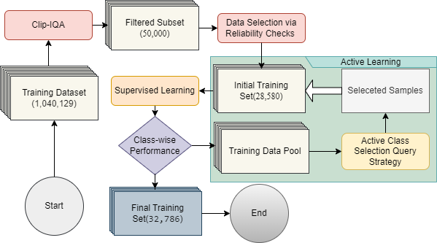
Methodology
Initial Dataset
Clip-IQA
Reliability Checks
Active learning training
Notes:
To reduce the dataset size while maintaining model performance, we developed an active learning-based approach. We began by filtering out visually low-quality images, followed by identifying and removing mislabeled samples. After this refinement, we applied an active learning strategy to selectively reintroduce samples that could help recover or even enhance model performance — reaching comparable results to a model trained on the full dataset.

Slide 9
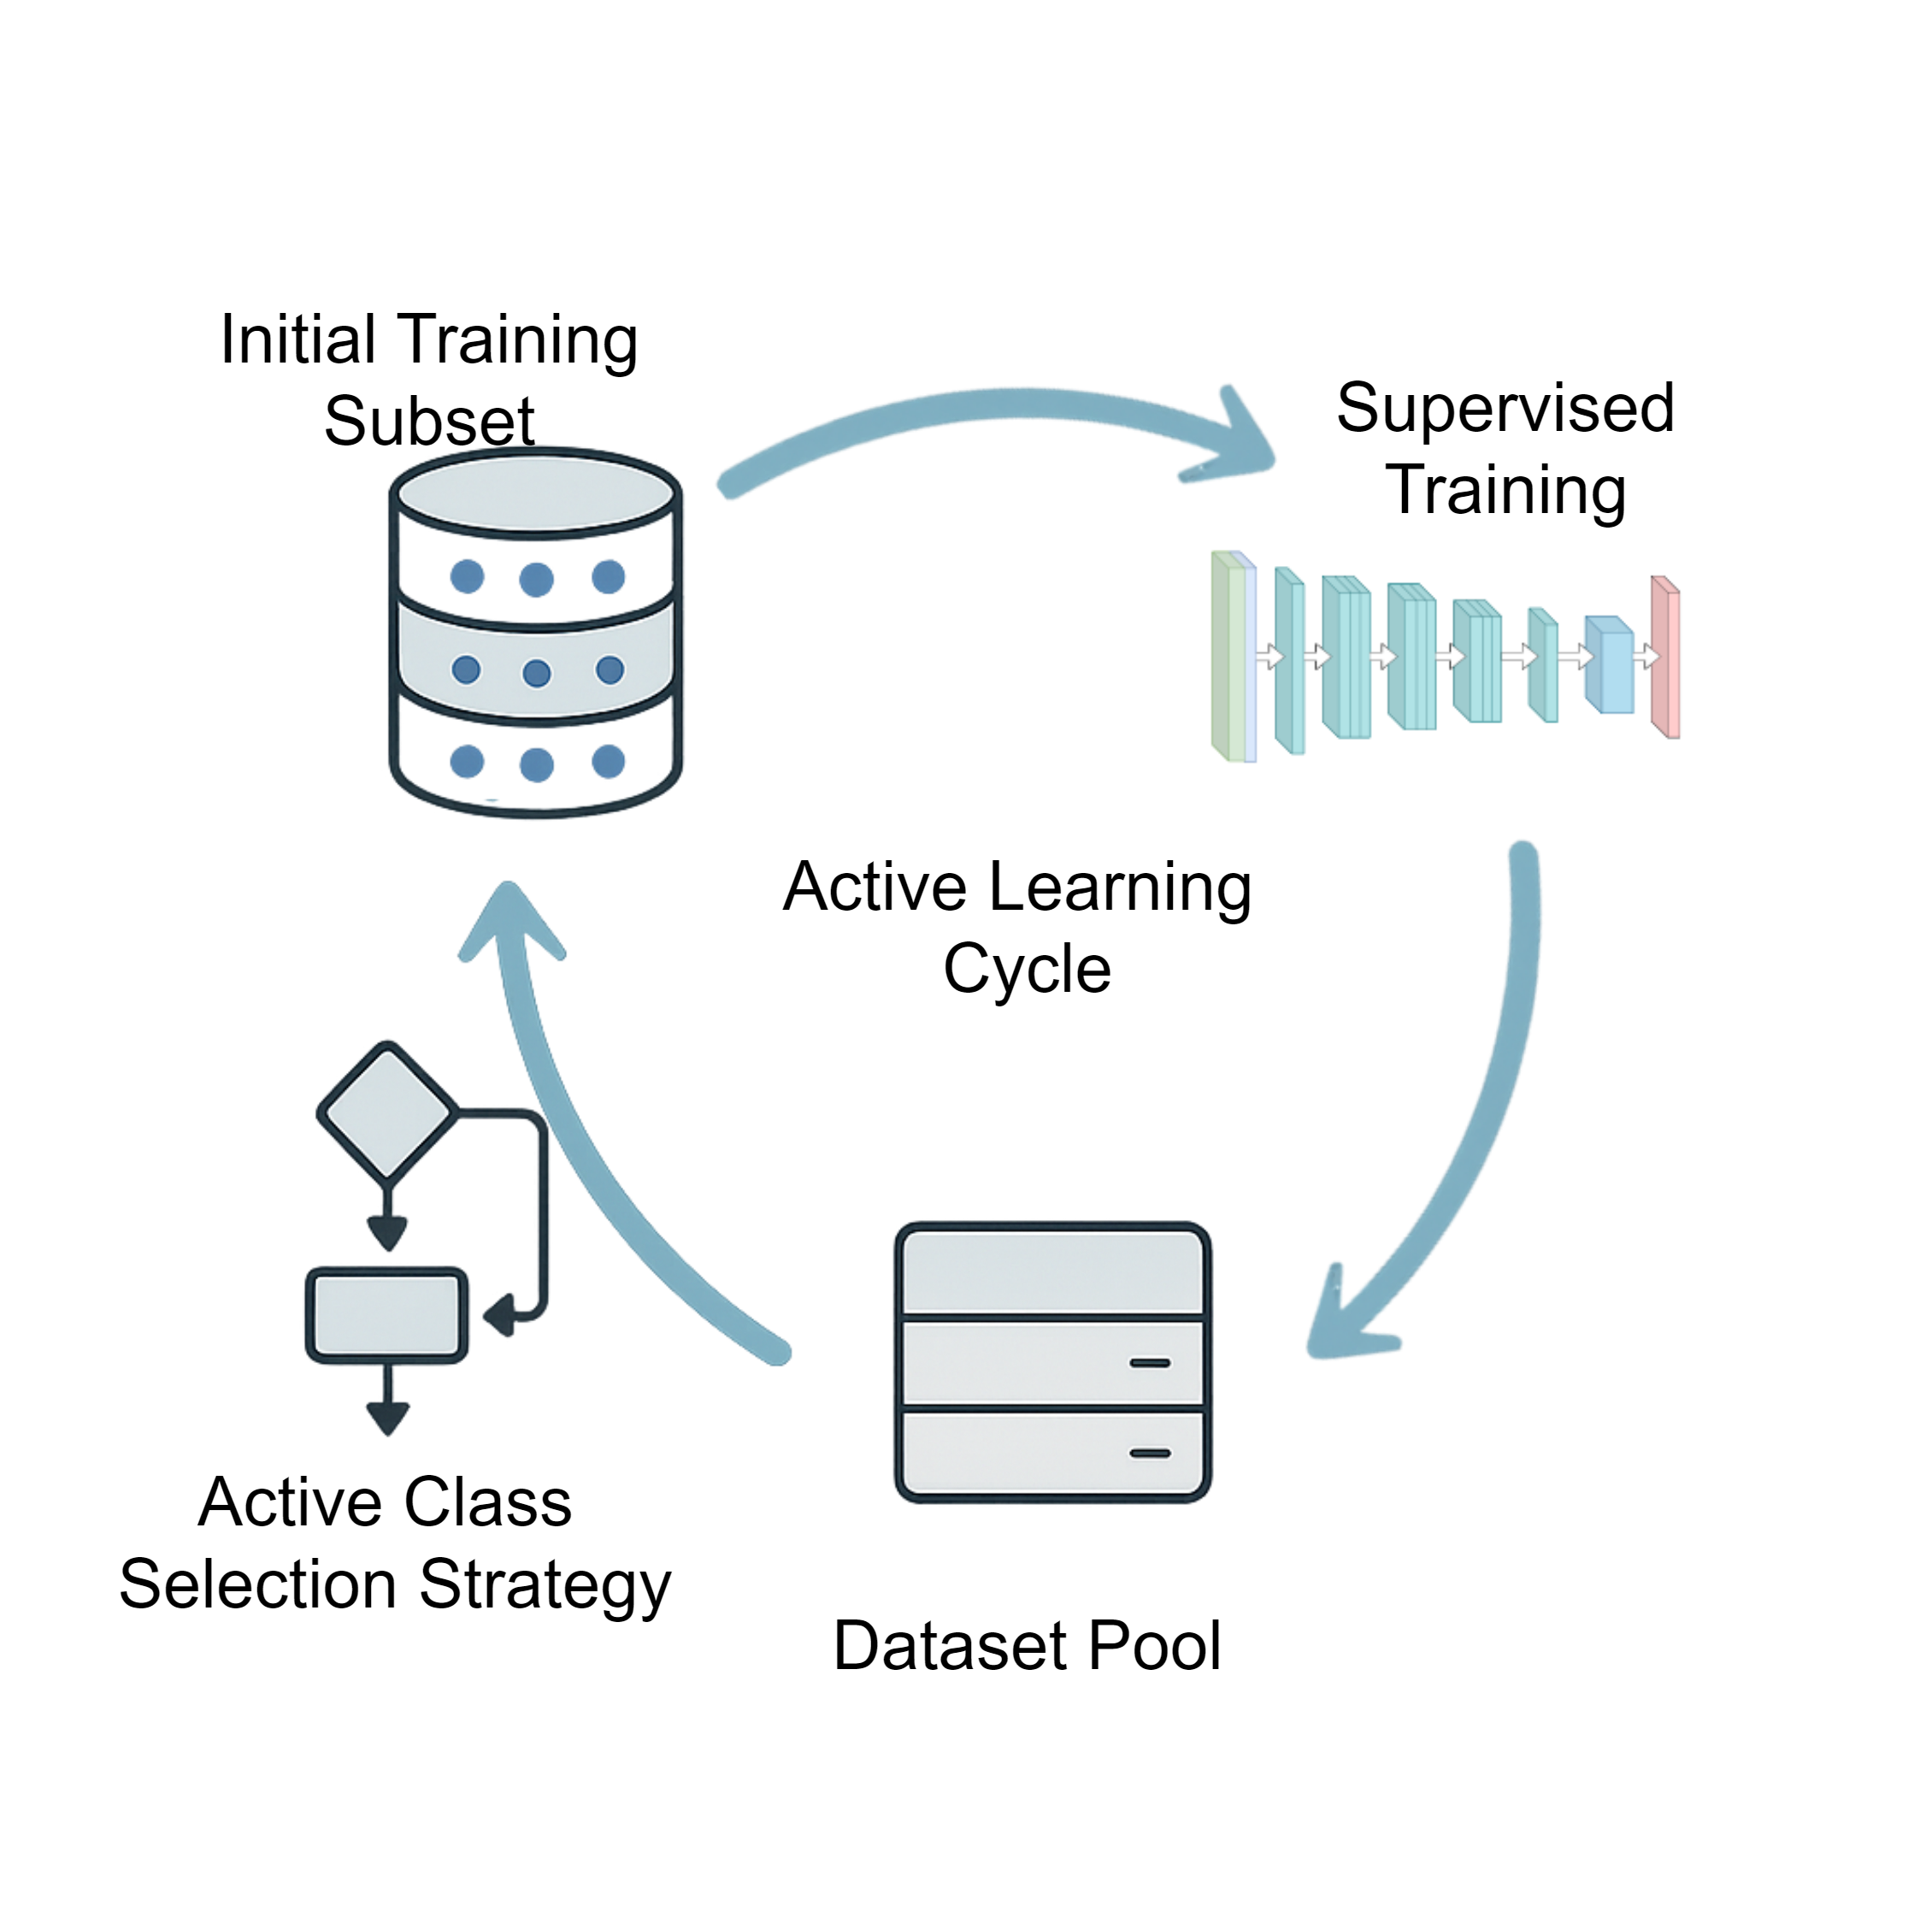
Active learning
Improve model performance by selectively choosing the most informative data samples.
Active class selection query strategy addresses performance disparities between classes.
Iteratively augments the training set.
Notes:
Active learning is a machine learning strategy where the model selects the most informative data samples to train in next iteration. Active learning enables the model to iteratively expand its training set with high-impact samples.
In our case, we used the F2CIW to guide this selection. We chose F2 because it emphasizes recall, which is critical in safety-focused tasks like sewer inspection where missing a defect is more dangerous than a false alarm.

Slide 10
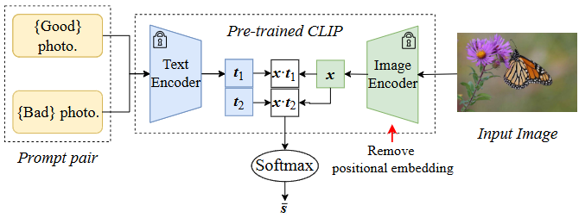
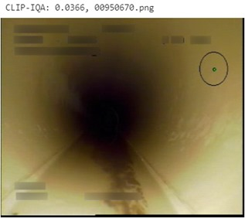
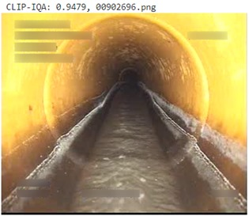
High-quality Data Filter
Image Quality Assessment (IQA) evaluates clarity, sharpness, and usability.
CLIP for image aesthetics (Wang et al., AAAI 2023)
CLIP-IQA uses two text prompts:
“Good photo”: sharp, balanced lighting, less noisy.
“Bad photo”: blurry, noisy, or poor exposure.
Notes:
To build our initial high-quality training set, we applied Image Quality Assessment (IQA). We used CLIP-IQA, a vision-language model that scores each image based on how closely it resembles a “good photo” — defined as sharp, well-lit, and usable for defect detection.
The model uses two reference prompts:
“Good photo” — clear, balanced lighting, minimal noise
“Bad photo” — blurry, noisy, or over/underexposed
CLIP projects the image into a joint embedding space and calculates a similarity score to the “good photo” prompt.

Slide 11
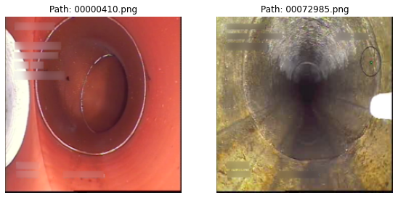
Reliability Checks
Absolute Error Filtering was applied using a pre-trained model that trained on the full dataset
Label Consistency Verification has done comparing with the ground truth
Notes:
Next, we refined the dataset by removing mislabeled or ambiguous samples using two techniques:
Absolute Error Filtering: we used a pre-trained model to compare predicted label probabilities against the ground truth.
Label Consistency Verification: if the model’s top predicted class didn’t match any ground truth label, the sample was flagged as potentially mislabeled. This step reduces noise and enhances training reliability. the branch pipe (GR) and a displaced joint

Slide 12
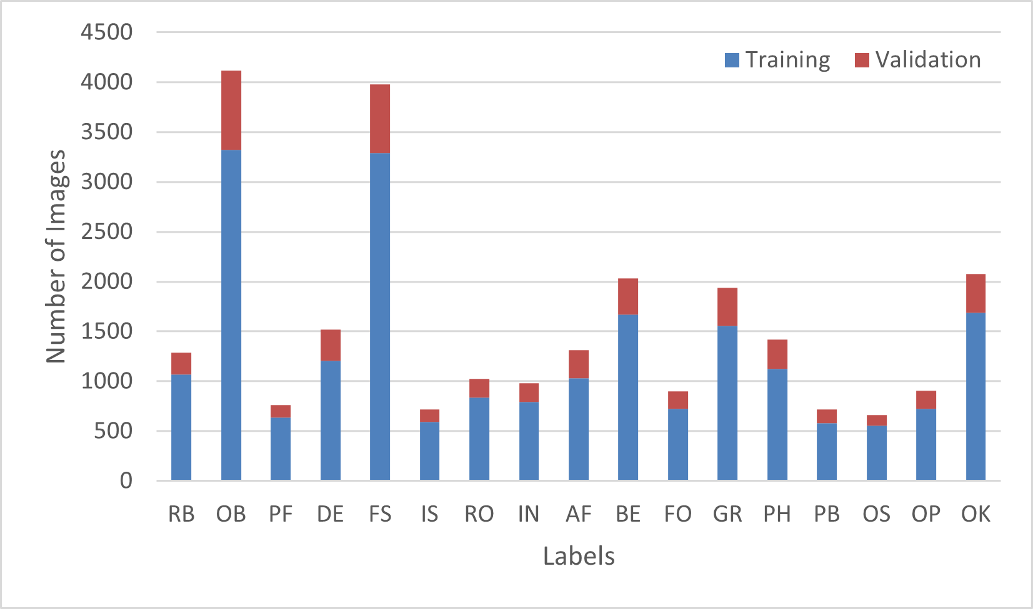
Subset
CLIP- IQA with 0.4 threshold reduce less than 50,000 images.
Reliability checks with 5% error rate reduce to less than 30,000 images.
Retaining just 3.2% of the original training data.
Notes:
To determine the optimal thresholds for filtering, we performed a grid search across different values. We selected a 0.4 threshold for CLIP-IQA and a 5% threshold for error filtering.
After applying these filters:from over 1 million images to fewer than 30,000 high-quality, reliable samples just 3.2% of the original dataset.
We used the same filtering thresholds on the validation split to ensure evaluation consistency. We also kept this validation split fixed for all experiments to allow a fair comparison of model performance across different dataset versions.
However, because many images were removed, some defect classes became severely underrepresented. This made it harder for the model to generalize on certain labels — highlighting the importance of our active learning strategy to selectively add informative samples back into the training set.

Slide 13
Results
Comparable or superior performance to the baseline model
Per epoch takes 15–16 hours on full dataset
Only takes 20 minutes on subset.
62
62.5
59
Notes:
Models trained on our carefully curated subsets demonstrated performance that was comparable to, or even better. The baseline model trained on the unfiltered dataset serves as our reference. We trained two additional ResNet101 variants: One on a reduced subset of 28,580. Another using the same reduced subset, further refined through active learning.
While training the baseline model takes 15–16 hours per epoch, the curated subset model trains in just 20 minutes per epoch on the same GPU — saving over 90% training time.
As shown in the graph, we achieved similar accuracy and even surpassed the baseline in the F₂CIW score.

Slide 14
Performance Across Labels
After Active Learning outperforms training with full data set or with small subset for most classes (13/18)
Notes:
Here, we compare the F₂ scores across all 18 classes — including 17 defect types and one non-defect class. After applying active learning, our model outperforms the baseline and the small filtered subset for 13 out of 18 classes. This result supports the core hypothesis of our study: That high-quality, targeted data — combined with intelligent selection strategies — can outperform models trained on larger but noisier datasets.
Particularly for underrepresented or challenging classes like PF, IS, and OS, active learning showed significant improvements — effectively addressing class imbalance and label noise.

Slide 15
Active learning Iteration
Targeted underrepresented classes score increases
Strategic data augmentation enhances model accuracy
Notes:
This chart shows how the training set grew from 28,580 to 38,847 samples across 8 active learning iterations. The bar chart represents the number of samples added in each round, while the line graph tracks the improvement in F₂ score over time. As we added informative samples, especially from rare classes like OS and PH, the model performance steadily improved. This demonstrates that targeted augmentation — even with modest increases in data volume — can boost performance, confirming the data efficiency of our approach.

Slide 16
Conclusion
Our method optimizes existing datasets to retain only high-quality, diagnostically viable samples
Training a model on just less than 3.2% of the original data achieved a 3% higher F₂CIW score 95% reduction in training time per epoch.
Validate the “less is more” hypothesis, demonstrating that strategic data refinement can enhance model robustness while minimizing computational costs.
Dependency on empirically set thresholds and a pre-trained model introduces potential biases.
Future work will explore automated data selection using reinforcement learning.
Notes:
In conclusion, our work challenges the “bigger is better” mindset in machine learning.
Instead of relying on large datasets, our method focuses on quality over quantity — retaining only high-quality, diagnostically viable samples.
Training with just 3.2% of the original data achieved a 3% higher F₂CIW score, with a 90% reduction in training time per epoch.
This supports the idea that “less is more”, especially in domains where data collection and annotation are expensive.
Of course, our method depends on empirically chosen thresholds and a pre-trained model, which may introduce bias. As future work, we aim to explore automated data selection using reinforcement learning to further refine the process.

Slide 17
Thank you
Looking forward to questions and discussion!
or contact me at:
j.ninic@bham.ac.uk
www.jelena-ninic.org
Per Ardua Ad Alta

