Slide 1
Early Alzheimer’s Detection in Norwegian via NLP and Transformer Models
Presented By : Nourin Mohammad Haider Ali Biswas
Co-Authors : Mina Farmanbar, Arezo Shakeri , Tahoura Morovati,

Slide 2
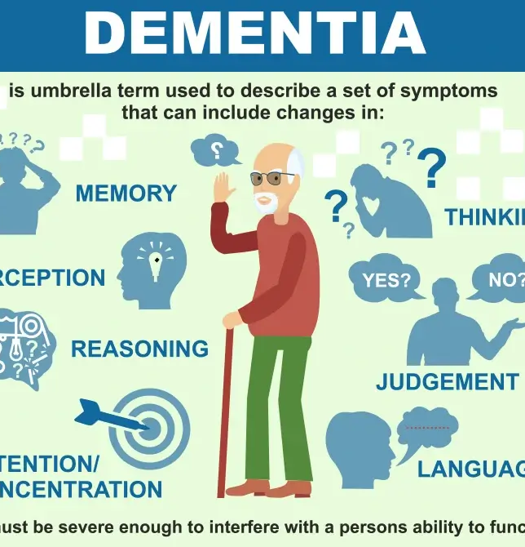
INTRODUCTION
Dementia (esp. Alzheimer’s) affects 57M globally (2019); projected 152M by 2050.
In Norway, 101K+ cases — 29% higher than previous estimates.
Language impairment is an early AD marker → speech-based biomarkers are promising for early detection.
Most research uses English-only datasets (e.g. Pitt, ADReSS), limiting global applicability.
We present a manually translated Norwegian DementiaBank dataset to enable NLP-based early AD detection in low-resource languages.

Slide 3
CHALLENGES IN TRADITIONAL ALZHEIMER'S DIAGNOSIS AND THE ROLE OF AI
Neuroimaging (MRI & PET) is widely used but often limited by noise and complexity.
Clinical tests can be expensive and difficult to access, especially in low-resource settings.
AI-powered methods (e.g., speech analysis, data simplification) are emerging as promising, scalable alternatives.
Blood-based biomarkers and novel cognitive assessments offer less invasive diagnostic possibilities.

Slide 4
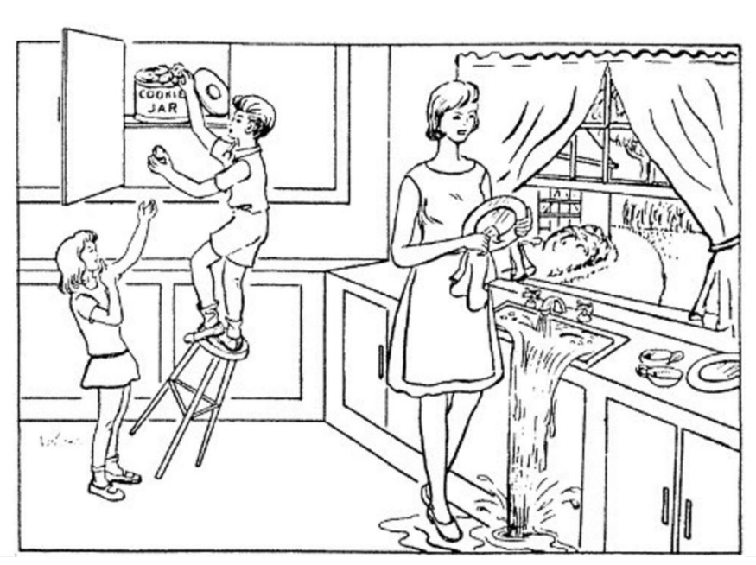
NEUROPSYCHOLOGICAL EVALUATIONS
There are different tasks employed as part of a language assessment.
They evaluate different areas of brain function and cognitive processes, including memory, attention, problem-solving, language, and executive functioning.
The most common test:
Picture description
Verbal and Semantic Fluency Tests
CHALLENGE AND LIMITATION:
MOST RESEARCH USES ENGLISH-ONLY DATASETS (E.G. PITT, ADRESS FROM DEMENTIABANK DATASET ), LIMITING GLOBAL APPLICABILITY.

Slide 5
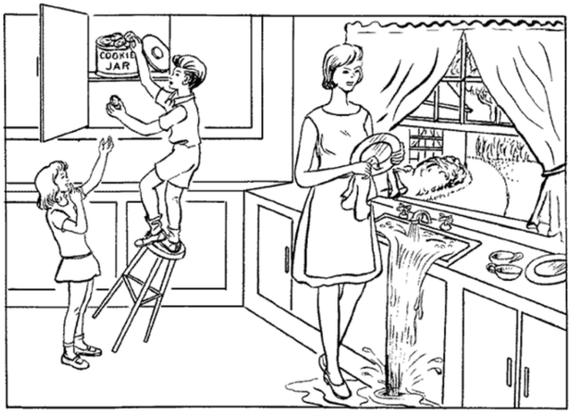
DATASET AND TRANSLATION
Speech transcripts from ADReSS Challenge (Cookie Theft description)
Natural language from AD patients & healthy controls
Manually translated to Norwegian (Bokmål) by native speaker
Preserved fillers, repetitions, syntax errors → key early AD markers

Slide 6
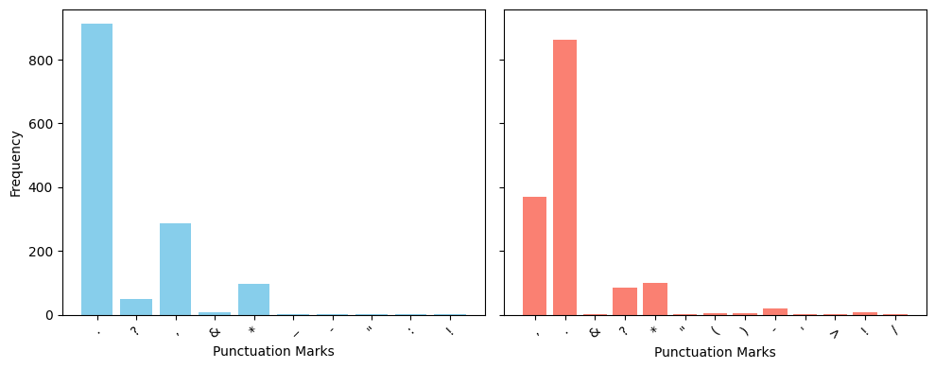
PREPROCESSING
Lowercased text, retained most punctuation (diagnostic value)
Removed common symbols (e.g. *, &); kept group-specific punctuation
Stop words retained → capture repetitive patterns in AD speech

Slide 7
METHADOLOGY
Feature Representation: Employed sparse text representations using TF-IDF and CountVectorizer to capture word importance and frequency.
Transformer Models: Used multilingual pre-trained BERT models (mBERT, NorBERT, Nb-BERT) fine-tuned for Norwegian to classify speech transcripts directly.
Baseline ML Models: Trained six classifiers (SVM, RF, NB, KNN, GBT, LR) with grid search and cross-validation, and evaluated them using macro-averaged accuracy, precision, recall, and F1-score.

Slide 8
RESULTS : TF-IDF / CountVect with ML

Slide 9
RESULTS : NORWEGIAN TRANSFORMER MODEL

Slide 10
CONCLUSION AND FUTURE WORK
Language-based features from speech and transcripts can effectively support early AD detection in Norwegian, with ML models—especially those using advanced language representations—offering scalable, cost-efficient diagnostic tools.
Future directions include integrating acoustic features, developing a native Norwegian AD corpus, ensuring fair data collection, and exploring hybrid human-machine translation to enhance accuracy and inclusivity.

Slide 11
THANK YOU !

