Slide 1
Structural Integrity of Flange Connection in Onshore Wind Turbine Towers
OES2025 Presentation
University of Stavanger
Elin Herredsvela, Stig Roar Lyse Rødne, Sudath C. Siriwardane, Fredrik Bjørheim

Slide 2
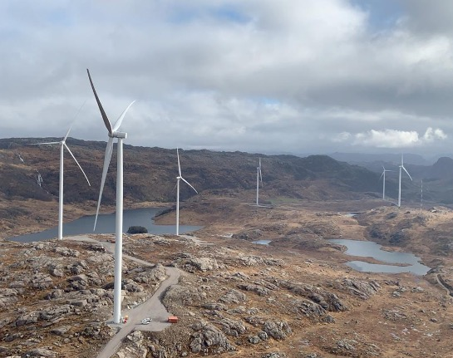
Introduction
Introduction to the study
Real-world bolt failure case
Objectives and methodology overview
Notes:
🎤 Speaker: Elin
⏱ Estimated Time: <1 min
📽️ Slide Objective: Welcome, introduce topic and presenters. Show title screen.
🗣 Script:
Good afternoon everyone, and thank you for attending.
This presentation addresses a real-world structural integrity issue in onshore wind turbines – specifically, premature failure of high-strength bolts in flange connections.
My name is Elin H, and I’m presenting alongside Stig Roar R

Slide 3
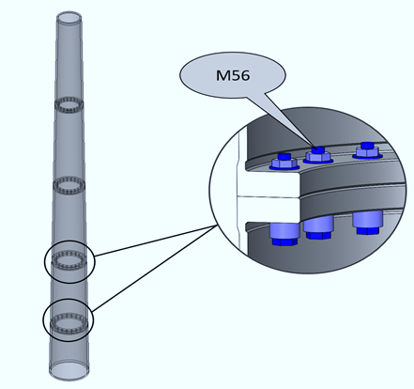
Real-World Bolt Failure Case Study
Scandinavian wind farm incident
Premature M56 bolt failures
Need for in-depth failure analysis
Notes:
🎤 Speaker: Stig
⏱ Estimated Time: 1 min
📽️ Slide Objective: Present real failure case, context for study.
🗣 Script:
The project was initiated following a failure at a wind farm in Scandinavia.
Bolts failed unexpectedly — well before end-of-life — causing operational disruption and raising safety concerns.
These were M56, grade 10.9 bolts, which, made by specification, should have had adequate durability.
We aimed to understand why this failure occurred, despite compliance with mechanical standards.

Slide 4

Background & Motivation
Personal connection
Wind turbines under complex loads
Bolts critical for structural integrity
Knowledge gap in failure mechanisms
Notes:
🎤 Speaker: Elin
⏱ Estimated Time: 2 min
📽️ Slide Objective: Explain turbine loads, bolt role, literature gap.
🗣 Script:
The first author has a long-standing personal connection to the turbines affected by these failures and began questioning why the bolts were failing. However, existing literature offered few straightforward answers, motivating a more comprehensive investigation.
Wind turbines are exposed to constant mechanical and environmental stresses — wind loads, vibration, temperature variation.
Bolts in flange connections are critical, yet they are often treated as “standard components”.
Literature shows recurring failures of similar bolts, but the causes are poorly understood by the on site personnel and therefor rarely documented.
We saw a clear need for comprehensive investigation — combining metallurgy, mechanics and failure analysis.

Slide 5
Objectives & Research Questions
Identify root causes of bolt failure
Investigate hydrogen embrittlement
Propose industry recommendations
Notes:
🎤 Speaker: Stig
⏱ Estimated Time: <1 min
📽️ Slide Objective: Define scope and investigative goals.
🗣 Script:
Our objectives: Determine the root cause of failure, evaluate if hydrogen embrittlement is involved, and provide evidence through testing — mechanical, chemical, and microstructural.
We approached this using both destructive and microscopic analysis that we will go a bit further into in the following slides.
We will also propose some recommendations for future work regarding the subject.

Slide 6
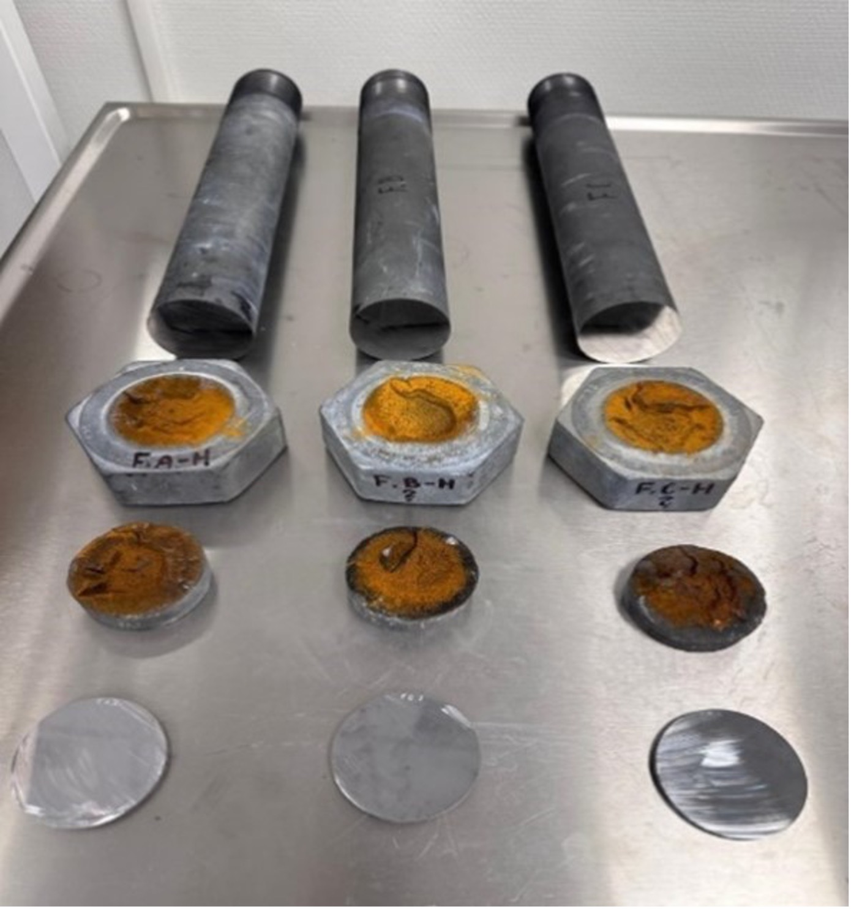
Material & Bolt Specifications
Bolts: M56, grade 10.9, 32CrB4 steel
Service time ~2 years, torqued 1000 Nm
Zinc coating
Notes:
🎤 Speaker: Elin
⏱ Estimated Time: 1 min
📽️ Slide Objective: Introduce material properties, bolt design, and limitation.
🗣 Script:
All three bolts were from the same production batch — M56, class 10.9, made from 32CrB4 steel, known for tempered martensitic microstructure.
They had been torqued to 1000 Nm by two stage bolt tightening (75% - 100%), used for ~2 years in tower-tower flange joints.
A major limitation was that the type of zinc coating used — hot- dip vs. electroplating — was unknown.

Slide 7
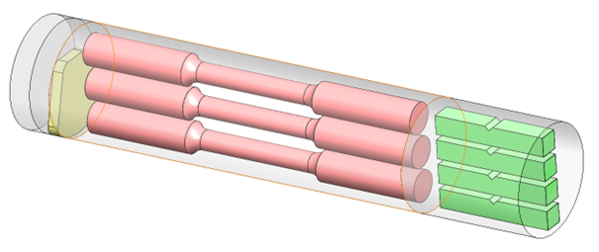
Methodology Overview
Mechanical testing: Tensile, Charpy, Vicker-hardness
Microstructural: SEM, EDS, EBSD
MTEX used for parent austenite phase reconstruction
Notes:
🎤 Speaker: Elin
⏱ Estimated Time: 2 min
📽️ Slide Objective: Overview of mechanical, chemical, and microstructural methods.
🗣 Script:
We used a multi-disciplinary test regime:
- Tensile, Charpy and Vicker-hardness testing were executed to test the mechanical properties and check whether they met minimum values in the relevant ISO standard. ISO 898-1
- SEM was used for checking the fracture surface, starting near the edge and moving towards the centre.
EDS scanning checked chemical composition to compare values against the material certificate.
- EBSD scan and the use of MTEX toolbox for reconstructing parent austenite phase from a measured martensitic phase.

Slide 8
Mechanical Test Results
Yield strength above minimum (940MPa)
Tensile Strength above minimum (1040 Mpa)
Charpy: Results varied but showed ductile behavior
Notes:
🎤 Speaker: Stig
⏱ Estimated Time: 2 min
📽️ Slide Objective: Present tensile, Charpy, hardness data.
🗣 Script:
Tensile tests showed yield and tensile strenght above the requirements in the standard. ISO-898-1 gives 940 Mpa for Yield Strenght and 1040 Mpa for Tensile strenght.
Charpy results varied — Bolt A had the lowest result at -18°C with 40.4 J. Since we did not know if the specimens where from the centre or an edge of the bolt we did not try to find the transition temperature. (Brittle to Ductile)
Vickers hardness: Was higher at the egdes and varied along the test specimen. But still all readings where above the minimum given in the standard, ISO-898-1. 320 HV.

Slide 9
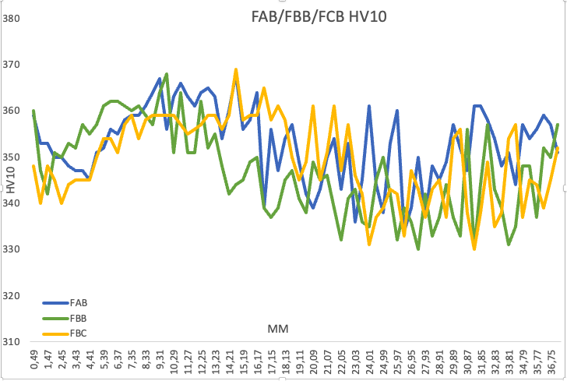
Mechanical Test Results
Vicker-hardness: Also above minimum (320 HV)
Notes:
🎤 Speaker: Stig
⏱ Estimated Time: 2 min
📽️ Slide Objective: Present tensile, Charpy, hardness data.
🗣 Script:
Vickers hardness: Was higher at the egdes and varied along the test specimen. But still all readings where above the minimum given in the standard, ISO-898-1. 320 HV.

Slide 10
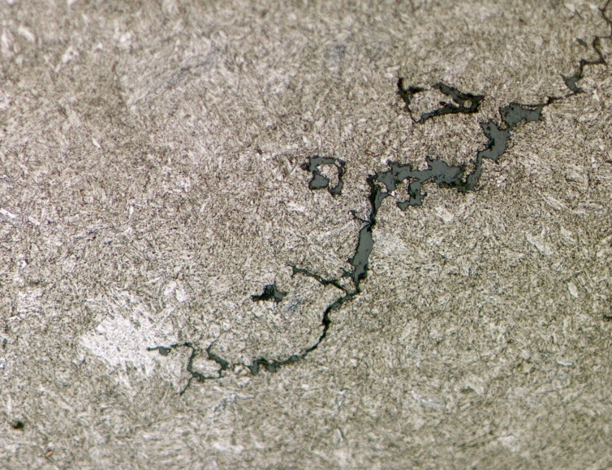
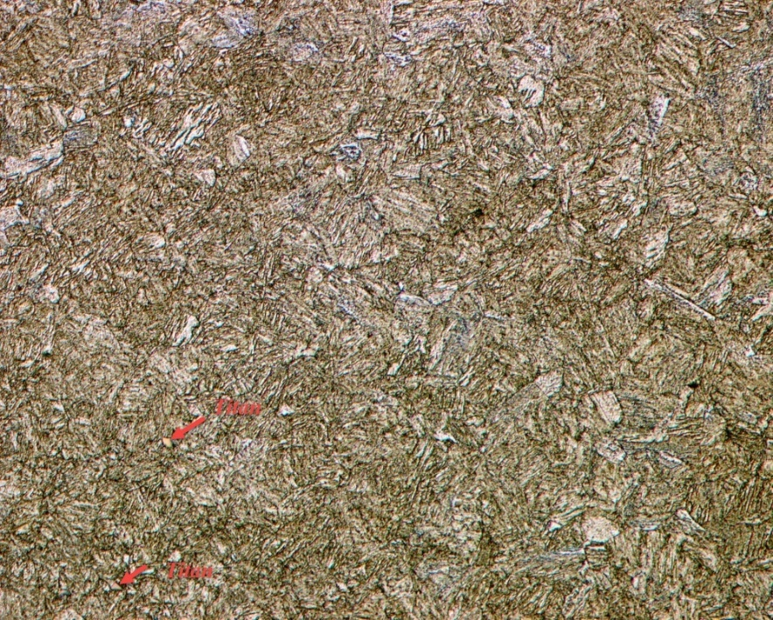
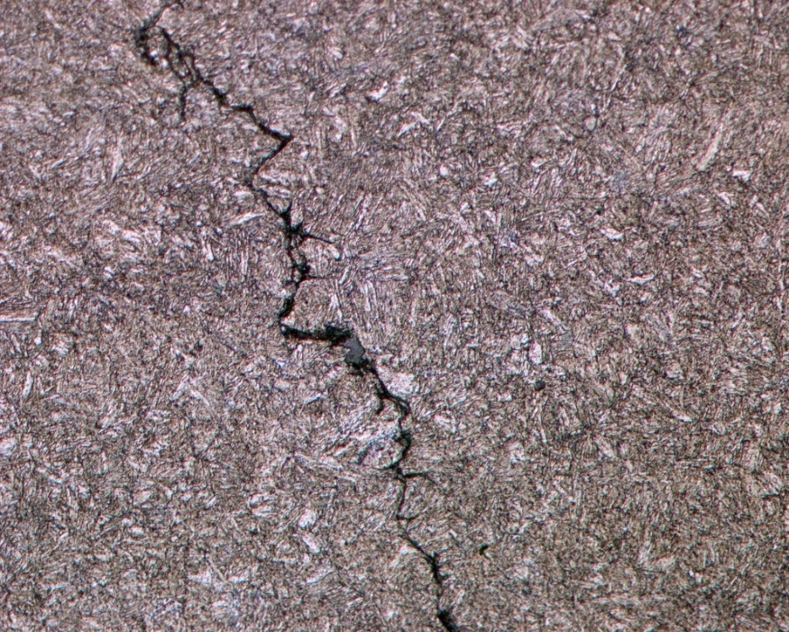
Microstructure & Porosity
Tempered martensite confirmed
Bolt B: highest pore count
Bolt C: largest pore sizes
FAH-2 50X
FBH-2 50X
FCH-1 50X
Notes:
🎤 Speaker: Elin
⏱ Estimated Time: 2 min
📽️ Slide Objective: Show pore distribution and its mechanical significance.
🗣 Script:
Microscopy showed tempered martensite throughout all the samples. We also saw zigzag crack pattern that often is seen ductile materials.
Bolt B had highest pore count and C had the largest pores.
Wether the porosity of our samples caused stress concentrations that could initiate cracks was not considered in our study.

Slide 11
SEM and EDS
Fracture Surface bolt A
Fracture surface bolt B
Fracture surface bolt C
SEM: Intergranular cracking near edges
EDS: Minor deviations, within spec
Notes:
🎤 Speaker: Stig
⏱ Estimated Time: 2 min
📽️ Slide Objective: Discuss crack type, composition, grain size.
🗣 Script:
SEM revealed intergranular cracks near edges. All the three fracture surfaces , near the edges had intergranular cracking. Which is a feature typically connected to hydrogen embrittlement.
EDS results showed minor deviations, but this is expected from the 0.1% uncertainty with the EDS scan.

Slide 12

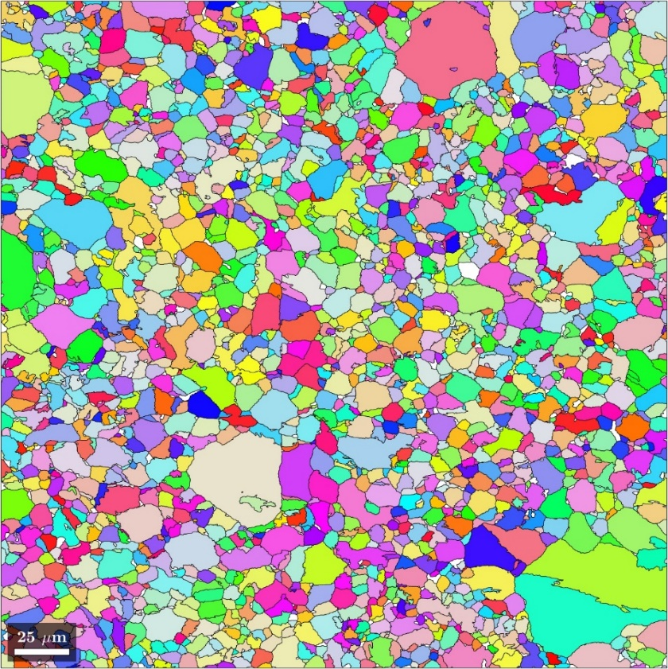
MTEX Findings
EBSD and MTEX: Finer grains at bolt edges
FAB-Edge: Original grain size and orientation
FAB-Edge: Reconstructed Parent Austenite grain size and orientation
Notes:
🎤 Speaker: Stig
⏱ Estimated Time: 2 min
📽️ Slide Objective: Discuss crack type, composition, grain size.
🗣 Script:
With good help a script was put together based on the MTEX toolbox. The simulations was based on the EBSD results and confirmed finer grain sizes at bolt edges and the slightly higher tensile test results from the specimens from the edges.
(Hall – Petch Relation, S_{y} = S_{i} + k_{y}d^{-1/2} ,𝜎y = 𝜎0 + kyd−1/2) Sy = yield strength, d = grain size.

Slide 13
Expert Consultation & Coating Concerns
Expert confirms hydrogen-induced cracking
Hydrogen from galvanization process
Critical risk for high-strength bolts
Notes:
🎤 Speaker: Elin
⏱ Estimated Time: 1.5 min
📽️ Slide Objective: Highlight expert validation, hydrogen insight.
🗣 Script:
In our study we reached out for a consultation with Dr. Angelique Lasseigne, expert in the field to discuss our findings,
She confirmed our findings and ads that hydrogen absorption to the bolts likely occurred during the galvanization process.
Just 1 ppm hydrogen is enough to cause failure in these bolts.

Slide 14
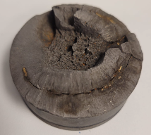
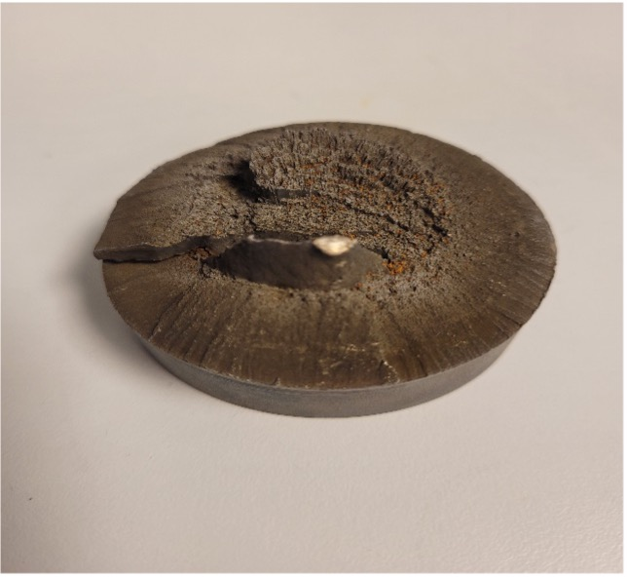
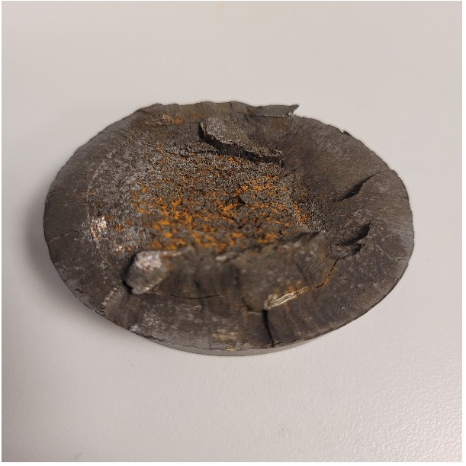
Discussion of Failure Mechanism
Bolt A
Bolt B
Bolt C
Atomic hydrogen weakens the grain boundaries
Crack initiation during tightening
Fracture from edge to center
Notes:
🎤 Speaker: Elin
⏱ Estimated Time: 2 min
📽️ Slide Objective: Synthesize results into failure narrative.
🗣 Script:
We notice how the outer circomference of the bolts have a smooth appearance, that is evidence of macroscopic brittle failure, as we see towards the center of the bolt it gains more and more ductility.
We find ratchet marks perpendicular to the Outer Diagonal surface, these marks gives indication of more than one crack initiated around the OD circumference of the bolt.
- Cracks initiated during tightening, due to the weakened grain boundaries from the galvanization process. Again It only takes 1 ppm of hydrogen to cause this.
- Operational stress propagated these cracks from edge inward.
- Center shows ductile behavior; edges are brittle.

Slide 15
Conclusions
Bolts met mechanical standards; fracture still occurred
Evidence of intergranular cracking consistent with hydrogen embrittlement (HE)
Hydrogen embrittlement not ruled out by hardness tests
Microstructure: tempered martensite with some ductile cracks
SEM: intergranular cracking at edges, mixed brittle/ductile fracture
Charpy tests: ductile surfaces; hydrogen effects may have diminished over time
Overall: complex failure mechanisms; further study required
Notes:
🎤 Speaker: Stig
⏱ Estimated Time: 1.5 min
📽️ Slide Objective: Deliver actionable takeaways.
🗣 Script:
Summary:
In conclusion, we found that the bolts generally met their mechanical specification, including tensile, Charpy impact, and hardness requirements.
However, the presence of intergranular cracking in SEM images suggests that hydrogen embrittlement may have contributed to failure.
Hardness tests did not conclusively rule out hydrogen embrittlement.
The microstructure was predominantly tempered martensite, with occasional evidence of ductile crack growth.
SEM images revealed intergranular cracking starting at the edges, progressing inward with mixed brittle and ductile characteristics.
Interestingly, Charpy tests showed ductile fracture surfaces, suggesting that some hydrogen may have escaped over time.
Overall, this points to a complex interplay of factors — hydrogen embrittlement likely being one component.
The lack of unfractured reference bolts limited our ability to fully isolate root causes.
Therefore, we strongly recommend further interdisciplinary research to fully understand these failure mechanisms and improve bolt reliability.

Slide 16
Recommendations for Future Work
Test unfractured bolts from same batch for comparison
Investigate manufacturing processes for potential impurities
Review bolt installation procedures and installer qualifications
Perform global FEM analysis of turbine structure and bolt loading
Study 32CrB4 steel’s response to hydrogen and tempering effects
Notes:
🎤 Speaker: Elin
⏱ Estimated Time: 1 min
📽️ Slide Objective: Reflect on gaps and future directions.
🗣 Script:
For future work, we suggest several areas that could further clarify the causes of bolt failures:
* First, testing unfractured bolts from the same production batch would provide valuable baseline data for comparison with the fractured bolts analyzed in this study.
* Second, a deeper investigation into the manufacturing process could reveal potential sources of material impurities or inconsistencies.
* Third, reviewing the bolt installation procedures and the qualification level of installation personnel could help identify whether human factors contributed to the failures.
Additionally, we recommend performing global finite element analysis of the entire wind turbine structure. This would allow verification of whether localized stresses in the flange region might exceed ultimate limit states (ULS).
Finally, we suggest studying the response of 32CrB4 steel to hydrogen exposure and varying tempering temperatures. Existing studies indicate that tempering can influence susceptibility to hydrogen embrittlement, potentially reducing the risk in future bolt applications.

Slide 17
Thank You
Thank you for your attention
Questions and discussion welcome
Notes:
🎤 Speaker: Elin
⏱ Estimated Time: 0.5 min
📽️ Slide Objective: Close and invite questions.
🗣 Script:
Thank you very much for your attention.
We now welcome any questions.

