Slide 1


Dynamic Monitoring of Bridge Structures under Seasonal Temperature Variability by Reconstruction Error-based Density Clustering for Anomaly Detection
2nd Olympiad in Engineering Science – OES 2025
Author: Mohammad Omidi^{1,2}, Alireza Entezami², Alberto Corigliano²
1 Department of Thermal and Fluid Engineering, University of Twente, Netherlands
2 Department of civil and environmental engineering, Politecnico di Milano, Milan, Italy

Slide 2
Motivation and Problem Statement
Ensuring safety of bridges under variable environmental & operational conditions is critical.
Modal frequencies: sensitive indicators of structural change.
Main challenge: Distinguishing real structural anomalies from environmental effects (e.g., seasonal temperature variations).
Traditional damage detection faces issues:
  False alarms (unnecessary interventions)
  Missed detections (safety risk)

Slide 3
Existing Methods
Traditional SHM Approaches:
  Physics-based: struggle under environmental variability.
  Data-driven: often require thresholds, are sensitive to noise.
Unsupervised Learning:
  Needs robust, threshold-free techniques.
  Single model approaches miss complex patterns.
Goal: Achieve robust anomaly detection, minimizing both false alarms and missed detections.

Slide 4
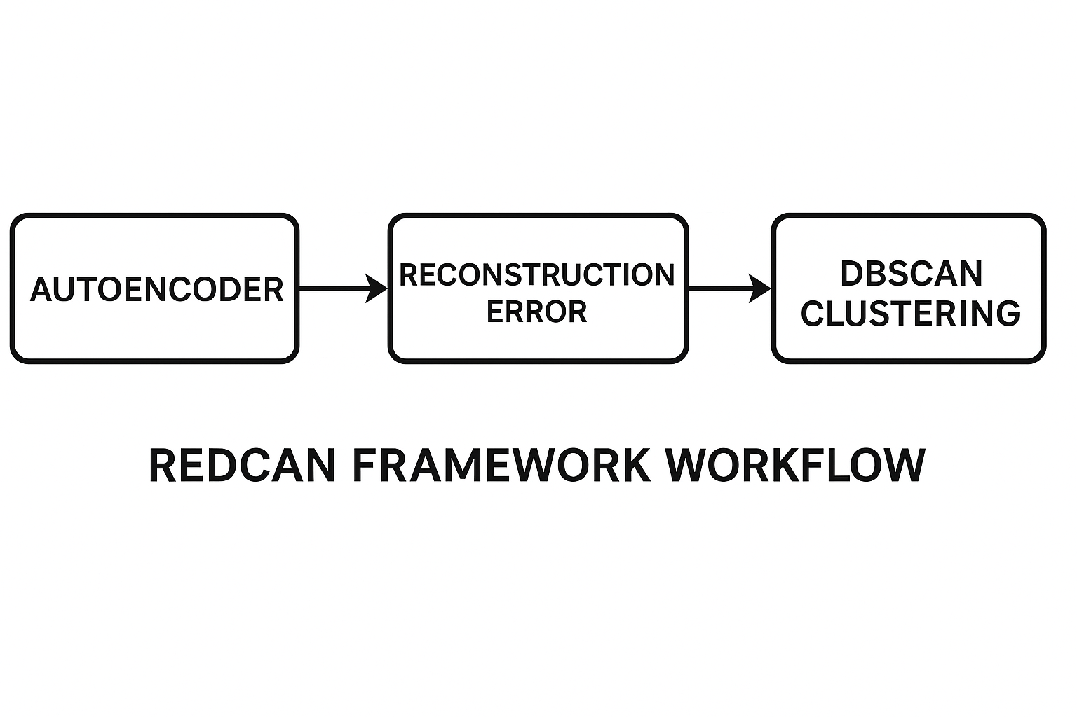
Proposed Solution – REDCAN Framework
Reconstruction Error-based Density Clustering for Anomaly Detection
Combines deep autoencoder with DBSCAN clustering.
Two main stages:
  Feature Normalization: Autoencoder reconstructs modal frequencies, errors highlight deviations.
  Clustering: DBSCAN clusters errors, separating normal from anomalous states.

Slide 5
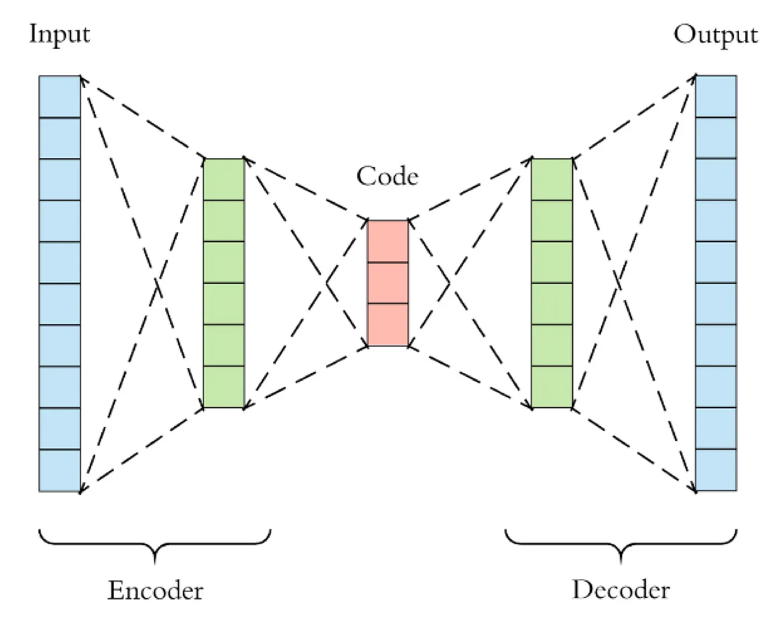
Deep Autoencoder – Feature Normalization
Unsupervised neural networks learns compressed data representation.
Trained to reconstruct normal modal frequency behavior.
Output: Reconstruction error for each data point (measures deviation).

Slide 6
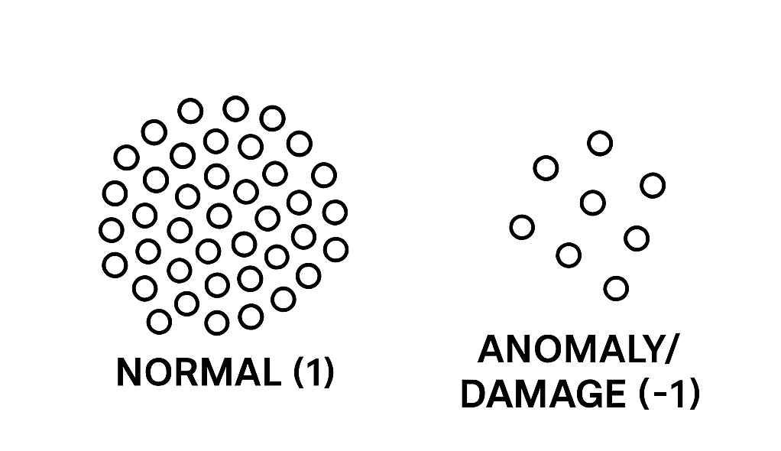
Density-Based Clustering (DBSCAN)
DBSCAN clusters data based on local density, not distance to center.
Auto-tuned into two clusters:
  Normal (label 1)
  Anomaly/Damage (label -1)
No need for preset thresholds or number of clusters.
Noise in reconstruction error → detected anomaly.

Slide 7
Experimental Validation – Z24 Bridge
Z24 bridge (Switzerland): benchmark for SHM validation.

Slide 8
Experimental Validation – Z24 Bridge
Dataset: Long-term modal frequencies under varying temperature and known damage events.
Key Environmental Factor: Temperature (esp. freezing events → frequency spikes).

Slide 9
Results: Reconstruction Errors
Modal frequencies affected by temperature (sharp spikes during freezing events).
Autoencoder reduces temperature effect, but outliers (due to anomalies or large temp changes) persist as reconstruction errors.

Slide 10
Results: Effective Anomaly Detection
DBSCAN on reconstruction errors:
  Separates normal from anomalous/damaged states.
  Achieves very low false alarm rate (<0.1%).
  Accurately identifies damage, even under environmental variability.

Slide 11
Conclusions
REDCAN achieves highly accurate, robust anomaly detection for bridges.
Outperforms traditional and single-model approaches under challenging environmental conditions.
Threshold-free, robust to severe environmental variability.
Binary classification: simple label interpretation.
REDCAN provides a powerful, automated, and reliable tool for real-world bridge health monitoring—effectively separating damage from environmental noise and paving the way for smarter, safer infrastructure management.

Slide 12
Thanks for your attention!

