Slide 1



Unsupervised Damage Detection in Bridges Using Outlier-Contaminated Vibration Data
2nd Olympiad in Engineering Science – OES 2025
Presenter: Wen Gao
Supervisor: Prof. Alireza Entezami
Affiliation: Department of Civil and Environmental Engineering, Politecnico di Milano, Milan, Italy
Date: 12/06/2025

Slide 2
Contents
01
02
03
Research Background and Themes
Methodology
Application and Achievement
Importance and challenges of SHM
Research themes and objectives
Feature reconstruction
Anomaly detection
Applied Case
Application results

Slide 3

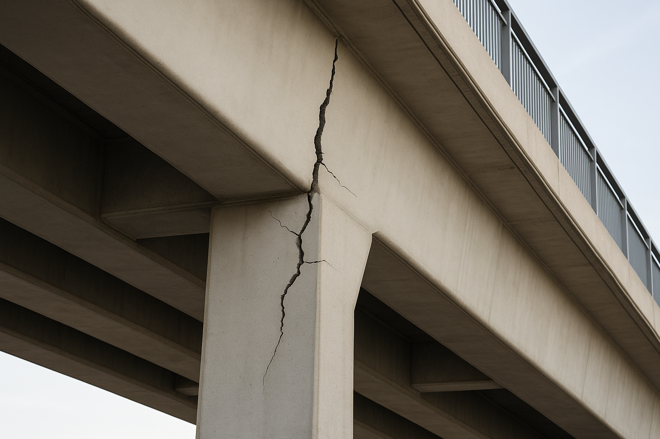
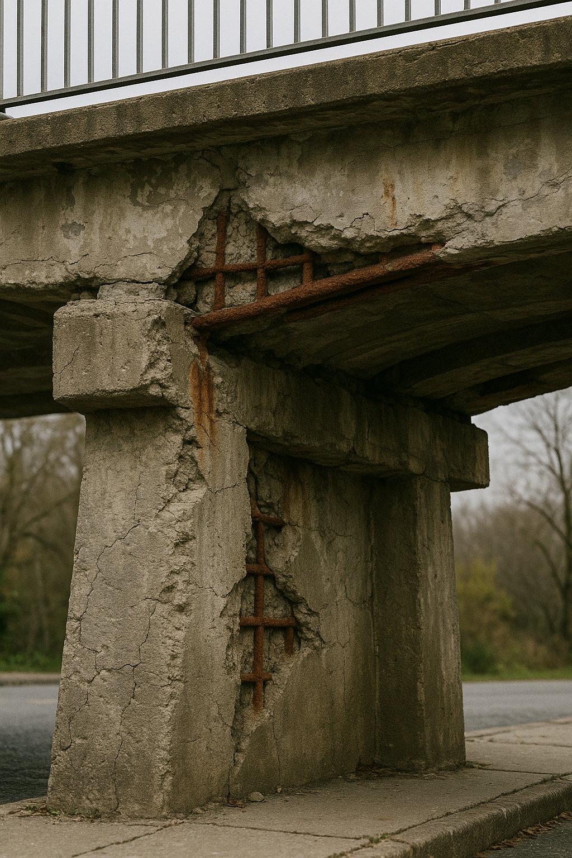
Research Background and Themes —— Importance and challenges of SHM
Core issues
Aging bridge structures, increasing loads, environmental erosion
Safety hazards
Environmental
erosion
Urgent need for structural health monitoring
Loading increase
Structural aging
Data challenges
Massive, high-dimensional, nonlinear vibration monitoring data
Natural fluctuations in modal parameters due to environmental factors (temperature, wind, traffic)
Existing methods are sensitive to minor damage and ambient noise and have poor robustness
Notes:
Research status → research topic (Enhancing Structural Monitoring in Civil Engineering through Machine Learning and Statistical Techniques) → 3 key points (Problem addressed, Key focus, Emphasis)

Slide 4
Research Background and Themes —— Research themes and objectives
Themes
Combining the powerful feature extraction capability of deep learning ( autoencoder) with classical outlier detection (LOF) to achieve robust modal vibration data anomaly monitoring.
Objectives
Learning an intrinsic feature representation of modal vibration data using a self-encoder to efficiently compress the information and separate ambient noise
Quantify the extent to which data points deviate from the normal feature distribution using the feature reconstruction error (L2 paradigm)
Identify true structural anomalies based on local density using the LOF algorithm to overcome the limitations of the global thresholding method
Notes:
Research status → research topic (Enhancing Structural Monitoring in Civil Engineering through Machine Learning and Statistical Techniques) → 3 key points (Problem addressed, Key focus, Emphasis)

Slide 5



Methodology —— Part 1：Feature reconstruction
Step 1: Obtain residual data using an autoencoder
Encoder maps:
$H=$ $σ ({ W}_{e}$X + $b_{e})$
Decoder reconstructs:
$\hat{X}=$ $φ({ W}_{d}$H + $b_{d})$
Extract the residual:
$$R_{x}=X−\hat{X}$$
Step 2: Compute the norm values of the residual matrices
Euclidean norm values:
$$N_{x}\left(i\right)={\left\|R_{x}(i,:)\right\|}_{2}$$
Hyperparameter Optimization Flowchart
Notes:
1. A brief explanation of AP clustering leads to the parameter P
2. Cutting from parameter P, a brief explanation of FOA was used.
3. Conclude with a sentence summarizing and highlighting the content and focus of the section (innovative).

Slide 6
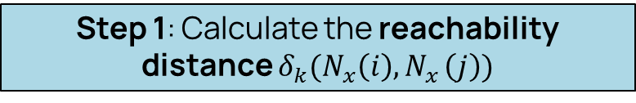
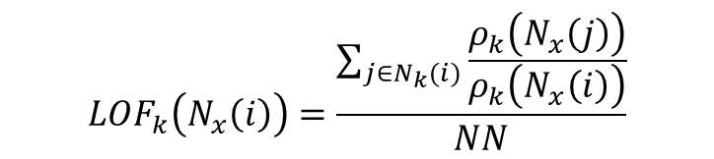
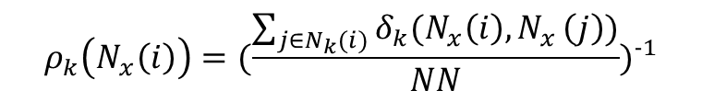
Methodology —— Part 2：Anomaly detection —— Unsupervised learning LOF
Step 1: Calculate the reachability distance $δ_{k}(N_{x}\left(i\right){,N}_{x}\left(j\right)$)
Step 3: Calculate the LOF score
$${LOF}_{k}\left(N_{x}\left(i\right)\right)=\frac{\sum_{j∈N_{k}(i)}{\frac{ρ_{k}\left(N_{x}\left(j\right)\right)}{ρ_{k}\left(N_{x}\left(i\right)\right)}}}{NN}$$
potential anomalies (damage)
LOF score ＞ threshold
Step 2: Calculate the local reachability density
$$ρ_{k}\left(N_{x}\left(i\right)\right)={(\frac{\sum_{j∈N_{k}(i)}{δ_{k}(N_{x}\left(i\right){,N}_{x}\left(j\right))}}{NN})}^{−1}$$
Notes:
1. A brief explanation of AP clustering leads to the parameter P
2. Cutting from parameter P, a brief explanation of FOA was used.
3. Conclude with a sentence summarizing and highlighting the content and focus of the section (innovative).

Slide 7
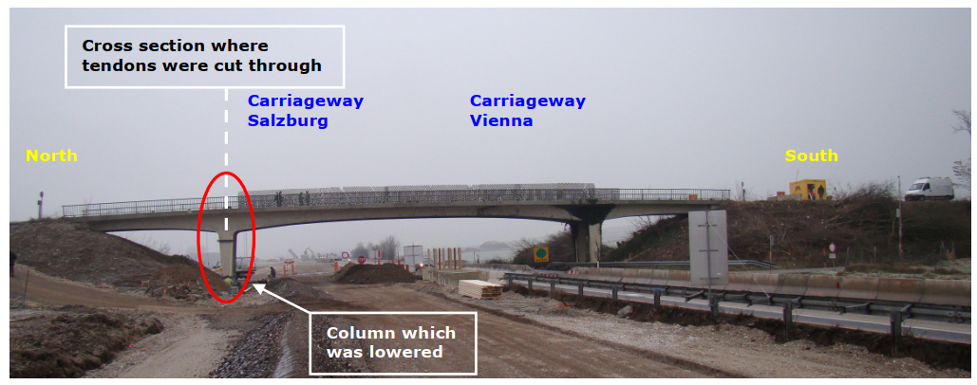
Application and Achievement —— Part 1: Applied Case :
View of the S101 Bridge
Structure Overview
Post-tensioned concrete bridge in Reibersdorf, Vienna
Main span: 32 m Side spans: 2x12 m Width: 6 m
Continuous deck design over piers/abutments (built 1960)

Slide 8
Application and Achievement —— Part 2: Application results
Damage detection of the S101 Bridge using the proposed method
Damage detection of the S101 Bridge using the residual norms of the autoencoder
CONCLUSION: The method in this paper can effectively identify the non-damage state of bridges and significantly improve the detectability of damage

Slide 9
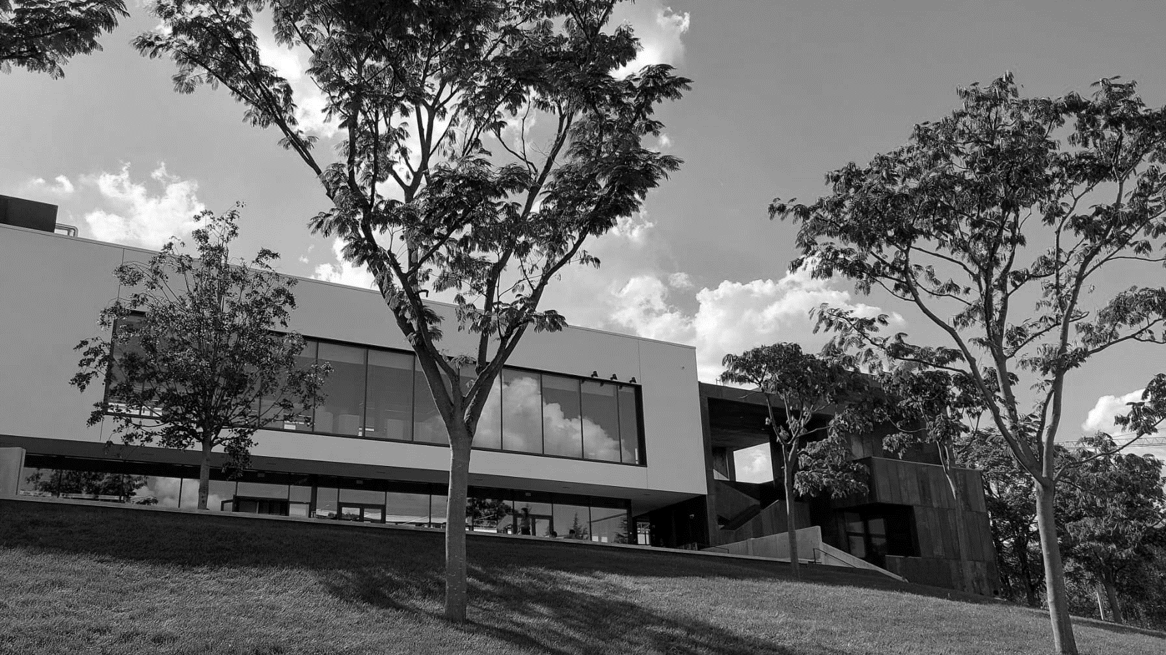
Thanks for your attention!
Wen Gao
Supervisor: Prof. Alireza Entezami
Email: wen.gao@polimi.it

