Slide 1
A Fully Customized Vehicle Scanning System:
Field Trials on Two Large-Scale Bridges
M. Alamdari¹, A. Calderon Hurtado¹, J. Xu¹, D. Dias-da-Costa², R. Salleh³
¹ School of Civil and Environmental Engineering, University of New South Wales, Sydney, NSW 2052, Australia
² School of Civil Engineering, The University of Sydney, NSW 2006, Australia
³ School of Computer Science and Engineering, University of New South Wales, Sydney, NSW 2052, Australia
m.makkialamdari@unsw.edu.au

Slide 2
Vehicle Scanning Method
(iSHM, drive-by bridge inspection)

Slide 3
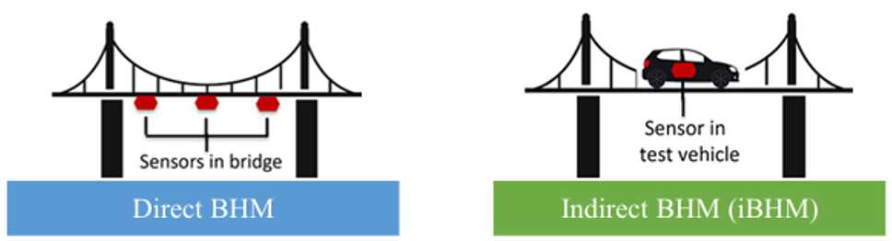
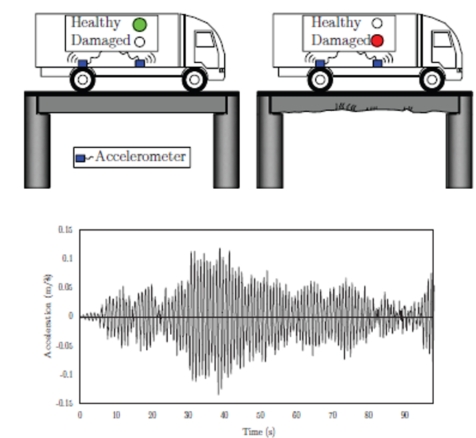
Drive-by Bridge Inspection
[1]
Drive by bridge inspection can potentially offer:
A scalable bridge monitoring solution
A more cost-effective approach
No need for power and data transmission access onsite
Removes the burden of ongoing system maintenance and sensor replacement with conventional SHM
[2]
Fujino, Y., & Siringoringo, D. M. (2011). Bridge monitoring in Japan: the needs and strategies. Structure and Infrastructure Engineering, 7(7-8), 597-611.
Malekjafarian, A., McGetrick, P.J. and OBrien, E.J., 2015. A review of indirect bridge monitoring using passing vehicles. Shock and vibration, 2015(1), p.286139.

Slide 4
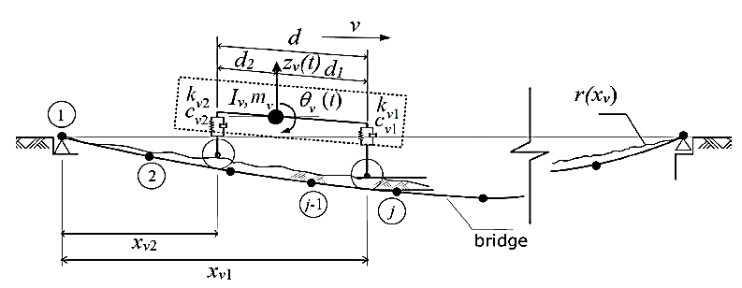
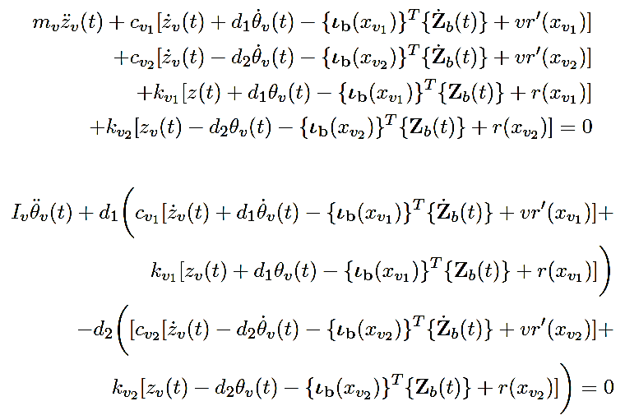
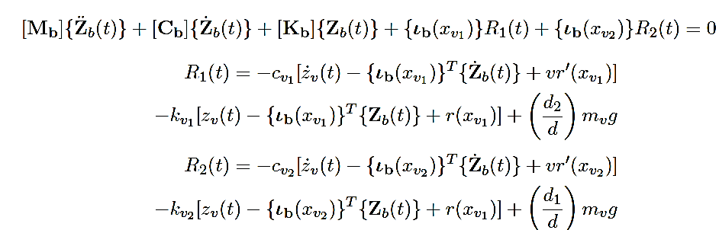
Vehicle-Bridge Interaction (VBI):
Alamdari, M.M., 2024. An evolutionary vehicle scanning method for bridges based on time series segmentation and change point detection. Mechanical Systems and Signal Processing, 210, p.111173.

Slide 5
Change Point Detection

Slide 6











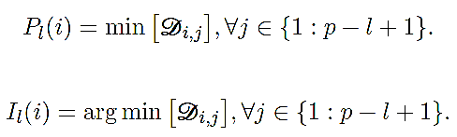
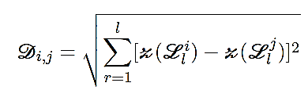
Matrix Profile
A subsequence with length
An all-subsequences set
:
The z-normalized Euclidean distance
Alamdari, M.M., 2024. An evolutionary vehicle scanning method for bridges based on time series segmentation and change point detection. Mechanical Systems and Signal Processing, 210, p.111173.

Slide 7
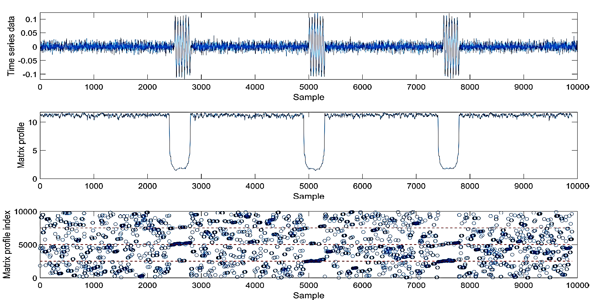
MP: Motif Discovery

Slide 8
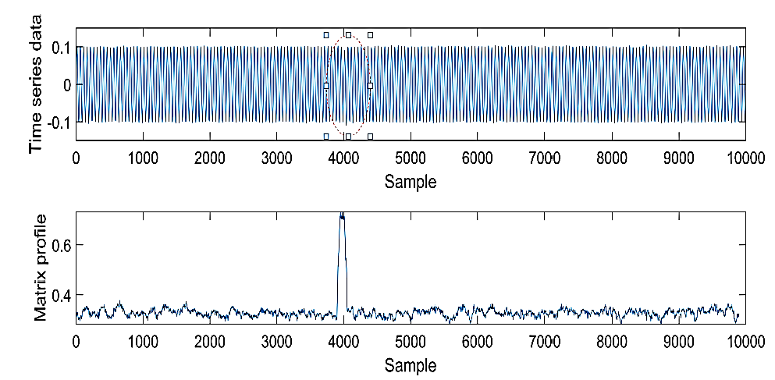
MP: Anomaly Detection

Slide 9
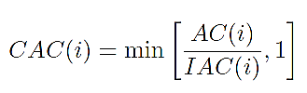
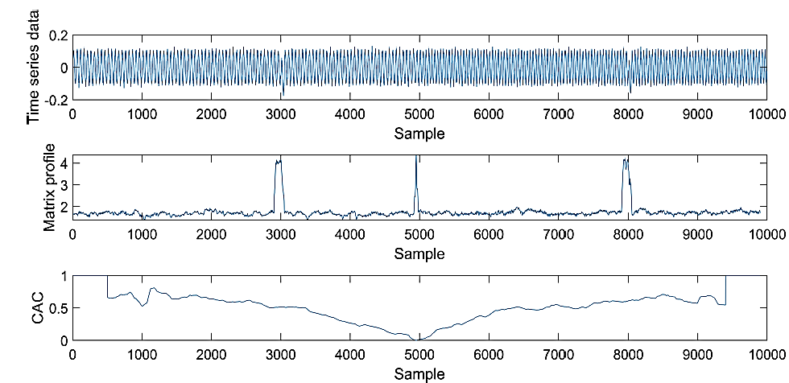
Change Point Detection

Slide 10
Change Point Detection

Slide 11
Bridge Inspection
Vehicle Set-up, Direct and Indirect Sensing

Slide 12
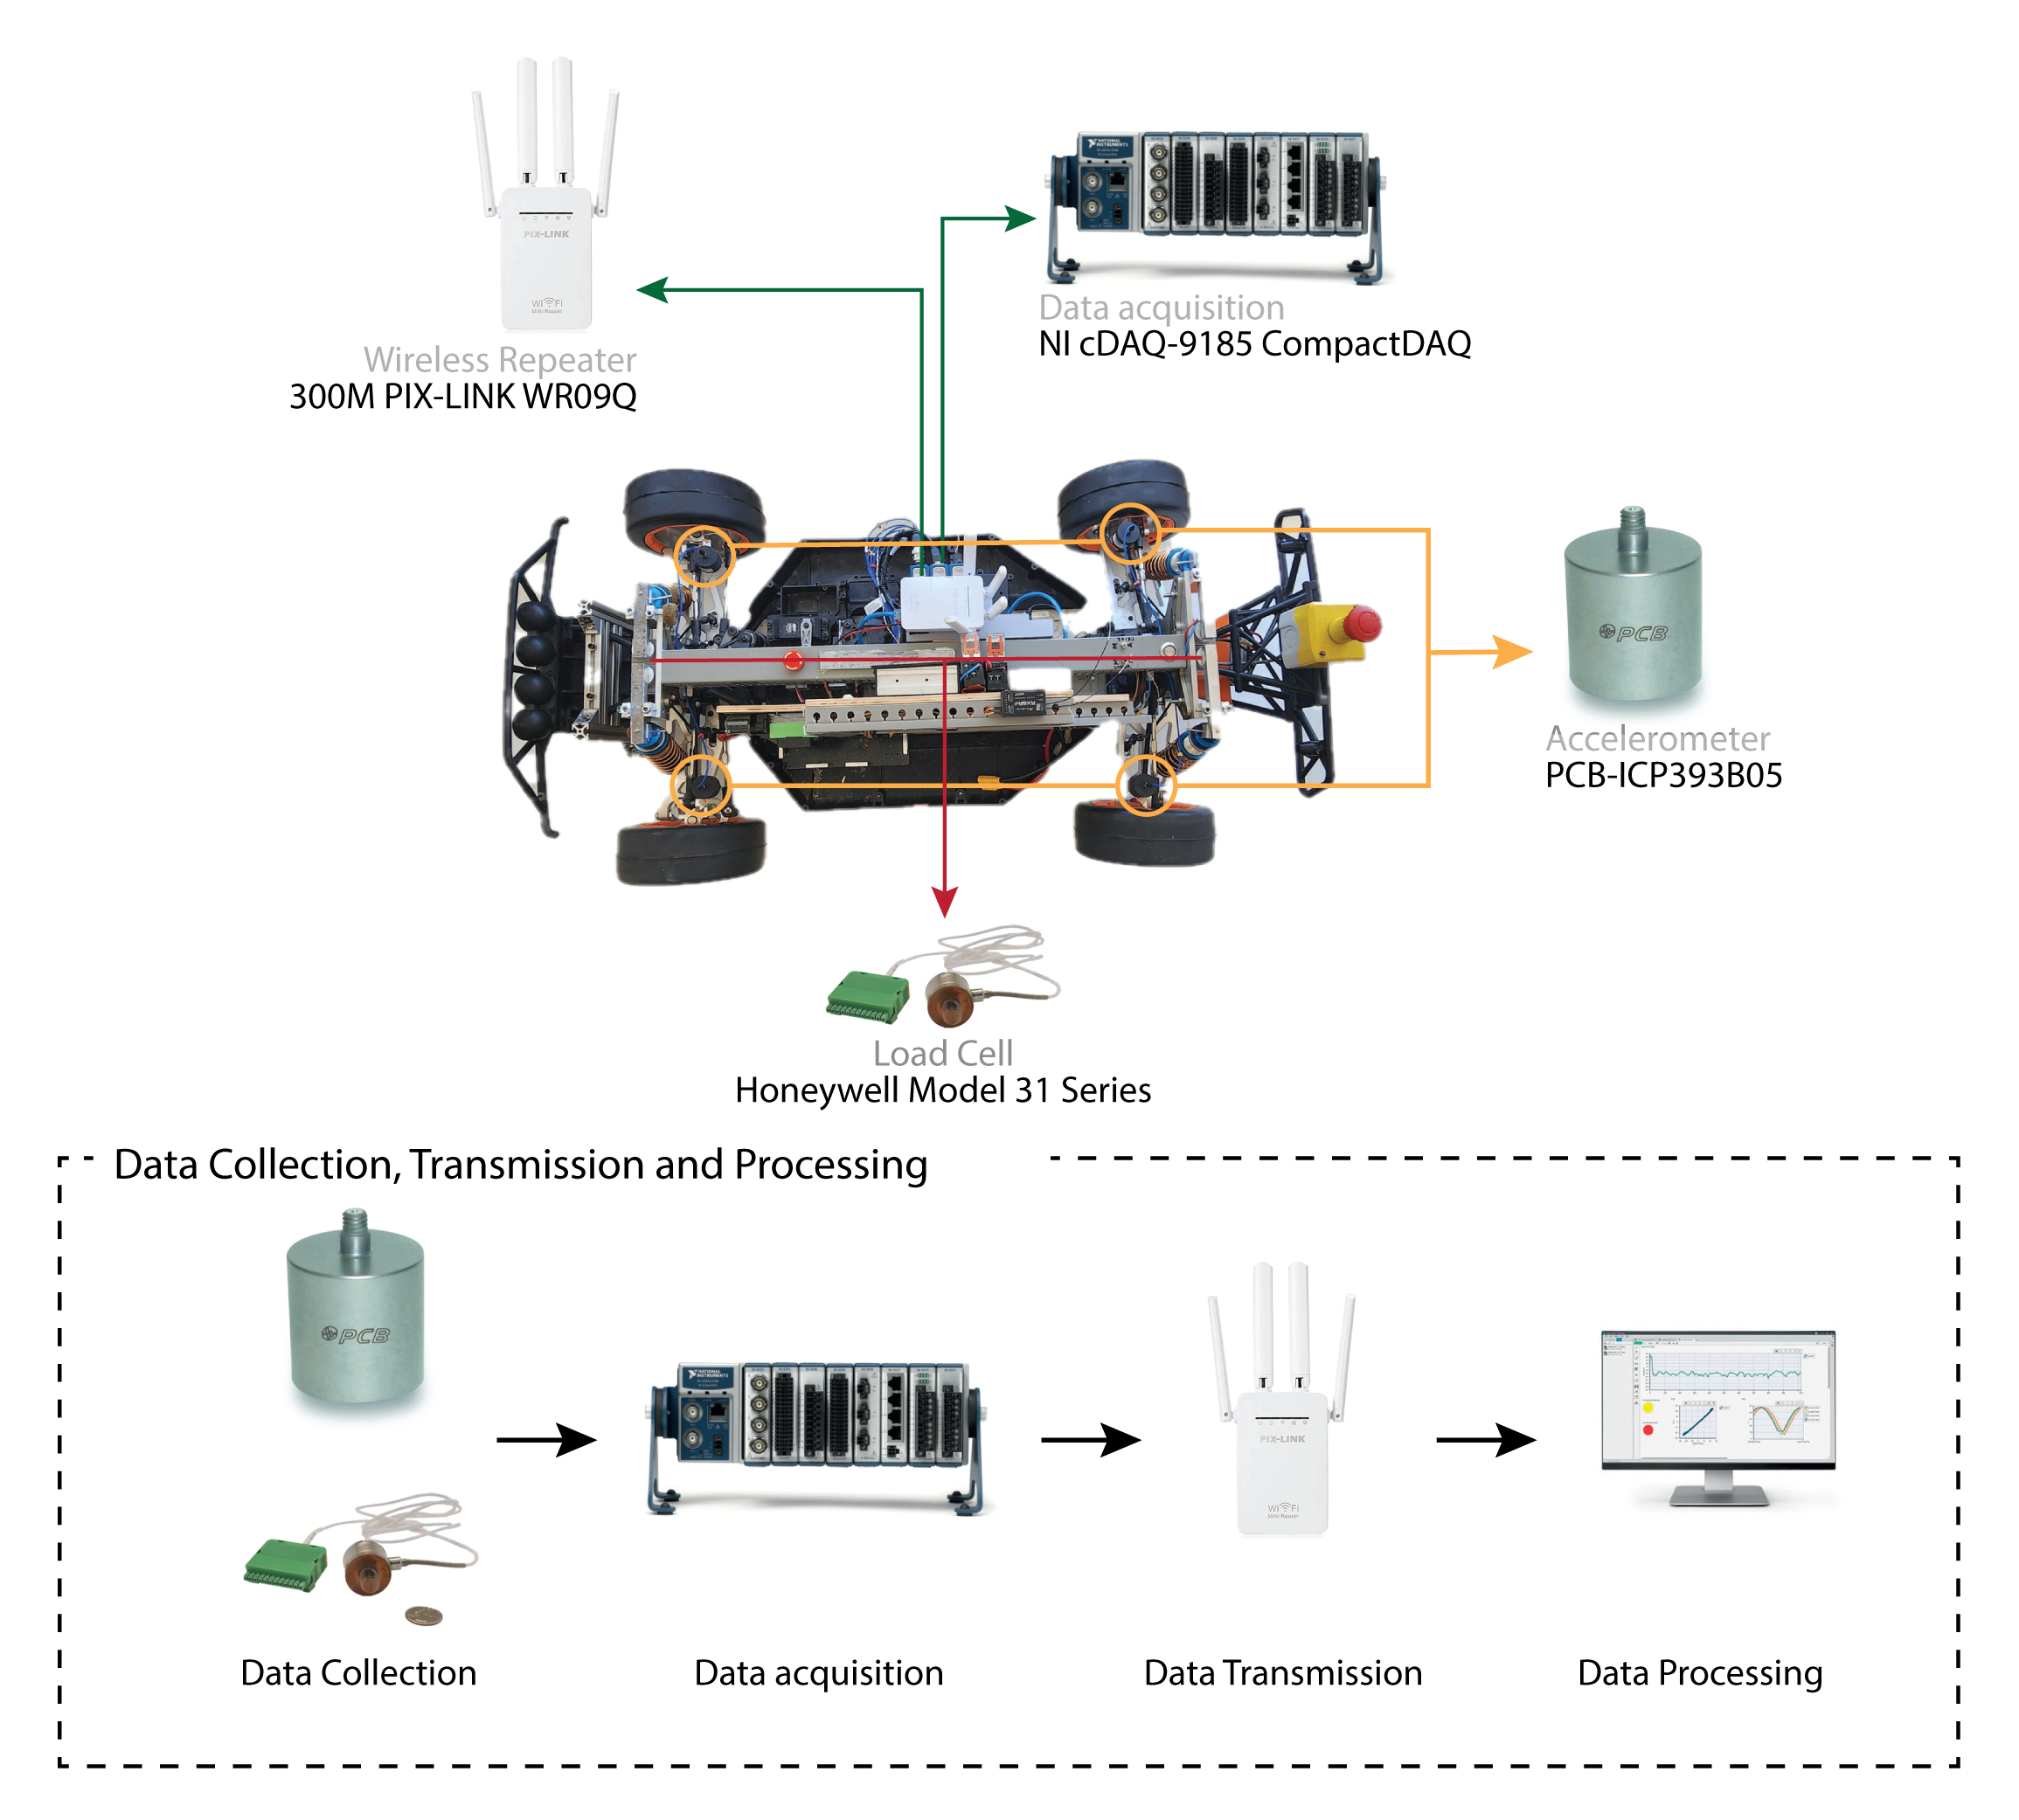
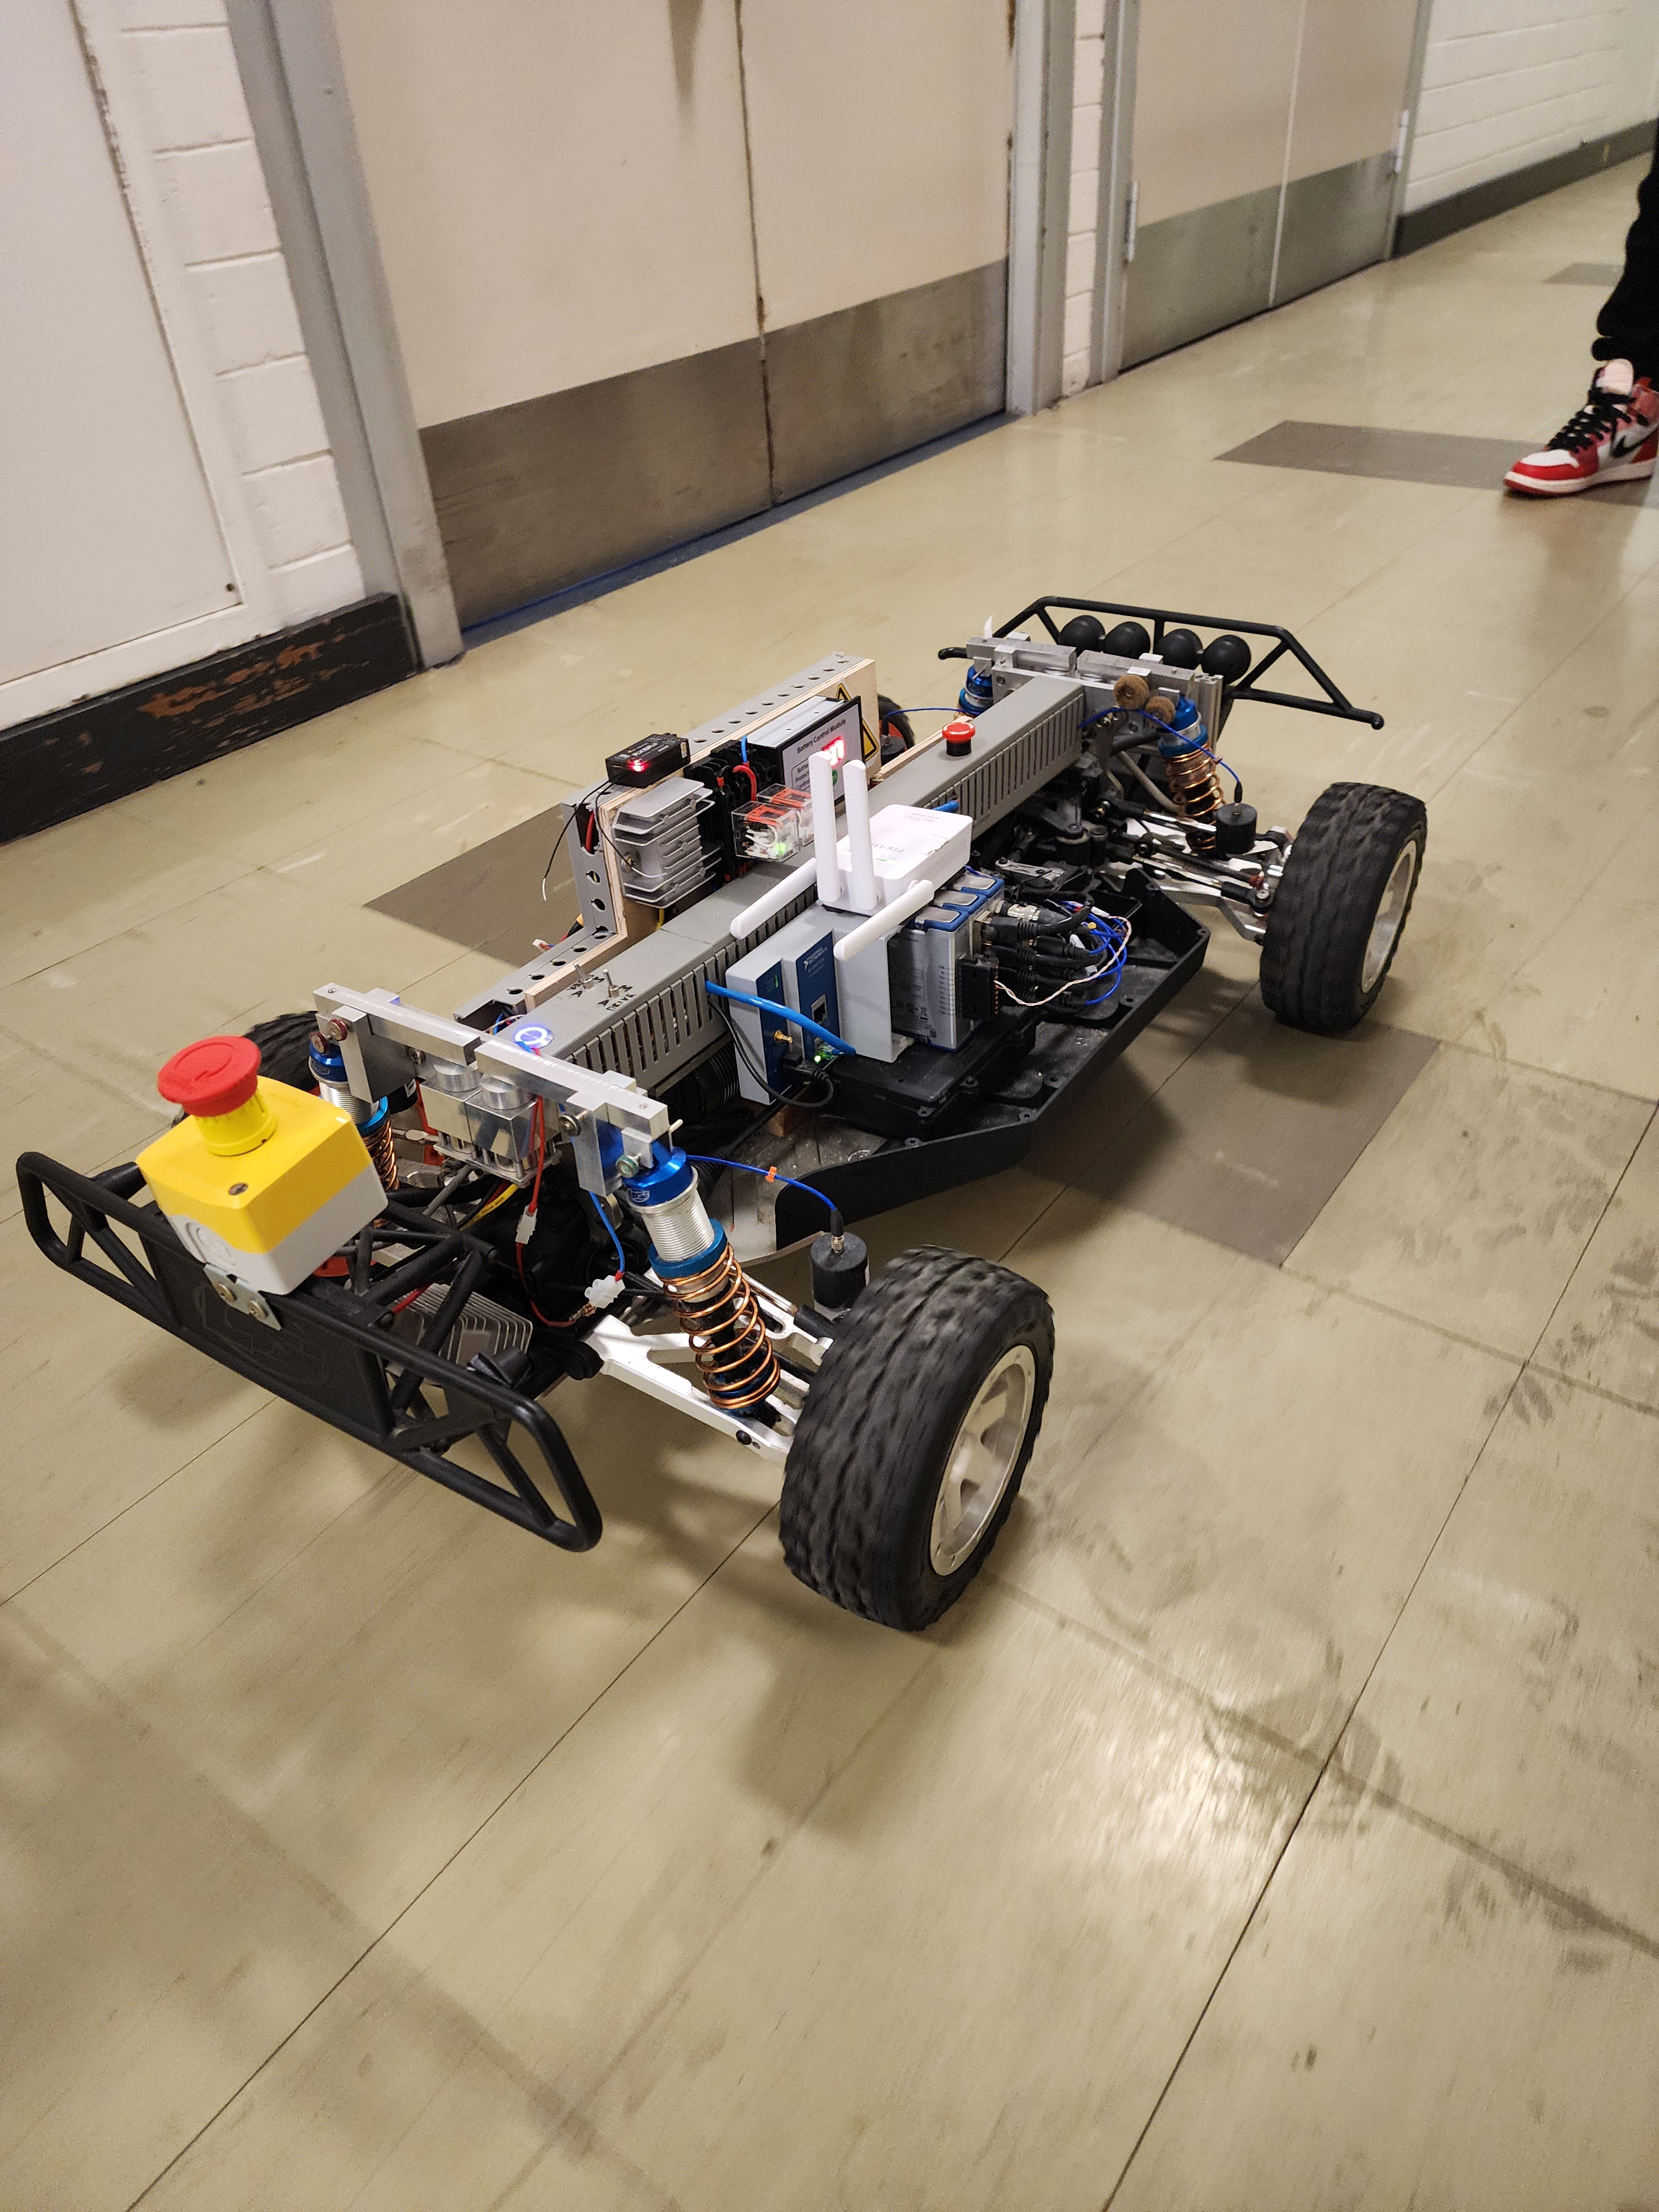
Inspection Vehicle
Vehicle Speed: [0.1 – 10] m/s
M: 20 Kg
L= 80 cm

Slide 13
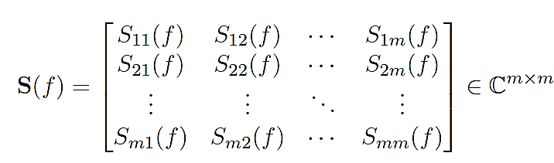
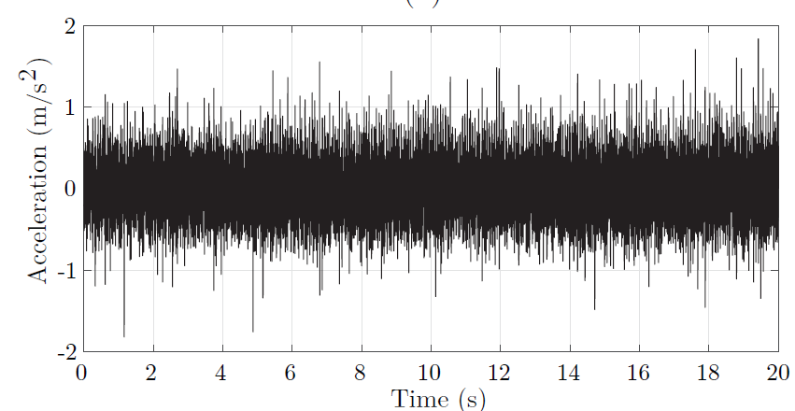

Inspection Vehicle
Acceleration response from the accelerometer mounted on the front-right suspension arm
Vehicle Speed: 0.17 m/s
Sampling Frequency: 1600 Hz

Slide 14
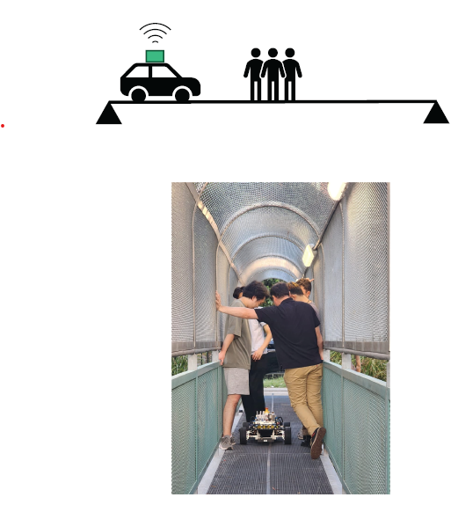
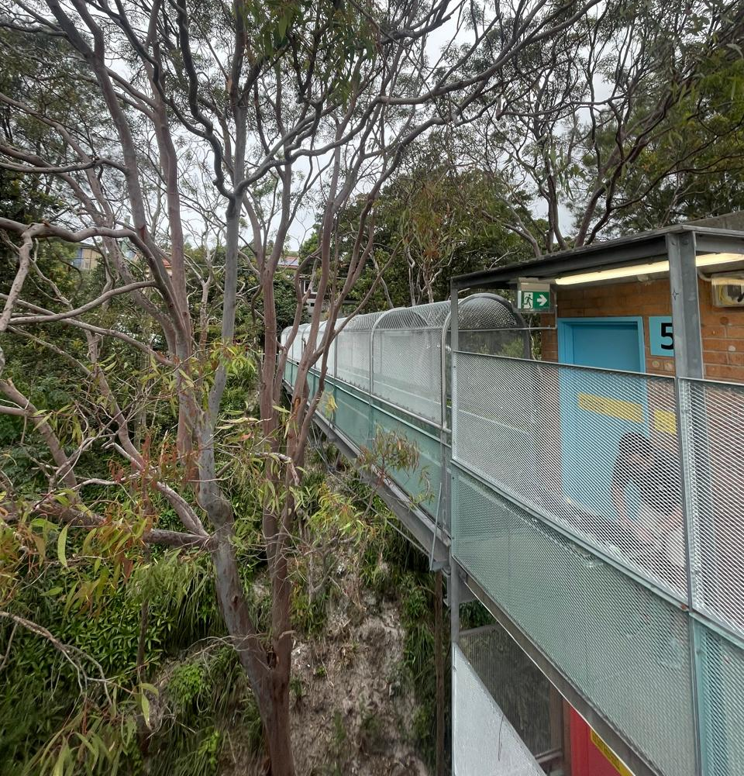
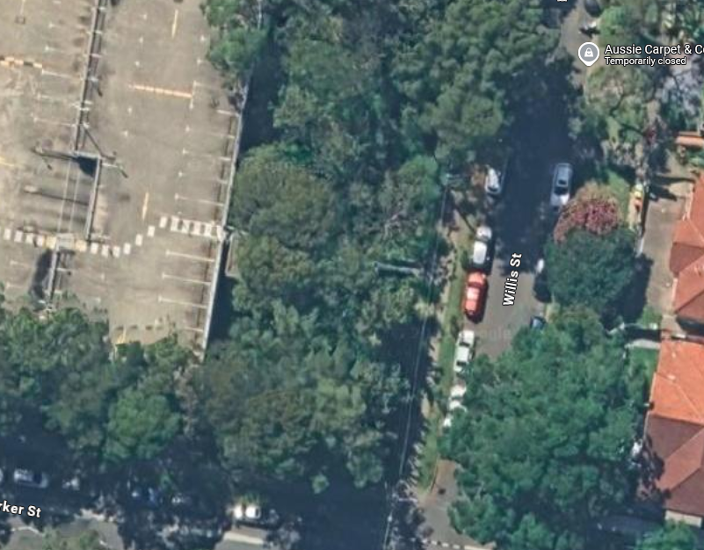
Target Bridge (I)
Pedestrian bridge at UNSW campus
Simply Supported Steel Bridge
17m length
~ 1m width

Slide 15
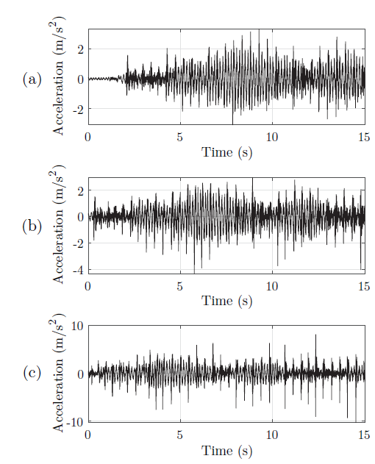
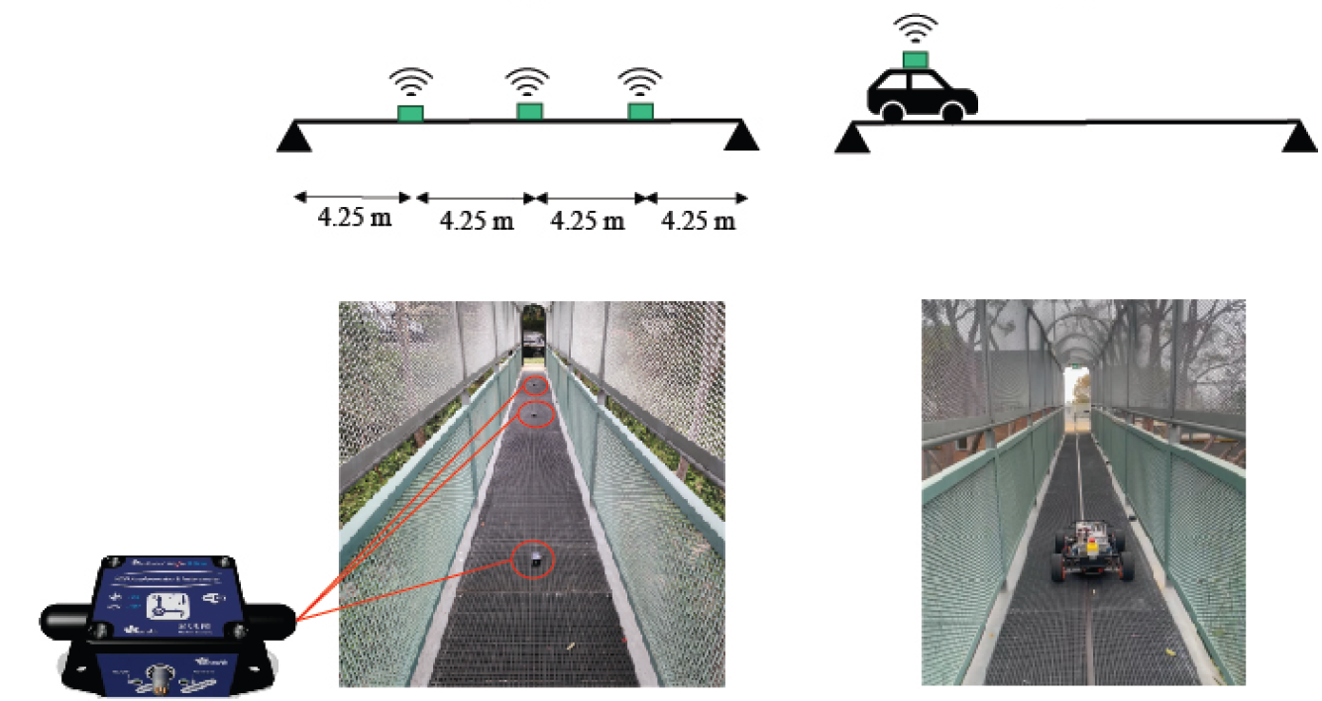
Direct Sensing
¼ of the span
¾ of the span
Mid-span

Slide 16

Direct Sensing
$$f_{b}=6.65 Hz$$

Slide 17
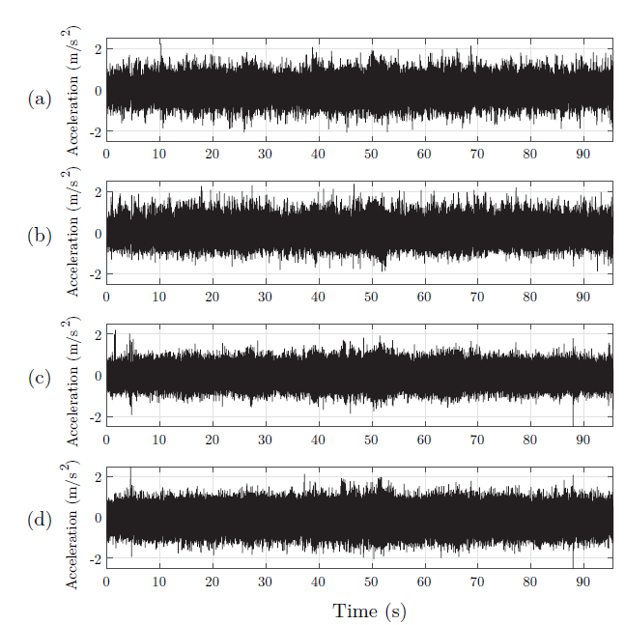
Indirect Sensing
Illustration of acceleration time series from indirect sensing,
  front-right axle,
  front-left axle,
  rear-right axle,
  rear-left axle.

Slide 18
Indirect Sensing
$$f_{b}=6.65 Hz$$

Slide 19
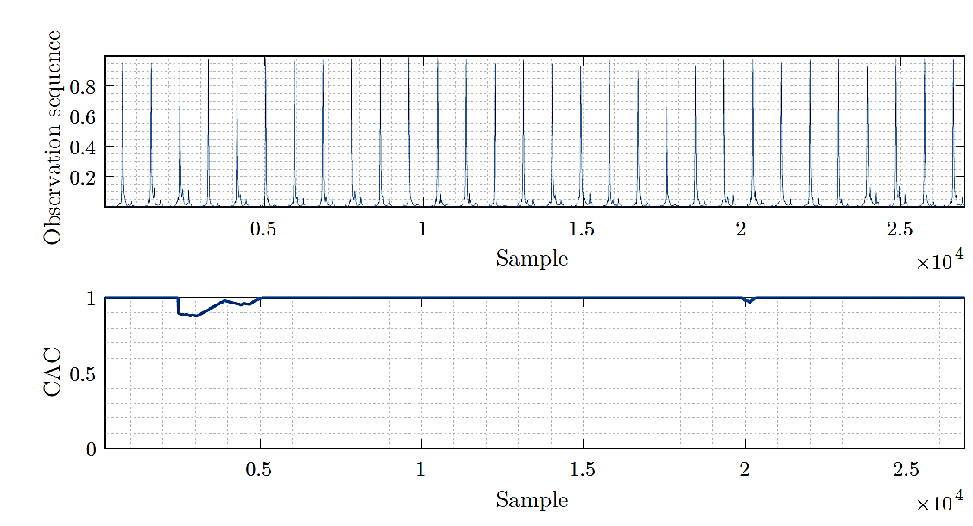
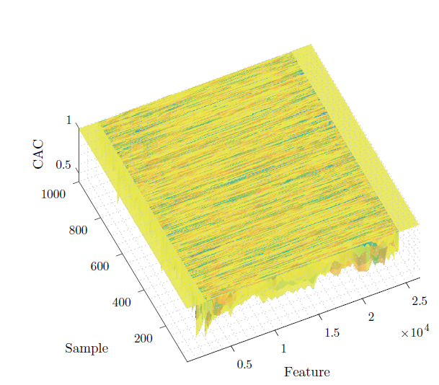
CAC Under Nominal Bridge State

Slide 20
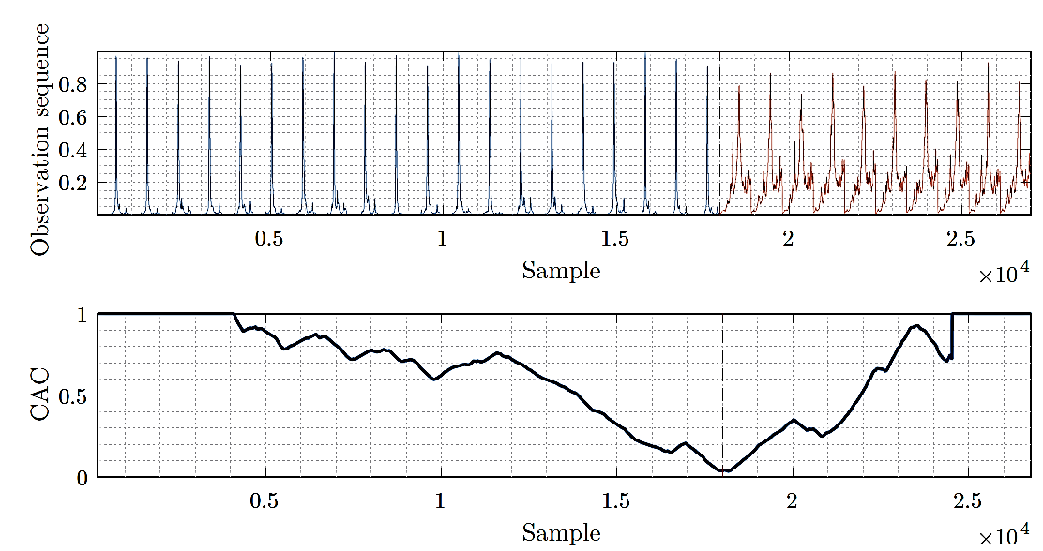
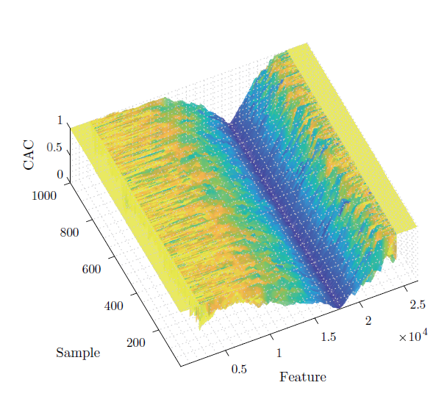
CAC Under Changed State

Slide 21
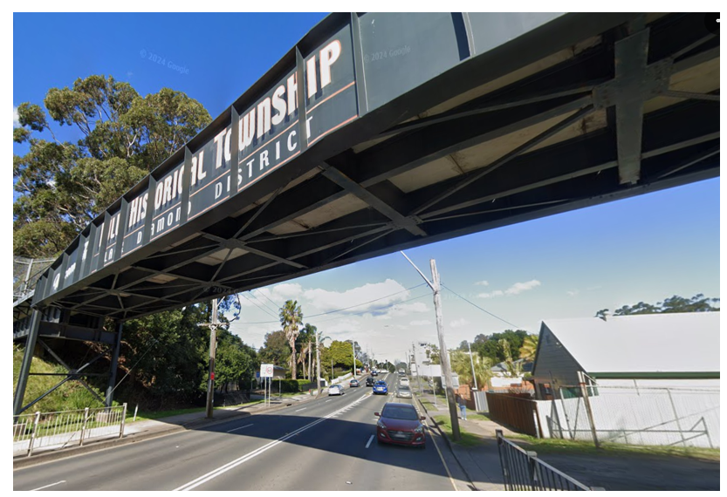
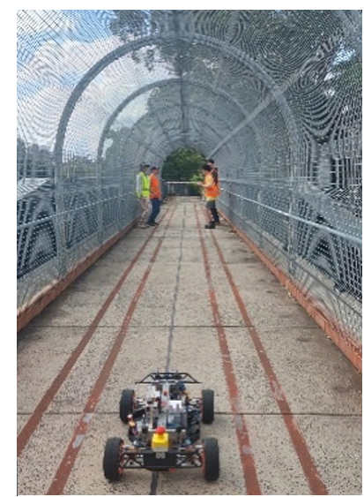
Target Bridge (II)
Bulli Colliery Bridge
A steel girder bridge
span is 23.9 m

Slide 22
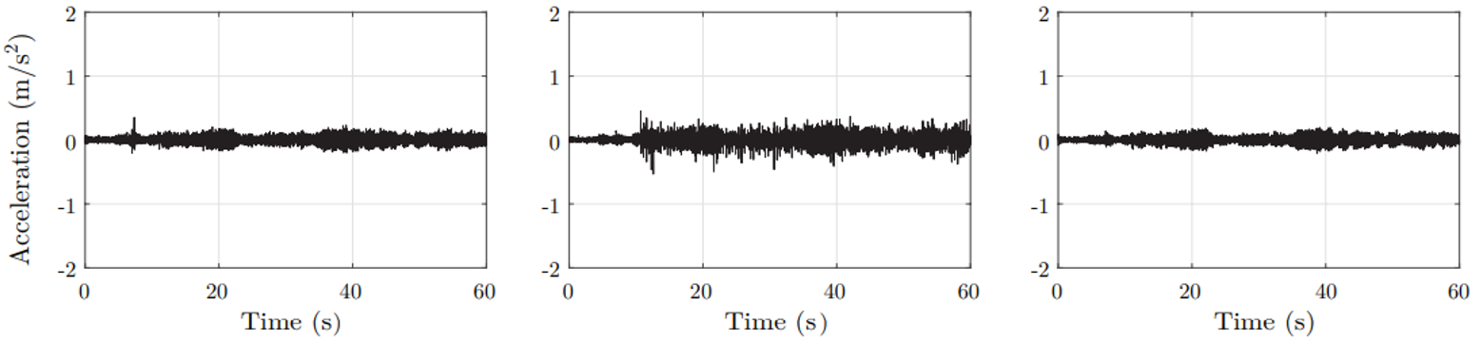
Direct Sensing
¼ of the span
¾ of the span
Mid-span

Slide 23

Direct Sensing
$$f_{b}=6.7 Hz$$

Slide 24
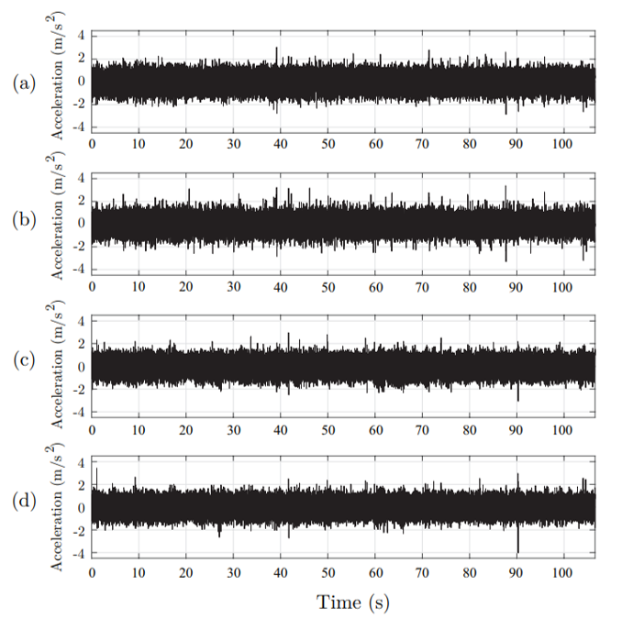
Indirect Sensing
Illustration of acceleration time series from indirect sensing,
  front-right axle,
  front-left axle,
  rear-right axle,
  rear-left axle.

Slide 25

Indirect Sensing
$$f_{b}=6.42 Hz$$

Slide 26
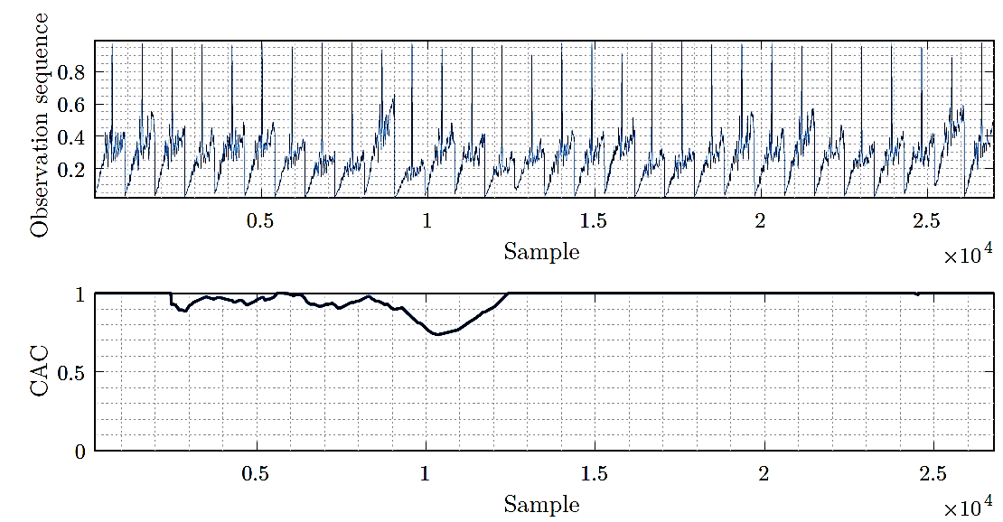
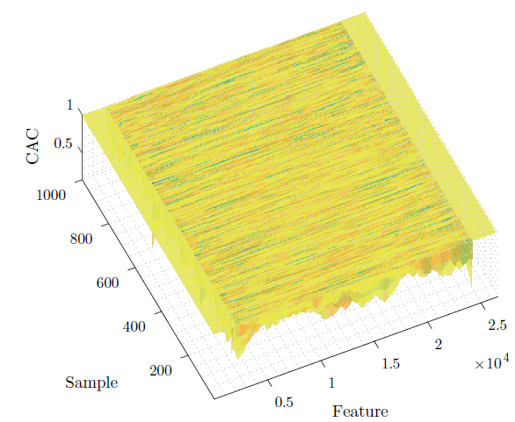
CAC Under Nominal Bridge State

Slide 27
Conclusions
A customised inspection vehicle was designed and tested for drive by bridge scanning.
The potential of iSHM to extract bridge fundamental frequency was shown on two large-scale bridges.
The extracted features from the acceleration response of the vehicle have the potential to be used for structural integrity assessment.
The effect of long-term trends, as well as environmental and operational variations, should be studied.
The framework should be tested on different types of bridge structures.
Future Works

Slide 28

Publications
Tyler, G., Luo, S., Hurtado, A.C. and Alamdari, M.M., 2025. Semi-supervised bridge indirect structural health monitoring using Isolation Distributional Kernels. Mechanical Systems and Signal Processing, 226, p.112296.
Alamdari, M.M., 2024. An evolutionary vehicle scanning method for bridges based on time series segmentation and change point detection. Mechanical Systems and Signal Processing, 210, p.111173.
Hurtado, A.C., Alamdari, M.M., Atroshchenko, E., Chang, K.C. and Kim, C.W., 2024. A data-driven methodology for bridge indirect health monitoring using unsupervised computer vision. Mechanical Systems and Signal Processing, 210, p.111109.
Hurtado, A.C., Kaur, K., Alamdari, M.M., Atroshchenko, E., Chang, K.C. and Kim, C.W., 2023. Unsupervised learning-based framework for indirect structural health monitoring using adversarial autoencoder. Journal of Sound and Vibration, 550, p.117598.
Cheema, P., Alamdari, M.M., Vio, G., Azizi, L. and Luo, S., 2023. On the use of matrix profiles and optimal transport theory for multivariate time series anomaly detection within structural health monitoring. Mechanical Systems and Signal Processing, 204, p.110797.
Cheema, P., Alamdari, M.M., Chang, K.C., Kim, C.W. and Sugiyama, M., 2022. A drive-by bridge inspection framework using non-parametric clusters over projected data manifolds. Mechanical Systems and Signal Processing, 180, p.109401.
Alamdari, M.M., Chang, K.C., Kim, C.W., Kildashti, K. and Kalhori, H., 2021. Transmissibility performance assessment for drive-by bridge inspection. Engineering Structures, 242, p.112485.
Kildashti, K., Alamdari, M.M., Kim, C.W., Gao, W. and Samali, B., 2020. Drive-by-bridge inspection for damage identification in a cable-stayed bridge: Numerical investigations. Engineering structures, 223, p.110891.
Google Scholar

Slide 29



Sponsors

Slide 30

m.makkialamdari@unsw.edu.au

