Slide 2
Structural Performance and Load-Carrying Capacity of Cross Laminated Timber-Concrete Composite Slabs: Influence of Shear Fasteners
Maria Bergfjord¹, Sudath C. Siriwardane² and Lars Henning Krokengen³
¹ Multiconsult AS, Oslo, Norway
² University of Stavanger, 4036 Stavanger, P.O. box 8600, Norway
³ COWI AS, Trondheim, Norway

Slide 3
Outline
Background
Research/Knowledge gaps
Objectives
Materials and test sample preparation
Laboratory testing
Theoretical prediction of load capacity and displacement
Discussion and comparison of the result
Conclusions

Slide 4
1. Background
Environmental impacts
Reinforced concrete
Timber
Usage of Cross Laminated Timber (CLT) relatively new

Slide 5
2. Research/Knowledge gaps
Limited Research on CLT-Concrete Composite Floor Systems
Absence of Standardized Design Guidelines
Limitations of Eurocode 5
Material Anisotropy and Defects
Insufficient Research on Shear Fasteners

Slide 6
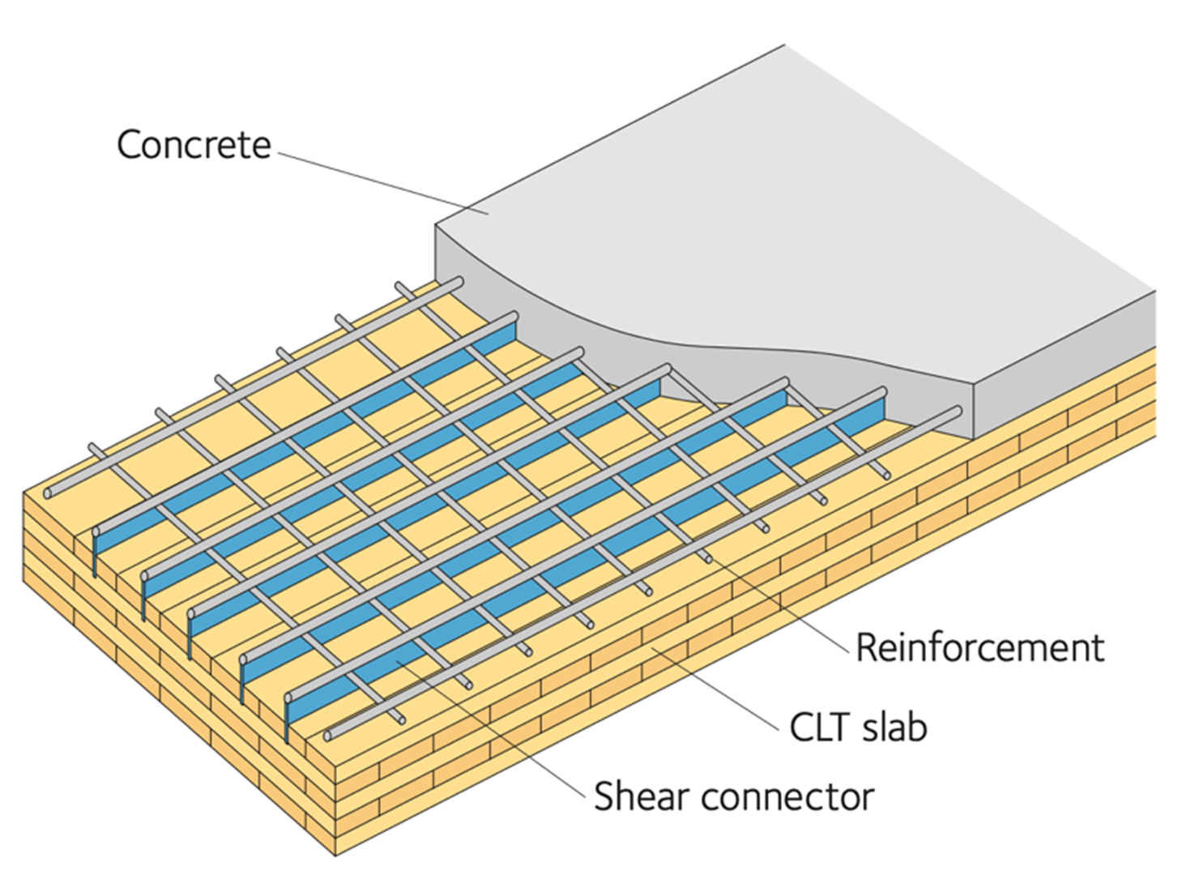
3. Objectives
To investigate the load capacity and structural response of 5-layeres CLT-concrete composite slabs with two different types of shear fasteners by medium scale laboratory testing
The validity of the modifications to the existing formulas in the Eurocode is investigated for theoretical prediction of 5-layered CLT-concrete composite slabs as a secondary objective of this paper.
10. A. Gustafsson + et al., “The CLT handbook CLT structures - facts and planning”,
1. Ed, Stockholm: Skogsindustrierna, 2019

Slide 7
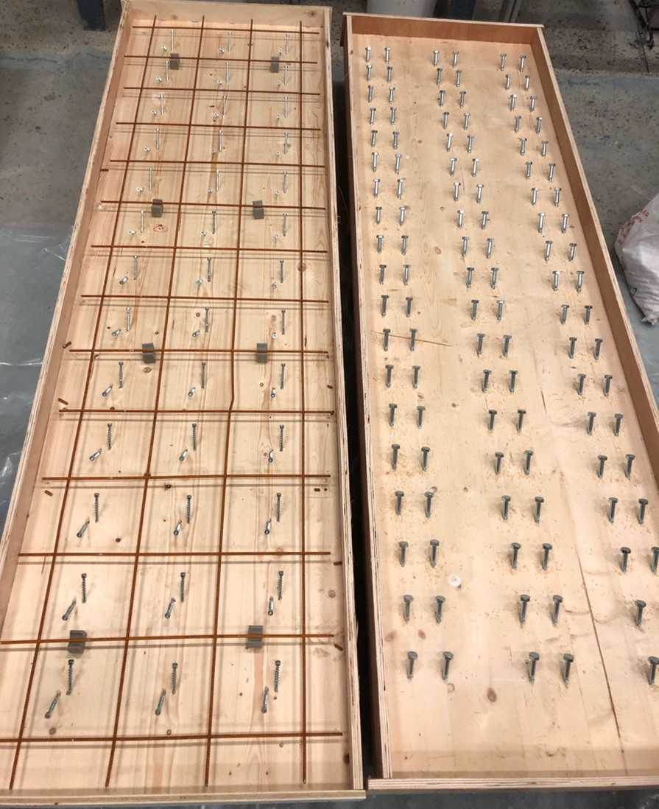
4. Materials and test sample preparation
SLAB Type A
SLAB Type B
Cross Laminated Timber (CLT)
Concrete B35
  Self-compacting concrete (SCC)
  Quality check
Shear fasteners
  CTC screw – SLAB type A
  KOP screw – SLAB type B
Formwork and casting
Curing and demoulding

Slide 8
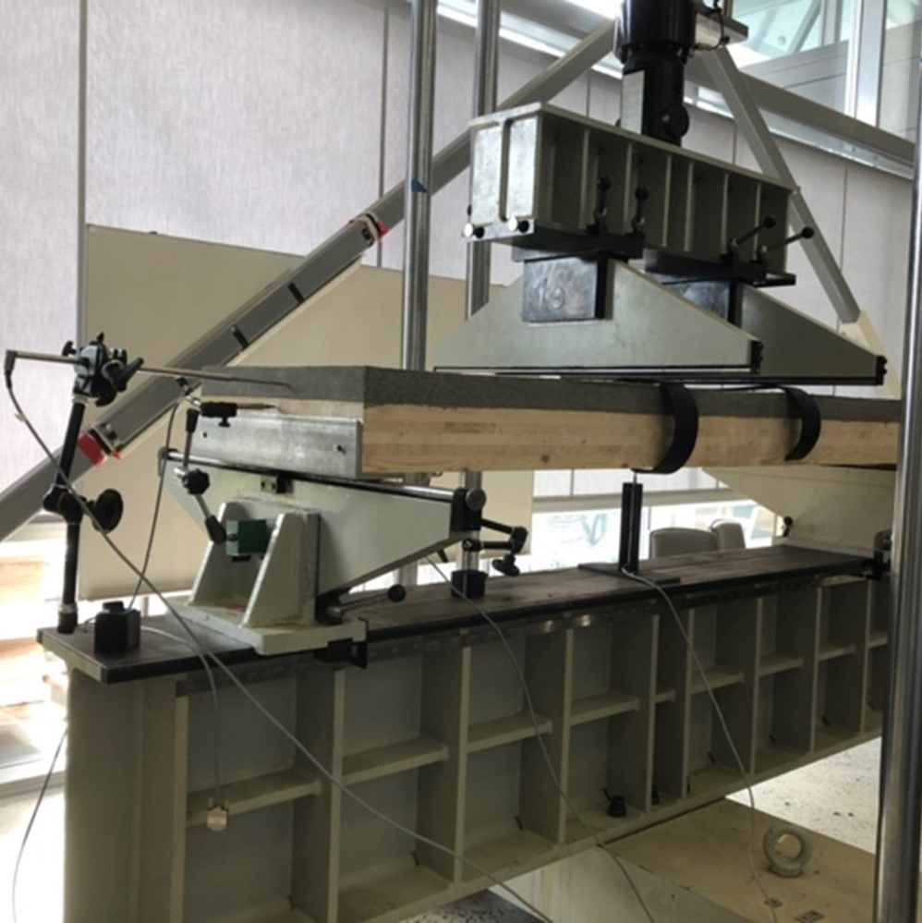
5. Laboratory testing
Test setup
Four point bending test
  NS-ISO 6891:1991 Timber structures – Joints made with mechanical fasteners
Trekonstruksjoner Mekaniske forbindelsesmidler
Generelle prinsipper for bestemmelse av styrke og
deformasjonsegenskaper (= EN 26891:1991) (ISO 6891:1983), NS-ISO 6891:1991

Slide 9
5. Laboratory testing (con.)
- Test result
SLAB | LOAD CAPACITY (kN) |  |  |  | MAXIMUM DISPLACEMENT (mm)
 | 1ST DROP | 2ND DROP | 3RD DROP | MAX | 1ST DROP | 2ND DROP | 3RD DROP | MAX
A1 | 107.16 | - | - | 226.60 | 6.16 | - | - | 25.03
A2 | 128.30 | 138.25 | 210.85 | 229.75 | 7.67 | 8.99 | 20.65 | 28.80
A3 | 124.25 | 133.62 | - | 245.96 | 6.86 | 8.07 | - | 26.01
A4 | 120.73 | 124.37 | - | 207.96 | 6.99 | 8.24 | - | 26.15
A5 | 114.69 | - | - | 171.63 | 8.59 | - | - | 15.86
A6 | 130.17 | 148.41 | - | 188.12 | 8.80 | 11.70 | - | 24.28
B1 | 72.40 | - | - | 191.88 | 5.04 | - | - | 26.91
B2 | 82.29 | - | - | 144.19 | 5.58 | - | - | 13.03
B3 | 85.96 | - | - | 191.43 | 5.73 | - | - | 22.61
B4 | 96.49 | - | - | 181.12 | 6.59 | - | - | 23.20
B5 | 86.88 | - | - | 211.78 | 4.76 | - | - | 22.69
B6 | 104.08 | - | - | 239.94 | 5.43 | - | - | 23.20

Slide 10
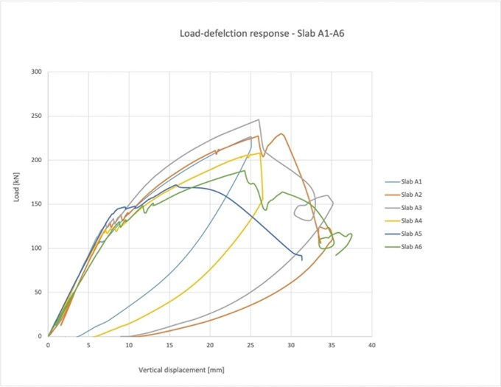
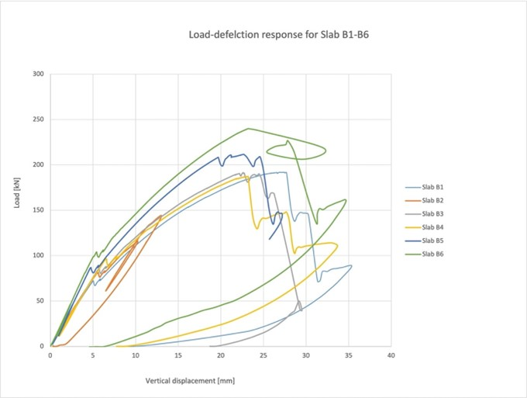
5. Laboratory testing (con.)
Load-deflection response for slab A1-A6
Load-deflection response for Slab B1-B6

Slide 11
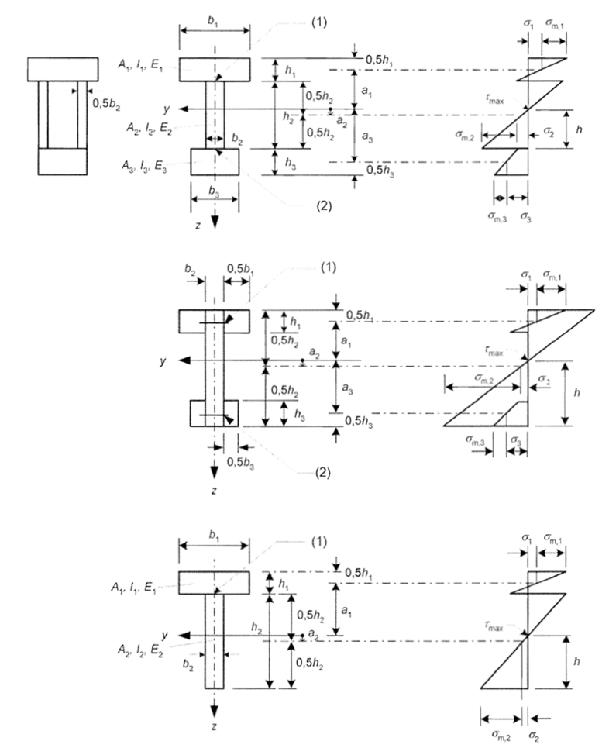
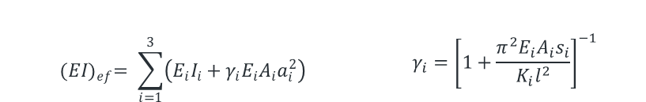
6. Theoretical prediction of load capacity and displacement
𝜸−method
  Mechanically jointed beams theory
  Limitations : 2/3 layered TCC
  Effective bending stiffness based on composite action
$${(EI)}_{ef}= \sum_{i=1}^{3}{\left(E_{i}I_{i}+γ_{i}E_{i}A_{i}a_{i}^{2}\right)}$$ | $$γ_{i}={\left[1+\frac{π^{2}E_{i}A_{i}s_{i}}{K_{i}l^{2}}\right]}^{−1}$$
Clause B.2:
EC 1995-1-1:2004+A1:2008+NA2010

Slide 12
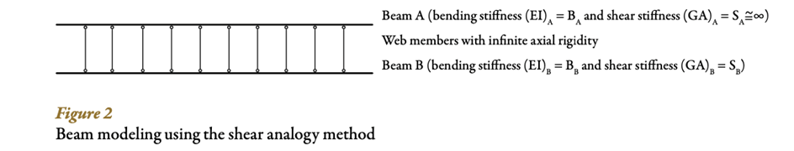
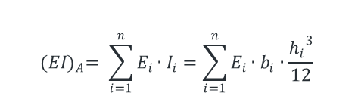
6. Theoretical prediction of load capacity and displacement (con.)
Shear analogy method
  Glued not nailed CLT
  No limitations to lamellae or shear fastener type
  The different moduli of elasticity of a single layer
  Shear deformation in longitudinal and transverse layer
$${(EI)}_{A}= \sum_{i=1}^{n}{E_{i}∙I_{i}=\sum_{i=1}^{n}{E_{i}∙b_{i}∙\frac{{h_{i}}^{3}}{12}}}$$
B. Douglas and E. Karacabeyli, “Structural design of cross laminated timber elements,”
in CLT Handbook – cross-laminated timber, US ed. Pointe-Claire,
QC, Canada: Library and Archives Canada Cataloguing in Publication, 2013, Chapter 3, p. 11

Slide 13
6. Theoretical prediction of load capacity and displacement (con.)
Short-term verification
Long-term verification
Alternative theoretical verification

Slide 14
6. Theoretical prediction of load capacity and displacement (con.)
TYPE OF THEORETICAL APPROACH | SHORT-TERM |  |  |  | LONG-TERM
 | LOAD CAPACITY (kN) |  | DISPLACEMENT (mm) |  | LOAD CAPACITY (kN) |  | DISPLACEMENT (mm)
 | A - CTC | B - KOP | A - CTC | B - KOP | A - CTC | B - KOP 3 | A - CTC | B - KOP
CONVENTIONAL APPROACH | 75.68 | 82.96 | 5.61 | 5.73 | 117.65 | 115.52 | 17.91 | 18.51
FAILURE OF TOP CLT (M3) | 136.52 | 133.90 | 9.86 | 10.13 | 188.88 | 116.04 | 18.34 | 18.82
FAILURE OF BOTTOM CLT (M4) | 177.93 | 166.44 | 14.36 | 13.82 | 153.93 | 143.62 | 26.33 | 25.41
CONVENTIONAL APPROACH USING B45 CONCRETE STRENGTH | 94.35 | 91.99 | 6.86 | 26.33 | 120.07 | 117.23 | 18.33 | 18.81
CONVENTIONAL APPROACH USING AVERAGE CONCRETE STRENGTH | 136.51 | 133.90 | 9.85 | 25.41 | 118.88 | 116.03 | 18.34 | 18.82

Slide 15
7. Discussion and comparison of the result
Observed failure scenarios
Limitations
Comparison of the theoretical and experimental results

Slide 16
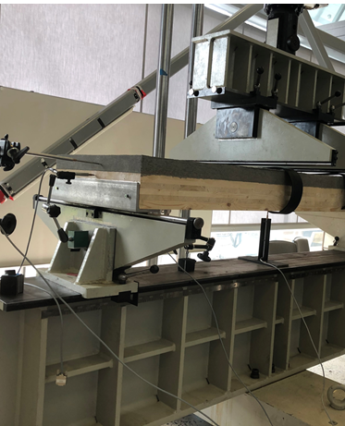
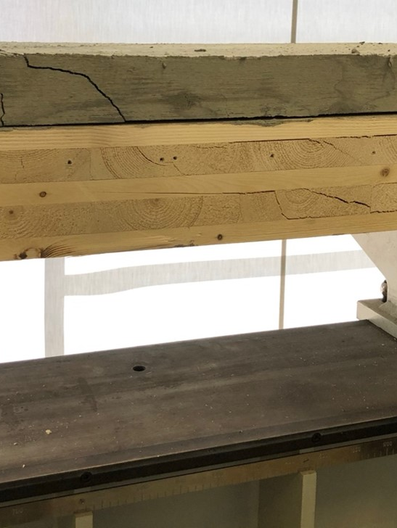
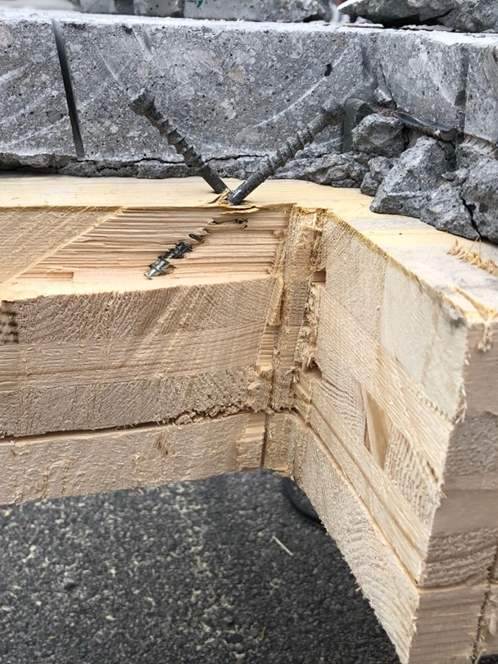
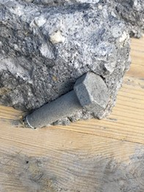
7. Discussion and comparison of the result (con.)
- Observed failure scenarios
Finger joint and knot failure in the timber
Cracks in both timber and concrete
Stability of slab A with CTC screws after four point bending test
Stability of slab B with KOP screws after four point bending test

Slide 17
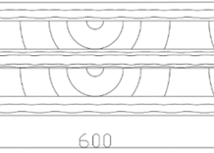
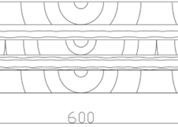
7. Discussion and comparison of the result (con.)
- Limitations of provided material
Length
Incorrect orientation of lamellae
Correct orientation of lamellae
SLAB | LENGTH
A2 | 2.068 m
A3 | 2.067 m
B5 | 2.069 m
C1 | 2.068 m
Concrete mix
Definition of failure
Theoretical vs. experimental predictions – long term

Slide 18
7. Discussion and comparison of the result (con.)
- comparison of theoretical predictions and experimental result
SLAB | DEFLECTION FOR NO COMPOSITE D_{N} (mm) | DEFLECTION FOR FULL COMPOSITE D_{C} (mm) | DEFLECTION MEASURED IN LAB TEST D_{I} (mm) | EFFICIENCY (%)
A1 | 5.547 | 5.612 | 6.160 | 9.616
A2 | 5.547 | 5.612 | 7.673 | 33.367
A3 | 5.547 | 5.612 | 6.859 | 20.586
A4 | 5.547 | 5.612 | 7.000 | 22.765
A5 | 5.547 | 5.612 | 8.586 | 47.963
A6 | 5.547 | 5.612 | 8.803 | 51.102
B1 | 6.354 | 5.725 | 5.037 | 2.094
B2 | 6.354 | 5.725 | 5.579 | 1.233
B3 | 6.354 | 5.725 | 5.730 | 0.993
B4 | 6.354 | 5.725 | 6.591 | -0.3767
B5 | 6.354 | 5.725 | 4.760 | 2.535
B6 | 6.354 | 5.725 | 5.436 | 1.466

Slide 19
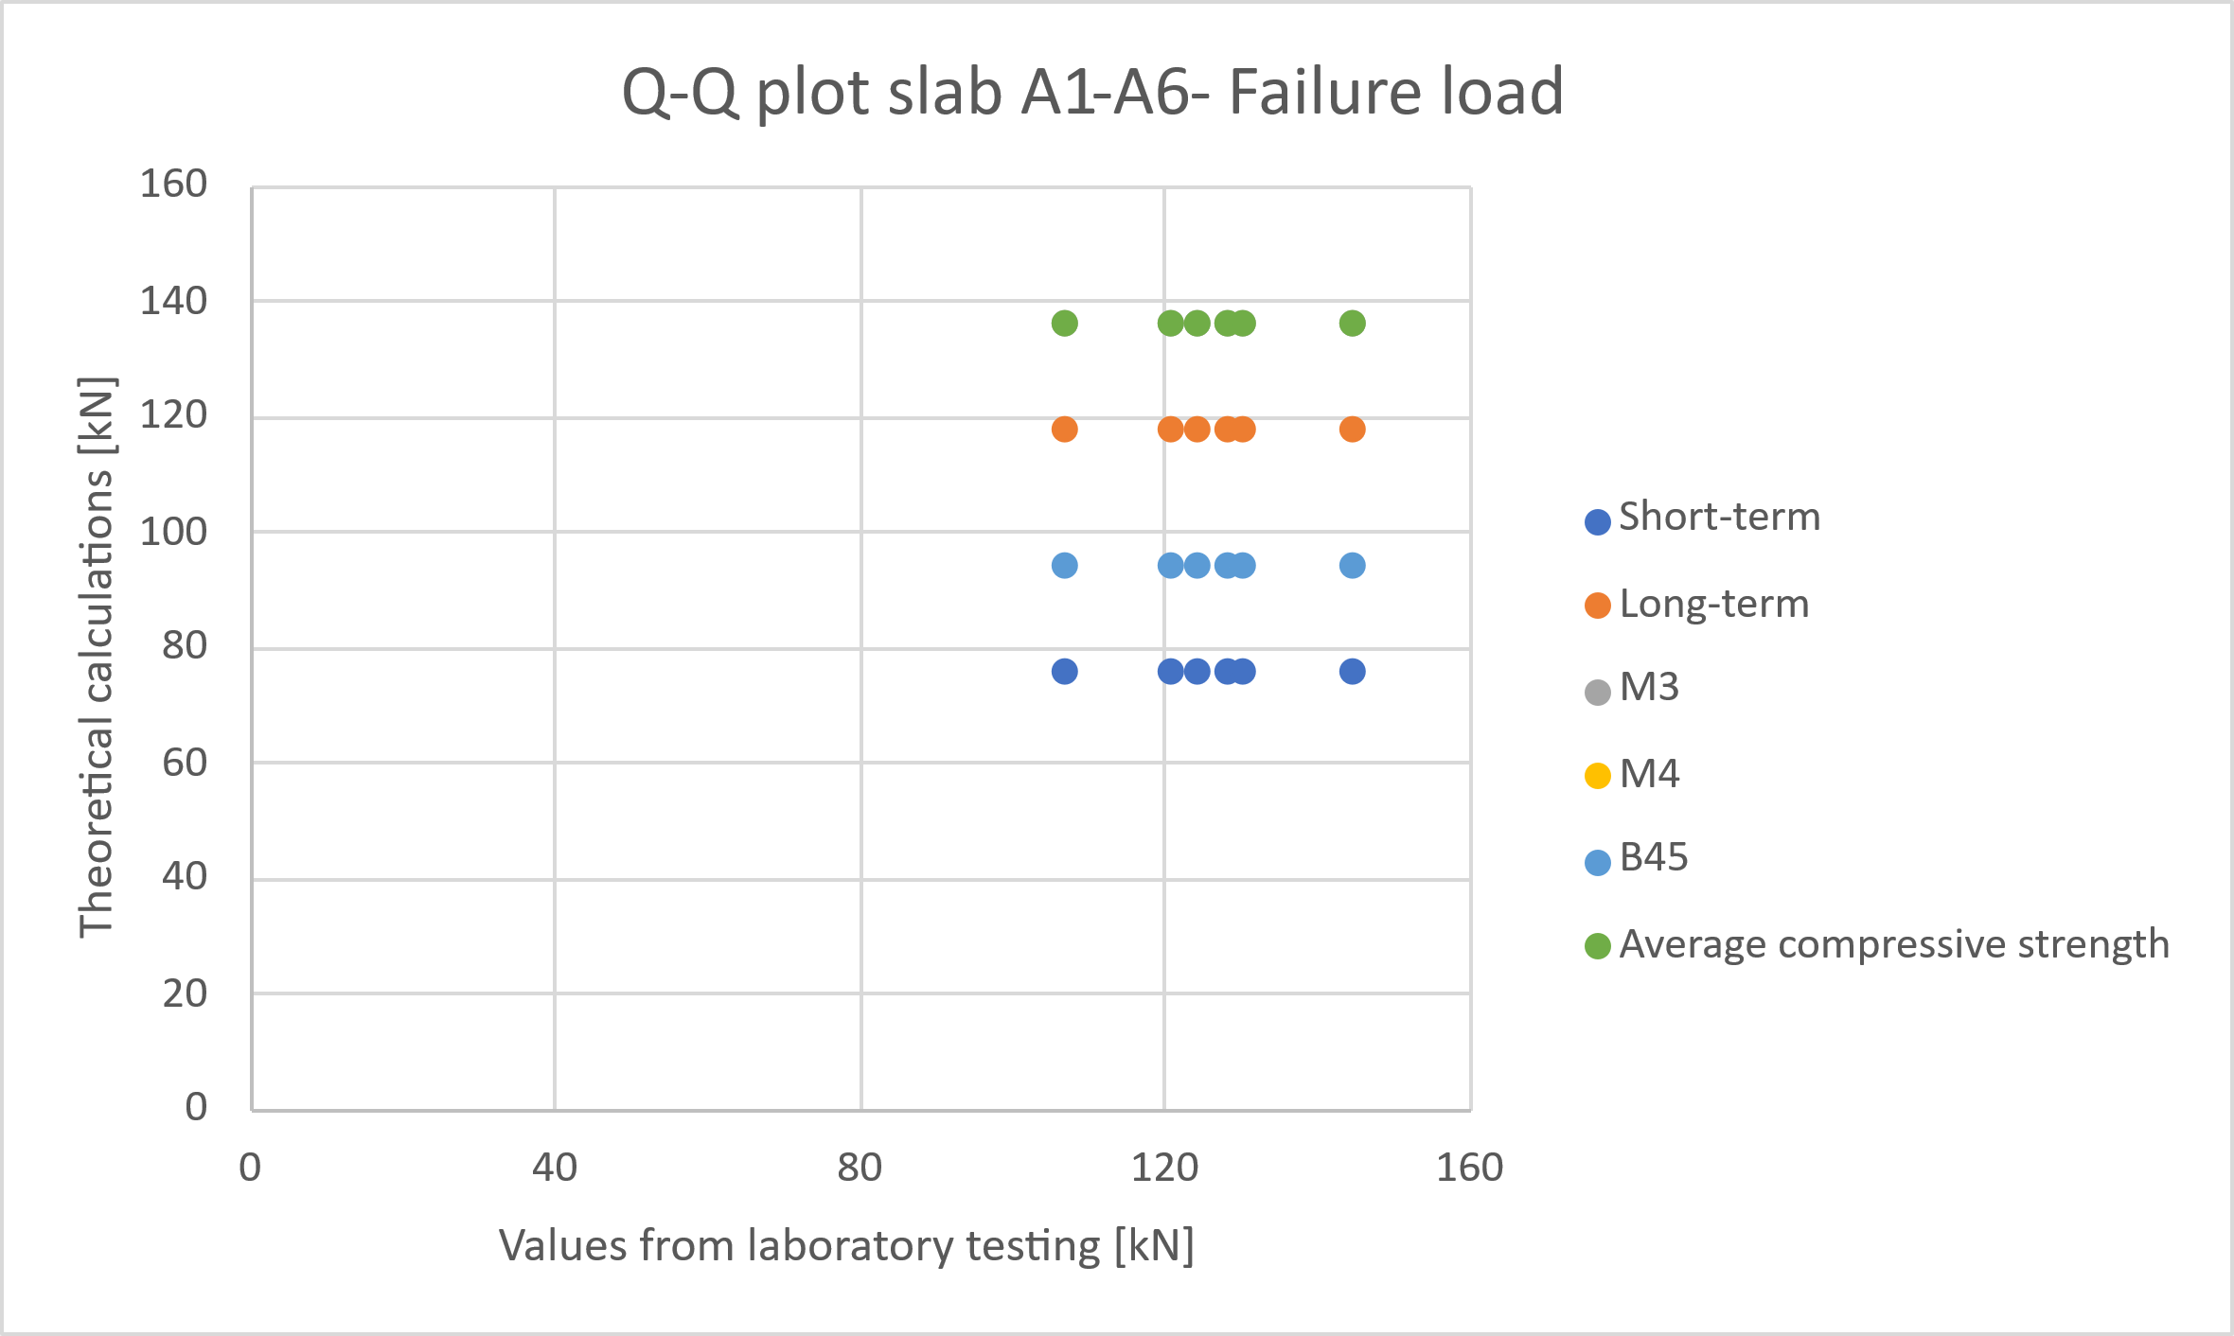
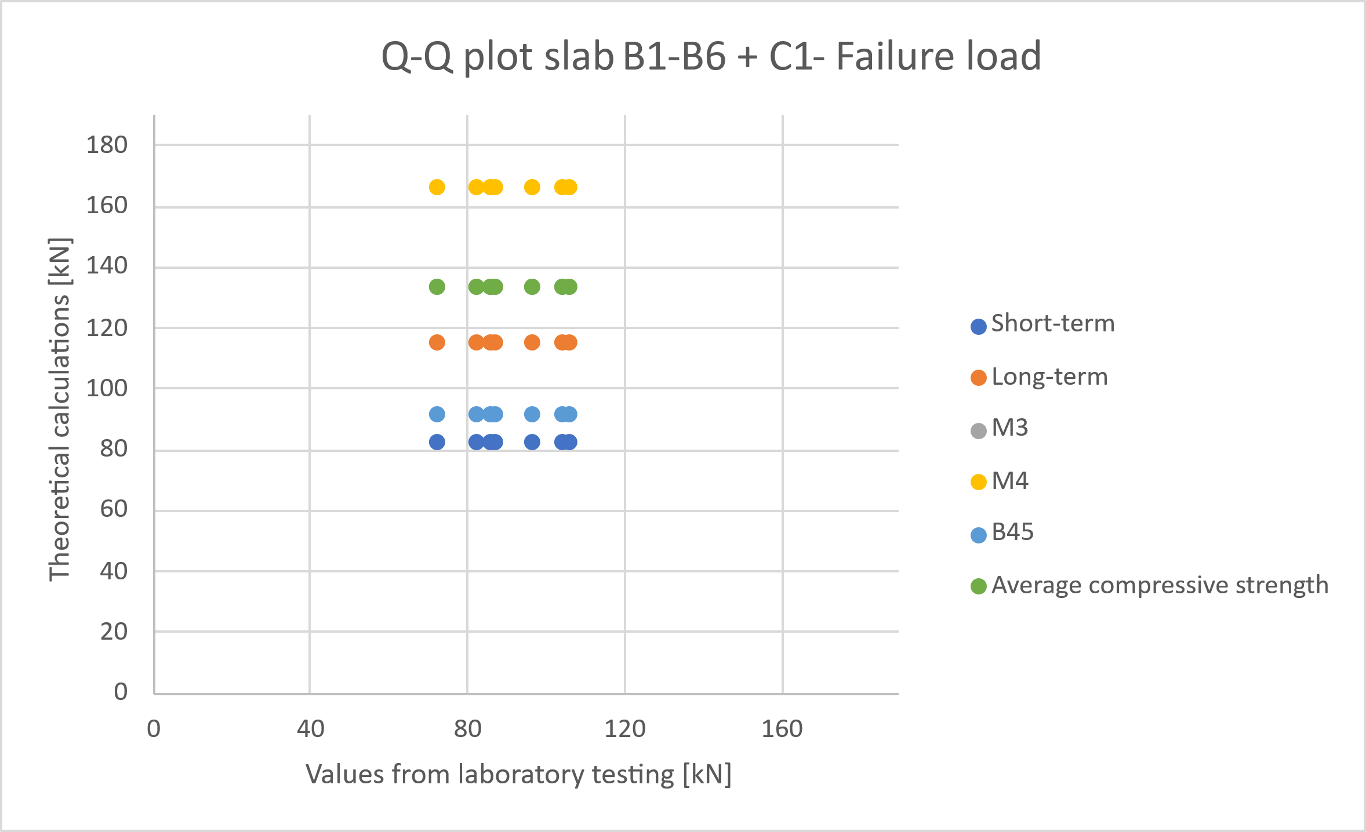
7. Discussion and comparison of the result (con.)
- comparison of theoretical predictions and experimental result

Slide 20
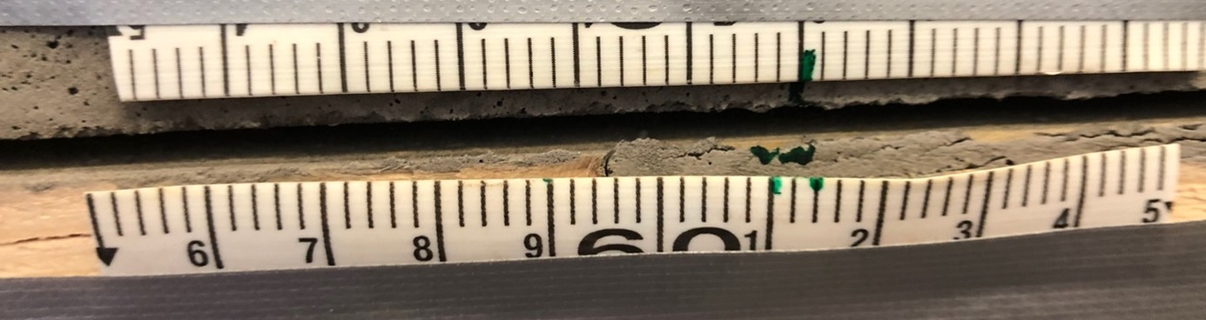
8. Conclusion
Key finding
  The load-displacement response
  Theoretical predictions vs. laboratory testing
Recommendations
  Additional testing with same five-layer CLT, concrete strength and fasteners type
  Enhanced instrumentation for slip behaviour (strain gauges)
  Further studies with exploring variations in fasteners type, spacing etc.

Slide 21

Acknowledgements
Jarle Berge, Samdar Kakay, Jan-Tore Jakobsen and Andreas Skaare – UiS
Eugenio Facchini, technical sales consultant in Rothoblaas

