Slide 1



Satellite-Based Damage Identification by Distributed Displacement Responses from SAR Images
2nd Olympiad in Engineering Science – OES 2025
Presenter: Wen Gao
Supervisor: Prof. Alireza Entezami
Affiliation: Department of Civil and Environmental Engineering, Politecnico di Milano, Milan, Italy
Date: 11/06/2025

Slide 2
Contents
01
02
03
Research Background
Methodology
Research Results
Traditional SHM pain points
Advantages of SAR technology
Displacement data acquisition
Anomaly detection model
Temporal displacement analysis
Damage localization results

Slide 3
Research Background
Traditional SHM pain points
Advantages and challenges of satellite remote sensing
Model-driven method:
SAR technology:
Rely on precise numerical models
Penetrate clouds, allowing for imaging in all weather conditions
High computational cost and difficult to scale
Continuous monitoring capacity
data-driven method:
Need for dense sensor networks
Core problem:
Expensive to deploy, monitoring blind spots
How to identify damage from sparse displacement data?
Notes:
Research status → research topic (Enhancing Structural Monitoring in Civil Engineering through Machine Learning and Statistical Techniques) → 3 key points (Problem addressed, Key focus, Emphasis)

Slide 4
Methodology —— Technology Overview
Graphical representation of distributed SAR-extracted displacement data
core process:
SAR image
Displacement extraction
Damage detection
Notes:
1. A brief explanation of AP clustering leads to the parameter P
2. Cutting from parameter P, a brief explanation of FOA was used.
3. Conclude with a sentence summarizing and highlighting the content and focus of the section (innovative).

Slide 5
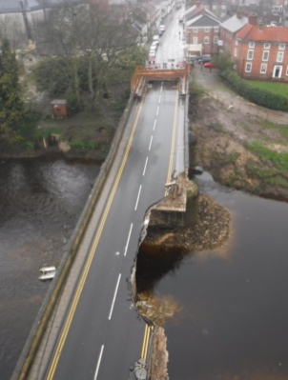
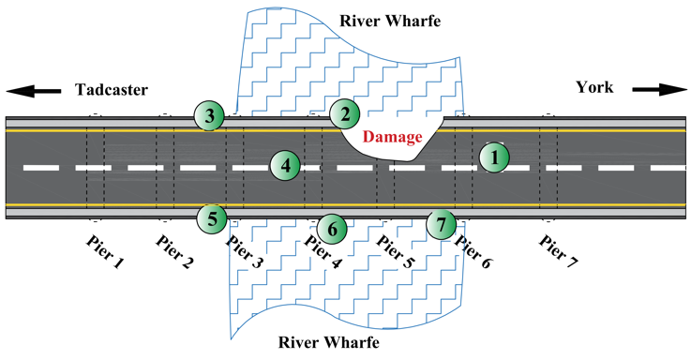
Methodology —— Displacement Data Acquisition
A picture of the bridge and the damaged area
Scattering point location
Key Steps:
Scattering point selection: prioritizing stability
DInSAR+SBAS technique to extract displacement
Phase disentanglement → actual displacement value
Notes:
1. A brief explanation of AP clustering leads to the parameter P
2. Cutting from parameter P, a brief explanation of FOA was used.
3. Conclude with a sentence summarizing and highlighting the content and focus of the section (innovative).

Slide 6



Methodology —— Anomaly Detection Model
Step 1: Calculate MSD and ESD
Mahalanobis distance (MSD):
Euclidean distance (ESD):
$$d_{E}^{(j)}=max⁡(\sum_{i=1}^{n}{(x_{ij}−μ_{j})^{2}})$$
$$d_{M}^{(j)}=max⁡( (x_{ij}−μ_{j})^{T}C_{j}^{−1}(x_{ij}−μ_{j}))$$
Step 2: Threshold estimation
Threshold estimation by Hamiltonian Monte Carlo sampler:
$$τ_{(1−α)}=\frac{1}{M}⁡\sum_{i=1}^{M}{Q_{(1−α)}^{(i)}}$$
Step 3: Determination
MSD/ESD＞ threshold
damage
Notes:
1. Briefly describe the principle of the DAD method.
Anomaly points make dense sets sparse
2. describe the method of calculating anomaly scores and the threshold.

Slide 7
Research Results —— Temporal Displacement Analysis
SAR-extracted displacement responses (D)
Key Findings:
Anomalous sudden increase in displacement at Point 2 (2015.11)
Significant deviation detected 11 days prior to collapse

Slide 8
Research Results —— Damage Localization Results
Damage identification by ESD: (a) training phase, (b) testing phase
Damage identification by MSD: (a) the training phase, (b) the testing phase
Conclusion:
Both models identify point 2 as exceeding the threshold.
The localization results are consistent with the actual collapsed area

Slide 9

Thanks for your attention!
Wen Gao
Supervisor: Prof. Alireza Entezami
Email: wen.gao@polimi.it

