Slide 1



Experimental Investigation of Smartphone MEMS Accelerometers Under Simulated Temperature and Humidity Changes for Long-Term SHM Programs
2nd Olympiad in Engineering Science – OES 2025
Author: Alireza Entezami
Department of civil and environmental engineering, Politecnico di Milano, Milan, Italy

Slide 2
Introduction
Smartphone sensing is an emerging tool in SHM, especially for large-scale civil structures.
Built-in sensors of sensors such as accelerometers, gyroscopes, and GPS enable vibration and vision-based monitoring of civil structures, particularly bridges.
Smartphones support real-time wireless data transmission via IoT connectivity.
For vibration-based monitoring, tri-axial capacitive MEMS accelerometers record vibrations in lateral, longitudinal, and vertical directions.
Despite moderate sensitivity (1–3 mg), smartphone accelerometers are effective for high-amplitude vibrations.

Slide 3
Challenges
Capacitive MEMS accelerometers are sensitive to temperature and humidity.
Temperature can cause thermal stress, misalignment, and bias drift (zero-point errors).
Humidity can lead to internal corrosion and capacitance changes, affecting sensor output.
Environmental factors also alter structural material properties, causing overlap in sensor and structural responses.
This can lead to misinterpretation of data and false assessment of structural conditions.

Slide 4
Possible Solutions
Unsupervised anomaly detection models can identify environmentally induced sensor anomalies.
Unsupervised anomaly detectors are generally developed from statistical and artificial neural network models.
These models isolate true structural behavior without requiring prior environmental data.
Structural behavior isolation enhances SHM reliability by filtering noise and improving response interpretation.

Slide 5
Aim and Scope
This research conducts a lab-scale experimental program to assess the impact of extreme environmental conditions on smartphone MEMS accelerometer performance.
A smartphone and a digital temperature/humidity recorder are used to collect tri-axial acceleration time histories and temperature and humidity data.
Three unsupervised outlier detectors are suggested to detect outliers caused by environmental conditions.
These models include Isolation Forest (IF), Robust Random Cut Forest (RRCF), and One-Class Support Vector Machine (OC-SVM).

Slide 6
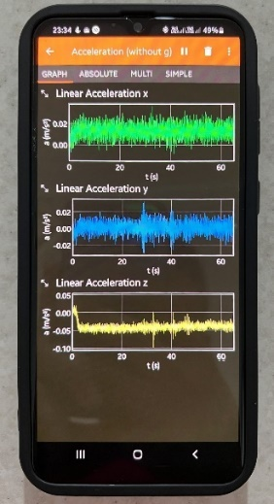
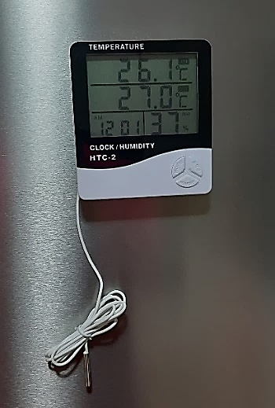
Experimental Program
Smartphone
Temperature/Humidity Sensor

Slide 7
Experimental Program
The experimental program is performed under the total of 40 test measurements in controlled lab conditions.
Each test includes synchronized recording of acceleration, temperature, and humidity.
Test scenarios span five environmental categories
Test conditions | Temperature (⸰C) |  | Humidity (%) |  | Test no.
 | Min | Max | Min | Max
Extremely cold and dry | -8.7 | -23.4 | 38 | 43 | 1 – 10
Cold and moderately humid | 2.1 | 8.4 | 32 | 58 | 11 – 20
Extremely hot and humid | 22.2 | 29.7 | 70 | 96 | 21 – 26
Mild and dry | 20.6 | 21.2 | 33 | 35 | 27 – 30
Extremely warm and dry | 27.6 | 41.0 | 28 | 40 | 31 – 40

Slide 8
Results
Temperature is the dominant factor influencing sensor response.
Extreme cold (Tests 8–10, down to –23.4°C) and extreme heat (Test 35, up to 41°C) cause significant spikes in RMS values.
RMS values of the vertical acceleration (z-axis) exhibit highest variability, especially under cold and hot extremes.
RMS values of the lateral acceleration (x-axis) show spikes at Tests 10 and 36 (cold and warm extremes).
RMS values of the longitudinal acceleration (y-axis) indicate smaller changes but spikes at the extreme warm condition.
Humidity causes moderate fluctuations, but effects are less significant than temperature.

Slide 9
Results
Three unsupervised outlier detection models (i.e., IF, RRCF, OC-SVM) were applied to detect temperature-induced sensor anomalies.
These models detect outliers in smartphone accelerometer data using RMS acceleration data across all tests, leading to a matrix of 40 observations from three variables.
All models detected key anomalies at: Test 10 (extremely cold, –23.4°C) and Test 36 (extremely hot, 41°C).
IF and RRCF showed some false detections, likely due to noise in lateral/longitudinal axes.
OCSVM outperformed the others by accurately identifying true outliers with fewer false positives. It is more robust when vertical RMS dominates temperature-related effects

Slide 10
Results
IF-Based Outlier Detection
RRCF-Based Outlier Detection
OC-SVM-Based Outlier Detection

Slide 11
Thanks for your attention!

