Slide 1


A Numerical Investigation into Freezing Impacts on the Dynamic Behavior of Bridges
2nd Olympiad in Engineering Science – OES 2025
Author: Mohammad Omidi^{1,2}, Alireza Entezami², Alberto Corigliano²
1 Department of Thermal and Fluid Engineering, University of Twente, Netherlands
2 Department of civil and environmental engineering, Politecnico di Milano, Milan, Italy

Slide 2
Motivation and Problem Statement
The Challenge: Seasonal temperature changes cause materials like steel and concrete to expand and contract, altering a bridge's structural properties .
Impact on Monitoring: These changes affect modal frequencies, which are key indicators in Structural Health Monitoring (SHM). Temperature effects can mimic or mask the signs of actual structural damage .
The Freezing Problem: In cold climates, water freezing within concrete pores causes a temporary increase in stiffness. This "freezing-induced stiffening" complicates damage detection further .
Study Aim: To numerically model the effects of freezing on a bridge's dynamic behavior to help distinguish environmental effects from structural damage .

Slide 3

Case Study: The I-40 Bridge
Structure: A multi-span steel plate-girder bridge with a composite concrete deck, formerly located over the Rio Grande in New Mexico.

Slide 4
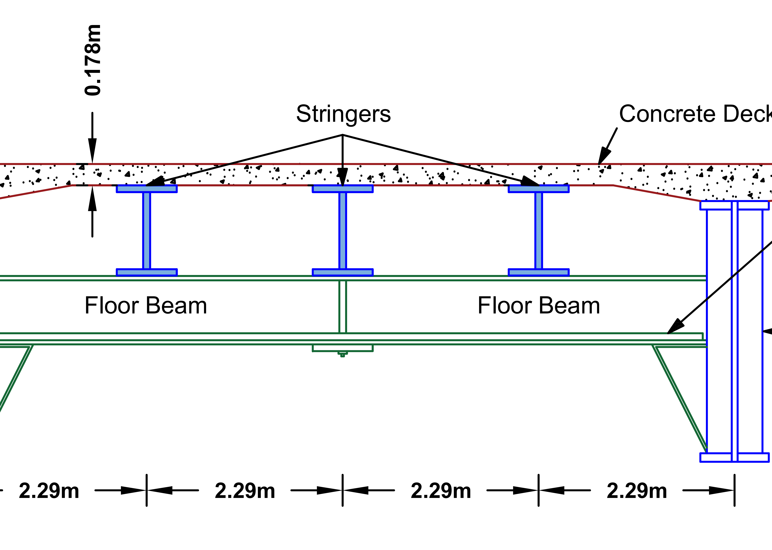
Case Study: The I-40 Bridge
Model Focus: A three-span section of the bridge was modeled for this study.
Key Components:
  Two main longitudinal steel plate girders.
  A reinforced concrete deck.
  Three intermediate steel stringers and transverse floor beams.
Material Properties (at reference temperature):
  Steel: Elastic Modulus of 200 GPa.
  Concrete: Elastic Modulus of 24.8 GPa

Slide 5
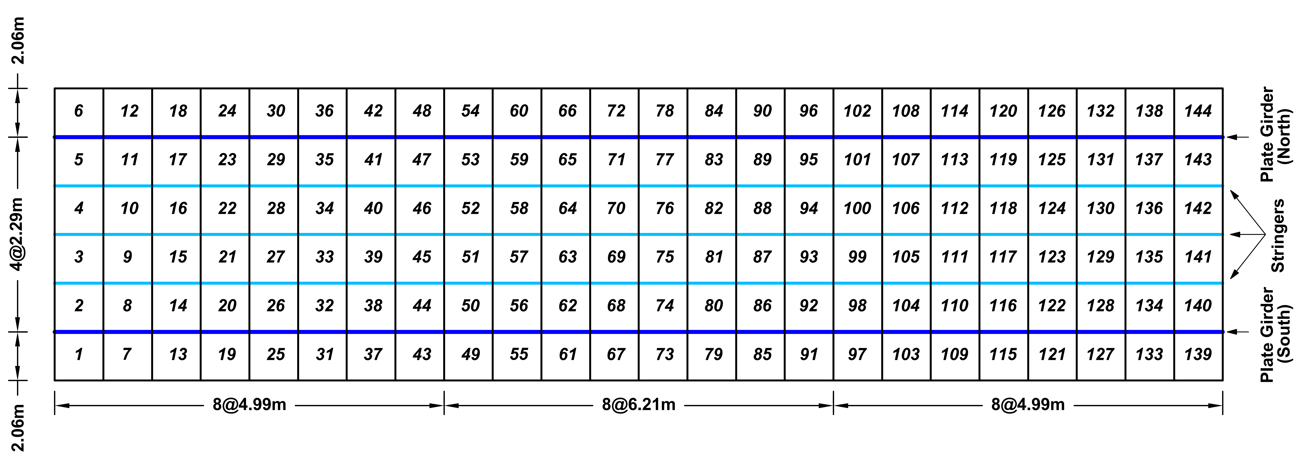
Methodology: Finite Element Model (FEM)
A detailed Finite Element (FE) model of the I-40 bridge was created in the MATLAB environment.
Model Composition:
  Shell Elements (192 total): Used for the concrete deck and girder webs.
  3D Beam Elements (280 total): Used for girder flanges, stringers, floor beams, and piers.
The model incorporated fixed supports and spring elements to realistically simulate the boundary conditions and stiffness from adjacent, unmodeled sections of the bridge

Slide 6
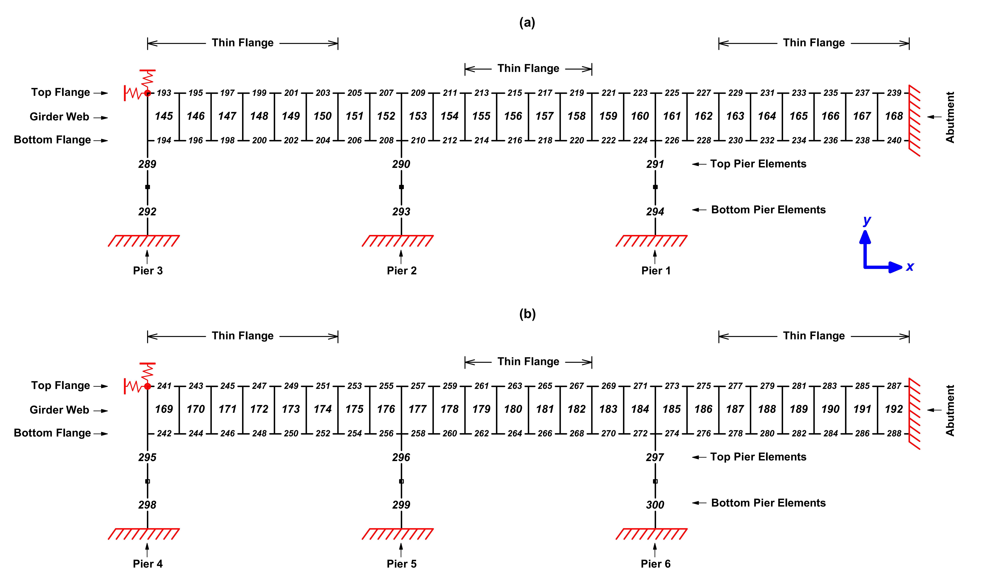
FEM model of the I-40 Bridge

Slide 7
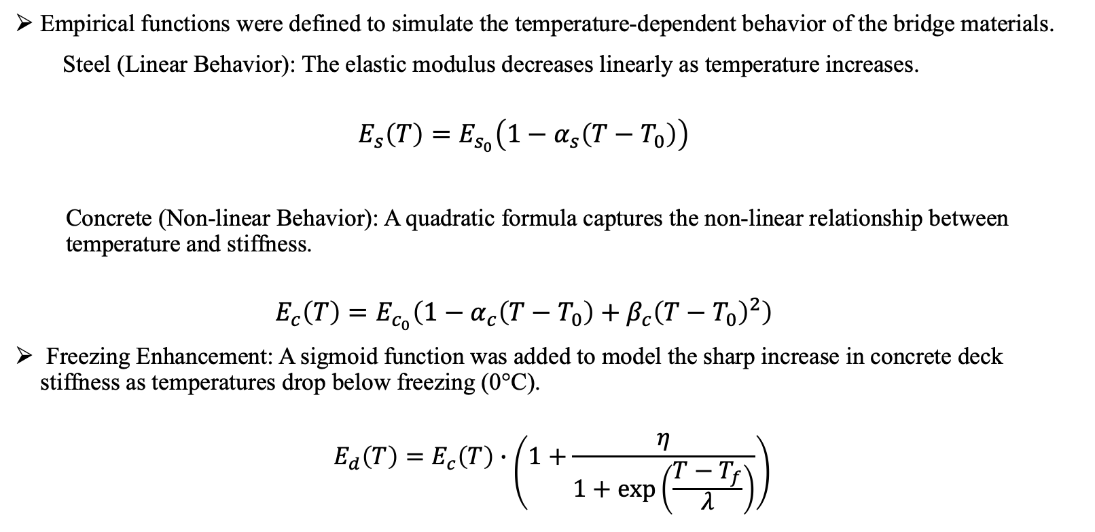
Methodology: Modeling Temperature Effects
Empirical functions were defined to simulate the temperature-dependent behavior of the bridge materials.
Steel (Linear Behavior): The elastic modulus decreases linearly as temperature increases.
$$E_{s}\left(T\right)=E_{s_{0}}\left(1−α_{s}\left(T−T_{0}\right)\right)$$
Concrete (Non-linear Behavior): A quadratic formula captures the non-linear relationship between temperature and stiffness.
$$E_{c}\left(T\right)=E_{c_{0}}\left(1−α_{c}\left(T−T_{0}\right)+β_{c}{\left(T−T_{0}\right)}^{2}\right)$$
Freezing Enhancement: A sigmoid function was added to model the sharp increase in concrete deck stiffness as temperatures drop below freezing (0°C).
$${ E}_{d}\left(T\right)=E_{c}\left(T\right)∙\left(1+\frac{η}{1+\exp\left(\frac{T−T_{f}}{λ}\right)}\right)$$

Slide 8
Simulation & Analysis
Input Data: The model was subjected to a full year of actual temperature data (October 2022–October 2023), with a range from -18°C to 41°C.
Analysis: Modal analysis was performed using the Ritz method to extract the modal frequencies and mode shapes of the bridge under varying temperatures.
Focus: The simulation tracked the evolution of the first four distinct vibration modes to observe their sensitivity to thermal changes .

Slide 9
Results: Impact on Modal Frequencies
The simulation confirmed that modal frequencies are highly sensitive to temperature.
Freezing Conditions: During winter, freezing temperatures caused a significant increase in the modal frequencies, reflecting the stiffening of the concrete deck.
Warm Conditions: In summer, higher temperatures led to a slight decrease in modal frequencies, indicating reduced structural stiffness.
These findings show strong agreement with data from real-world bridge monitoring studies

Slide 10
Results: Impact on Mode Shapes
In contrast to frequencies, the fundamental mode shapes remained almost identical across the entire temperature range.
Analysis: The Modal Assurance Criterion (MAC) was used to compare the mode shapes at the extreme minimum (-18°C) and maximum (41°C) temperatures.

Slide 11
Results: Impact on Mode Shapes
Finding: The self-MAC values for the first four modes were all above 0.98, confirming that the spatial deformation patterns of the bridge are robust and largely unaffected by uniform temperature changes.

Slide 12
Conclusions
The numerical model successfully replicated the dynamic behavior of a bridge under seasonal temperature variations, especially freezing.
Key Finding 1: Freezing significantly increases concrete stiffness and, consequently, modal frequencies. This underscores the risk of misinterpreting SHM data, where such shifts could be mistaken for structural changes.
Key Finding 2: Mode shapes demonstrated high stability despite large temperature fluctuations, suggesting they may be a more reliable indicator for damage detection in climates with extreme temperature swings.
Implication: Accounting for thermal effects is critical for developing reliable SHM systems to avoid false alarms and ensure the accurate assessment of bridge health in cold regions .

Slide 13

Thanks for your attention!

