Slide 1
Mitigating Variability in Bridge Displacement Responses through Synergistic Use of Supervised and Unsupervised Artificial Neural Networks
June, 12th, 2025 | Chen Zheng-Han

Slide 2
Contents
Introduction
Proposed Framework
  2.1 SMOGN technique
  2.2 GRU model
Application: Hardanger Bridge
Prediction of Vertical Vibration Responses
Conclusion

Slide 3
Introduction
01

Slide 4
Mitigating Variability in Bridge Displacement Responses through Synergistic Use of Supervised and Unsupervised Artificial Neural Networks
Introduction Existing work
Background
SHM ensures bridge safety/longevity; real-time monitoring demand grows with infrastructure durability needs.
SHM
(Structural Health
Monitoring)
Existing Studies
Sensor-based SHM measures responses/environmental factors; SAR remote sensing extracts displacements for inaccessible bridges.
Challenges
Environmental factors (temp, extreme weather) interfere with SAR displacements, causing misinterpretations from incomplete data/variability

Slide 5
Mitigating Variability in Bridge Displacement Responses through Synergistic Use of Supervised and Unsupervised Artificial Neural Networks
Introduction This study
Framework
Dual supervised/unsupervised learning normalizes SAR displacement data to eliminate environmental noise.
Step 1: SR-ANN
Uses temperature/displacement data to model relationships; R-squared evaluates correlation for residual calculation.​
Step 2: UR-ANN
Reconstructs displacement data alone when correlation is low to extract noise-reduced residuals.
Advantages
Handles measured/unmeasured factors, requires few sensors, validates accurately on long-span bridges.

Slide 6
Proposed Technique
02

Slide 7
Mitigating Variability in Bridge Displacement Responses through Synergistic Use of Supervised and Unsupervised Artificial Neural Networks
Proposed Technique Framework
★
Hybrid Framework
Combines supervised ANN (using predictors and responses) and unsupervised ANN (using only responses) for data normalization.
Supervised Processing
01
Trains SR-ANN to predict responses and compute residuals; assesses via R² (>0.9).
Unsupervised Processing
02
Fig. Graphical flowchart of the proposed framework
If R² <0.9, activates UR-ANN using only response data for reconstruction/normalization.

Slide 8
Real-world Bridge Structure
03

Slide 9
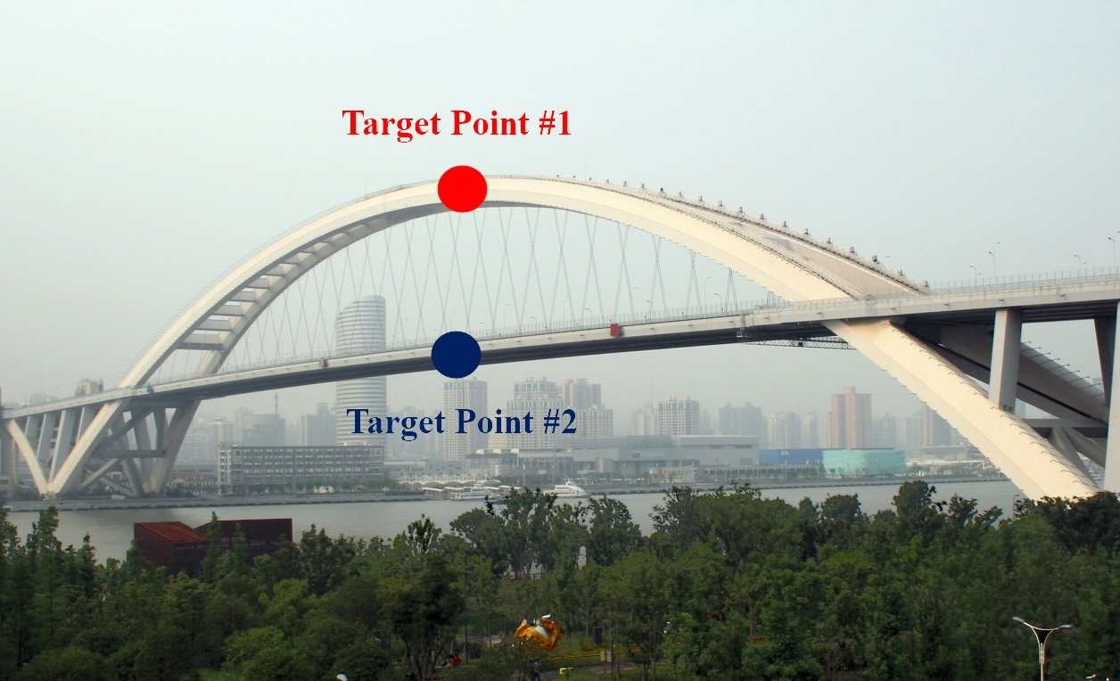
Mitigating Variability in Bridge Displacement Responses through Synergistic Use of Supervised and Unsupervised Artificial Neural Networks
Real-world Bridge Structure Overview
Span Configuration
1
550-meter main span + two 100-meter side spans.
Girder Design
2
Main girder: Open steel box-beams with cross-beams (39.5m width × 2.7m height).
Structural Connections
3
Side span girders attach to arch ribs. Main span girders rest on sliding bearings at arch cross-beam intersections.
Fig. Bridge with target points

Slide 10
Mitigating Variability in Bridge Displacement Responses through Synergistic Use of Supervised and Unsupervised Artificial Neural Networks
Real-world Bridge Structure Overview
Monitoring Motivation
1
Bridge performance significantly affected by geological / environmental factors.
SHM Data
2
1-year SAR monitoring extracted displacements at arch and girder; contact sensors recorded temperature.
Synthetic aperture radar(SAR) Data
3
SAR-extracted displacements (arch & girder) and concurrent temperature data were collected in 2009-2010.
Fig. Recorded data (a)displacement responses; (b)temperature

Slide 11
Results and Discussions
04

Slide 12

Mitigating Variability in Bridge Displacement Responses through Synergistic Use of Supervised and Unsupervised Artificial Neural Networks
Results and Discussions SR-ANN
D
ataset
Temperature & original displacement
H
yperparameter
Bayesian hyperparameter optimization tuning
A
ssessment
use $R^{2}$ to determine if perform UR-ANN
Hyperparameters and Residual
Component | Layer no. | Neurons | R²
Arch | 1 | 5 | 0.8352
Girder | 2 | 6, 7 | 0.9222
Fig. Output of SR-ANN (comparison between the original and predicted responses; normalized responses)

Slide 13
Mitigating Variability in Bridge Displacement Responses through Synergistic Use of Supervised and Unsupervised Artificial Neural Networks
Results and Discussions UR-ANN
D
ataset
Original displacement
H
yperparameter
Bayesian hyperparameter optimization tuning
E
nhancement
Significantly improve the accuracy of Girder
Hyperparameters and Residual
Component | Layer no. | Neurons | R²
Arch | 1 | 7 | 0.9461
Girder | 1 | 7 | 0.9711
Fig. Output of UR-ANN (comparison between the original and predicted responses; normalized responses)

Slide 14
Conclusion
05

Slide 15
Mitigating Variability in Bridge Displacement Responses through Synergistic Use of Supervised and Unsupervised Artificial Neural Networks
Conclusion
Proposed hybrid framework
Synergistic integration of supervised (SR-ANN) and unsupervised (UR-ANN) models for environmental normalization of SAR-extracted displacements.
Key findings
SR-ANN (temperature + displacements) achieves reliable normalization when R² > 0.9.
UR-ANN (displacement) outperforms SR-ANN in arch displacement normalization, handling unmodeled variability.
Automatic switching between models ensures optimal performance across data scenarios.

Slide 16
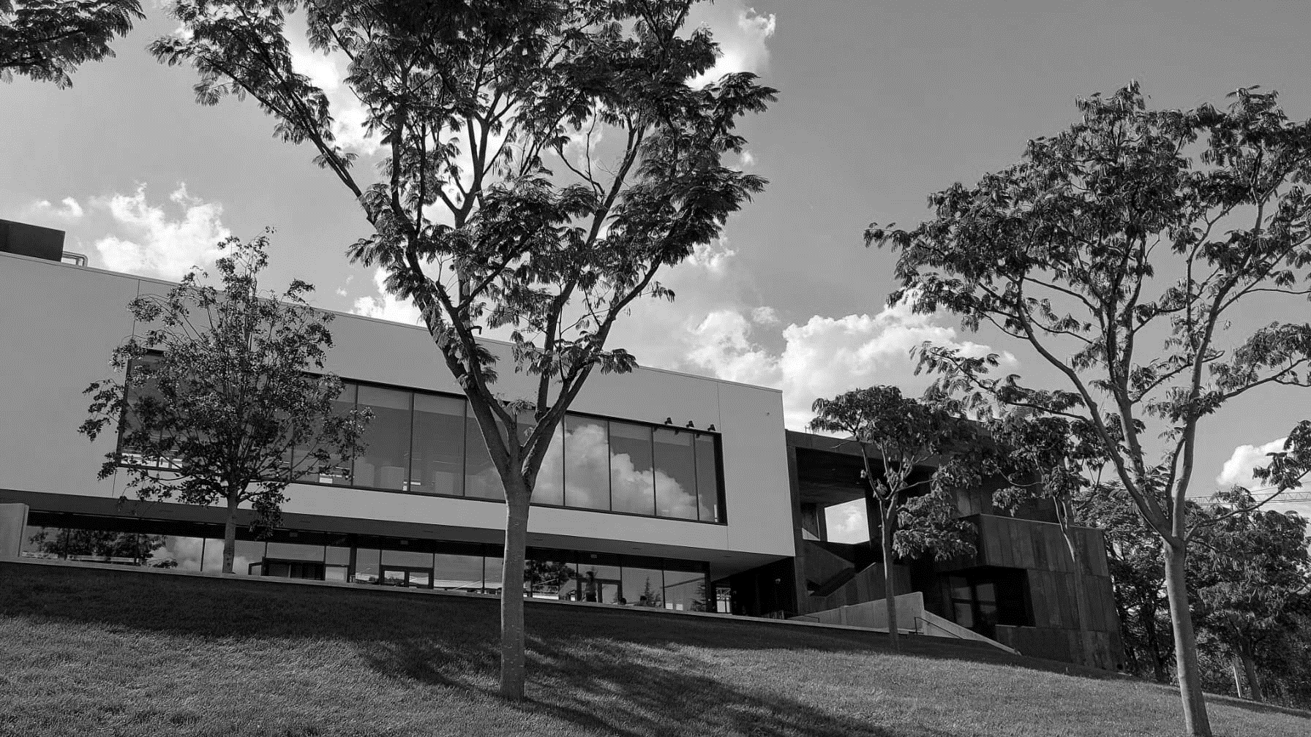
Thank you for your attention.
Chen Zheng-Han

