Slide 1
Low-Carbon Composite Mortar With High Cement Replacement Ratios Using Volcanic Pozzolan and Silicon Manganese Slag
Dileepa Hettiarachchi, Albert Gomez Meldahl, S.M Samindi M.K Samarakoon and Hassan Sharif Isaq Sharif Omar,
Department of Structural and Mechanical Engineering and Materials Science, University of Stavanger, Norway
2nd Olympiad in Engineering Science - OES 2025

Slide 2
Content
Introduction
Objective
Materials
Experimental Program
Results and Discussion
Conclusions
Acknowledgements
References

Slide 3
Introduction
Of global CO₂ emissions from the concrete industry.
8.0%
Tons of CO₂ released from cement production.
1.6 Billion
(Statista, 2025)
Reduction of CO₂ emissions required by the Paris Climate Agreement for the concrete industry.
16.0%
(Slanger and Skinner, 2025)
Notes:
2.4 billion tons of CO2 from the industry as a whole in 2023, 1.6 of that is from direct production of cement

Slide 4
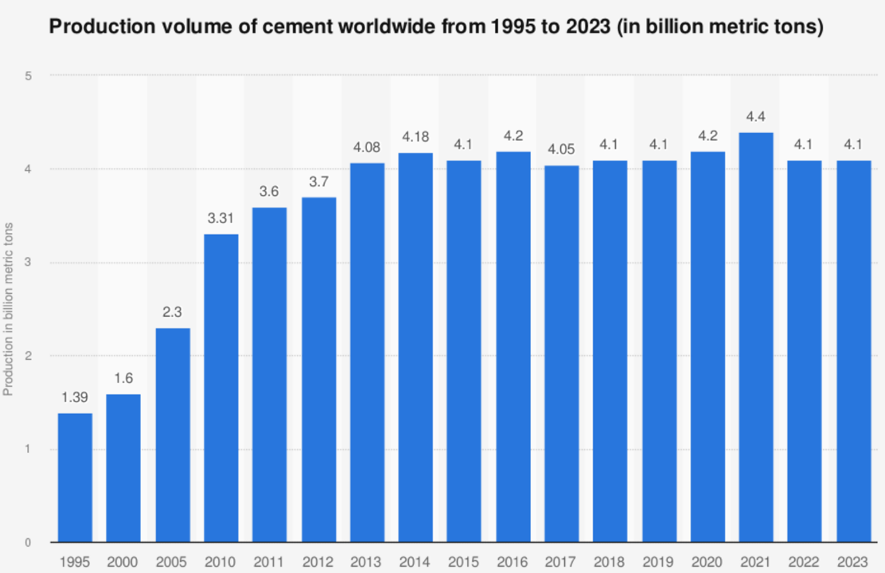
Cement Production over Time
(Statista, 2025)
Notes:
Cement production levels have remained steady, but are already too high, and with increased urbanization and the need for further development in the energy sector, more concrete will be needed, and concrete is unlikely to be phased out anytime soon.

Slide 5
Reduce the amount of Cement in Concrete
Reduce Cement CO₂ Emission
Optimize the use of Concrete Use
Wood
Reduce Clinker
Steel
Reduce Cement to Clinker Ratio
Carbon Capture &
Storage
Higher Energy Efficiency
Geo- Polymer
Cleaner Energy Sources
Biological
Energy
Recovery
Better Insulation
Geological
Renewable Energy
Pre- Heating of
Clinker
Notes:
High temperature processes are very hard to make fully electric, fuel is much easier.

Slide 6
Reduce the amount of Cement in Concrete
Reduce the amount of Cement in Concrete by partial replacement
Supplementary Cementitious Materials (SCMs)
Reduce Cement CO₂ Emission
Reduce Cement CO2 Emission
Optimize the use of Concrete Use
Wood
Reduce Clinker
Steel
Reduce Cement to Clinker Ratio
Carbon Capture &
Storage
Carbon Capture
Higher Energy Efficiency
Higher Energy Efficiency
Geo- Polymer
Cleaner Energy Sources
Cleaner Energy Sources
Biological
Energy
Recovery
Better Insulation
Geological
Renewable Energy
Pre- Heating of
Clinker
Renewable Energy
Notes:
High temperature processes are very hard to make fully electric, fuel is much easier.

Slide 7
Existing SCMs
Fly Ash
Blast Furnace/steel Slag
Natural Pozzolana
Limestone
Silica fume
Technology Roadmap - Low-Carbon Transition in the Cement Industry
Notes:
Limited supplies of each, fly ash is running out, natural pozzolana is not used as much as the others. existing SCMs are limited in supply, and the key one, Fly ash the mostly wide used one is produced as a byproduct of the dirty use of coal power plants, which there are now far fewer of

Slide 8
Objectives
The objective of this study is to investigate the use of Icelandic Volcanic Pozzolan (VPI) as a partial replacement for Ordinary Portland Cement (OPC), both in binary and ternary mortars with Silicon manganese slag (SiMn slag).

Slide 9
Material Details
Material | Supplied by | Reference Standard
CEM I 52.5 R cement | Heidelberg Materials- Norway | NS-EN 197-1:2011
VPI | Heidelberg Materials- Norway
SiMn slag | ERAMET-Norway
Sand | manufactured sand –Heidelberg Materials Aggregate Årdal, Stavanger, Norway | NS-EN 2620:2002+A1:2008+NA:2016 & NB21
Superplasticizer: Dynamon SX-N | MAPEI, Norway
Water | Local treated Potable tap water

Slide 10
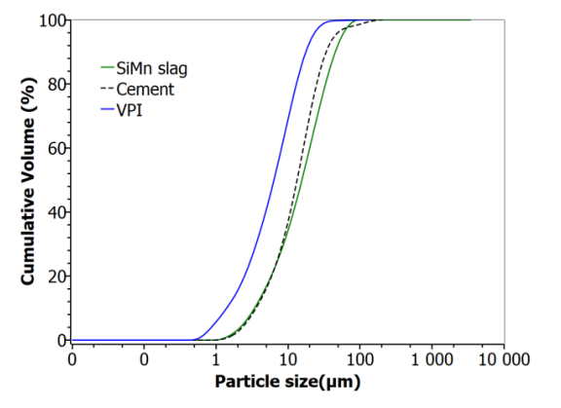
Particle Size Distribution
PSD was conducted with a PSD analyzer in wet conditions.
VPI, followed by Cement, then SiMn slag has increasing particle size.
Raw Material | Cement | VPI | SiMn slag | Sand
Dv,90 (µm) | 38.7 | 20.2 | 51.7 | 1690
Dv,50 (µm) | 15.2 | 7.25 | 17.7 | 658
Dv,10 (µm) | 4.1 | 1.6 | 3.9 | 152
BET, Specific surface area (m²/g) | 1.76 | 2.84 | 0.96 | -

Slide 11
XRF Studies
Material | SiO₂ | Al₂O₃ | CaO | MgO | Na₂O | K₂O | MnO | TiO₂ | SO₃ | P₂O₅ | SrO₂ | Fe₂O₃
Cement | 23.59 | 5.05 | 59.14 | - | - | 2.01 | 0.1 | 0.25 | 5.51 | 0.35 | 0.09 | 3.84
SiMn slag | 46.86 | 9.91 | 26.05 | 3.85 | - | 1.03 | 7.15 | 0.05 | 0.55 | - | 0.58 | 0.13
VPI | 53.36 | 7.86 | 16.52 | 3.18 | - | 0.52 | 0.29 | 1.46 | - | 0.13 | - | 16.67
Sand | 79.76 | 8.15 | 2.22 | - | - | 5.31 | 0.07 | 0.32 | - | - | 0.13 | 3.87
SiO₂, CaO and Al₂O₃ are the primary components of VPI and SiMn slag, collectively comprising between 77 and 83% of the mass. VPI has the lowest quantity with 77.74% compared to Cement, with 87.78%.
VPI has the lowest CaO and highest SiO₂, while SiMn slag has the highest Al₂O₃ and MnO

Slide 12
Mix Proportions
Mortar type | Cement replaced % | VPI % | SiMn Slag % | Material requirement (g) for 1 kg of Concrete
 |  |  |  | Cement | VPI | SiMn slag | Sand | Water | Admixture
Control (C) | - | - | - | 230 | - | - | 695.5 | 73.3 | 2.3
Binary-2 (B2) | 50 | 50 | - | 114.7 | 114.7
Binary-3 (B3) | 70 | 70 | - | 68.8 | 160.6
Binary-4 (B4) | 90 | 90 | - | 22.9 | 206.4
Ternary-2 (T2) | 50 | 30 | 20 | 114.7 | 68.8 | 45.9
Ternary-3 (T3) | 70 | 50 | 20 | 68.8 | 114.7 | 45.9
Ternary-4 (T4) | 90 | 70 | 20 | 22.9 | 160.6 | 45.9
W/C ratio = 0.35
SP Dose = 1% of Binder
Specimen Size = 50 x 50 x 50 mm

Slide 13
Results and Discussion

Slide 14
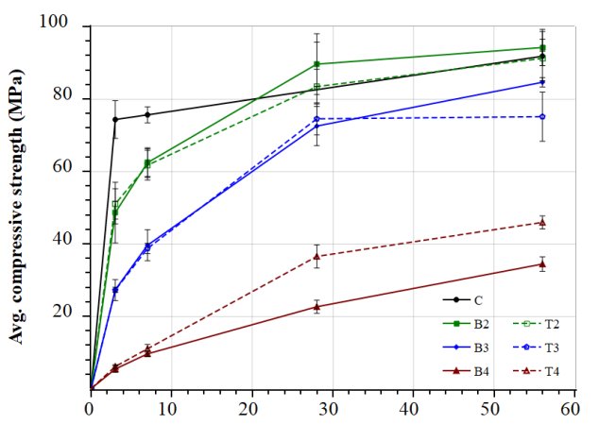
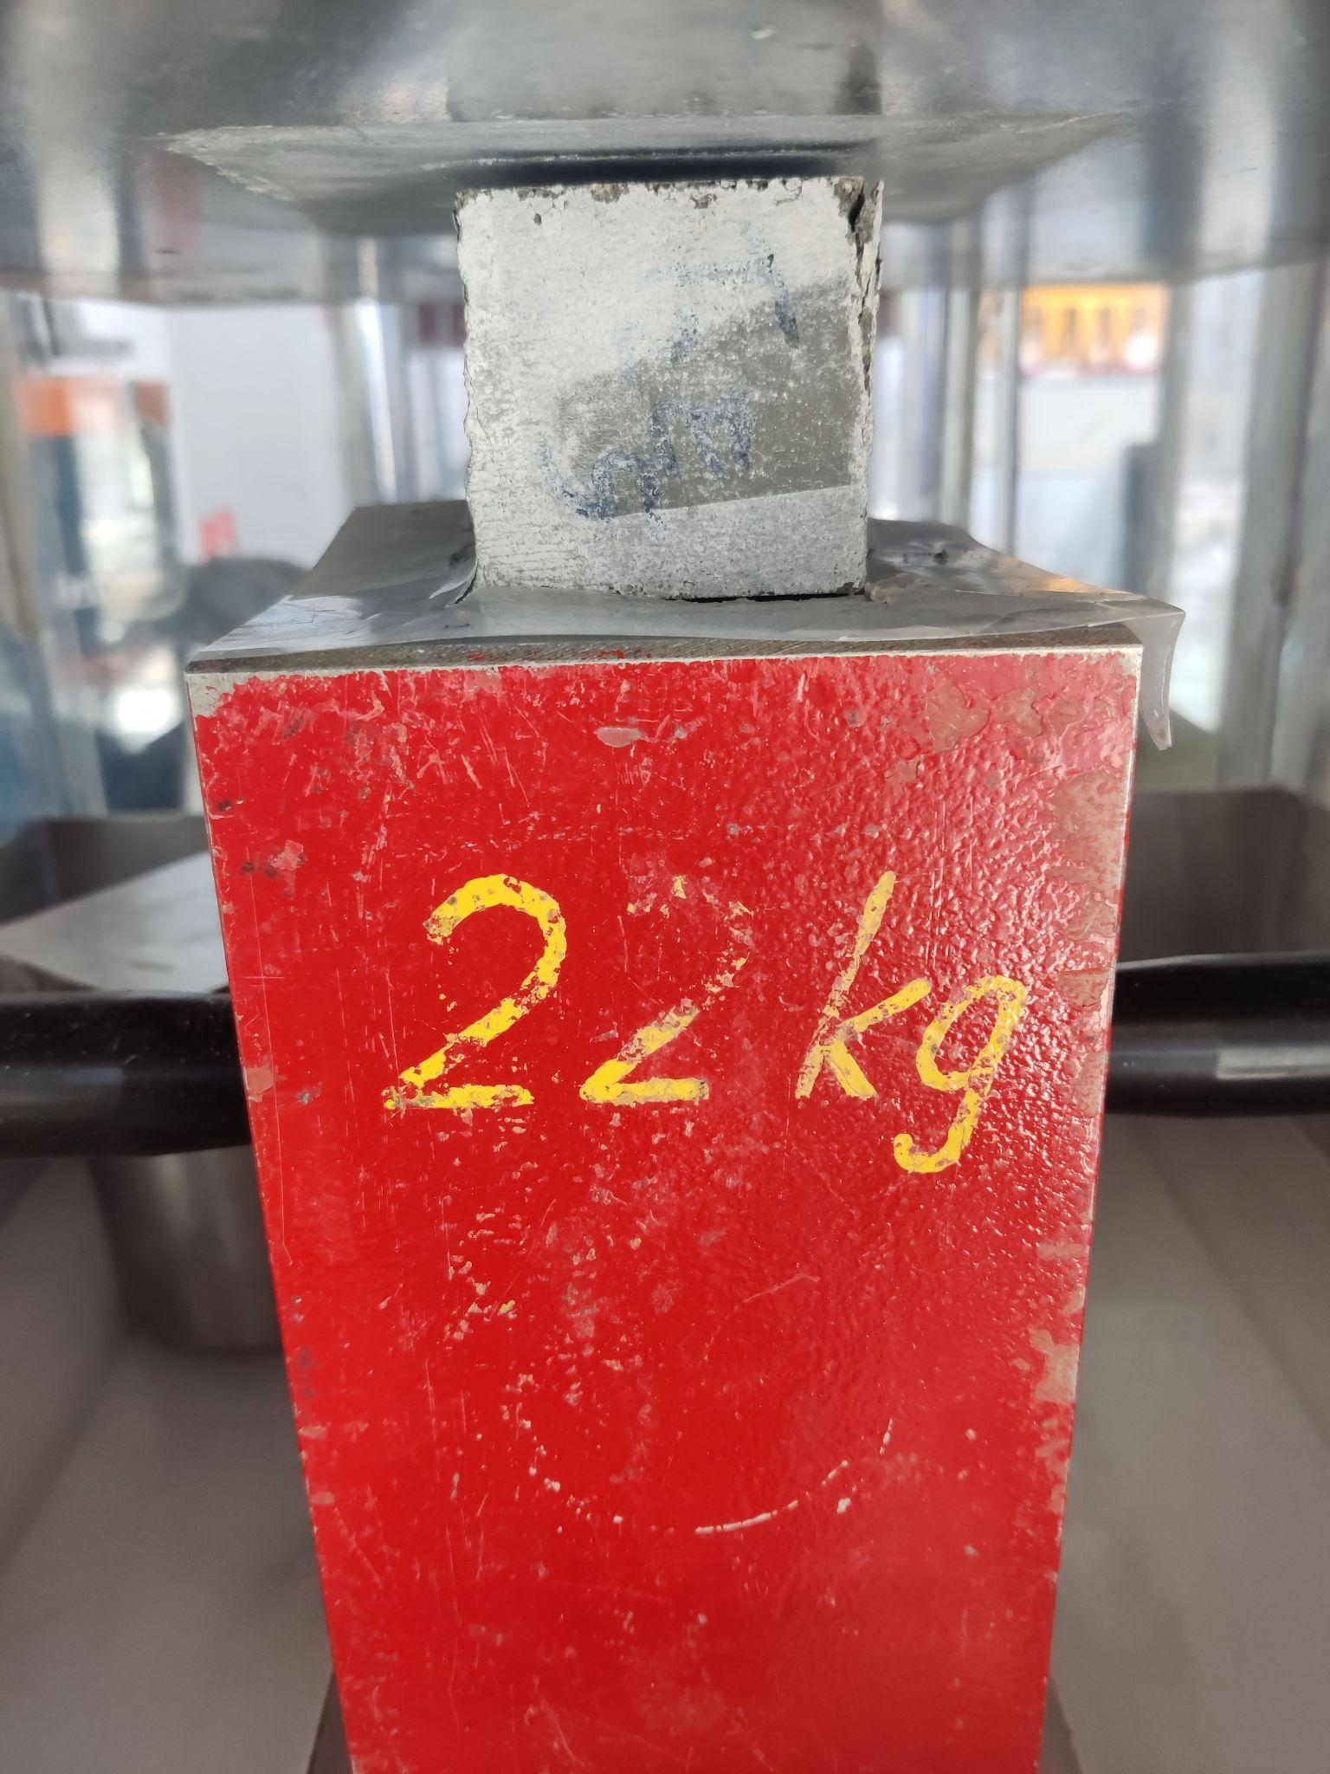
Compressive Strength
Cement provided initial strength development
B2&T2 match or exceed C for maximum strength development.
B2, B3, T2 & T3 all passed 70 Mpa
B4&T4 showed poor strength development

Slide 15
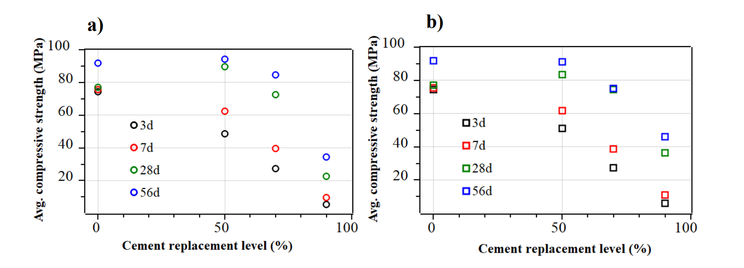
Strength Development
Binaries
Ternaries

Slide 16
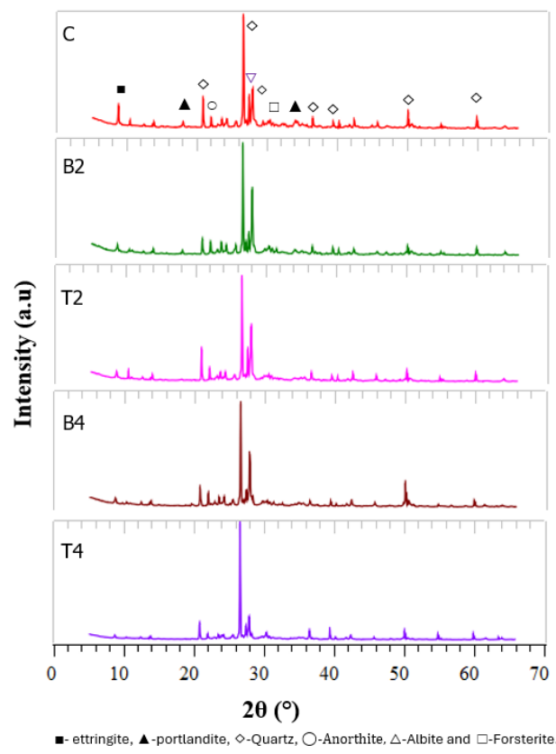
XRD Observation
Key peaks are assigned to Quartz and co-existing components like feldspar(albite, microcline, etc) from the use of aggregate
Ettringite(2θ angle 9.1°) and Portlandite (2θ angle 18° and 34.1°) showed a reduction in peak intensity with increased replacement levels
B4 & T4 showed negligible portlandite diffraction patterns

Slide 17
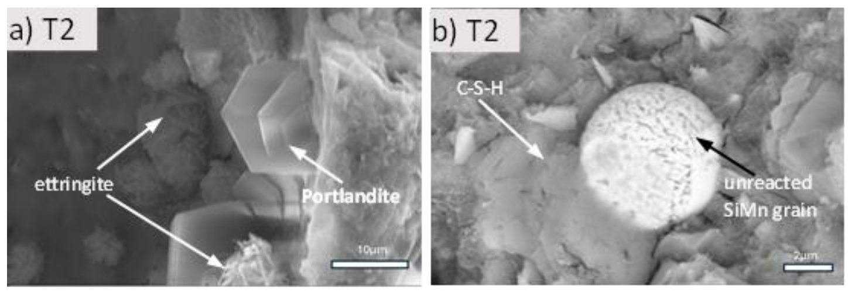
SEM Observation
Portlandite and Ettringite were observed in all binders of B2, T2, B3 & T3 following the control
Lower concentrations of Portlandite and Ettringite were observed with higher replacement rates, matching XRD observations

Slide 18
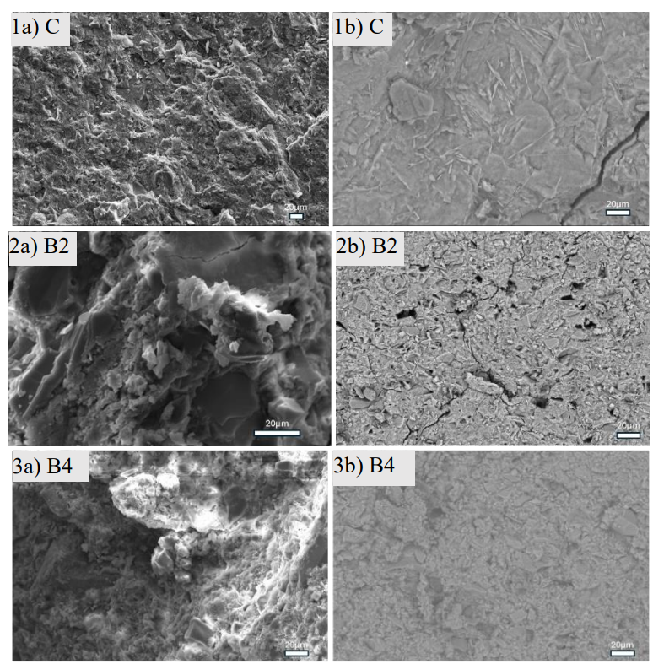
SEM Observation
Increased replacement decreases microstructural densification which leads to deterioration of strength development characteristics.
B2 microstructure follows similarly to that of control’s
The microstructure becomes more glassy and dense due to the formation of C-S-H in the control
More unreacted phases are present in B4 compared to others as again verified by XRD also.
Mortar Sample & Paste at 28 days

Slide 19
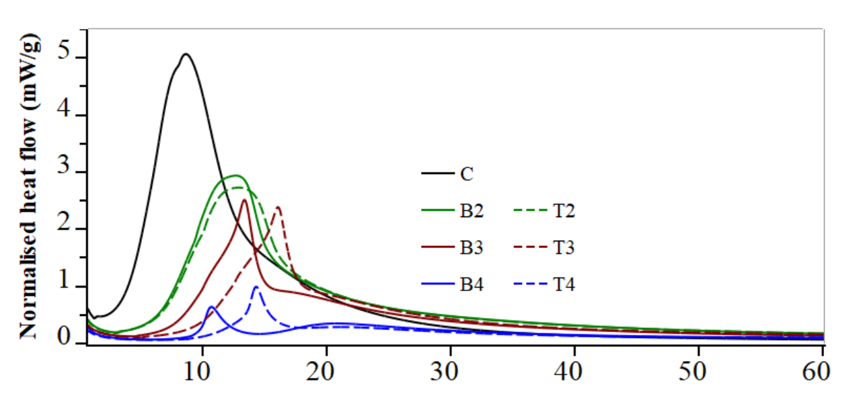
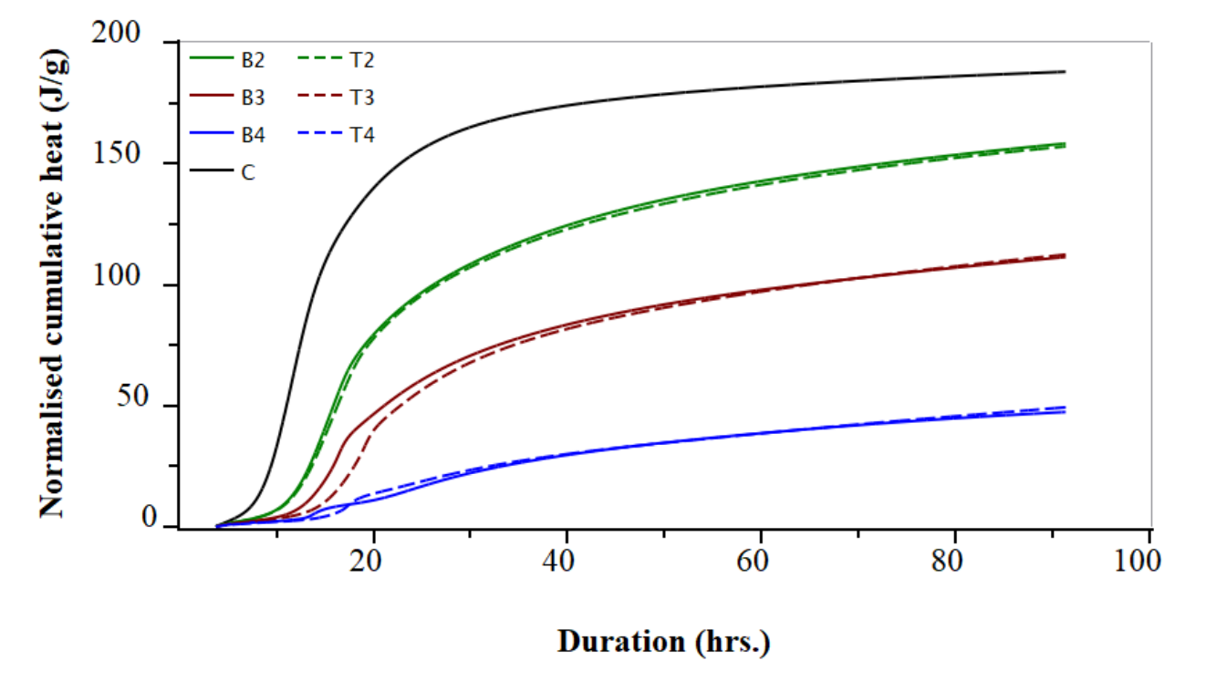
Hydration Kinetics
Normalized heat flow respective to binder weight
Control showed both highest peak and highest total
Decreasing peak and total heat flow based on replacement
One significant peak shown in all systems from the reaction of C₃S phase primarily, followed by C₂S to form C-S-H and CH [12]
The majority of heat for the control and the 50-70% binders was generated within the first 24-30 hours, with decreasing heat released with higher replacement
This may reduce thermal cracking in the binder matrix, especially in large volume concrete works

Slide 20
Conclusion
50% replacement binders (B2&T2) with VPI and SiMn slag matched or exceeded the compressive strength of the control at 28
70% replacement binders(B3&T3) had compressive strengths reaching or exceeding 70 Mpa at 28 days
90% replacement reached a compressive strength between 20-40 Mpa at 28 days
Significant replacement of cement with VPI and SiMn slag led to similar or higher compressive strength development compared to the control.
Further research is needed to confirm and verify these findings and to further determine other significant properties of the replacement concretes with respect to other aspects like durability concerns etc...

Slide 21
Acknowledgements
Thank you to Knut O. Kjellsen of Heidelberg Materials Sement Norge AS, Norway for providing ground VPI and Leif Hunsbedt and Kjorkleiv Oyvind Karstein of ERAMET, Norway for providing the ground SiMn slag to conduct this study.
We would like to express our sincere gratitude to all the lab engineers from the departments of Mechanical and Structural Engineering and Materials Science, Energy and Petroleum Engineering, Chemistry, and Bioscience and Environmental Engineering at the Faculty of Science and Technology, University of Stavanger, Norway. Their invaluable assistance in providing necessary training and access to laboratory facilities was crucial for the successful completion of this study.

Slide 22
References
Slanger, D. and Skinner, B. (2025) With concrete, less is more. https://rmi.org/with-concrete-less-is-more/.
Statista (2025) Global CO₂ emissions from cement manufacturing 1960-2023. https://www.statista.com/statistics/1299532/carbon-dioxide-emissions-worldwide-cement-manufacturing/.
Tiseo, I. (2025) Cement industry emissions worldwide - Statistics & Facts. https://www.statista.com/topics/11056/cement-industry-emissions-worldwide/#topicOverview.
Statista (2025) Global cement production 1995-2024. https://www.statista.com/statistics/1087115/global-cement-production-volume/.
Khatib, J.M. (2016) 'Conclusion,' in Elsevier eBooks, pp. 717–721. https://doi.org/10.1016/b978-0-08-100370-1.00027-5.
Technology Roadmap - Low-Carbon Transition in the cement Industry – Analysis - IEA (2018). https://www.iea.org/reports/technology-roadmap-low-carbon-transition-in-the-cement-industry.
Cementitious Materials | National Concrete Pavement Technology Center (no date). https://www.cptechcenter.org/cementitious-materials/#:~:text=Coal%20fly%20ash%20is%20the,are%20both%20hydraulic%20and%20pozzolanic.
Belaïd, F.: How does concrete and cement industry transformation contribute to mitigating climate change challenges, Resources, Conservation & Recycling Advances, (15), 200084 (2022).
2. Martin Skancke C. S. G., Halvorsen K., Hansen M., Hanssen, Audun G.S., Kvaløy O., Lilliestråle A., Mohn K., Maltby L.P., Nybø S., Trømborg E.: Climate policy roadmap towards 2050, Ministry of Climate and Environment, Norway, (2023).
3. Kanafani, K., Magnes, J., Lindhard, S.r.M., and Balouktsi, M.: Carbon Emissions during the Building Construction Phase: A Comprehensive Case Study of Construction Sites in Denmark, (2023).
4. Chen, H., Li, N., Unluer, C., Chen, P., and Zhang, Z.: 200 years of Portland cement: Technological advancements and sustainability challenges, Journal of Cleaner Production (486), 144500 (2025).
5. Ahmad, J., Kontoleon, K.J., Majdi, A., Naqash, M.T., Deifalla, A.F., Ben Kahla, N., Isleem, H.F., and Qaidi, S.M.A.: A Comprehensive Review on the Ground Granulated Blast Furnace Slag (GGBS) in Concrete Production, (2022).
6. Montgomery, A., Kasaniya, M., Zhao, P., Thomas, M., and Peterson, K.: The dam that fly ash built, Journal of Microscopy 294 (2), 117-127 (2024).
7. Scrivener, K., Martirena, F., Bishnoi, S., and Maity, S.: ‘Calcined clay limestone cements (LC3)’, Cement and Concrete Research, 2018, 114, pp. 49-56
8. Hettiarachchi, D., Samarakoon, S.M.S.M.K., Fosså K.T., Gebremariam, K.F., and Khalifeh, M.: Exploring the Potential Utilization of Silicon Manganese Slag as a Supplementary Cementitious Material for Cement Replacement in Developing Low Carbon Composite Binder’, Springer Nature, Switzerland, pp. 155-168, (2025).
9. Zeng, J., He, X., Zhang, Y., Su, Y., and Tan, H.: Sustainable clinker-free solid waste binder produced from wet-ground granulated blast-furnace slag, phosphogypsum and carbide slag,Construction and Building Materials (330), 127218 (2022).
10. Marsh, A.T.M., Yang, T., Adu-Amankwah, S., and Bernal, S.A.: Utilization of metallurgical wastes as raw materials for manufacturing alkali-activated cements, Waste and Byproducts in Cement-Based Materials, Woodhead Publishing, 335-383 (2021).
11. Kumar, S., García-Triñanes, P., Teixeira-Pinto, A., and Bao, M.: Development of alkali activated cement from mechanically activated silico-manganese (SiMn) slag, Cement and Concrete Composites (40), 7-13 (2013).
12. Zunino, F., and Scrivener, K.: ‘The influence of the filler effect on the sulfate requirement of blended cements’, Cement and Concrete Research (126),105918 (2019).

Slide 23
Questions?

