Slide 1



Statistical Indicators for Structural Damage Localization by Autoregressive-Extracted Time Series Features
Authors:
Ali Ramezani
Soroush Safakhah
Soheila Goli
OES 2025 – Stavanger
11 June

Slide 2
Introduction & Background
SHM program consists of 4 levels:
1
Detecting the existence of damage
2
Identifying the location of damage
3
Estimating the severity of damage
4
Predicting the remaining service life of the damaged structure
Damage localization in civil structures is of paramount importance for ensuring structural safety, optimizing maintenance efforts, and extending service life.

Slide 4
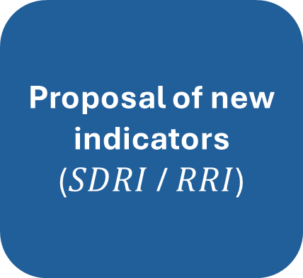
Methodology and Proposed Indicators
Our approach consists of 3 key steps:
Data Acquisition
(vibration sensors)
Feature extraction using AR models
Proposal of new indicators
($SDRI$ / $RRI$)

Slide 5
Methodology and Proposed Indicators
Autoregressive (AR) Modeling
Evaluate the stationarity of time series data using Leybourne-Mc Cabe (LMC) test
It gives a p-value
a test statistic (Q)
and a c-value based on a significance level.
Using a 5% significance level, if p-value≥0.05 or Q<c-value, one can infer that the time series data is not only stationary but also conforms to the AR model.

Slide 6
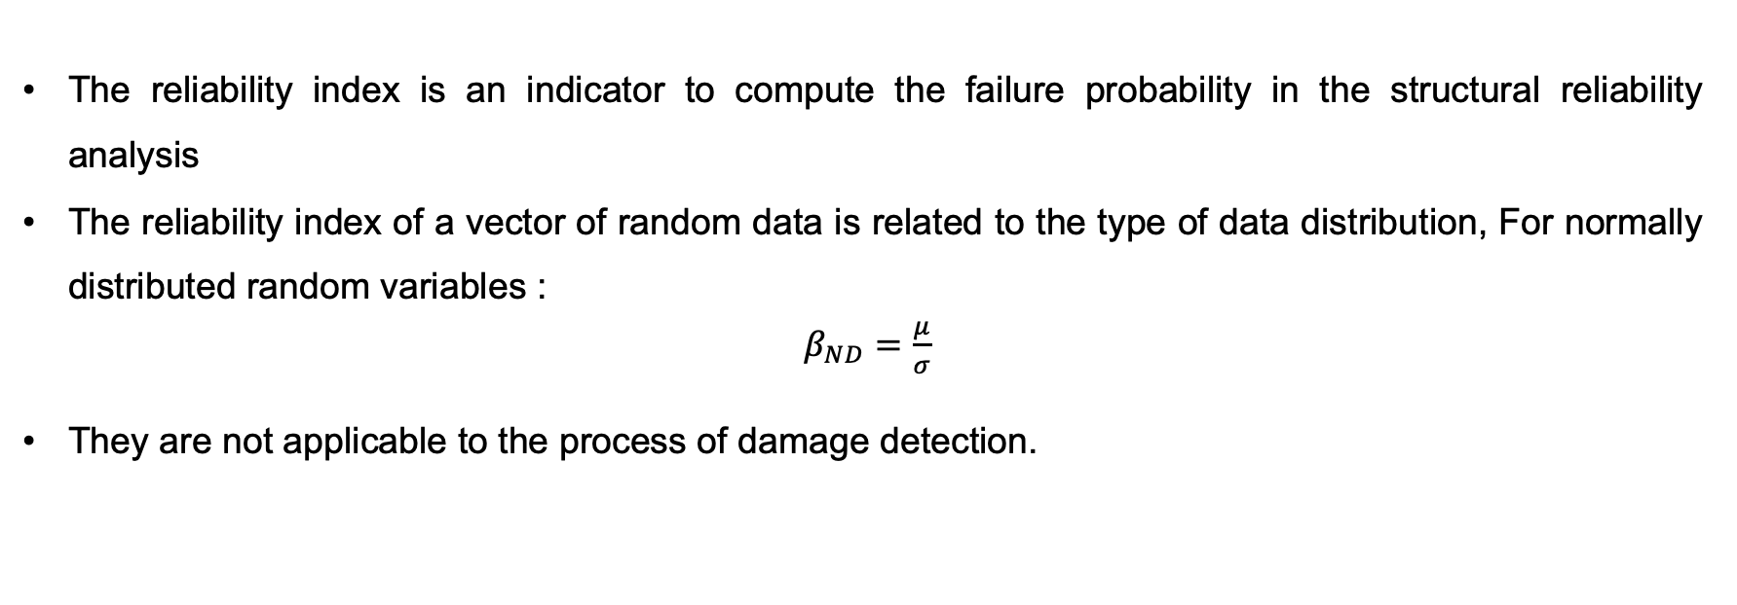
Methodology and Proposed Indicators
Reliability Indices
The reliability index is an indicator to compute the failure probability in the structural reliability analysis
The reliability index of a vector of random data is related to the type of data distribution, For normally distributed random variables :
$β_{ND}=\frac{μ}{σ}$
They are not applicable to the process of damage detection.
SO:
SDRI
RRI

Slide 7
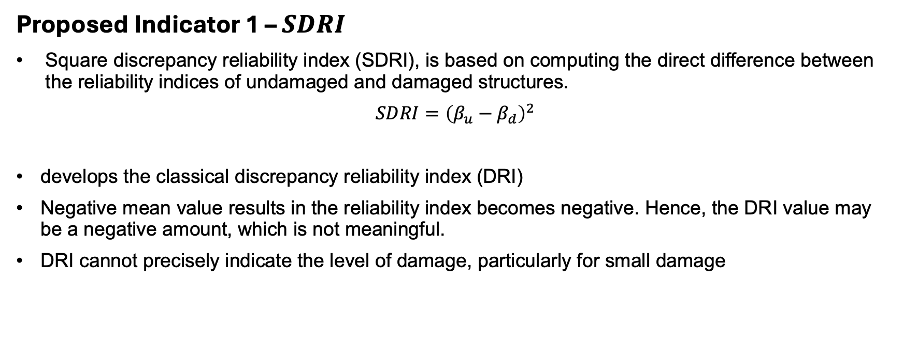
Methodology and Proposed Indicators
Proposed Indicator 1 – $SDRI$
Square discrepancy reliability index (SDRI), is based on computing the direct difference between the reliability indices of undamaged and damaged structures.
$SDRI={\left(β_{u}−β_{d}\right)}^{2}$
develops the classical discrepancy reliability index (DRI)
Negative mean value results in the reliability index becomes negative. Hence, the DRI value may be a negative amount, which is not meaningful.
DRI cannot precisely indicate the level of damage, particularly for small damage

Slide 8
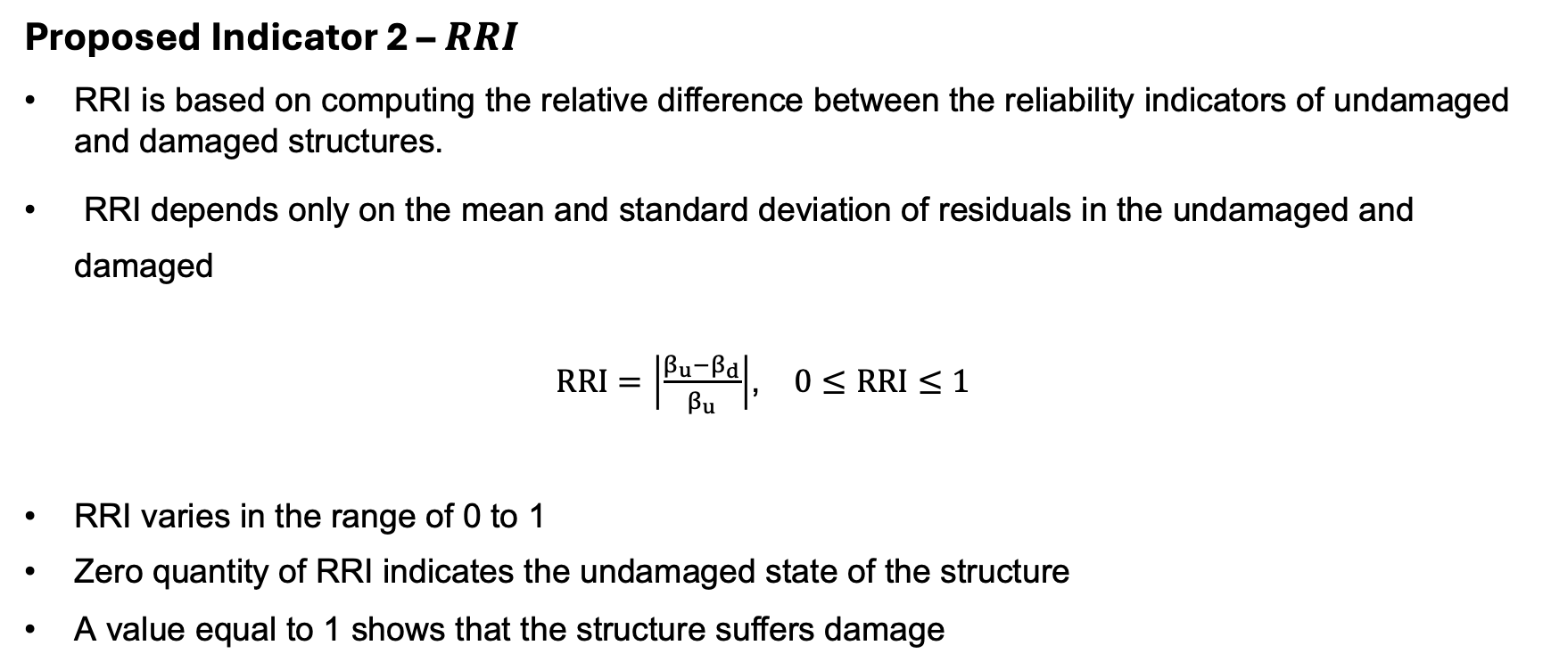
Methodology and Proposed Indicators
Proposed Indicator 2 – $RRI$
RRI is based on computing the relative difference between the reliability indicators of undamaged and damaged structures.
RRI depends only on the mean and standard deviation of residuals in the undamaged and damaged
$RRI=\left|\frac{β_{u}−β_{d}}{β_{u}}\right|$, $0≤RRI≤1$
RRI varies in the range of 0 to 1
Zero quantity of RRI indicates the undamaged state of the structure
A value equal to 1 shows that the structure suffers damage

Slide 10
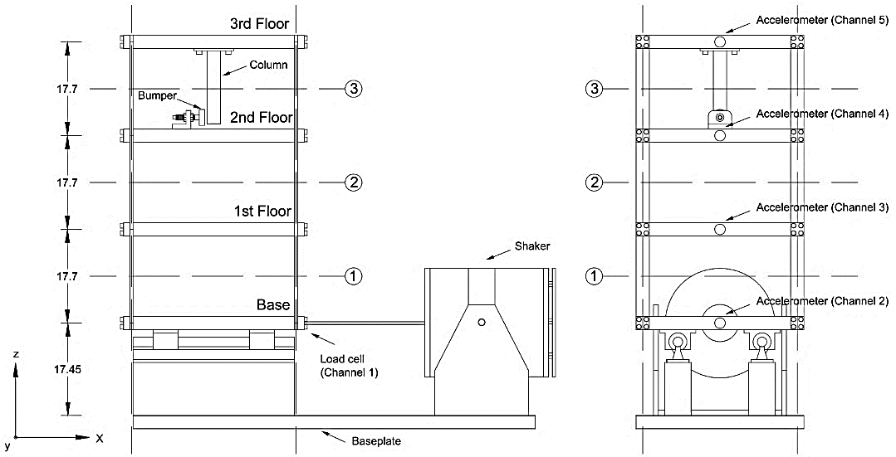
Experimental Validation
Experimental Setup
Benchmark test structure: 3-story steel frame (LANL dataset)
4 accelerometers (sensors) placed strategically on frame floors
Conducted tests under 17 structural states: varying healthy, EOV, and damage condition

Slide 11
Experimental Validation
Structural State Conditions
State no. | Condition | Description
1 | Undamaged | Baseline condition without damage and EOV
2-3 | Undamaged | Simulated operational variability by adding a concentrated mass (1.2 kg) on the base and first floors
4-9 | Undamaged | Simulated environmental variability by decreasing structural stiffness at the first, second and third floors
10-14 | Damaged | Nonlinear damage (Gap = 0.20, 0.15, 0.13, 0.10, and 0.05 mm)
15-17 | Damaged | Nonlinear damage (Gap = 0.20, 0.20, and 0.10 mm) with simulated operational variability at the base and first floors

Slide 13
Results
SDRI evaluation of sensor 4.
SDRI evaluation of sensor 5.

Slide 14
Results
RRI evaluation of sensor 4.
RRI evaluation of sensor 5.

Slide 15
Results
Damage Localization Maps : states 10-14
SDRI.
RRI.

Slide 16
Results
Damage Localization Maps: states 15-17
SDRI.
RRI.

Slide 18
Conclusion
Conclusions
Successfully proposed two robust indicators (SDRI, RRI) for structural damage localization
Indicators effectively handle realistic environmental and operational variability
RRI specifically provides highly intuitive interpretation for practical engineering usage
Demonstrated accurate damage localization through experimental validation

Slide 19
Future Work & Acknowledgements
Future Directions:
Extend indicators to multi-output ARX modeling approaches
Develop real-time monitoring systems with adaptive damage thresholds
Acknowledgements:
Los Alamos National Laboratory (LANL) dataset
Collaborators, institutions, and funding sources involved in the research

Slide 20
Thanks For Your Attention

