Slide 1




Enhancement of Time Series-Based Feature Extraction for Structural Health Monitoring
OES 2025 – 11 June
Authors: Ali Ramezani, Soroush Safakhah, Soheila Goli

Slide 2
SHM
Types
Model-based
Data-based
Advantages
decrease maintenance costs
improve dynamic behaviour
provide appropriate operation
Components
operational evaluation
sensing and data acquisition
feature extraction
feature discrimination for damage detection
Introduction

Slide 3
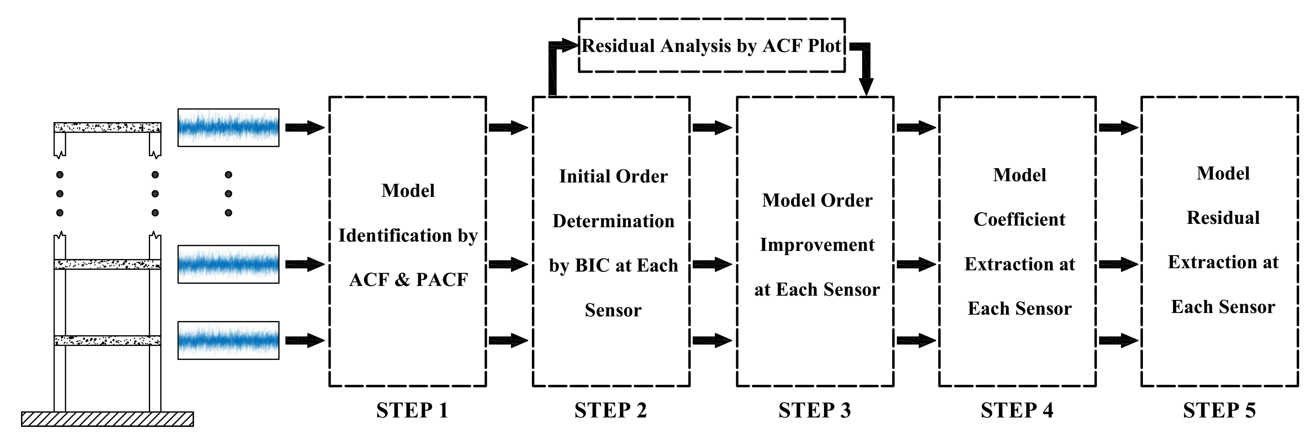
Objectives and Contribution
Introduction

Slide 4
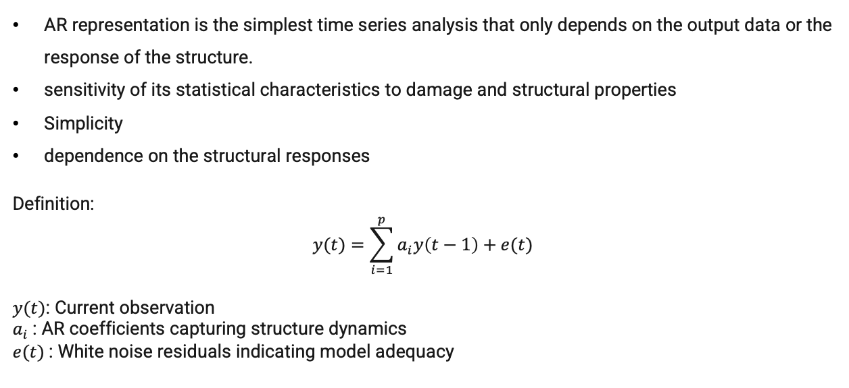
Autoregressive (AR) Model
AR representation is the simplest time series analysis that only depends on the output data or the response of the structure.
sensitivity of its statistical characteristics to damage and structural properties
Simplicity
dependence on the structural responses
Definition:
$$y(t)=\sum_{i=1}^{p}{a_{i}y\left(t−1\right)+e(t)}$$
$y(t)$: Current observation
$a_{i}$​: AR coefficients capturing structure dynamics
$e(t)$: White noise residuals indicating model adequacy
Methodology

Slide 5
Autoregressive Model and Residuals consist Model
Statistical modelling:
Extract coefficient of damaged condition
Fitting Model
Methodology
Extract coefficient of undamaged condition

Slide 6
Autoregressive Model and Residuals consist Model
Extract coefficient of damaged condition
Statistical modelling:
Fitting Model
Extract coefficient of undamaged condition
Residual consist model:
Methodology
1
2
3
4
Fit model on undamaged condition
Predict response of damaged condition
Change in residuals
Damage detection
* White noise residual demonstrate that the model fits perfectly

Slide 7
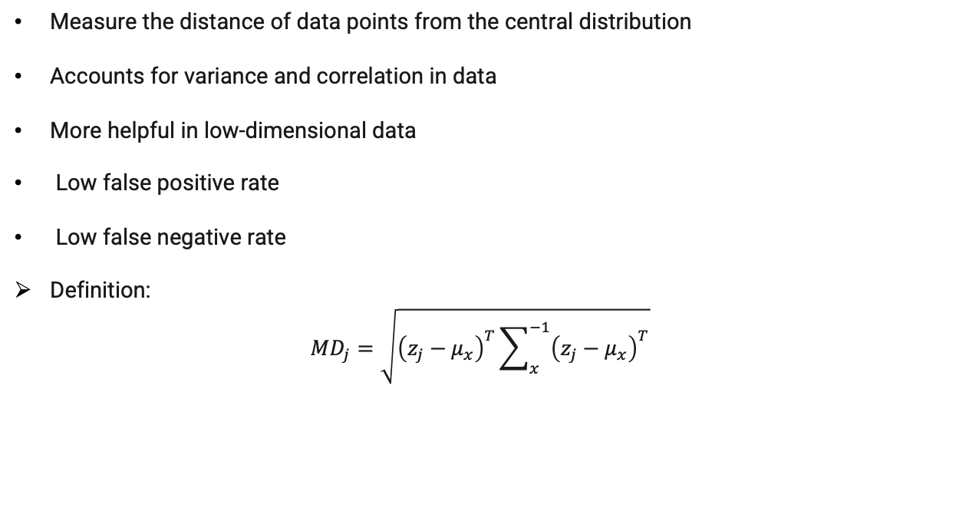
Mahalanobis Distance (MD)
Measure the distance of data points from the central distribution
Accounts for variance and correlation in data
More helpful in low-dimensional data
Low false positive rate
Low false negative rate
Definition:
$${MD}_{j}=\sqrt{{\left(z_{j}−μ_{x}\right)}^{T}\sum_{x}^{−1}{{\left(z_{j}−μ_{x}\right)}^{T}}}$$
Methodology

Slide 8
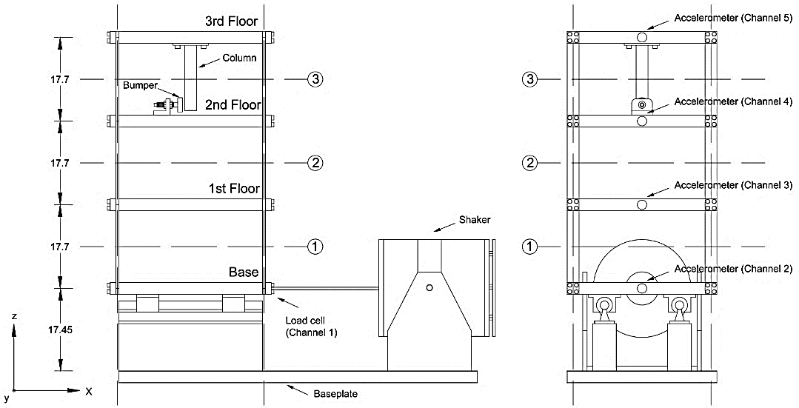
Los Alamos National Laboratory (LANL) Experimental Frame
Structure Details:
3-story experimental frame with accelerometers
Excited with known inputs (shaker device)
Dataset:
17 operational and damage states (baseline, EOV, various damage severities)
Sampling rate: 320 Hz, duration:
25.6 s per sample set
Experimental Validation

Slide 9
Auto Correlation Function (ACF) and Partial Auto Correlation Function (PACF)
Results

Slide 10
Damage Detection Results
Improved Method
Conventional Method
AR Coefficients
Results
AR Residuals

Slide 11
Damage Detection Results
Improved AR-order reduced false alarms significantly
Clear distinction between damaged and undamaged states
Residual norm provided additional sensitivity
Enhanced separation of damage severity level
Results

Slide 12
Conclusions
Validating residuals leads to significantly improved AR models
Combination of AR coefficients and residual-based features enhances sensitivity
Proposed method ideal for ambient structural monitoring (no external inputs required
Conclusions and Future Directions
Future Work Recommendations
Extension to non-stationary (adaptive) AR models
Validation using real-world infrastructure data
Integration with advanced machine-learning frameworks for damage localization

Slide 13
Thanks For Your Attention!

