Slide 1
Laser Powder Bed Fusion of Co-Cr-Fe-Mo alloy:
Effect of Process Parameters on
the Microstructure and Texture
Dena Khazeni, Navid Sayyar, Vidar Folke Hansen
MetAMeT Symposium

Slide 2
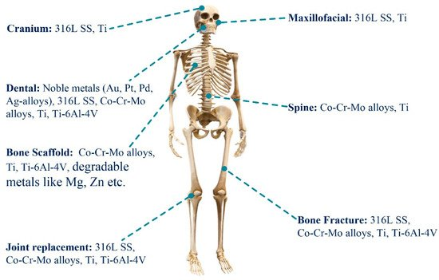
Implants and Prosthetics
Bai, Long, et al. "Additive manufacturing of customized metallic orthopedic implants: Materials, structures, and surface modifications." Metals 9.9 (2019): 1004.

Slide 3
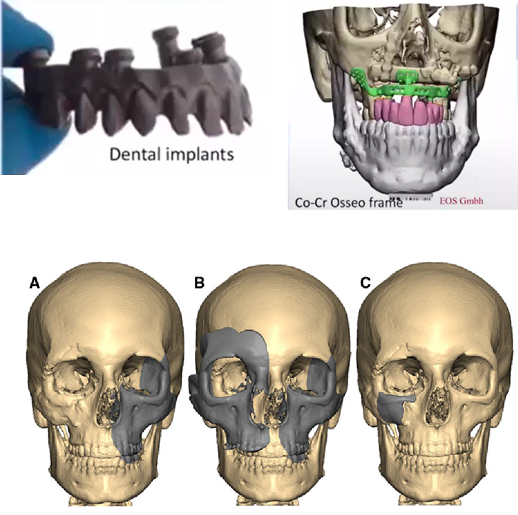
Maxillofacial Reconstructive and Dental Implants
Co-Cr-Mo Alloys:
Bio compatible
Good fatigue resistance
Enough toughness
Good corrosion resistance
Relatively light weight
Oral Health Reports, 2017 4 (3), 201-208
Maxillofacial reconstructive implants
Aesth Plast Surg (2012) 36-660-665

Slide 4
Conventional Method: Casting, Milling, Cad/Cam
Problems:
Material efficiency
Issues with complicated prosthesis structure
Time consuming
labor-intensive task
Ivan Smuk / Alamy Stock Photo, Dental milling machine

Slide 5
The needs for the proposed project
Conventional Co-Cr-Mo alloys contain 60% Cobalt.
Cobalt issues:
Limited resources - high price
Economic, security, and societal issues
Lithium-ion batteries and high-temperature alloys for turbines needs Co which cannot be replaced
High amount of Cobalt is toxic in case of releasing in body
Solution:
Replacing cobalt with more readily available and cheaper elements (Iron)
Replacing the process of casting and milling with additive manufacturing

Slide 6
Additive Manufacturing
reduced material waste
allows for safe re-use of superfluous metal
Material savings
Print-on-demand
reducing the need for production of unused spare parts, costs, material use, energy and space
Complex structure design
unprecedented geometrical freedom which utilize no part-specific tooling
Parts can be produced within few hours after finalizing a design.

Slide 7
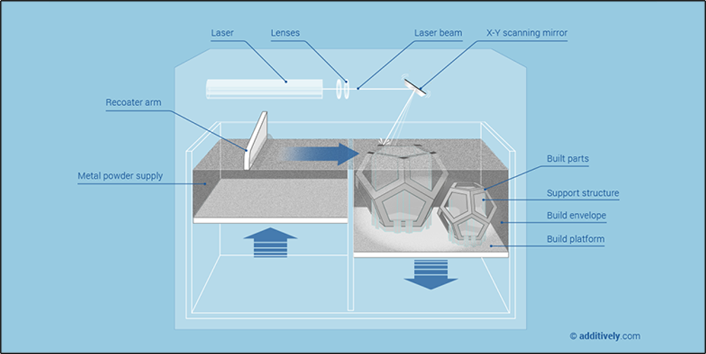
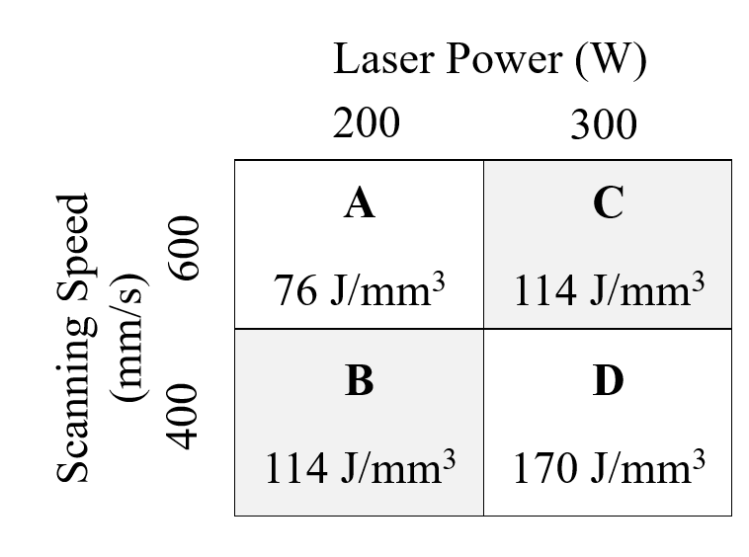
Schematic illustration of laser powder bed fusion (L-PBF) selective laser melting (SLM) process
Printing parameters used for cube fabrication
Z (BD)
Y
C
D
X
A
B
Schematic illustration of selective laser melting (SLM) technology working mechanism. Courtesy : Additevely.com

Slide 8
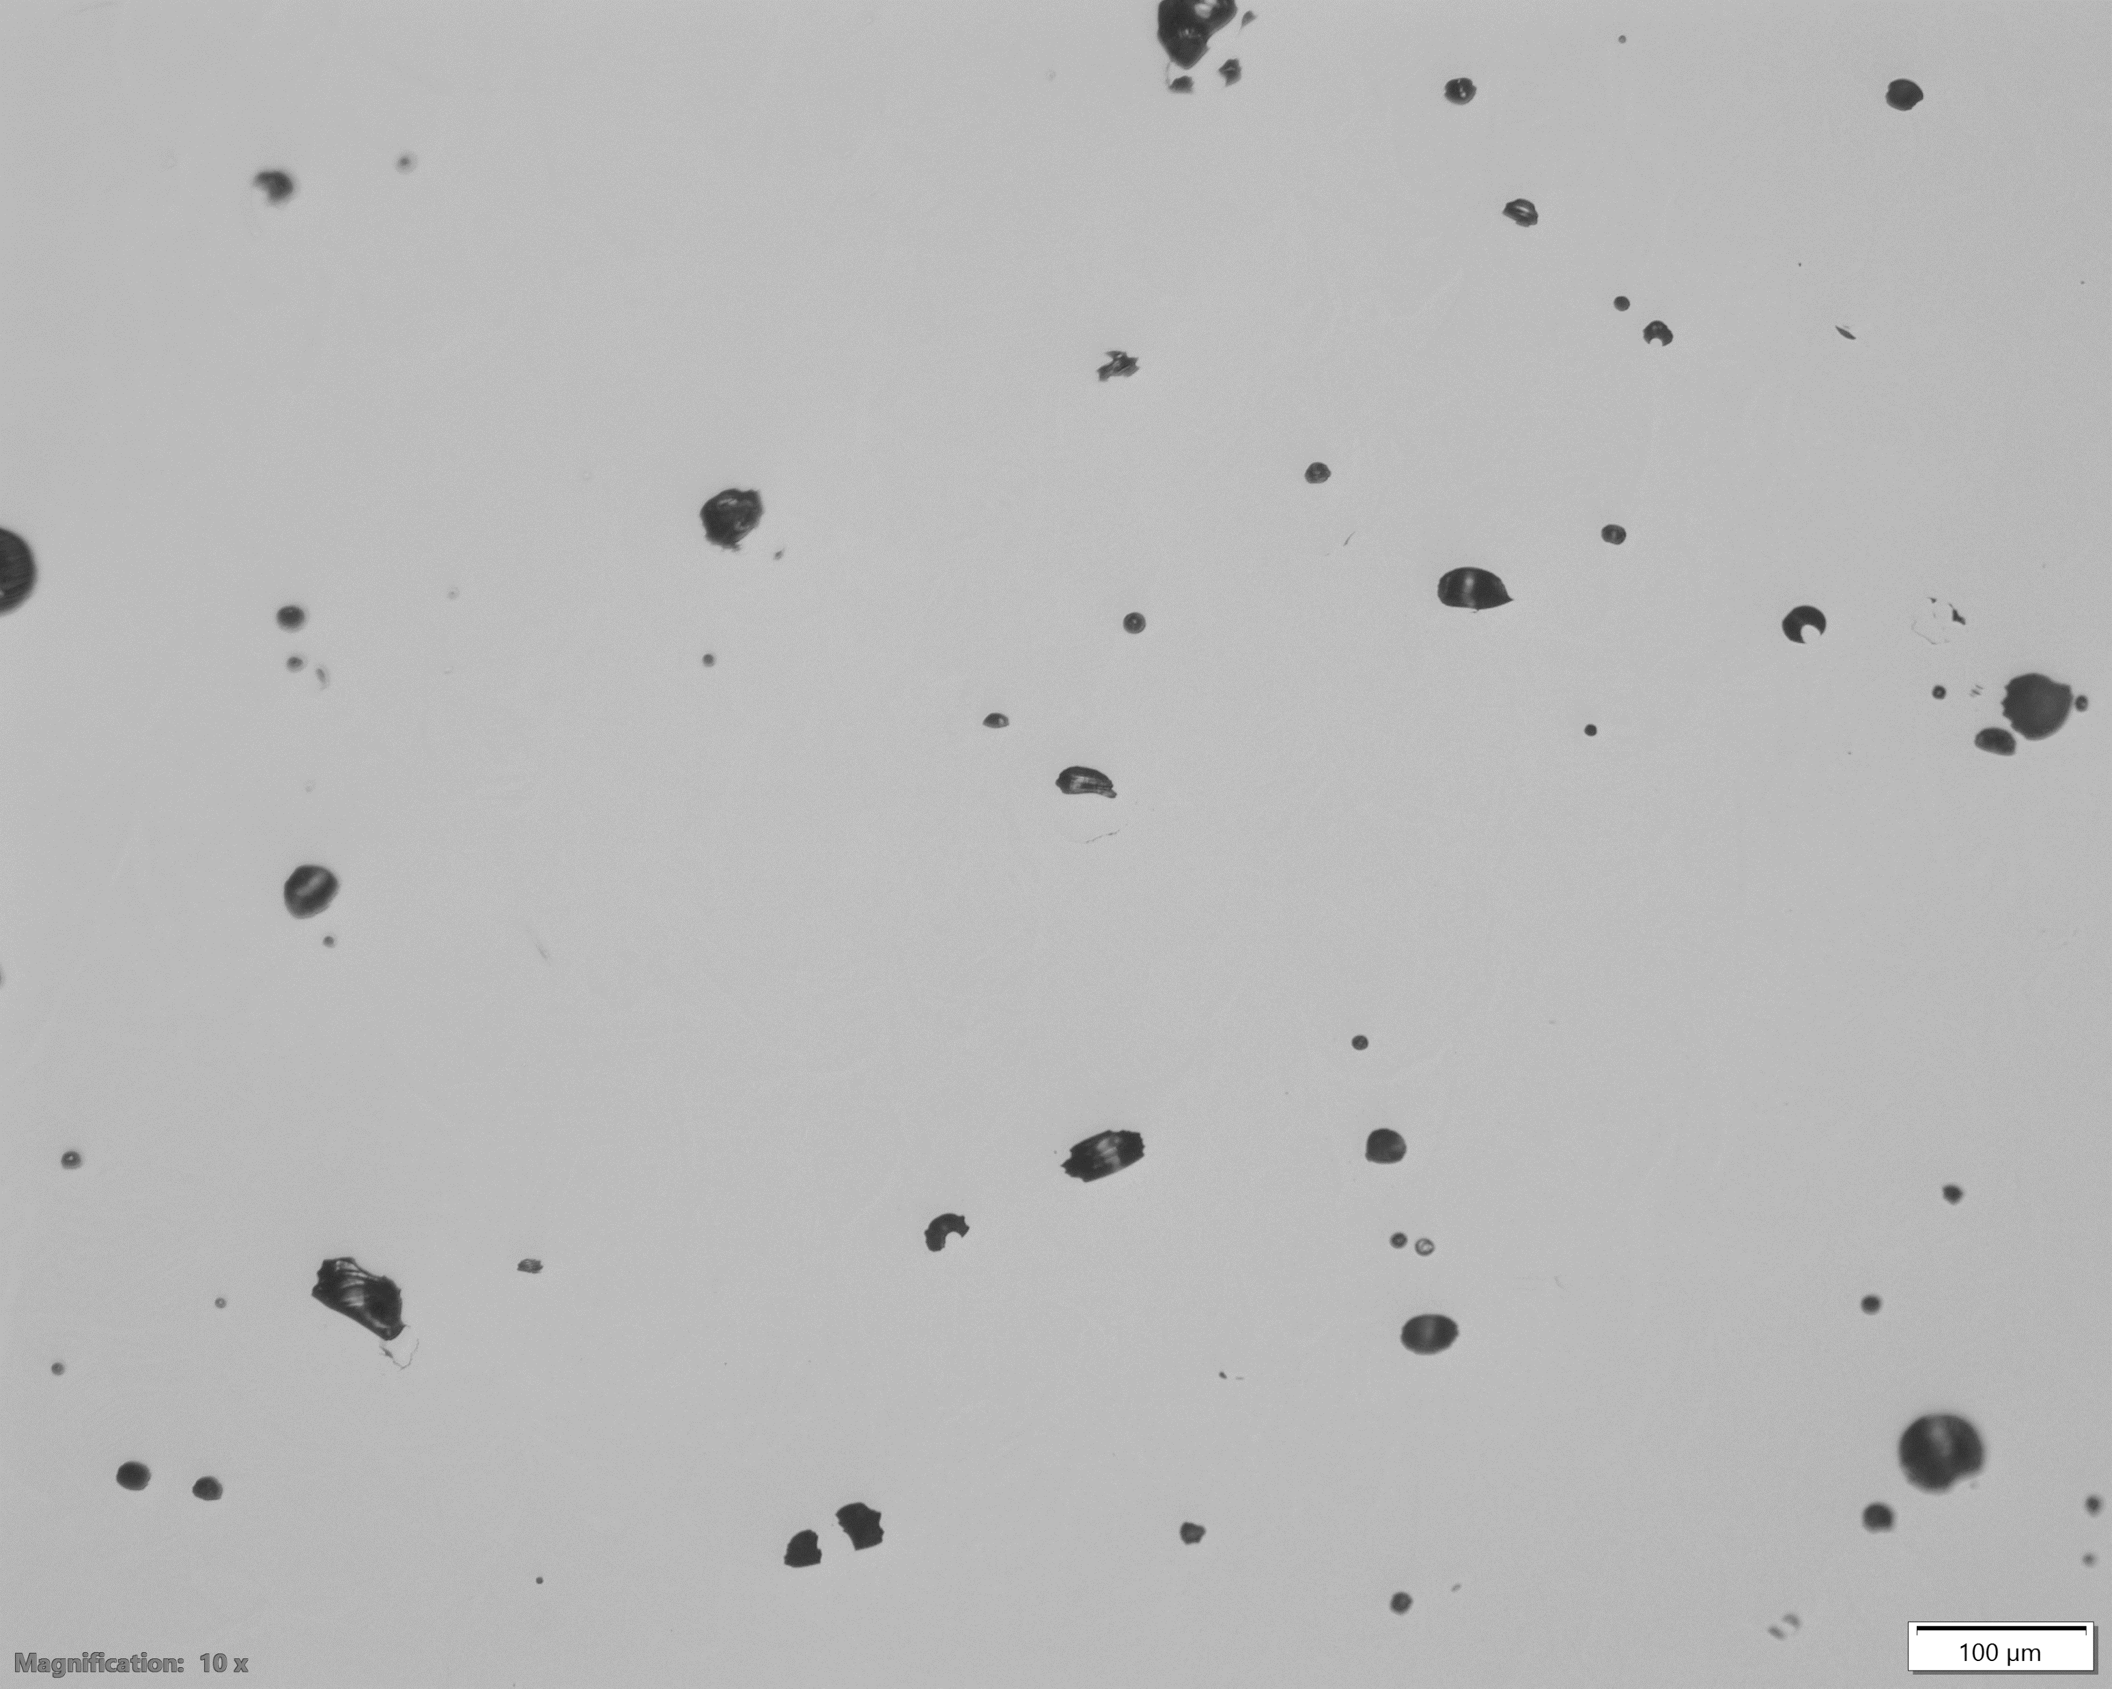
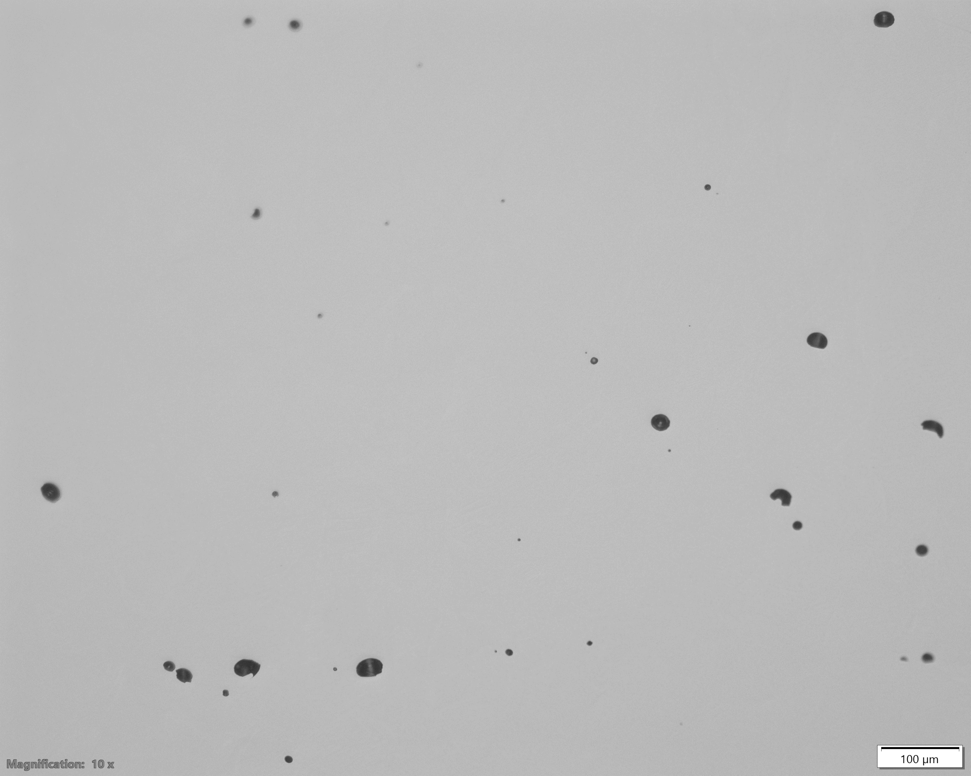
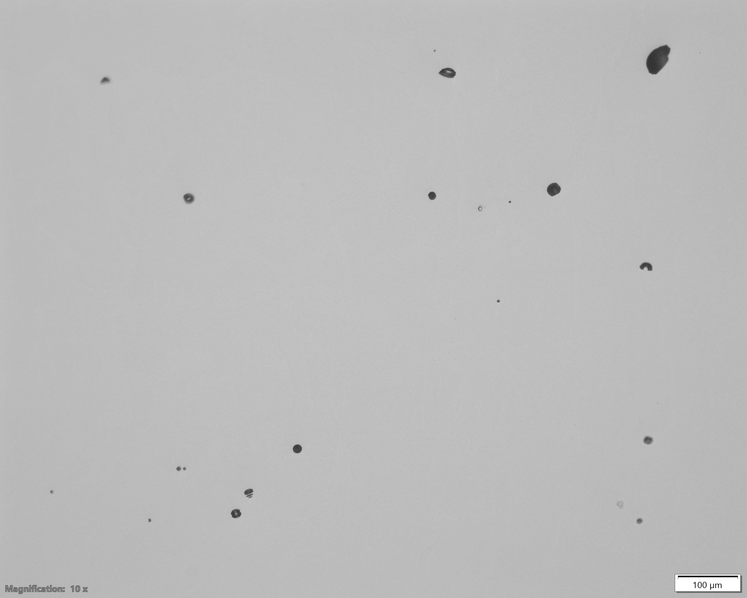
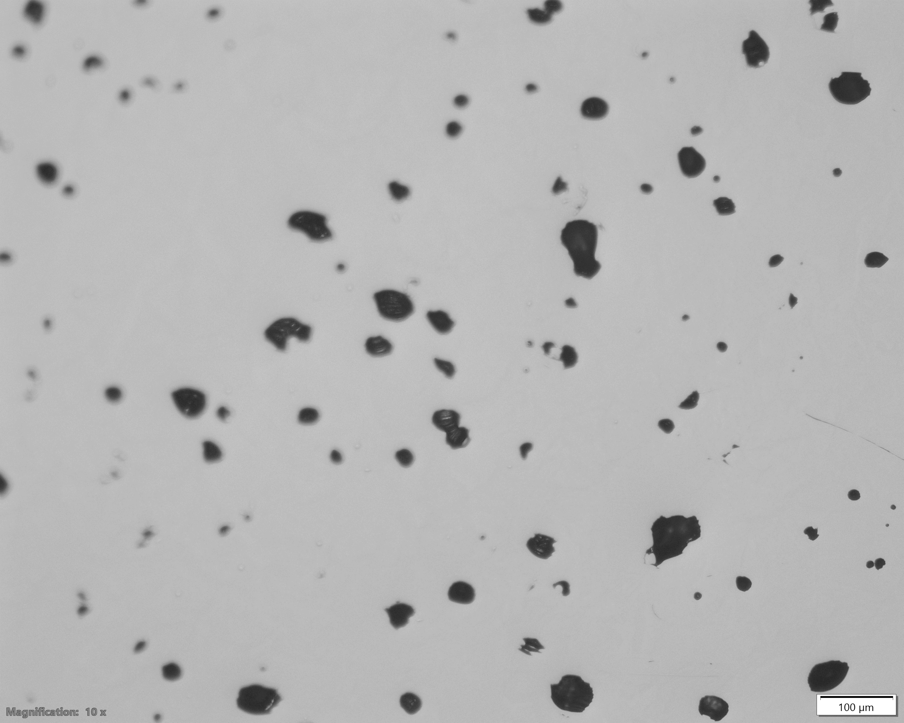
Results
A
1.9%
Density measurement
Low LED
Incomplete melting
and lack of fusion
300 μm
99.2
99.2
B
0.8%
Relative density (%)
98.1
97.5
Optimal balance
laser power & scan speed
300 μm
Moderate LED
C
0.7%
300 μm
D
2.4%
LED: 76
LP: 200
SS: 600
LED: 114
LP: 200
SS: 400
LED: 114
LP: 300
SS: 600
LED: 170
LP: 300
SS: 400
Deep melt pools,
increased vaporization,
keyhole formation
High LED
300 μm

Slide 9
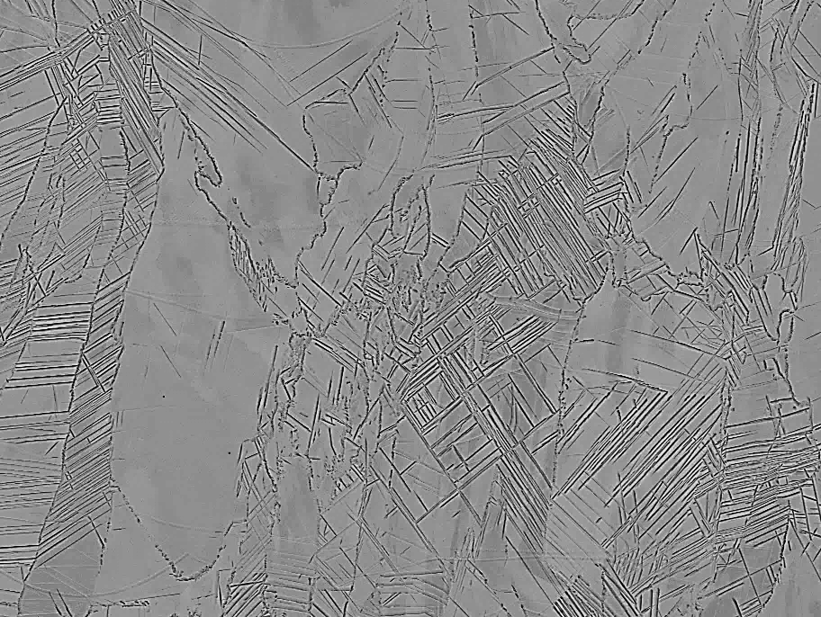
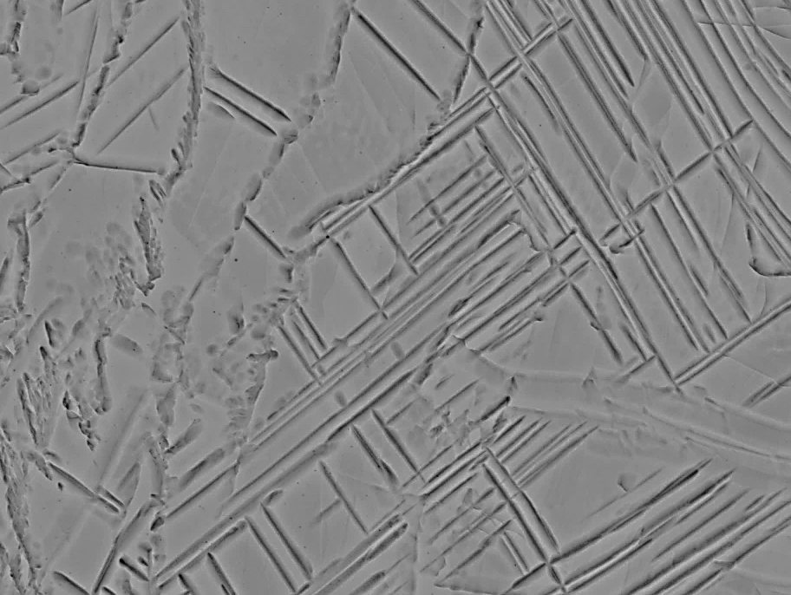
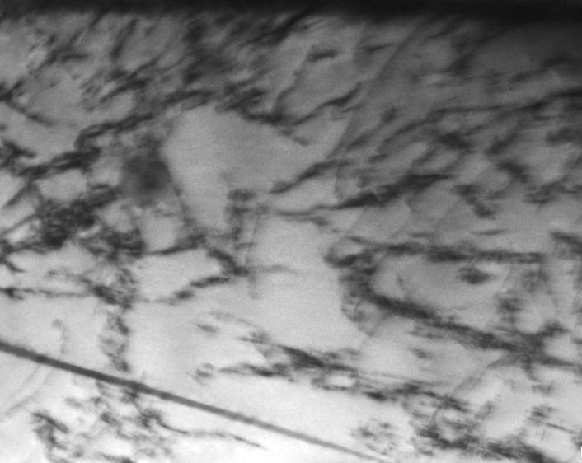
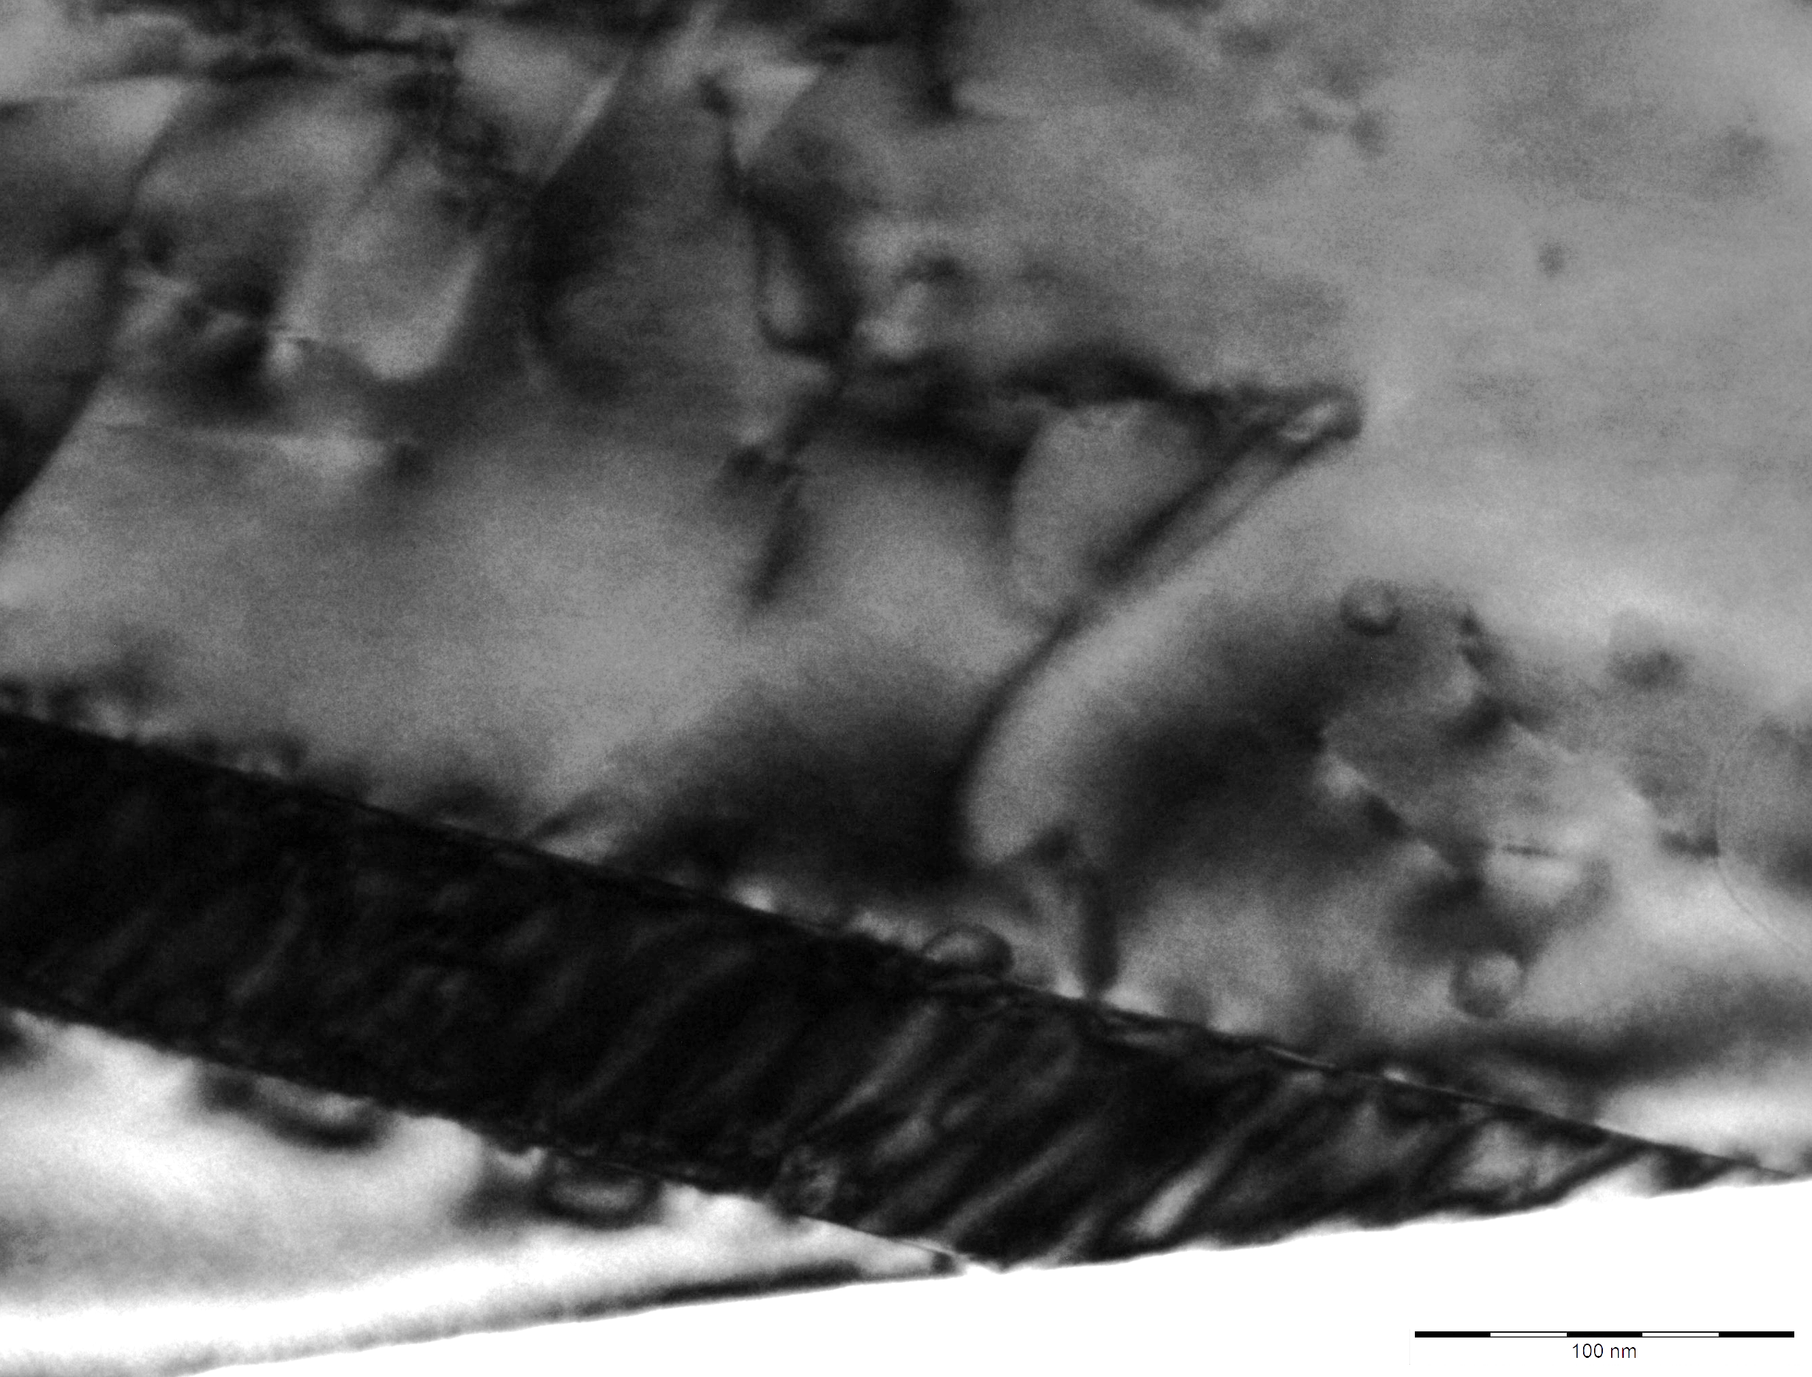
Results
SEM images of sample C
(a)
(b)
40 μm
8 μm
TEM study of sample C
(a)
(b)
(c)
(d)
$$\overline{2}02$$
$$\overline{1}13$$
011
111
020
01$\overline{1}$
400 nm
100 nm
[1$\overline{2}1$]_{fcc}
[100]_{bcc}
Particle
Matrix

Slide 10
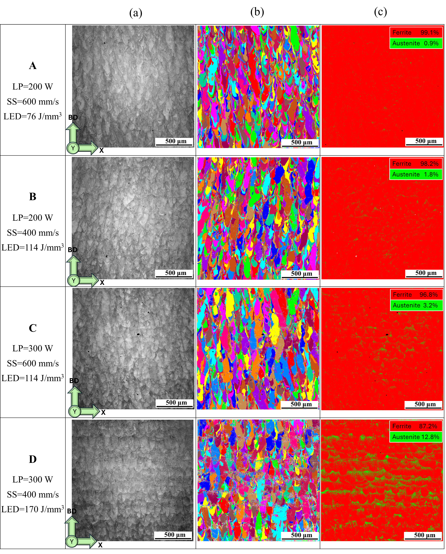
Effect of printing parameters on
grain size and second phase formation
Sharp heat flux along building direction
Epitaxial growth in grains
Grain size (μm)

Slide 11
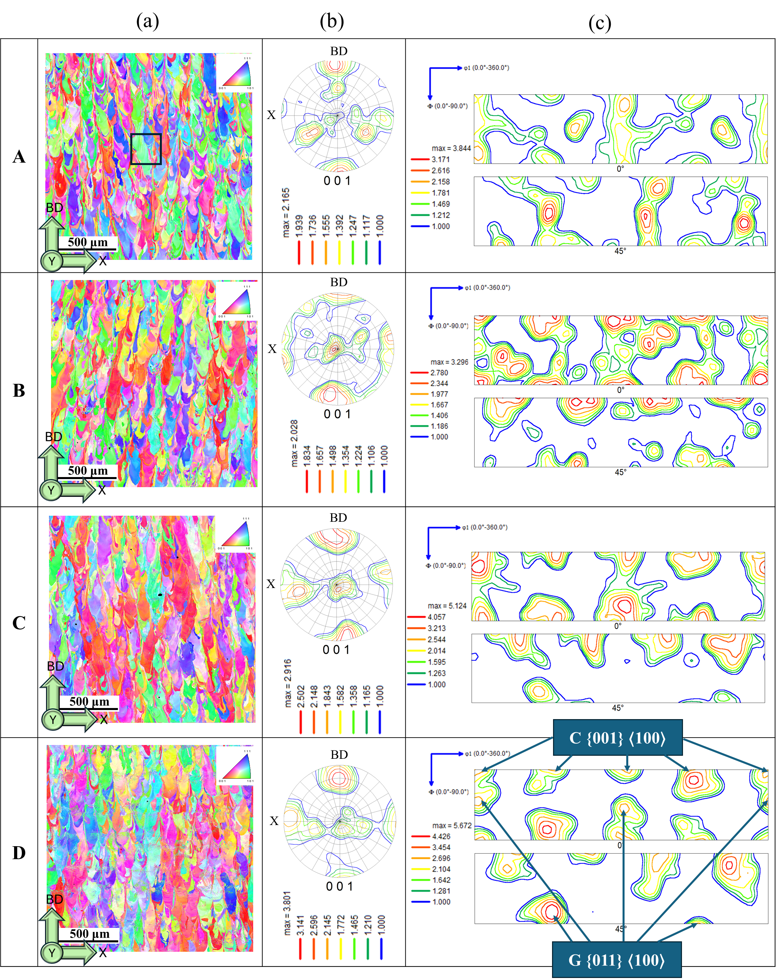
Effect of printing parameters on
texture of the matrix (bcc phase)
bcc is the primary phase that initiates and ends the solidification.
Transition from weak/mixed orientations to dominant Cube and Goss components at higher LED.
Random texture intensity
LED: 76
LP: 200
SS: 600
LED: 114
LP: 200
SS: 400
LED: 114
LP: 300
SS: 600
LED: 170
LP: 300
SS: 400

Slide 12
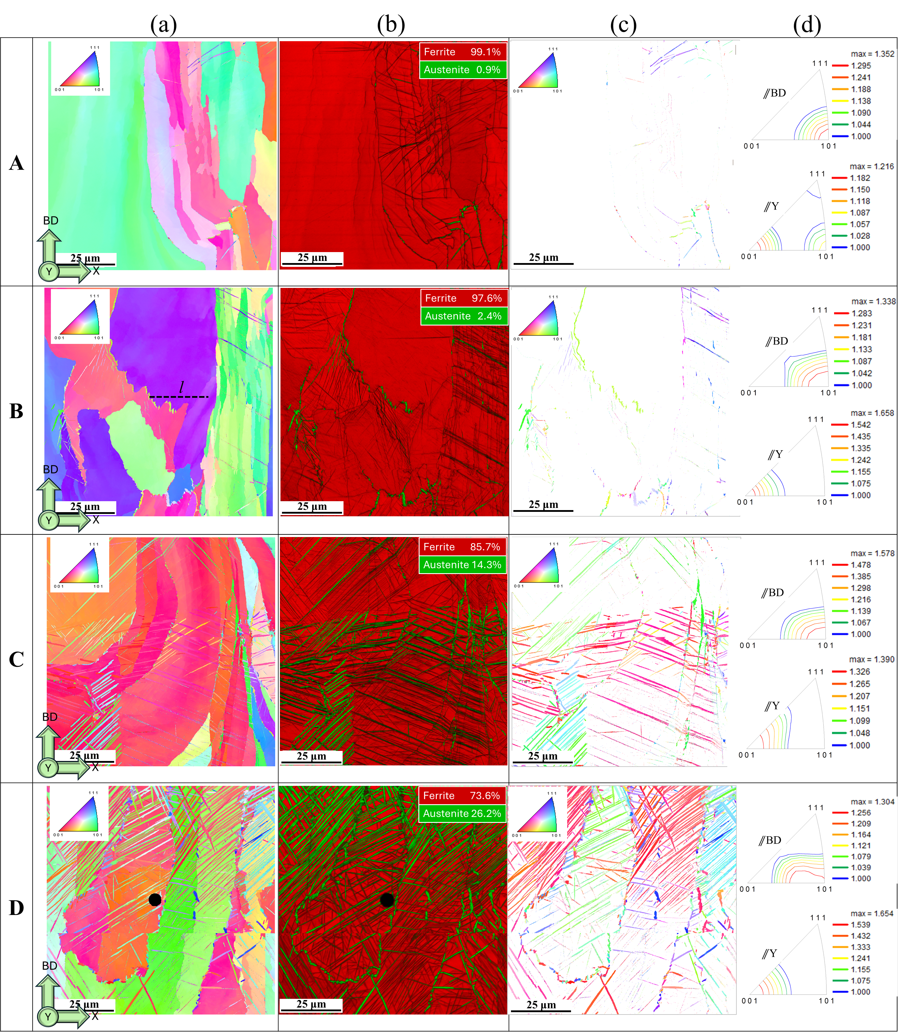
Effect of printing parameters on
texture of the second phase (fcc phase)
Shift of parallelism from <001>_{bcc} to <101>_{fcc} with respect to BD can happen due to the orientation relationship (OR) between the parent bcc and product fcc crystal systems.
Damped intensity (often less than 1.5 times random) of <101>_{fcc}⫽BD happened due to the decomposition of the bcc’s sharp orientation into several transformation textures.

Slide 13
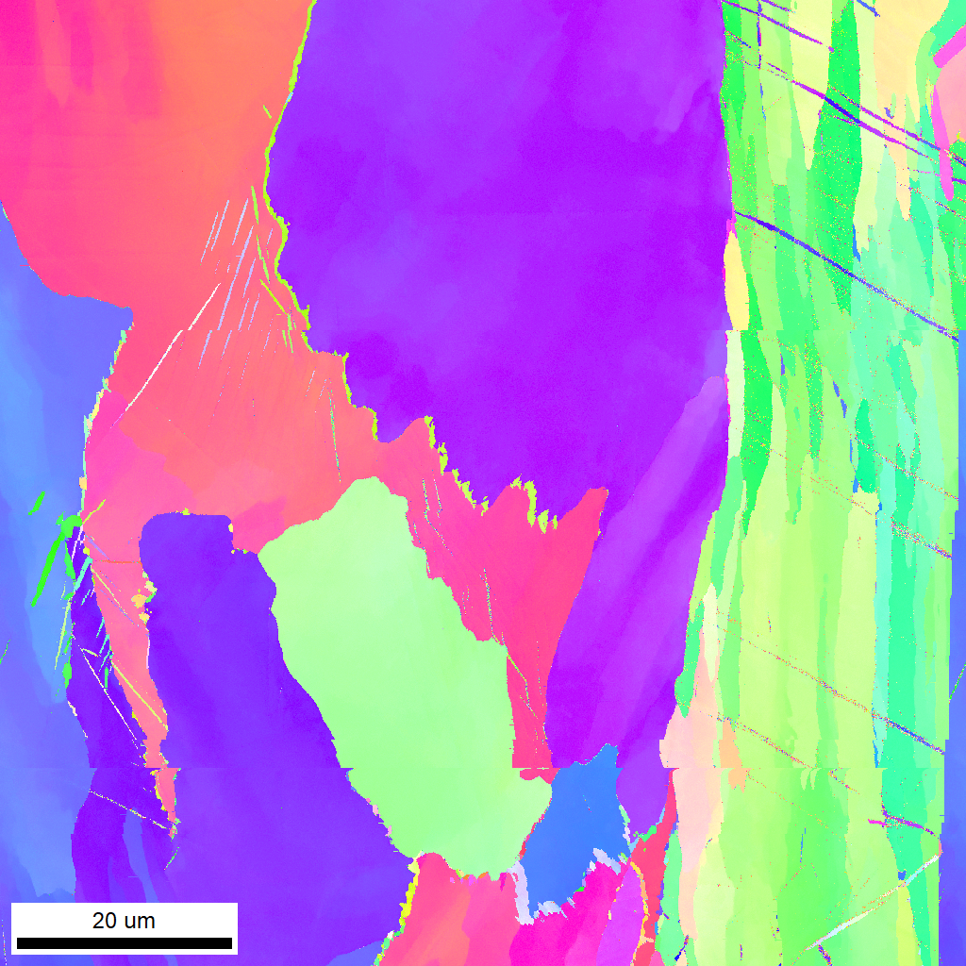
Orientation relationship between the matrix (bcc) and the particles (fcc)
The overall misorientation angle (MA) profile of the fcc/bcc interphase boundaries shows a main hump near 43° and a secondary hump around 36°.
A has the lowest degree of phase transformation due to its faster cooling rate.
This indicates a significant deviation from the K-S or N-W orientation relationship, potentially leading to multiple fcc orientations in specimen A compared to the others.
MA of ⁓43° referring to Kordjumov-Sachs or Nishiyama-Wassermann
A
B
Number Fraction
C
l
Angle (degrees)
D
BD
25 μm
Y
X
MA (degree)
fcc grain boundary
bcc grain
Sub-grain in bcc
Distance (microns)

Slide 14
Effect of printing parameters on hardness, grain size and fcc formation
A shows the lowest hardness despite having the smallest grain size, suggesting that second-phase formation plays a more significant role in hardness than grain size.
B and C, printed at the same energy density, have different hardness values due to variations in second-phase formation.
D has a higher degree of phase transformation and smaller grain size than C but shows only a slight increase in hardness.
The limited hardness gain in D is attributed to its lower density, where defects can significantly influence hardness measurements.
Hardness
Grain size
FCC content
LED: 76
LP: 200
SS: 600
LED: 114
LP: 200
SS: 400
LED: 114
LP: 300
SS: 600
LED: 170
LP: 300
SS: 400

Slide 15
Conclusion
Relative density: Peaked at moderate LED value of 114 J/mm³.
Phase transformation: Higher LED, and at the same LED, higher laser power and scan speed, promoted bcc→fcc transformation.
Grain size: Coarsened with increasing LED. Significant second-phase formation in Sample D (highest LED) refined matrix structure.
Hardness: Second-phase formation had a greater impact on hardness than grain size. Fine plate-like particles impeded dislocation motion, enhancing strength.
Texture evolution: Transitioned from weak/mixed orientations to dominant Cube and Goss components aligned with build direction at higher LED.
EBSD analysis: High magnification revealed Kurdjumov–Sachs and Nishiyama–Wasserman orientation relationships between bcc and fcc phases.
LED alone is not sufficient to predict phase transformation, texture, and hardness.
Process-specific thermal profiles and melt pool dynamics (laser power and scan speed) are crucial for controlling microstructure and mechanical properties in LPBF-fabricated CoCrFeMo alloys.

Slide 16
THANK YOU FOR YOUR ATTENTION

