Slide 1
A Risk Management Toolbox for Minimizing Seismicity and Maximizing Production HEU-URGENT Update
Justin Pogacnik, Edgar Hernandez, Damian Janiga, Pawel Wojnarowski, Virginie Harcouët-Menou

Slide 2
OUTLINE
WP Description
VITO Geothermal Project
Reservoir Modelling
Stress Evaluation
Well Optimization

Slide 3
OVERVIEW OF WORK PACKAGE
Innovative seismic survey design, processing, and modelling
Optimize Survey Design
Simulaneous shooting, source/reciever design parameters, sparsified sampling methods
Processing workflow
Use of harmonic wavefields to enhance bandwidth, far-field wavelet determination as in offshore O&G
Post-processing and fault detection
Opendtect – development of tool to improve manual edits on AI generated fault pickings during interpretation
Risk Management simulation toolbox
Couple reservoir numerical model + geomechanical model + machine learning to optimize well placement for:
Maximizing heat recovery
Minizing risk of induced seismicity

Slide 4
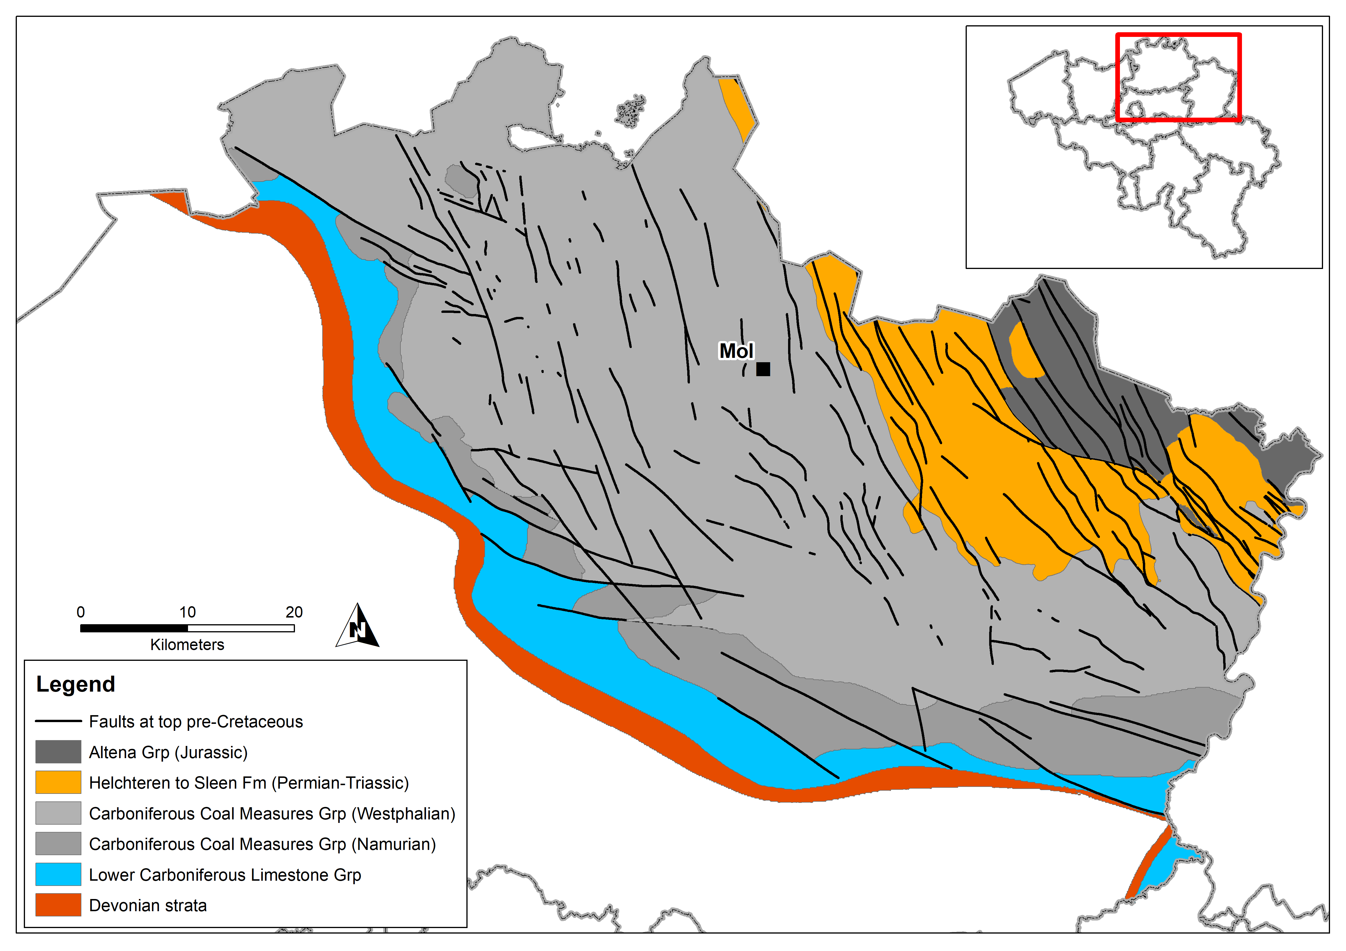
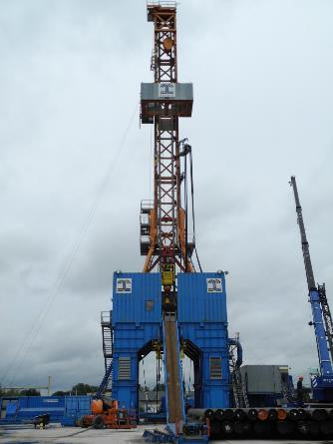
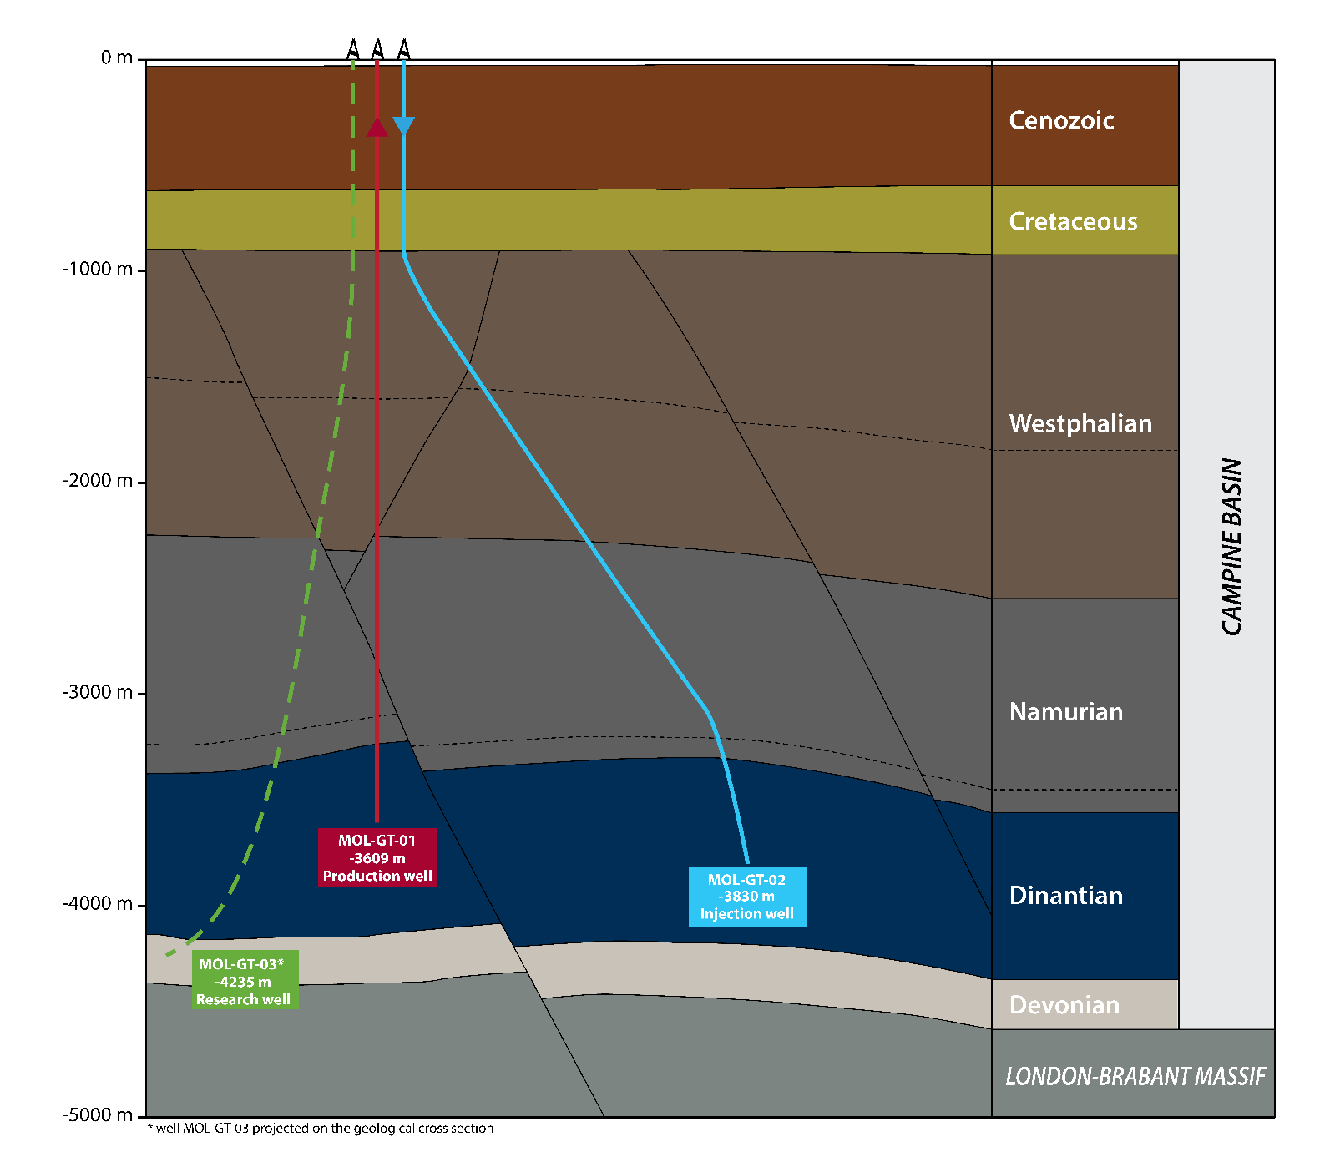
INTRO TO VITO GEOTHERMAL PROJECT
Operation research doublet
Drilled in 2016-2018
3 wells – 1 deep monitoring (seismometer)
3000 – 5000 m depth
Lower carboniferous limestones

Slide 5
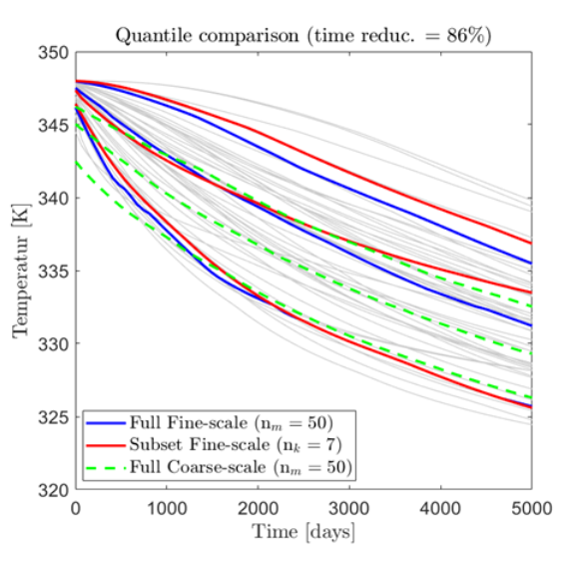
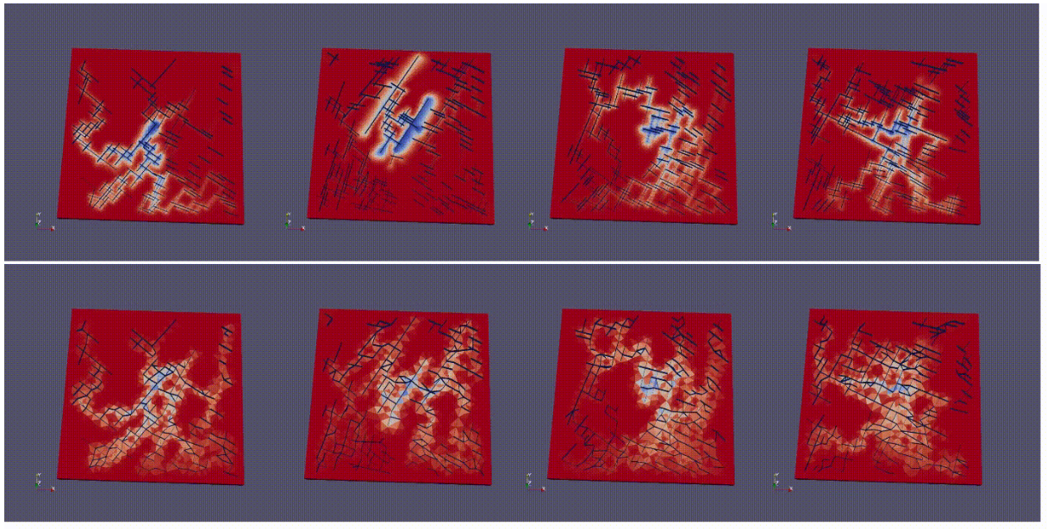
RESERVOIR MODELLING
DARTS – Delft Advanced Research Terra Simulator
C++/Python based reservoir simulator
Operator-Based Linearization (OBL) approach for Jacobian formulation

Slide 6
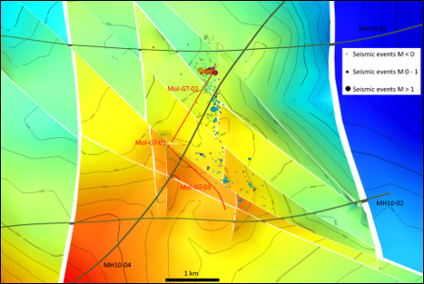
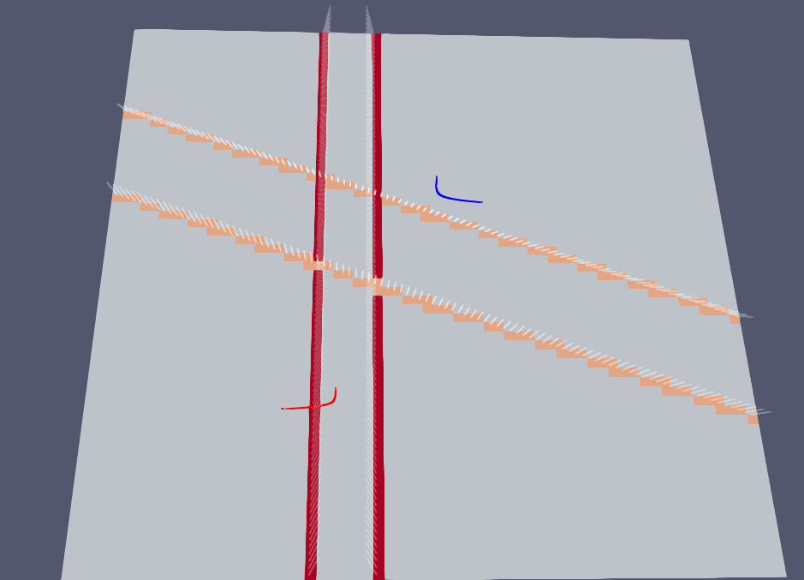
VITO CONCEPTUAL MODEL
Normal faulting region
Min horizontal principal stress ~E-W
High permeability N-S running fractures
Lower permeability NW-SE fractures
Numerical model
2 faults in each direction
Deviated well test
120,000 blocks (50mx50mx10m)
3.2 x 3.2 x 0.36 km domain
12.5 m3/hr initially
25 year simulation

Slide 7
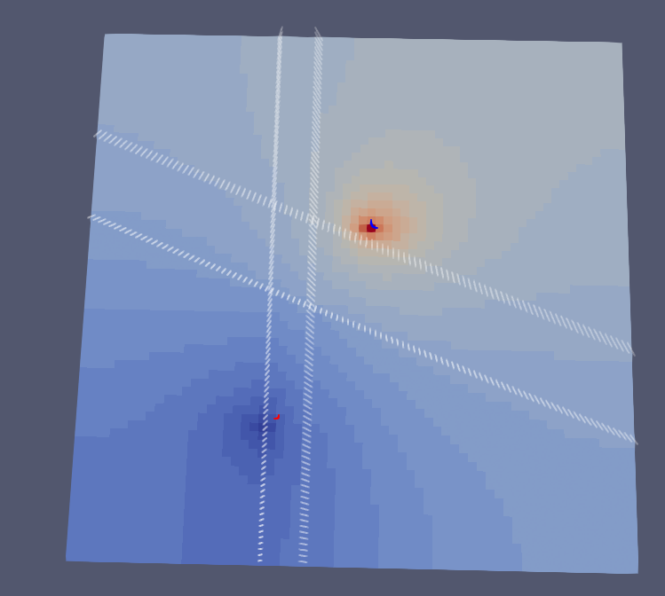
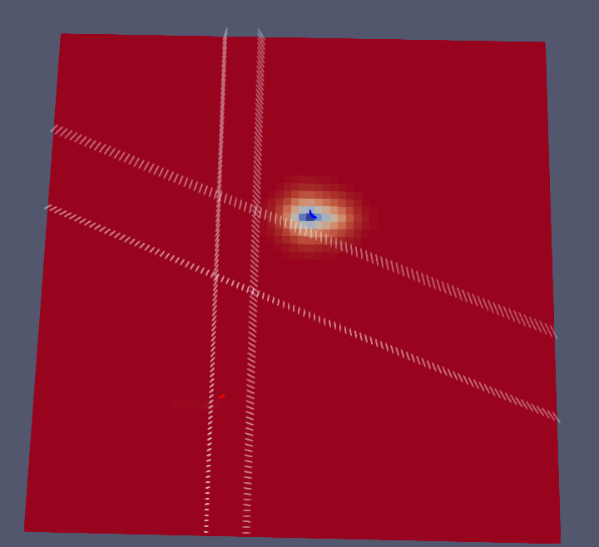
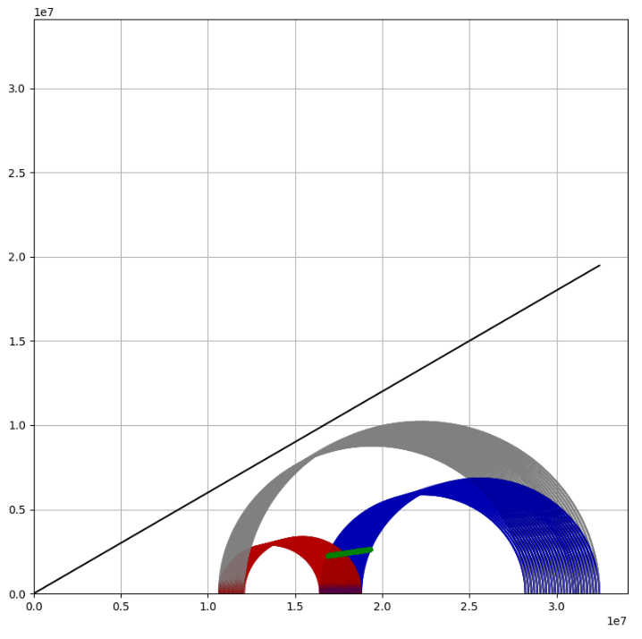
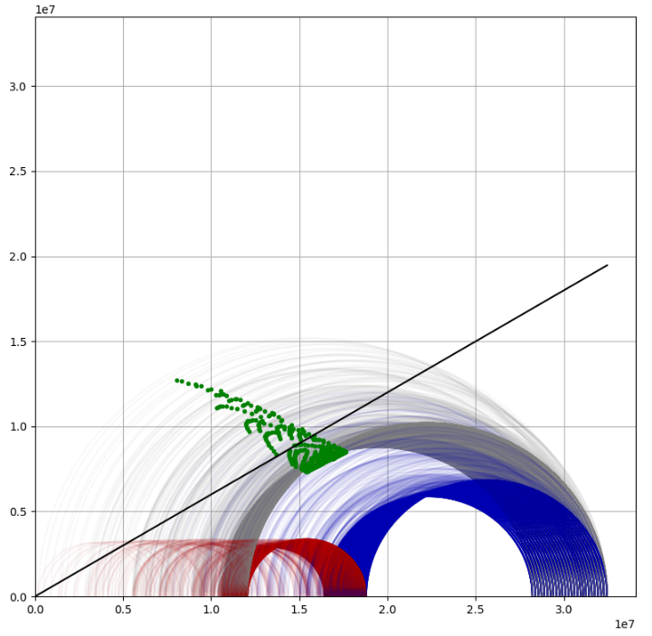
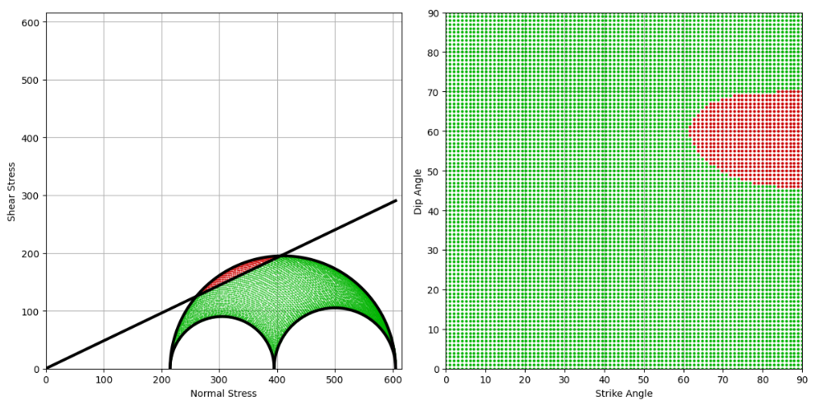
NUMERICAL MODEL RESULTS
P and T changes -> stress changes
Analytical Stress estimation
Only pore pressure and thermal stress so far
Interested in stress change on known faults
Fault orientation is very important
Plan is to link to geomechanical simulator package: GEOS
$$Δσ=\frac{α_{T}E}{1−ν}ΔT−ΔP$$
N-S Fault
NW-SE Fault

Slide 8
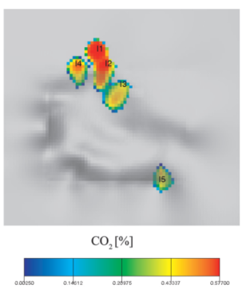
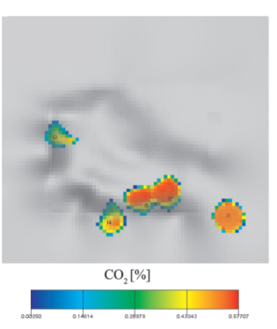
WELL PLACEMENT
Genetic Algorithm (GA) and Particle Swarm Optimization (PSO) approaches for:
well placement and well flow rate optimization
applied previously to CCS
Optimization scheme has to check for two things:
Heat production rate (maximize)
Induced seismic – fault reactivation (minimize)
The cause of fault reactivation can affect the solution:
- pore pressure – reduce flowrate
- thermal effect – increase injection temp?
- combination?

Slide 9
THANK YOU

