Slide 1

European Geothermal Workshop 2024, 13-14/11/2024, Stavanger-Norway
Mineral scaling risk prediction in geothermal wells by integrating a geochemical tool into a well flow simulator
Application to production wells in different magmatic contexts
Vlasios Leontidis, Nathalie Collard, Anthony Michel & Christine Souque

Slide 2
Introduction
CHALLENGE
  Mineral scaling within geothermal production wells may disturb flow regimes and impact long-term geothermal energy production
SOLUTION
  Development of a numerical tool coupling the geochemical calculator Arxim, the well flow model GWellFM, and the thermodynamic library Carnot to estimate the deposition risk along production wells under subcritical conditions
APPLICATION to geothermal fields characterized by different geological settings and host rocks, ranging in composition from dilute to saline fluids

Slide 3
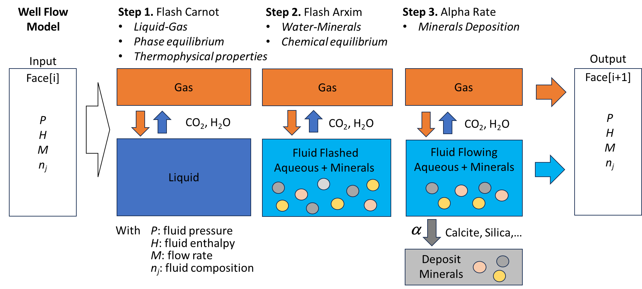
Numerical TOOLS
Multiphase flash-deposition model
Coupling steps
  Compute well flow model coupled with thermo model
  Mass balance per phase and component
  Overall momentum balance
    Single or two-phase flow
  Overall energy balance + Flash(P, H, nj)
    For two-phase flow, the temperatures are the same
  Compute element flow rate with pseudo transformation
  n_{ele,gas} = A_{ele,pseudo} x n_{gas,pseudo}
  n_{ele,water} = n_{ele,Tot} - n_{ele,gas}
  Compute mineral deposition rate
  n_{mineral,deposited} = α x n_{mineral}
n: the amount of matter (mol)
A: the formula matrix of the pseudo
pseudo: the pseudo component
      α = 1: all minerals are deposited
      α = 0: risk of deposition, no mineral deposition
      0 < α < 1: model of kinetic deposition to be calibrated

Slide 4
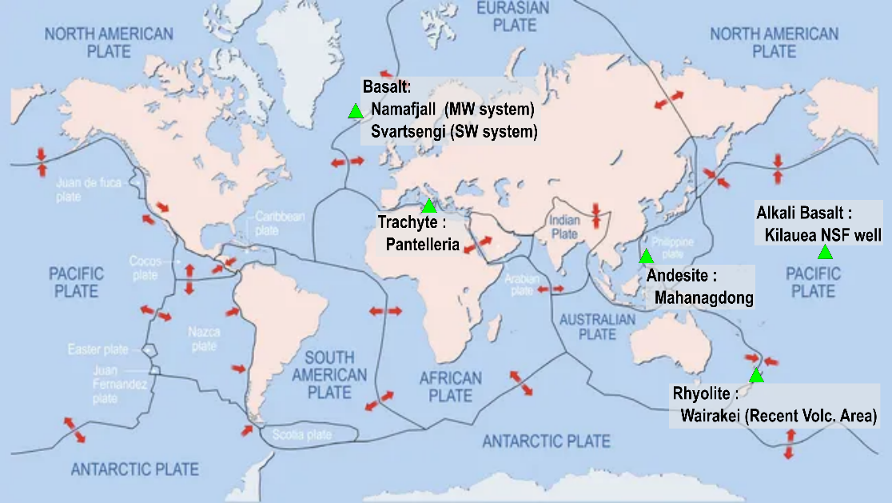
Study Cases
 | Basalt SW[1] | Basalt MW[2] | Andesite[3] | Rhyolite[4] | Trachyte[5]
T [°C] | 241 | 266 | 286 | 242 | 240
Depth [m] | 1438 | 1500 | 2000 | 2000 | 600
pH | 5.03 | 6.7 | 5.3 | 6.2 | 6.5
Na [mol/kg_{w}] | 2.87e⁻⁰¹ | 5.05e⁻⁰³ | 8.41e⁻⁰² | 5.65e⁻⁰² | 1.63e⁻⁰¹
K | 2.44e⁻⁰² | 5.37e⁻⁰⁴ | 1.00e⁻⁰² | 4.91e⁻⁰³ | 1.28e⁻⁰²
Ca | 2.65e⁻⁰² | 8.75e⁻⁰⁶ | 7.19e⁻⁰⁴ | 5.74e⁻⁰⁴ | 1.62e⁻⁰⁴
Mg | 1.60e⁻⁰⁵ | 1.65e⁻⁰⁷ | 1.00e⁻⁰⁶ | 8.23e⁻⁰⁷ | 6.99e⁻⁰⁶
Cl | 3.64e⁻⁰¹ | 2.69e⁻⁰³ | 9.49e⁻⁰² | 6.12e⁻⁰² | 1.71e⁻⁰¹
S | 7.50e⁻⁰⁴ | 5.74e⁻⁰³ | 1.65e⁻⁰³ | 8.10e⁻⁰⁴ | 1.84e⁻⁰³
C | 1.59e⁻⁰² | 1.26e⁻⁰² | 1.28e⁻⁰¹ | 1.09e⁻⁰² | 1.15e⁻⁰²
Si | 7.08e⁻⁰³ | 9.00e⁻⁰³ | 1.79e⁻⁰² | 9.82e⁻⁰³ | 5.18e⁻⁰³
Al | 2.22e⁻⁰⁶ | 3.11e⁻⁰⁵ | 1.00e⁻⁰⁵ | − | 2.19e⁻⁰⁴
Fe | 6.45e⁻⁰⁷ | 7.16e⁻⁰⁸ | 1.92e⁻⁰⁶ | − | 1.97e⁻⁰⁵
Pb | 4.83e⁻¹⁰ | 1.42e⁻⁰⁹ | − | − | −
Sr | − | − | − | − | 2.40e⁻⁰⁶
Log(pCO₂) | -2.01 | -2.16 | -1.27 | -2.24 | -1.77
Log(pH₂S) | -3.85 | -2.95 | -3.49 | -4.01 | -4.11
[1, 2] Kaasaleinen et al. (2015), https://doi.org/10.1016/j.apgeochem.2015.02.003
[3] Angcoy (2010), http://hdl.handle.net/1946/4463
[4] Ellis & Mahon (1964), https://doi.org/10.1016/0016-7037(64)90132-2
[5] Gianelli & Grassi (2001), https://doi.org/10.1016/S0009-2541(01)00276-5
Production rate: 20 kg/s; Inclination: 90°; Casing ID: 24 cm
Gas-Liquid: Soreide & Whitson
Liquid-Solid: Thermoddem thermodynamic database + B-dot activity model
Deposition rate α: 0.2

Slide 5
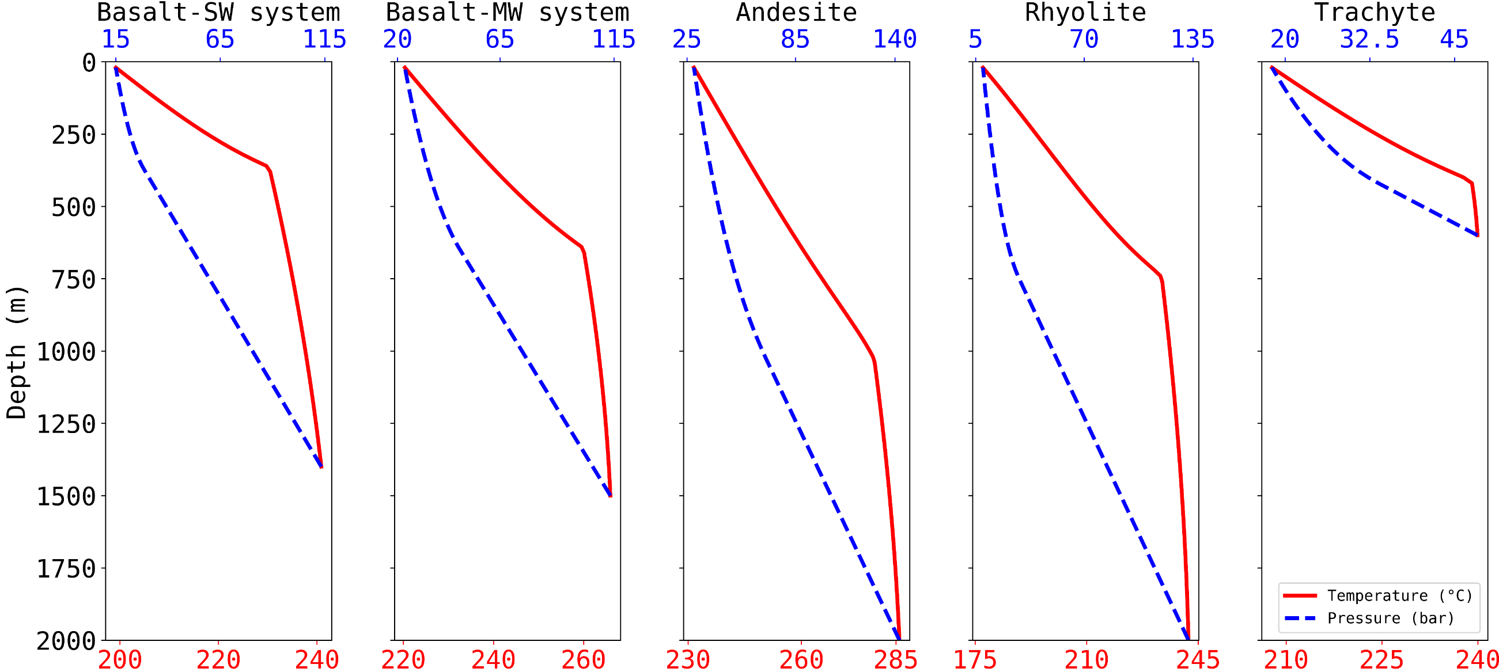
Results – Well Flow and Thermo Models
T and P along the well bore
Surface →
P [bar]
Bottom-hole →
Two-phase (vapour-aqueous) flow
Single-phase (aqueous) flow
T [°C]
First deposition mechanism: Cooling of the fluid while ascending

Slide 6
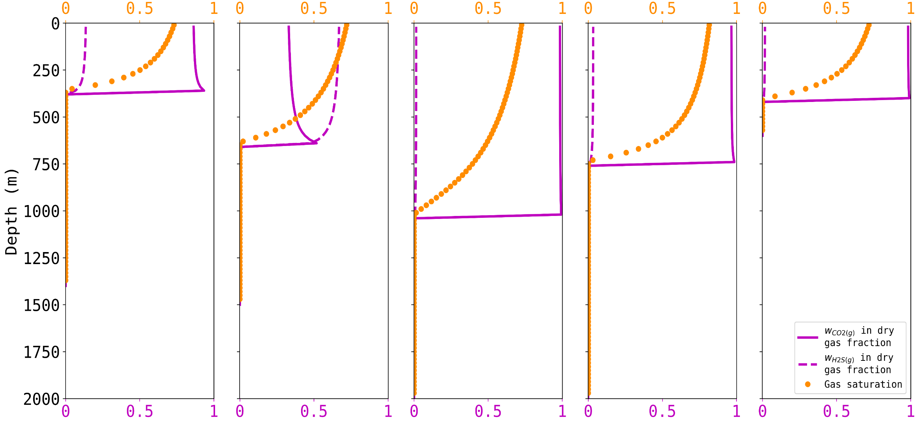
Results – Well Flow and Thermo Models
Gas saturation and CO_{2(g)} - H₂S_{(g)} mass fractions in dry gas mixture
GS [-]
w [-]
Second deposition mechanism: Degassing

Slide 7
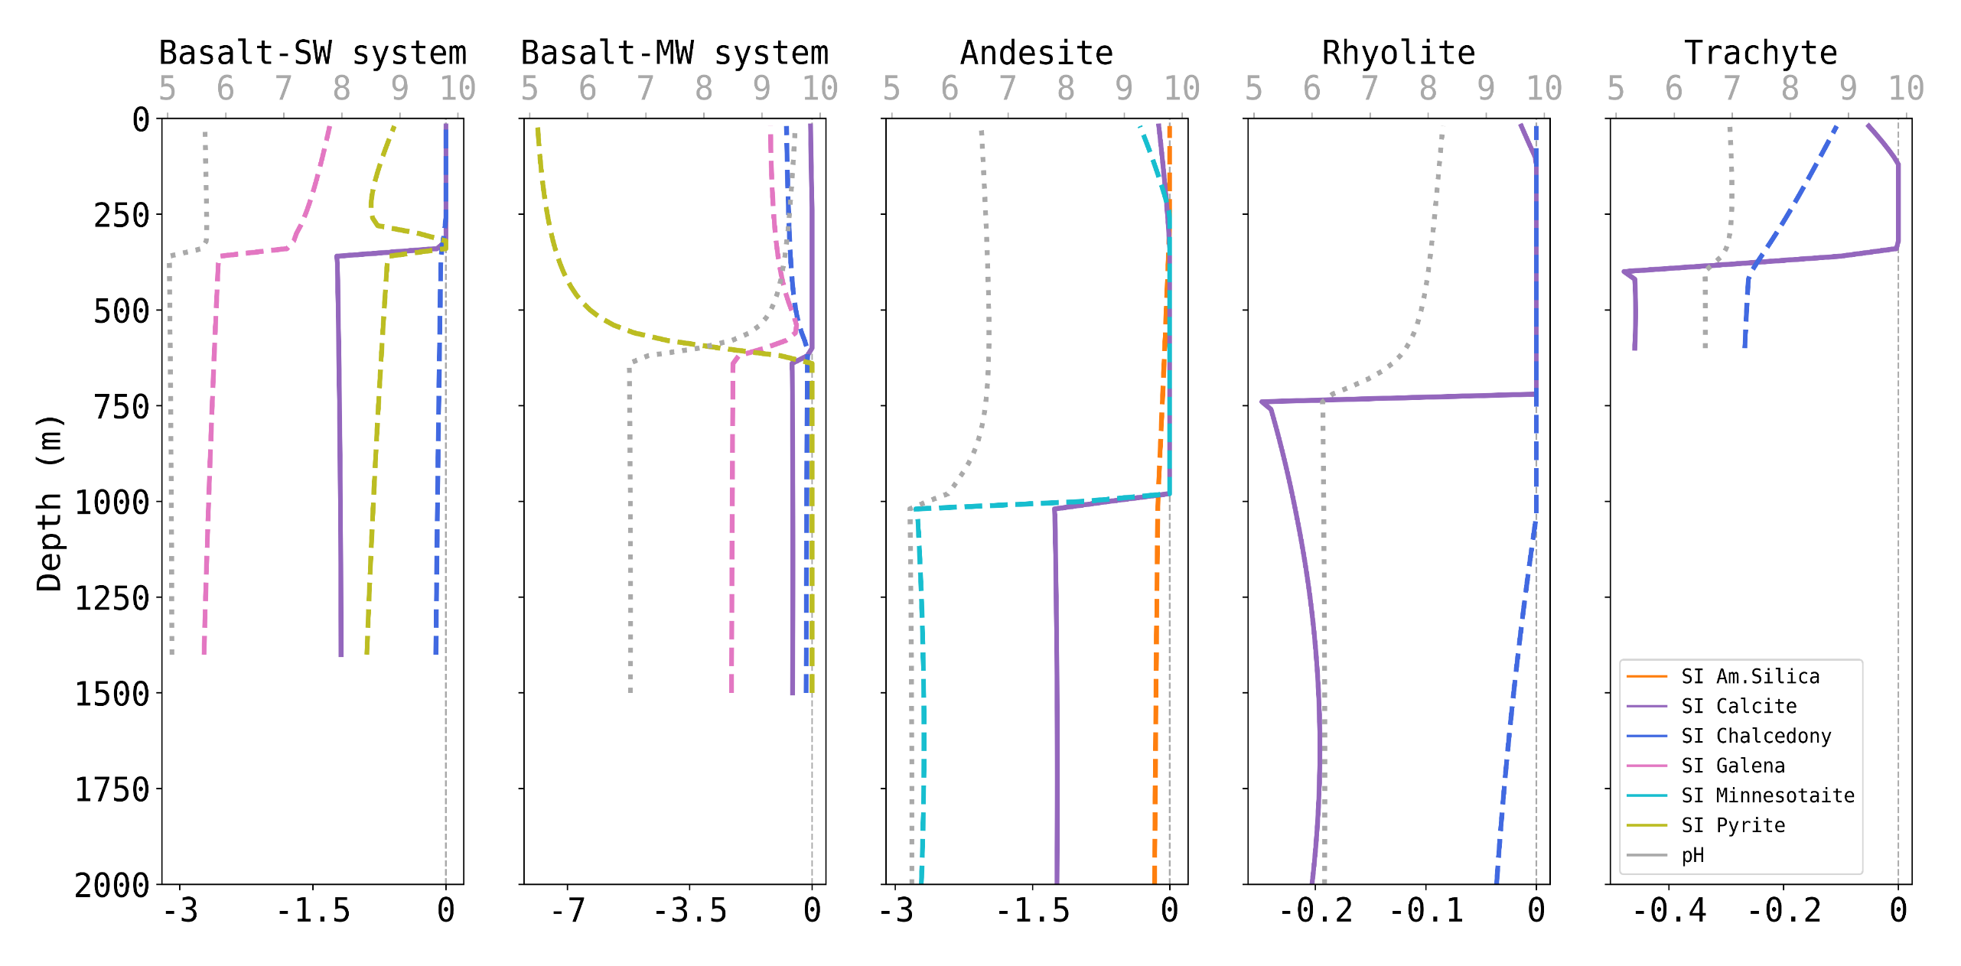
Results – Deposition Model
Scaling risk map
pH [-]
SI [-]

Slide 8
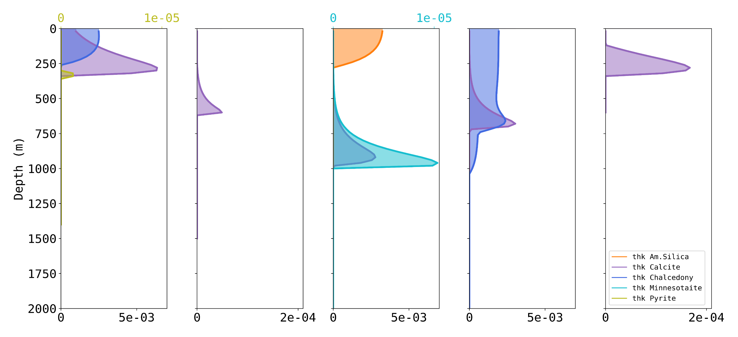
Results – Deposition Model
Scale layer thickness (ε)
ε [cm]
ε [cm]
Calcite: Most common scaling mineral, linked to the first CO₂ gas bubble. Highest scale amount in seawater system due to high [Ca²⁺] concentration (case1>case3>case4>case5>case1)
Amorphous silica: Only present in the system characterized by the highest temperature and H₄SiO₄ concentration (case3). Formation of a CO₂- and H₂S-rich gas phase → basic pH → increase in silica solubility
Iron sulphide: Common in H₂S-rich environments and where the reservoir is mafic rock (case3)
ε [cm]

Slide 9
Conclusions & Perspectives
Coupling between a geothermal wellbore calculator and a multiphase flash-deposition model allowing to predict:
  The scaling risk along the wellbore
  The dominant scaling mechanisms under equilibrium constraint and subcritical conditions
Future work:
  Calculation of the deposition rate (parameter α)
  Coupling with eCPA equation-of-state considering Na⁺-Cl⁻ ion association-dissociation and density models to predict scaling risk from supercritical to subcritical conditions

