Slide 1
Dynamics of Ionic liquids confined in porous glasses – a showcase for pA in QENS
July 2025 I o. holderer (JCNS)

Slide 2

MLZ – View into the Neutron guide hall
MLZ virtual visit:
https://mlz-garching.de/panorama/full/de/index.html

Slide 3
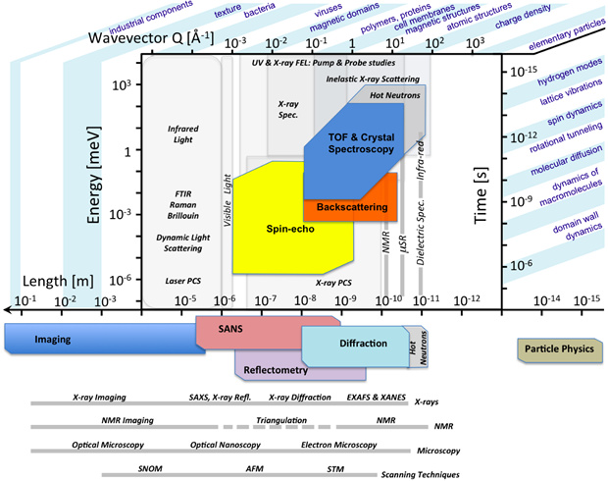
Relevant Time- and lengthscales
http://europeanspallationsource.se/feature-series-ess-instrument-suite

Slide 4
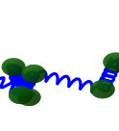
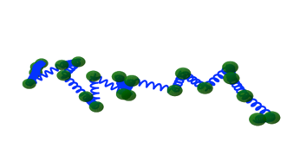


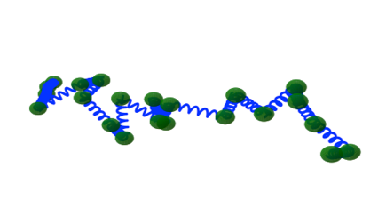
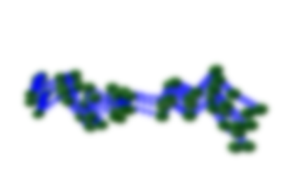





Correlation function
q (inverse length scale)
q=2π/d
Time

Slide 5
Correlation function
q (inverse length scale)
q=2π/d
Time

Slide 6
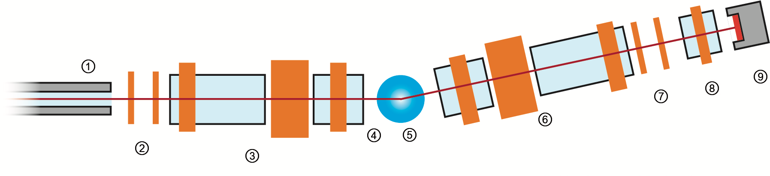
Neutron spin echo spectroscopy
S. Pasini et al., Rev. Sci. Instr. (2019)
P.A. Zolnierczuk, J. Appl Cryst. (2019)

Slide 7
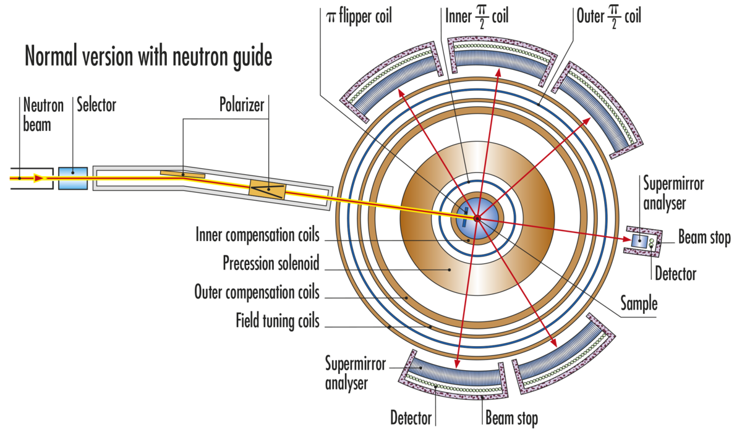
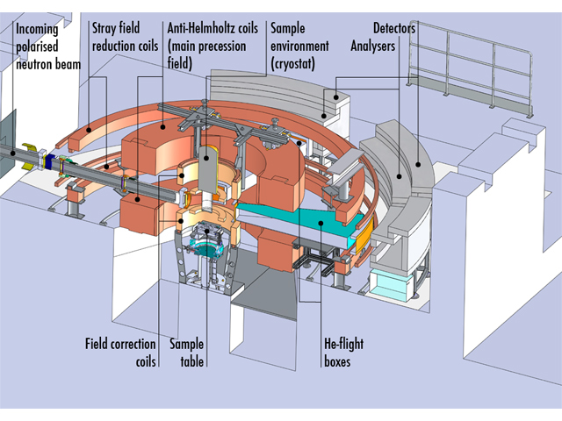
Wide angle NSE: WASP

Slide 8
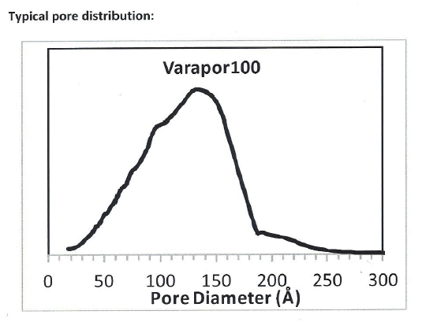
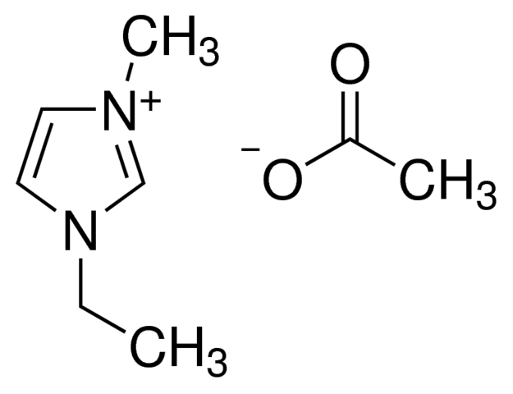
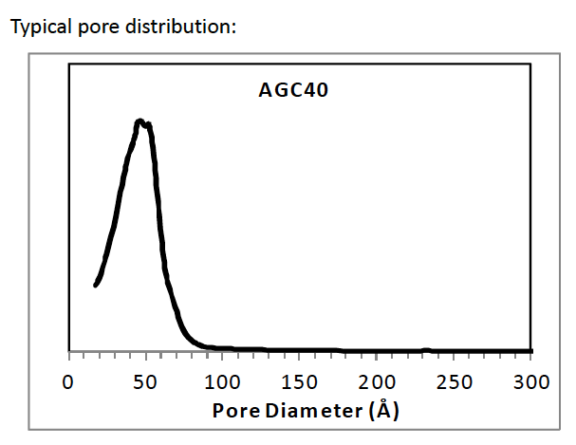
EMIM Ac and porous glasses
1-ethyl-3-methylimidazolium acetate
How does confinement in porous glasses
influence the IL structure and dynamics?

Slide 9
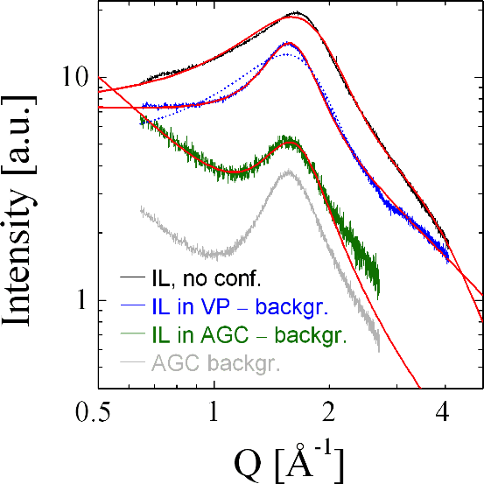
Confined lamellar structure
0.5 molar H2O to IL
X-ray diffraction: Broad peak
with characteristic length
scale similar to sponge phase
Fit with Teubner-Strey function
In confinement: increased correlation length
Lamellar ordering
H. Frielinghaus, ...,OH, Frontiers in Physics (2022) 10, 872616
D. Noferini, O. Holderer, H. Frielinghaus, Phys. Chem. Chem. Phys. (2020) 22, 9046

Slide 10
Confined lamellar structure

Slide 11
Intensity
Mixed coherent and incoherent scattering
Here: focus on incoherent scattering only

Slide 12
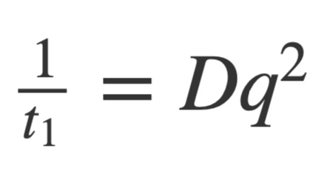
I(Q,t)
Hydrogen motion captured in t₁.
Other contributions mainly elastic on the time scales of the experiment.

Slide 13
RESULTS
Diffusion of H2O follows mainly acetate dynamics
Slight reduction of activation energy in confinement
H2O in low concentration (0.5 molar) strongly linked to ionic liquid
Molecular mixture of water and acetate

Slide 14
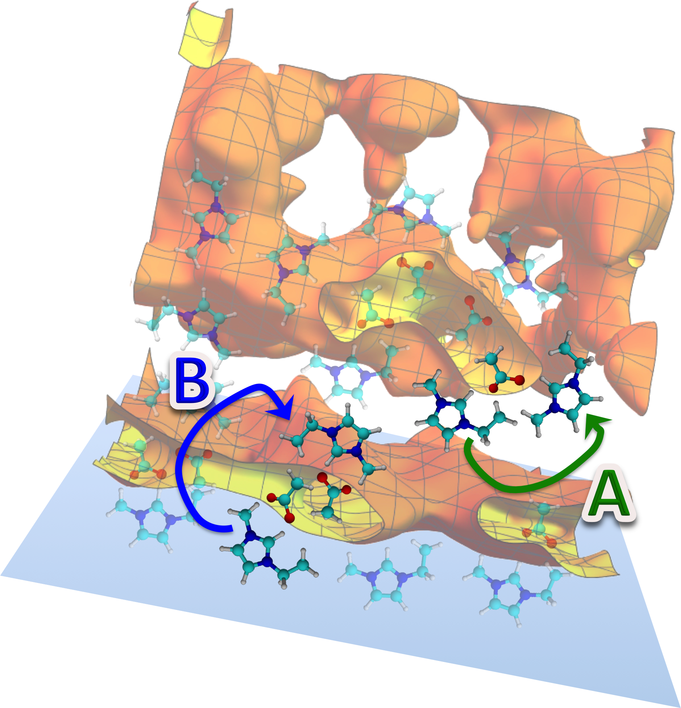
picture
Confinement:
Induced lamellar structure
Reduced activation energy
Water addition:
Little influence on proton dynamics
Bulk IL
At interface
D. Noferini, O. Holderer, H. Frielinghaus, Phys. Chem. Chem. Phys. (2020) 22, 9046
H. Frielinghaus, ...,OH, Frontiers in Physics (2022) 10, 872616

Slide 15
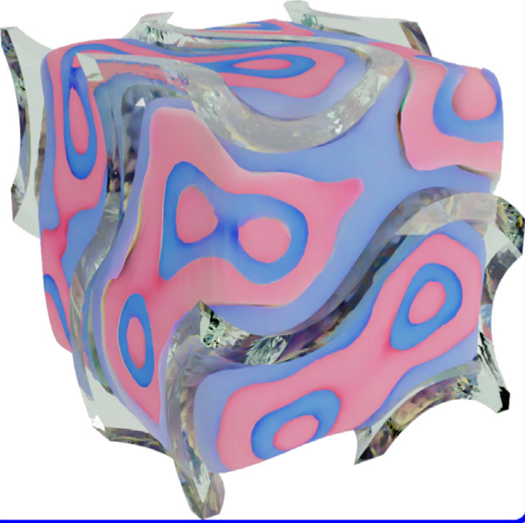
What about coherent scattering? High Q

Slide 16
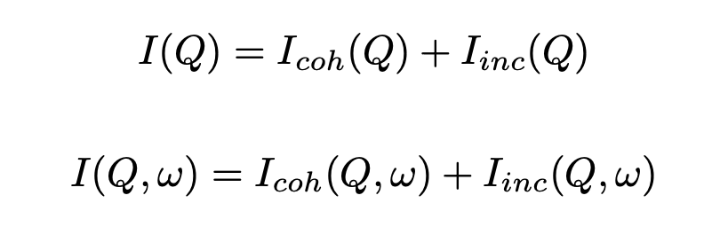
Intensity and polarization
NSE:
BS:
Complementary information
from NSE and BS

Slide 17
Separation of contributions
Hypothetical scenarios:

Slide 18
Conclusion
Insight into dynamics under confinement from QENS
Wide Angle Spin Echo provides right time-scale
data analysis involved due to coherent/incoherent contributions
Interfaces affect structure and diffusion
Backscattering provides complementarity, especially with polarization analysis

Slide 19


Acknowledgement
ILL local contacts from WASP:
Peter Falus
Peter Fouquet
Jülich Deuteration Lab:
Lisa Fruhner
JCNS at MLZ:
Henrich Frielinghaus
Margarita Fomina
Dominic Hayward
Purushottam Dubey
Sebastian Jaksch

Slide 20


June 15-19, 2026
go.fzj.de/neutronsandfood8

Slide 21
Structure
X-ray diffraction:
IL: Broad peak with
characteristic length scale similar to sponge phase
Fit with Teubner-Strey function
In confinement: increased correlation length
Lamellar ordering
D. Noferini, O. Holderer, H. Frielinghaus, Phys. Chem. Chem. Phys. (2020) 22, 9046

Slide 22
Neutron Backscattering spectroscopy: S(q,E)
Self correlation function:
Hopfenmüller et al, JCP 2018

Slide 23
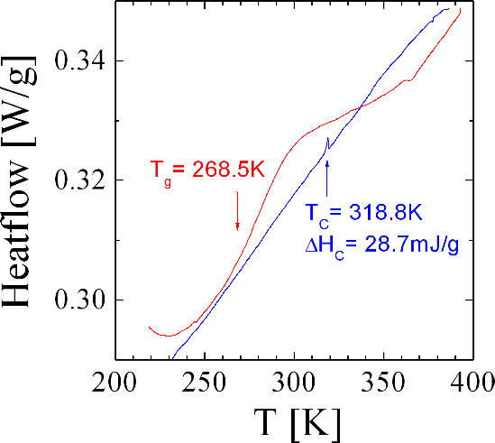
Phase behaviour: elastic scans and DSC
D. Noferini, O. Holderer, H. Frielinghaus, Phys. Chem. Chem. Phys. (2020) 22, 9046
Help from Jia-Jhen Kang (TU München) for the DSC measurements is acknowledged

Slide 24
S(q,E)
Neutron backscattering spectroscopy at SPHERES (MLZ)
Bulk VP AGC
D. Noferini, O. Holderer, H. Frielinghaus, Phys. Chem. Chem. Phys. (2020) 22, 9046

Slide 25
Diffusion in confinement
Singwi-Sjölander jump diffusion model:
Jump length l and residence time τ
Larger effects of confinement at higher T
D. Noferini, O. Holderer, H. Frielinghaus, Phys. Chem. Chem. Phys. (2020) 22, 9046

