Slide 1
Phonon Dynamics of CsAg5Te3-based Thermoelectric Materials by Combining First-principles and Neutron Scattering
Bao-Tian Wang (王保田)
Institute of High Energy Physics, Chinese Academy of Sciences
Spallation Neutron Source Science Center
PAQMAN2025

Slide 2
Contents
1
Background
2
Neutron Scattering and DFT Calculations of CsAg₅Te₃
3
Computational study of α–CsCu₅Se₃
4
Neutron Scattering and DFT study of CsCu₄Se₃

Slide 3
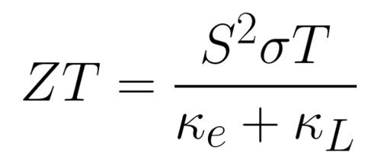
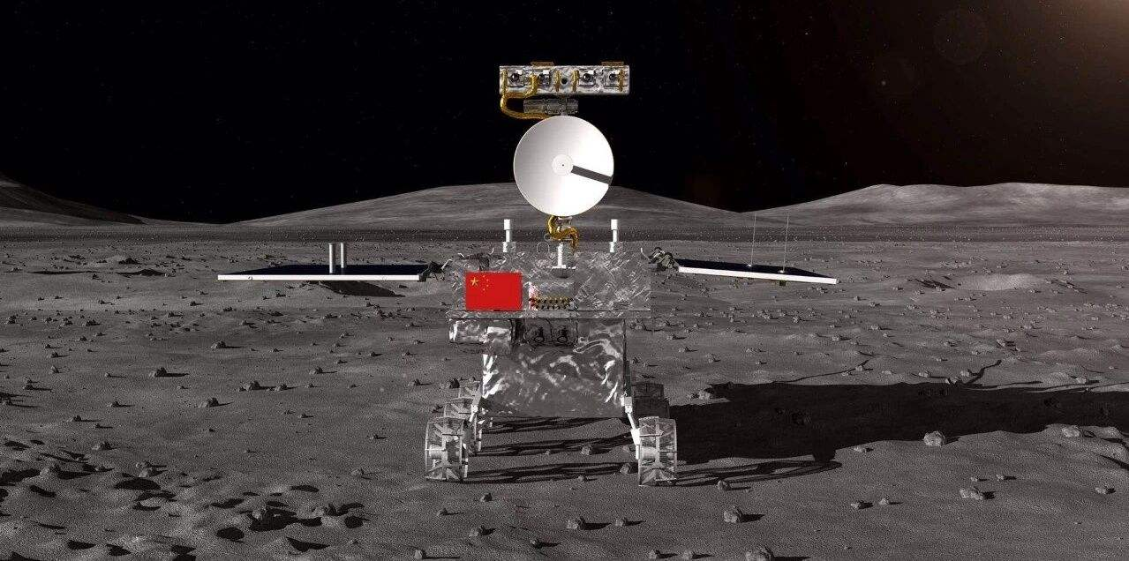
1. Background
Thermelectric Materials
Merits:
Thermal-to-electric energy conversion and vice versa
Small volume and light mass
Small ∆T for temperature control
Environment friendly

Slide 4
1. Background
Two main mechanisms for low lattice thermal conductivity (κ_{L}) of high-performance thermoelectric materials:
Giant Anharmonic Phonon Scattering
SnSe、SnTe、PbTe
2. Suppressing Phonon Scattering by Disordered Structures
CuCrSe₂、AgCrSe₂、CsAg₅Te₃
Nat. Phys., 2015, 11, 1063; Nat. Mater., 2011, 10, 614; Nat. Mater., 2018, 17, 226; Nat. Phys., 2019,15, 73.

Slide 5
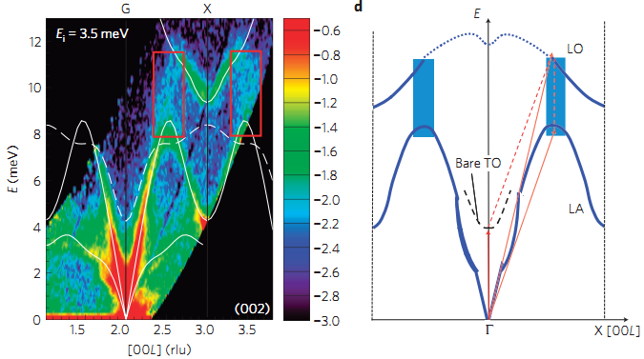
1. Background
Nat. Phys., 2015, 11, 1063; Nat. Mater., 2011, 10, 614; Nat. Mater., 2018, 17, 226; Nat. Phys., 2019,15, 73.

Slide 6
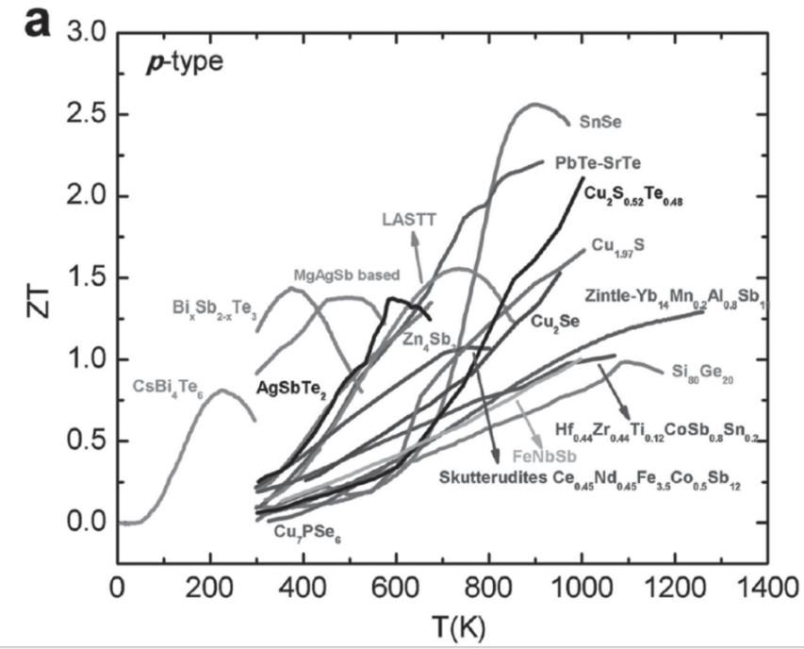
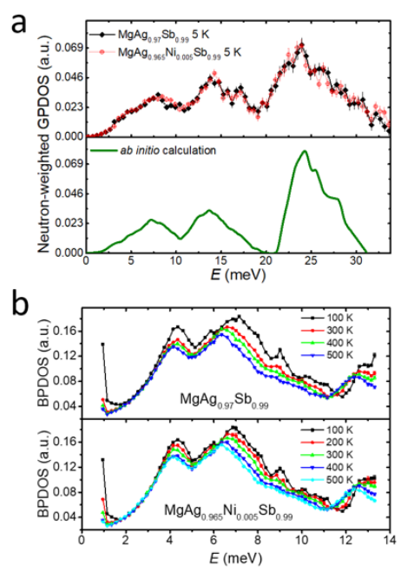
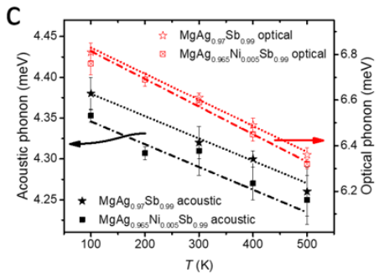
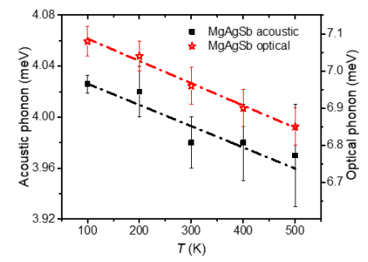
1. Background
α-MgAgSb:
Room-temperature TE material
Low κ_{L}
ZT up to 1.4 at 525 K
High conversion efficiency
Nano Energy 2014, 7, 97; Adv. Funct. Mater. 2015, 25, 6478
X.Y. Li#, P.F. Liu#, B.T. Wang*, Z.F. Ren*, H.Z. Zhao*, F. Wang*, et al., Nat. Commun. 2020, 11, 942.

Slide 7
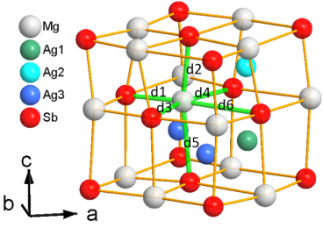
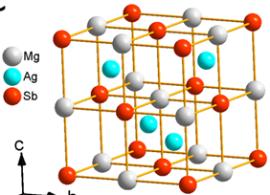
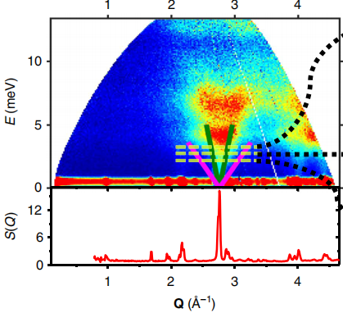
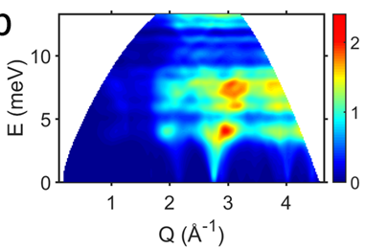
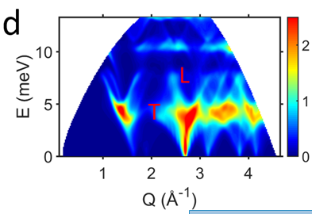
1. Background
1. Neutron scattering and DFT calculations on α-MgAgSb
Intrinsic Mg-Sb distorted rocksalt sublattice structure
Transverse Acoustic Phonons
Ultralow k_{lat}
Longitudinal Acoustic Phonons
X.Y. Li#, P.F. Liu#, B.T. Wang*, Z.F. Ren*, H.Z. Zhao*, F. Wang*, et al., Nat. Commun. 2020, 11, 942.

Slide 8
2. Neutron Scattering and DFT Calculations of CsAg₅Te₃
Experiments
High-temperature solid state reaction method
Spark plasma sintering (SPS)/Hot-pressed (HP) samples
Laser flash diffusivity method
Neutron Diffraction Measurements: CSNS@MPI
Inelastic Neutron Scattering (INS) Measurements: J-PARC@AMATERAS
DFT calculations
Ab initio calculations:
Harmonic phonons: Phonopy
Anharmonic phonons & κ_{lat}: Phono3py/TDEP/DynaPhoPy
S(Q,E) map: Euphonic

Slide 9
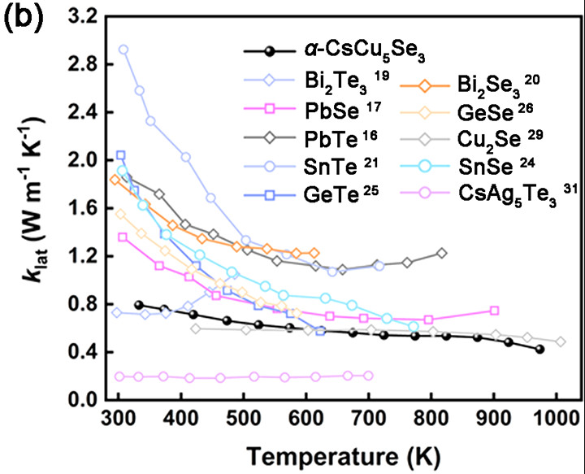
2. Neutron Scattering and DFT Calculations of CsAg₅Te₃
2. Neutron scattering and DFT calculations on CsAg₅Te₃
The most key and remarkable features of CsAg₅Te₃：
1. Complex structure (large unit cell)
1. Ultralow κ_{L} (<0.2 Wm⁻¹K⁻¹@300K)
2. A constant κ (300~700 K)
3. High ZT >1.5@700 K (p-type)
4. Large optic-to-acoustic phonon ratio
Low-κ_{L} mechanism?
1. Neutron scattering
2. DFT calculations
Lin et al., Angew. Chem. Int. Ed. 55, 11431–11436 (2016).
Ma et al., J. Am. Chem. Soc., 142, 5293-5303 (2020).

Slide 10
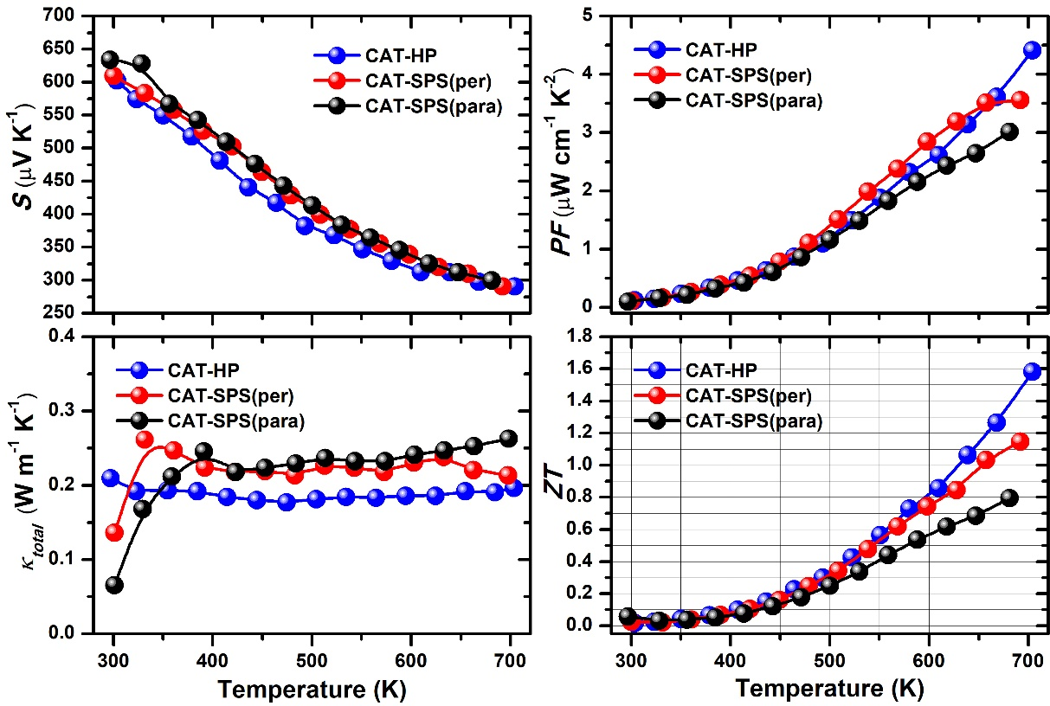
2. Neutron Scattering and DFT Calculations of CsAg₅Te₃
2. Neutron scattering and DFT calculations on CsAg₅Te₃
CsAg₅Te₃：High ZT >1.5@700K
P.F. Liu#, X.Y. Li#, Hua Lin*, J. Zhang*, J. He*, Bao-Tian Wang*, et al., Natl. Sci. Rev., 2024, 11, nwae216.

Slide 11
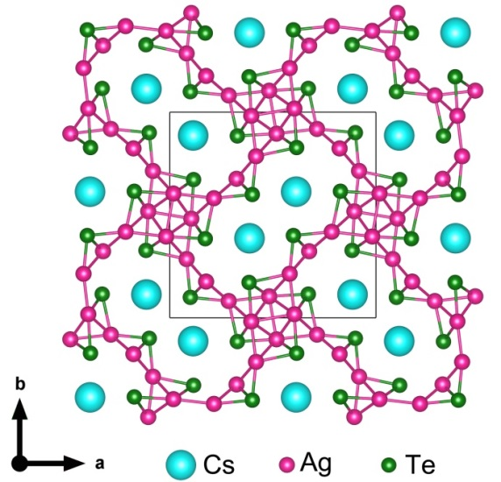
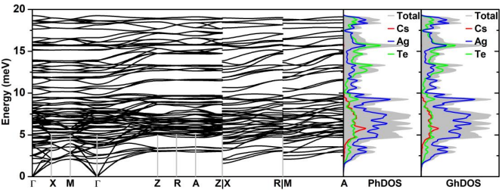
2. Neutron Scattering and DFT Calculations of CsAg₅Te₃
Low-κ mechanism in CsAg₅Te₃?
Neutron scattering & DFT calculations
P.F. Liu#, X.Y. Li#, Hua Lin*, J. Zhang*, J. He*, Bao-Tian Wang*, et al., Natl. Sci. Rev., 2024, 11, nwae216.

Slide 12
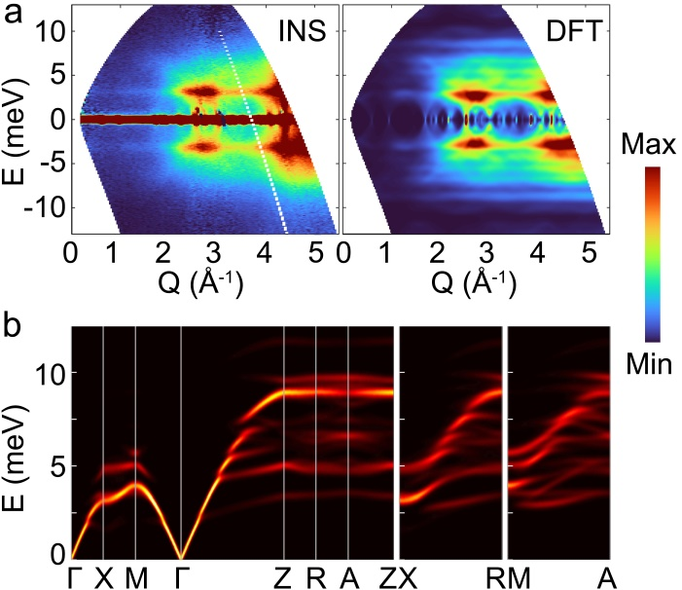
2. Neutron Scattering and DFT Calculations of CsAg₅Te₃
AMATERAS
Proposal No.: 2022A0304
S(Q,E)
Neutron-weighted phonon
calculated by DFT
P.F. Liu#, X.Y. Li#, Hua Lin*, J. Zhang*, J. He*, Bao-Tian Wang*, et al., Natl. Sci. Rev., 2024, 11, nwae216.

Slide 13
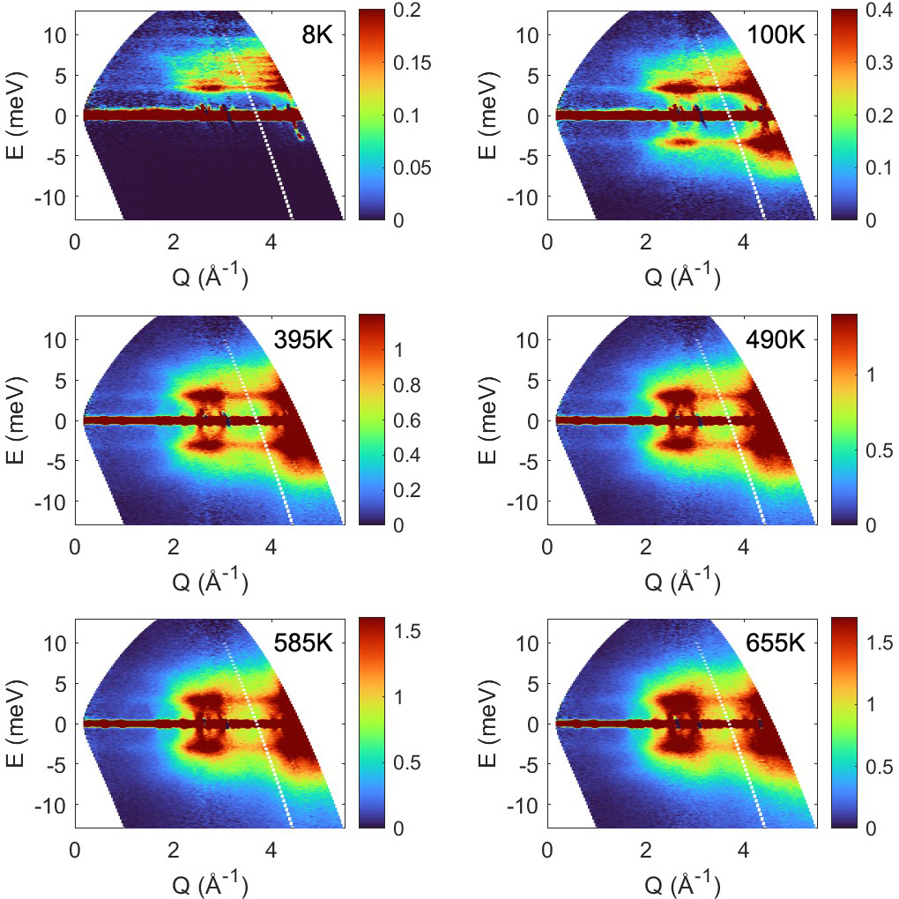
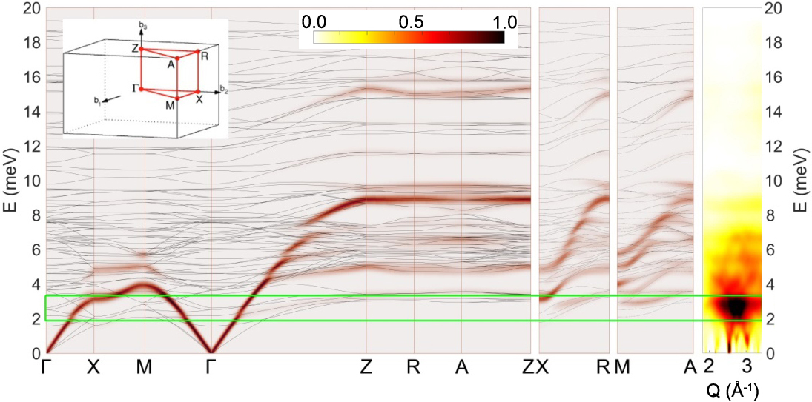
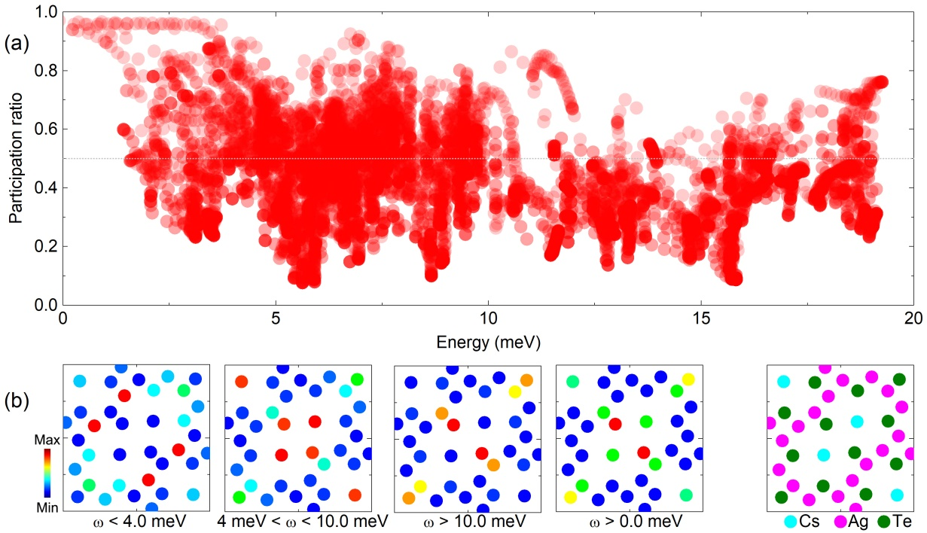
2. Neutron Scattering and DFT Calculations of CsAg₅Te₃
S(Q,E)
Neutron-weighted phonon calculated by DFT
P.F. Liu#, X.Y. Li#, Hua Lin*, J. Zhang*, J. He*, Bao-Tian Wang*, et al., Natl. Sci. Rev., 2024, 11, nwae216.

Slide 14
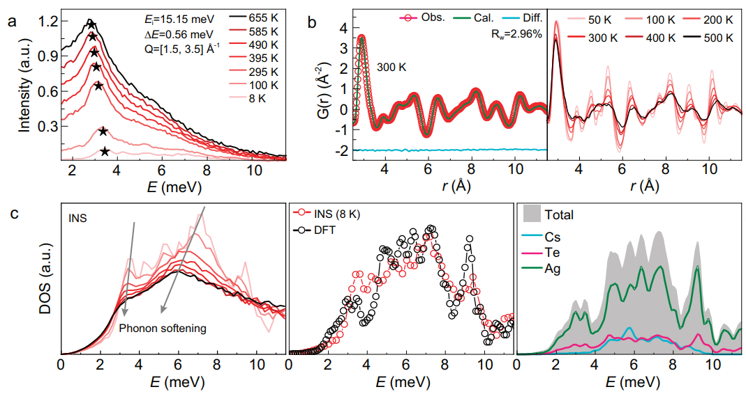
2. Neutron Scattering and DFT Calculations of CsAg₅Te₃
Neutron-weighted phonon calculated by DFT
P.F. Liu#, X.Y. Li#, Hua Lin*, J. Zhang*, J. He*, Bao-Tian Wang*, et al., Natl. Sci. Rev., 2024, 11, nwae216.

Slide 15
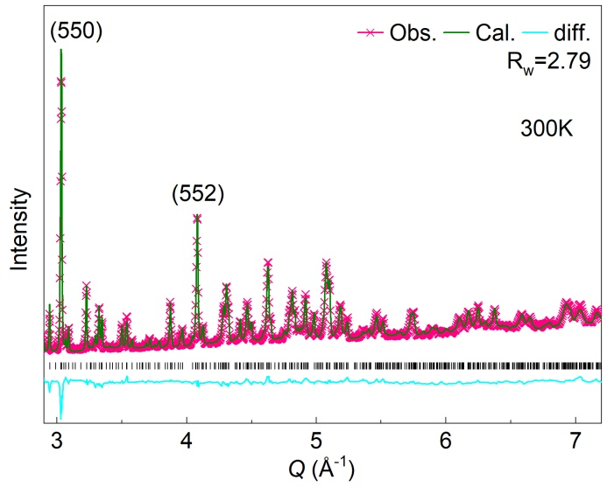
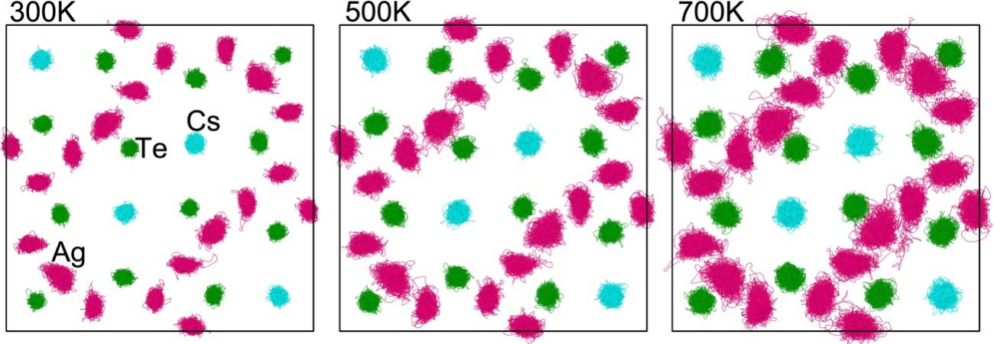
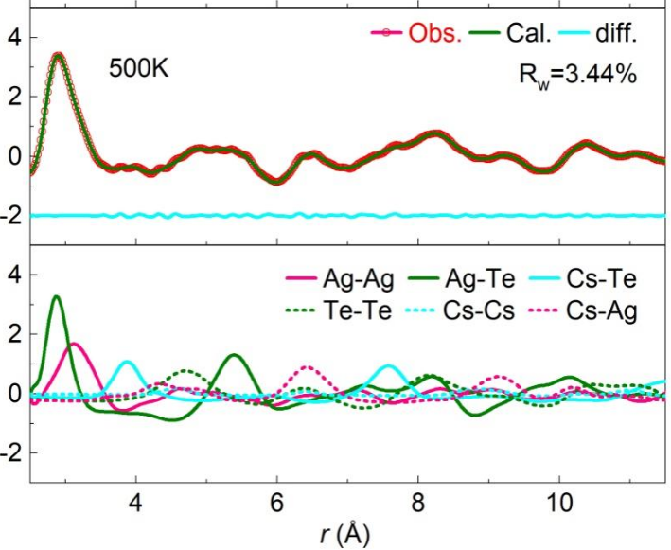
2. Neutron Scattering and DFT Calculations of CsAg₅Te₃
Stable in wide temperature range of 8-700 K: No structural phase transition or superionic transition occurred;
The Ag-Te/Ag-Ag bonds exhibit significant softening behavior upon heating from 300 K to 500 K；
The liquid-like vibrational behavior of Ag ions induces strong phonon anharmonicity and ultralow κ_{L}.
P.F. Liu#, X.Y. Li#, Hua Lin*, J. Zhang*, J. He*, Bao-Tian Wang*, et al., Natl. Sci. Rev., 2024, 11, nwae216.

Slide 16
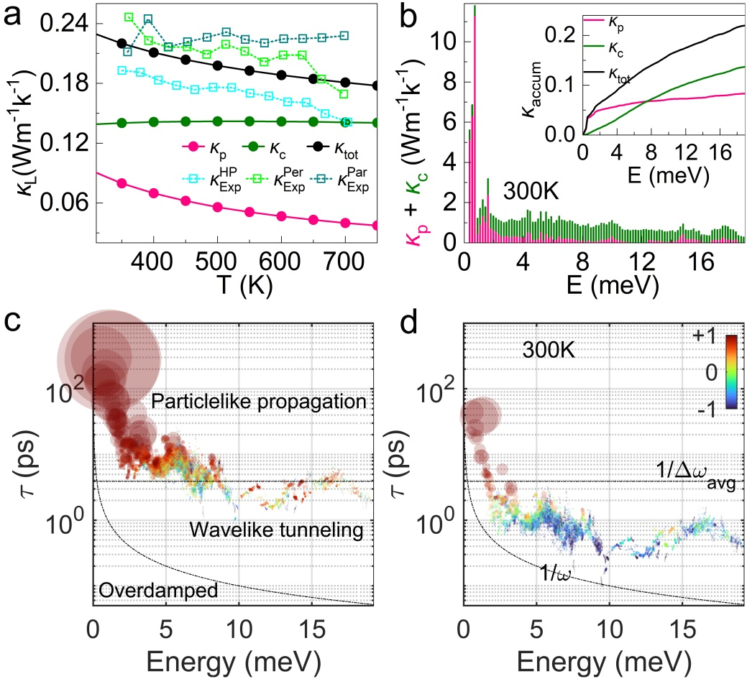
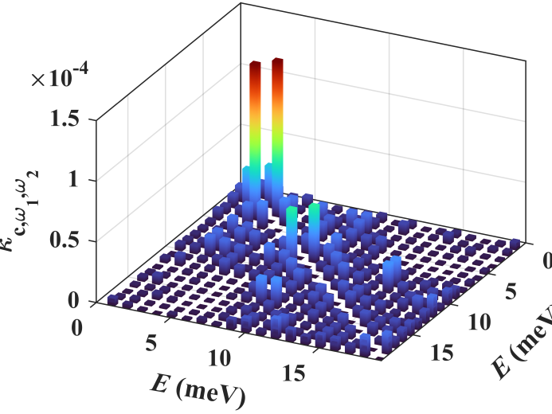
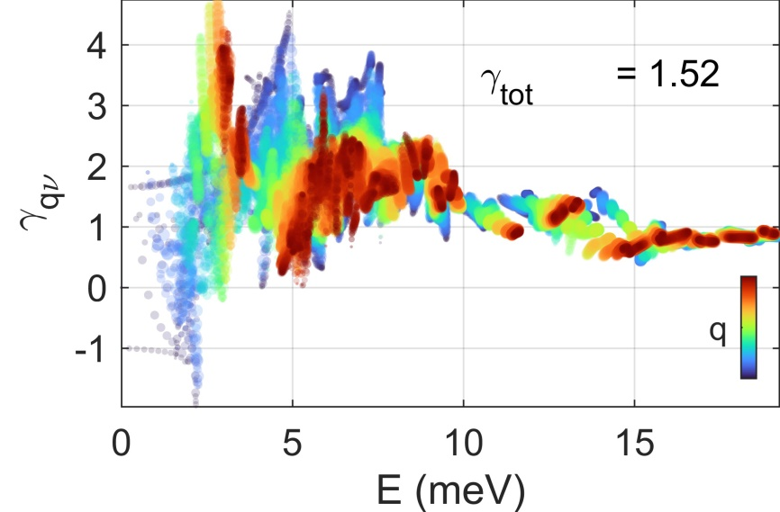
2. Neutron Scattering and DFT Calculations of CsAg₅Te₃
P.F. Liu#, X.Y. Li#, Hua Lin*, J. Zhang*, J. He*, Bao-Tian Wang*, et al., Natl. Sci. Rev., 2024, 11, nwae216.

Slide 17
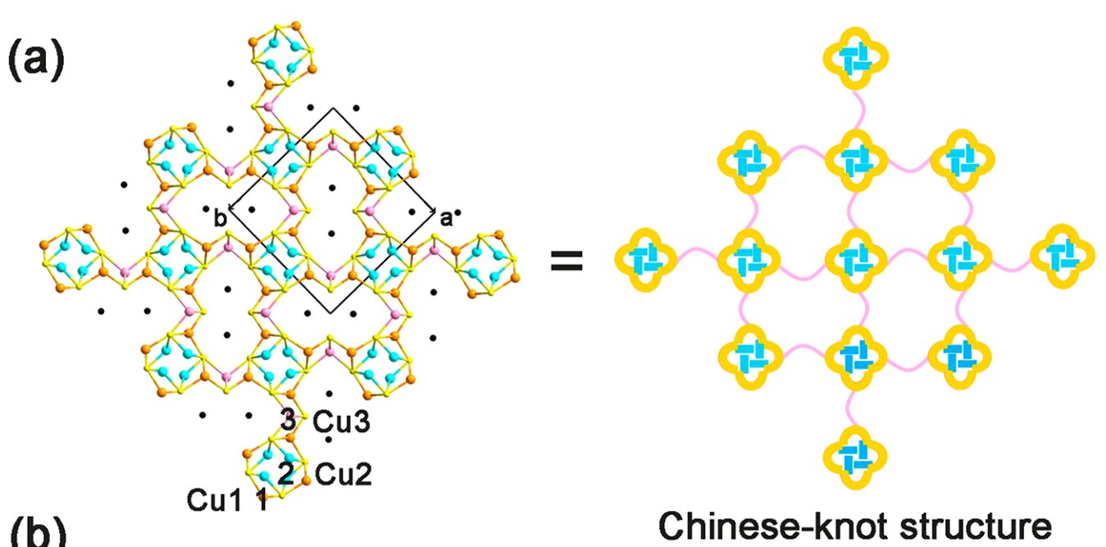
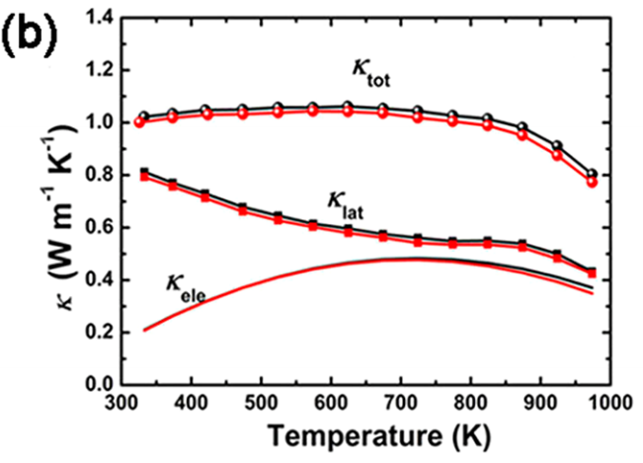
3. Computational study of α-CsCu₅Se₃
CW
CW
CW
Ref: Ma et al., J. Am. Chem. Soc., 142, 5293-5303 (2020).

Slide 18
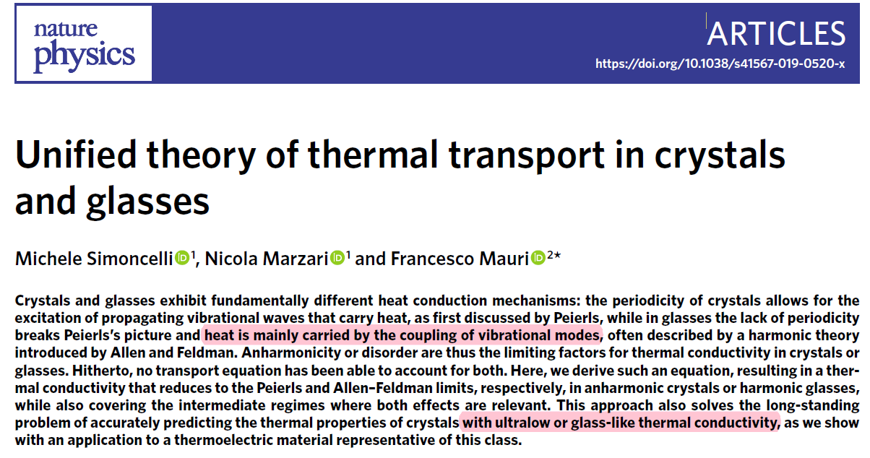
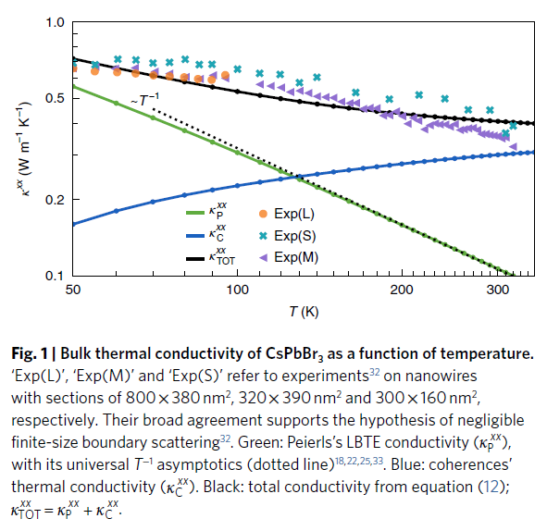
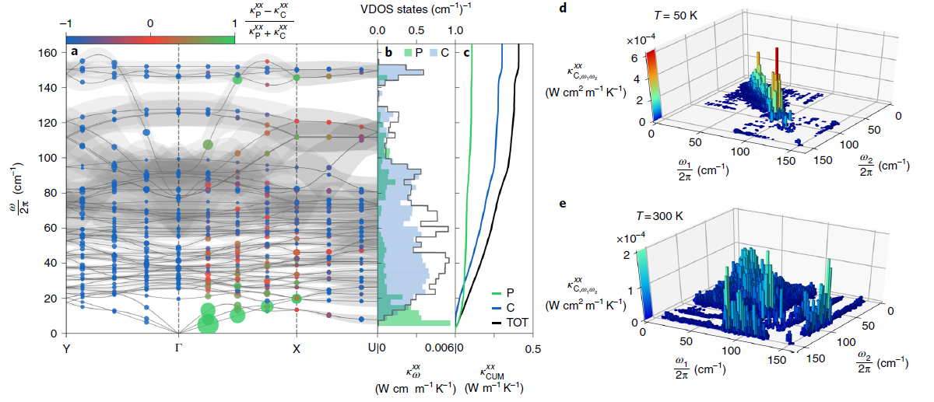
3. Computational study of α-CsCu₅Se₃
CSLD
Alamode
Phonopy
ShengBTE (Phono3py)
HiPhive
Alamode-CSLD
(compressive sensing lattice dynamics)
Refs: Zhou et al., Phys. Rev. Lett., 113, 180511 (2014).
Simoncelli et al., Nat. Phys., 15, 809 (2019).

Slide 19
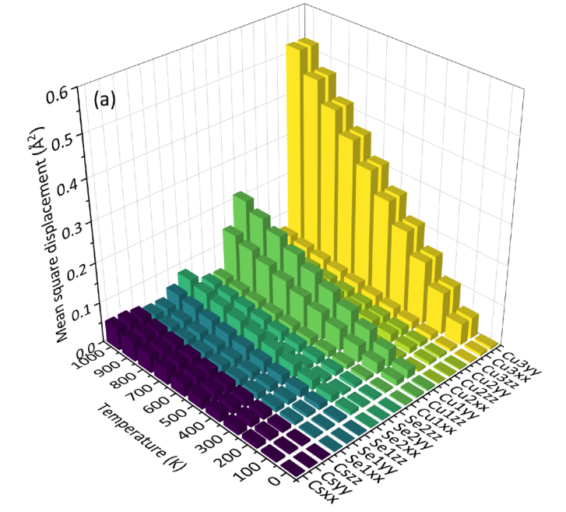
3. Computational study of α-CsCu₅Se₃
Crystal structure and anharmonicity
The rattling modes associated with the Cu3 atoms are expected to play an important role in its phonon transport.
Qing-Yu Xie, Bao-Tian Wang*, et al., PRB, 2023, 108, 014302.

Slide 20
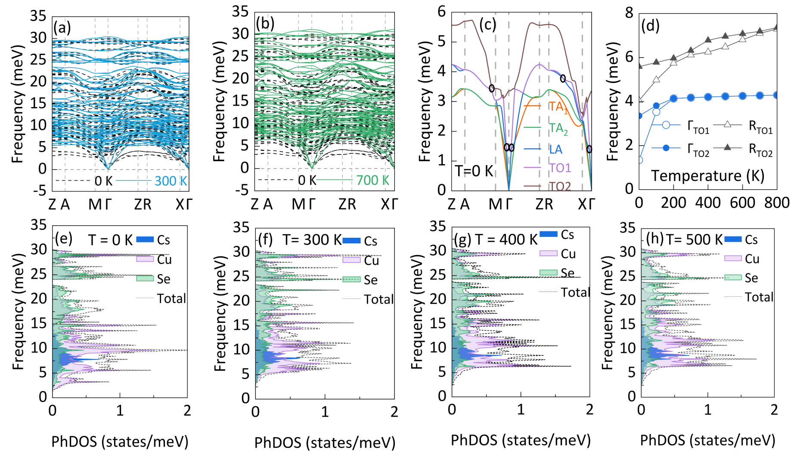
3. Computational study of α-CsCu₅Se₃
Temperature-induced anharmonic phonon renormalization
Strong quartic anharmonicity of tetragonal α-CsCu5Se3 strongly hardens the low-energy phonon branches.
Qing-Yu Xie, Bao-Tian Wang*, et al., PRB, 2023, 108, 014302.

Slide 21
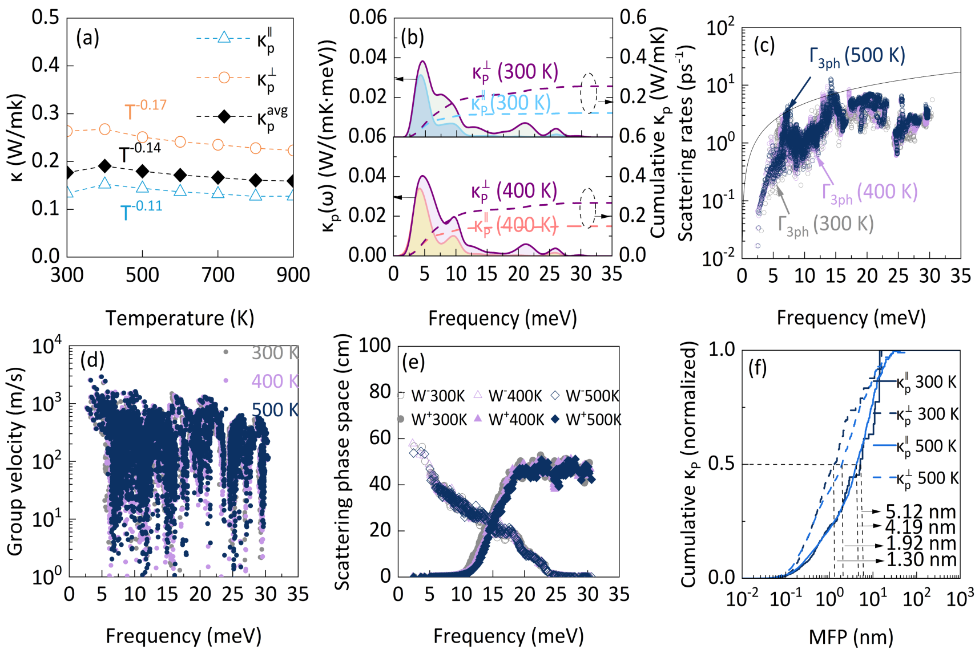
3. Computational study of α-CsCu₅Se₃
Particle-like contributions to κ_{L}
The hardening effect diminishes the three-phonon scattering processes at finite temperatures.
Qing-Yu Xie, Bao-Tian Wang*, et al., PRB, 2023, 108, 014302.

Slide 22
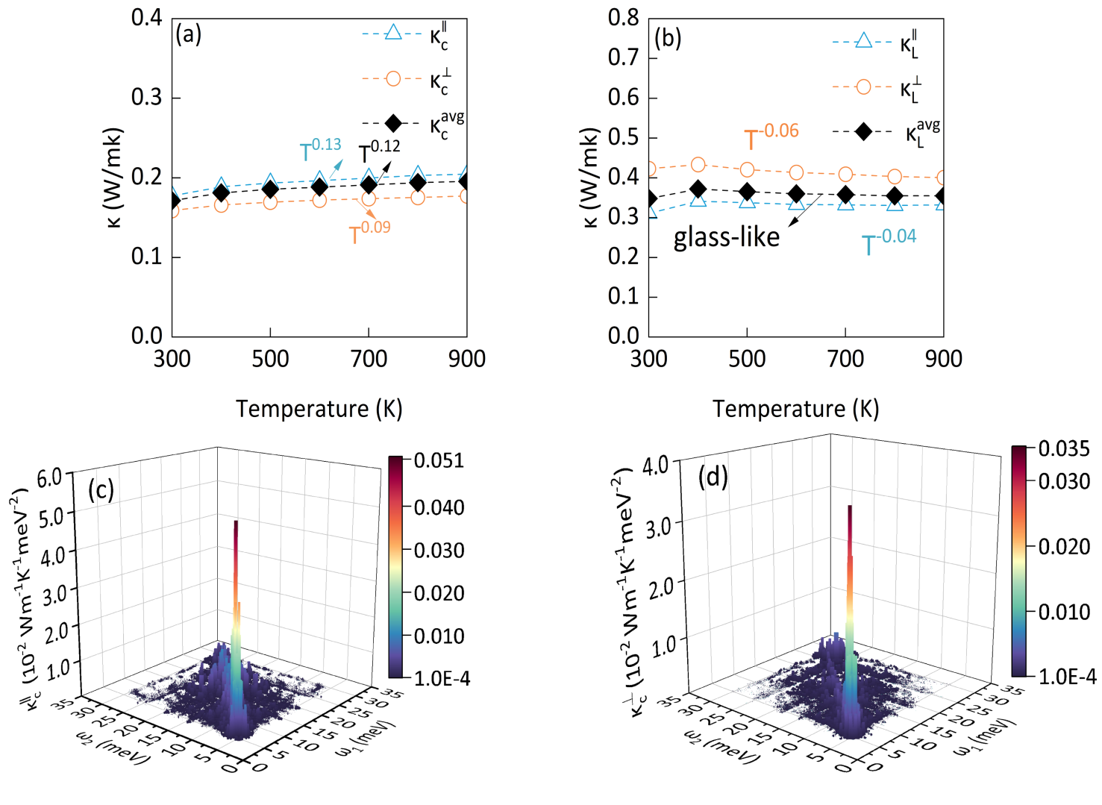
3. Computational study of α-CsCu₅Se₃
Wave-like contributions to κ_{L}
Strong phonon broadening leads to a strong coupling between interbranch coherent vibration eigenstates, manifested in glasslike κ_{L} and dominated by wave-like tunneling of phonons.
Qing-Yu Xie, Bao-Tian Wang*, et al., PRB, 2023, 108, 014302.

Slide 23
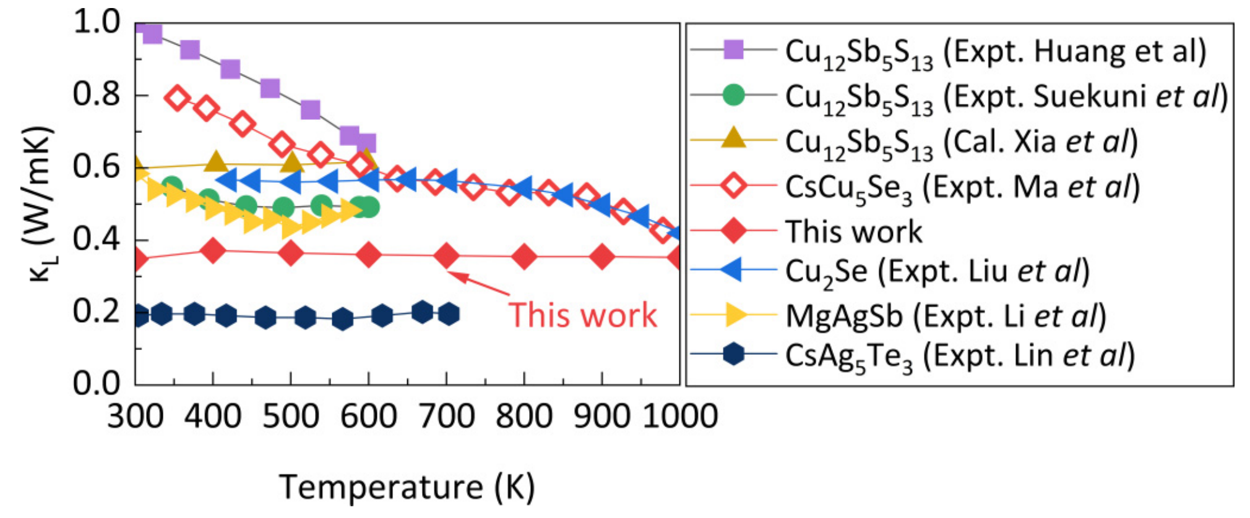
3. Computational study of α-CsCu₅Se₃
Experiment:
Single crystal
Electronic thermal conductivity
Off-stoichiometry between various Cu atoms
Theory and computational:
Thermal expansion effect
Anharmonic contributions to heat-flux
Higher-order phonon linewidths
Relaxation time approximation (RTA)
Qing-Yu Xie, Bao-Tian Wang*, et al., PRB, 2023, 108, 014302.

Slide 24
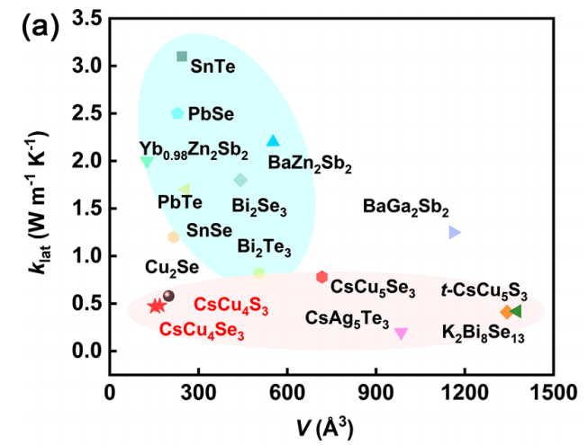
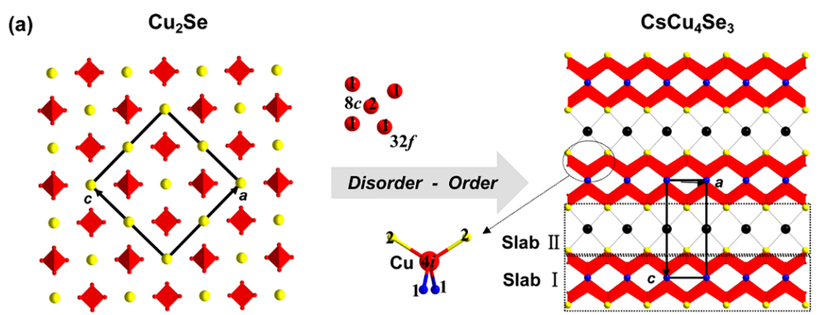
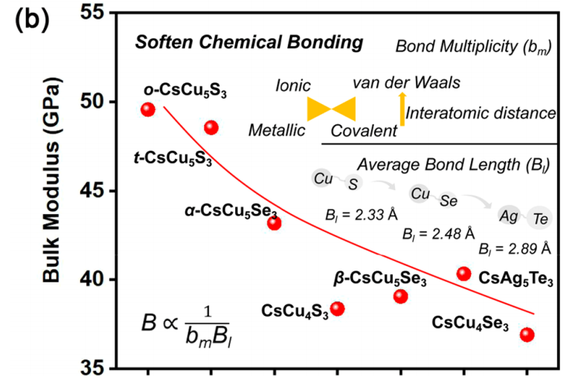
4. Neutron Scattering and DFT study of CsCu₄Se₃
CW
CW
CW
Refs:
Ma et al., J. Am. Chem. Soc., 142, 5293-5303 (2020).
Ma et al., J. Am. Chem. Soc., 143, 18490-18501 (2021).
Qing-Yu Xie#, Xi-Yang Li#, Fei Jia#, Li-Ming Wu*, Bao-Tian Wang*, et al., in progressing

Slide 25
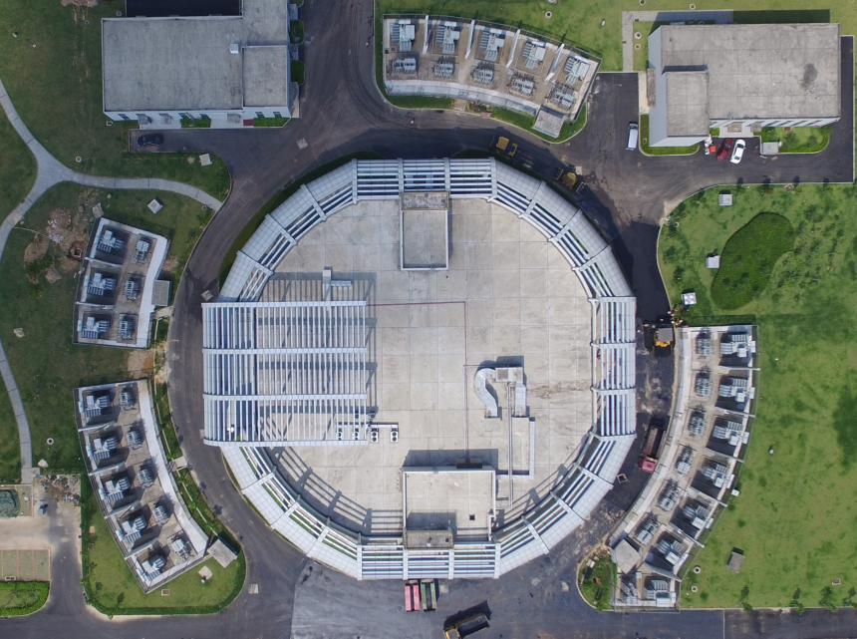
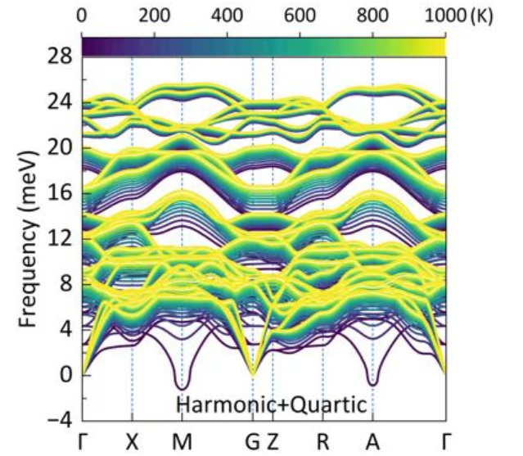
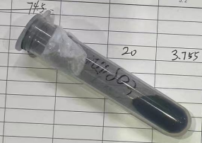
4. Neutron Scattering and DFT study of CsCu₄Se₃
Structure and phonon dynamics in CsCu₄Se₃
Structure, PhDOS, and S(Q,E) at different temperatures.
NPD/INS/DFT
CSNS
Neutron scattering experiments:
CSNS@MPI Finished No. P1622120100031
J-PARC@AMATERAS Finished No. 2023B0040
Qing-Yu Xie#, Xi-Yang Li#, Fei Jia#, Li-Ming Wu*, Bao-Tian Wang*, et al., in progressing

Slide 26
4. Neutron Scattering and DFT study of CsCu₄Se₃
Unpublished
Unpublished
Unpublished
Unpublished
Qing-Yu Xie#, Xi-Yang Li#, Fei Jia#, Li-Ming Wu*, Bao-Tian Wang*, et al., in progressing

Slide 27
Overall Planning
INS
NPD
XRD
RIXS
Raman
(Magnetic) Structure
Phonon Dynamics
USPEX
Calypso
MagGene
Euphonic
OCLIMAXDynasor
MD/MC
LAMPPS
UppASD
ShengBTE
Phono3py
ALAMODE
DFT
VASP/QE
DFT/MD
LAMPPS/GUPMD
VASP/QE
ML

Slide 28
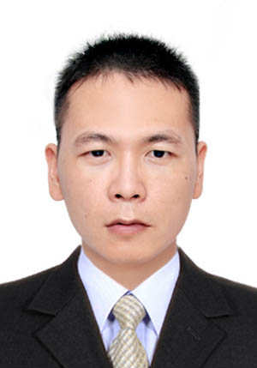
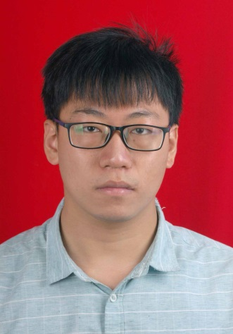
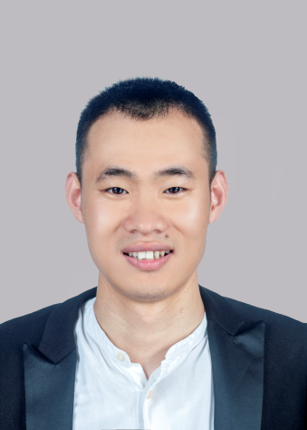
5 Acknowledgment
Dr. Peng-Fei Liu Dr. Qing-Yu Xie Dr. Xiyang Li

Slide 29
d
Thanks!

