Slide 1

Dynamics of Organic Ferroelectrics using Quasi-elastic Neutron Scattering and
Molecular Dynamics Simulations
Sanghamitra Mukhopadhyay
ISIS Neutron and Muon Source,
Science and Technology Facilities Council, UKRI
Didcot, Oxfordshire
sanghamitra.mukhopadhyay@stfc.ac.uk

Slide 2
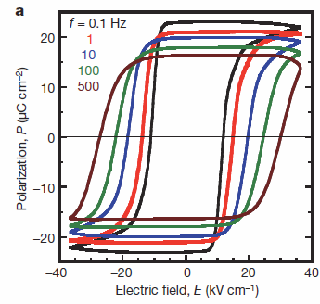

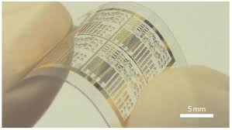
Motivation
  What is ferroelectricity?
    When polarisation of a material can be reversed by applying external electric fields.
    A property of non-centrosymmetric polar materials.
  Why is this important ?
    Ferroelectric materials are called electrocaloric materials and one of the key material in Materials Development Road Maps to meet global challenges.
    Energy and climate: Ferroelectric super capacitors are used for energy storage
    Health: Ferroelectric capacitors are used in medical devices
    Informatics and security: Low power high speed computer memories (RAM) are made of ferroelectrics (quantum materials).
  Why Organic ferroelectrics?
    Flexible electronics
    Low cost
    Low processing temperatures
    Free of toxic heavy metals

Slide 3
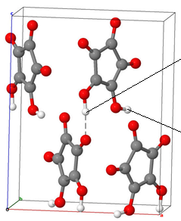

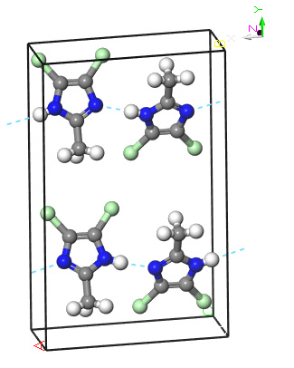

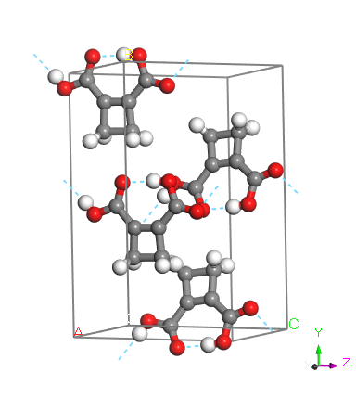
Motivation
  Flexibility and ferroelectricity is rare combination.
  Croconic acid and haloimidazoles are ferroelectrics at room temperature. Squaric acid is anti-ferroelectric upto 373K and paraelectric above that temperature
  Hydrogen bonding plays an important role in these properties.
  Neutron scattering is an important tool to investigate organic ferroelectrics
  Predictive modelling is important to design these ferroelectric materials .
Cl
N
Horiuchi et. al, Nat. Comm. 8, 14426 (2017).
M. Owczarek et al. Nature Commn. 7, 1308 (2016).

Slide 4
Overview
Structure of organic ferroelectrics
Quasi-elastic neutron scattering spectroscopy
Predictive modelling using ab-initio MD simulations
Ferroelectric polarisation using Born Effective Charge tensor
Conclusions

Slide 5
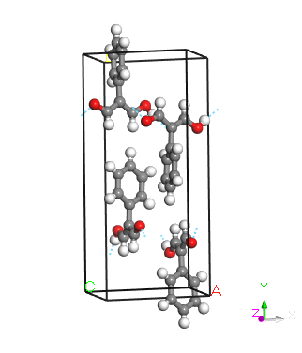
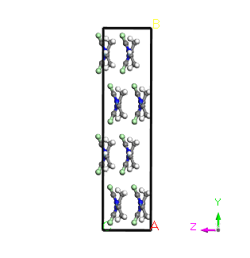
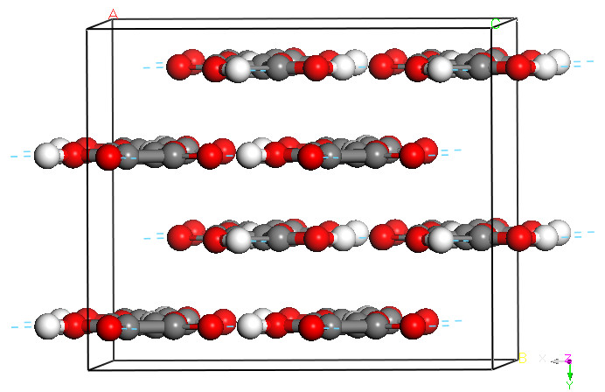
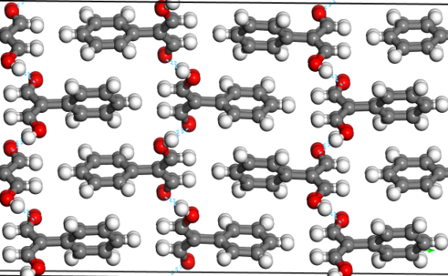
Structure of Organic Ferroelectrics
Cl
N
PhMDA
Squaric acid
Croconic acid
HaloImidazole, DCMeI
Hydrogen bonds are very important for changing polarisations
What about halogen bonds?
S. Mukhopadhyay, Front. Phys. 10, 834902 (2022); S. Mukhopadhyay, J. Phys. Comm. 3, 11 (2019);
S, Mukhopadhyay et. al, PCCP, 19, 32216 (2017); S. Mukhopadhyay et al. Phys. Chem. Chem. Phys. (2014);
S. Mukhopadhyay et al. J. Chem Phys, 427, 95 (2013).

Slide 6
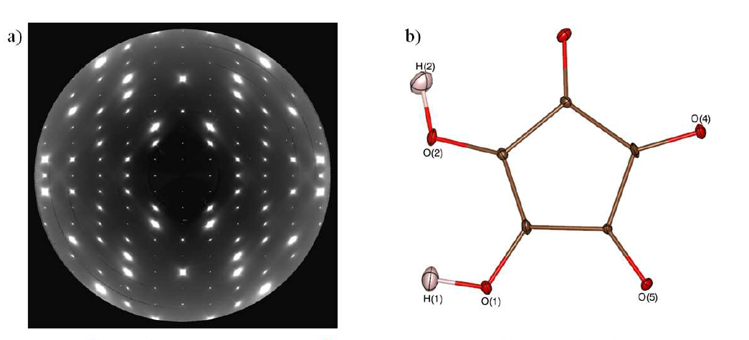
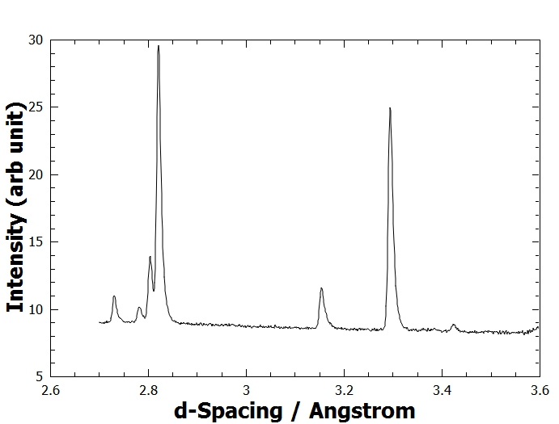
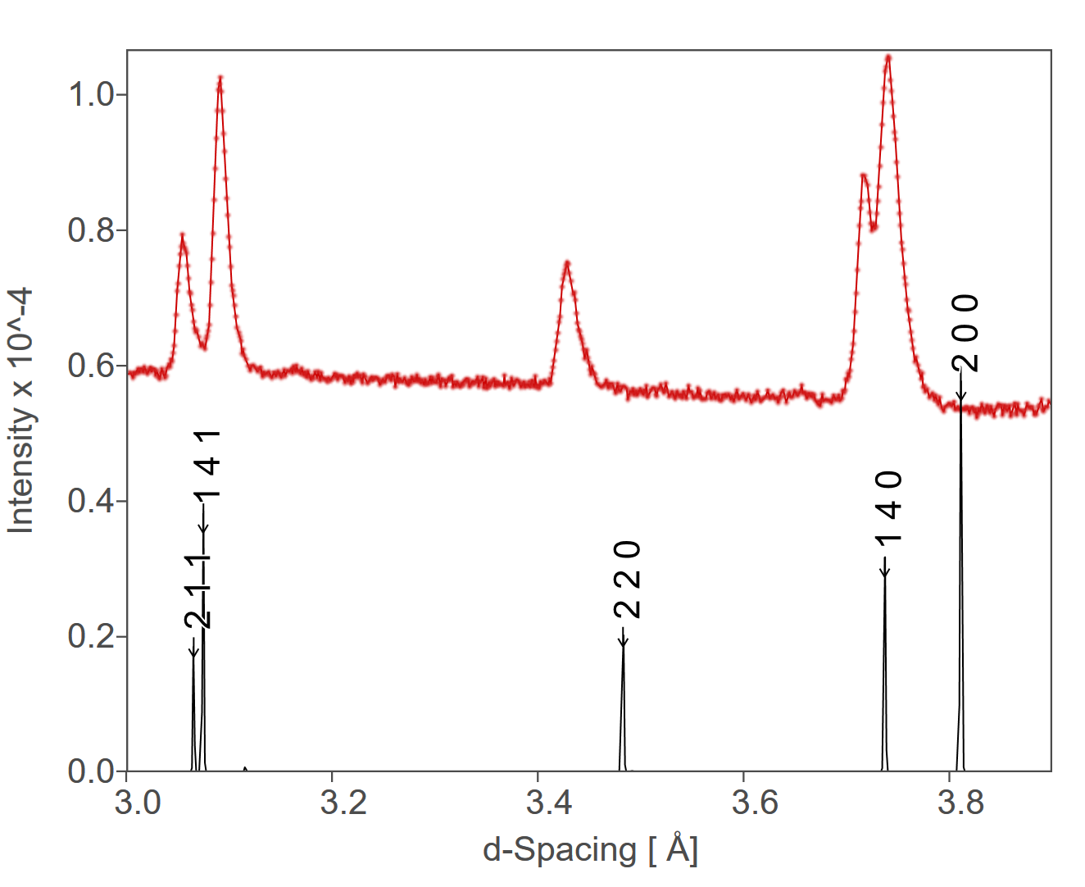
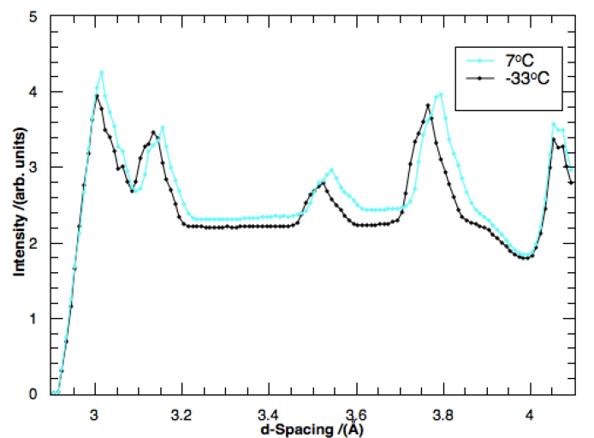
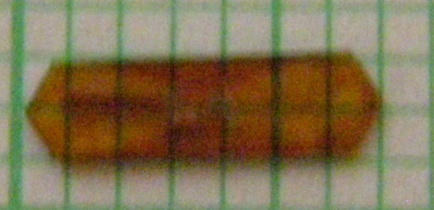
Structure of Organic Ferroelectrics
212
210
004
211
Croconic single crystal neutron diffraction
PhMDA powder neutron diffraction
DCMeI powder neutron diffraction
1 mm
Experiments on SXD, IRIS and OSIRIS instruments at ISIS
S. Mukhopadhyay, Front. Phys. 10, 834902 (2022); S. Mukhopadhyay, J. Phys. Comm. 3, 11 (2019);
S, Mukhopadhyay et. al, PCCP, 19, 32216 (2017); S. Mukhopadhyay et al. Phys. Chem. Chem. Phys. (2014);
S. Mukhopadhyay et al. J. Chem Phys, 427, 95 (2013).

Slide 7
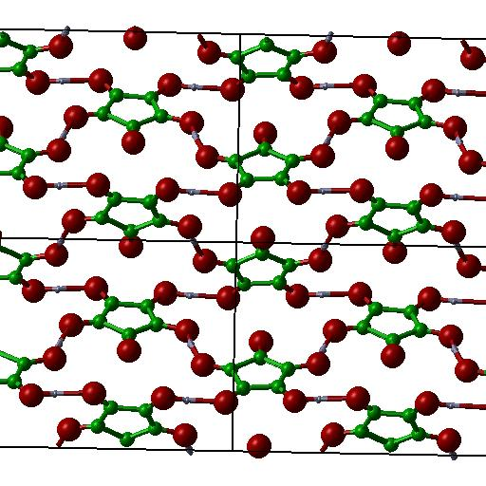
Calculations using DFT
Density functional calculations using Plane wave pseudo-potentials (CASTEP Code)
48 atoms in the unit cell (croconic),
PC2₁ symmetry
Dispersion corrected DFT to get accurate layered structure.
Linear response theory and lattice dynamics for calculating phonon frequencies and eigenvectors
2x2x2 cell for MD simulations (384 atoms)
NVT and NVE ensemble for MD simulations. Production time 30 ps.

Slide 8
Predictive Modelling using DFT
Crystal | Lattice Parameters | Experiments | PBE | PBE+D
Croconic | a (Å) | 8.619 | 9.116 (5.8) | 8.881 (3.0)
 | b (Å) | 5.097 | 5.728 (12.4) | 5.148 (1.0)
 | c (Å) | 10.915 | 10.904 (0.1) | 10.816 (1.0)
DCMeI | a (Å) | 9.931 | 9.979 (0.5) | 9.822 (1.1)
 | b (Å) | 15.946 | 16.702 (4.7) | 16.359 (2.6)
 | c (Å) | 3.737 | 14.618 (23.5) | 3.859 (3.3)
DFT+D calculations is key to understand the structure of these hydrogen bonds
S. Mukhopadhyay, Front. Phys. 10, 834902 (2022); S. Mukhopadhyay, J. Phys. Comm. 3, 11 (2019);
S, Mukhopadhyay et. al, PCCP, 19, 32216 (2017); S. Mukhopadhyay et al. Phys. Chem. Chem. Phys. (2014);
S. Mukhopadhyay et al. J. Chem Phys, 427, 95 (2013).

Slide 9
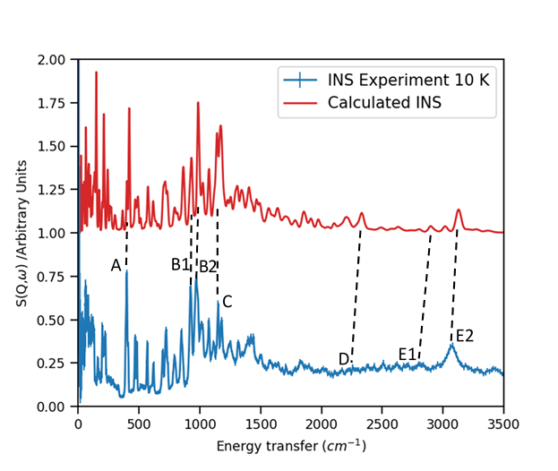
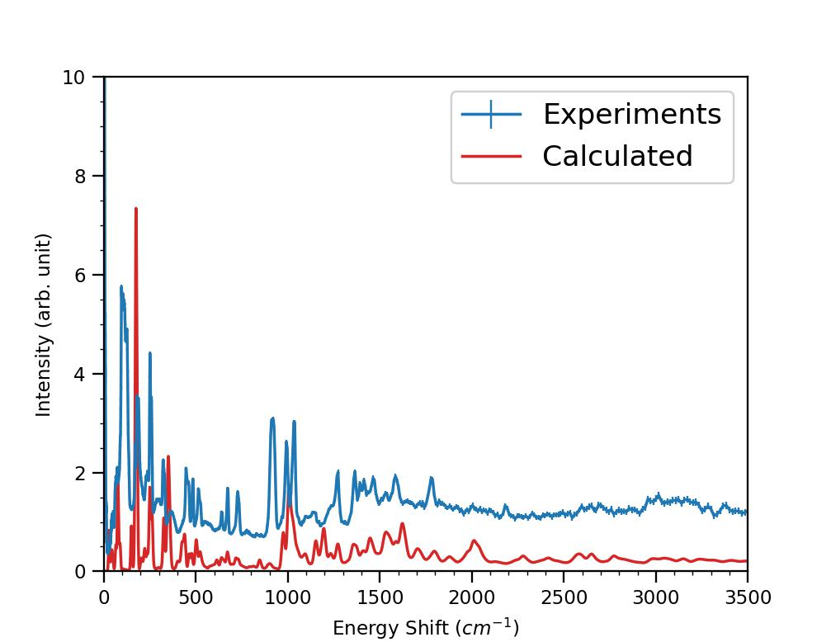
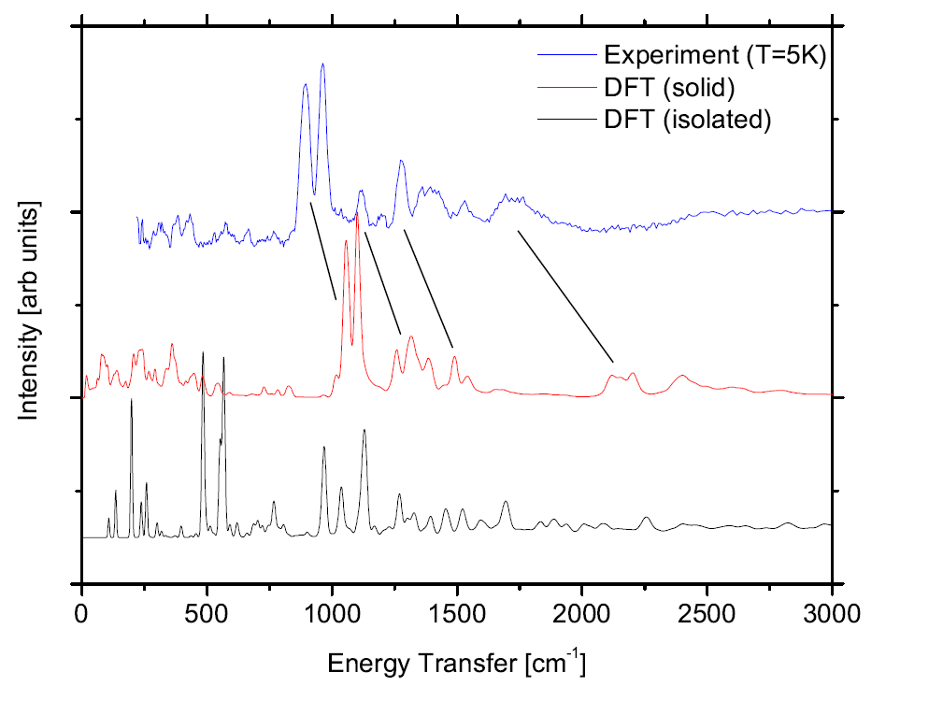
Inelastic Neutron Scattering Spectroscopy and
Predictive Modelling using DFT
Croconic acid
PhMDA
DCMeI
INS experiments have been done on TOSCA and Lagrange instruments

Slide 10
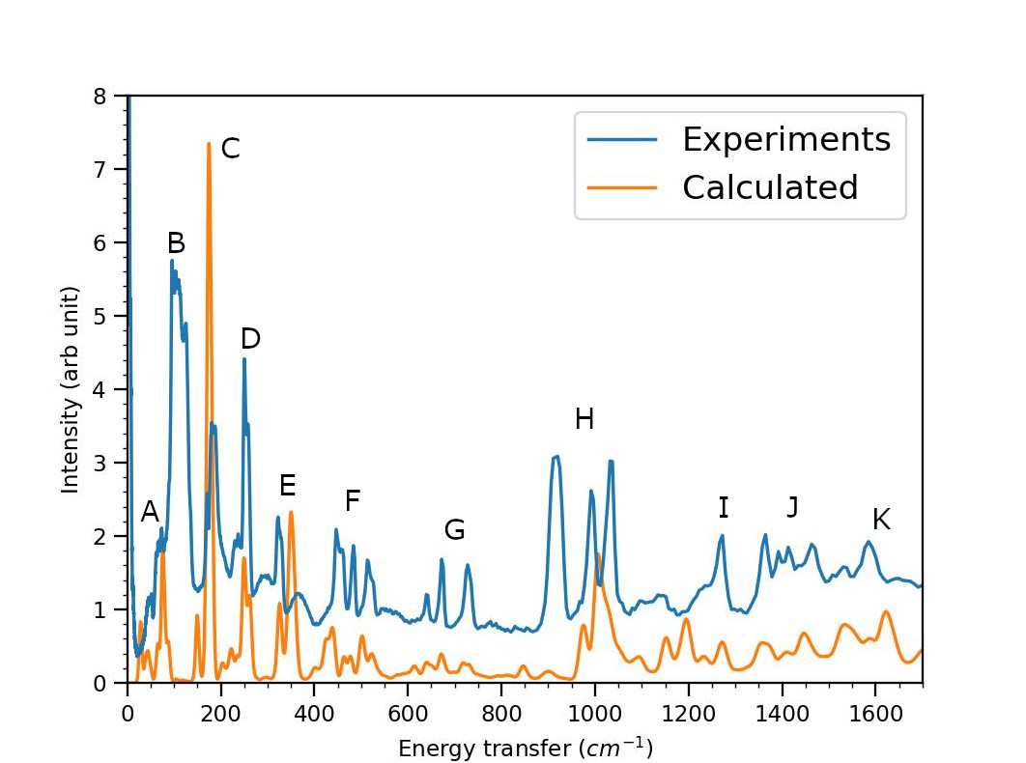
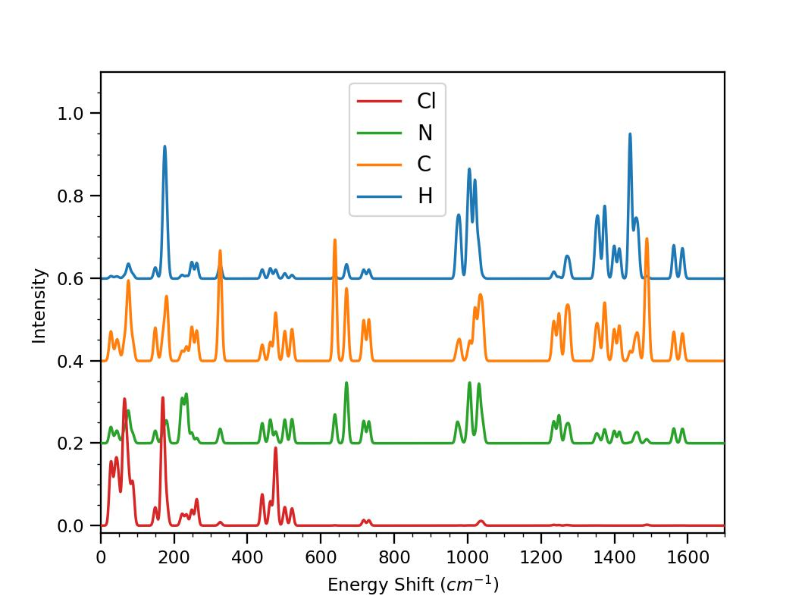
Inelastic Neutron Scattering Spectroscopy and
Predictive Modelling using DFT
Low energy peaks can be predicted only by calculations beyond Γ point

Slide 11
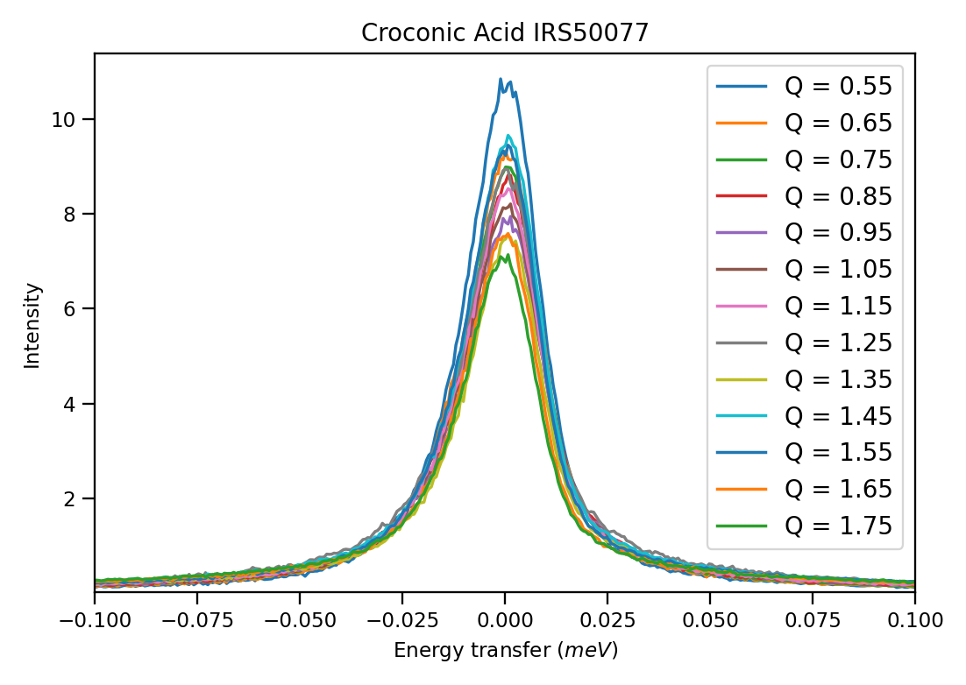
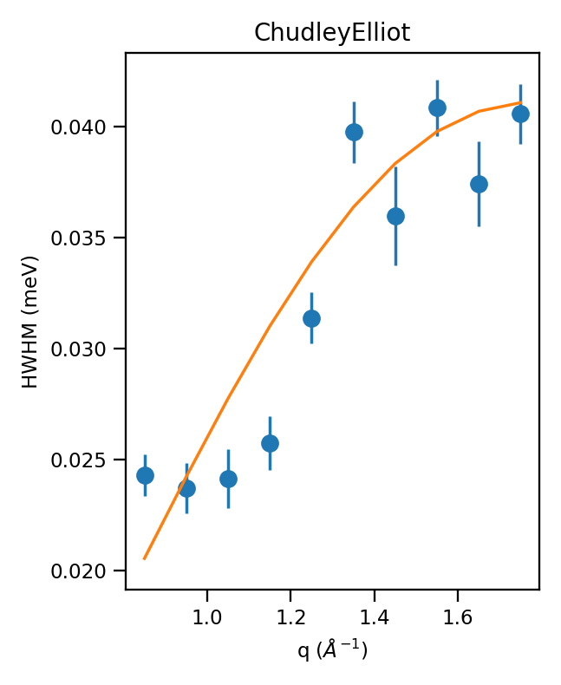
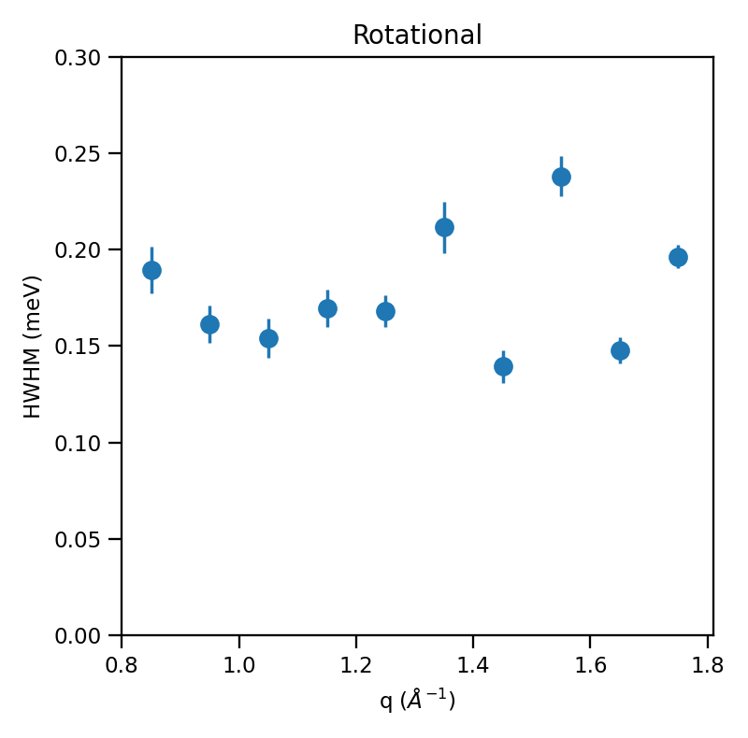
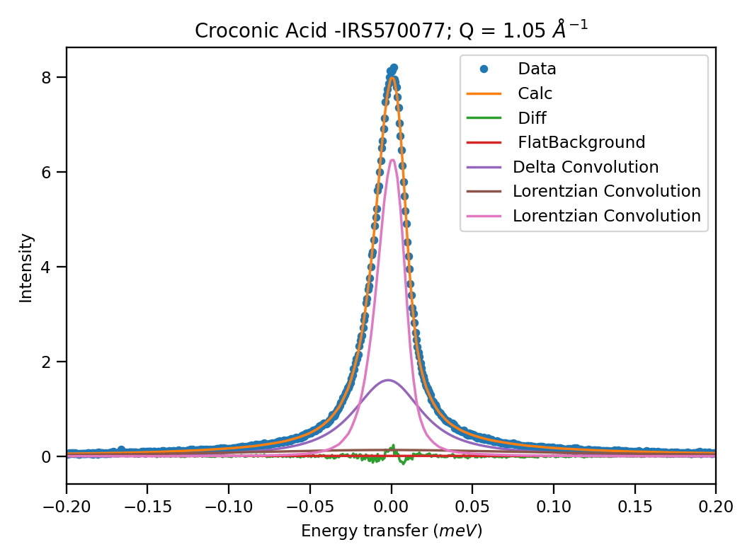
Dynamics of Croconic Acid
QENS experiments tell us the nature of dynamics
Experiments are done on IRIS and OSIRIS spectrometers at ISIS
L = 2.5 Å
t = 20 ps
t=23 ps

Slide 12
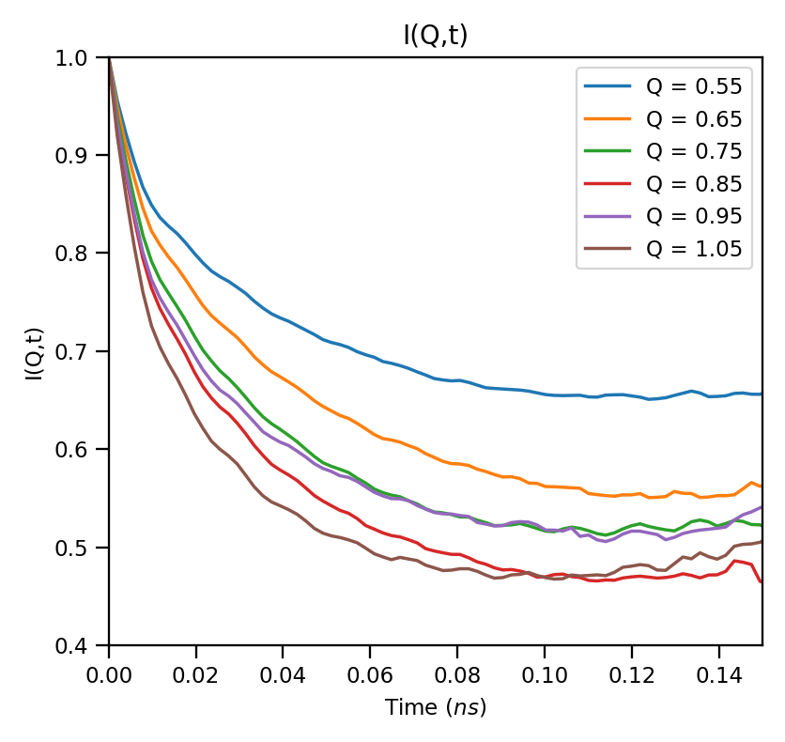
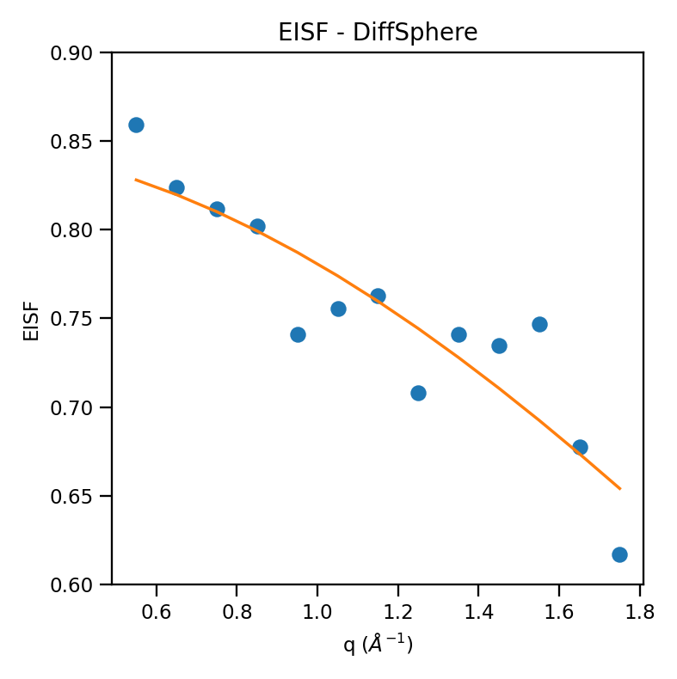
Dynamics of Croconic Acid
t=23 ps
Fitting EISF with Diff Sphere model gives R = 0.65Å
Fitting with 2 exponentials functions gives lifetime around 22 ps

Slide 13
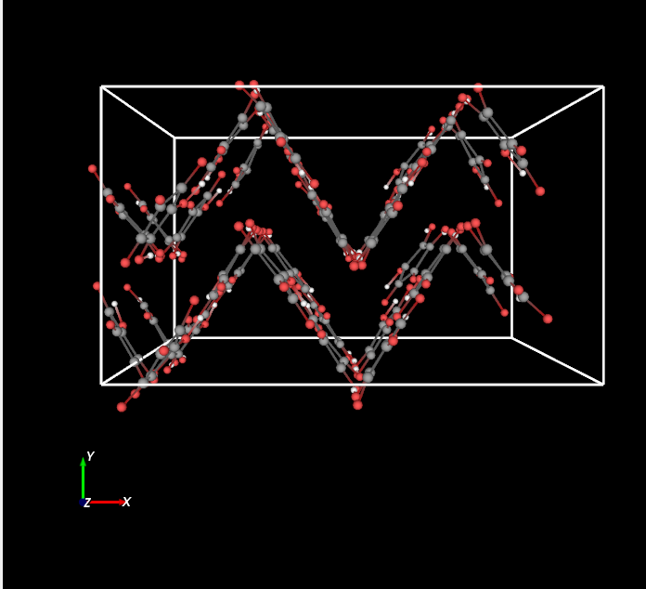
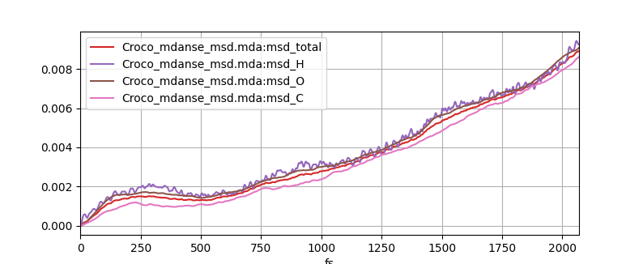
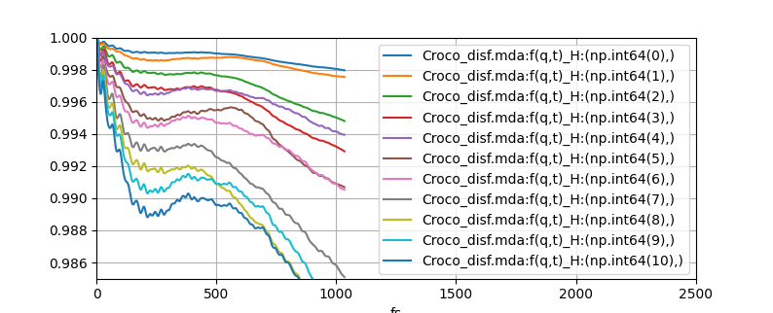
Dynamics of Croconic Acid
Ab-initio MD simulations have been done on 2x2x2 cell (384 atoms)
NVT and NVE ensemble for MD simulations. Production time 30 ps.

Slide 14
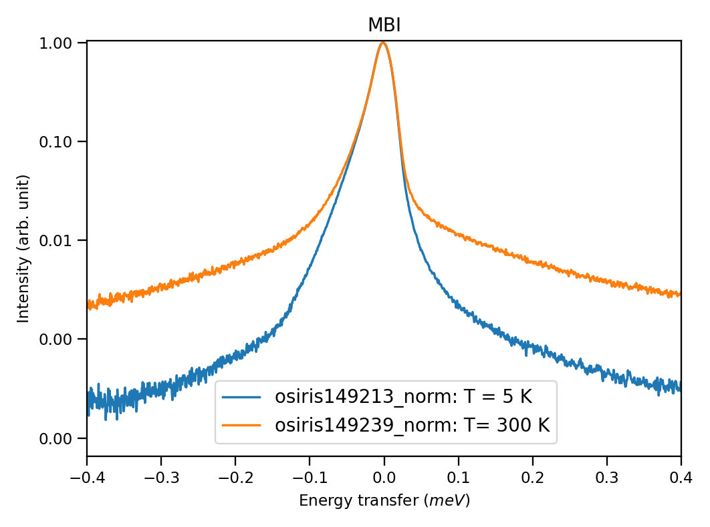
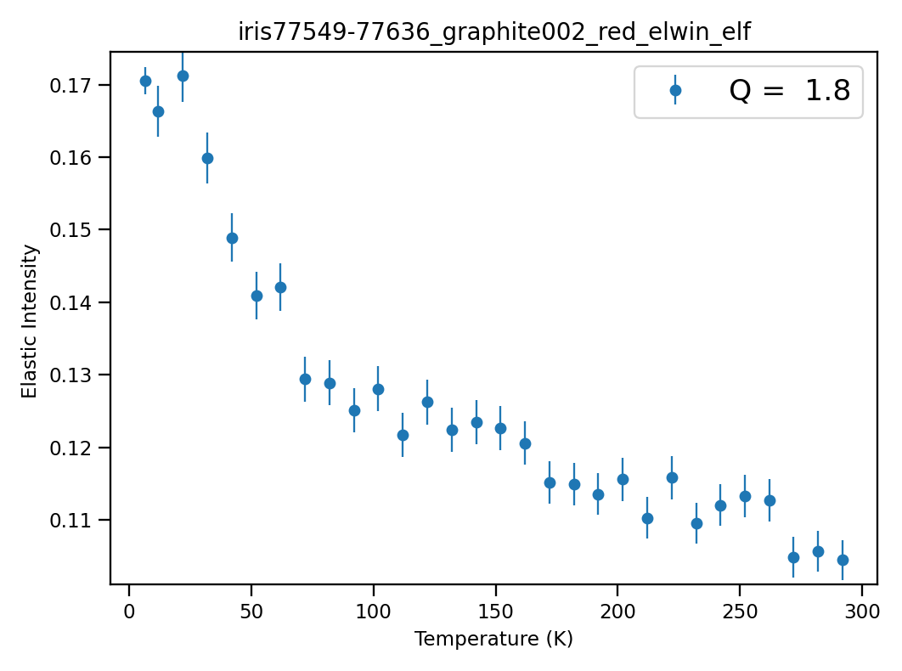
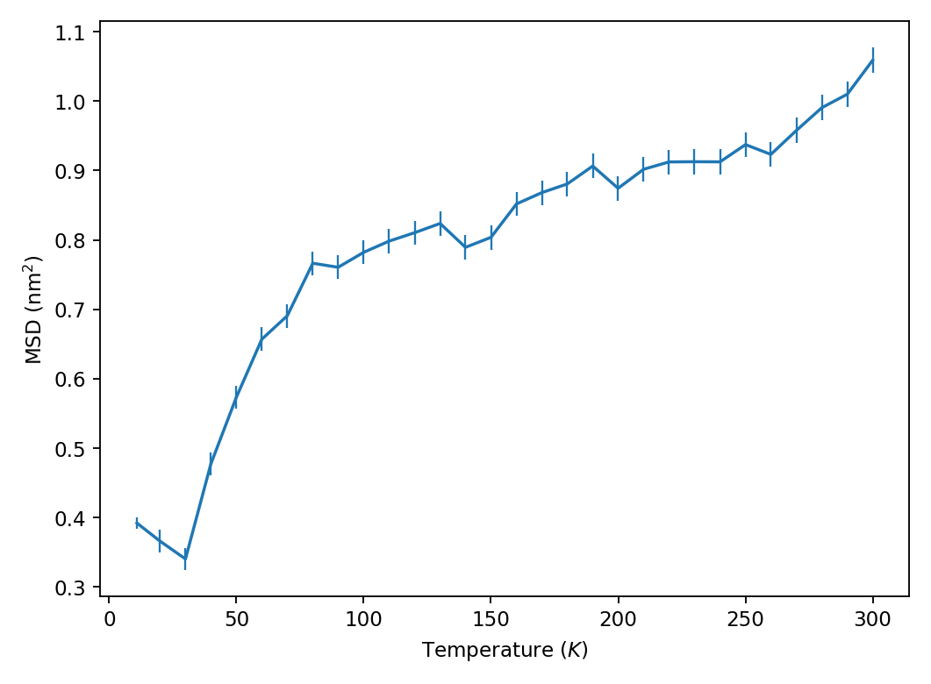
Dynamics of Halo-Imidazole DCMeI
Temperature dependent QENS experiments tell us the nature of dynamics
MSD increases with increasing temperature is due to proton transfer across N-H—N bonds
Fitting with Chudley Elliot model gives similar jumping distance about 2.5 Å , but resting time increases to 28 ps. Slower movement may be due to nature of N-H bond.

Slide 15


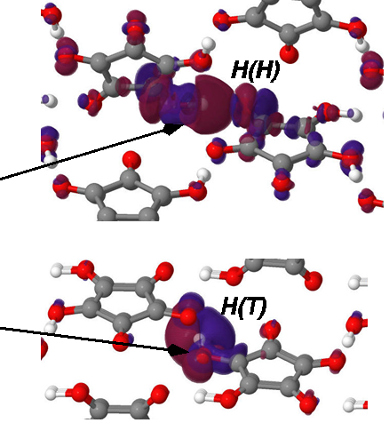
Crystal | Atoms | PBE +D
Croconic | H-hinge | (0.34, 0.28, 2.91)
 | H-terrace | (0.88, 1.37, 1.09)
DcMeI | H (N-H—N) | (1.99, 0.36, 0.29)
 | H (CH3) | (0.07, 0.07, 0.07)
Electronic polarisation can be interpreted from Born effective charges
Asymmetric and large values of Born effective charge tensors indicate their contributions in polarization
Ferroelectric modes are assigned on OH or NH bonds aligned along c /a axis. Not on halogen bonds
Bulk polarisation calculated by Berry phase method compare within 1% of experiments

Slide 16
Conclusions
Hydrogen bond strength and shape are important in the dynamics of organic ferroelectrics.
High-resolution INS experiments complemented by DFT+D calculations identified characteristic peaks in organic ferroelectrics and helped to understand the structure and dynamics of these hydrogen bonds, correlating dynamics with ferroelectricity.
QENS experiments and AIMD calculations showed jumping motion of H in O-H—O and N-H—N bonds
Calculations predict that O-H—O bond for croconic acid and H-N—H hydrogen bonds in haloimidazoles are responsible for the ferroelectricity in these materials.

Slide 17
Acknowledgements
Felix Fernandez-Alonso
Matthias Gutmann
Monica Jimenez-Ruiz (ILL)
Dominik Jochym
Keith Refson
Adam Jackson
Kristof Dymkowski
Simran Kukran
STFC-SCARF cluster and the EPSRC-funded HECTOR and ARCHER HPC facilities under Materials Chemistry Consortium for the DFT calculations. ISIS and ILL for access to neutrons beam times.
Thank you
sanghamitra.mukhopadhyay@stfc.ac.uk
Isis_quantum@stfc.ac.uk

