Slide 1
MDANSE: Molecular Dynamics Analysis for Neutron Scattering Experiments
Chi Y. Cheng, Maciej Bartkowiak, Rob Buchanan, Jacob Wilkins, Miguel González, Eric Pellegrini, Rémi Perenon, Sanghamitra Mukhopadhyay
PAQMAN 2025
03/07/2025

Slide 2
Presentation Overview
MDANSE introduction and workflow
A history of MDANSE
MDANSE 2: Updates and new features
Tips for neutron scattering calculations
Questions and answers

Slide 3
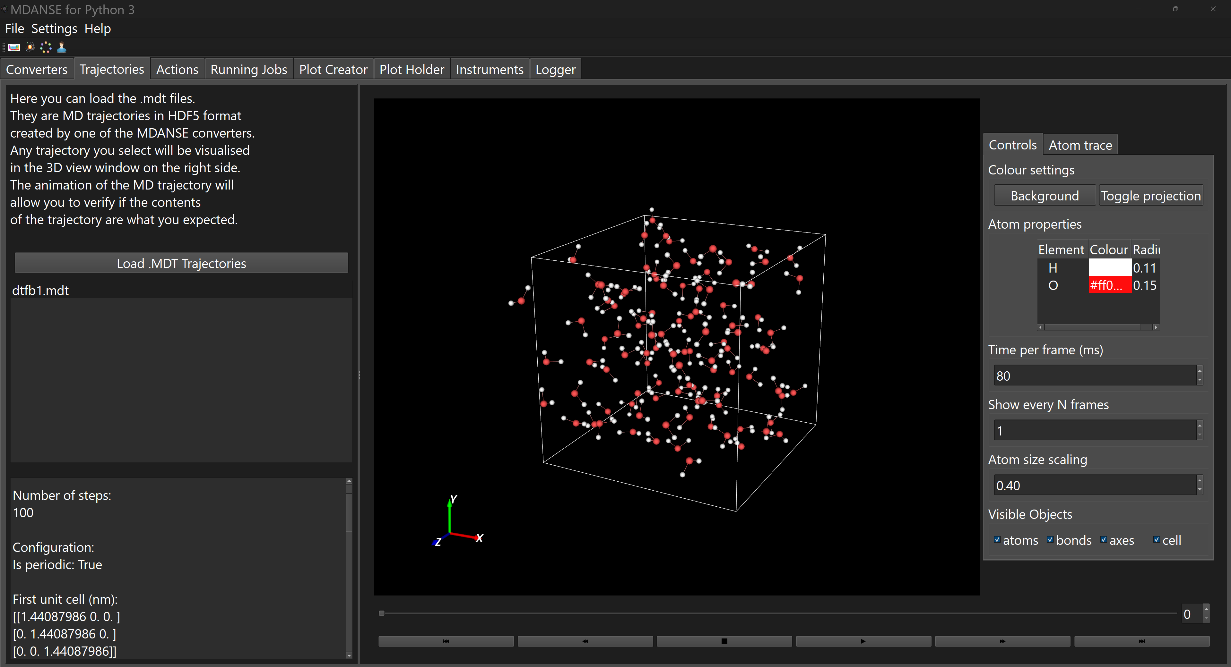
MDANSE and MDANSE_GUI
MDANSE
MDANSE_GUI
MDANSE: Molecular Dynamics Analysis for Neutron Scattering Experiments
Originally developed to calculate results related to neutron scattering experiments. But it’s more of general-purpose tool for molecular dynamics analysis.
Most users operate MDANSE through its GUI. MDANSE can also be accessed through its Python API so that custom scripts and analysis calculations can be run.

Slide 4
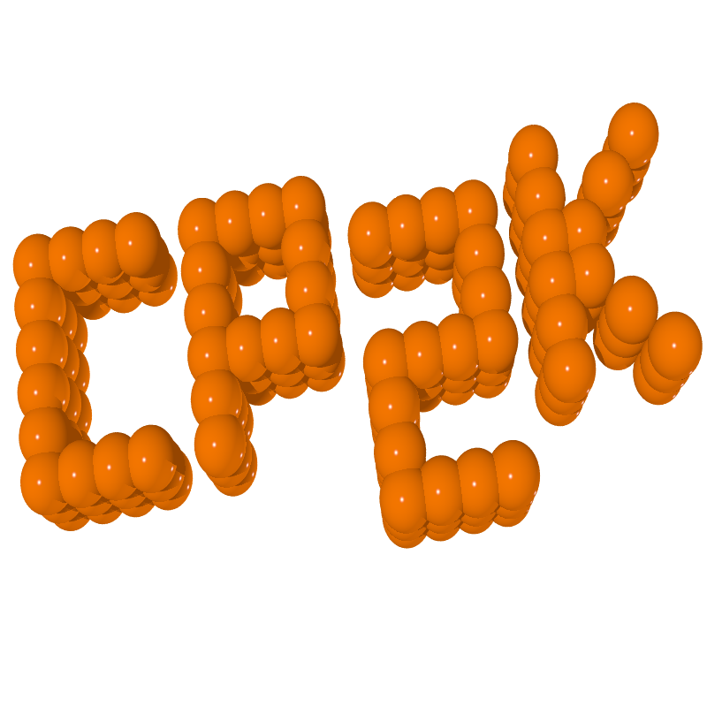
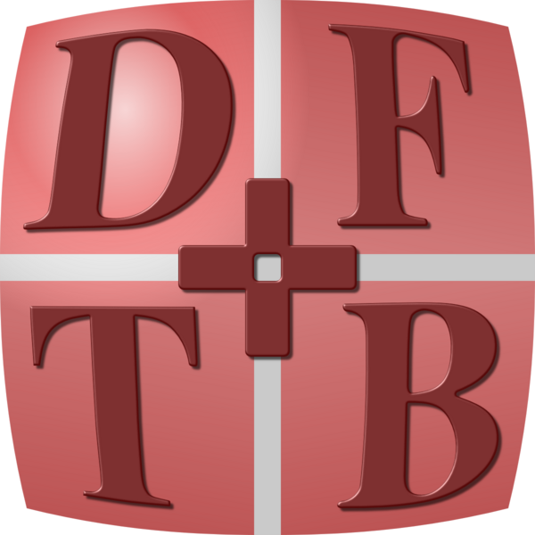
MDANSE Basic Workflow
Trajectory Conversion
Run a molecular dynamics simulation dump positions, velocity, etc.
Convert trajectory to MDT (HDF5) format.

Slide 5
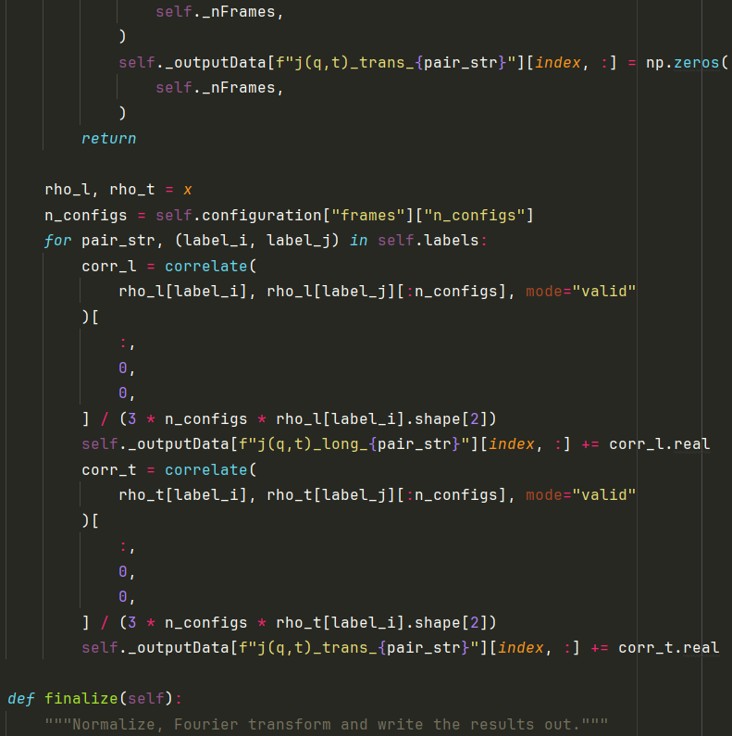
MDANSE Basic Workflow
Trajectory Conversion
MD Analysis
Run a molecular dynamics simulation dump positions, velocity, etc.
Convert trajectory to MDT (HDF5) format.
Load trajectory and run analysis calculation.
Save results as MDA (HDF5) or other formats.

Slide 6
MDANSE Basic Workflow
Trajectory Conversion
MD Analysis
Plotting
Run a molecular dynamics simulation dump positions, velocity, etc.
Convert trajectory to MDT (HDF5) format.
Load (MDA format) analysis results and plot using MDANSE GUI.
Load trajectory and run analysis calculation.
Save results as MDA (HDF5) or other formats.

Slide 7
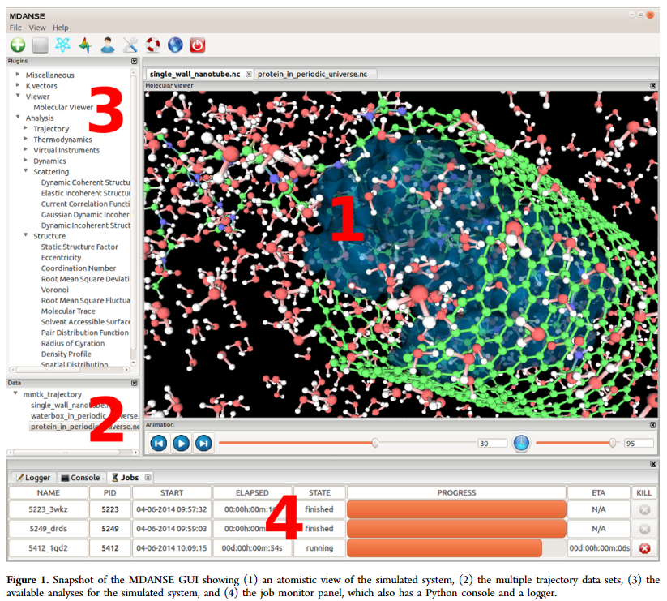
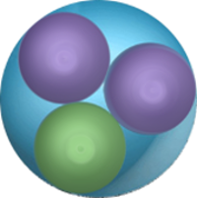
A short history: MDANSE 1
1992 nMOLDYN
Regarded a fork of the nMOLDYN3 program. Not all features were retained in the transition from nMOLDYN to MDANSE.
Originally developed at the ILL by Pellegrini et al.
2002 nMOLDYN2
2012 nMOLDYN3
2015 MDANSE 1
2025 MDANSE 2

Slide 8
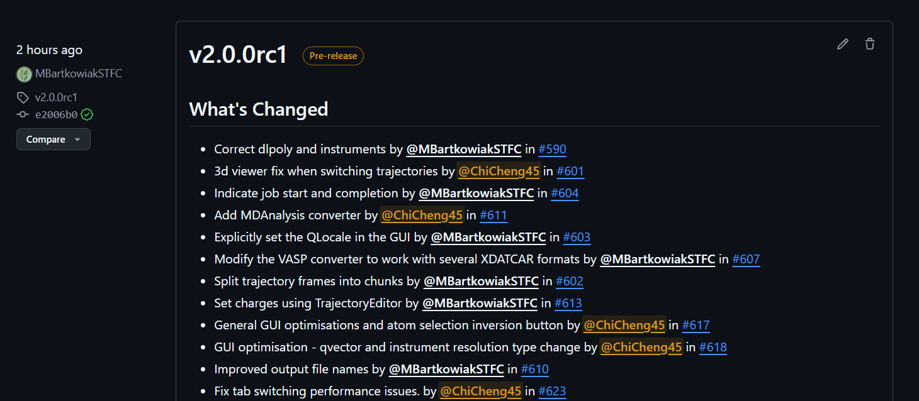
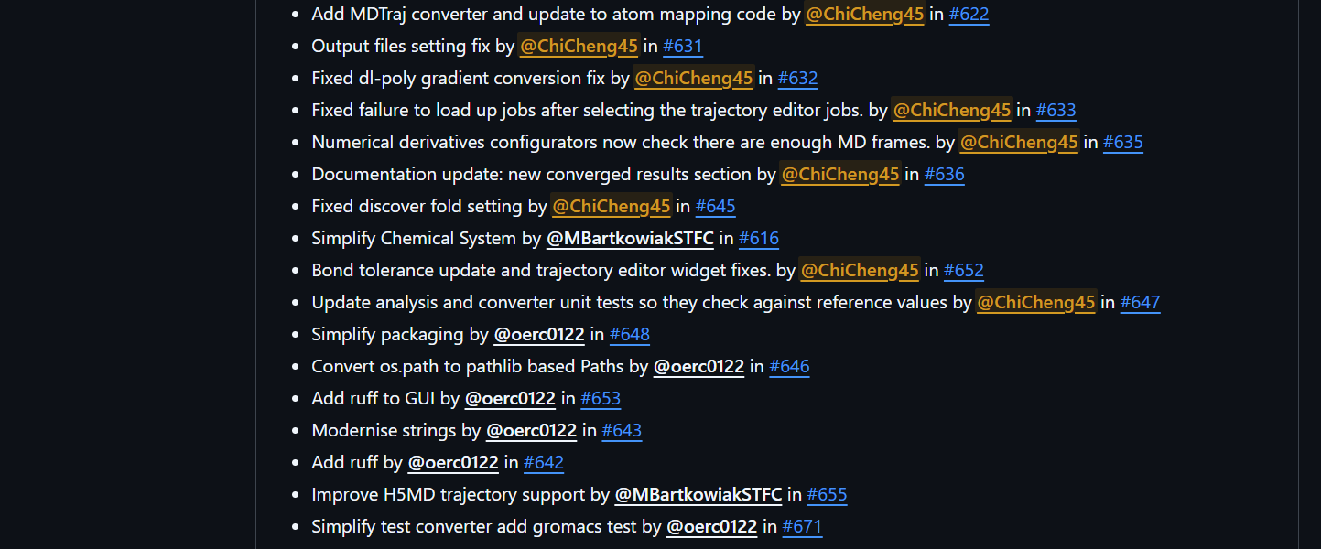
A short history: MDANSE 2
1992 nMOLDYN
A new MDANSE version developed primarily by RSE at ISIS Neutron and Muon Source.
First release candidate of MDANSE 2 with first official release planned later this year.
Manuscript in preparation.
2002 nMOLDYN2
2012 nMOLDYN3
2015 MDANSE 1
2025 MDANSE 2

Slide 9
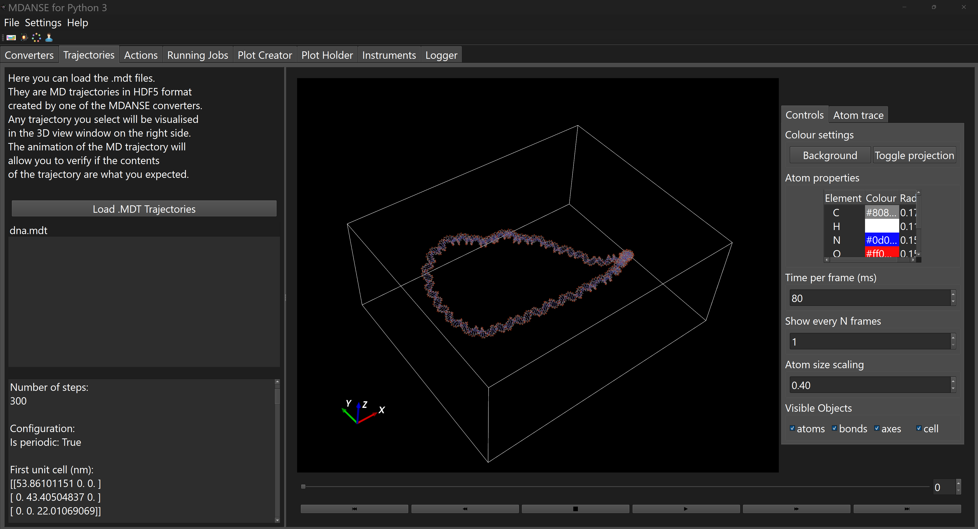
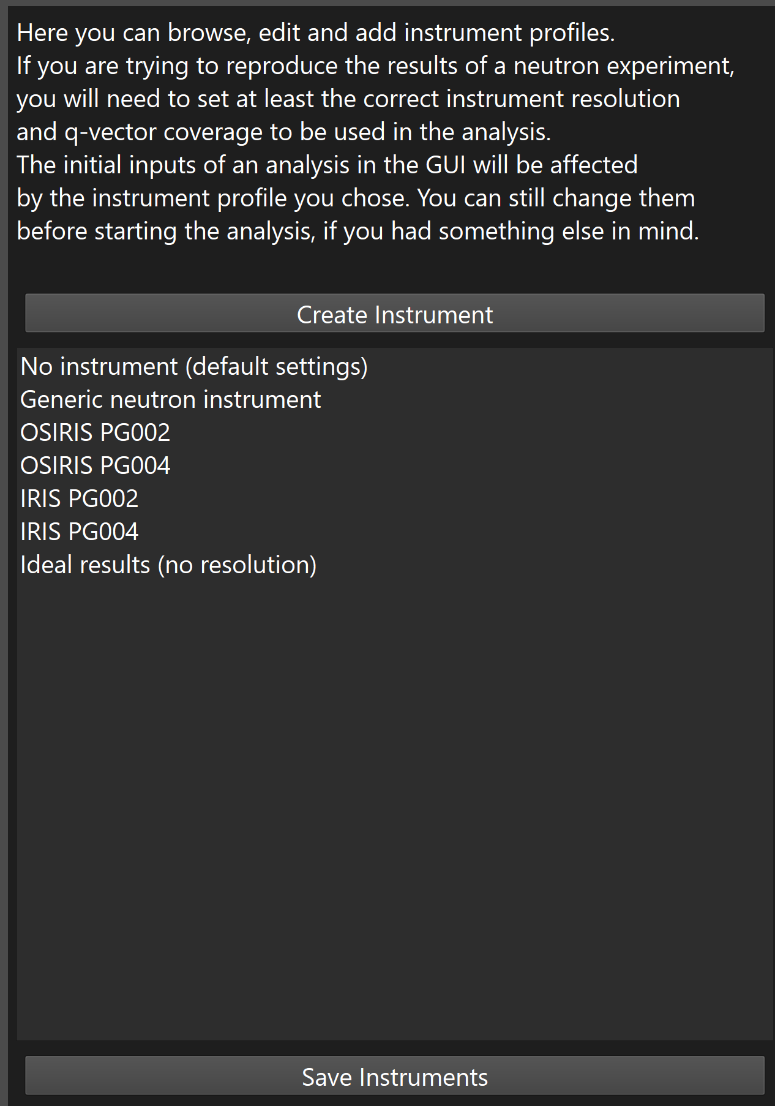
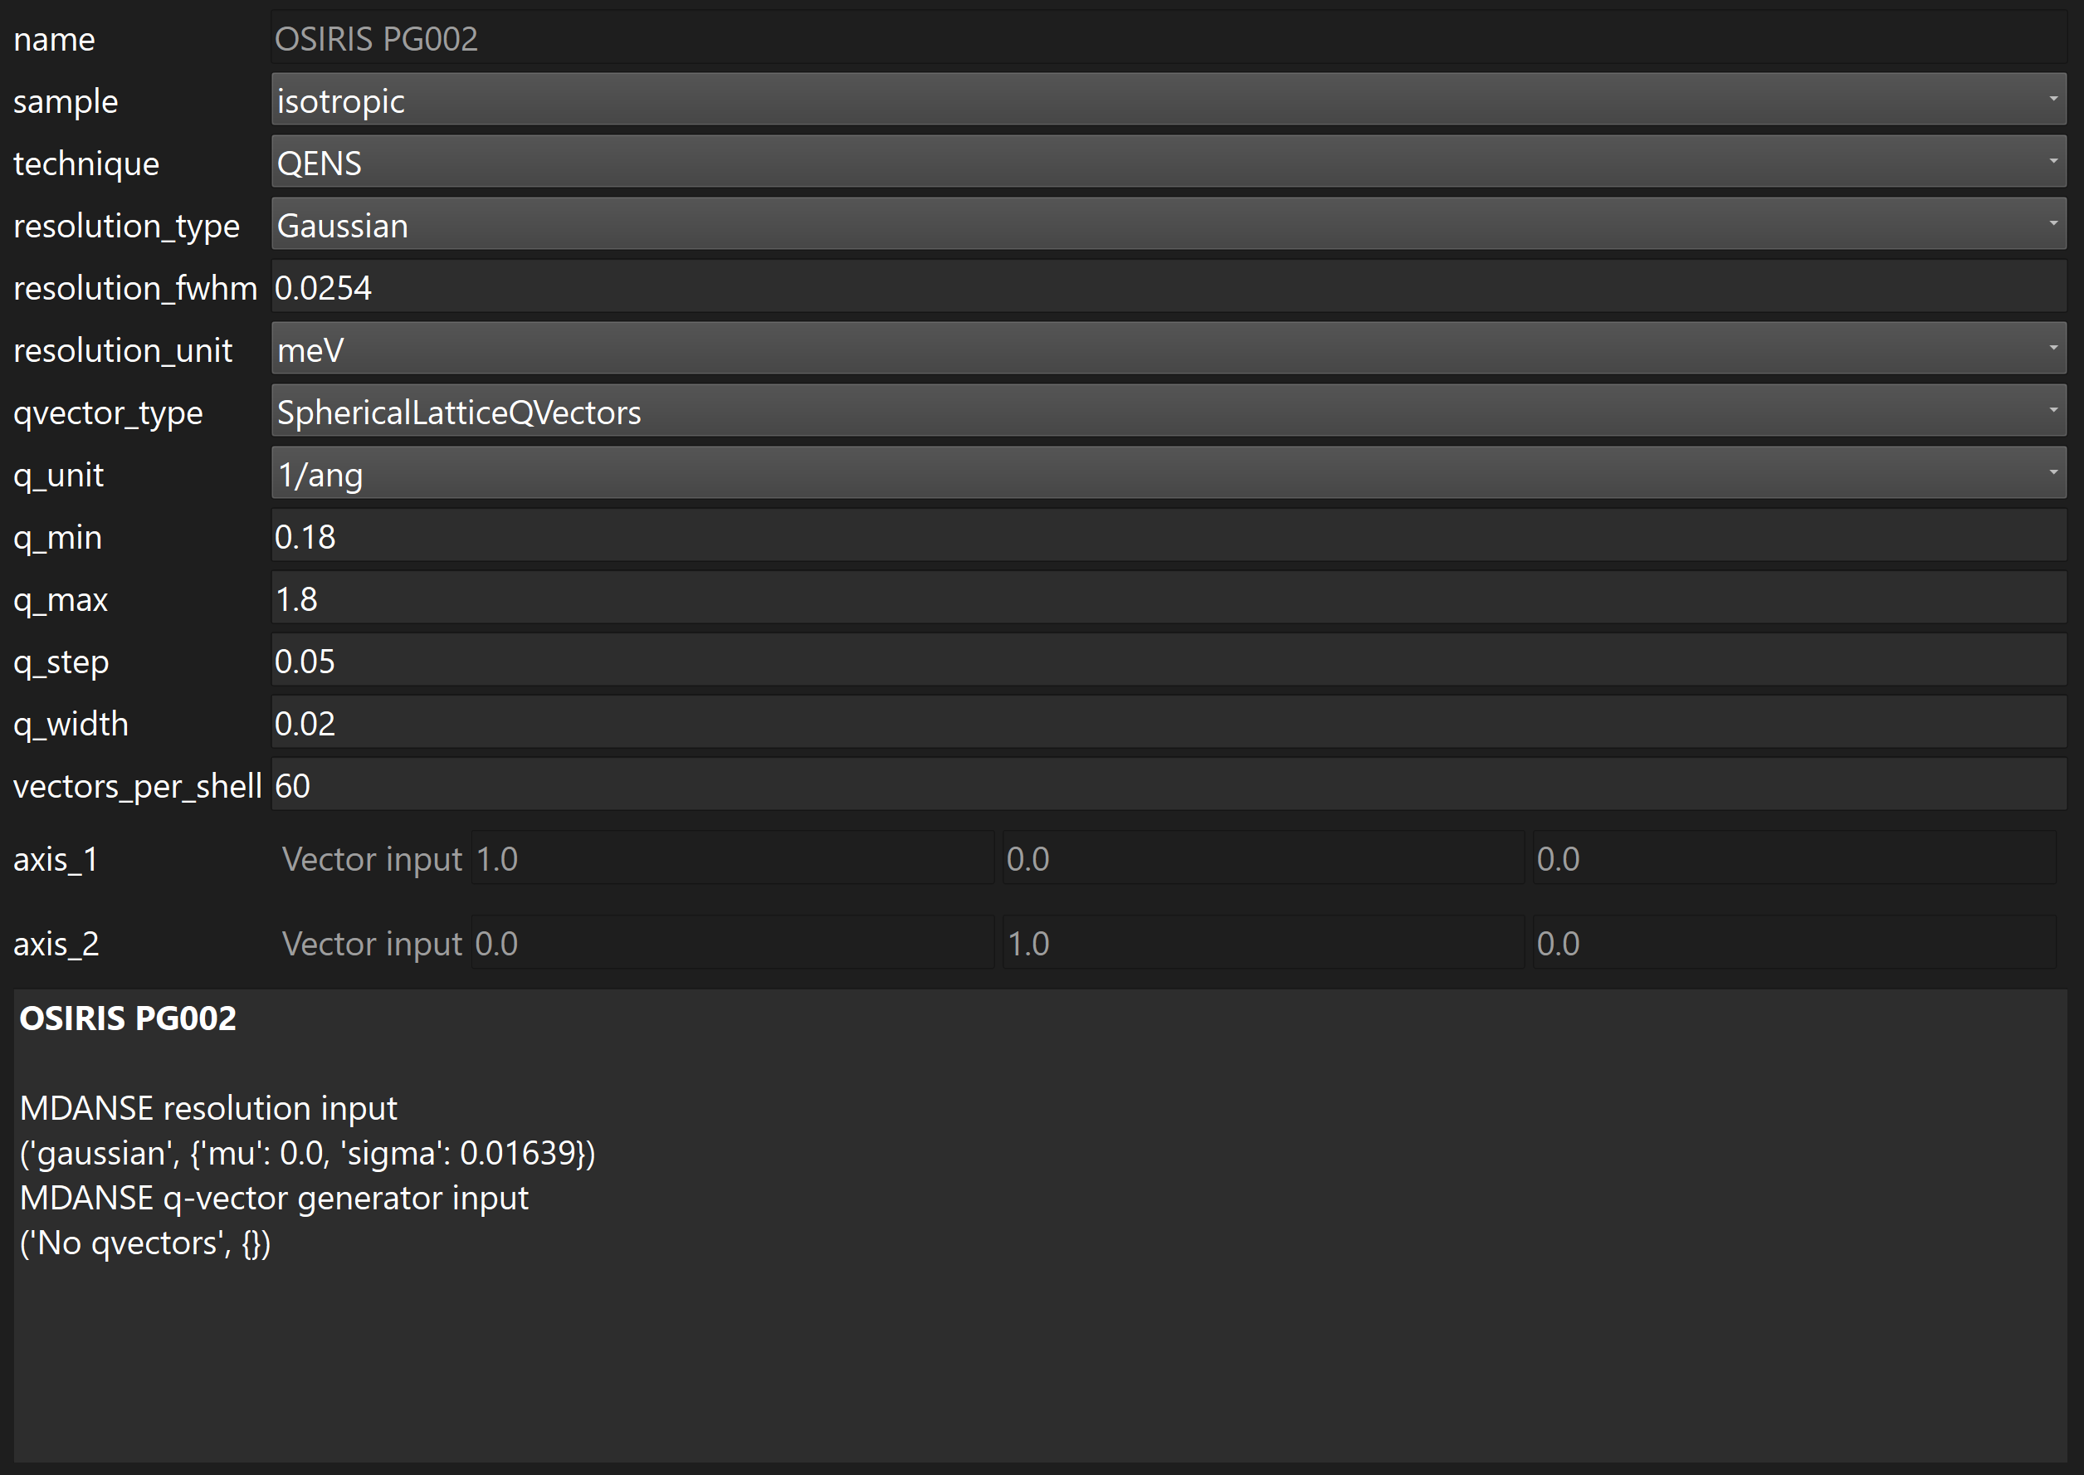
What's new in MDANSE 2
MDANSE 2 has been updated so that it now uses Python3.
Complete overhaul of the front end to use Qt and VTK.
A new tab-based interface and results plotter.
Instrument profiles – define and reuse scattering analysis parameters.

Slide 10
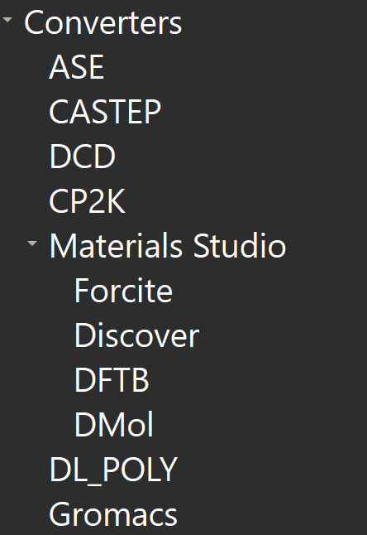
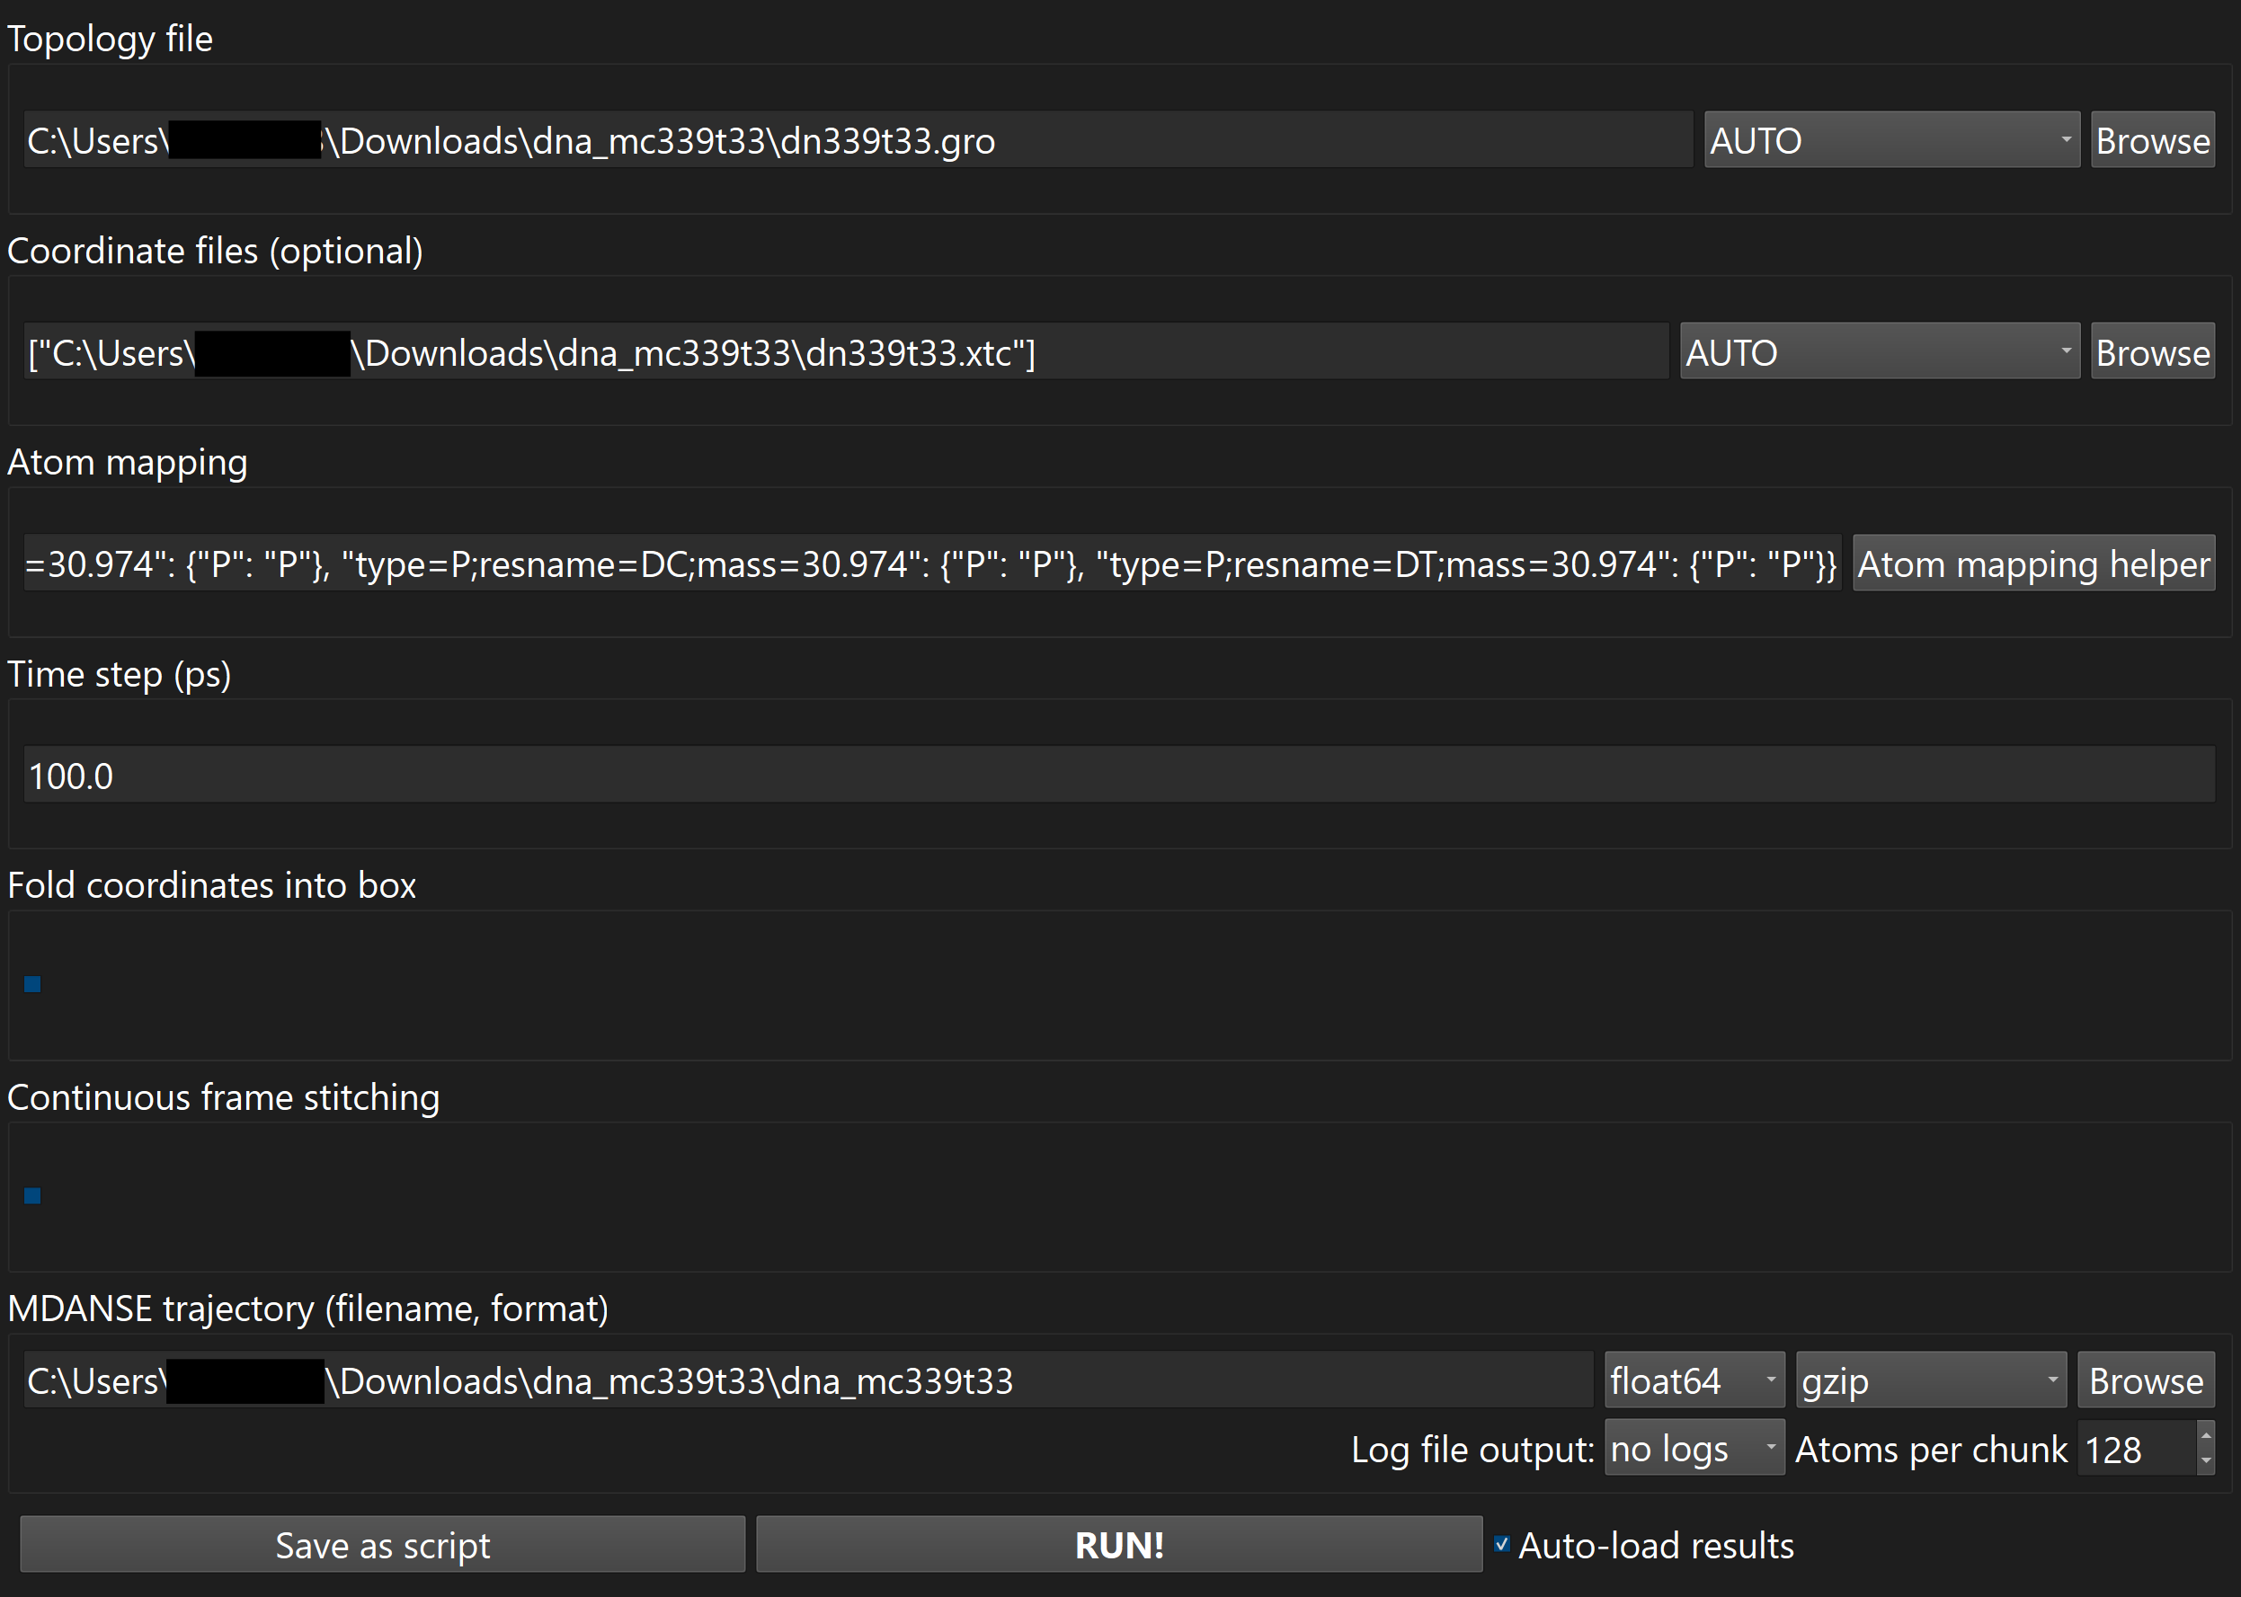
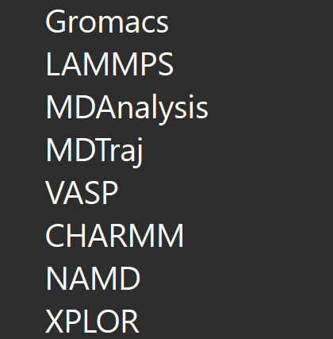
New and updated trajectory converters
A few new general converters have been added, which use other MD trajectory libraries to convert them.
ASE

Slide 11
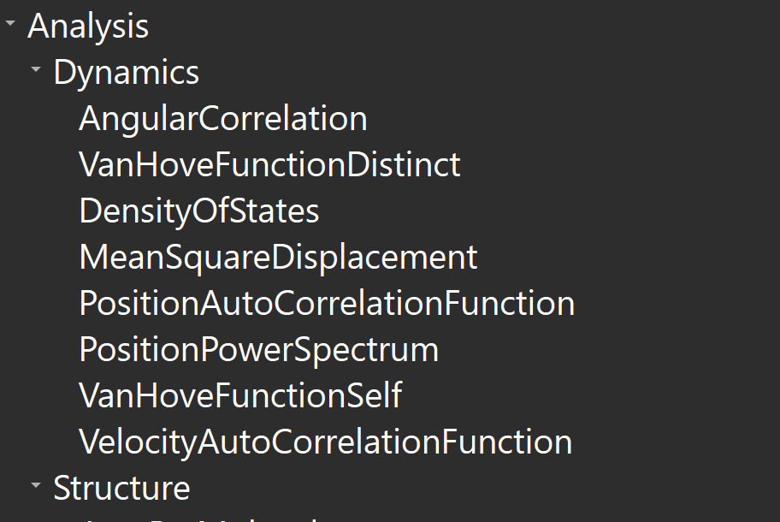
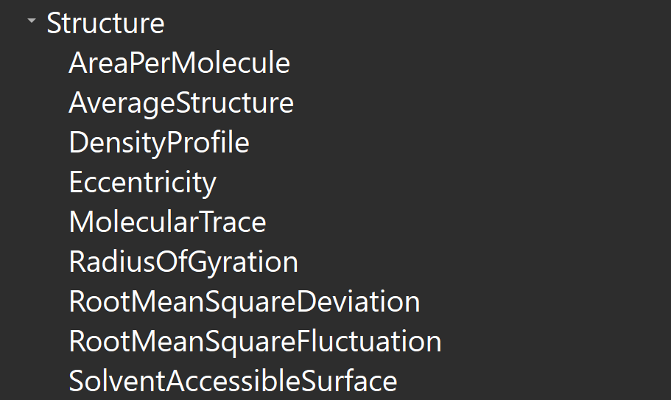
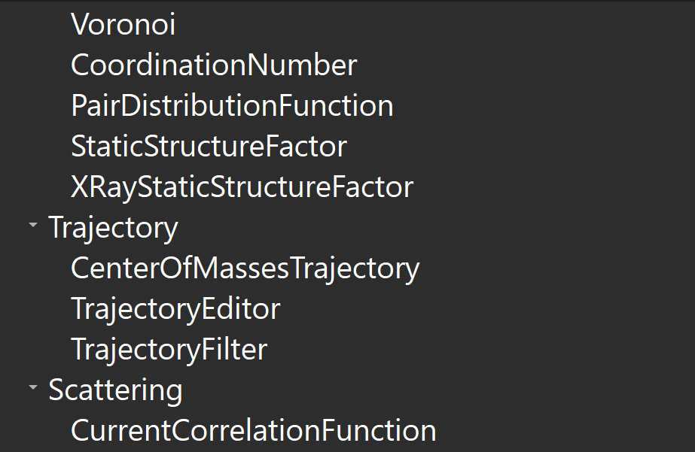
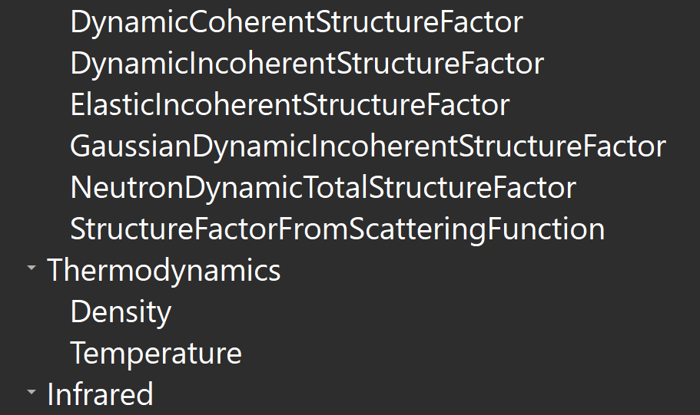
New and fixed jobs
Current Correlation Function
van Hove function (self)
van Hove function (distinct)
Position Power Spectrum
Eccentricity
Dipole Autocorrelation Function
Infrared (molecular)
Trajectory Filter
Solvent Accessible Surface
Centre of Masses Trajectory
MDANSE now has a total of 36 different analysis or trajectory editing jobs.

Slide 12
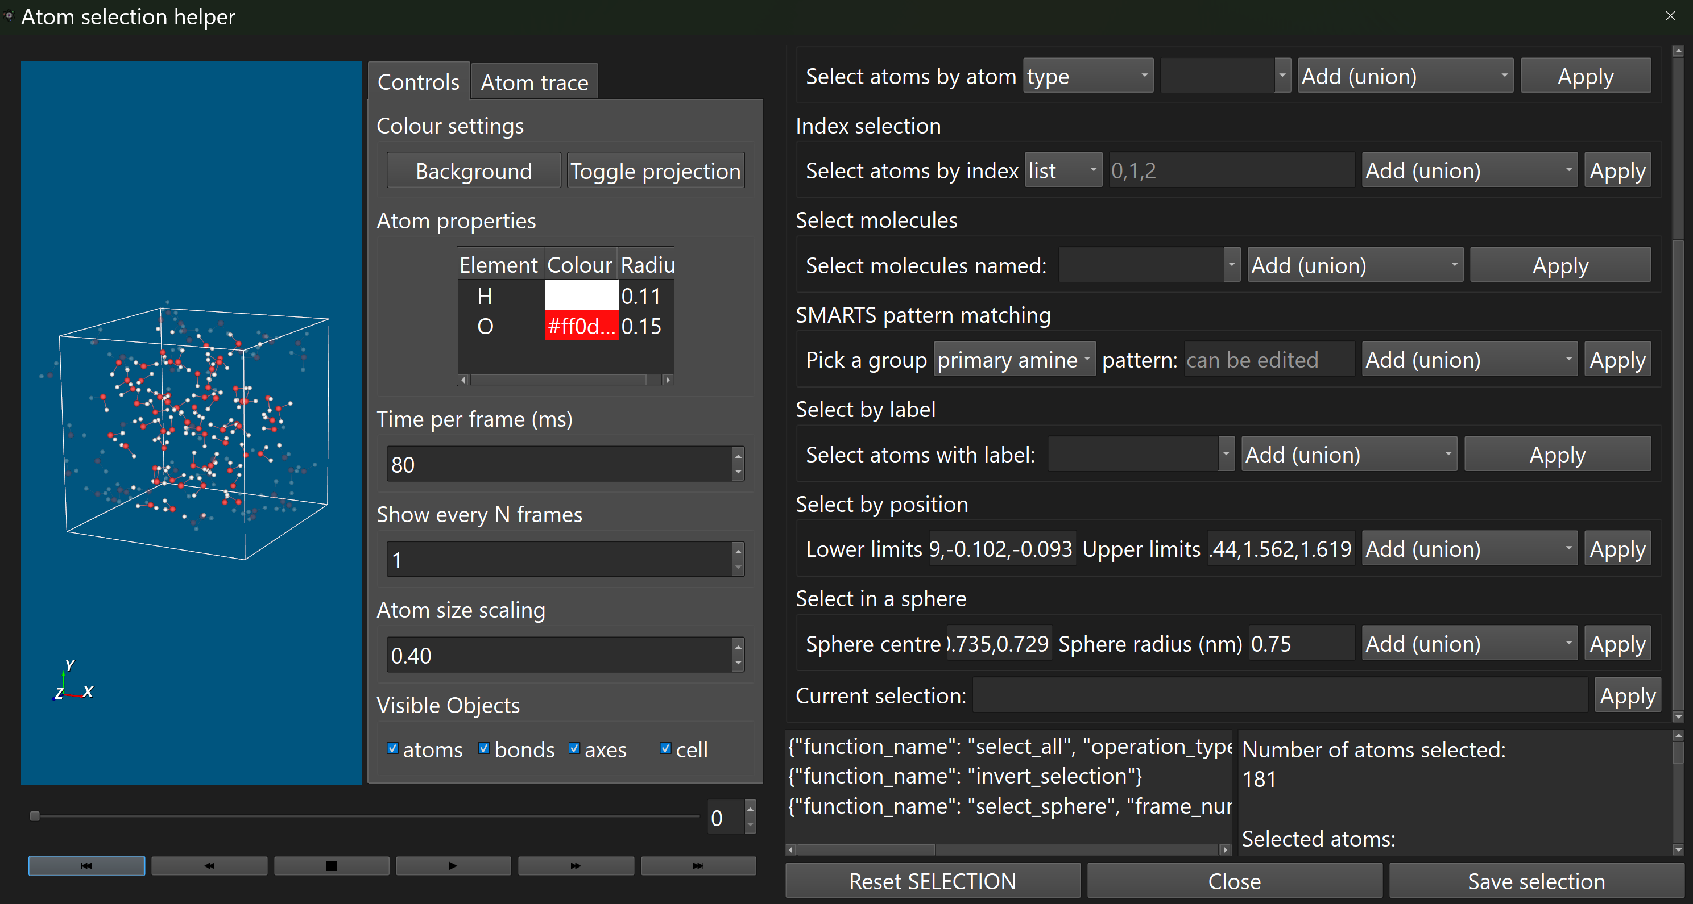
Updated and fix job configurators
Each analysis job in MDANSE can be run with different settings such as the selection of the atoms or grouping level of the results.
Some of the settings can be quite difficult to set manually. In these cases, the GUI includes helper windows which allow the settings to be generated.
Here we have the helper window for the atom transmutation configurator.

Slide 13
Grouping
Atom grouping
MDANSE groups atoms into molecules based on information in the MD engine output or from bond distances.
Almost all analysis job results can be grouped by atoms or molecules.
Let’s see how atom grouping work with the dynamic incoherent structure factor.

Slide 14
Grouping
Atom grouping
MDANSE groups atoms into molecules based on information in the MD engine output or from bond distances.
Almost all analysis job results can be grouped by atoms or molecules.
Let’s see how atom grouping work with the dynamic incoherent structure factor.

Slide 15
Grouping
Molecule grouping
MDANSE groups atoms into molecules based on information in the MD engine output or from bond distances.
Almost all analysis job results can be grouped by atoms or molecules.
Let’s see how atom grouping work with the dynamic incoherent structure factor.
Molecule grouping is much the same we just split up the summation in different ways.

Slide 16
Grouping
Molecule grouping
MDANSE groups atoms into molecules based on information in the MD engine output or from bond distances.
Almost all analysis job results can be grouped by atoms or molecules.
Let’s see how atom grouping work with the dynamic incoherent structure factor.
Molecule grouping is much the same we just split up the summation in different ways.

Slide 17
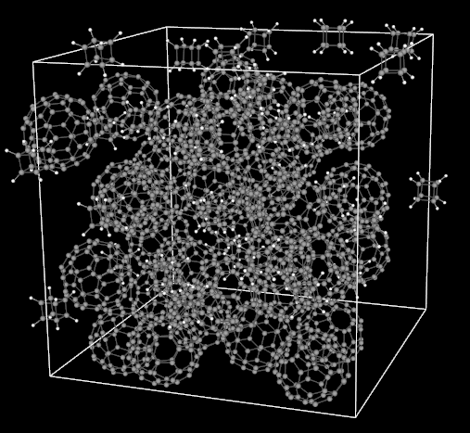
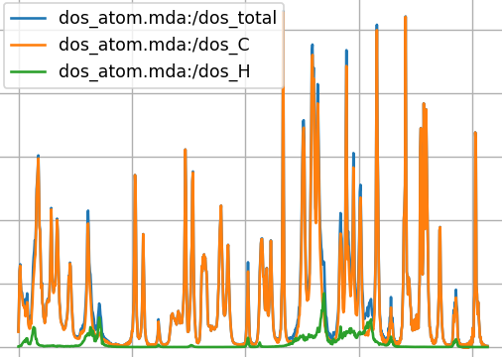
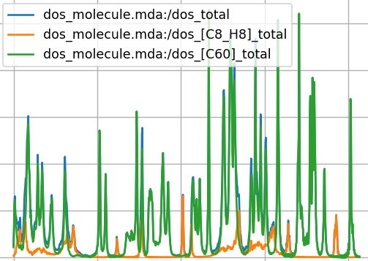
Grouping
Atom grouping
Molecule grouping

Slide 18
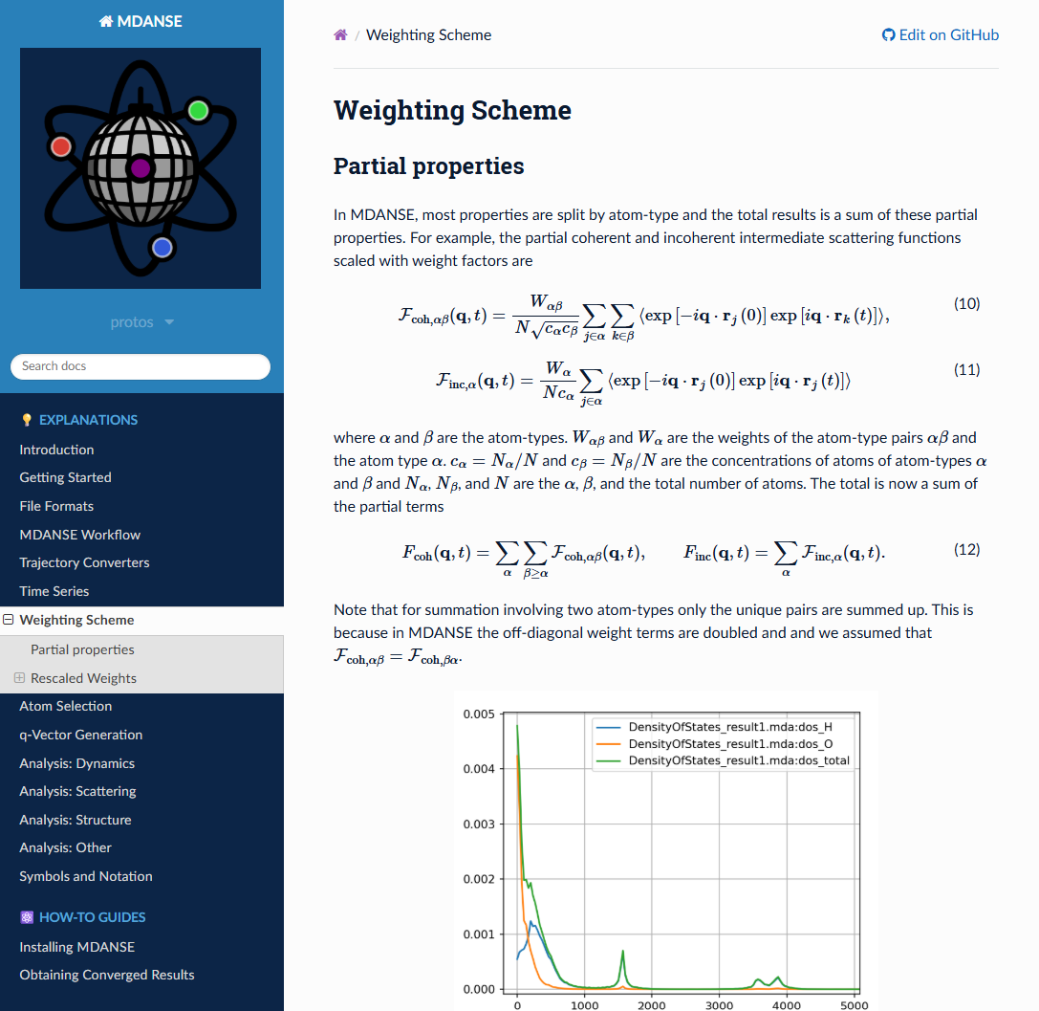
MDANSE Read the Docs
As with the code and GUI, large parts of the MDANSE documentation has been completely rewritten.
Almost all the theory behind the analysis calculations in MDANSE can be found here.
Additionally, some sections with guides to using some parts of the GUI such as the plotter.
https://mdanse.readthedocs.io/

Slide 19
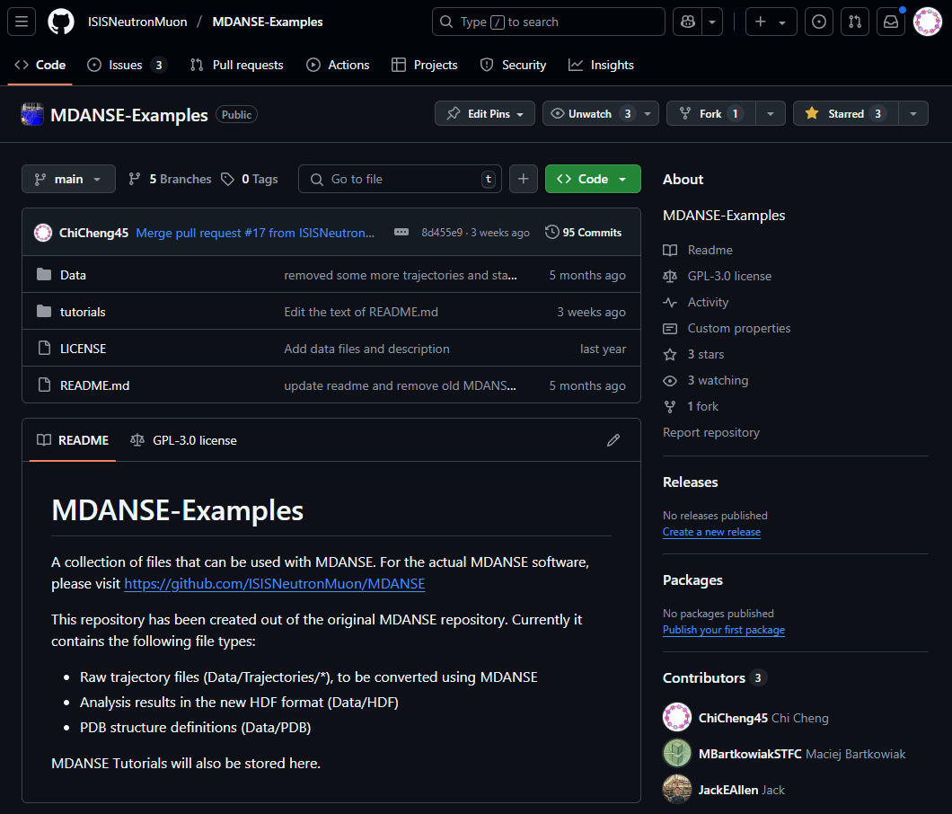
MDANSE-Examples
MDANSE-Examples is a GitHub repository which contain a few molecular dynamics trajectory outputs and MDANSE tutorials.
https://github.com/ISISNeutronMuon/MDANSE-Examples

Slide 20
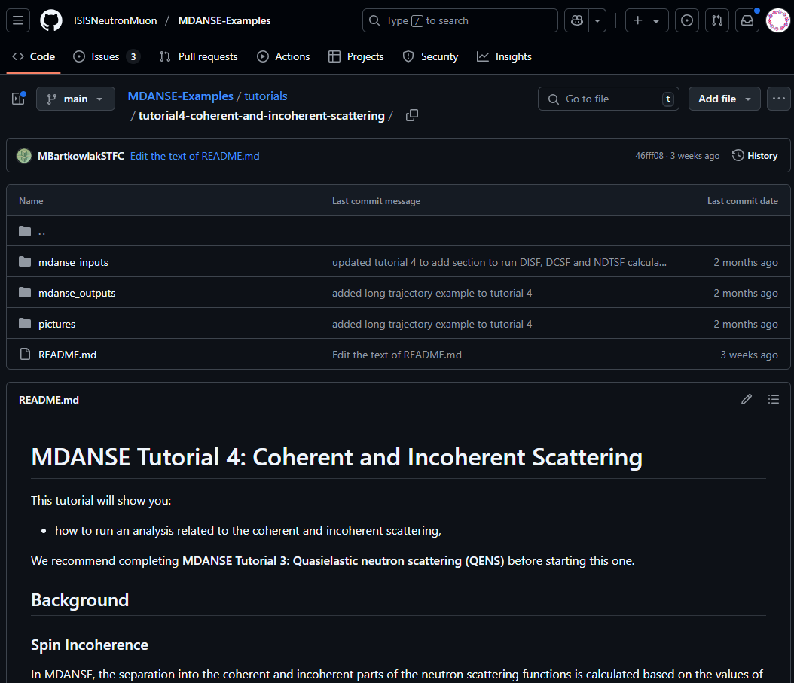
MDANSE-Examples
MDANSE-Examples is a GitHub repository which contain a few molecular dynamics trajectory outputs and MDANSE tutorials.
Currently there are around four tutorials, which should be useful for those new to MDANSE, molecular dynamics analysis and/or neutron scattering.
https://github.com/ISISNeutronMuon/MDANSE-Examples

Slide 21
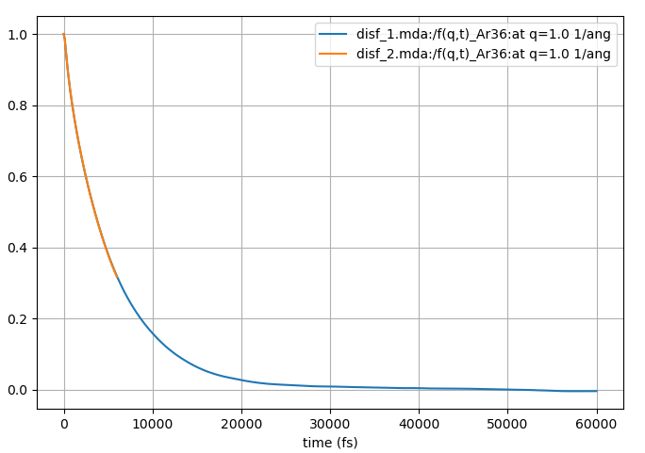
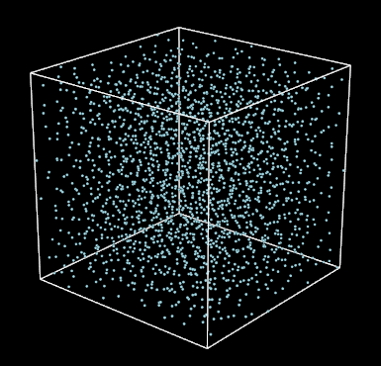
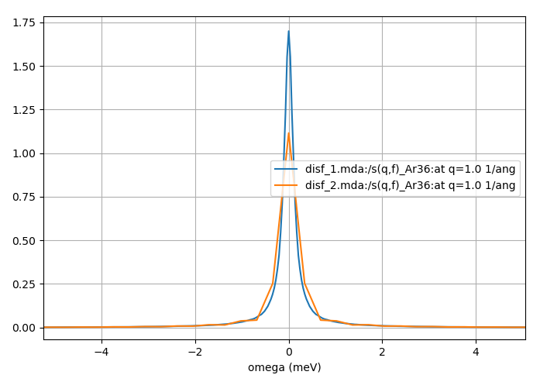
MDANSE tips
Trajectory too short
Although it may seem like MDANSE could be used as a black box, poor or noisy results could be obtained without the user realising that.
Here the trajectory is too short for the given value of |q|. Not enough time has elapsed for F(q,t) to decay to zero.

Slide 22
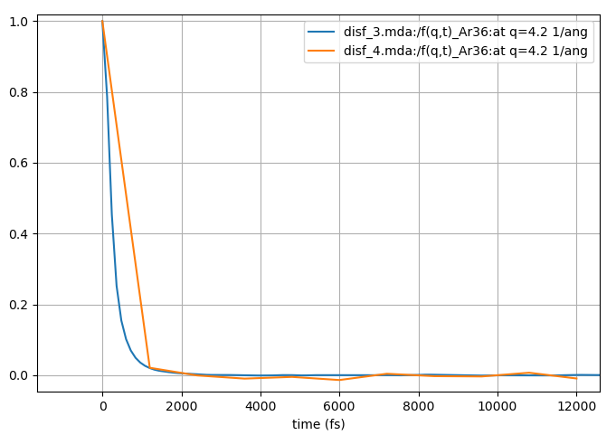
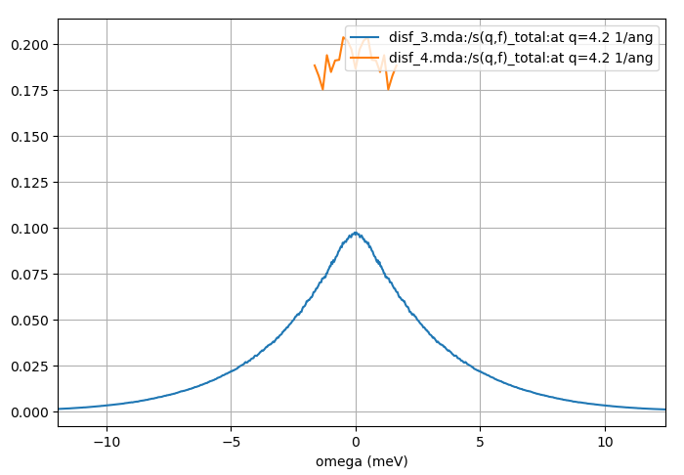
MDANSE tips
Time step is too long
Although it may seem like MDANSE could be used as a black box, poor or noisy results could be obtained without the user realising that.
Here the trajectory is too short for the given value of |q|. Not enough time has elapsed for F(q,t) to decay to zero.
Here the trajectory time step is too long for the given value of |q|. F(q,t) decays quickly and the large time step doesn’t capture the details of the function around t=0.

Slide 23
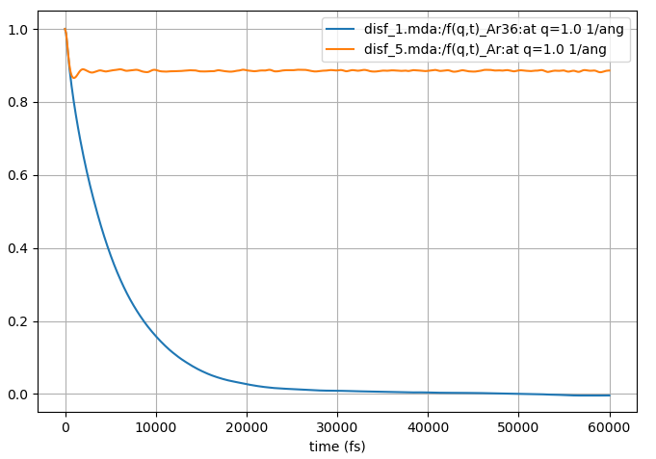
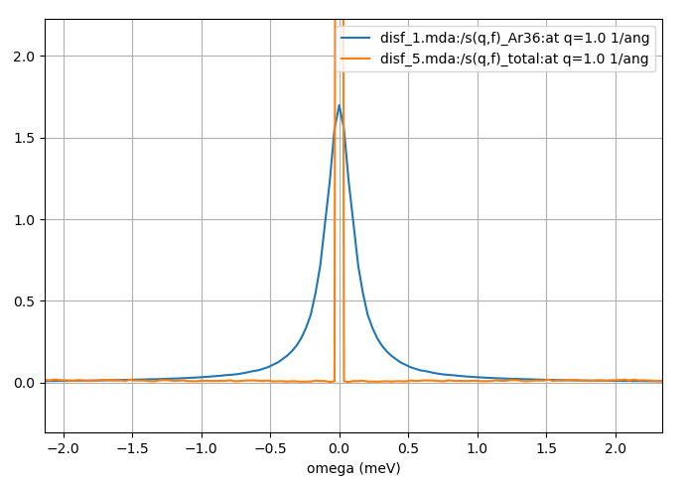
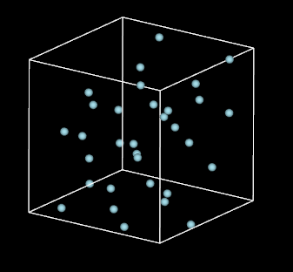
MDANSE tips
Simulation box too small
Although it may seem like MDANSE could be used as a black box, poor or noisy results could be obtained without the user realising that.
Here the trajectory is too short for the given value of |q|. Not enough time has elapsed for F(q,t) to decay to zero.
Here the trajectory time step is too long for the given value of |q|. F(q,t) decays quickly and the large time step doesn’t capture the details of the function around t=0.
Here the trajectory is too small and artifacts due to the periodic images dominate. F(q,t) does not decay to zero.

Slide 24
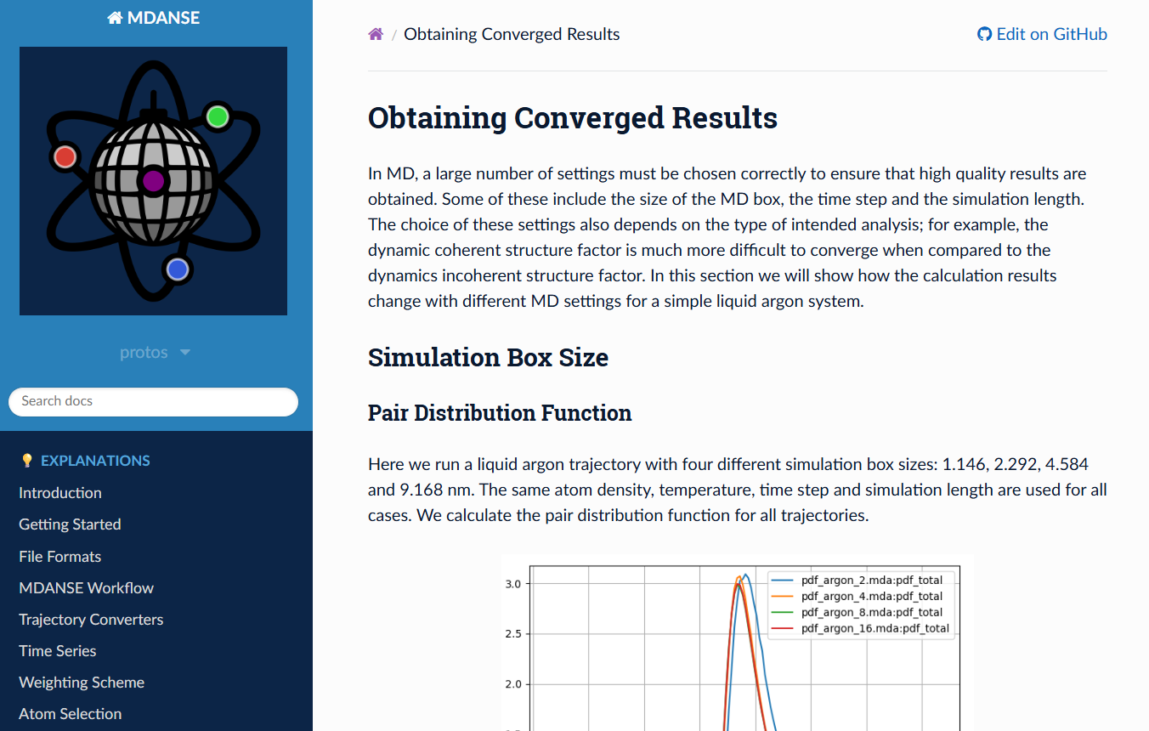
MDANSE tips
Simulation box too small
Although it may seem like MDANSE could be used as a black box, poor or noisy results could be obtained without the user realising that.
Here the trajectory is too short for the given value of |q|. Not enough time has elapsed for F(q,t) to decay to zero.
Here the trajectory time step is too long for the given value of |q|. F(q,t) decays quickly and the large time step doesn’t capture the details of the function around t=0.
Here the trajectory is too small and artifacts due to the periodic images dominate. F(q,t) does not decay to zero.

Slide 25
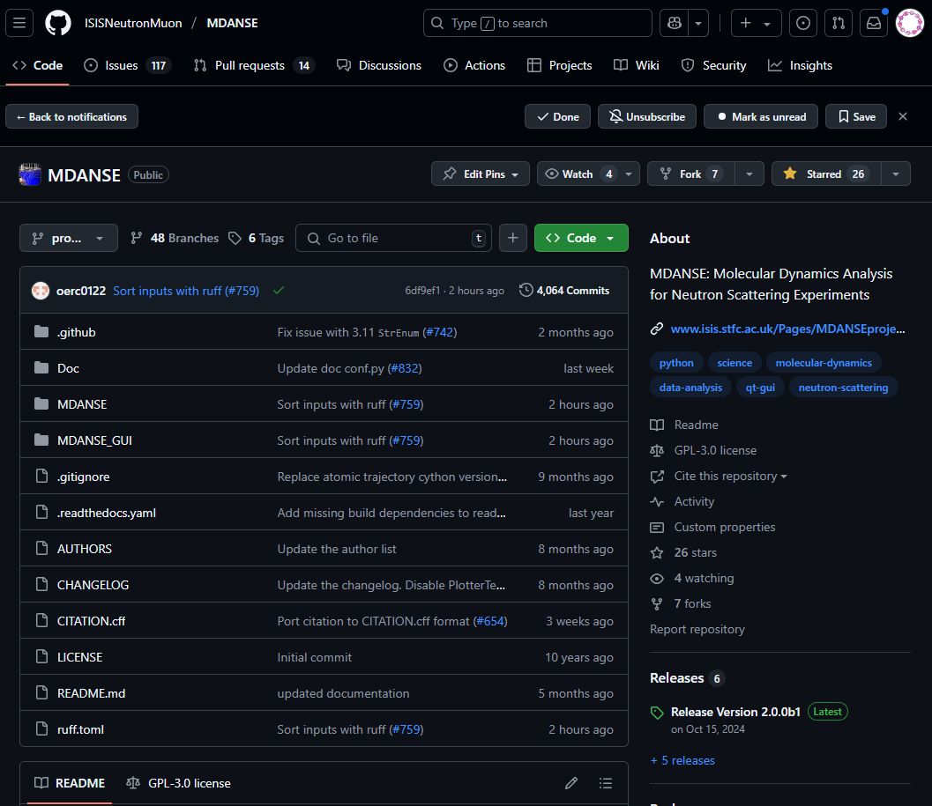
MDANSE: open-source software
MDANSE is an open-source software project currently hosted on GitHub.
If you have a GitHub account you can make requests, suggestions, and report issues on our GitHub page in the issues tab.
Alternatively, you can contact us at: MDANSE-help@stfc.ac.uk
https://github.com/ISISNeutronMuon/MDANSE

Slide 26
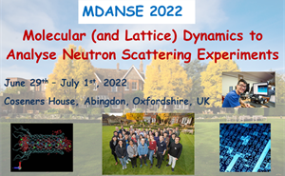
MDANSE School 2026
MDANSE: Molecular (and Lattice) Dynamics to Analyse Neutron Scattering Experiments.
Run every 2 years and includes lectures on the computational methods used to simulate inelastic and quasi-elastic neutron scattering spectra.
Hands-on workshops with the MDANSE program and others programs such as abINS.
Next MDANSE school will be sometime next year!
2026

Slide 27
Acknowledgements
Contributors
The MDANSE project is supported by:
Science and Technology Facilities Council,
ISIS Neutron and Muon Source,
Institut Laue-Langevin,
Ada Lovelace Centre.
Sanghamitra Mukhopadhyay
Franz Lang
Rastislav Turanyi
Maciej Bartkowiak
Ashley Meigh
Chi Cheng
Rob Buchanan
Raunakk Banerjee
Jacob Wilkins
Gerald Kneller
Konrad Hinsen
Tomasz Rog
Krzysztof Murzyn
Slawomir Stachura
Eric Pellegrini
Bachir Aoun
Vania Calandrini
Paolo Calligari
Gael Goret
Remi Perenon
Miguel Gonzalez
https://github.com/ISISNeutronMuon/MDANSE https://github.com/ISISNeutronMuon/MDANSE-Examples https://mdanse.readthedocs.io/
MDANSE-help@stfc.ac.uk

Slide 28
Live Demo: Argon QENS
Chi Y. Cheng, Maciej Bartkowiak, Rob Buchanan, Jacob Wilkins, Miguel González, Eric Pellegrini, Rémi Perenon, Sanghamitra Mukhopadhyay
PAQMAN 2025
03/07/2025

Slide 29
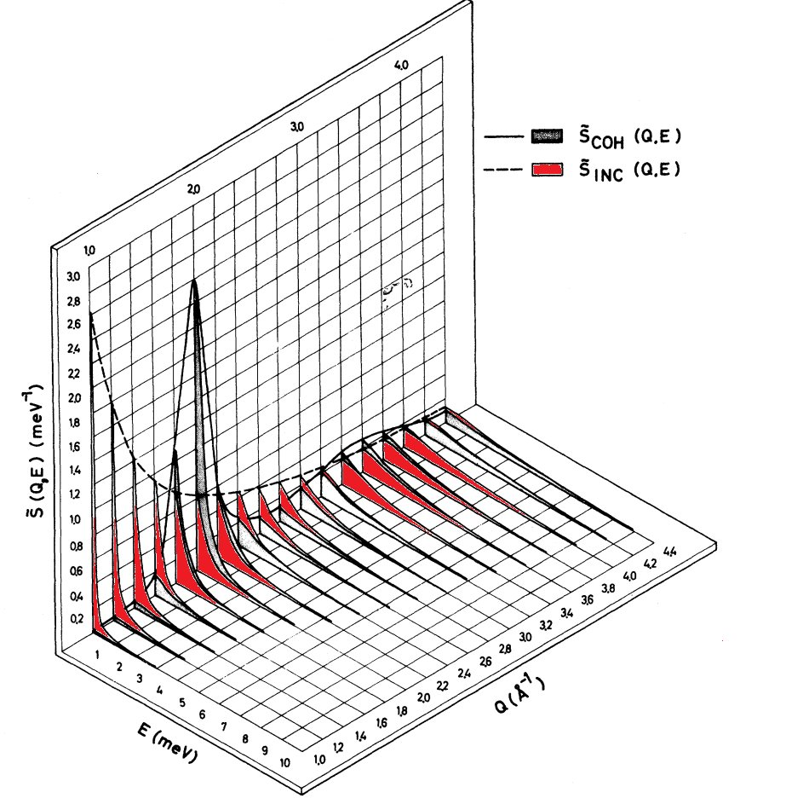
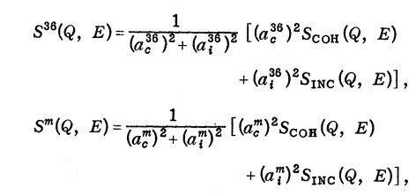
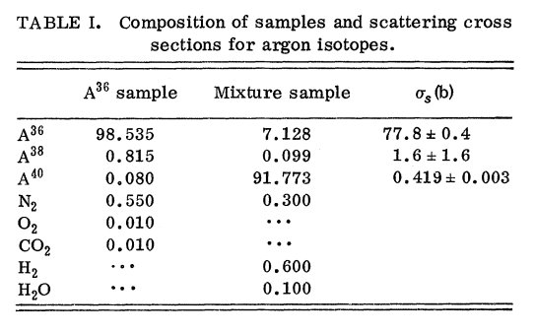
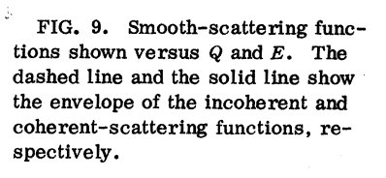
Quasi-elastic neutron scattering
We’ll be looking this paper by Sköld et al.
They determine the dynamic incoherent scatter function of liquid argon from measurements of a 36Ar and a mixture of predominately 36Ar and 40Ar.
Let’s try to reproduce their results using MDANSE.

