Slide 1


QENS Study of the interface dynamics IN HUMID iron oxide nanoparticles
04.07.2025 I Matei Pascariu

Slide 2
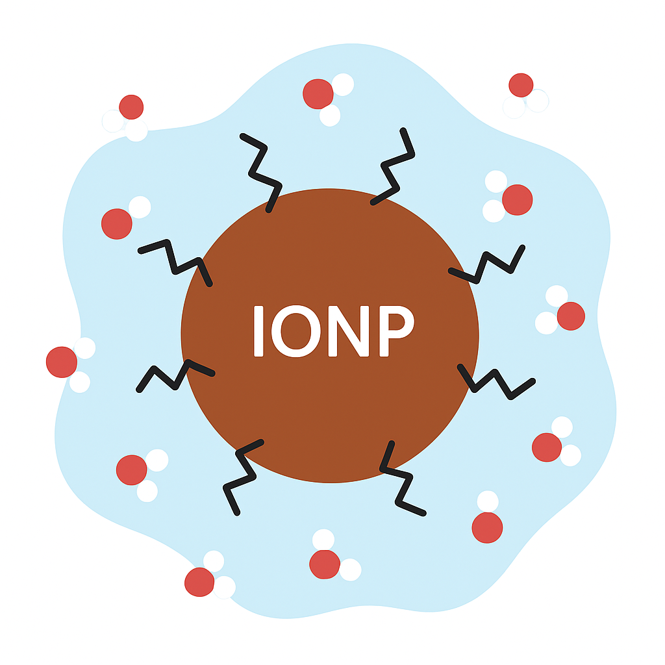
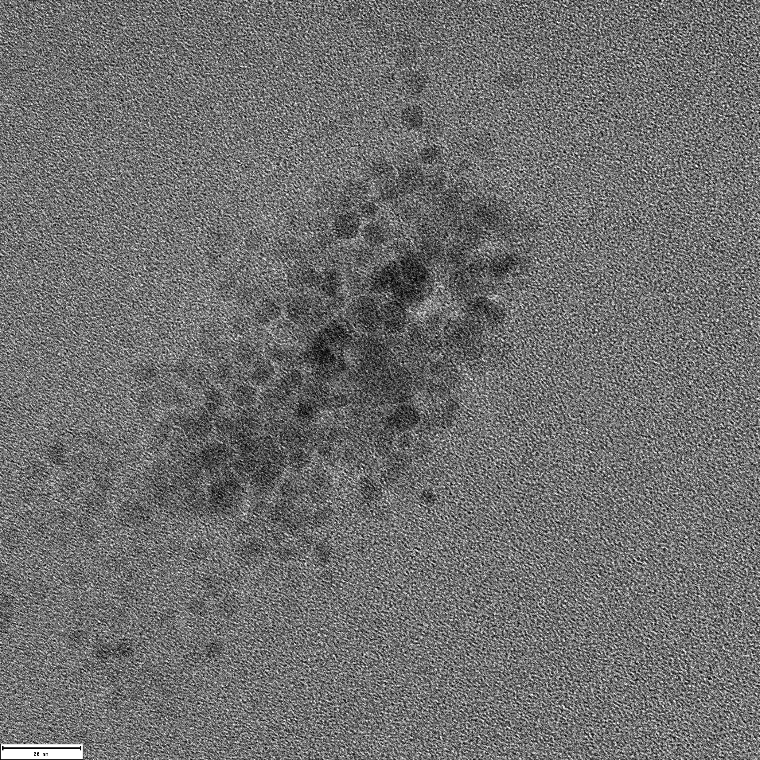
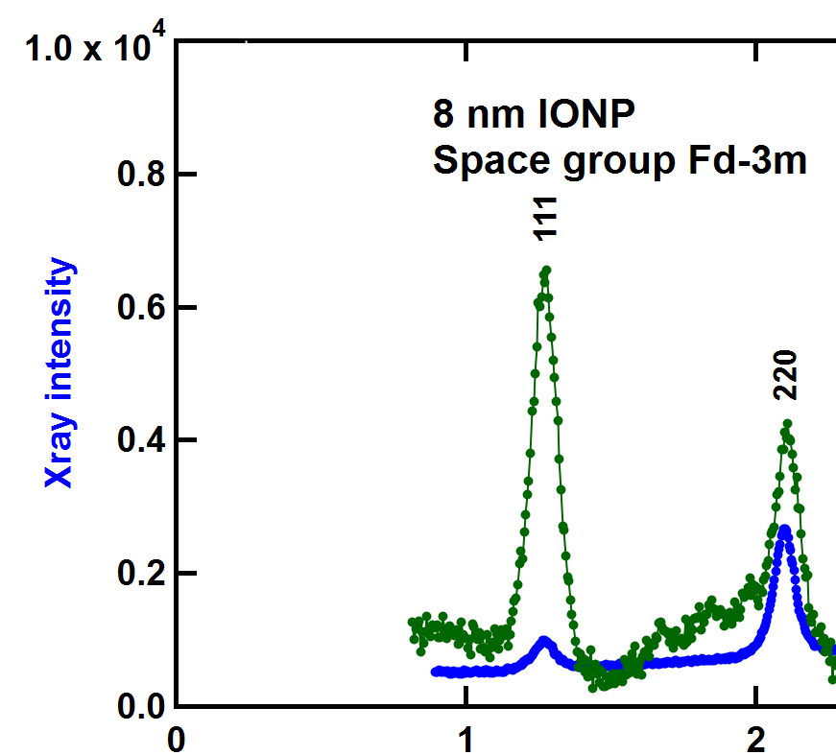

Introduction & Scientific Motivation
Versatile
Interactions can be tailored by surface functionalization
Measuring Surface Dynamics with QENS
IN16B @ ILL in BS mode:
λ = 6.271 Å
energy-resolution HWHM ≈ 0.37 µeV
ΔE range ± 30 µeV
$7±2$ nm IONP
WOMBAT, ANSTO
Sample composition (85% RH)
≈ 15 wt% water and citrate
H_{water} : H_{cit} = 2.81 : 1
XPD
NPD
I [a. u.]
20 nm
TEM, © Sascha Ehlert, FZJ
Q [Å⁻¹]

Slide 3
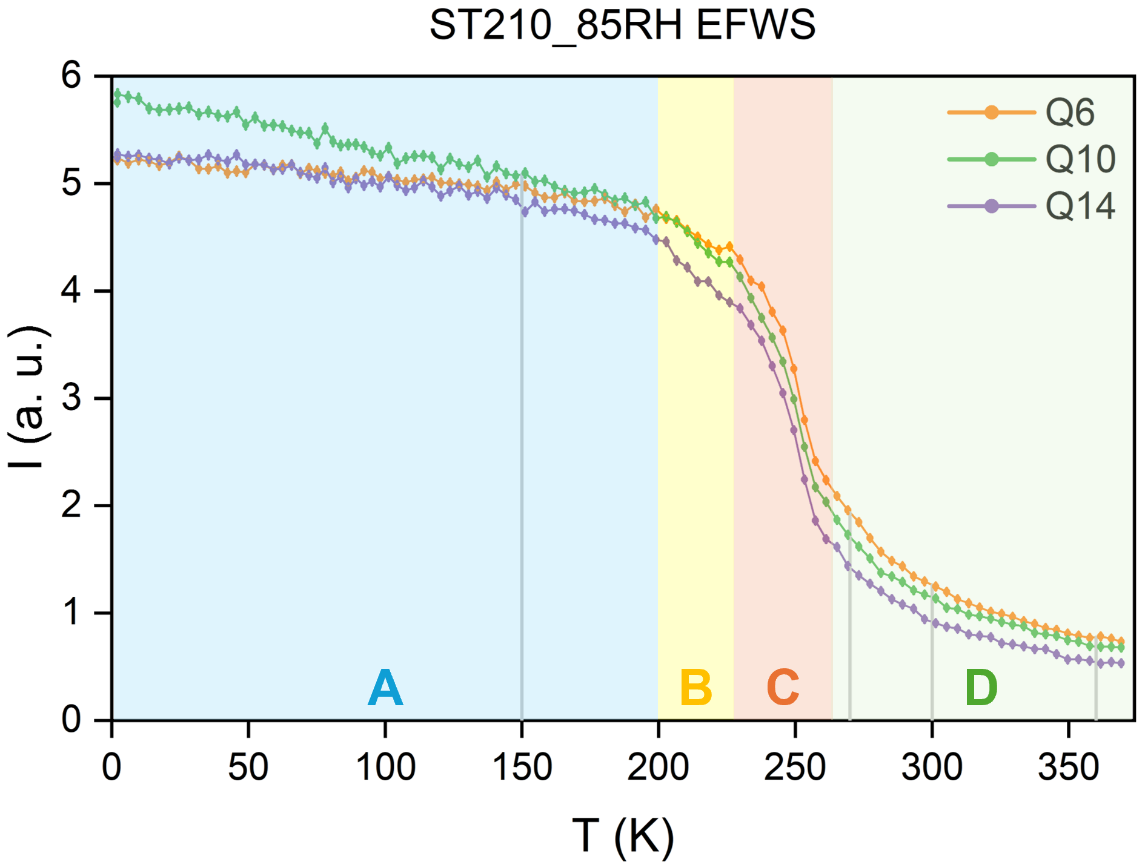
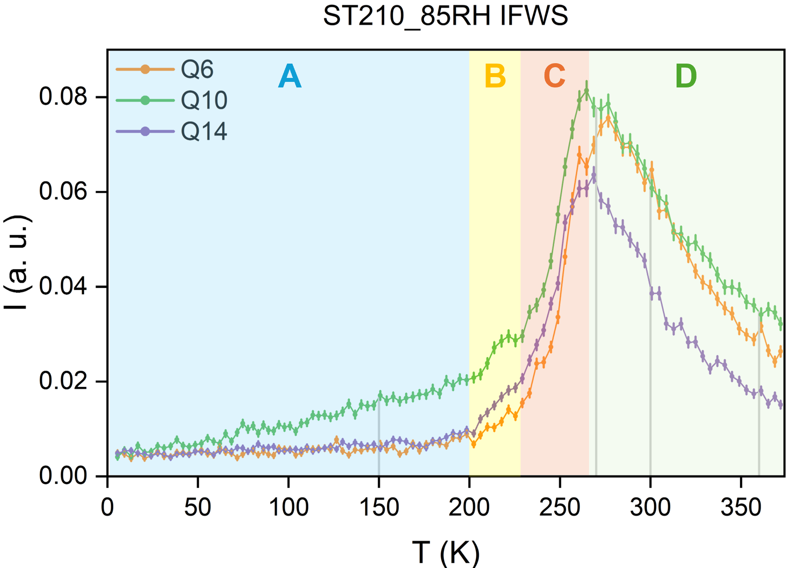
Citrate-Capped IONPs at 85% RH
FWS Analysis
EFWS
IFWS (3 μeV)
• 0.94 Å⁻¹
• 1.31 Å⁻¹ (Bragg peak)
• 1.62 Å⁻¹
• 0.94 Å⁻¹
• 1.31 Å⁻¹ (Bragg peak)
• 1.62 Å⁻¹
I [a. u.]
I [a. u.]
T [K]
T [K]
A: water and ligand motions are largely “frozen”, magnetic process most noticeable at Q10
B: feature observable at higher Q values
C: possible phase transition in the hydration water, the dynamics here are optimally active
D: possible dynamics after the phase transition, qe component exits the spectrometer’s observable window

Slide 4

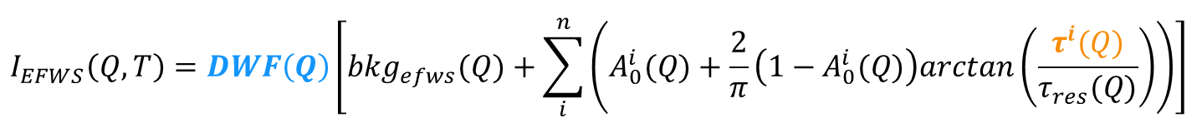


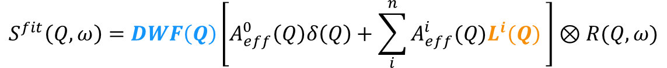
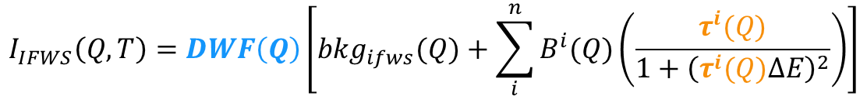

FWS & ERS Analysis
Lorentzian function
Global Fitting Model
$$L^{i}\left(Q\right)≡\frac{1}{π}×\frac{Γ^{i}(Q)}{{∆E}^{2}+{Γ^{i}(Q)}^{2}}$$
ERS fit:
$$S^{fit}\left(Q,ω\right)=DWF\left(Q\right)\left[A_{eff}^{0}\left(Q\right)δ\left(Q\right)+\sum_{i}^{n}{A_{eff}^{i}(Q)L^{i}(Q)} \right]⊗R(Q,ω)$$
HWHM
Relaxation time
$$Γ\left(Q\right)=ℏ\frac{1}{τ}$$
$$τ=τ_{0}exp\left(\frac{E_{a}}{k_{B}T}\right)$$
$$DWF\left(Q\right)=exp\left(−\frac{1}{3}Q^{2}\left\langle u^{2}\right\rangle \right)$$
FWS fit (adapted from H. Grapengeter et al., Colloid Polym. Sci. 1987):
$$I_{EFWS}\left(Q,T\right)=DWF\left(Q\right)\left[{bkg}_{efws}(Q)+\sum_{i}^{n}{\left(A_{0}^{i}(Q)+\frac{2}{π}\left(1−A_{0}^{i}(Q)\right)arctan\left(\frac{τ^{i}(Q)}{τ_{res}(Q)}\right)\right)}\right]$$
$$I_{IFWS}\left(Q,T\right)=DWF\left(Q\right)\left[{bkg}_{ifws}(Q)+\sum_{i}^{n}{B^{i}(Q)\left(\frac{τ^{i}(Q)}{1+{\left(τ^{i}(Q)∆E\right)}^{2}}\right)}\right]$$
Fitting parameters are shared between different datasets
Notes:
These equations assume independent motion and Arrhenius behavior of the described processes.

Slide 5
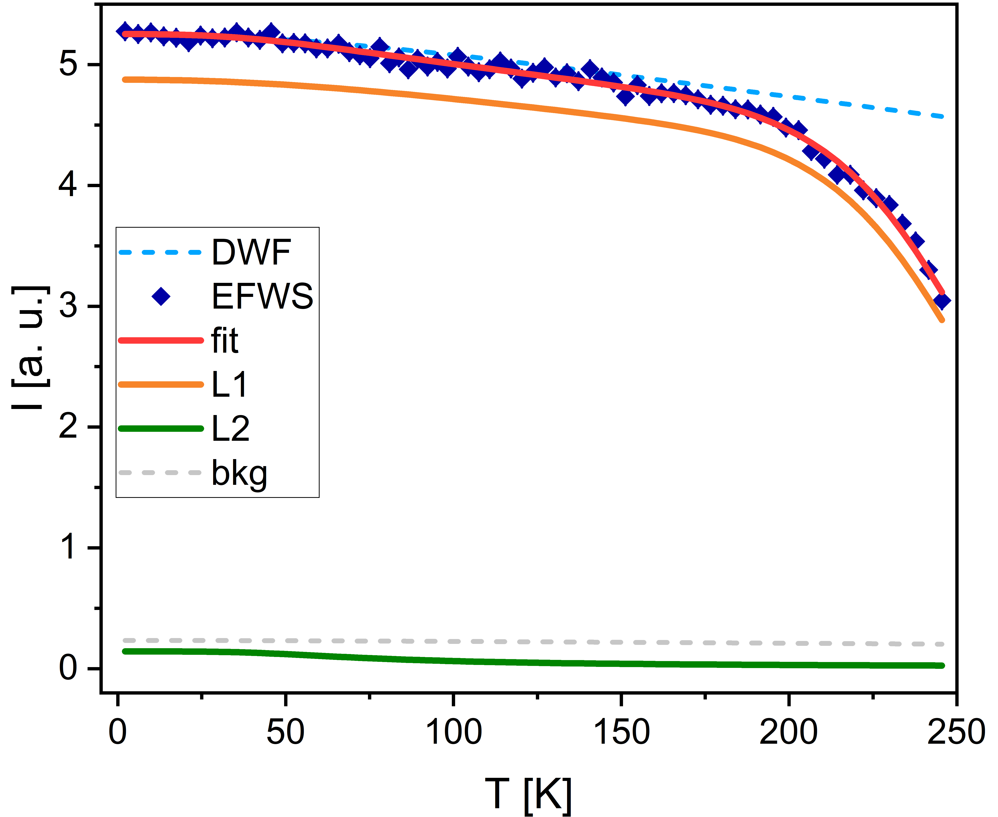
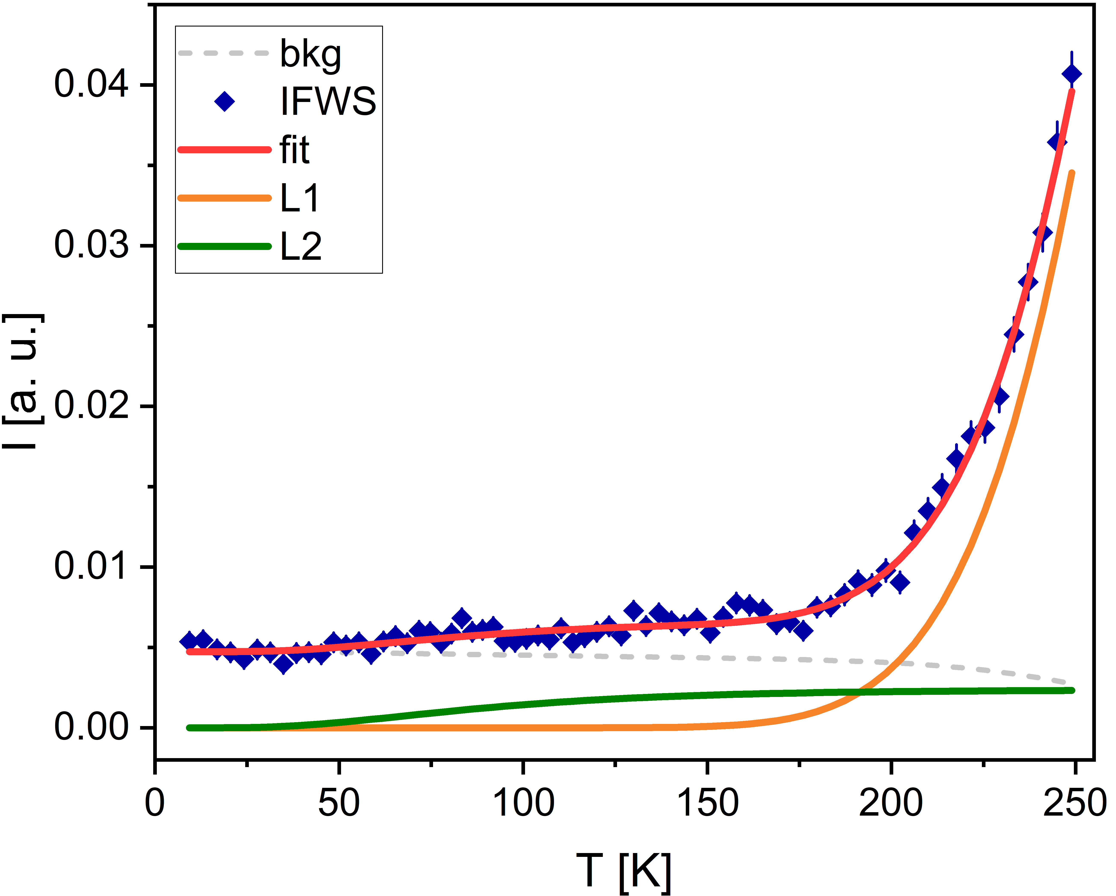
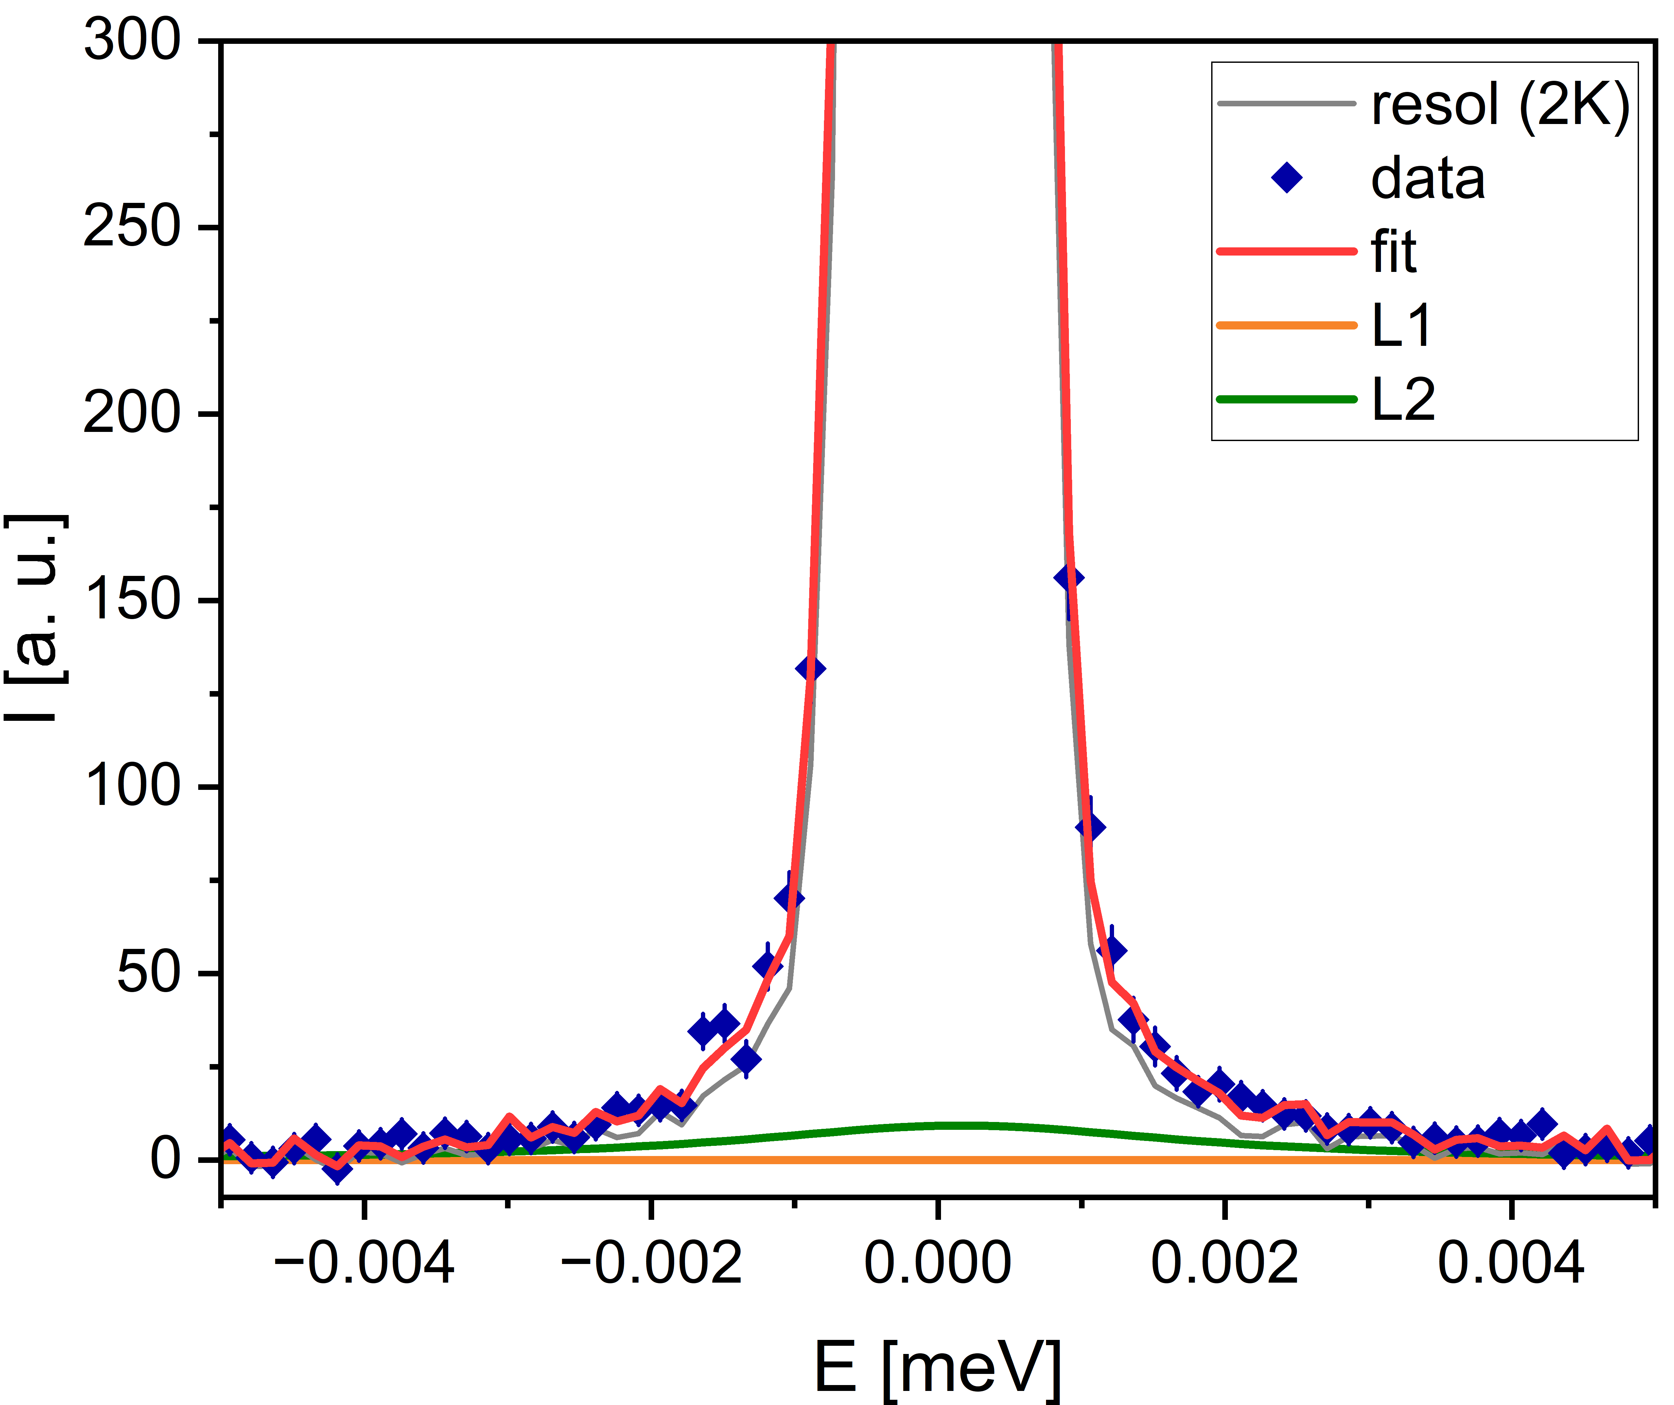

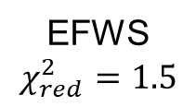


FWS Analysis – Regions A + B
$$χ_{red}^{2}=\frac{χ^{2}}{\#points−\#free parameters}$$
Q = 1.62 Å⁻¹
Results from global fitting
ERS, BS
T = 150 K
$$χ_{red}^{2}=1.1$$
IFWS
$$χ_{red}^{2}=0.93$$
EFWS
$$χ_{red}^{2}=1.5$$
IFWS shows the need for a low-T process

Slide 6
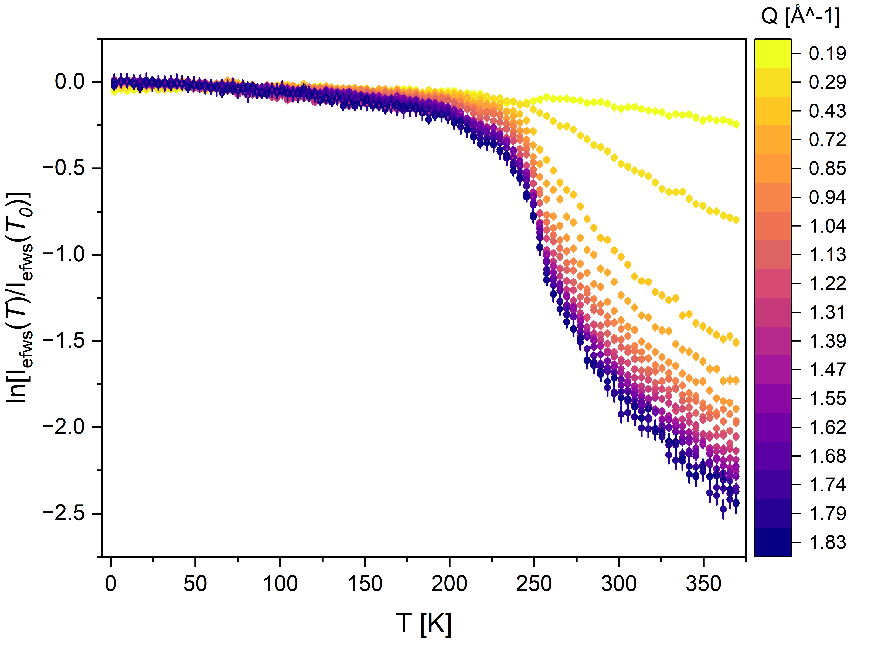
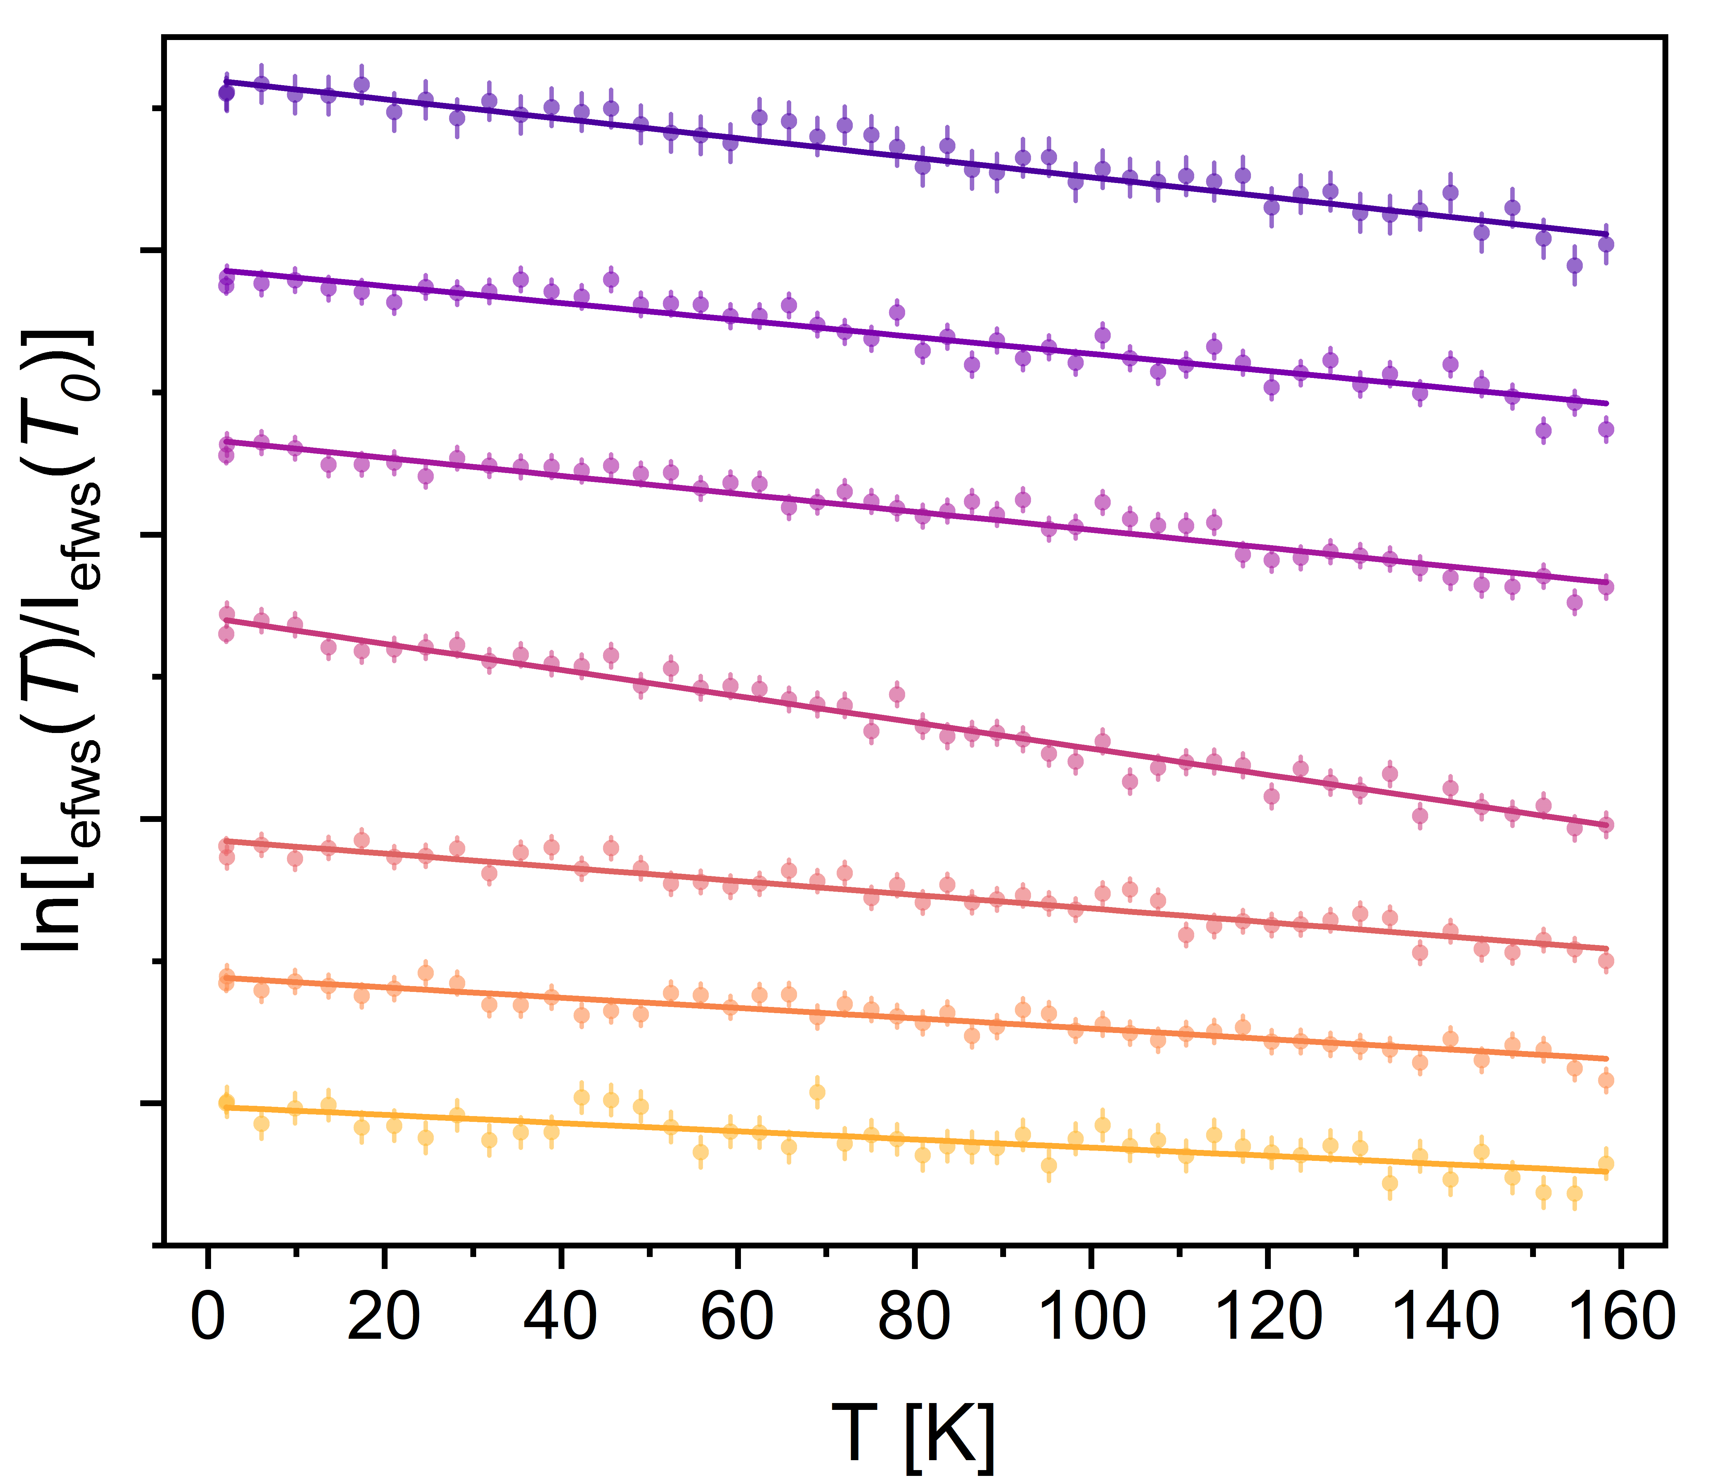

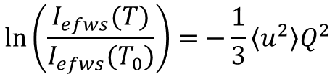
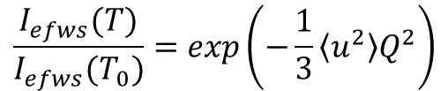
Low-T Analysis - DWF
$$\frac{I_{efws}(T)}{I_{efws}(T_{0})}=exp\left(−\frac{1}{3}\left\langle u^{2}\right\rangle Q^{2}\right)$$
$$\ln\left(\frac{I_{efws}(T)}{I_{efws}(T_{0})}\right)=−\frac{1}{3}\left\langle u^{2}\right\rangle Q^{2}$$
$$\frac{ⅆln\left(I/{I_{0}}\right)}{ⅆT}=−\frac{1}{3}\frac{ⅆ\left\langle u^{2}\right\rangle }{ⅆT}Q^{2}$$
Cut at 160 K
Get slope from linear fit

Slide 7
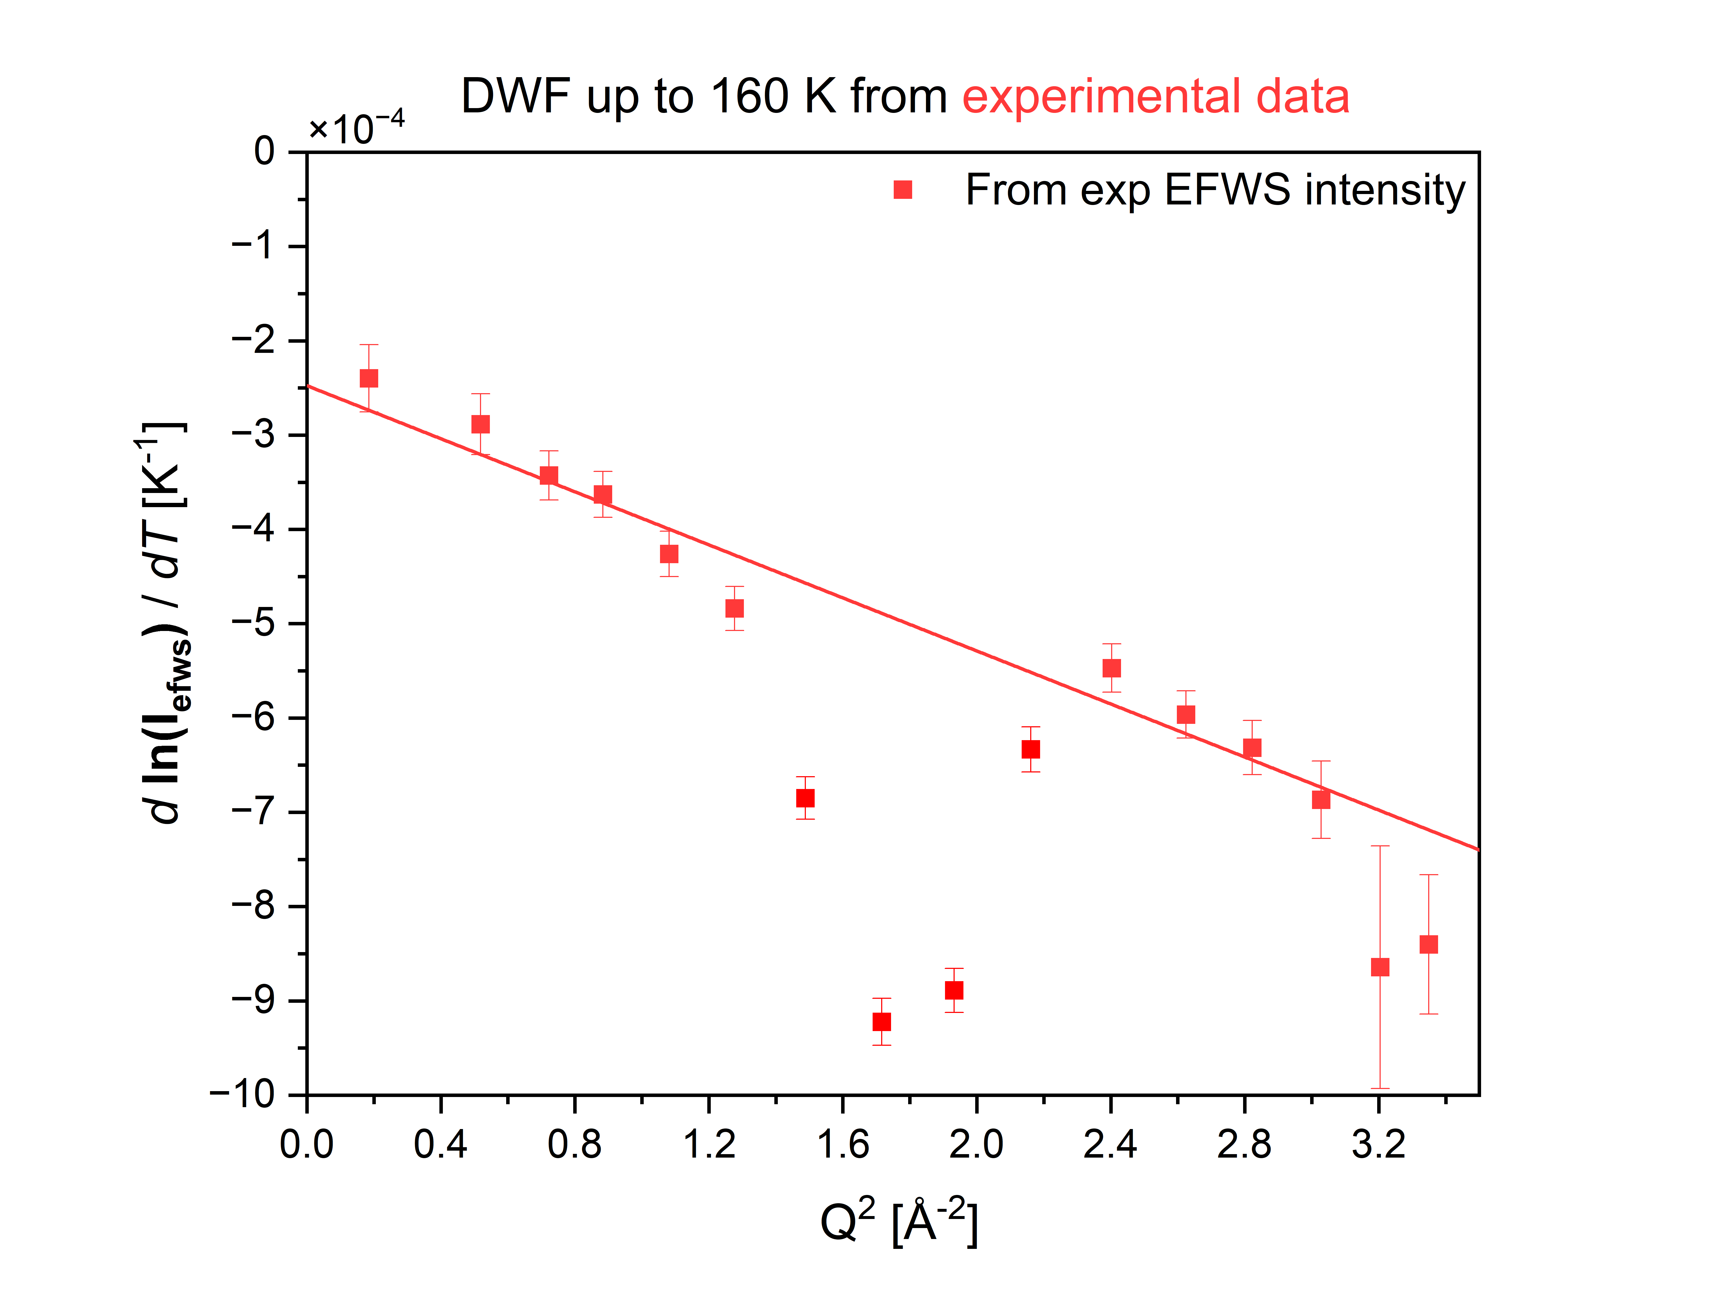

Low-T Analysis - DWF
$$\frac{ⅆln\left(I/{I_{0}}\right)}{ⅆT}=−\frac{1}{3}\frac{ⅆ\left\langle u^{2}\right\rangle }{ⅆT}Q^{2}$$

Slide 8
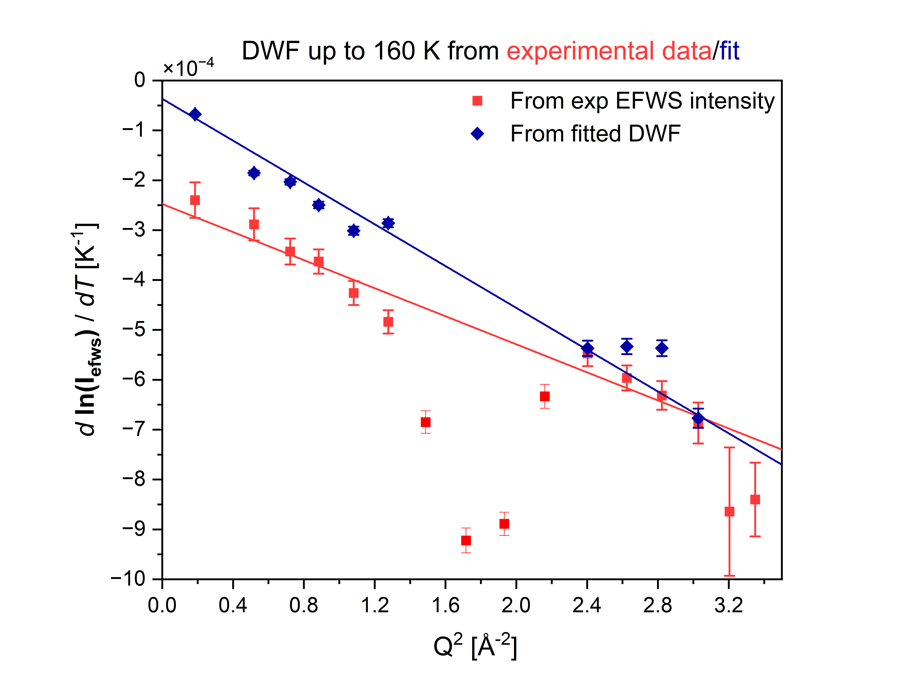
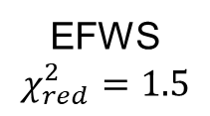
Low-T Analysis - DWF
$$\frac{ⅆln\left(I/{I_{0}}\right)}{ⅆT}=−\frac{1}{3}\frac{ⅆ\left\langle u^{2}\right\rangle }{ⅆT}Q^{2}$$
Fitted DWF
EFWS
$$χ_{red}^{2}=1.5$$

Slide 9


Low-T Analysis - DWF
$$\frac{ⅆln\left(I/{I_{0}}\right)}{ⅆT}=−\frac{1}{3}\frac{ⅆ\left\langle u^{2}\right\rangle }{ⅆT}Q^{2}$$
(From fitted DWF)
$$\frac{ⅆ\left\langle u^{2}\right\rangle }{ⅆT}=(6.3±0.1)×{10}^{−4}{ Å}^{2}K^{−1}$$
$$\left\langle u^{2}(298 K)\right\rangle =1.86±0.03{ Å}^{2}$$
Rather low, but comparable with confined water systems

Slide 10
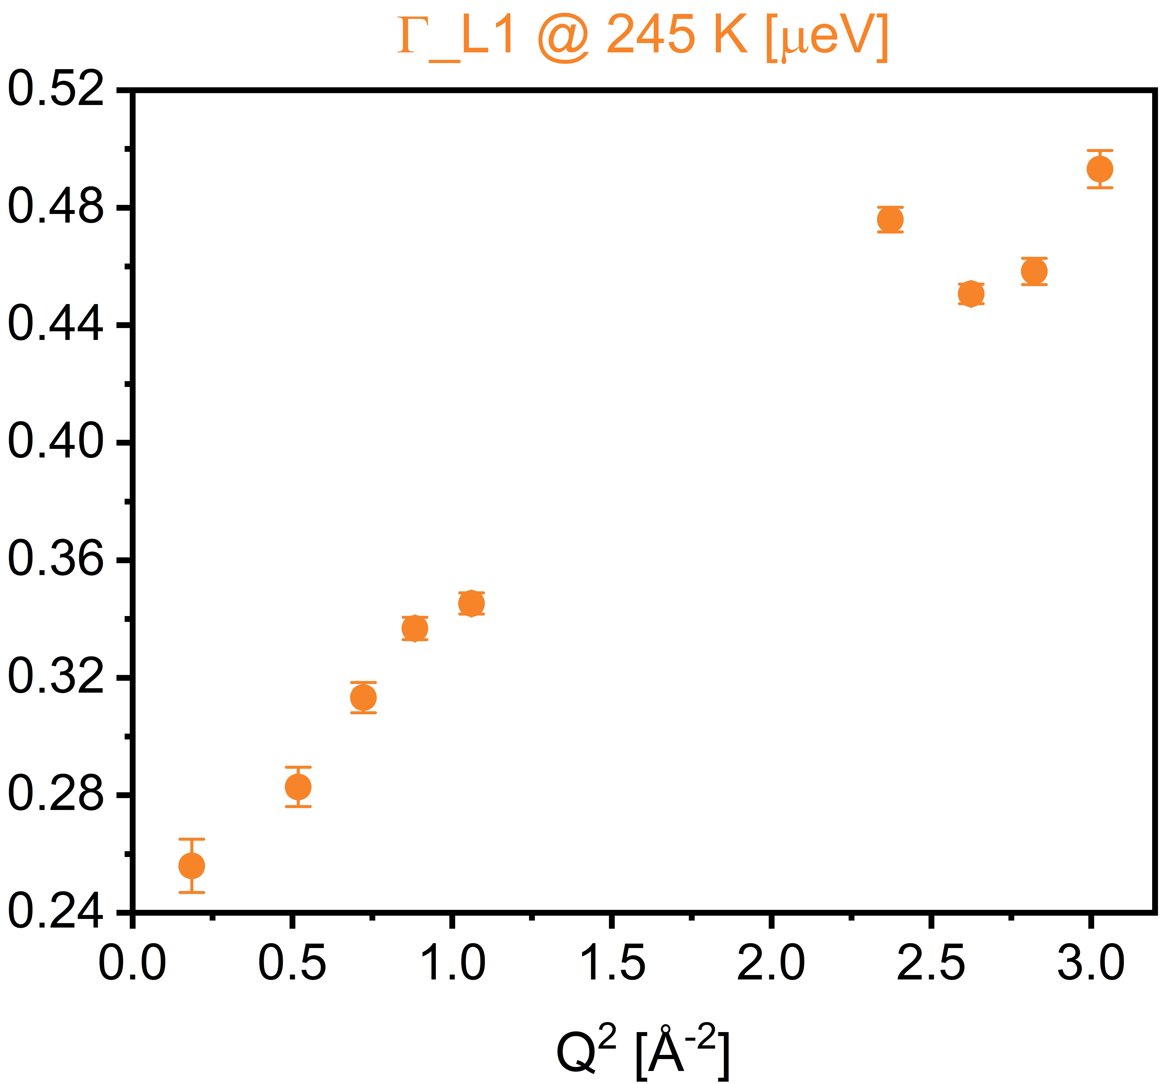
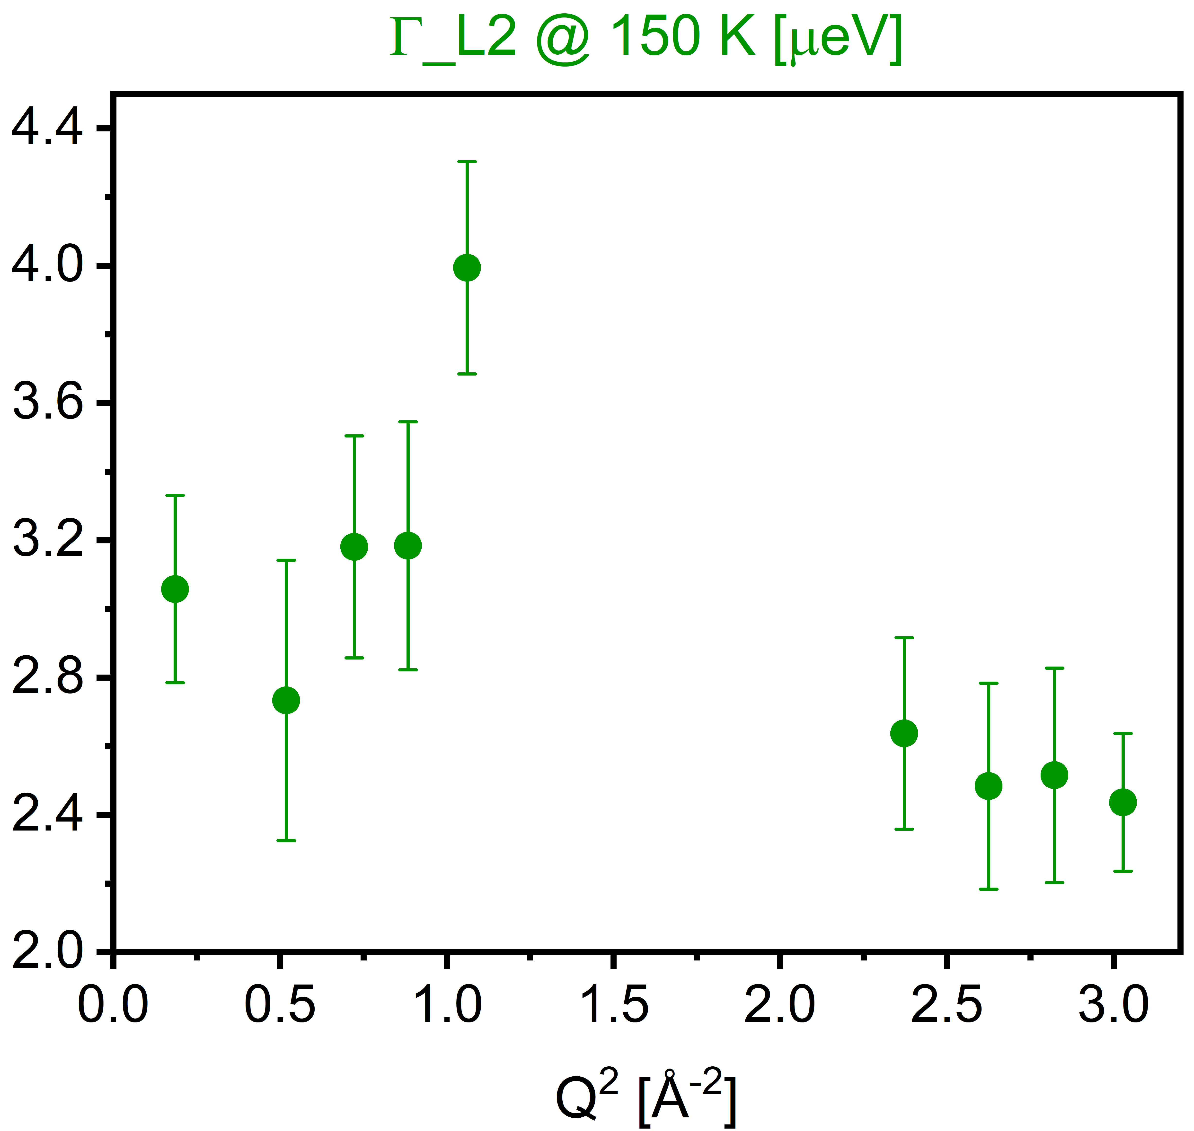
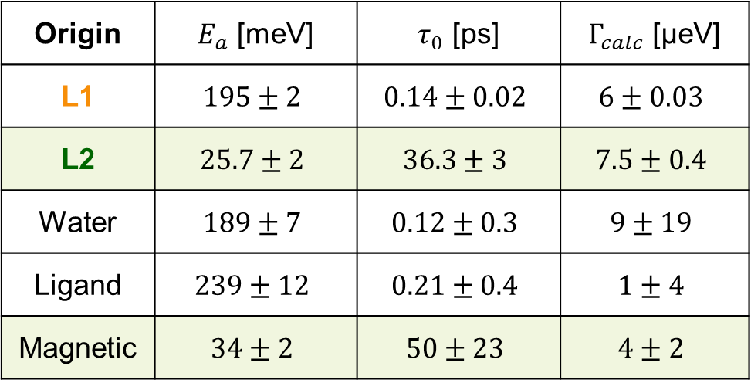
Fit Parameters
Fit parameters for 85% RH sample compared to published results for 8% RH sample at Q14 = 1.62 Å⁻¹
Origin | $E_{a}$ [meV] | $τ_{0}$ [ps] | $Γ_{calc}$ [μeV]
L1 | $$195±2$$ | $$0.14±0.02$$ | $$6±0.03$$
L2 | $$25.7±2$$ | $$36.3±3$$ | $$7.5±0.4$$
Water | $$189±7$$ | $$0.12±0.3$$ | $$9±19$$
Ligand | $$239±12$$ | $$0.21±0.4$$ | $$1±4$$
Magnetic | $$34±2$$ | $$50±23$$ | $$4±2$$
Current work
M. Plekhanov et al., J. Phys. Chem. C 2024
L1 suggests diffusion, ligand contribution is not excluded

Slide 11
Conclusions & Future Directions
EFWS
Summary
Pre-Melting Phase Transition: continuous Arrhenius process is unsuitable
Data Treatment Solution: Splitting into pre- (T < 248 K) and post-transition (T > 258 K) fits; DWF analysis
Outlook
Analysis of D₂O data to separate water and citrate ligand contributions
Model pre-melting phase transition
MD simulations for a better understanding of surface water dynamics at high RH
I [a. u.]
• 0.94 Å⁻¹
• 1.31 Å⁻¹ (Bragg peak)
• 1.62 Å⁻¹
T [K]

Slide 12
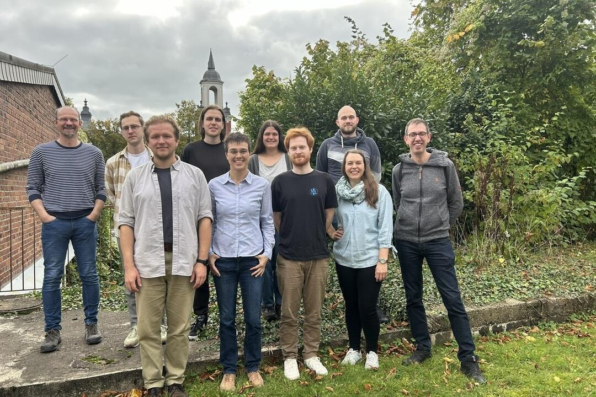


Acknowledgements
IFK and JCNS teams
Mirijam Zobel, Andreas Magerl
DFG (grant nr. ZO 369/3-1)
Markus Appel, ILL
Dieter Richter
Reiner Zorn
Margarita Kruteva
Ralf Biehl
Sascha Ehlert
Thank you!

Slide 13
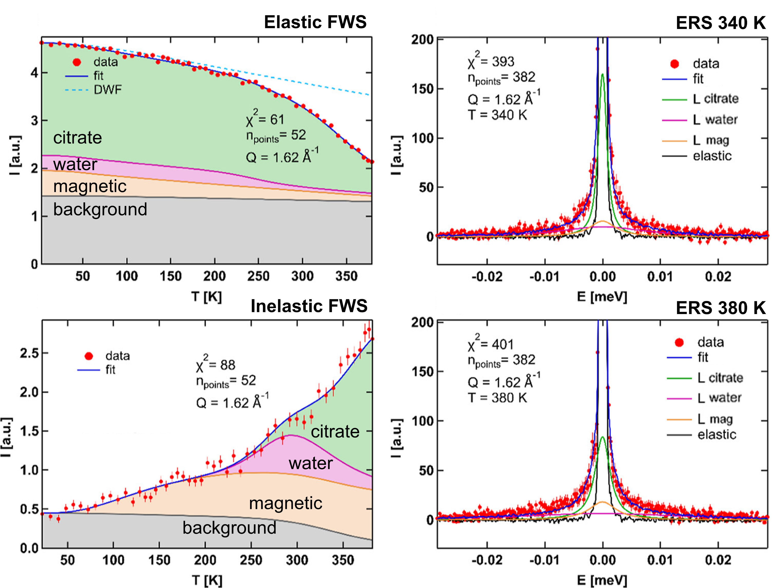
FWS & ERS analysis
Citrate-Capped IONPs at 8% RH: “dry” sample
M. Plekhanov et al., J. Phys. Chem. C 2024
A 3-process model describes the data well in the non-Bragg region.
Q = 1.62 Å⁻¹

Slide 14
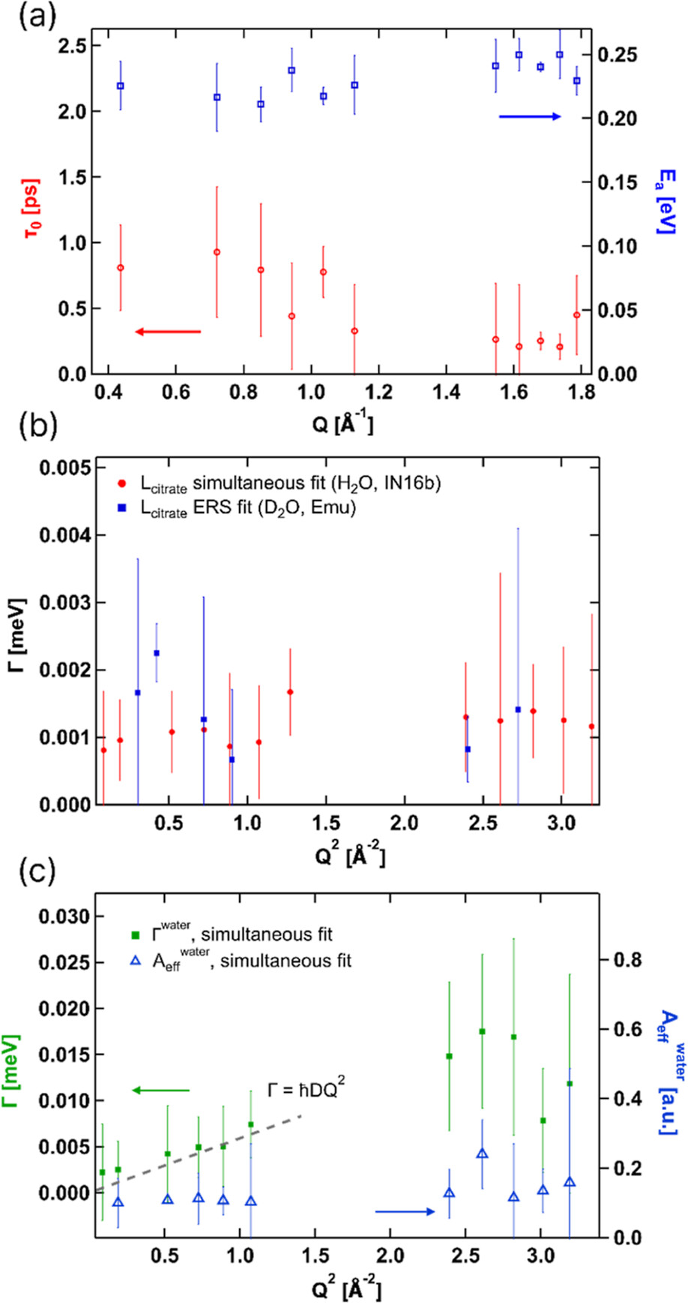
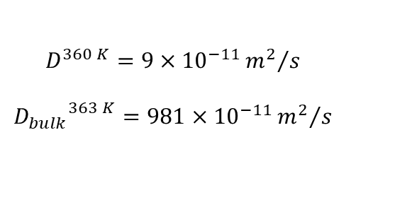
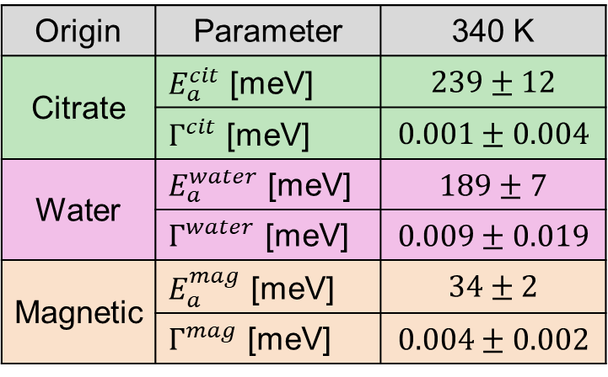


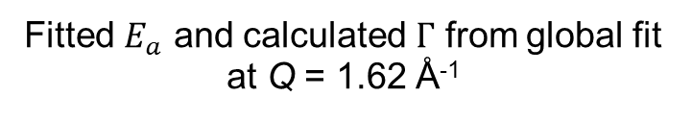
FWS & ERS analysis
Q dependence of citrate $E_{a}$ and $τ_{0}$
Citrate-Capped IONPs at 8% RH: “dry” sample
M. Plekhanov et al., J. Phys. Chem. C 2024
Fitted $E_{a}$ and calculated $Γ$ from global fit at Q = 1.62 Å⁻¹
Origin | Parameter | 340 K
Citrate | $E_{a}^{cit}$ [meV] | $$239±12$$
 | $Γ^{cit}$ [meV] | $$0.001±0.004$$
Water | $E_{a}^{water}$ [meV] | $$189±7$$
 | $Γ^{water}$ [meV] | $$0.009±0.019$$
Magnetic | $E_{a}^{mag}$ [meV] | $$34±2$$
 | $Γ^{mag}$ [meV] | $$0.004±0.002$$
Q² dependence of water $Γ$ and $A_{eff}$
$$D^{360 K}=9×{10}^{−11}{m^{2}}/s$$
$${D_{bulk}}^{363 K}=981×{10}^{−11}{m^{2}}/s$$

Slide 15
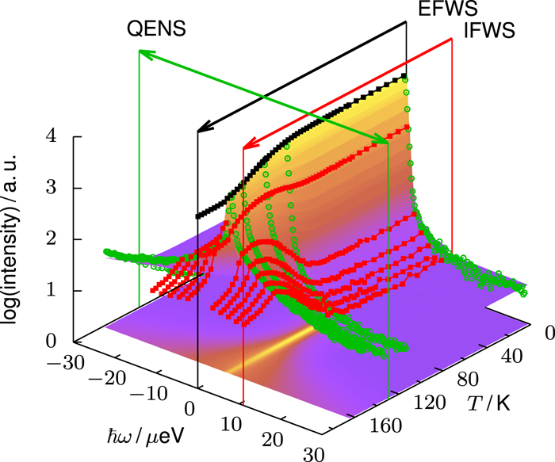
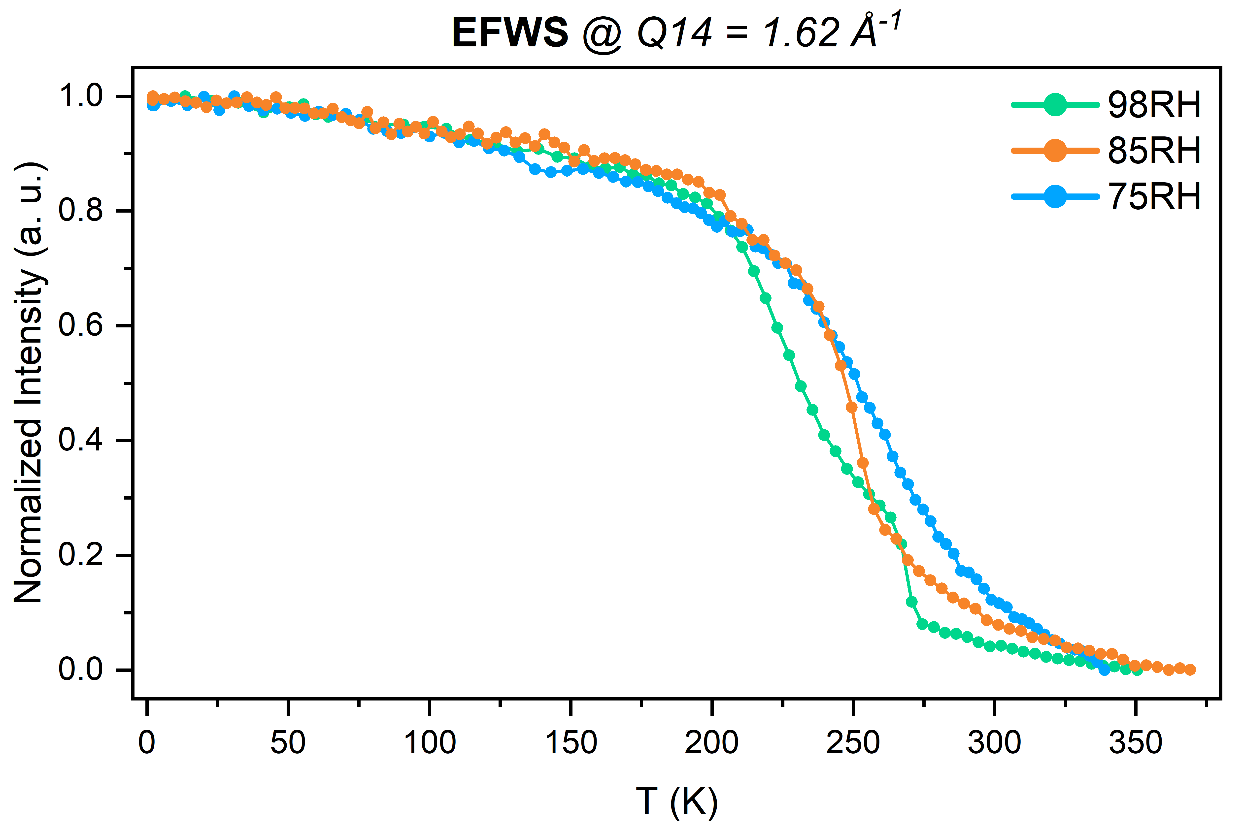
Sample information
Truncated octahedra (∼ 6-7 nm), citrate coverage ∼ 2.8 ligands / nm²
Mixed Fe₃O₄/γ-Fe₂O₃ phases: main magnetic Bragg at Q ≈ 1.31 Å⁻¹ (magnetite), minor maghemite peaks at Q ≈ 1.54 Å⁻¹ and 1.74 Å⁻¹
Fixed-Window Scans (FWS):
• EFWS (ΔE = 0 µeV) & IFWS (ΔE = 3 µeV) from 2 K to 380 K
Energy-Resolved Spectra (ERS):
• BS mode, at 2 K, 150 K, 270 K, 300 K, 360 K

Slide 16
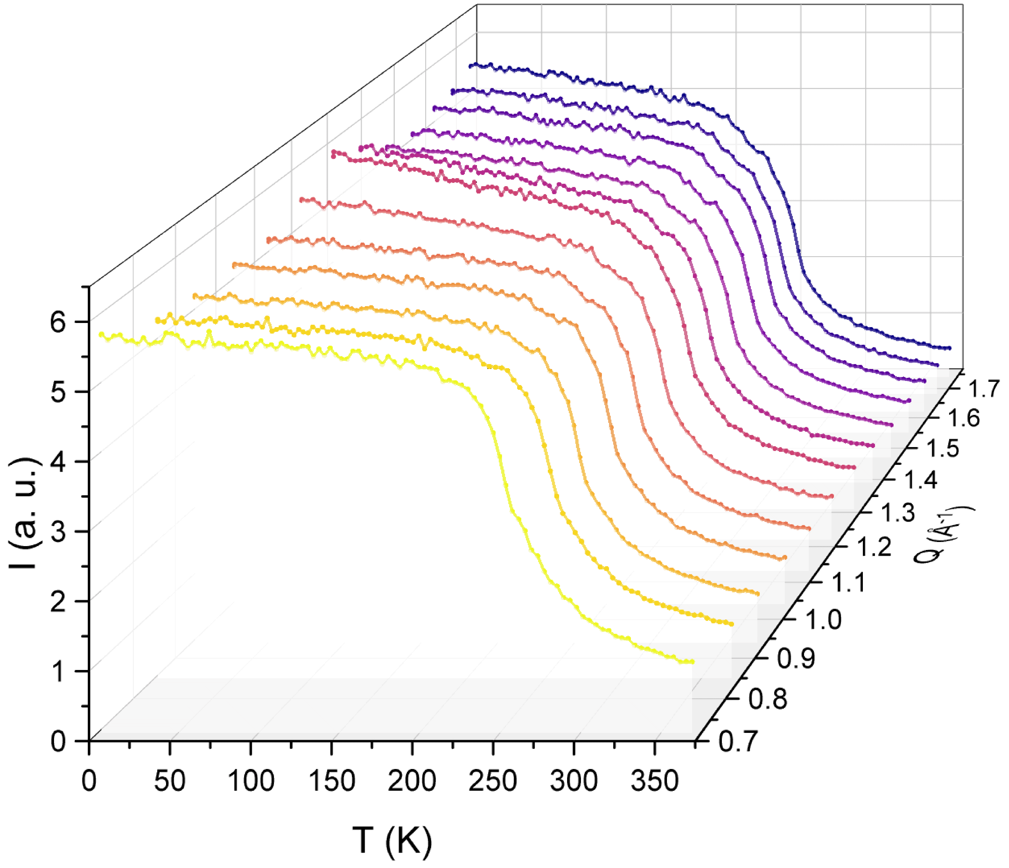
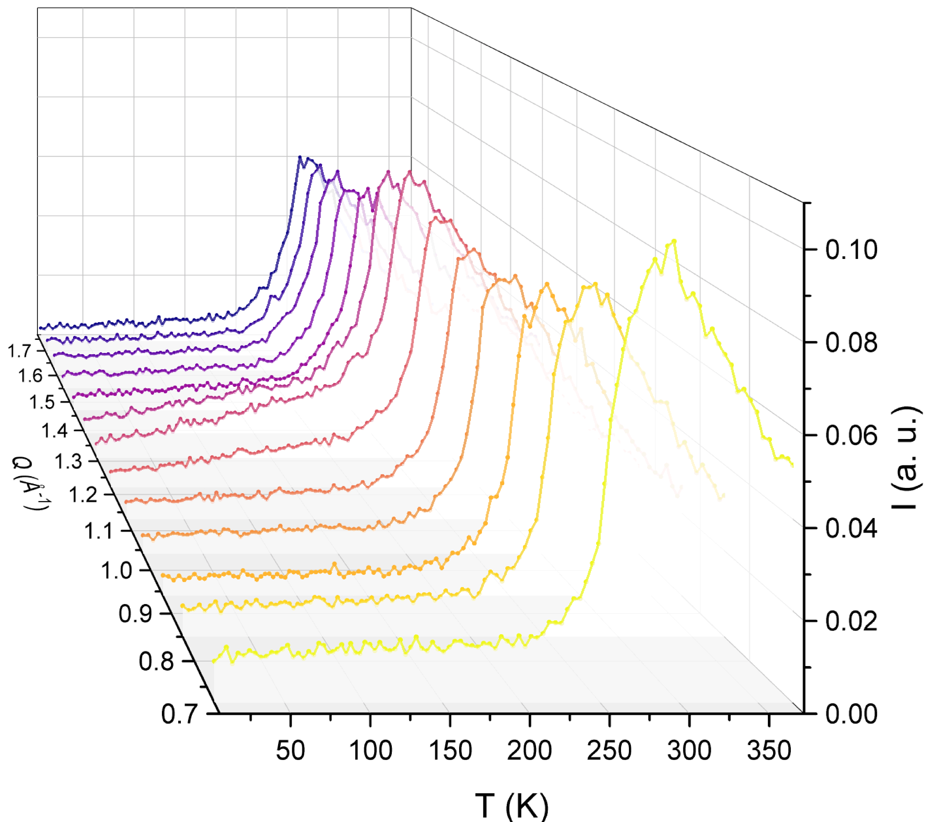


EFWS ($∆E=0$) Q4 – Q16
IFWS ($∆E=3 μeV$) Q4 – Q16

