Slide 1


Potential of neutron spectroscopies in studies of complex hydrides for hydrogen storage applications
Olena Zavorotynska, Associate professor
Department of Mathematics and Physics
University of Stavanger, Norway
NAME, title

Slide 2






Stavanger, Norway
«Three swords» commemorate the historic Battle of Hafrsfjord (y. 872) which united Norway under one crown.

Slide 3

University of Stavanger
20 years
1 900 employees
12 300 students

Slide 4



Department of Mathematics and Physics
Materials’ Physics devision
Helge B. Larsen
(Prof.)
Eva Rauls
(Prof.)
Olena Zavorotynska
(Assoc. Prof.)
x-ray diffraction
materials physics
crystallography
ab-initio modelling
surface physics, defect physics, heterostructures, amorphous materials
synchrotron techniques: XAS, PXRD
Raman spectroscopy
metal hydrides, surface physics, porous materials, functional oxides

Slide 5
Overview
Metal hydrides as hydrogen-carrier media
2. Classification, structure, hydrogen storage properties
3. Applications beyond hydrogen storage
4. Mg(BH₄)₂ : hydrogen storage and electrolyte
5. Mg(BH₄)₂ : insights with neutron spectroscopies
6. Summary

Slide 6
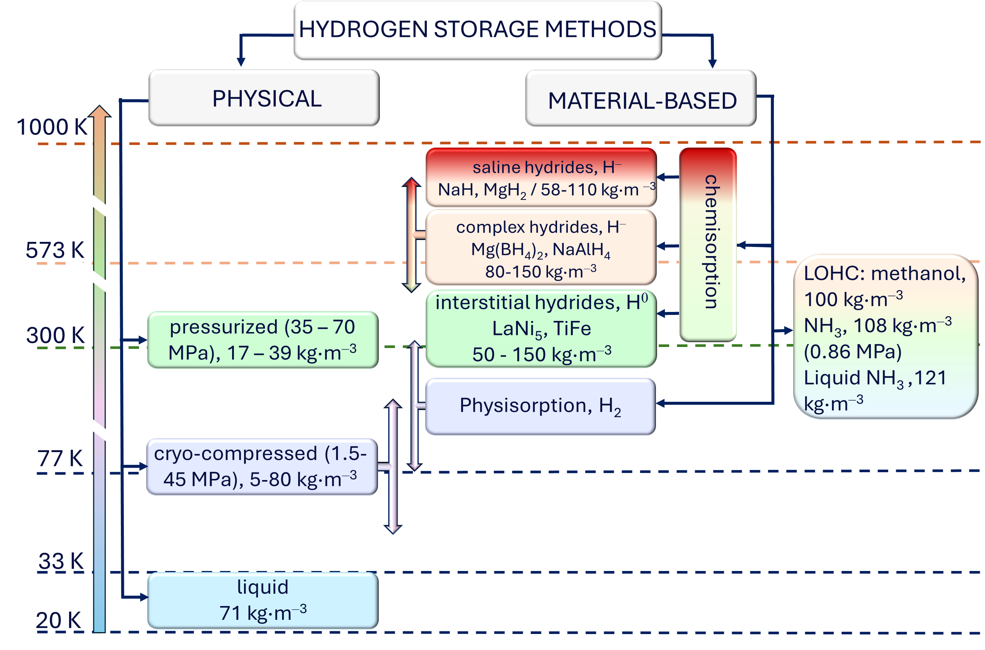
Low H₂ density calls for storage and transportation solutions

Slide 7
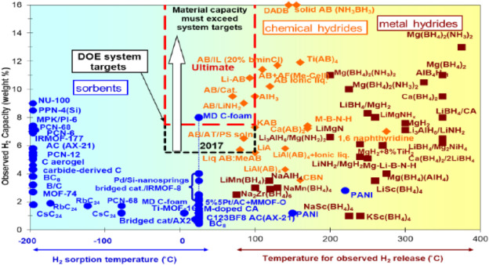
Material-based storage as the alternative to the physical storage
materials-based hydrogen storage aims at outperforming the liquid and high-pressure solutions
Metal hydrides (MH) is a very large class of materials that can offer a wide range of working conditions and gravimetric / volumetric hydrogen densities. New compounds, mixtures, composites are being constantly reported.
more favorable storage T, p
avoid liquefaction and pressurization costs
avoid costly insulating tanks
higher volumetric H-energy densities than that in liquid H₂
Scott McWhorter, et al.Moderate temperature dense phase hydrogen storage materials within the US department of energy (DOE) H2 storage program: trends toward future development
Crystals, 2 (2012), pp. 413-445

Slide 8
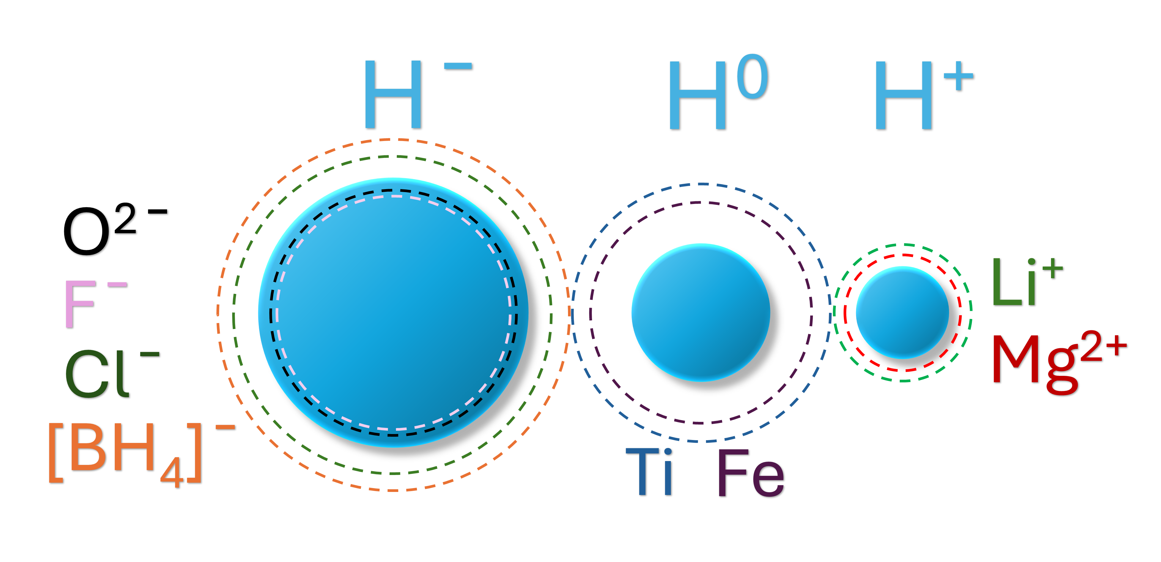
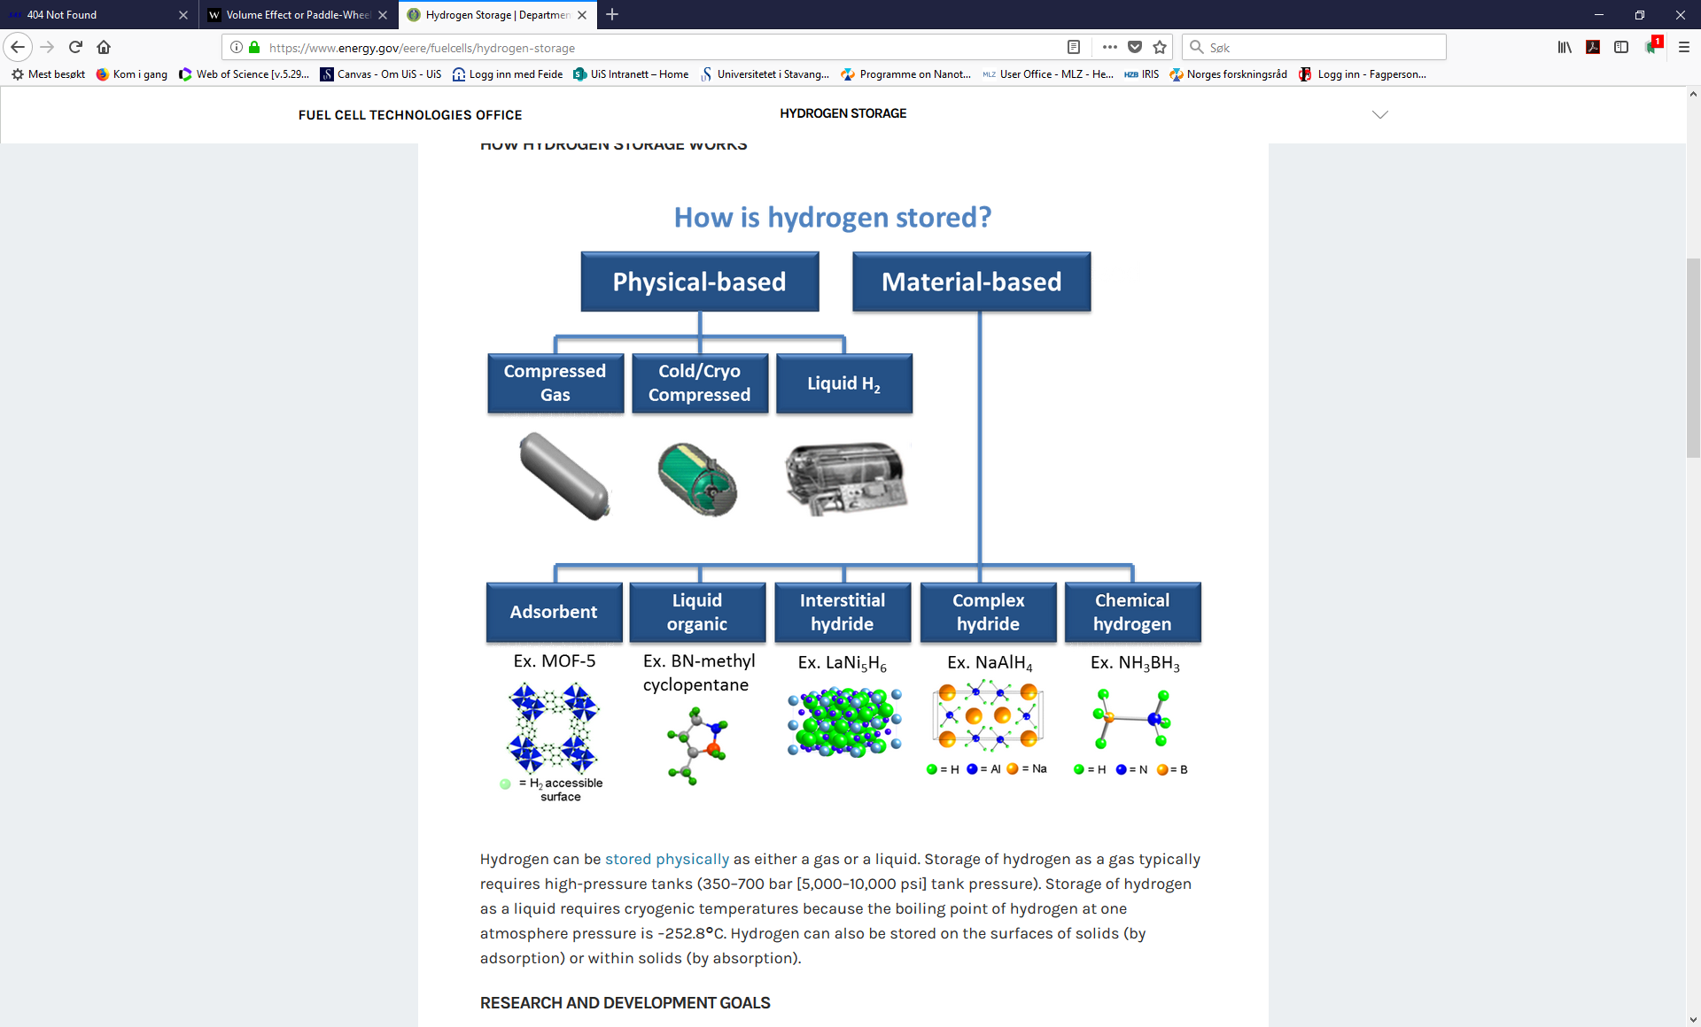



Hydrides for hydrogen storage
Saline
hydride
Complex TM
hydride
LiH, MgH₂, CaH₂…
Mg₂NiH₄, Mg₂FeH₆
operate near RT and at suitable p
fast kinetics of adsorption/desorption
contain plenty of hydrogen per volume
heavy: low wt% of H (1-2 wt%)
expensive/rare transition metals
https://www.energy.gov/eere/fuelcells/hydrogen-storage

Slide 9
Hydrides for hydrogen storage
Saline
hydride
Complex TM
hydride
LiH, MgH₂, CaH₂…
Mg₂NiH₄, Mg₂FeH₆
contain plenty of hydrogen per mass and volume
abundant elements
very stable («bad» thermodynamics)
slow kinetics of H absorption/desorption, complex reaction pathways (complex and chemical hydrides)
hazardous by-products
https://www.energy.gov/eere/fuelcells/hydrogen-storage

Slide 10
MH for hydrogen storage: research directions
Tune / change / enhance thermodynamics and kinetics of H absorption and desorption reactions by:
New structures and synthesis methods
New composites
Find catalysts / additive and understand their effect on absorption/desorption kinetics and reaction pathways
Nanostructuring / dispersion on porous matrix
Understand the fundamentals of H in solids

Slide 11
MH: new horizons
US department of energy notes that “Metal hydrides (MH_{x}) are the most technologically relevant class of hydrogen storage materials for a wide range of applications …*
neutron moderation
Batteries (all solid-state battery, beyond-Li, Mg-battery electrolytes)
thermal storage
heat pumps
smart windows / sensors
purification/separation
superconductivity (near-RT superconductivity was recently achieved in super hydrides)
* (https://www.energy.gov/eere/fuelcells/metal-hydride-storage-materials)

Slide 12
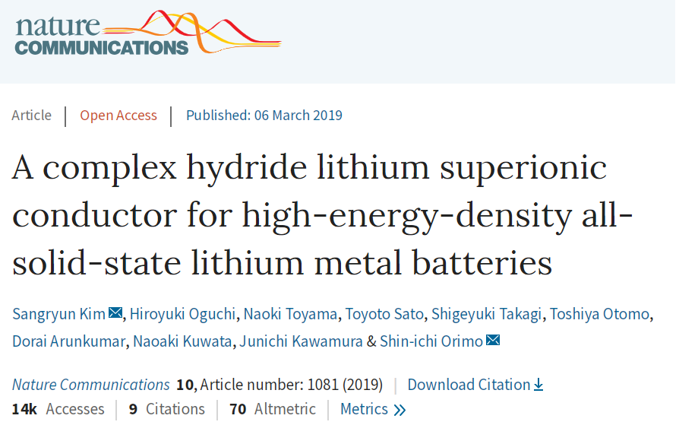
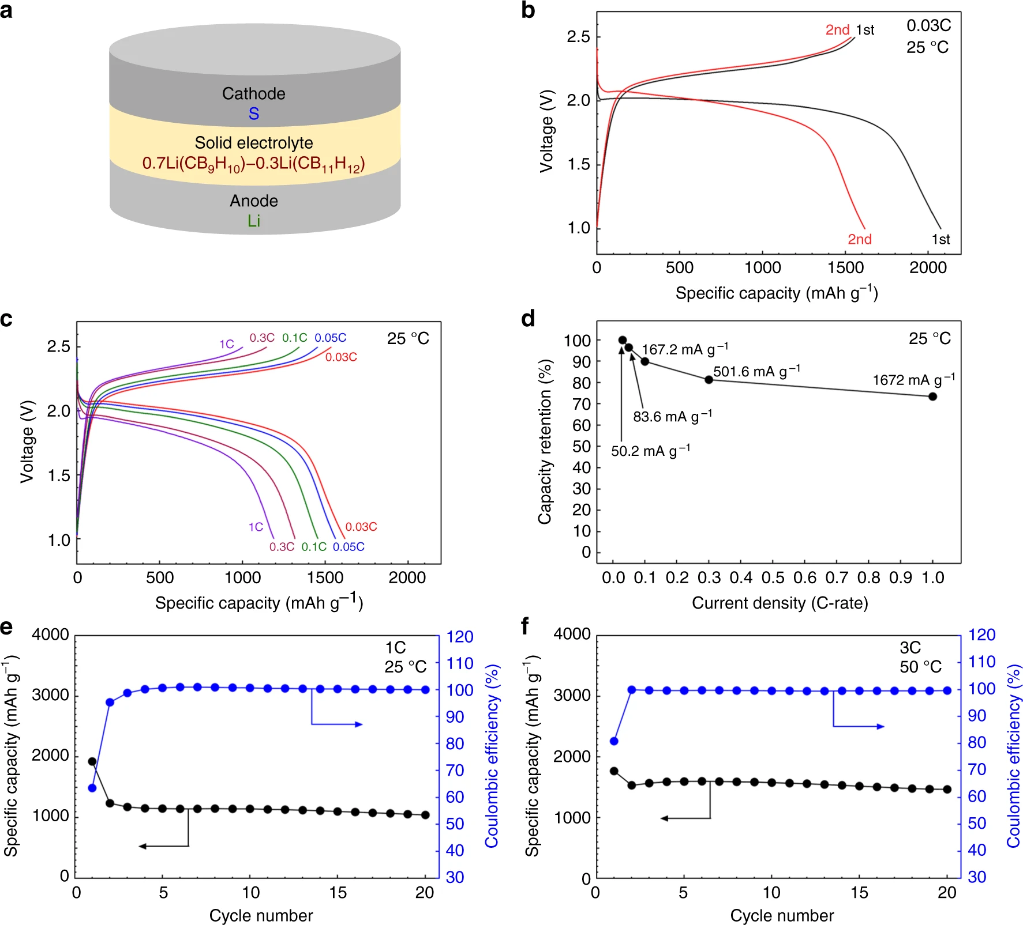
Results:
Electrolyte:
0.7Li(CB₉H₁₀)–0.3Li(CB₁₁H₁₂)
Conductivity:
6.7 × 10⁻³ S cm⁻¹ at 25 °C – highest among all known SS electrolytes
stable for 300 cycles
Motivation:
avoid flammable organic liquid electrolytes
avoid low-capacity carbonaceous anodes
All solid-state battery performance:
Notes:
One recent result I would like to mention here. It was published just recently by the same group in Tohoku University who published the first paper that I showed you a while ago.
They have prepared this complex electrolyte which exhibited best ever conductive properites for the solid-state electrolyte at room temperature. Also this electrolyte was stable for more than three hundred cycles. They have also assembled the battery call which has shown quite interesting properties for 20 cycles.

Slide 13
Why are they ionic conductors?
Cation diffusion is facilitated by:
rotational disorder of [BH₄]─ (or other anions)
formation of metastable interstitial sites
«paddle-wheel» mechanism of cation mobility similar to that in oxides*
Guzik et al., J of Materials Research, 2019, 877; Matsuo et al., Adv. Energy Mater. 1, 161 (2011); Buchter et al., Phys. Rev. B, 78, 094302 (2008); Remhof et al., Phys. Rev. B, 81, 214304 (2010); M. Jansen et al., Angew. Chem., Int. Ed. 30, 1547 (1991)*

Slide 14
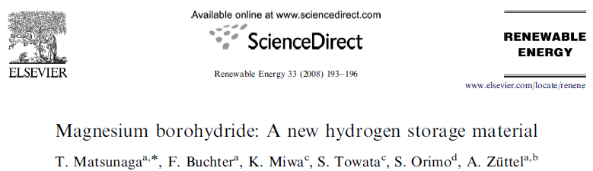
Mg(BH₄)₂ for solid-state hydrogen storage
High hydrogen content (14.8 wt%)
Less stable than LiBH₄
2-steps decomposition process
From theory: decomposition below 100 °C

Slide 15
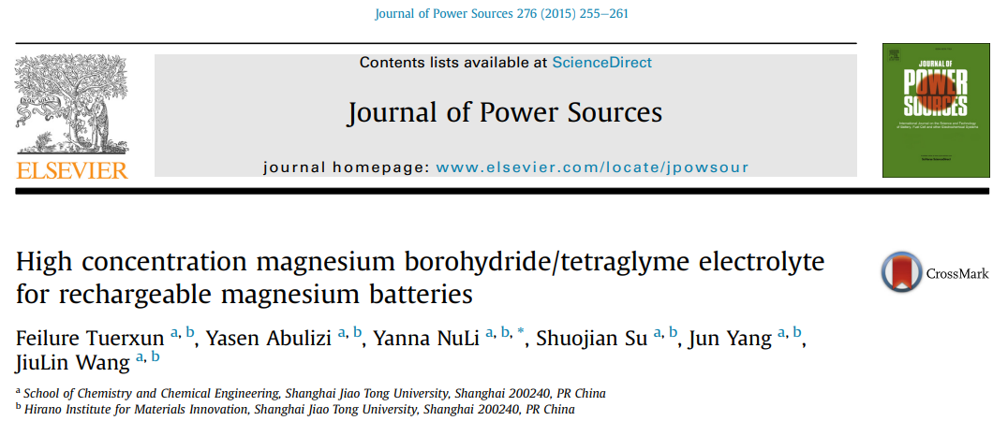


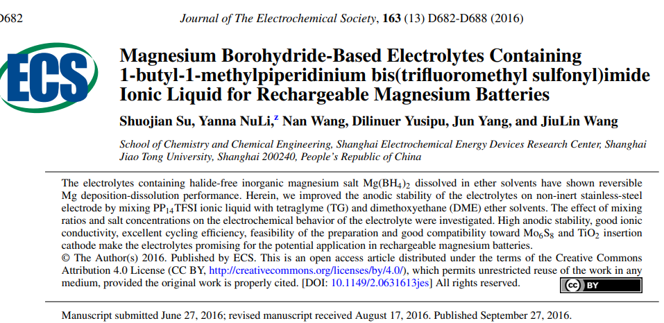
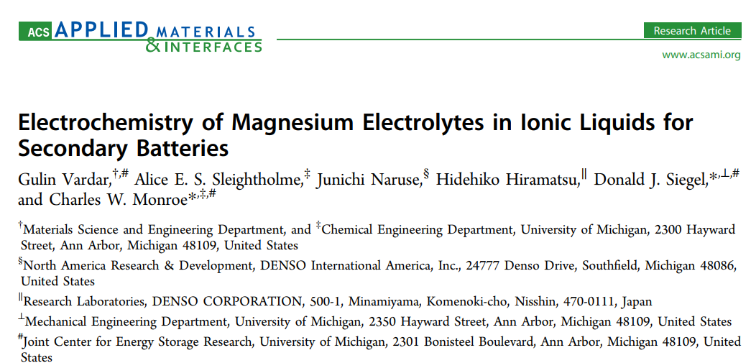

Mg(BH₄)₂ as electrolyte in batteries

Slide 16
Research questions addressed with neutron techniques (so far)
Structure (diffraction)
Vibrational properties (INS)
Rotational dynamics of (BH₄)⁻ and additives in complexes Mg(BH₄)₂ · additive (QENS)
Infiltration into porous matrix (SANS)

Slide 17
Phase polymorphism in Mg(BH₄)₂
Synthesis
150-200ºC
1.1 – 1.6 GPa
γ-Mg(BH₄)₂ Ia-3d
ε-Mg(BH₄)₂ ?
δ-Mg(BH₄)₂ I4₁/acd
(porous, high SSA )
β´-Mg(BH₄)₂ ?
α-Mg(BH₄)₂ P6₁22
amorphous
β-Mg(BH₄)₂ Fddd
ζ-Mg(BH₄)₂ P3₁12
O. Zavorotynska et al. Int. J. of Hydrogen Energy, 2016, 14387-14403
Y. Filinchuk, R. Cerny, H.Hagemann, Chem. Mater. 2009, 21, 925.
Y. Filinchuk, B. Richter, T.R. Jensen, V. Dmitrivev, V. Chernyshov, H. Hagemann, Angew. Chem. Int. Ed. 2011, 50, 11162.
J.-H. Herr, P.W. Stephens, Y.Gao, G-L. Soloveichik, J.Rijssenbeek, M. Andrus, J.-C. Zhao, Acta Crystallogr. Sect B, 2007, 63, 561
B. Richter, D.B. Ravnsbæk, N. Tumanov, et al. Dalton Trans., 44 (2015), pp. 3988-3996.
Notes:
Loads of useful information on structure and related functionality of metal hydrides have have been learnt from neutron studies.
Traditionally it is structure. Neutron diffraction is indispensible to obtain precise positions for hydrogen atoms which for these experiments are substituted by deuterium

Slide 18
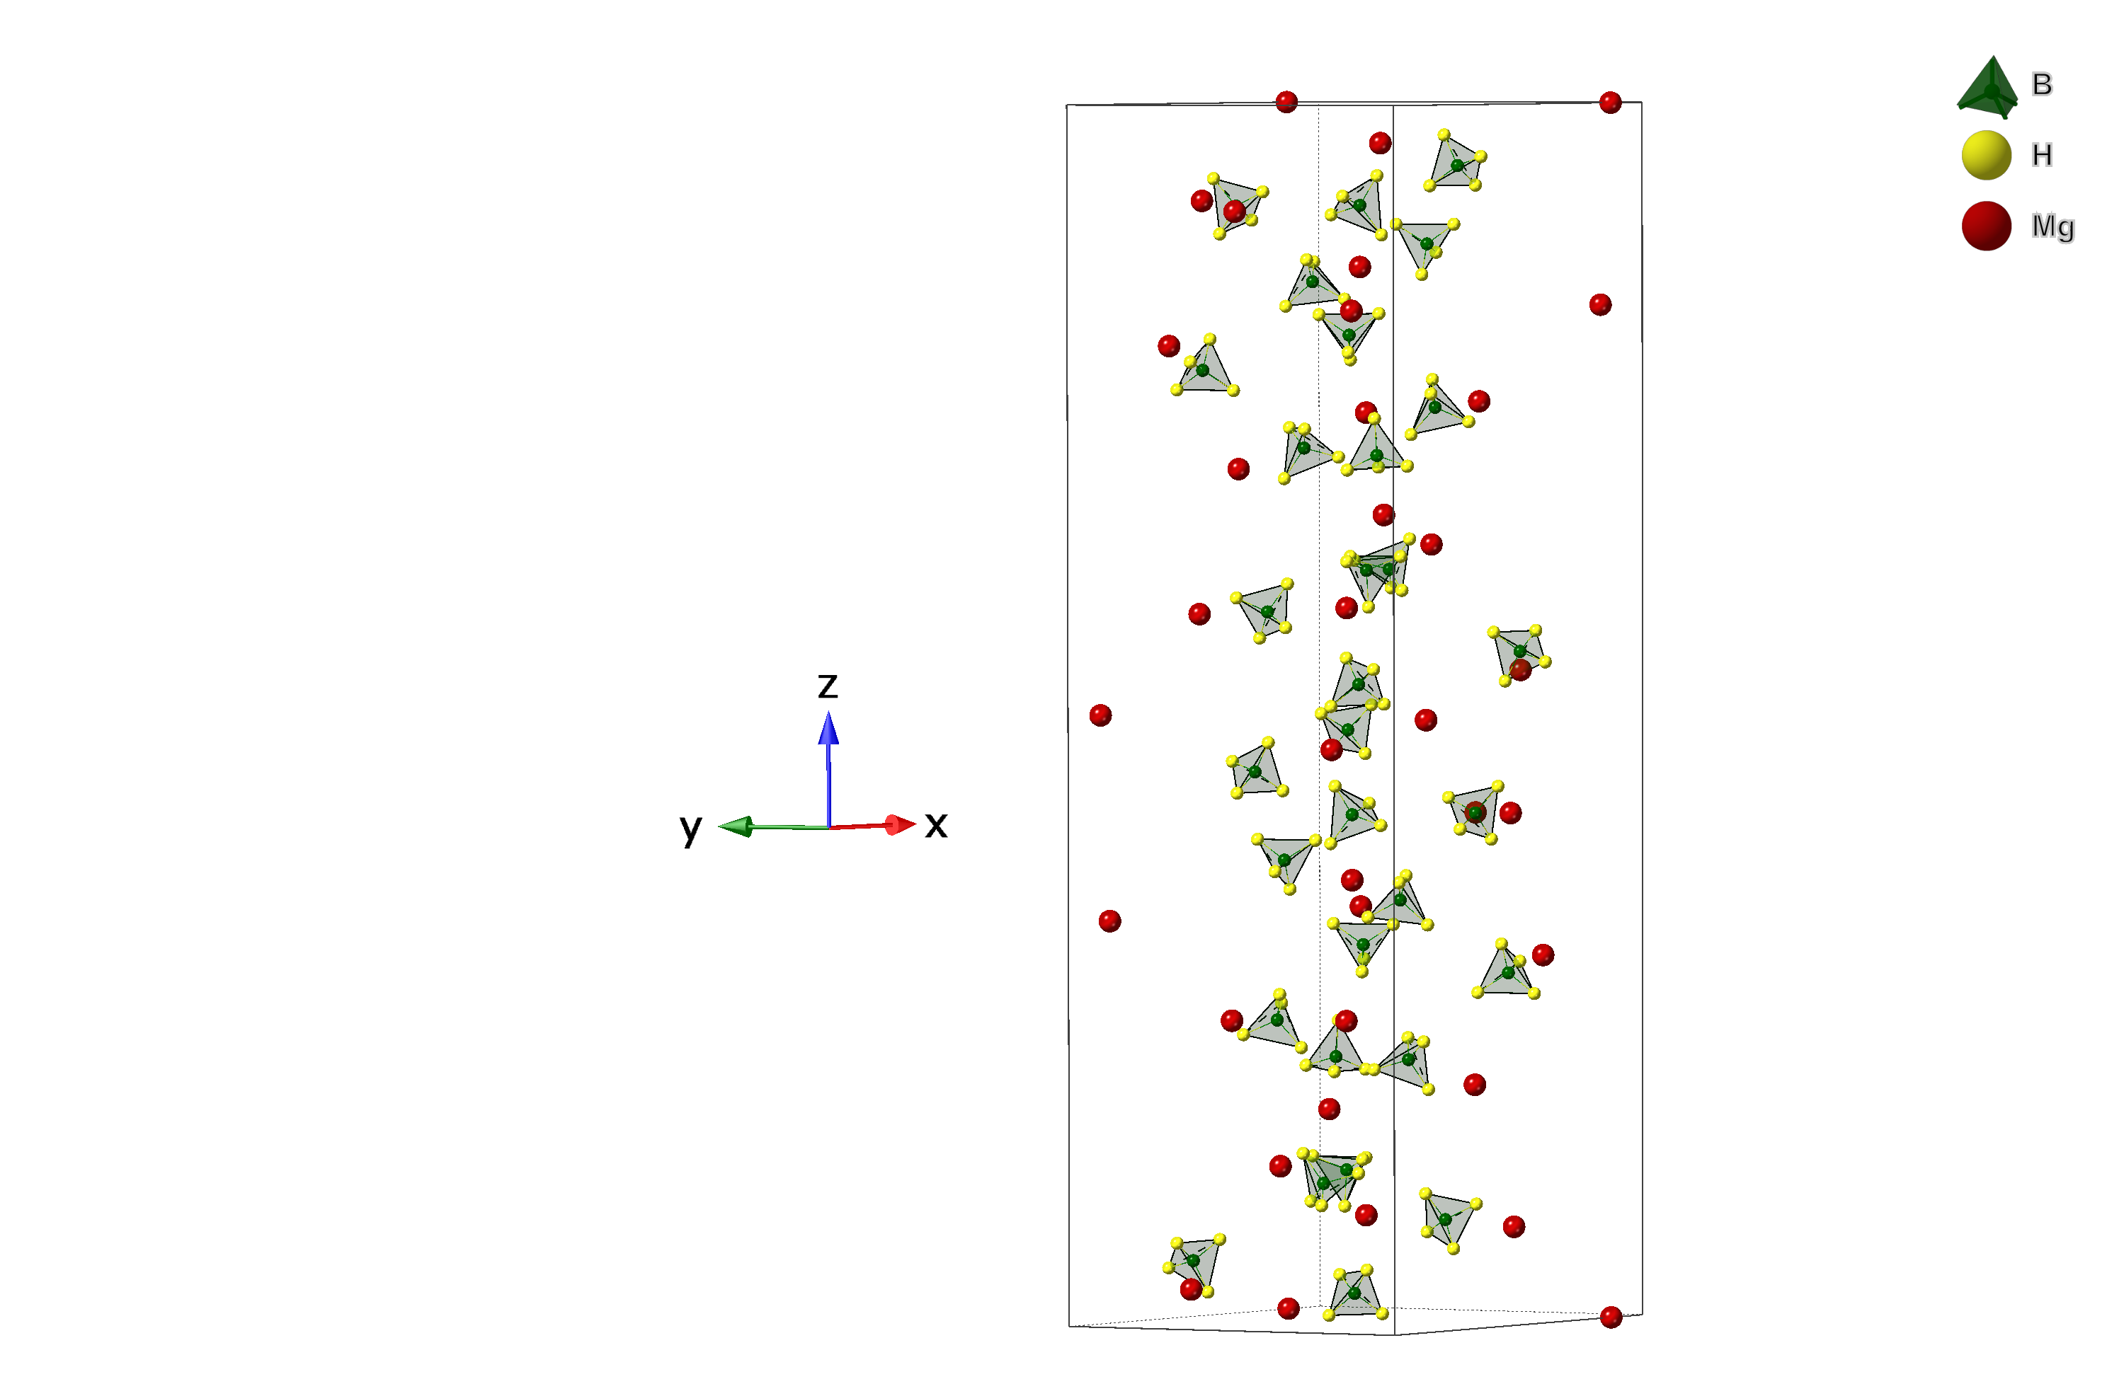
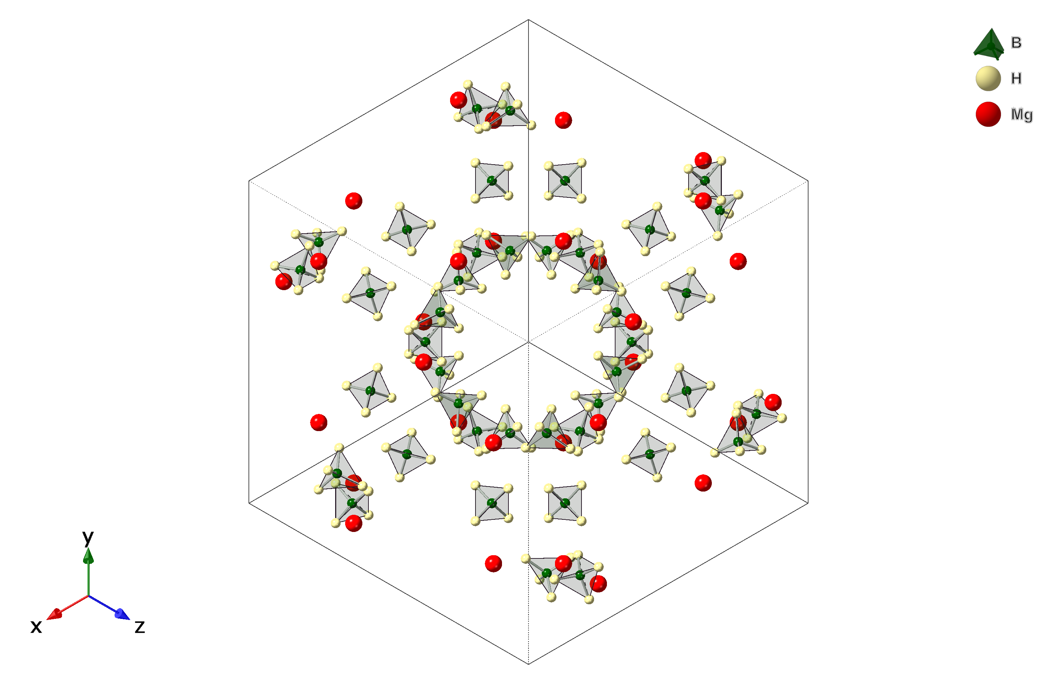
Phase polymorphism in Mg(BH₄)₂
α-Mg(BH₄)₂: P 61 2 2
γ-Mg(BH₄)₂: I a ͞3 d
Notes:
Loads of useful information on structure and related functionality of metal hydrides have have been learnt from neutron studies.
Traditionally it is structure. Neutron diffraction is indispensible to obtain precise positions for hydrogen atoms which for these experiments are substituted by deuterium

Slide 19
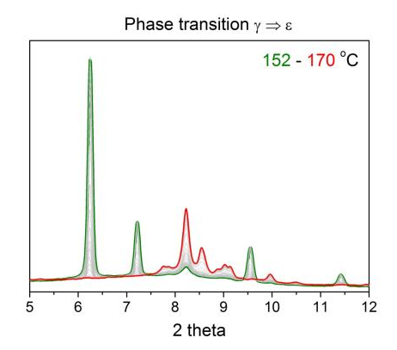
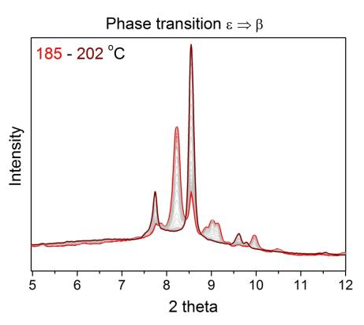
Phase polymorphism and phase transitions in Mg(BH₄)₂
In-situ synchrotron XRD (λ = 0.70135 Å) at 3 bar H₂
γ-Mg(BH₄)₂
ε-Mg(BH₄)₂
ε-Mg(BH₄)₂
β-Mg(BH₄)₂
Zavorotynska, et al., Energies 2015, 8, 9173-9190; doi:10.3390/en8099173
Notes:
Phase transitions can be readily observed by in-situ X-ray diffraction as in this examples: RT gamma phase is transformed to the intermediate epsilon, and then to the stable beta-Mg(BH4)2

Slide 20
Phase polymorphism in Mg(BH₄)₂
Incoherent INS
TOSCA-II, ISIS
Incoherent INS
FANS, NIST-NCNR
Incoherent INS spectra of β-Mg(BH₄)₂
Exp.
BH₄ in lattice
H-B-H bending
Calc.
B-H stretching
Exp.
Exp.
Calc.
Giannasi A. et al. (2010), J. Phys. Chem. A, 114, 2788–2793. Dimitrievska, M., et al. (2016). PCCP 18(36): 25546-25552
Notes:
Loads of useful information on structure and related functionality of metal hydrides have have been learnt from neutron studies.
Traditionally it is structure. Neutron diffraction is indispensible to obtain precise positions for hydrogen atoms which for these experiments are substituted by deuterium

Slide 21
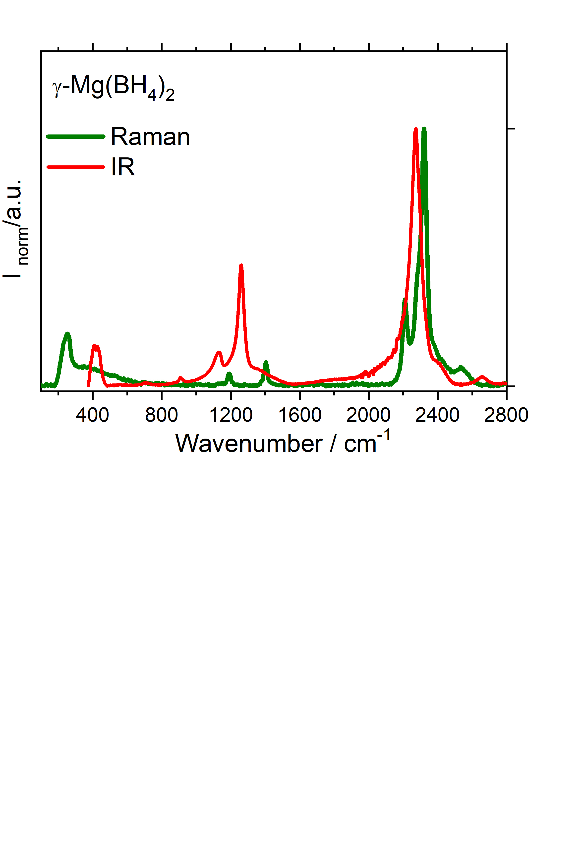
Comparison to Raman and FTIR / γ-Mg(BH₄)₂
Dimitrievska, M., et al. (2016). PCCP 18(36): 25546-25552
Vibrational modes in free (BH₄)²⁻ (T_{d})
C₂
C₃
In solid state (BH₄)²⁻ has C_{s} symmetry and F₂, E mode split
INS with no selection rules detects all librations and split bending modes
Stretching modes are better assessed by FTIR/Raman
Notes:
Loads of useful information on structure and related functionality of metal hydrides have have been learnt from neutron studies.
Traditionally it is structure. Neutron diffraction is indispensible to obtain precise positions for hydrogen atoms which for these experiments are substituted by deuterium

Slide 22
Phase polymorphism in Mg(BH₄)₂
Incoherent INS
TOSCA-II, ISIS
Incoherent INS
FANS, NIST-NCNR
Incoherent INS spectra of β-Mg(BH₄)₂
Exp.
BH₄ in lattice
H-B-H bending
Calc.
B-H stretching
Exp.
Exp.
Calc.
Giannasi A. et al. (2010), J. Phys. Chem. A, 114, 2788–2793. Dimitrievska, M., et al. (2016). PCCP 18(36): 25546-25552
Notes:
Loads of useful information on structure and related functionality of metal hydrides have have been learnt from neutron studies.
Traditionally it is structure. Neutron diffraction is indispensible to obtain precise positions for hydrogen atoms which for these experiments are substituted by deuterium

Slide 23
Mg(BH₄)₂ for hydrogen storage
H2 release pathway is still unclear
Depends on the starting phase and reaction conditions
Some decomposition phases are amorphous that makes it difficult to distinguish with diffraction methods
FTIR/Raman – broad peaks hampers phase identification
Decomposition occurs above 200 C although theoretically predicted at 80 – 100 C
Theoretical assessment depends on the starting phase – importance for correct structure determination
Partially reversible at an intermediate decomposition step at relatively mild conditions (200 – 300 C, 100 – 150 bar)
Decomposition (H2 release) pathway
Zavorotynska et al. Int. J. of Hydrogen Energy, 2016, 14387-14403
Notes:
Loads of useful information on structure and related functionality of metal hydrides have have been learnt from neutron studies.
Traditionally it is structure. Neutron diffraction is indispensible to obtain precise positions for hydrogen atoms which for these experiments are substituted by deuterium

Slide 24
Mg(BH₄)₂ as HS medium
H2 release pathway is still unclear
Depends on the starting phase and reaction conditions
Some decomposition phases are amorphous that makes it difficult to distinguish with diffraction methods
FTIR/Raman – broad peaks hampers phase identification
Decomposition occurs above 200 C although theoretically predicted at 80 – 100 C
Theoretical assessment depends on the starting phase – importance for correct structure determination
Partially reversible at an intermediate decomposition step at relatively mild conditions (200 – 300 C, 100 – 150 bar)
Decomposition (H2 release) pathway:
Example of phase identification with INS
Dimitrievska, M., et al. (2016). PCCP 18(36): 25546-25552
Notes:
Loads of useful information on structure and related functionality of metal hydrides have have been learnt from neutron studies.
Traditionally it is structure. Neutron diffraction is indispensible to obtain precise positions for hydrogen atoms which for these experiments are substituted by deuterium

Slide 25
QENS: reorientational dynamics in β-Mg(BH₄)₂
Incoherent QENS
SPHERES (Leibnitz), MARS (SINQ)
QENS + DFT
QENS is optimal due to large incoherent H2 scattering cross-section of H
Two thermally activated reorientations of the [BH₄]⁻ units, around C₂ and C₃ axes observed at 120 to 440 K
E_{C2} = 39 meV, 76 meV; E_{C3} = 214 meV
Only 15% of [BH₄]⁻ were active at 120 K supposedly those close to Mg-Mg axis
QENS finding in close agreement with DFT calculations
Blanchard, D., et al. (2012). "Hindered Rotational Energy Barriers of BH4- Tetrahedra in β-Mg(BH4)2 from Quasielastic Neutron Scattering and DFT Calculations." Journal of Physical Chemistry C 116(2): 2013-2023.

Slide 26
QENS: reorientational dynamics in β-Mg(BH₄)₂
Incoherent QENS
SPHERES (Leibnitz), MARS (SINQ)
Blanchard, D., et al. (2012). "Hindered Rotational Energy Barriers of BH4- Tetrahedra in β-Mg(BH4)2 from Quasielastic Neutron Scattering and DFT Calculations." Journal of Physical Chemistry C 116(2): 2013-2023.

Slide 27
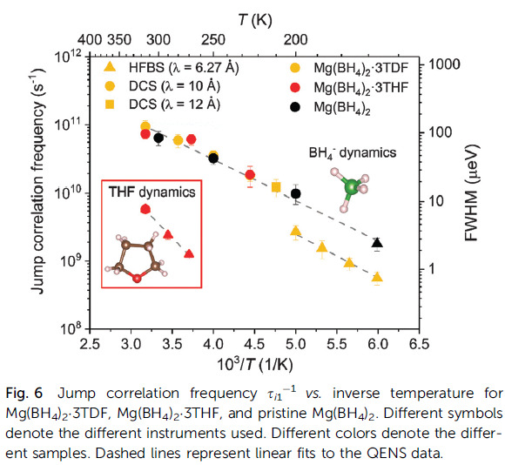
INS + QENS: reorientational dynamics in Mg(¹¹BH₄)₂·3TDF/THF
Instruments: DCS (QENS), HFBS (QENS)
FANS (INS)
THF shows positive effect on dehydrogenation but its role is unknown
Vibrational properties of [BH₄]⁻ are strongly influenced by the THF environment (INS) (symmetry lowering)
Rotations of [BH₄]⁻ around C₂ were NOT affected by presence of THF (QENS)
The majority of the studies of Mg(BH₄)₂ + additives with QENS follow this procedure
Dimitrievska, M., et al. (2020). PCCP ,22: 368.

Slide 28


QENS: reorientational dynamics in Mg(BH₄)₂·additive: correlation with Mg²⁺ conductivity
QENS + INS // DFT + MD
addition of methylamine significantly speeds up the reorientational frequency of the BH₄– anion compared to Mg(BH₄)₂
NH₂ group of the methylamine ligand exhibits much slower reorientation
EIS + PDF + QENS
In amorphous Mg(BH₄)₂ Mg²⁺ conductivity is ~10² times higher than in γ-Mg(BH₄)₂
Local structures are same in 5.1 Å scale
a much larger fraction of activated [BH₄] rotations in amorphous Mg(BH₄)₂ (QENS)

Slide 29
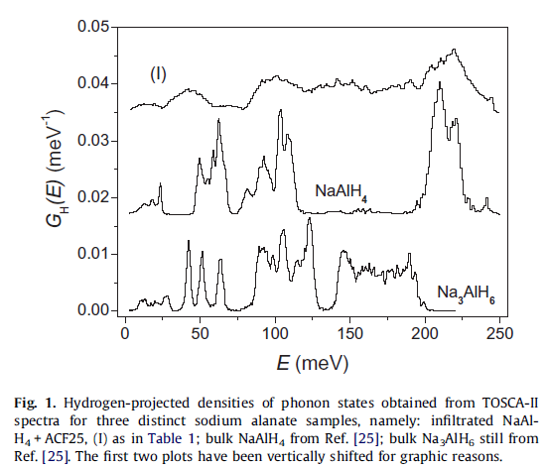
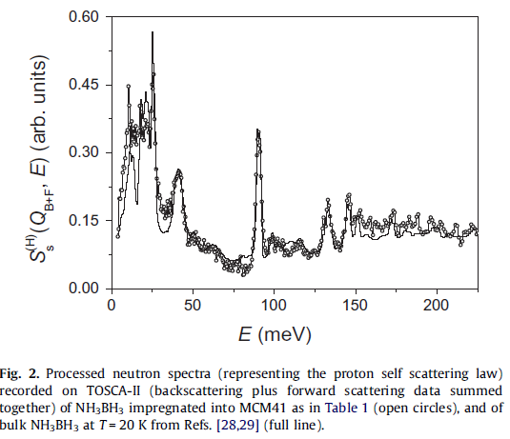
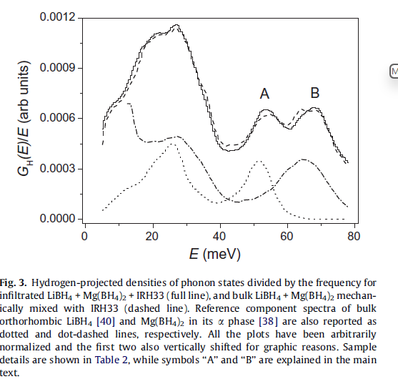
Hydride dispersion in porous matrix (INS)
INS
TOSCA-II, ISIS
IN4C, ILL
Conclusions are based on comparison of INS spectra of bulk hydrides and hydride + porous scaffold composite
Colognesi et al., et al. (2012). JALCOM, 538: 91-99.

Slide 30
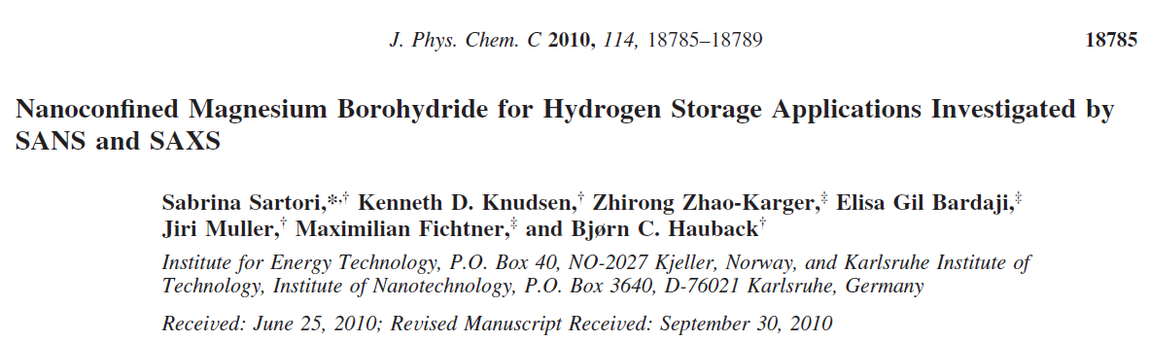
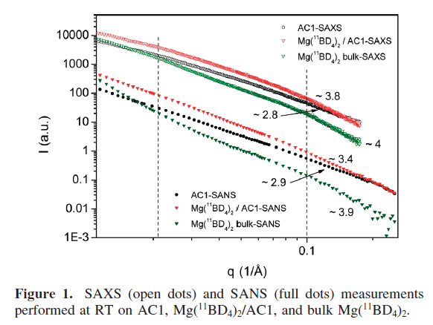
Infiltration into porous matrix (SANS)
Mg(¹¹BD₄)₂ in activated carbon scaffold
Infiltration was shown by SANS measurements
Up to 400 °C the nanoconfined particles maintain their size distribution 1-6 nm
decomposition affects only the morphology of the particle surface

Slide 31
Molecular hydrogen storage in porous complex hydride
INS + neutron diffraction
H2 and N2 occupy distinctly different adsorption sites: 2.33 H2 and 0.66 N2 / Mg(BH4)2.
Extremally high volumetric density of the molecular H2: 144 g / L
Penta-H2 cluster: some H2 molecules rotate, other have a well-defined orientation and a directional interaction with the framework.
Oh, H., et al. (2024). "Small-pore hydridic frameworks store densely packed hydrogen." Nature Chemistry 16(5): 10.

Slide 32
Summary
H-containing compounds are of special interest for neutron studies due to large neutron scattering cross-sections with H
Structure of hydrides is primarily determined by neutron diffraction
INS has been used to study vibrational properties of hydrides and composites. Advantages: no selection rules, emphasized lattice modes, straightforward calculations of the spectra for assignment, cryostat availability. Disadvantages: no selection rules, low-intensity stretching modes, expensive, large amount of sample, long collection times, long idea – experiment time.

Slide 33
Summary
QENS studies of rotational dynamics of (BH₄)⁻ , effect of additives on the dynamics, correlation between rotations and ionic conductivity
INS, SANS: infiltration into porous matrix
Potential for polarized neutron spectroscopy?

Slide 34

Thank you for your attention

