Slide 1
Nuclear quantum effects in liquid water explored using polarized QENS
Miguel A. González
Institut Laue-Langevin, Grenoble (France)

Slide 2

My unsuccesful search of quantum effects in liquid water using D7 and LET
Miguel A. González
Institut Laue-Langevin, Grenoble (France)

Slide 3
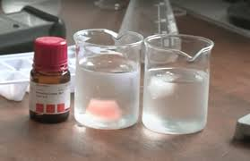
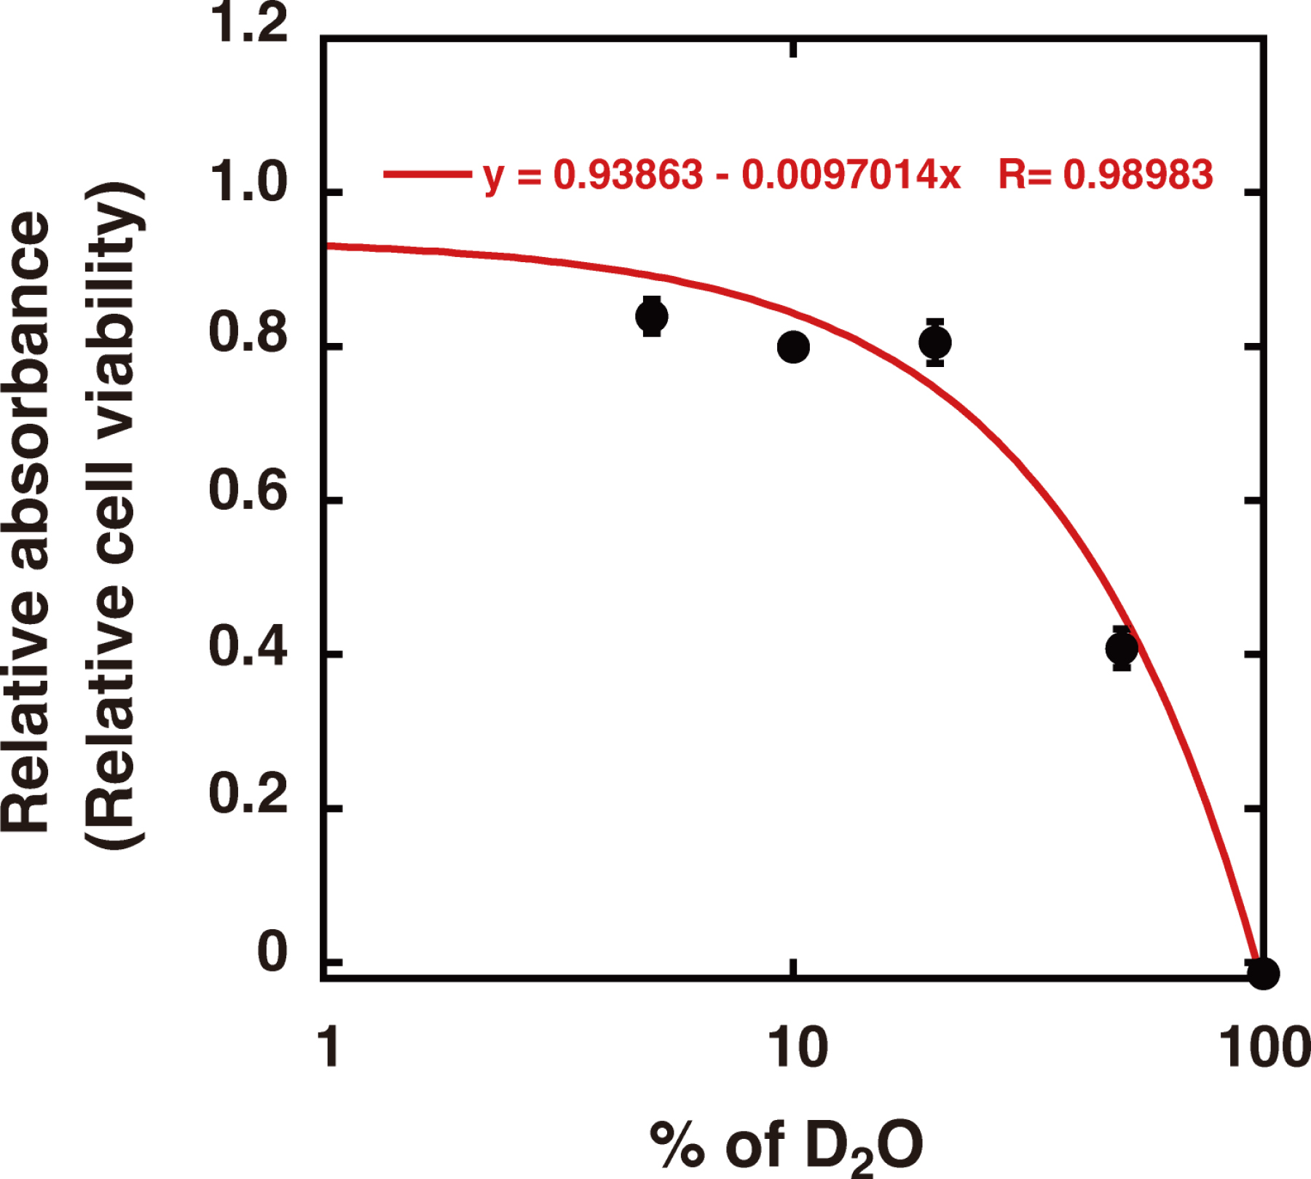
H₂O vs D₂O

Slide 4


Nuclear quantum effects (NQEs)
What is the influence (if any) of NQEs on the structure and dynamics of liquid water?
Competing effects on H-bond network!
$$0.78±0.33 \text{kJ}\text{/}\text{mol}$$
$$0.74±0.20 \text{kJ}\text{/}\text{mol}$$
Chiang et al., Sci. Adv. 11, eadv7218 (2025)

Slide 5
H₂O vs D₂O: Structure
Tomberli et al., J. Phys.: Condens. Matter 12, (2000) 2597-2612
Badyal et al., J. Chem. Phys. 116, 10833 (2002)

Slide 6
H₂O vs D₂O: Structure
Tomberli et al., J. Phys.: Condens. Matter 12, (2000) 2597-2612
Badyal et al., J. Chem. Phys. 116, 10833 (2002)

Slide 7
H₂O vs D₂O: Structure
Soper & Benmore, Phys. Rev. Lett. 101, 065502 (2008)
Zeidler et al., Phys. Rev. Lett. 107, 145501 (2011)

Slide 8
H₂O vs D₂O: Structure
“Thus, even though experiments have consistently found that liquid D₂O is more structured than liquid H₂O, the structural differences between liquid H₂O and D₂O due to nuclear quantum effects remain a subject of vivid discussion up to the present time. This concerns the order of magnitude of isotope effects on the structure and even their sign.”
Stolte et al., J. Phys. Chem. Lett. 2024, 15, 12144
Kim et al., Phys. Rev. Lett. 119, 075502 (2017)

Slide 9
H₂O vs D₂O: Dynamics
Ceriotti et al., Chem. Rev. 2016, 116, 7529

Slide 10
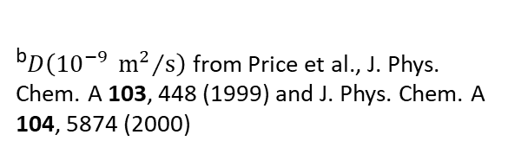
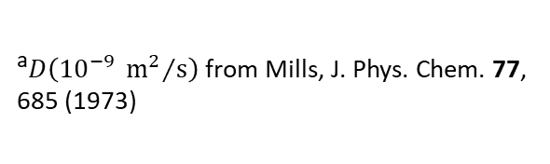
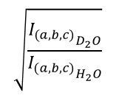
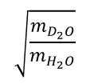
H₂O vs D₂O: Dynamics
T/K | D(H₂O) | D(D₂O) | Ratio
298 | 2.299ª | 1.872ª | 1.23
 | 2.300^{b} | 1.768^{b} | 1.30
278 | 1.313ª | 1.015ª | 1.29
 | 1.25^{b} | 0.94^{b} | 1.33
D_{t}(NMR)
$$\sqrt{\frac{{I_{(a,b,c)}}_{D_{2}O}}{{I_{(a,b,c)}}_{H_{2}O}}}$$
dielec
D_{r}(NMR)
D_{t}(NMR)
ª$D\left({10}^{−9} {{\text{m}}^{2}}/{\text{s}}\right)$ from Mills, J. Phys. Chem. 77, 685 (1973)
η
$$\sqrt{\frac{m_{D_{2}O}}{m_{H_{2}O}}}$$
^{b}$D\left({10}^{−9} {{\text{m}}^{2}}/{\text{s}}\right)$ from Price et al., J. Phys. Chem. A 103, 448 (1999) and J. Phys. Chem. A 104, 5874 (2000)
Hardy et al., J. Chem. Phys. 114, 3174 (2001)

Slide 11
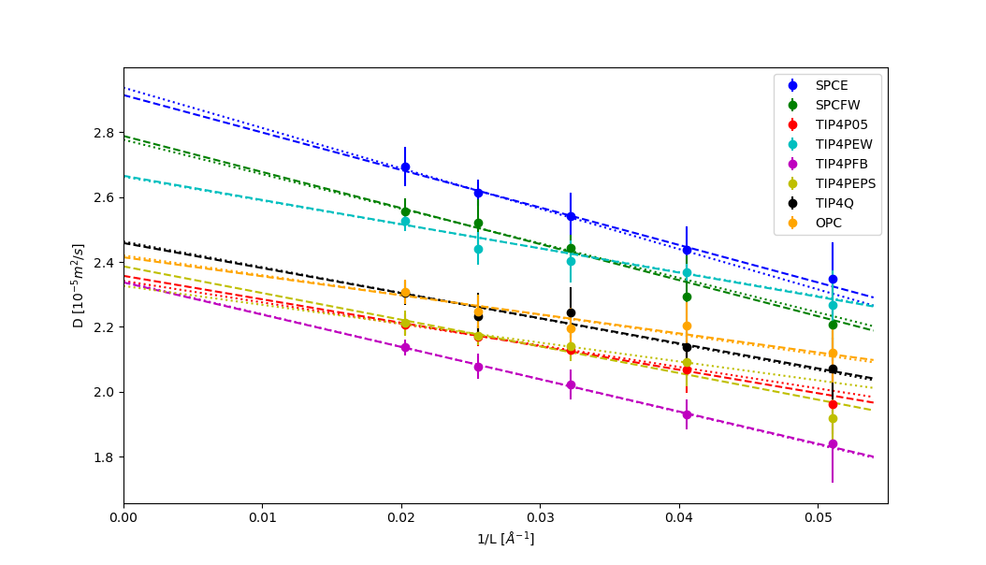
H₂O vs D₂O: Classical MD
Model | D (H2O) | D_(D2O) | Ratio
SPCE | 2.94 ± 0.12 | 2.47 ± 0.12 | 1.19 ± 0.08
SPCFW | 2.78 ± 0.12 | 2.30 ± 0.10 | 1.21 ± 0.07
TIP4P05 | 2.34 ± 0.09 | 2.11 ± 0.07 | 1.11 ± 0.05
TIP4PEW | 2.66 ± 0.07 | 2.42 ± 0.10 | 1.10 ± 0.05
TIP4PFB | 2.34 ± 0.07 | 1.99 ± 0.07 | 1.18 ± 0.05
TIP4PEPS | 2.33 ± 0.10 | 2.12 ± 0.08 | 1.10 ± 0.06
TIP4Q | 2.46 ± 0.09 | 2.18 ± 0.08 | 1.13 ± 0.05
OPC | 2.42 ± 0.10 | 2.16 ± 0.08 | 1.12 ± 0.06
Model | τ_{r}/ps (H2O) | τ_{r}/ps (D2O) | Ratio
SPCE | 1.752 ± 0.003 | 2.019 ± 0.003 | 1.152 ± 0.003
SPCFW | 2.030 ± 0.004 | 2.370 ± 0.006 | 1.167 ± 0.004
TIP4P05 | 2.148 ± 0.003 | 2.429 ± 0.003 | 1.131 ± 0.002
TIP4PEW | 1.882 ± 0.003 | 2.138 ± 0.003 | 1.136 ± 0.002
TIP4PFB | 2.222 ± 0.003 | 2.531 ± 0.004 | 1.139 ± 0.002
TIP4PEPS | 2.066 ± 0.003 | 2.364 ± 0.003 | 1.144 ± 0.002
TIP4Q | 1.995 ± 0.003 | 2.272 ± 0.003 | 1.139 ± 0.002
OPC | 1.929 ± 0.003 | 2.207 ± 0.003 | 1.144 ± 0.002

Slide 12
H₂O vs D₂O: Quantum simulations
Path Integral methods well stablished to compute static properties, but much less reliable to simulate time-dependent properties.
Predictions vary significantly depending on the force field or DFT approach used.
Overall simulations disagree on the magnitude and sign of H/D isotope effects on the structure of liquid water.
But RPMD using a NN potential to reproduce high accurate electronic calculations is able to reproduce very well available experimental data:
Stolte et al., J. Phys. Chem. Lett. 2024, 15, 12144

Slide 13
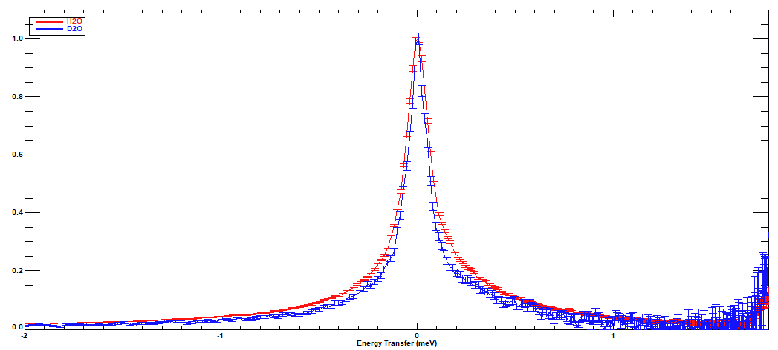
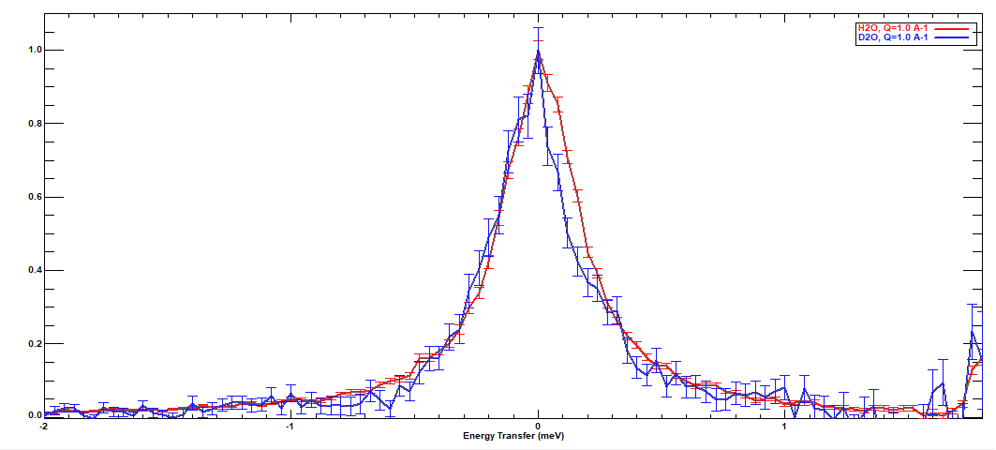
A first try in D7
D7 (2019)
× 10
D007 (2026)

Slide 14
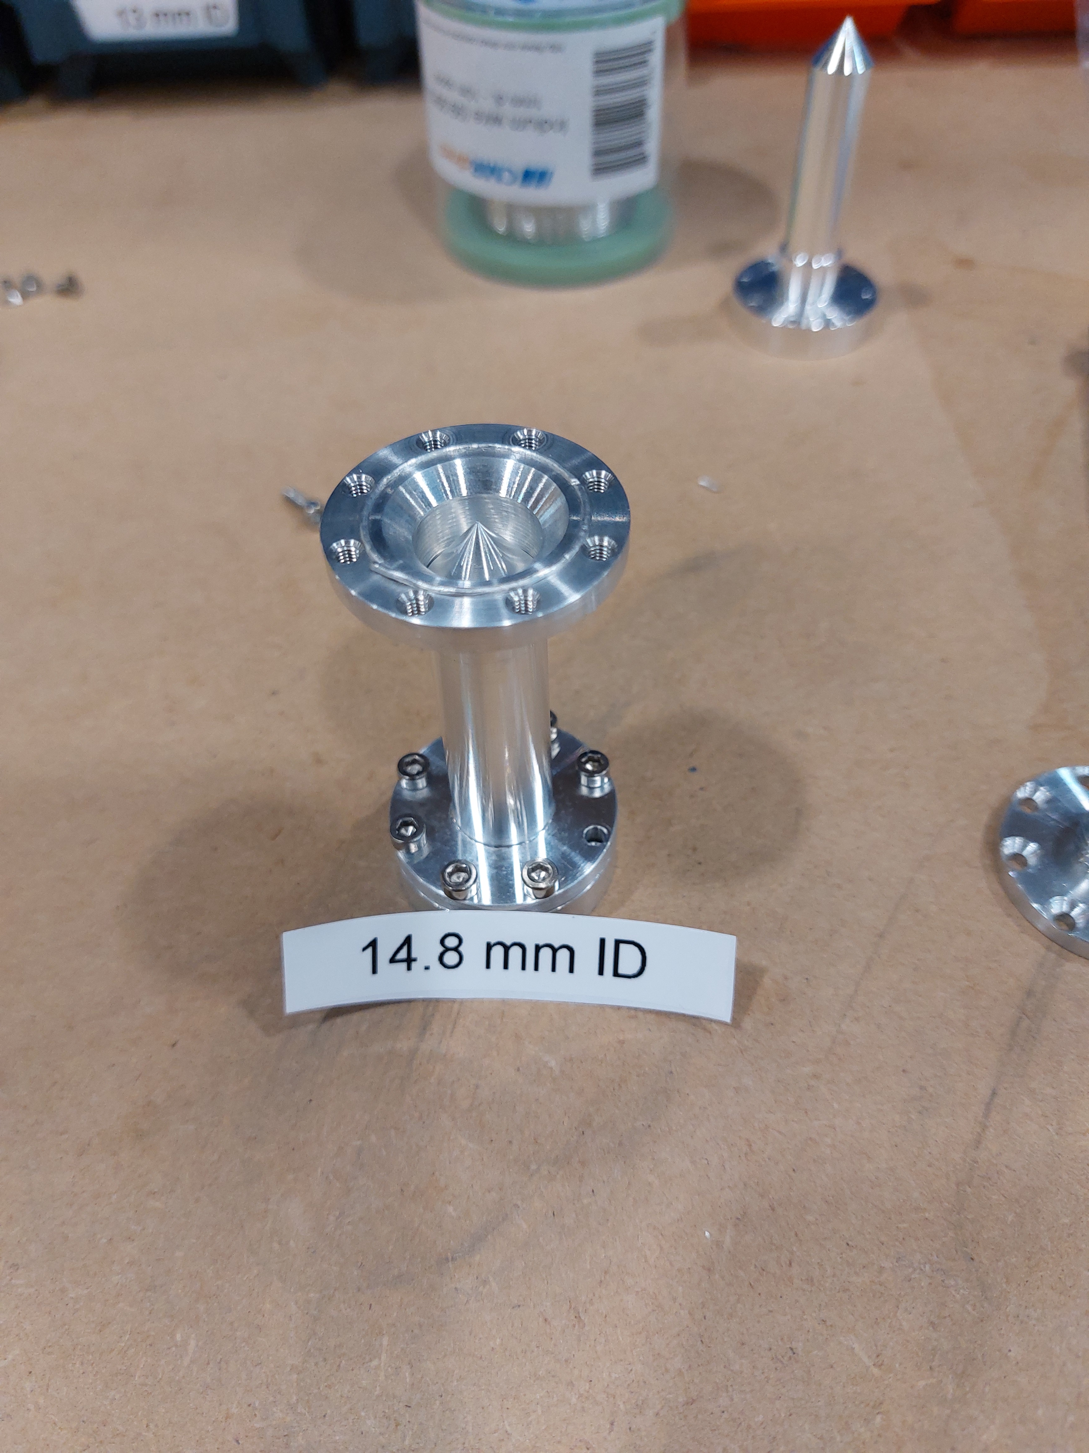
LET experiment
E_{i} = 1.05, 1.81, 3.84, (12.9) meV
H₂O, d=0.2 mm, T_{theo}=0.89
D₂O, d=2.0 mm, T_{theo}=0.92
T=278 K,
~18 hours each sample
Cassella et al., J. Phys.: Conference Series 1316 (2019) 012007

Slide 15
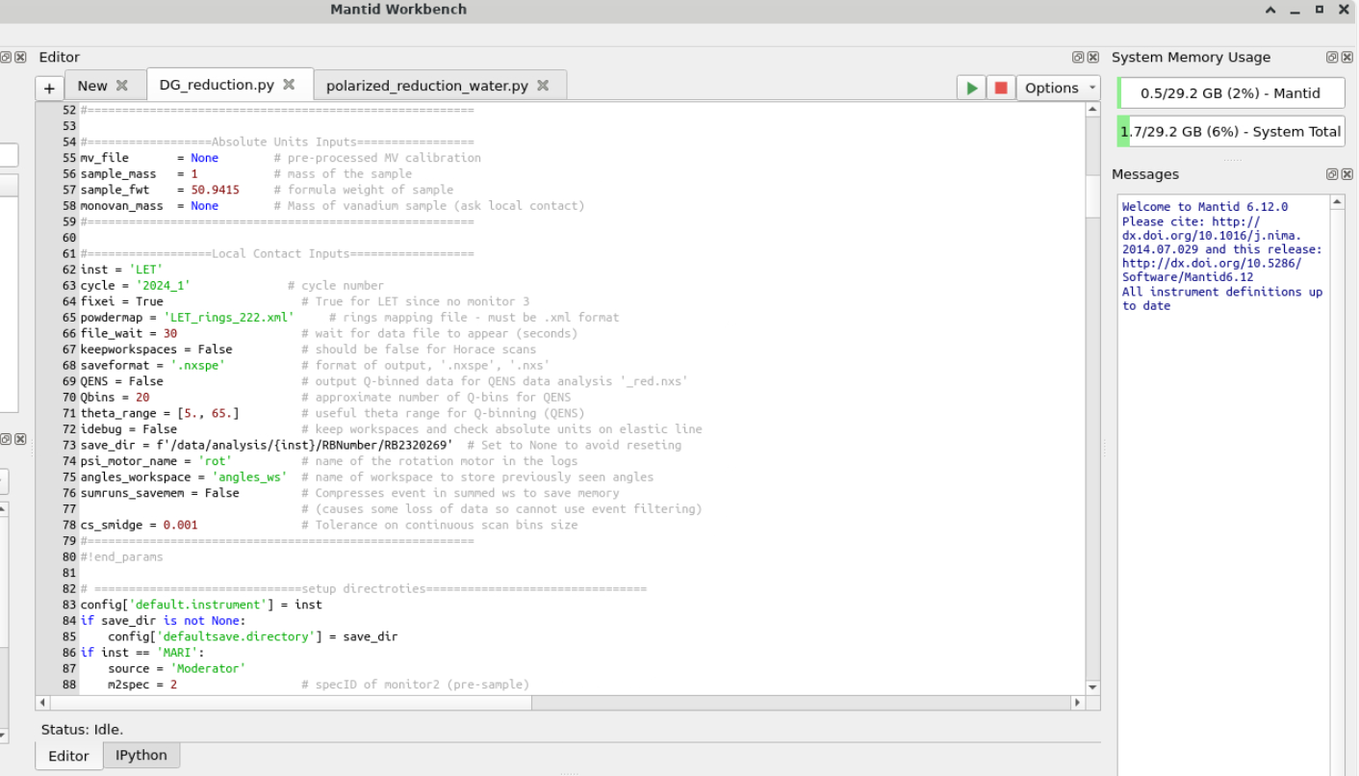
LET: Standard reduction using Mantid
Normalize by current
Normalize by ‘white vanadium’
Mask detectors
Convert to E-transfer
Correct detector efficiency (E)
Correct k_{i}/k_{f}
Group detectors
Correct polarization efficiency
Get incoherent and coherent contributions

Slide 16
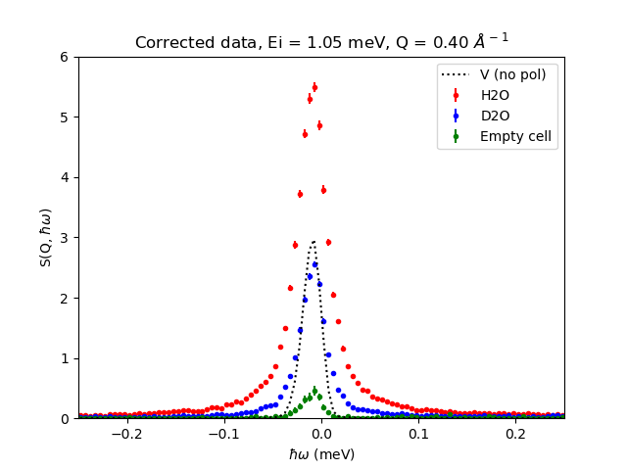
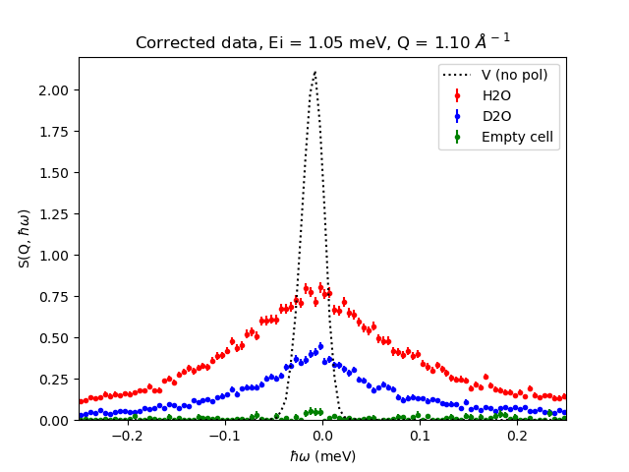
LET: Incoherent “raw” data

Slide 17
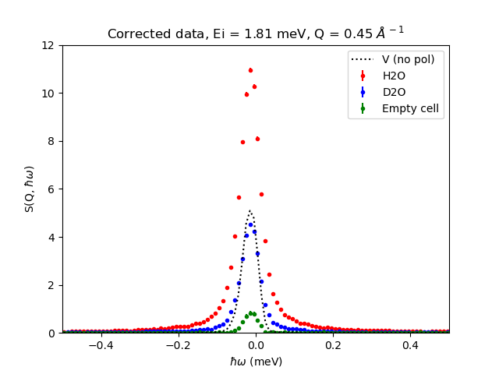
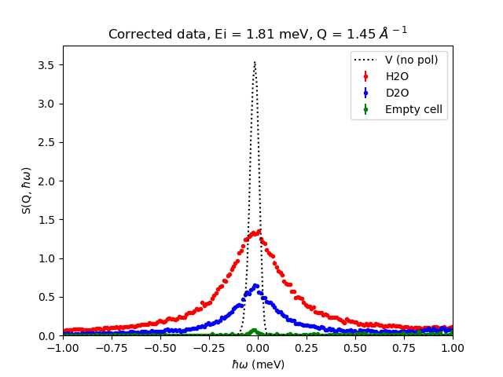
LET: Incoherent “raw” data

Slide 18
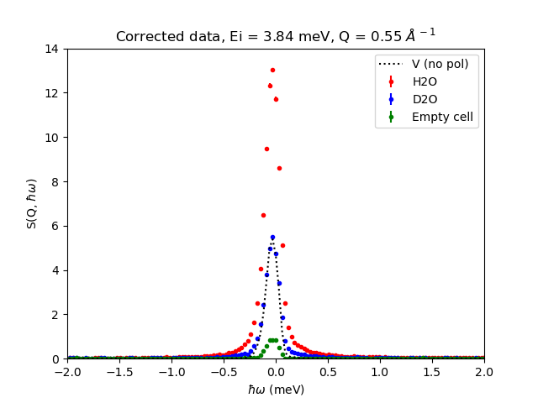
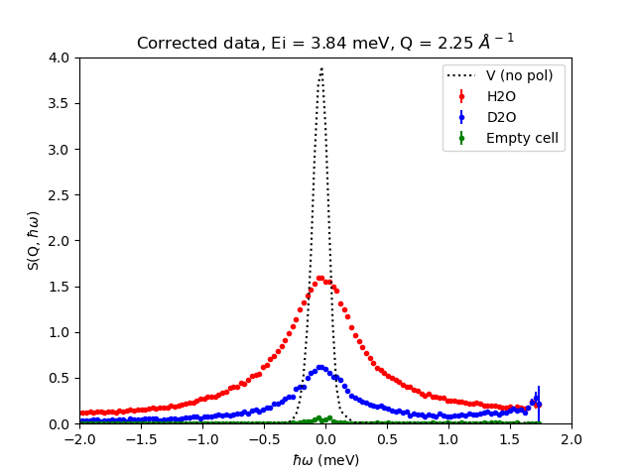
LET: Incoherent “raw” data

Slide 19
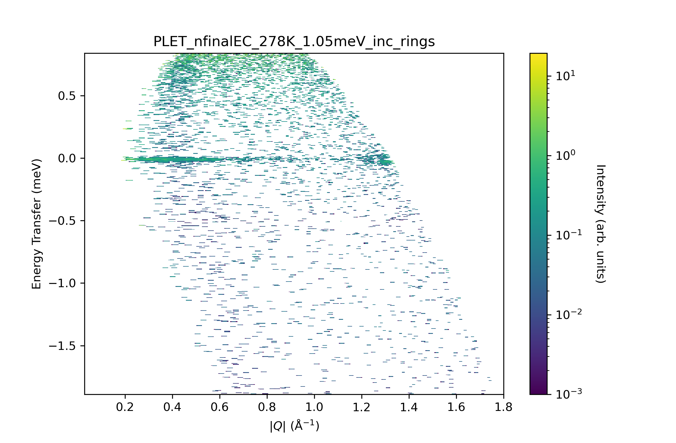
LET: Empty cell

Slide 20
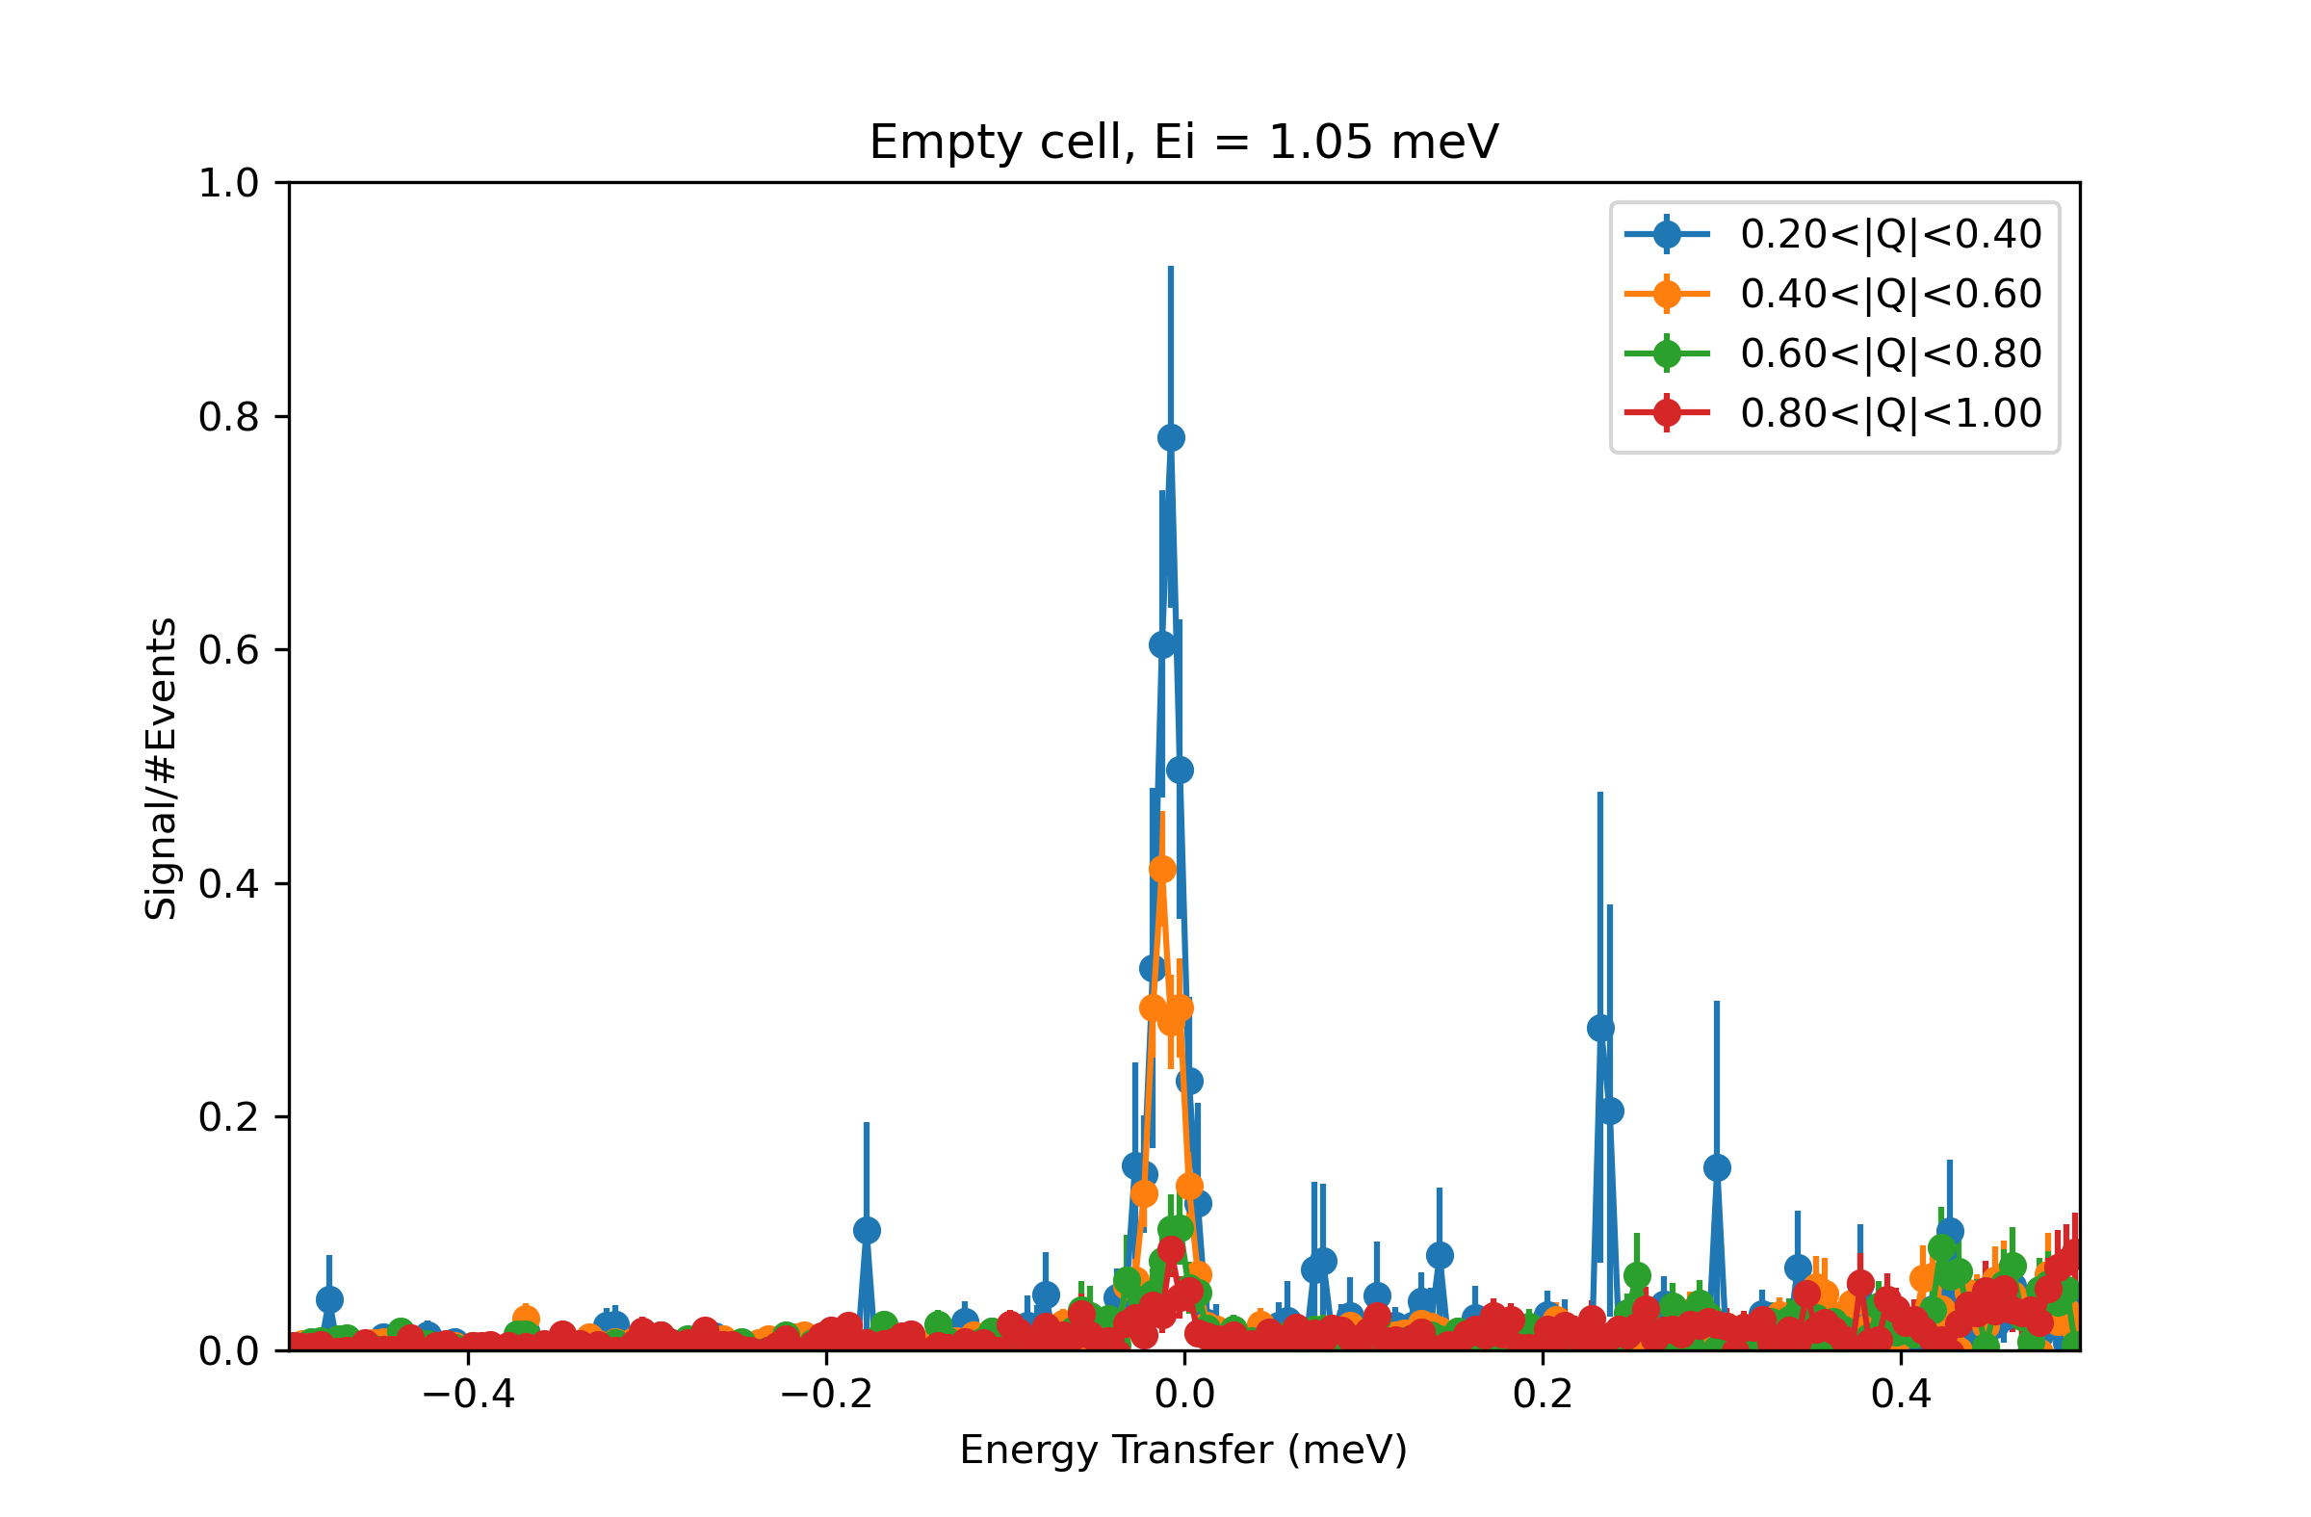
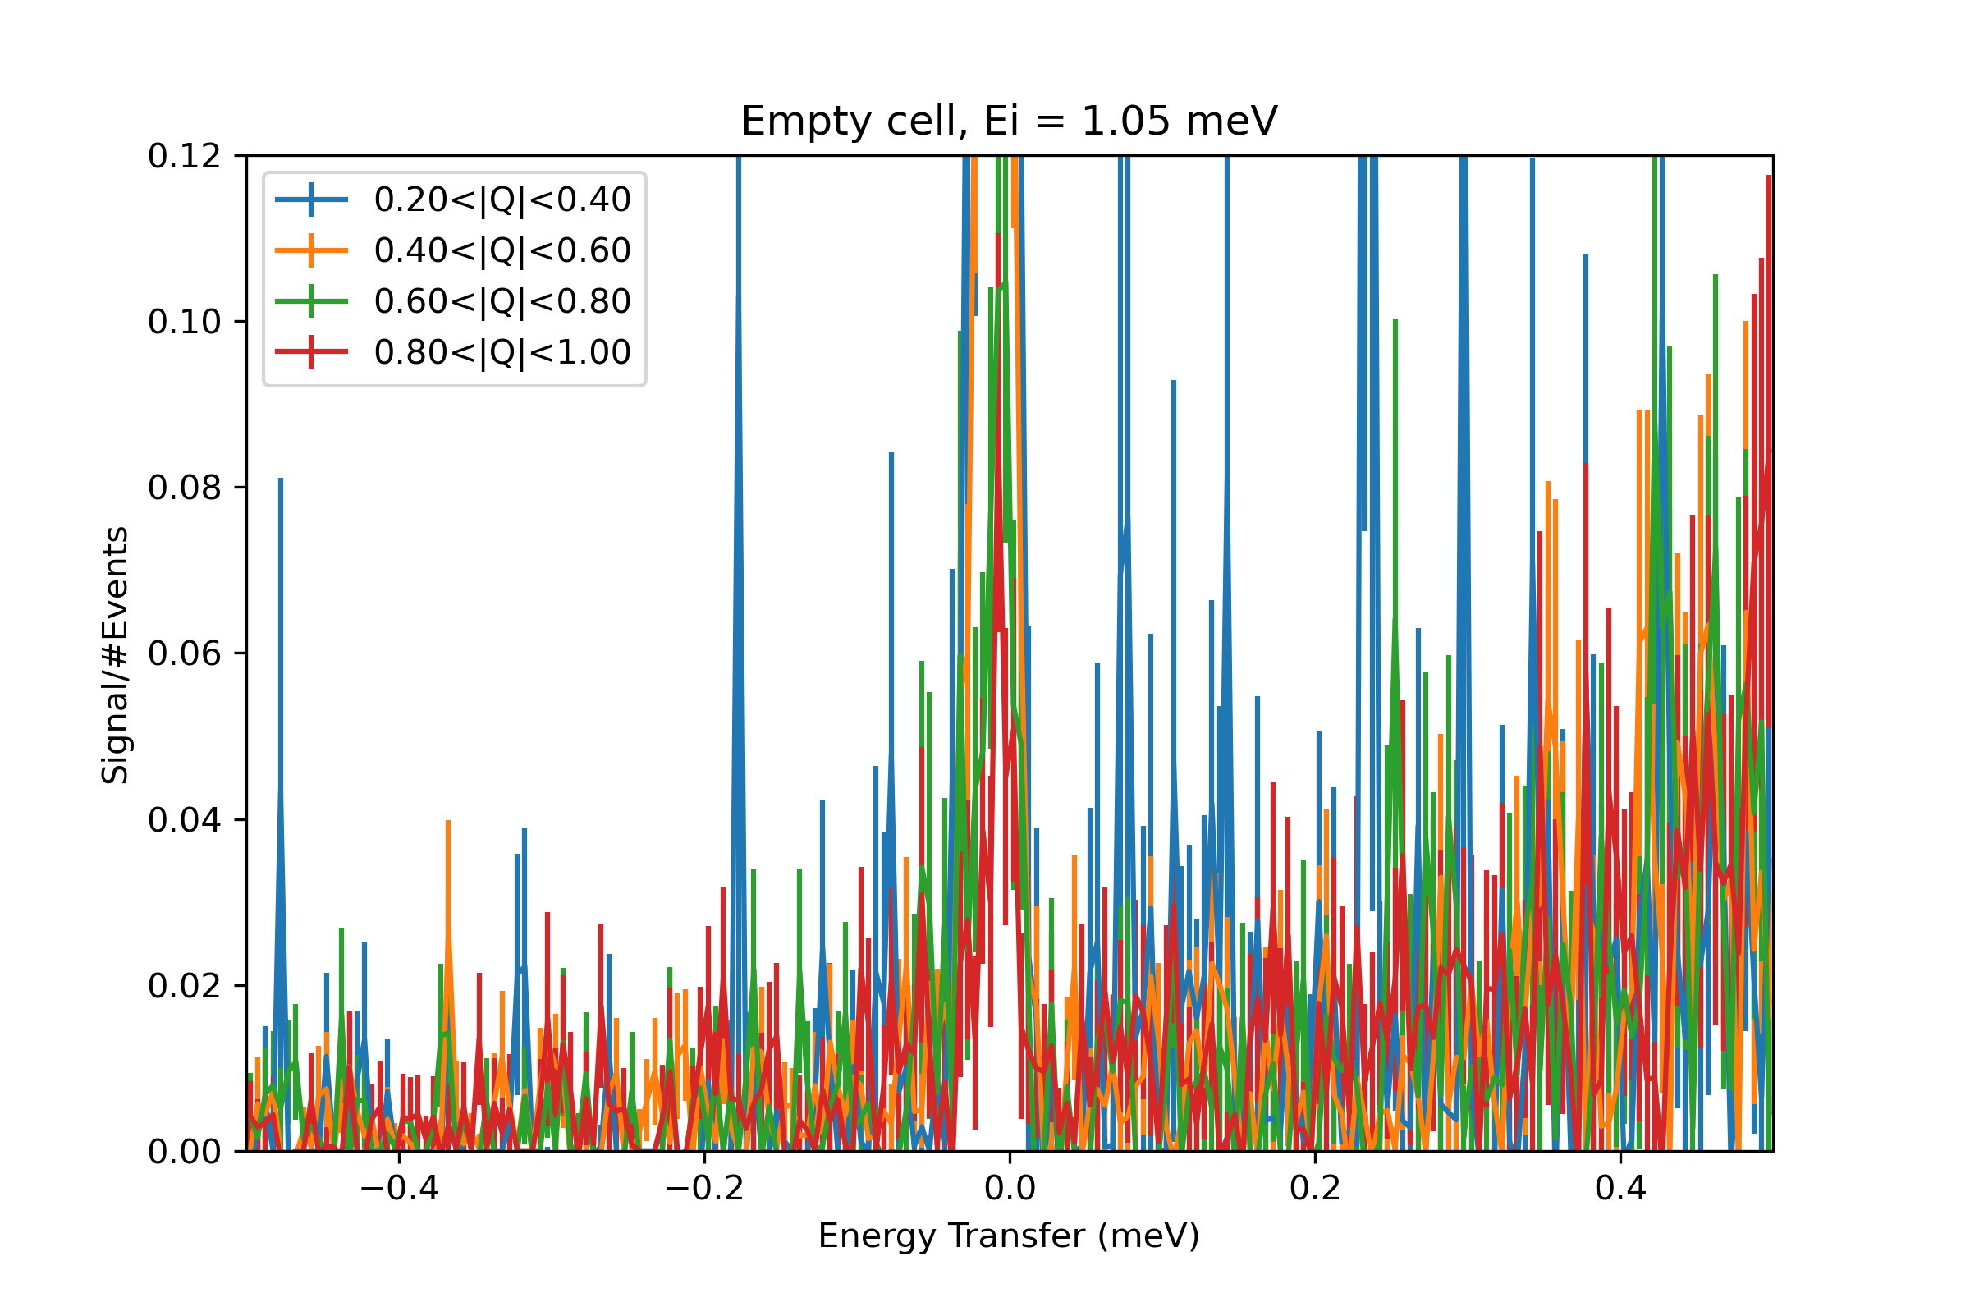
LET: Empty cell

Slide 21
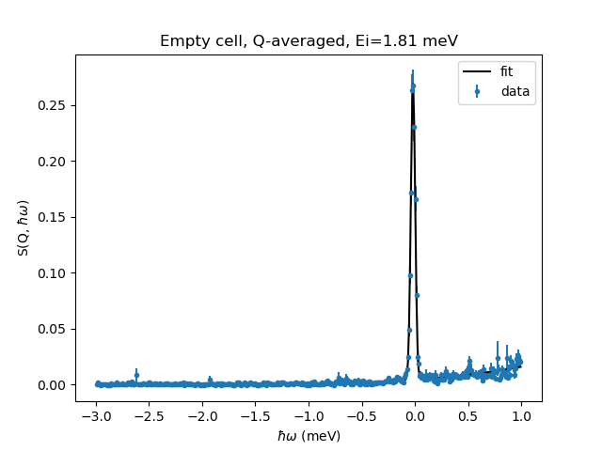
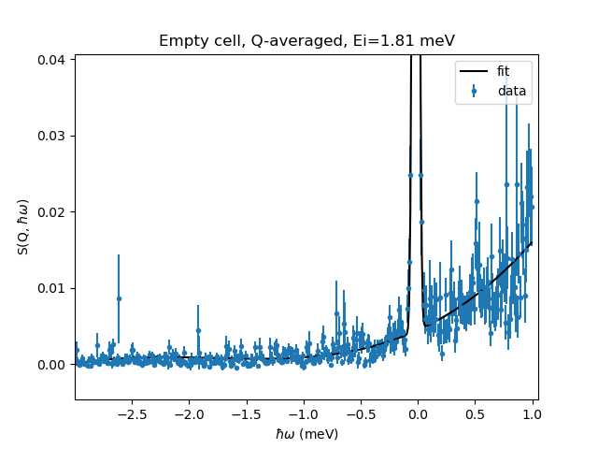
LET: Empty cell

Slide 22
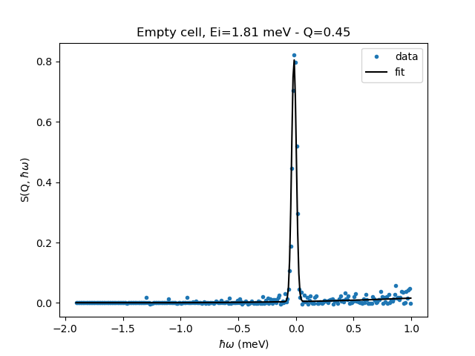
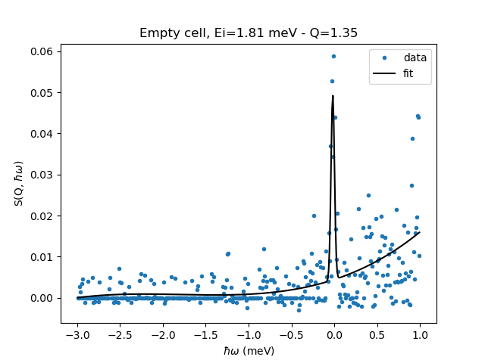
LET: Empty cell

Slide 23
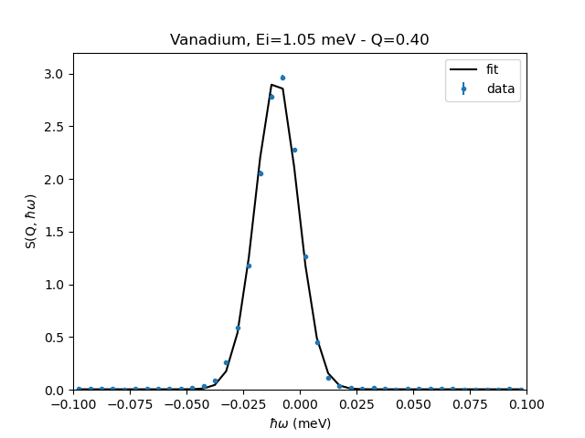
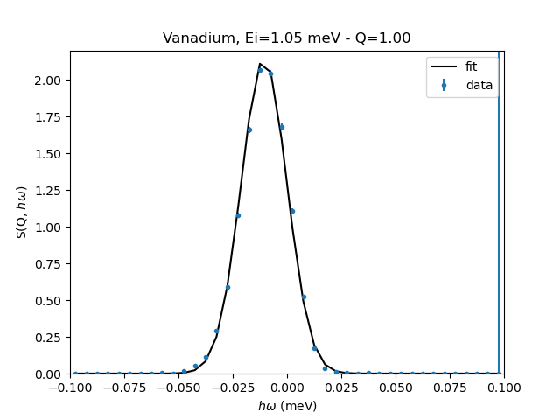
LET: Resolution (and Gaussian fit)

Slide 24
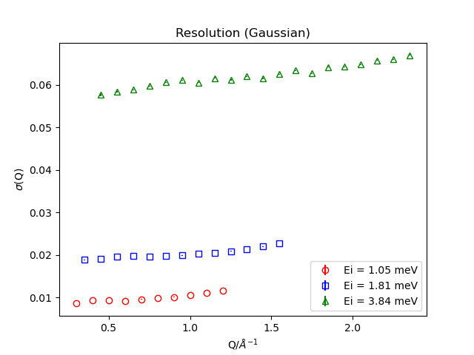
LET: Resolution (and Gaussian fit)

Slide 25
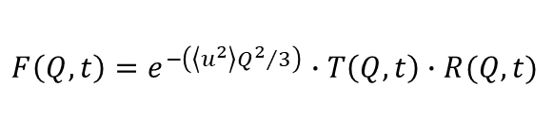

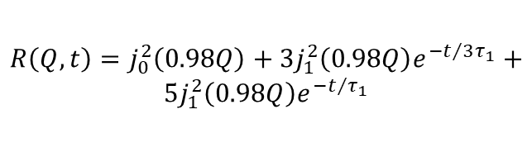

Water model
Teixeira et al., Phys. Rev. A 31, 1913 (1985)
Qvist et al., J. Chem. Phys. 134, 144508 (2001)
Model free (no physical assumptions)
$$F\left(Q,t\right)=e^{−\left({\left\langle u^{2}\right\rangle Q^{2}}/3\right)}∙T\left(Q,t\right)∙R(Q,t)$$
$$T\left(Q,t\right)=\text{exp}\left(\frac{−DQ^{2}t}{1+DQ^{2}τ_{0}}\right)$$
$$I\left(Q,ω\right)∝ \left\{\begin{aligned}A\left(Q\right)ℒ\left(Γ_{1},Q,ω\right)+ \\ \left[1−A\left(Q\right)\right]ℒ(Γ_{1+2},Q,ω)\end{aligned}\right\}⊗ℛ(Q,ω)$$
$$R\left(Q,t\right)=j_{0}^{2}\left(0.98Q\right)+3j_{1}^{2}\left(0.98Q\right)e^{−t/{3τ_{1}}}+$$
$$5j_{1}^{2}\left(0.98Q\right)e^{−t/{τ_{1}}}$$

Slide 26
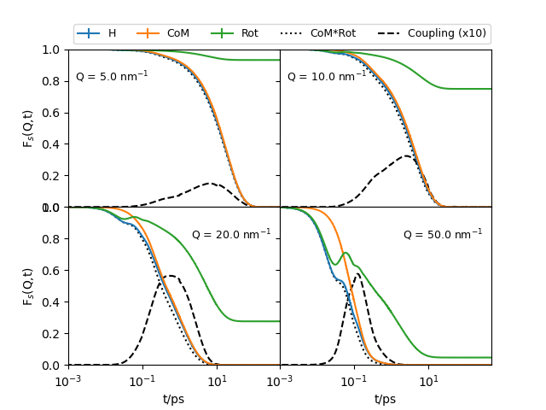
Water model

Slide 27
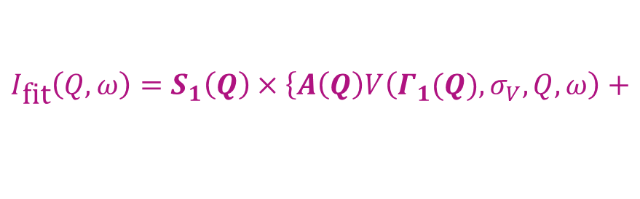
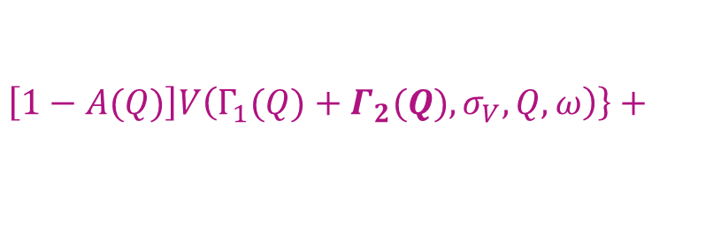
Water model
Teixeira et al., Phys. Rev. A 31, 1913 (1985)
Qvist et al., J. Chem. Phys. 134, 144508 (2001)
Model free (no physical assumptions)
$$F\left(Q,t\right)=e^{−\left({\left\langle u^{2}\right\rangle Q^{2}}/3\right)}∙T\left(Q,t\right)∙R(Q,t)$$
$$T\left(Q,t\right)=\text{exp}\left(\frac{−DQ^{2}t}{1+DQ^{2}τ_{0}}\right)$$
$$I\left(Q,ω\right)∝ \left\{\begin{aligned}A\left(Q\right)ℒ\left(Γ_{1},Q,ω\right)+ \\ \left[1−A\left(Q\right)\right]ℒ(Γ_{1+2},Q,ω)\end{aligned}\right\}⊗ℛ(Q,ω)$$
$$R\left(Q,t\right)=j_{0}^{2}\left(0.98Q\right)+3j_{1}^{2}\left(0.98Q\right)e^{−t/{3τ_{1}}}+$$
$$5j_{1}^{2}\left(0.98Q\right)e^{−t/{τ_{1}}}$$
$$I_{\text{fit}}\left(Q,ω\right)=S_{1}\left(Q\right)×\left\{A\left(Q\right)V\left(Γ_{1}(Q),σ_{V},Q,ω\right)\right.+$$
$$\left.\left[1−A(Q)\right]V\left(Γ_{1}(Q)+Γ_{2}(Q),σ_{V},Q,ω\right)\right\}+$$
$S_{2}\left(Q\right)×I_{\text{empty} \text{cell}}+$ $S_{3}\left(Q\right){×I}_{\text{bgr}}$

Slide 28
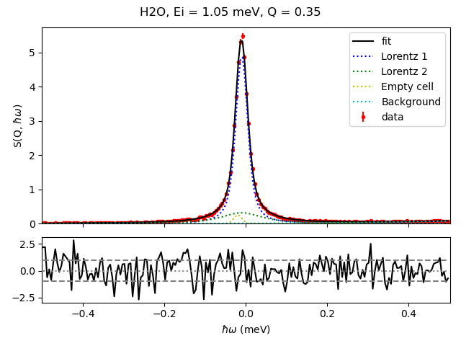
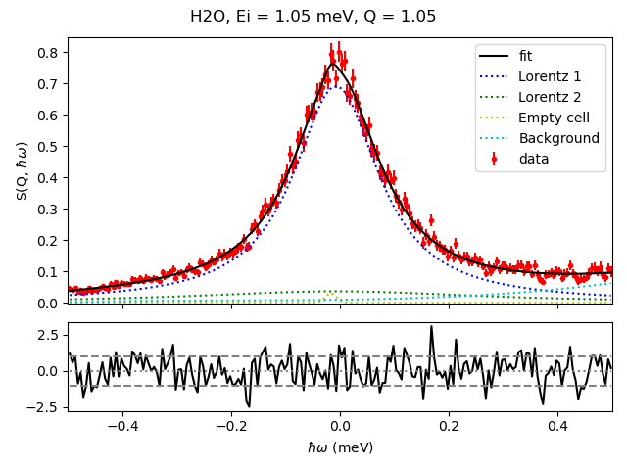
LET: Fits

Slide 29
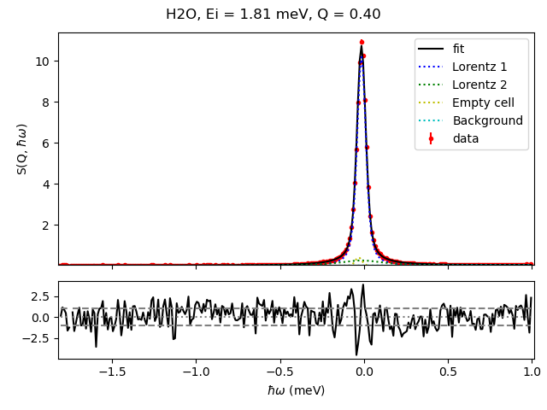
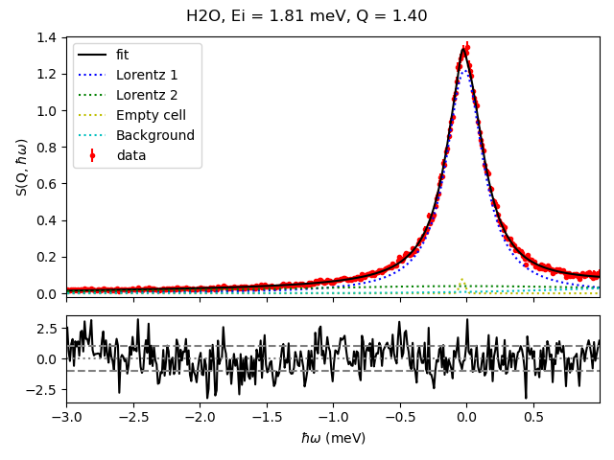
LET: Fits

Slide 30
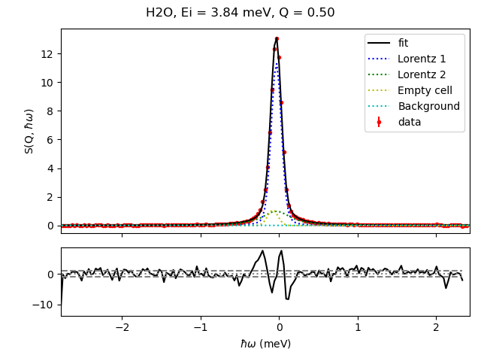
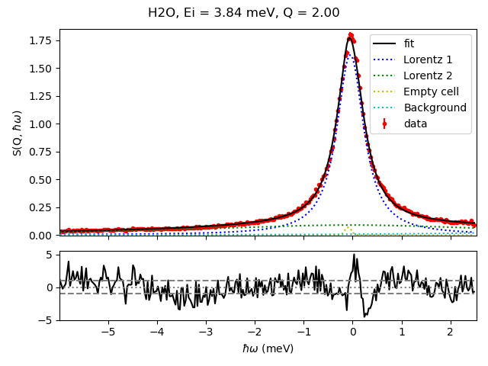
LET: Fits

Slide 31
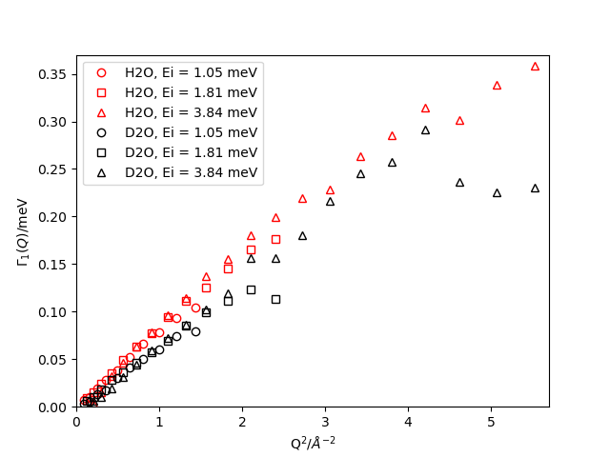
Γ₁(Q): H₂O vs D₂O

Slide 32
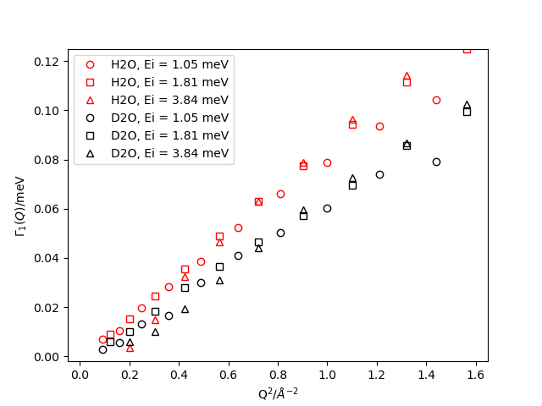
Γ₁(Q): H₂O vs D₂O

Slide 33
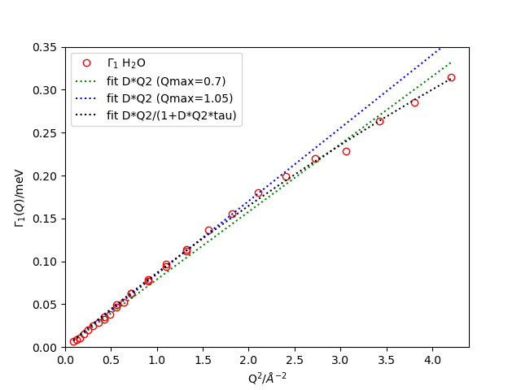
Γ₁(Q): H₂O

Slide 34
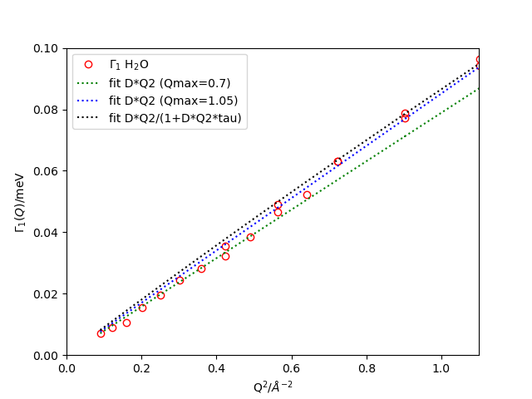
Γ₁(Q): H₂O

Slide 35
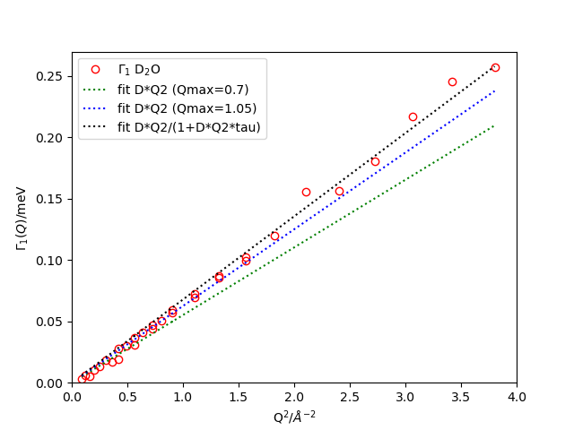
Γ₁(Q): D₂O

Slide 36
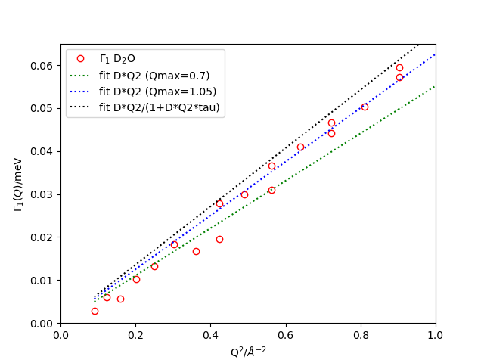
Γ₁(Q): D₂O

Slide 37
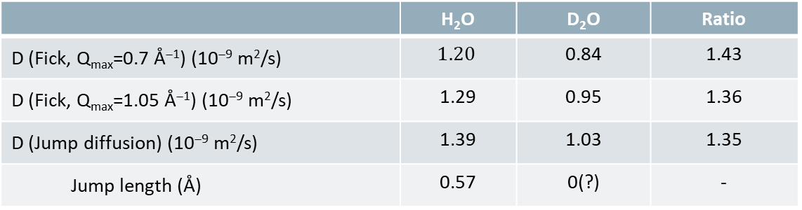
Γ₁(Q): H₂O vs D₂O
 | H₂O | D₂O | Ratio
D (Fick, Q_{max}=0.7 Å⁻¹) (10⁻⁹ m²/s) | $$1.20$$ | 0.84 | 1.43
D (Fick, Q_{max}=1.05 Å⁻¹) (10⁻⁹ m²/s) | 1.29 | 0.95 | 1.36
D (Jump diffusion) (10⁻⁹ m²/s) | 1.39 | 1.03 | 1.35
Jump length (Å) | 0.57 | 0(?) | -
 | H₂O | D₂O | Ratio
D (Tracer diffusion) (10⁻⁹ m²/s) | 1.313 | 1.015 | 1.29
D (PFG-NMR) (10⁻⁹ m²/s) | 1.25 | 0.94 | 1.33
 | H₂O | D₂O | Ratio
D (Teixeira, 1985) (10⁻⁹ m²/s) | 1.25 | - | -
D (Qvist, 2011) (10⁻⁹ m²/s) | 1.32* | - | -
*Average from values at 273 and 283 K

Slide 38
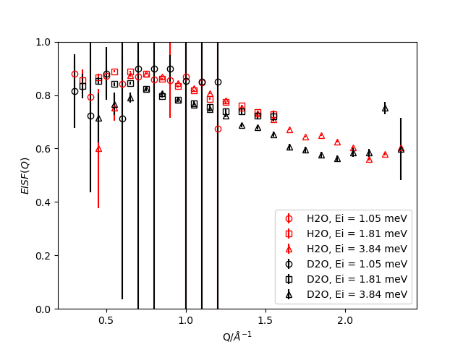
EISF(Q): H₂O vs D₂O

Slide 39
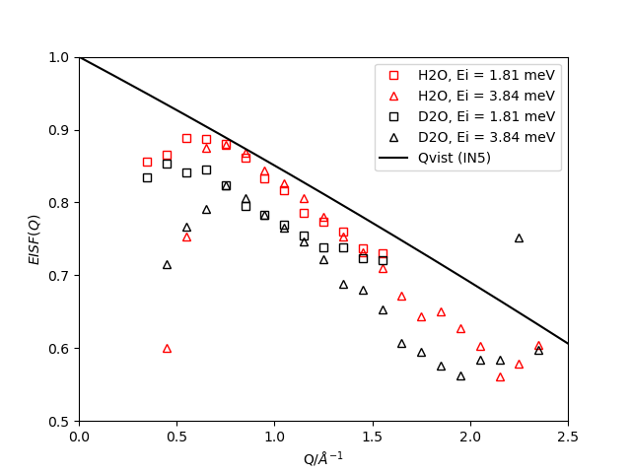
EISF(Q): H₂O vs D₂O
Qvist et al., J. Chem. Phys. 134, 144508 (2001)

Slide 40
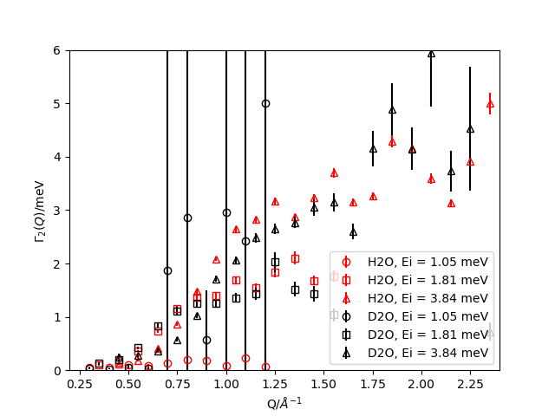
Γ₂(Q): H₂O vs D₂O
Qvist et al., J. Chem. Phys. 134, 144508 (2001)
τ_{L}
(Qvist, 2011)
τ₁
(Teixeira, 1985)

Slide 41
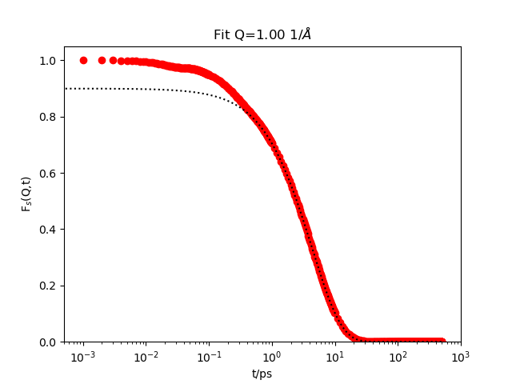

Classical MD
Self-intermediate scattering function from a series of simulations at 298 K using the TIP4P/2005 rigid water model and 4000 water molecules.
$$I_{\text{fit}}\left(Q,t>1\text{ps}\right)=DW(Q)×e^{−t/{τ_{1}(Q)}}×\left[A_{0}(Q)+\left(1−A_{0}(Q)\right)e^{−t/{τ_{2}(Q)}}\right]$$
H₂O
D₂O

Slide 42
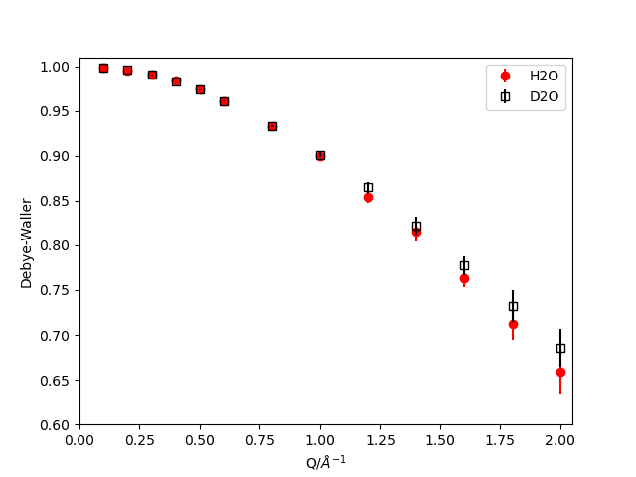

Classical MD
Vibrational amplitude
Geometry fast motion

Slide 43


Classical MD
Long-range diffusion
Local fast motion

Slide 44
Conclusions
PLET allowed us to measure the incoherent dynamic structure factor for both H₂O and D₂O and observe the expected differences in dynamics between them.
Self-diffusion coefficients and other parameters in reasonable agreement with previous QENS experiments for H₂O (Teixeira 1985, Qvist 2011) and existing NMR/tracer diffusion measurements.
But current uncertainties are too large to provide new insights into quantum effects in liquid water (jump length for D₂O?, differences in EISF between H₂O and D₂O?)
Fitted parameters for “fast” motion are not completely independent of fitting range and/or resolution.
Possible to find many different solutions compatible with the QENS data (similar χ² values) → Need to limit degrees of freedom by using a global model and fitting (but this will also introduces some bias, e.g. assuming rotational model is correct).
Help from quantum simulations?

Slide 45


Acknowledgments
Andrew Wildes
Shangamitra Mukhopadhyay
Kirill Nemkovskiy
Mark Devonport
Goran Nilsen

